Slide 1

Customer Shopping Behavior Analysis
Uncovering insights from transactional data to guide strategic business decisions.

Slide 2

Project Overview
Analyze 3,900 Purchases
Uncover Spending Patterns
Transactional data across various product categories.
Identify customer segments and product preferences.
Guide Business Decisions
Optimize strategies with data-driven insights.

Slide 3

Dataset Summary
Data Snapshot
Rows: 3,900
Columns: 18
Key Features
Customer demographics (Age, Gender, Location, Subscription)
Purchase details (Item, Category, Amount, Season, Size, Color)
Shopping behavior (Discount, Promo, Previous Purchases, Frequency, Review, Shipping)
Missing Data
37 values in Review Rating column

Slide 4
Exploratory Data Analysis in Python
01
02
03
Data Loading & Exploration
Missing Data Handling
Column Standardization
Imported dataset with pandas, checked structure and summary statistics.
Imputed missing Review Rating values using median by product category.
Renamed columns to snake case for readability.
04
05
Feature Engineering
Database Integration
Created age_group and purchase_frequency_days.
Loaded cleaned data into PostgreSQL for SQL analysis.

Slide 5
Data Analysis using SQL: Key Insights
1
2
3
Revenue by Gender
High-Spending Discount Users
Top 5 Products by Rating
Male customers generated higher revenue.
Gloves, Sandals, Boots, Hat, Skirt.
Identified 839 customers who spent above average with discounts.
4
5
Shipping Type Comparison
Subscribers vs. Non-Subscribers
Express shipping users had slightly higher average purchases.
Non-subscribers generated more total revenue.

Slide 6
SQL Insights: Product & Customer Focus
1
2
3
Discount-Dependent Products
Customer Segmentation
Top 3 Products per Category
Loyal (3116), Returning (701), New (83).
Hat, Sneakers, Coat, Sweater, Pants had highest discounted purchases.
Jewelry, Blouse, Sandals, Jacket lead their categories.
4
5
Repeat Buyers & Subscriptions
Revenue by Age Group
Repeat buyers are more likely to subscribe.
Young Adult group contributed highest revenue.

Slide 7
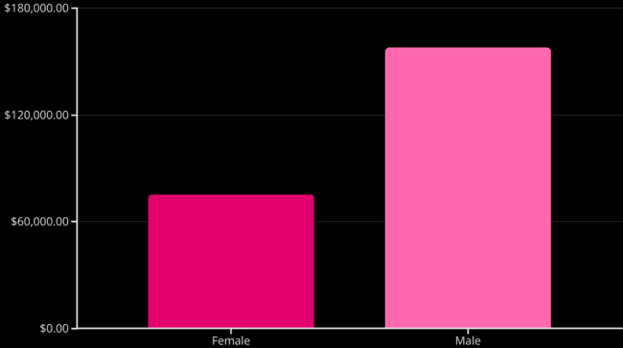
Revenue by Gender
Male customers generated significantly more revenue than female customers.

Slide 8
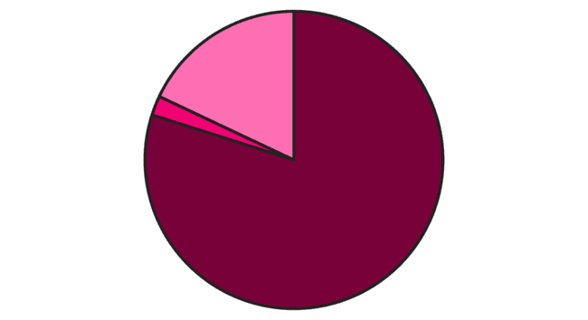
Customer Segmentation
Loyal
New
Returning
The majority of customers are loyal, highlighting strong retention.

Slide 9
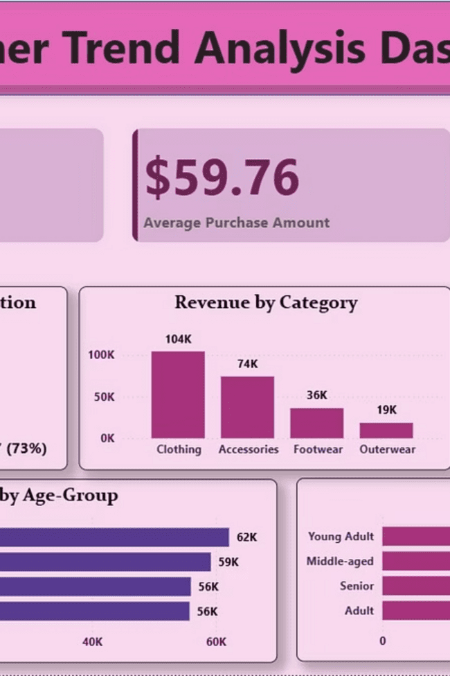


Power BI Dashboard: Visualizing Trends
Interactive dashboard for customer trend analysis.
3.9K Customers
Total customer base.
$59.76 Avg. Purchase
Average transaction value.
3.75 Avg. Review
Overall customer satisfaction.

Slide 10
Business Recommendations
Boost Subscriptions
Promote exclusive benefits for subscribers.
Customer Loyalty Programs
Reward repeat buyers to foster loyalty.
Review Discount Policy
Balance sales boosts with margin control.
Product Positioning
Highlight top-rated and best-selling products.
Targeted Marketing
Focus on high-revenue age groups and express-shipping users.

