Slide 1







A convincing offer lands in the family chat
sajag. Understand before you act.
01 THE PROBLEM
Family group
Forwarded message
Har mahine 8% pakka return. Join our VIP group today; only 5 places left.
“8% guaranteed every month. Join today; only 5 places left.”
Urgent wording and unfamiliar financial terms make it hard to judge. The challenge is understanding what a message asks before money or personal details change hands.
WHAT SAJAG POINTS OUT
Promotional cues
WHO WE BUILT FOR
A promise that needs evidence “pakka return”
First-time investors in Tier-2 and Tier-3 cities
People more at home in Hindi or Bengali
Pressure to act quickly “only 5 places left”
Families who receive forwarded offers
Anyone who prefers listening to reading
A possible selling incentive “VIP group”
Team FirstBest · Anshuman Biswal · Masud Ali
SANGYAN Investor Resilience Hackathon · Track C and Track E
Fictional example from the app
Notes:
Imagine a convincing investment offer arriving in your family chat. Urgent wording and unfamiliar financial terms make it hard to judge. For first-time investors, the challenge is understanding the request before money or personal information changes hands.

Slide 2
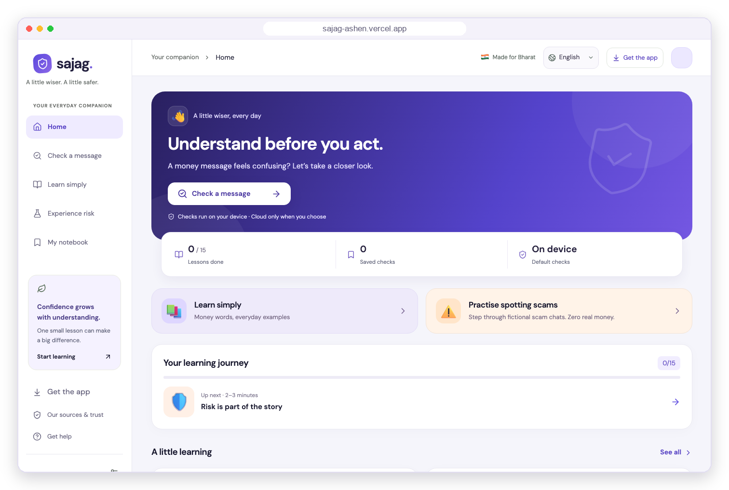



Sajag connects checking with learning
02 OUR SOLUTION
Check a message
Paste, type, share or speak it. The first check runs on the device.
Understand the warning
See the exact words behind it, with relevant official guidance.
Learn the idea behind it
Short lessons, fictional chat stories and a money simulator.
Web + Android app
Private on-device check
Optional AI review
No investment advice
Notes:
Now, this is Sajag. Sajag connects checking with learning. Bring a message, understand the quoted warning, then explore the lessons behind it. Our web and Android prototype combines a private offline check with an optional AI review. No investment advice.

Slide 3




Built for Track C and Track E
03 OUR TRACKS
TRACK C
Investor Education for Bharat
TRACK E
Misinformation & Financial Content Literacy
SUGGESTED DIRECTION
Voice-first explainer
Lessons for all 7 terms the track names: NAV, risk, diversification, volatility, compounding, fees and nomination. Everyday analogies in English, Hindi and Bengali, read aloud with Listen.
SUGGESTED DIRECTION
Claim evidence-checker
Quotes the exact words, links relevant SEBI, RBI and government guidance, and shows Potential, Strong or Not enough evidence, never a true/false verdict. Guidance explains the pattern; the sender and the claim stay unverified.
SUGGESTED DIRECTION
Consequence simulator
Feel a sudden dip, an uneven journey or borrowing with fictional tokens: zero real money. Four chat stories show where a scam’s choices lead.
SUGGESTED DIRECTION
Promotion vs education
Every message gets a purpose label: Promotional cues, Explanatory wording, Education + promotion, or Purpose unclear.
Notes:
Sajag combines two tracks in one journey.
Track C, Investor Education for Bharat: the lessons cover all seven terms the track names (NAV, risk, diversification, volatility, compounding, fees and nomination) with everyday analogies in English, Hindi and Bengali, and Listen reads them aloud. The money simulator lets people feel a sudden dip, an uneven journey or borrowing with fictional tokens.
Track E, Misinformation and Financial Content Literacy: the checker quotes the words behind each warning, links relevant official guidance and states uncertainty as levels instead of a true or false verdict. Each message also gets a purpose label that separates promotion from education.

Slide 4
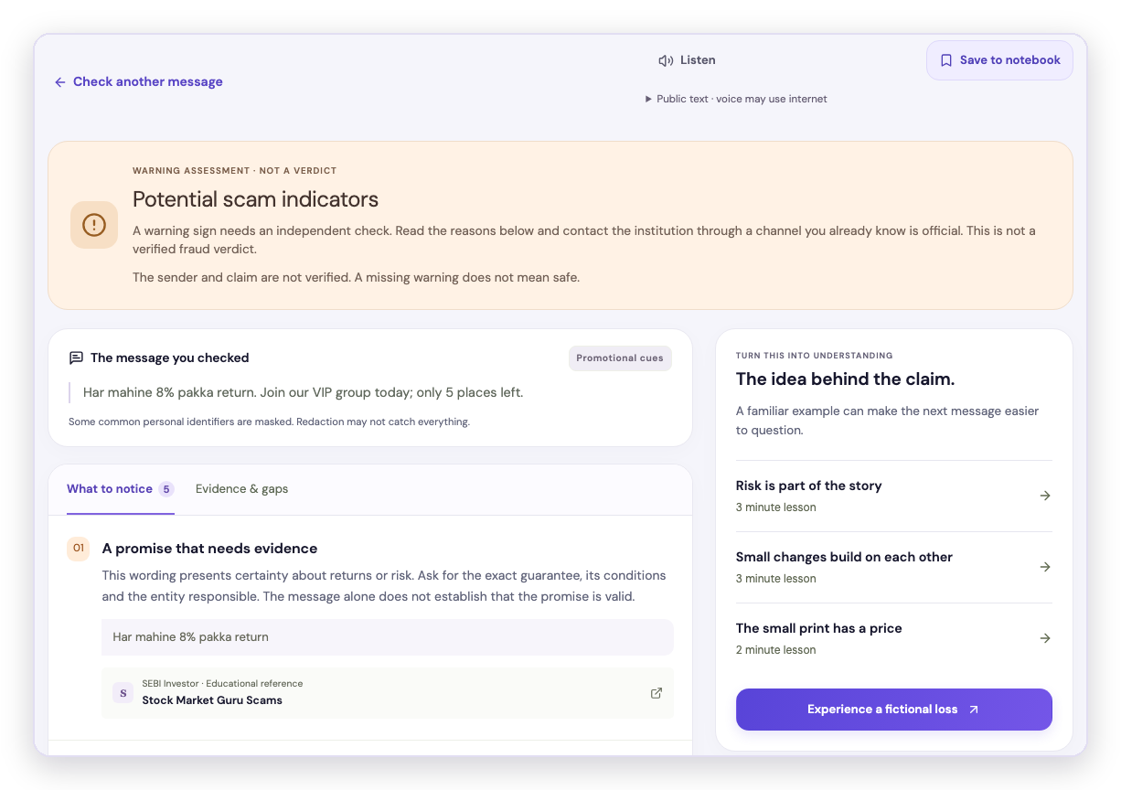

Features that explain, not just alert
04 FEATURES AND WHY THEY MATTER
3
1
Quoted words
Each warning points to the exact words that raised it.
2
Official guidance
Relevant SEBI, RBI and government material explains the pattern.
3
Your choices stay separate
Checking, sharing, AI review and saving are each a deliberate step.
4
Lessons and simulations
Fictional practice turns a warning into understanding.
4
1
2
Android Back closes overlays first, then returns to Home.
Notes:
So, look at the quoted words on screen. They explain what triggered the warnings, with relevant official guidance and context. Sharing and saving remain separate choices. Lessons and fictional simulations turn a warning into understanding. Android Back returns sections Home after closing overlays.

Slide 5
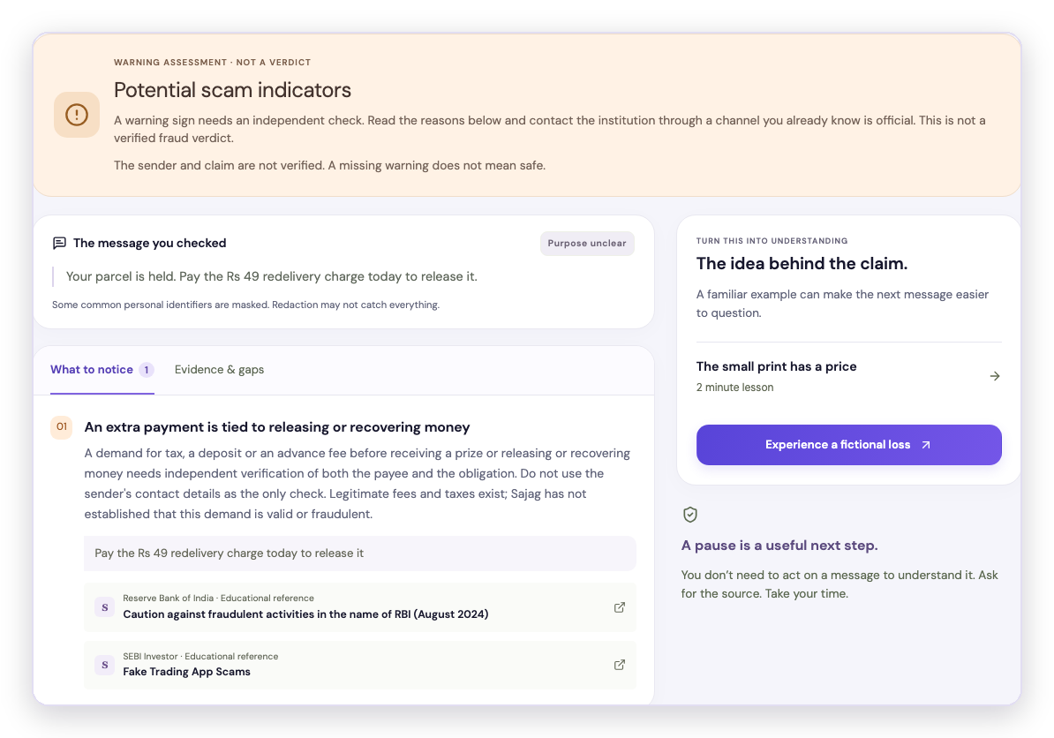
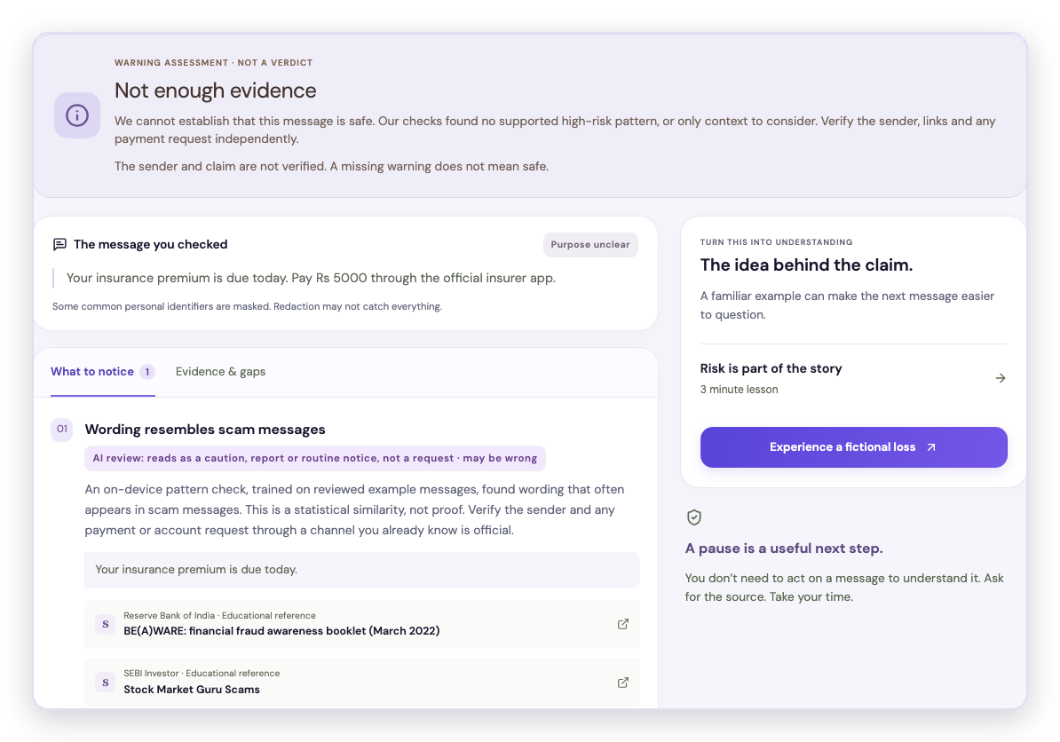
Two real checks on the live website
05 LIVE DEMO
Fictional messages · AI can be wrong
1 Type a message
2 Check on the device
3 Allow the AI review
4 Read the result
Parcel fee request
The warning stays after the AI review.
Insurance premium notice
The AI review withdrew the warning; it stays visible as context.
Notes:
Now that we have seen what the warning tells us and why these features matter, let's put them to a test. We'll move from the explanation to a few actual checks to see how the system responds to different types of messages. We'll start with a fictional parcel message asking for ₹49 to release a delivery. We'll run it locally, give permission for AI review, and then see what the result looks like. Next, we'll look at a routine insurance premium notice. The offline check raises a pattern warning, and the AI review label shows why the warning was withdrawn while keeping the result visible as context. These are genuine website checks using fictional messages, to demonstrate how the system behaves without making any claim about real-world accuracy. AI can still be wrong.

Slide 6
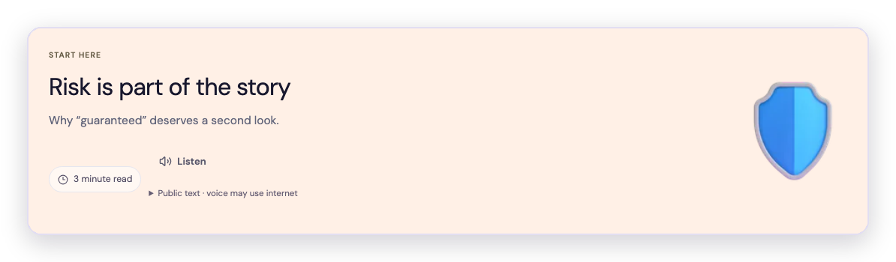
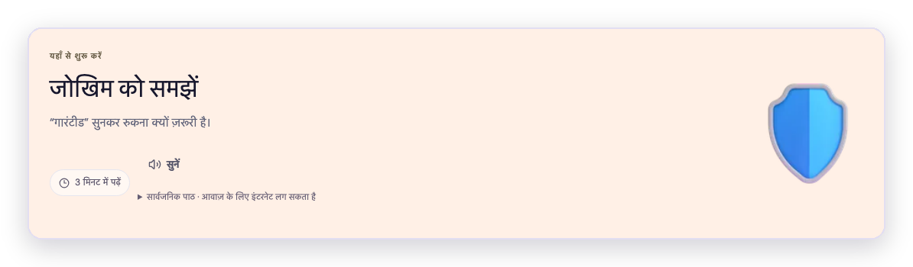
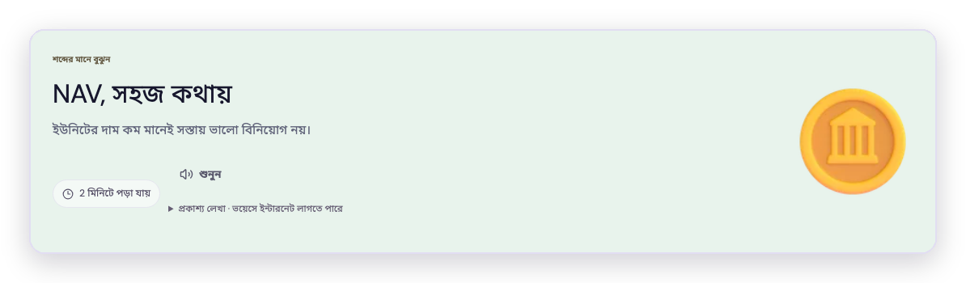

Three languages, five ways of writing, and voice
06 LANGUAGES AND VOICE
5 tested ways of writing a message
English
English
हिन्दी
বাংলা
Hinglish
Banglish
Hinglish and Banglish are Hindi and Bengali typed in English letters, as many people write in chats. Bengali is in beta, awaiting native-speaker review.
हिन्दी · Hindi
VOICE, FOR PEOPLE WHO PREFER LISTENING
Listen
Hear results and lessons read aloud.
বাংলা · Bengali (beta)
Speak it
Say the message instead of typing it.
In English, Hindi and Bengali, using the phone’s speech services; available voices vary by device.
Notes:
Now look at the language screens: English, Hindi and Bengali are interface choices. Messages can also use Hinglish and Banglish. That gives 5 tested language forms, including Romanised Hindi and Bengali. Bengali remains beta, awaiting native-speaker review.

Slide 7
Tested on 150 held-out messages
07 ACCURACY
99.3%
0 of 75
74 of 75
82.7%
correct with AI review · 149 of 150
harmless messages wrongly flagged with AI
risky messages flagged with AI · 57 offline
correct offline, without internet · 124 of 150
Offline vs with AI review
Offline
With AI review
Correct by language form (%)
149
74
100.0
96.7
100.0
100.0
100.0
124
57
83.3
83.3
83.3
80.0
83.3
8
0
Correct
of 150
Risky flagged
of 75
False alarms
of 75 · lower is better
English
Hindi
Bengali
Hinglish
Banglish
Held-out set of 150 synthetic messages (75 risky, 75 harmless) in English, Hindi, Bengali, Hinglish and Banglish, written before tuning and scored once. The AI completed 145 reviews; 5 used the offline result. Not a real-world guarantee.
Notes:
Look at the counts from the test: 150 synthetic messages, 75 risky and 75 harmless, across 5 language forms. Offline got 124 correct, which is 82.7%. With AI, that makes 149 correct, which is 99.3%: a very good accuracy. Risky messages flagged rose from 57 to 74 out of 75. Harmless false alarms fell from 8 to 0 out of 75. AI completed 145 reviews; 5 used offline fallback. These results are not real-world guarantees, but yes, these are the testing results of our product.

Slide 8









Two layers: offline first, AI when you choose
08 ARCHITECTURE AND TECHNOLOGY
ON THE DEVICE · ALWAYS ON
Context-aware rules + small pattern model
Checks the wording without internet. Nothing is sent. Can raise Potential or Strong.
Result you see
Potential · Strong · Not enough evidence
Strong results cannot be withdrawn.
If the AI is unavailable, the offline result stands.
Your message
ONLINE · ONLY WITH YOUR PERMISSION
Mask personal details
RAG: SEBI, RBI and government guidance
Gemini 3.5 Flash-Lite reads the context
Exact quote and guidance check
Second pass confirms or withdraws
Offline gives access
After a verified sign-in, the downloaded app checks without internet and keeps the message on the device.
AI adds context
In testing it cleared all 8 offline false alarms; 74 of 75 risky messages were flagged.
Built with
React + Vite web app · Capacitor Android app · Express API on Vercel · Supabase sign-in · Gemini API · 22 curated guidance cards
Notes:
Follow the two layers on the screen. Local rules and a small pattern model check wording on the device without sending any message. With permission, RAG retrieves relevant SEBI, RBI and government guidance for Gemini, our AI model. New AI warnings need matching quoted words and official guidance. A second pass confirms or withdraws warnings. Strong results cannot be withdrawn. Offline provides access; AI adds context.

Slide 9
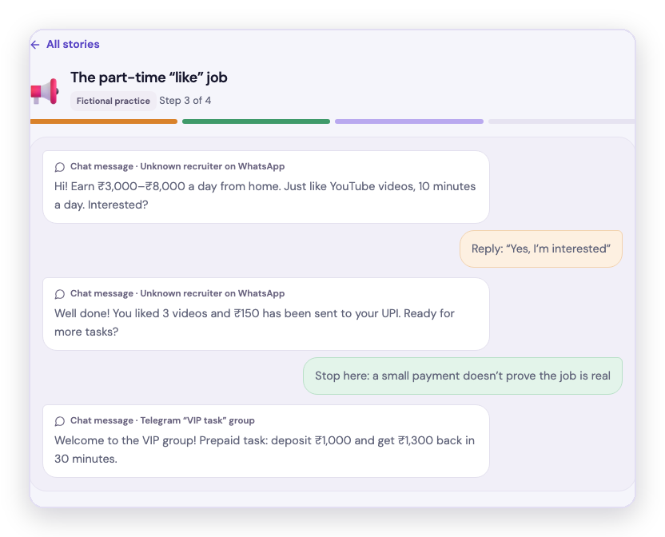
Learning through consequences
09 LEARNING
15 lessons
A 20% fall needs a 25% rise to recover
7 money terms (NAV, risk, diversification, volatility, compounding, fees, nomination) and 8 scam lessons
10,000
10,000
8,000
4 chat stories
Fictional chats that reveal pressure tactics through your choices
3 money scenarios
Task-job story: a small reward builds trust before the deposit demand.
Start
After a 20% fall
Back to start
A sudden dip, an uneven journey and borrowing, with fictional tokens
−2,000 = −20%
+2,000 = +25% of 8,000
Fictional tokens · zero-fee example · arithmetic, not a forecast.
Notes:
Next, look at 15 lessons: 7 money concepts and 8 scam lessons. 4 fictional chat stories reveal pressure tactics through your choices. A small task-job reward can lead to deposit demands. In the money simulator, a 20% loss needs a 25% rise to recover. This is arithmetic, not a forecast.

Slide 10
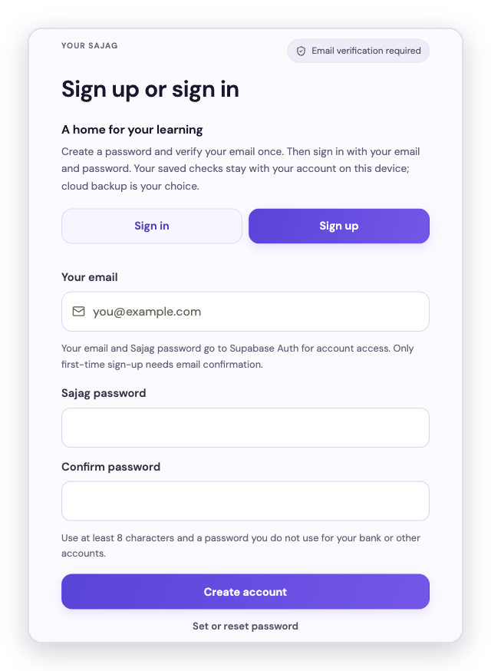




Private by default, open about trade-offs
10 PRIVACY AND ACCOUNTS
ACCOUNT
PRIVACY
1
Create an account
Email, a password and its confirmation.
Permission before every AI check
You see what will be shared first.
Masked before it leaves
Best-effort masking can miss details, so review the text first.
2
Verify the email once
A one-time code confirms the address.
Saving is your choice
Each account has its own notebook.
3
Sign in with the password
No code on later visits; a verified reset is available.
Core features work offline
After sign-in; AI is used only by choice.
Trade-offs we state openly: AI submissions follow Google’s data terms (the free tier may use them to improve its products). The notebook saved on the device is not encrypted.
Notes:
Users create and verify their account once, and returning users sign in securely with their password. Before every AI check, users can see what information will be shared and give explicit permission. Sensitive content is masked before it leaves the device, and users remain in control of what they choose to save. Core features continue to work offline, while AI review is used only by user choice. AI submissions may be subject to the provider's data policies, and locally saved notebook data is not encrypted.

Slide 11
How Sajag meets the judging criteria
11 EVALUATION CRITERIA
30%
Resilience and safety impact
Flags risky messages before money moves and explains why. With AI, 74 of 75 risky and 0 of 75 harmless test messages were flagged. Lessons and stories give practice for safer responses.
25%
Bharat-first usability
English, Hindi and Bengali screens; Hinglish and Banglish input; Listen and Speak it; core features offline; a 5.2 MB Android app.
15%
Guardrail compliance and trust
No tips, predictions, product promotion or monetisation. No SMS or OTP reading: people choose what to check. AI only with permission. Uncertainty shown, never “safe”.
15%
Technical execution
On-device rules and pattern model; RAG over 22 curated SEBI, RBI and government guidance cards with Gemini 3.5 Flash-Lite; quote checks and a second review pass.
15%
Feasibility and scalability
Live website and Android app today; a low-cost AI model; new languages and guidance cards plug into the same pipeline. Next: real-user validation.
Notes:
This slide maps Sajag to the five published evaluation criteria and their weights.
Performance figures come from the held-out test on the accuracy slide. The weights come from the hackathon brief. Product details such as languages, app size and the number of guidance cards come from the released app. Real-user impact is the next stage of validation.

Slide 12





From a warning to understanding
sajag. Understand before you act.
12 IMPACT AND NEXT STEPS
TRY IT
sajag-ashen.vercel.app
Android app 2.0
Download from the website
Sajag brings warning, explanation and practice together. It is designed to help people understand why a message is risky and consider a safer next step.
THE TEAM
Team FirstBest
Anshuman Biswal · Masud Ali
NEXT: REAL-WORLD VALIDATION
Test with real users and real communication patterns
Evaluate on a wider range of real scam messages
SANGYAN INVESTOR RESILIENCE HACKATHON
Track C Investor Education for Bharat
Track E Misinformation & Financial Content Literacy
Measure where it works, where it fails, and whether decisions improve
We do not yet claim a reduction in financial loss; the next stage is designed to measure it.
Notes:
Sajag brings warning, explanation and practice together into a learning journey, helping people not just identify a risky message, but understand why it is risky and make a safer decision next time. This is Sajag by Team FirstBest: Anshuman Biswal and me, Masud Ali. Understand before you act.

