Slide 1
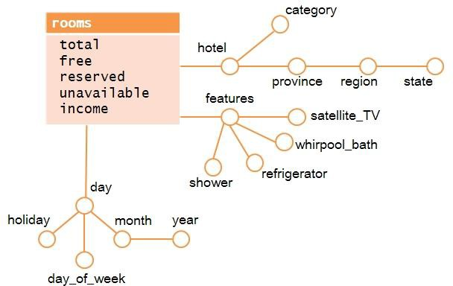
Conceptual Design
Logical Design
Fact: ROOMS
FEATURES (Features_id, beds, shower, refrigerator, whirpool, satellite_TV)
TIME (Time_id, day, month, holiday, day_of_week, year)
HOTEL (Hotel_id,hotel_name, category, provice, region, state)
ROOMS (Features_id, Time_id, Hotel_id, total,free, reserved, unavailable,income)

Slide 2
OLAP ANALYSIS
Query
A)
SELECT state, month, round(SUM(reserved)*100/SUM(total),2) as Reserved, round(SUM(free)*100/SUM(total),2) as Free, round(SUM(unavailable)*100/SUM(total),2) as Unavailable
FROM Rooms r, Time t, Hotel h
WHERE r.hotel_id=h.hotel_id AND r.time_id = t.time_id AND t.year = 2008
GROUP BY h.state, t.month
ORDER BY month ASC,state ASC;
B)
SELECT state, round(SUM(reserved)*100/SUM(total),2) as Reserved
FROM Rooms r, Time t, Hotel h
WHERE r.hotel_id=h.hotel_id AND r.time_id = t.time_id AND year = 2008 GROUP BY state
C)
SELECT state, month, SUM(income) as TotIncome,
FROM Rooms r, Time t, Hotel h
WHERE r.hotel_id=h.hotel_id AND r.time_id = t.time_id AND category = 4 AND year=2008
GROUP BY state, month
Cardinality ROOMS: 500 hotles x (365 days X 2 years) X 2⁸ configurations = ~ 10⁷ tuples
Query | Group By | Where clauses
A | State, month | year
B | state | year
C | State, month | Year, category

Slide 3
Materialized Views
MATERIALIZED VIEW M: A Single View-Query (M) can answer queries A-B-C
Based on Query A, a Materialised View named as MA is defined. So I can use MA to redefine queries b and c.
How?
CREATE MATERIALIZED VIEW MA AS
SELECT state, month, category, round(SUM(reserved)*100/SUM(total),2) as Reserved, round(SUM(free)*100/SUM(total),2) as Free, round(SUM(unavailable)*100/SUM(total),2) as Unavailable, SUM(income) as TotalIncome
FROM Rooms r, Time t, Hotel h
WHERE r.hotel_id=h.hotel_id AND r.time_id = t.time_id AND t.year = 2008
GROUP BY h.state, t.month, h.category
Query A using MA
SELECT state, month, round(SUM(reserved)*100/SUM(total),2) as Reserved, round(SUM(free)*100/SUM(total),2) as Free, round(SUM(unavailable)*100/SUM(total),2) as Unavailable
FROM MA
GROUP BY h.state, t.month,
Query B using MA
SELECT state, round(SUM(reserved)*100/SUM(total),2) as Reserved
FROM MA
GROUP BY state
Query C using MA
SELECT state, month, SUM(income) as TotIncome,
FROM MA
WHERE category= 4
GROUP BY state, month

