Slide 1
1. DWH DESIGN: From Conceptual DWH Models to Logical Data Models
2. DWH DESIGN
Metamodels→ Conceptual DWH Models→ Logical DWH Models

Slide 2
Data Warehouse Process
From a functional point of view, the data warehouse-process consists of three phases:
The first phase encompasses typical issues concerning distributed heterogeneous information integration, such as inconsistent data, incompatible data structures, data granularity, etc., …known as ETL
The second phase, encompasses typical issues concerning the conceptual design of a DWH. DWH design requires techniques completely different from those adopted for operational information systems.
The third phase requires capabilities of aggregate navigation, optimization of complex queries, friendly visual interface to be used for On-Line Analytical Processing (OLAP) and data mining.

Slide 3
Conceptual DWH Design
Is now universally recognized that a DW is based on a multidimensional view of data (facts and dimensions): But there is still no agreement on HOW to implement its conceptual design !
Most of the time, DW design is at the logical level : a multidimensional model (star/snowflake schema) is directly designed :
But a star schema is nothing but a relational schema: it contains only the definition of a set of relations and integrity
constraints !
A better approach:
1) design first a conceptual model : Conceptual Design
2) which is then translated into a logical model : Logical Design

Slide 4
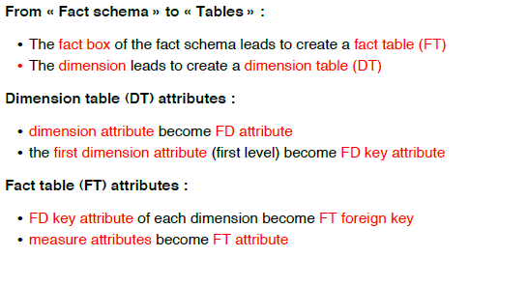
From DFM to Relational Schema

Slide 5
Logical design
We address the relational model (ROLAP)
inputs
conceptual fact schema
workload
data volume
system constraints
output
relational logical schema
Based on different principles with respect to traditional logical design
data redundancy
table denormalization

Slide 6
Star schema
Dimensions
one table for each dimension
surrogate (generated) primary key
it contains all dimension attributes
hierarchies are not explicitly represented
all attributes in a table are at the same level
totally denormalized representation
it causes data redundancy
Facts
one fact table for each fact schema
primary key composed by foreign keys of all dimensions
measures are attributes of the fact table

Slide 7
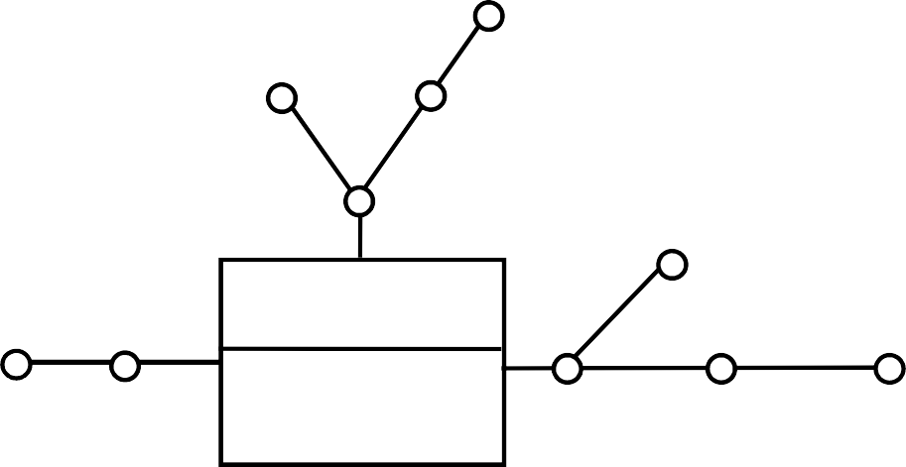
Star schema
Category
Supplier
Type
Product
Salesman
Month
Week
SALES
Quantity Amount
Shop
City
Country
Week
Shop
Dimension table
Week_ID
Week
Month
Shop_ID
Week_ID
Product_ID
Quantity
Amount
Shop_ID
Shop
City
Country
Salesman
Dimension table
Product
Product_ID
Product
Type
Category
Supplier
Dimension table
Fact table
From Golfarelli, Rizzi, McGraw Hill

Slide 8
Snowflake schema
Some functional dependencies are separated, by partitioning dimension data in several tables
a new table separates two branches of a dimensional hierarchy (hierarchy is cut on a given attribute)
a new foreign key correlates the dimension with the new table
Decrease in space required for storing the dimension
decrease is frequently not significant
Increase in cost for reading entire dimension
one or more joins are needed

Slide 9
Snowflake schema
Week
Week_ID
Week
Month
Shop
 | Shop_ID
 | Week_ID
 | Product_ID
 | Quantity
 | Amount
Shop_ID
Shop
City_ID
Salesman
Product
Product_ID
Product
Type_ID
Supplier
Foreign key
City
Type
City_ID
City
Country
Type_ID
Type
Category

Slide 10
Star or snowflake?
The snowflake schema is usually not recommended
storage space decrease is rarely beneficial
most storage space is consumed by the fact table (difference with dimensions is several orders of magnitude)
cost of join execution may be significant
The snowflake schema may be useful
when part of a hierarchy is shared among dimensions (e.g., geographic hierarchy)
for materialized views, which require an aggregate representation of the corresponding dimensions

Slide 11
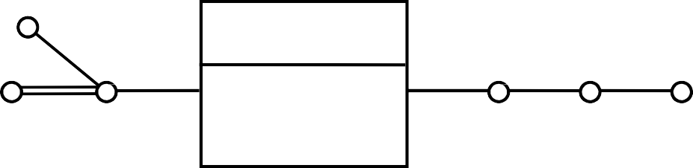
Multiple edges
genre
SALE
quantity income
author
book
date month year
Implementation techniques
bridge table
new table which models many to many relationship
new attribute weighting the contribution of tuples in the relationship
push down
multiple edge integrated in the fact table
new corresponding dimension in the fact table

Slide 12
Multiple edges
genre
SALE
quantity income
author
book
date
month
year
Books
Books
BRIDGE
Book_ID
Book
Genre
Sales
Sales
Book_ID |  | Book_ID
Book |  | Author_ID
Genre
 |  | Weight
 | Book_ID
 | Author_ID
 | Date_ID
 | Quantity
 | Income
 | Book_ID
 | Date_ID
 | Quantity
 | Income
Authors
Authors
Author_ID
Author_ID
Author
Author

Slide 13
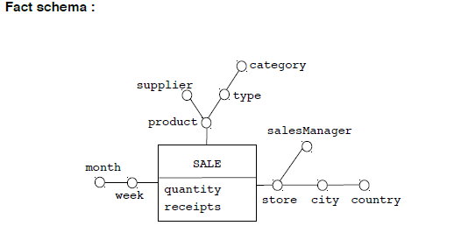
DFM “Sales”

Slide 14
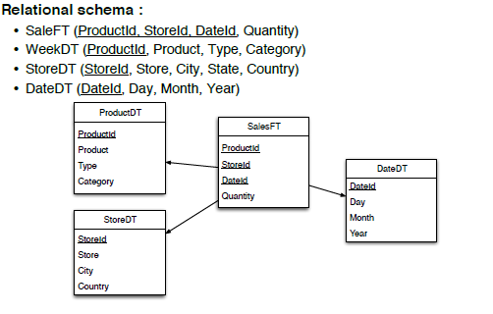
Star ‘Sales’ Schema

Slide 15
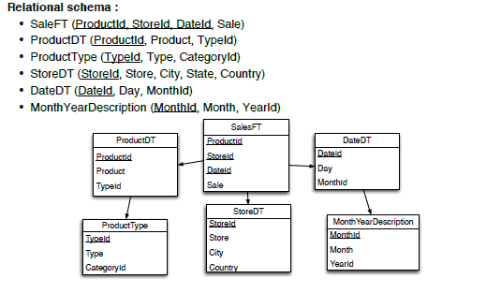
Snowflake ‘Sales’ Schema

Slide 16
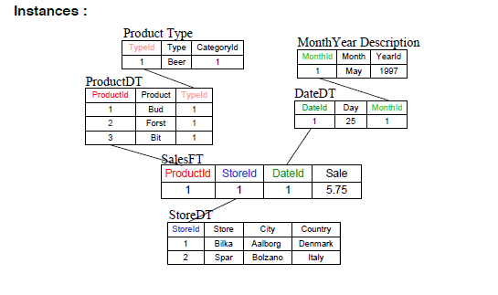
Relational Snowflake Schema Sale

Slide 17
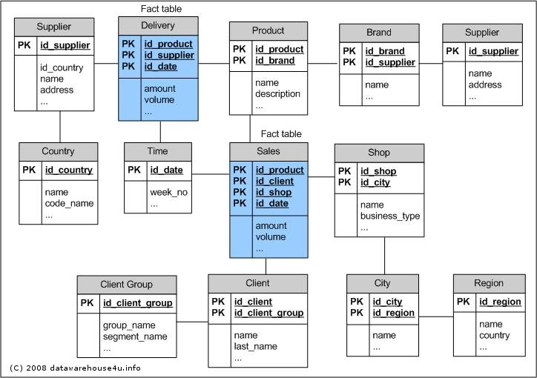
Relational Fact Constellation Schema

Slide 18
DMQL
DMQL: A Data Mining Query Language for Relational Databases (Han et al, Simon Fraser University)
Data warehouses and data marts can be defined by cube definition and dimension definition

Slide 19
DMQL
Create and manipulate data mining models through a SQL-based interface (“Command-driven” data mining)
Abstract away the data mining particulars
Data mining should be performed on data in the database (should not need to export to a special-purpose environment)
Approaches differ on what kinds of models should be created, and what operations we should be able to perform

Slide 20
Cube Definition Syntax in DMQL
Cube Definition (Fact Table)
define cube <cube_name> [<dimension_list>]: <measure_list>
Dimension Definition (Dimension Table)
define dimension <dimension_name> as (<attribute_or_subdimension_list>)

Slide 21
Defining Snowflake Schema in DMQL
define cube sales_snowflake [time, item, branch, location]:
dollars_sold = sum(sales_in_dollars), avg_sales = avg(sales_in_dollars), units_sold = count(*)
define dimension time as (time_key, day, day_of_week, month, quarter, year)
define dimension item as (item_key, item_name, brand, type, supplier(supplier_key, supplier_type))
define dimension branch as (branch_key, branch_name, branch_type)
define dimension location as (location_key, street, city(city_key, province_or_state, country))

Slide 22
Defining Fact Constellation in DMQL
define cube sales [time, item, branch, location]:
dollars_sold = sum(sales_in_dollars), avg_sales = avg(sales_in_dollars), units_sold = count(*)
define dimension time as (time_key, day, day_of_week, month, quarter, year)
define dimension item as (item_key, item_name, brand, type, supplier_type)
define dimension branch as (branch_key, branch_name, branch_type)
define dimension location as (location_key, street, city, province_or_state, country)
define cube shipping [time, item, shipper, from_location, to_location]:
dollar_cost = sum(cost_in_dollars), unit_shipped = count(*)
define dimension time as time in cube sales
define dimension item as item in cube sales
define dimension shipper as (shipper_key, shipper_name, location as location in cube sales, shipper_type)
define dimension from_location as location in cube sales
define dimension to_location as location in cube sales

Slide 23
Terminology
Model = A semantically closed abstraction of a system
Meta-model = A semantic information model
Meta-metamodel = The language in which to express
meta-models
Metamodeling = Is an activity, and this activity produces
meta-models

Slide 24
Scope
An attempt at describing the world around us for
a particular purpose
As a schema for data that needs to be exchanged or
that needs to be stored
As a language that supports a particular methodology or process(the original purpose of the UML meta-model)

Slide 25
Use
Some traditional types of users for meta-models:
Repository vendor:
For example, you may sell a repository (or database, or directory, ...) to customers who want to
store software/systems development information in it. They may call it "meta-data".
Systems integrator:
One the first activities in such a project is to understand the meaning of the data in all the
systems that need to be integrated: which data has the same meaning, which data is
complementary, and how everything relates. Performing this analysis yields a semantic
model for the types of data to be integrated, in other words, a meta-model.

Slide 26
Four Levels
M0 it represents the data busines level
(client n° 1234.)used from DBMS, the value.
M1(model) describes the structure of M0 level
(identifier client=1234)1234 is an instances of M1 level.
M2(metamodel) describes the structures of M1 level
(attribute=identifier client) identifier client is an
instances of M2.
M3(meta-metamodel)its a model to decribe another
model and the structures of m2 level(i.e.meta-atr = attribute).

Slide 27
DFM Schema Metamodel
It allows to model any number of Fact tables. Each fact table can have any number of optional Measures and must have atleast two Dimensions connected to it, at least one of which is usually a Time dimensions.
Dimensions may be shared between facts and have one or more Aggregation Levels, which form the aggregation hierarchy.
There is no universally accepted, generic metamodel for multi-dimensional modeling.
The profile used here adapts the UML class diagram for multi-dimensional modeling,
the base class of the stereotypes is the Class. It allows to create detailed models of the conceptual Characteristics

Slide 28
Conclusions
Data warehouse Design
Data warehouse Models

