Slide 1

Ant Colony Optimization with Multi-Pheromones for Solving Constraint Satisfaction Problems
Takuya Masukane, Kazunori Mizuno
Department of Computer Science
Takushoku University, Japan

Slide 2
Summary
Purpose
propose the new method to efficiently solve large-scale constraint satisfaction problems (CSPs)
Method
based on Ant Colony Optimization (ACO)
employ another pheromone trail
Result
Our method can be effective around phase transition region.
Notes:
“Let me give”
“”
“we employ a algorithm” “with”
“achieved” “for the rate of solved instances”

Slide 3
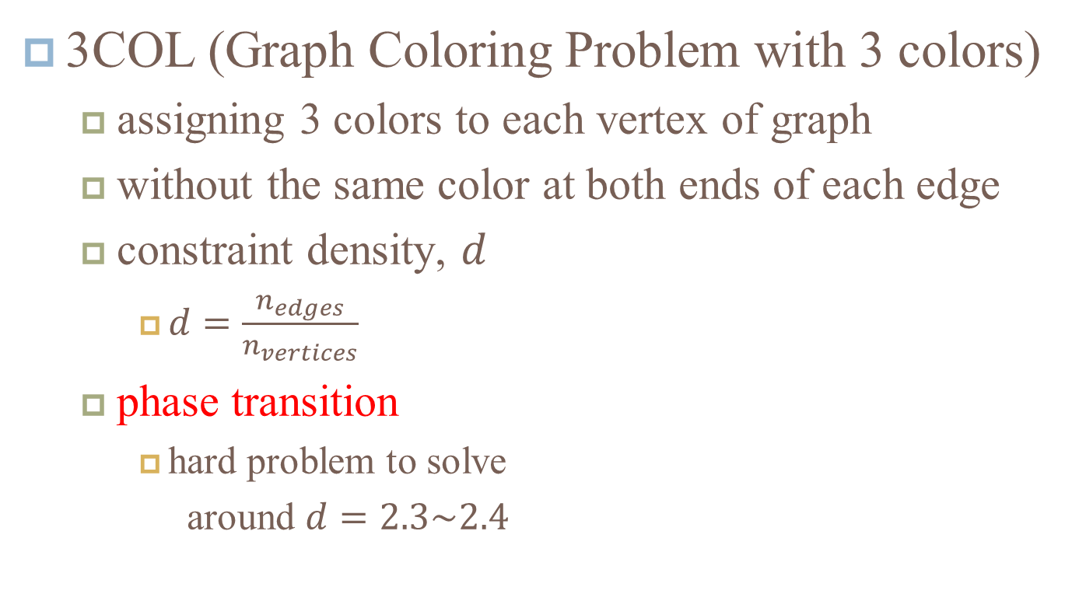
Background
3COL (Graph Coloring Problem with 3 colors)
assigning 3 colors to each vertex of graph
without the same color at both ends of each edge
constraint density, $d$
$d=\frac{n_{edges}}{n_{vertices}}$
phase transition
hard problem to solve
around $d=2.3\sim 2.4$
x
x
x
x
Notes:
“target” “one kind of ”
“Now,” “divided by” “For the prior work”

Slide 4
ACO (Ant Colony Optimization)
feed
!!
?
?
meta-heuristics
pheromone communication
?
Notes:
“This is the model” “imitating” “drops pheromone on the path”
“many ants use the path”
“evaporates”

Slide 5
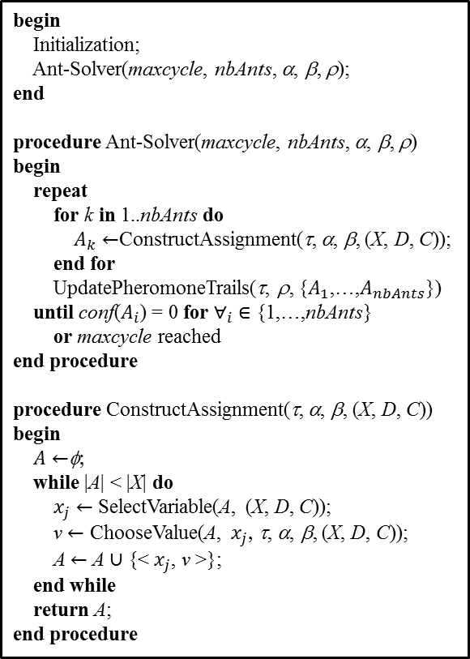
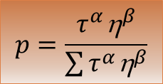
AS (Ant System) [Dorigo 96]
begin
Initialization;
Ant-Solver(maxcycle, nbAnts, α, β, ρ);
end
procedure Ant-Solver(maxcycle, nbAnts, α, β, ρ)
begin
repeat
for k in 1..nbAnts do
$A_{k}←$ConstructAssignment(τ, α, β, (X, D, C));
end for
UpdatePheromoneTrails(τ, ρ, {$A_{1}$,…,$A_{nbAnts}$})
until conf($A_{i}$) = 0 for $∀_{i} ∈$ {1,…,nbAnts}
or maxcycle reached
end procedure
procedure ConstructAssignment(τ, α, β, (X, D, C))
begin
$A←$φ;
while |A| < |X| do
$x_{j}←$ SelectVariable(A, (X, D, C));
v $←$ ChooseValue(A, $x_{j}$, τ, α, β, (X, D, C));
A $←$ A $∪$ {< $x_{j}$, v >};
end while
return A;
end procedure
$$p=\frac{τ^{α}{\text{h}}^{β}}{\sum{τ^{α}{\text{h}}^{β}}}$$
R
R
R
G
G
G
B
B
B
Notes:
“algorithm”
“Each ant constructs”
“In this work, we define” “least violations”

Slide 6
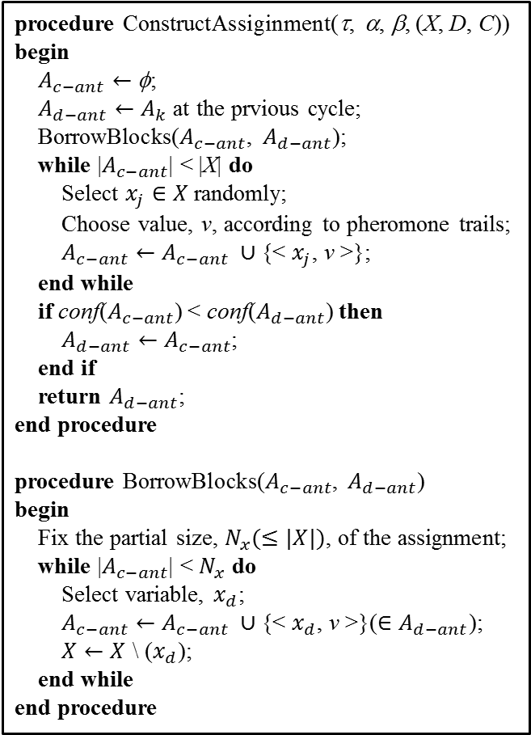

cunning Ant System (cAS) [Tsutsui 06]
procedure ConstructAssiginment(τ, α, β, (X, D, C))
begin
$A_{c−ant}←$ φ;
$A_{d−ant}←A_{k}$ at the prvious cycle;
BorrowBlocks($A_{c−ant}$, $A_{d−ant}$);
while |$A_{c−ant}$| < |X| do
Select $x_{j}∈X$ randomly;
Choose value, v, according to pheromone trails;
$A_{c−ant}←A_{c−ant} ∪${< $x_{j}$, v >};
end while
if conf($A_{c−ant}$) < conf($A_{d−ant}$) then
$A_{d−ant}←A_{c−ant}$;
end if
return $A_{d−ant}$;
end procedure
procedure BorrowBlocks($A_{c−ant}$, $A_{d−ant}$)
begin
Fix the partial size, $N_{x}(≤|X|)$, of the assignment;
while |$A_{c−ant}$| < $N_{x}$ do
Select variable, $x_{d}$;
$A_{c−ant}←A_{c−ant} ∪${< $x_{d}$, v >}($∈A_{d−ant}$);
$X←X$ \ ($x_{d}$);
end while
end procedure
donor ant
(d-ant)
G
R
B
B
R
cunning ant
(c-ant)
$$p=\frac{τ^{α}{\text{h}}^{β}}{\sum{τ^{α}{\text{h}}^{β}}}$$
R
G
G
G
B
B
Notes:
“improving” “feature”
“at previous cycle”
“a part of their assignments”
“the other variables” “available” “reduce the search time”

Slide 7
Drawback
using only single pheromone trail
updated with the best assignment
including low-quality parts
affect later generation
getting stuck in local optimum
Notes:
“”
“refer to”
“may tend to”

Slide 8
Purpose
divide assignment into “high-quality” and “low-quality”
high-quality part: reliable
low-quality part: unreliable
provide several pheromone trails
Notes:
“need to divide”
“in the same way as” “avoid to assign according to”
“to store each”

Slide 9
Basic idea
use another pheromone trail
called “negative pheromone”
updated with worst assignment
avoid to construct invalid assignments
Notes:
“Now, let me talk about”
“To achieve our purpose”
“”
“Considering” “it is avoided”

Slide 10
Proposed model
feed
Negative Pheromone
!!!!
?
Usual Pheromone
?
?
Notes:
“This is”
“At the ineffective path” “more rarely chosen”
“store apart”

Slide 11
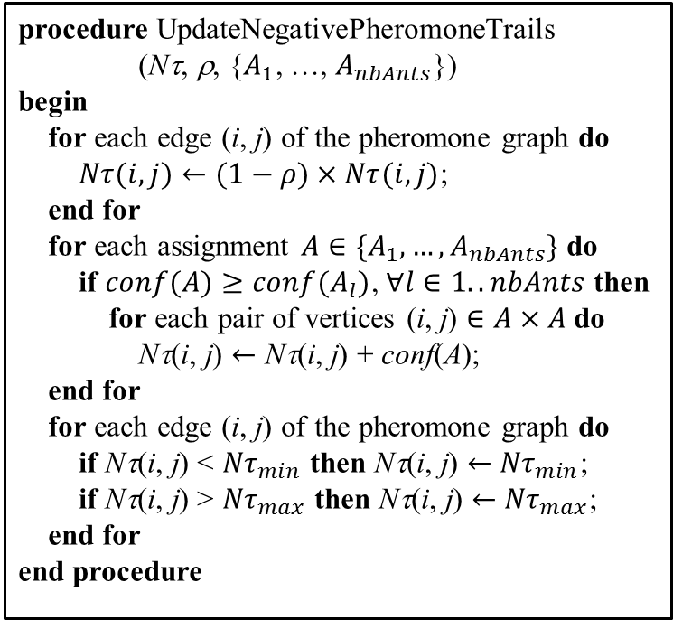




Algorithm
$$x_{1} x_{2} x_{3} x_{4} x_{5}$$
procedure UpdateNegativePheromoneTrails
(Nτ, ρ, {$A_{1}$, …, $A_{nbAnts}$})
begin
for each edge (i, j) of the pheromone graph do
$Nτ(i,j)←(1−ρ)×Nτ(i,j)$;
end for
for each assignment $A∈\{A_{1}, …, A_{nbAnts}\}$ do
if $conf(A)≥conf(A_{l})$, $∀l∈1..nbAnts$ then
for each pair of vertices (i, j) $∈A×A$ do
Nτ(i, j) $←$ Nτ(i, j) + conf(A);
end for
for each edge (i, j) of the pheromone graph do
if Nτ(i, j) < ${Nτ}_{min}$ then Nτ(i, j) $←$ ${Nτ}_{min}$;
if Nτ(i, j) > ${Nτ}_{max}$ then Nτ(i, j) $←$ ${Nτ}_{max}$;
end for
end procedure
$$p=\frac{\frac{Uτ^{α_{u}}{\text{h}}^{β}}{{Nτ}^{α_{n}}}}{\sum{\frac{Uτ^{α_{u}}{\text{h}}^{β}}{{Nτ}^{α_{n}}}}}$$
$$x_{1} x_{2} x_{3} x_{4} x_{5}$$
$$p=\frac{τ^{α}{\text{h}}^{β}}{\sum{τ^{α}{\text{h}}^{β}}}$$
R
R
R
R
G
G
G
B
B
B
Notes:
“apply our model to”
“The probability to assign value”
“method to update”
“as the amount of” “increase” “probability” “decrease”

Slide 12
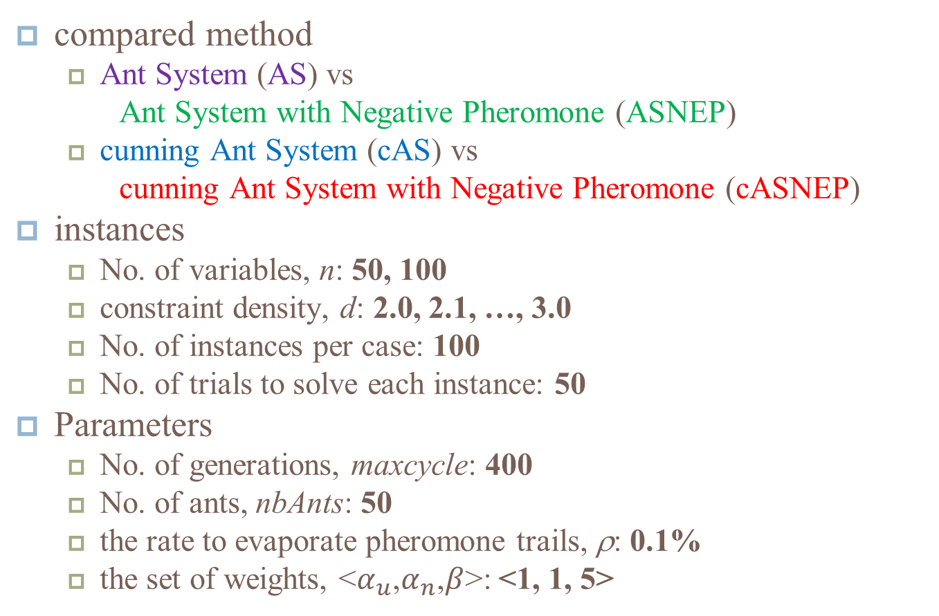
Experimental setting
compared method
Ant System (AS) vs
Ant System with Negative Pheromone (ASNEP)
cunning Ant System (cAS) vs
cunning Ant System with Negative Pheromone (cASNEP)
instances
No. of variables, n: 50, 100
constraint density, d: 2.0, 2.1, …, 3.0
No. of instances per case: 100
No. of trials to solve each instance: 50
Parameters
No. of generations, maxcycle: 400
No. of ants, nbAnts: 50
the rate to evaporate pheromone trails, ρ: 0.1%
the set of weights, <$α_{u}$,$α_{n}$,$β$>: <1, 1, 5>
Notes:
“To evaluate the effectiveness”
“2,200 instances”
“20,000 assignment” “at most” “respectively”

Slide 13
Experimental results (1/2) ~search cost~
n = 50
n = 100
Notes:
“These are”
“horizontal line”
“vertical line”
“purple and blue”
“green and red”
“cost to solve instances”

Slide 14
Experimental results (2/2) ~rate of success~
n = 50
n = 100
Notes:
“superior from the viewpoint of”
“vertical line”
“solve instances with high probability”
“seen more clearly”

Slide 15
Discussion (1/2) ~search cost~
single pheromone trail
little time
double pheromone trails
much time
take more costs to refine two pheromone trails

Slide 16
Discussion (2/2) ~rate of success~
for smaller-scale instances
little difference
for larger-scale instances
more effective than naive
effective to solve
much larger-scale instances
.
.
.
?
Notes:
“if we ignore to take large costs”

Slide 17
Conclusion
We propose new model based on ACO.
We provide another pheromone trail.
Proposed model is superior in the rate of solved instances.
Future work
evaluate the effectiveness for larger-scale problem
compare with other method
Notes:
“meta-heuristics”

Slide 18
Meta-heuristics
heuristics
stochastic search
take little time
not guaranteed integrity
meta-heuristics
not depend on the type of problems
example
Genetic Algorithm (GA)
Particle Swarm Optimization (PSO)
Ant Colony Optimization (ACO)
Artificial Bee Colony Algorithm (ABC)
Simulated Annealing (SA)

Slide 19
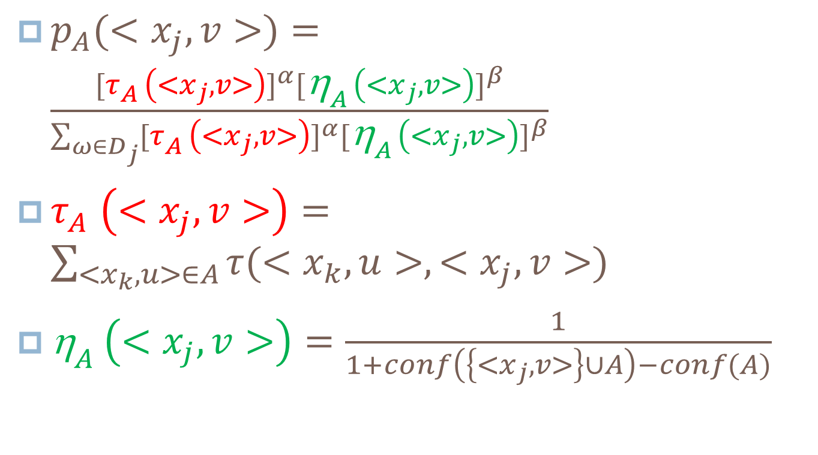
Probability to assign ~AS, cAS~
$p_{A}(<x_{j},v>)=\frac{{[τ_{A}^{}\left(<x_{j},v>\right)]}^{α}{[{\text{h}}_{A}^{}\left(<x_{j},v>\right)]}^{β}}{\sum_{ω∈D_{j}}{{[τ_{A}^{}\left(<x_{j},v>\right)]}^{α}{[{\text{h}}_{A}^{}\left(<x_{j},v>\right)]}^{β}}}$
$τ_{A}^{}\left(<x_{j},v>\right)=\sum_{<x_{k},u>∈A}{τ(<x_{k},u>,<x_{j},v>)}$
${\text{h}}_{A}^{}\left(<x_{j},v>\right)=\frac{1}{1+conf\left(\left\{<x_{j},v>\right\}∪A\right)−conf(A)}$

Slide 20
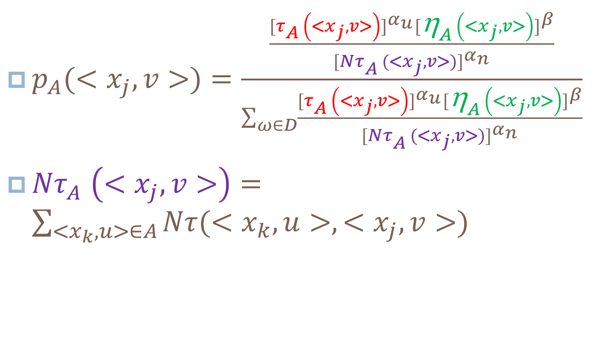
Probability to assign ~ASNEP, cASNEP~
$p_{A}(<x_{j},v>)=\frac{\frac{{[τ_{A}^{}\left(<x_{j},v>\right)]}^{α_{u}}{[{\text{h}}_{A}^{}\left(<x_{j},v>\right)]}^{β}}{{[{Nτ}_{A}^{}(<x_{j},v>)]}^{α_{n}}}}{\sum_{ω∈D}{\frac{{[τ_{A}^{}\left(<x_{j},v>\right)]}^{α_{u}}{[{\text{h}}_{A}^{}\left(<x_{j},v>\right)]}^{β}}{{[{Nτ}_{A}^{}(<x_{j},v>)]}^{α_{n}}}}}$
${Nτ}_{A}^{}\left(<x_{j},v>\right)=\sum_{<x_{k},u>∈A}{Nτ(<x_{k},u>,<x_{j},v>)}$

Slide 21

Instances
Problem size
n=50 : $3^{50}=7×{10}^{23}$
n=100: $3^{100}=5×{10}^{47}$
All instances can be solved.

