Slide 1

Solving Constraint Satisfaction Problems by Cunning Ants with Multi-Pheromones
Takuya Masukane, Kazunori Mizuno
Department of Computer Science
Takushoku University, Japan

Slide 2
Summary
Purpose
to solve efficiently hard constraint satisfaction problems (CSPs)
Method
based on Ant Colony Optimization (ACO)
employ another pheromone
Result
Our method can be effective around phase transition region.

Slide 3

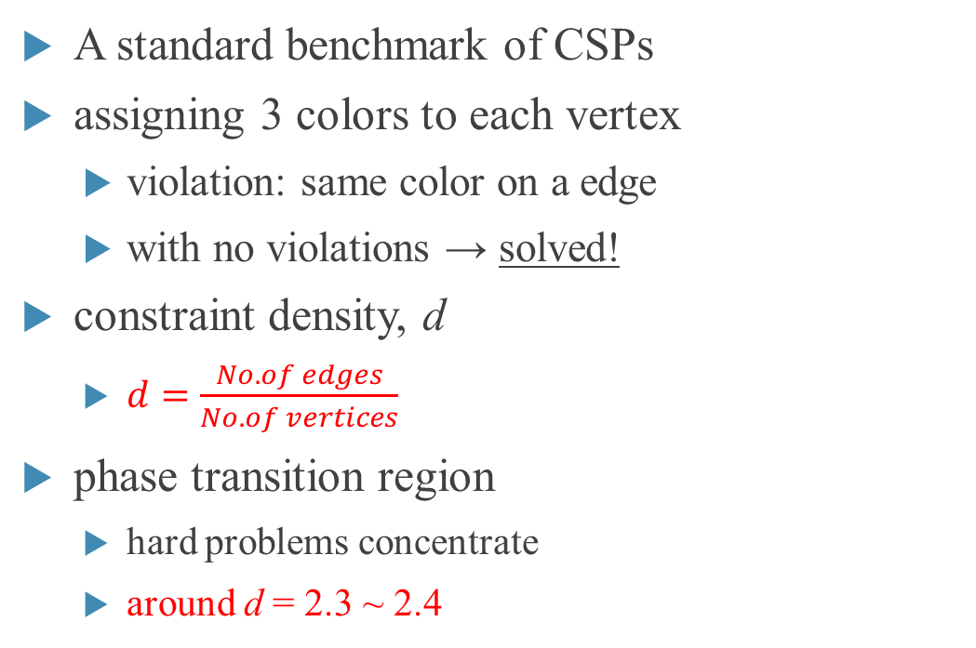
Background -3COL (Graph Coloring Problem with 3 colors)-
A standard benchmark of CSPs
assigning 3 colors to each vertex
violation: same color on a edge
with no violations → solved!
constraint density, d
$d=\frac{No. of edges}{No. of vertices}$
phase transition region
hard problems concentrate
around d = 2.3 ~ 2.4
seach cost
2.3 2.4
$$d$$

Slide 4
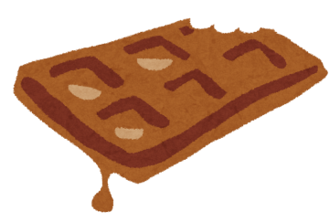
Ant Colony Optimization (ACO)
meta-heuristics
imitation of pheromone communication of ants
Ants drop pheromones on the path from the feed to their nest.
Ants return to their nest by following pheromones.
The pheromone on a long path evaporates soon.
The pheromone on a short path ( = useful for their return to their nest) should remain there.
pheromone

Slide 5
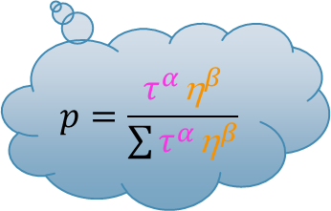

cunning Ant System (cAS)
one of algorithms based on ACO
pheromone
$$p=\frac{τ^{α}{\text{h}}^{β}}{\sum{τ^{α}{\text{h}}^{β}}}$$
evaporation rate: $ρ$
Notes:
説明すること
解構築方法
確率式に用いる各記号について
フェロモン更新
$ρ$だけ蒸発する
Best な解をもとに更新する
ASをもとにしたnaïveなアルゴリズムは解構築に時間がかかる
cASは解構築にかかる時間を削減するために提案されたもの
cASは1から解構築するのではなく前世代から1部を使用する
説明しないこと
フェロモンの構造
フェロモンの堆積量

Slide 6
Purpose
Depending on the pheromone state, cAS can tend to get caught in local optima.
It may be because assignment construction of cAS has only one aim.
to converge the assignment candidates to the assignment having less violations
In addition to same purpose as cAS, we set other aims.

Slide 7
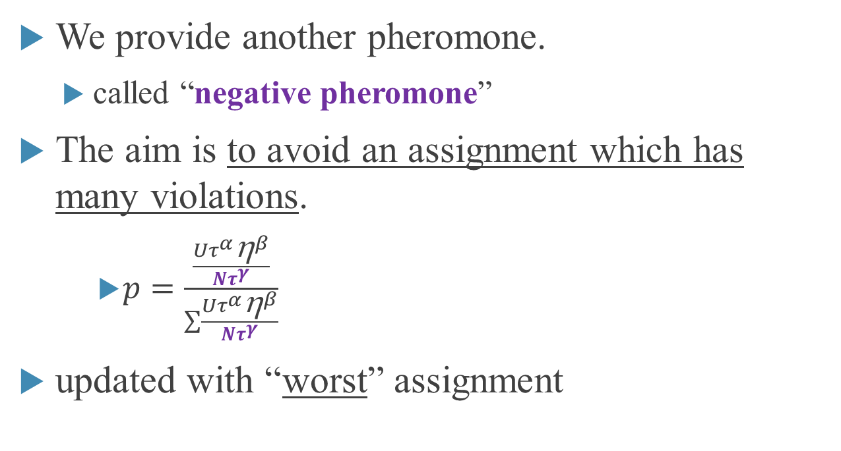
Proposed Model
We provide another pheromone.
called “negative pheromone”
The aim is to avoid an assignment which has many violations.
$p=\frac{\frac{Uτ^{α}{\text{h}}^{β}}{{Nτ}^{γ}}}{\sum{\frac{Uτ^{α}{\text{h}}^{β}}{{Nτ}^{γ}}}}$
updated with “worst” assignment

Slide 8
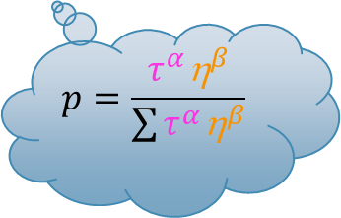

cAS with Negative Pheromone (cASNEP)
negative pheromone
usual pheromone
pheromone
$$p=\frac{τ^{α}{\text{h}}^{β}}{\sum{τ^{α}{\text{h}}^{β}}}$$
$$p=\frac{\frac{Uτ^{α}{\text{h}}^{β}}{{Nτ}^{γ}}}{\sum{\frac{Uτ^{α}{\text{h}}^{β}}{{Nτ}^{γ}}}}$$
Notes:
解構築方法を説明
cASと同様，ネガティブフェロモン構造，堆積量の説明はしない

Slide 9
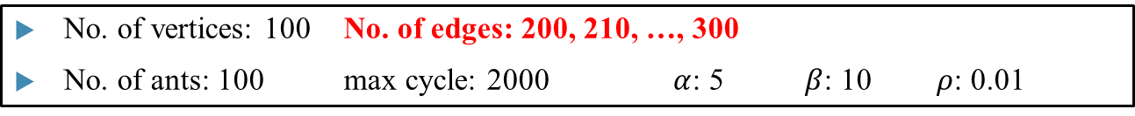
Experimental Results (1/3) -percentage of solved instances-
No. of vertices: 100 No. of edges: 200, 210, …, 300
No. of ants: 100 max cycle: 2000 $α$: 5 $β$: 10 $ρ$: 0.01

Slide 10
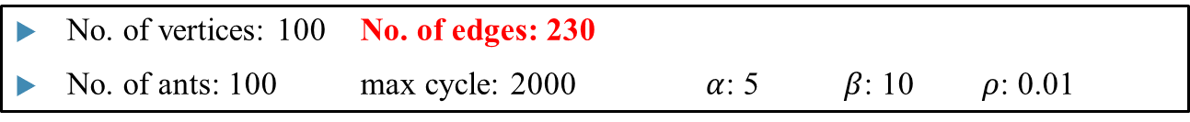
Experimental Results (2/3) -search cost-
No. of vertices: 100 No. of edges: 230
No. of ants: 100 max cycle: 2000 $α$: 5 $β$: 10 $ρ$: 0.01

Slide 11


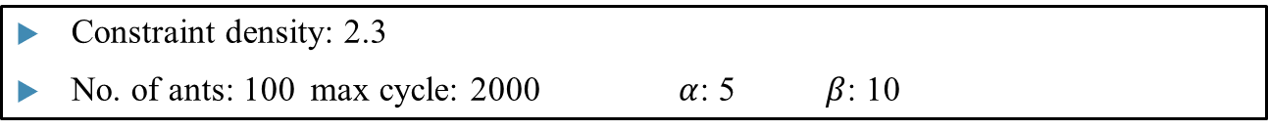
Experimental Results (3/3) -several varieties of situations-
Constraint density: 2.3
No. of ants: 100 max cycle: 2000 $α$: 5 $β$: 10
No. of vertices: 100
$ρ$: 0.001, 0.002, 0.005, 0.01, 0.02, 0.05
No. of vertices: 200
$ρ$: 0.01

Slide 12
Conclusion
We propose a new model based on ACO.
We provide another pheromone.
Proposed model should be more superior in …
percentage of solved instances
robustness against the variation of parameters
adaptability to larger instances.
Future works
to compare with other meta-heuristics
to apply to other types of CSPs

Slide 13
以下質疑応答用スライド

Slide 14
フェロモン データ構造

Slide 15
フェロモン更新

Slide 16
他のメタヒューリスティクス

