Slide 1
Using Quartus and ModelSim for FPGA Power Analysis
Jari Ylimäinen
jariy@ee.oulu.fi
v.1.3

Slide 2
Prerequisites
Software
Altera Quartus II
ModelSim Altera Starter Edition (ASE)
A working project in Quartus

Slide 3
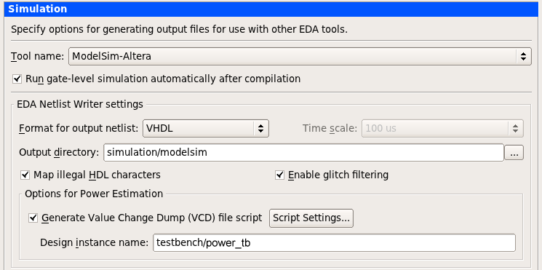
Setting up simulation (1/3)
Go to simulation settings and set everything as below (Assignments/Settings/EDA Tool Settigns/Simulation)
Optional

Slide 4

Setting up simulation (2/3)
Click More EDA Netlist Writer Settings...
Set Generate third-party EDA tool command script for gate-level simulation
Select compile test bench from NativeLink settings
Add new test bench

Slide 5
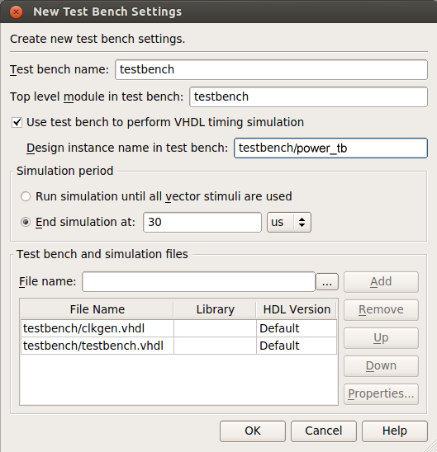
Setting up simulation (3/3)
Fill as shown
Length of simulation can calculated from TCE simulation cycle count by multiplying it with 20 ns (50MHz)*
Add clkgen.vhdl above testbench.vhdl
Disable SignalTap from options window and close it
*) Clock speed is defined in testbench.vhdl’s PERIOD generic

Slide 6
Compiling
Compile project
If you selected automatic simulation ModelSim should start after compiling. Otherwise click Tools/Run Simulation Tools/Gate-level simulation
ModelSim can give you an error because the testbench doesn’t match the design. In this case open simulation/modelsim/[design].vho Find your design entity declaration.
Copy port definitions to your testbench.vhdl
ENTITY fft IS
PORT (
led : OUT std_logic_vector(7 DOWNTO 0);
seq : OUT std_logic_vector(7 DOWNTO 0);
clk : IN std_logic;
reset_n : IN std_logic
);
END fft;

Slide 7
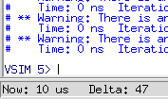
Setting up testbench
fft.vho ENTITY fft IS
PORT (
led : OUT std_logic_vector(7 DOWNTO 0);
seq : OUT std_logic_vector(7 DOWNTO 0);
clk : IN std_logic;
reset_n : IN std_logic
);
END fft;
testbench.vhdl
component fft
PORT (
led : OUT std_logic_vector(7 DOWNTO 0);
seq : OUT std_logic_vector(7 DOWNTO 0);
clk : IN std_logic;
reset_n : IN std_logic
);
END component;
-- ten or so lines below
-- CPU
-- Change the name of your design here
power_tb : fft
port map (
clk => clk,
reset_n => rst_x
);
• While editing the testbench change also the mapping to point to the name of your design [here, fft is the top-level design module, not the processor!]
• In ModelSim press the ”up” key and ”enter” to rerun the previous script. Now it should compile and run.
• When you see the vsim prompt the simulation has finished. Close ModelSim and Quartus will continue.

Slide 8
Setting up PowerPlay
After succesful compilation and simulation go back to settings → PowerPlay Power Analyzer Settings
Check Use input file(s) to initilize toggle rates...
Add the [design].vcd from simulation/modelsim directory
Use same entity as in your [design].vdo
Check Perform glitch filtering on VCD files
See the next slide for a screenshot

Slide 9
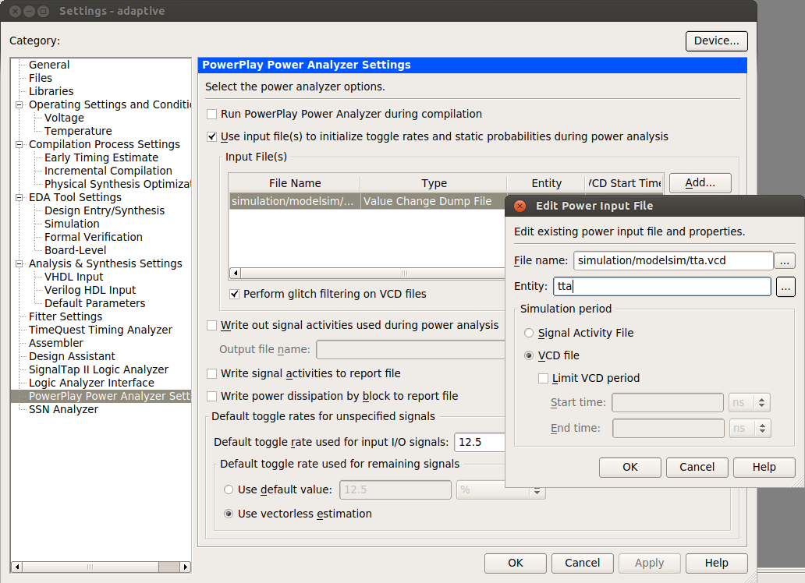
Optional

Slide 10
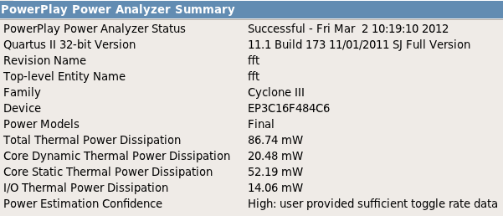
Running PowerPlay
Open Processing/PowerPlay Power Analyzer Tool
Hit Start
After running check from the report summary for confidence. It should be ”high”.
All done.

Slide 11
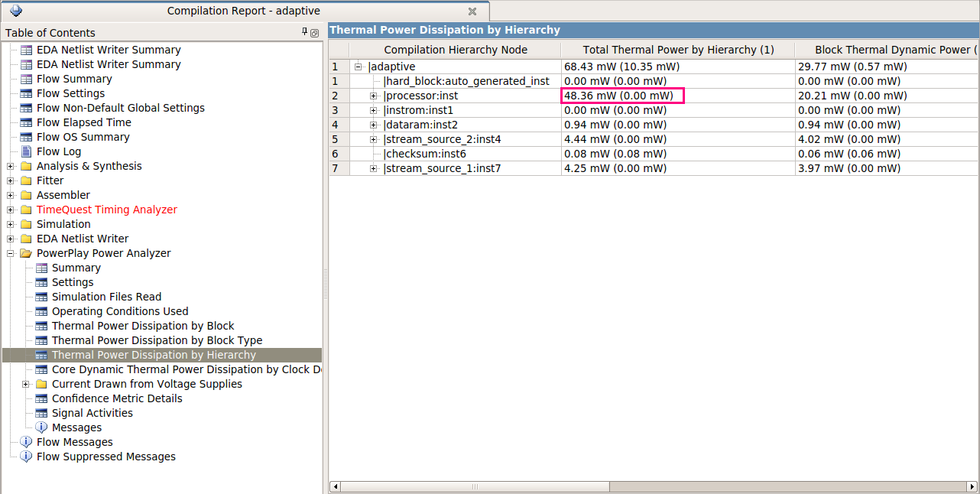
Viewing Results

