Slide 1
Virtual Classroom

Slide 2

FRONT PAGE

Slide 3
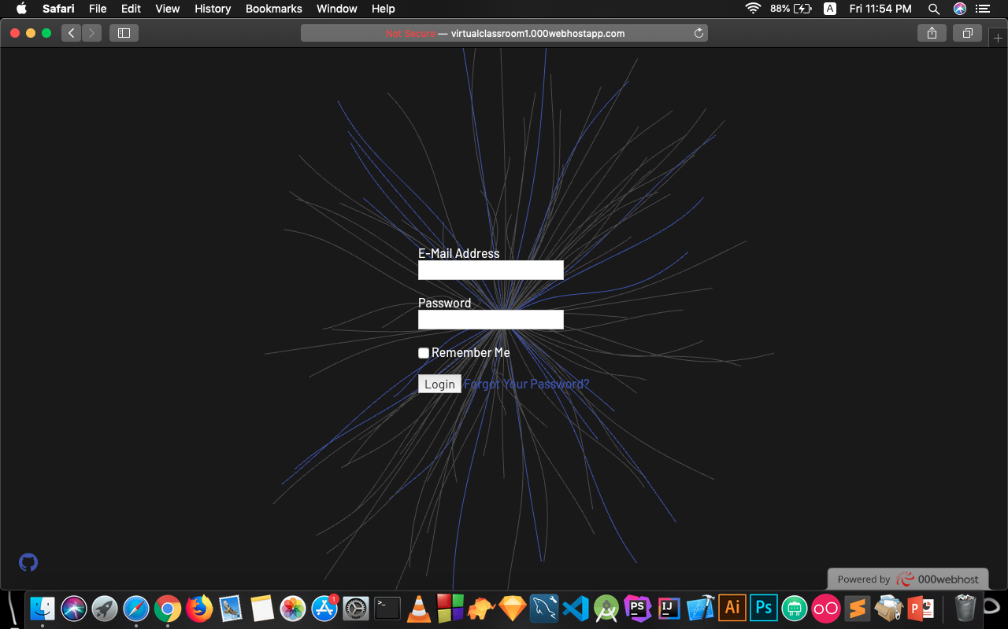
Login | Registration PAGE

Slide 4
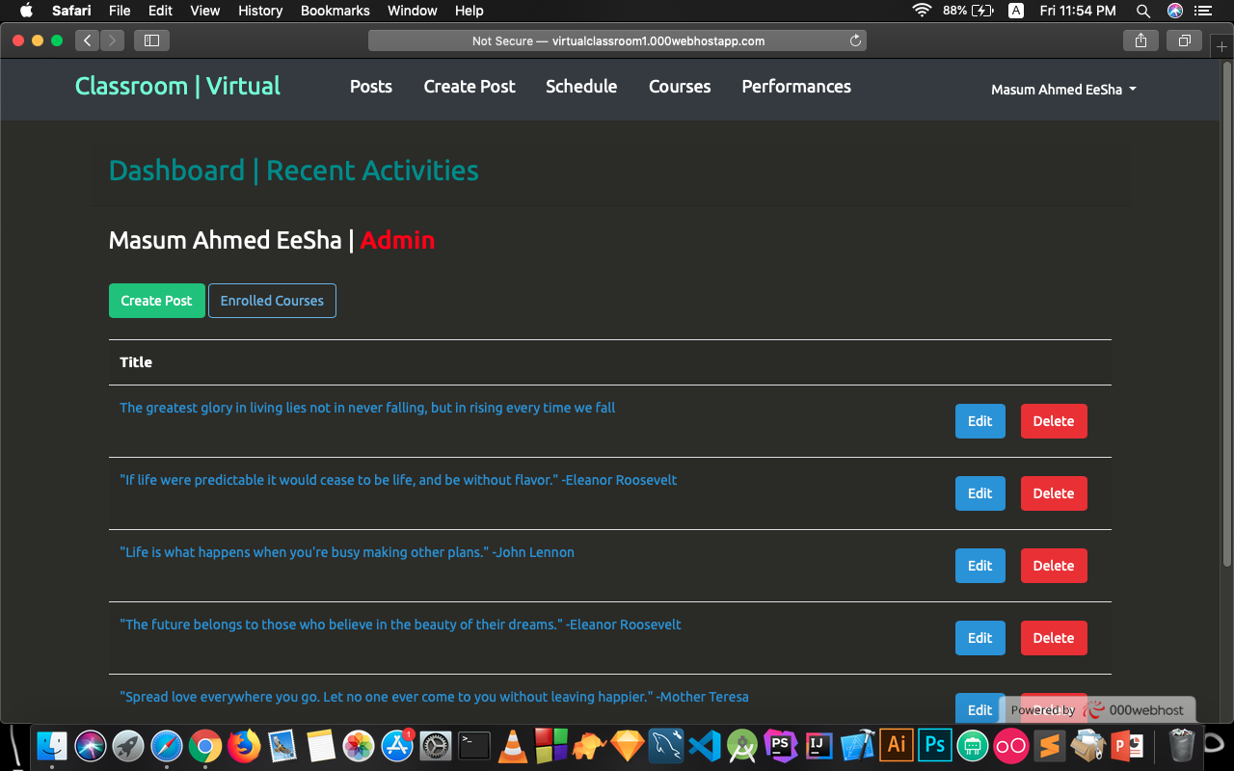
DASHBOARD PAGE

Slide 5
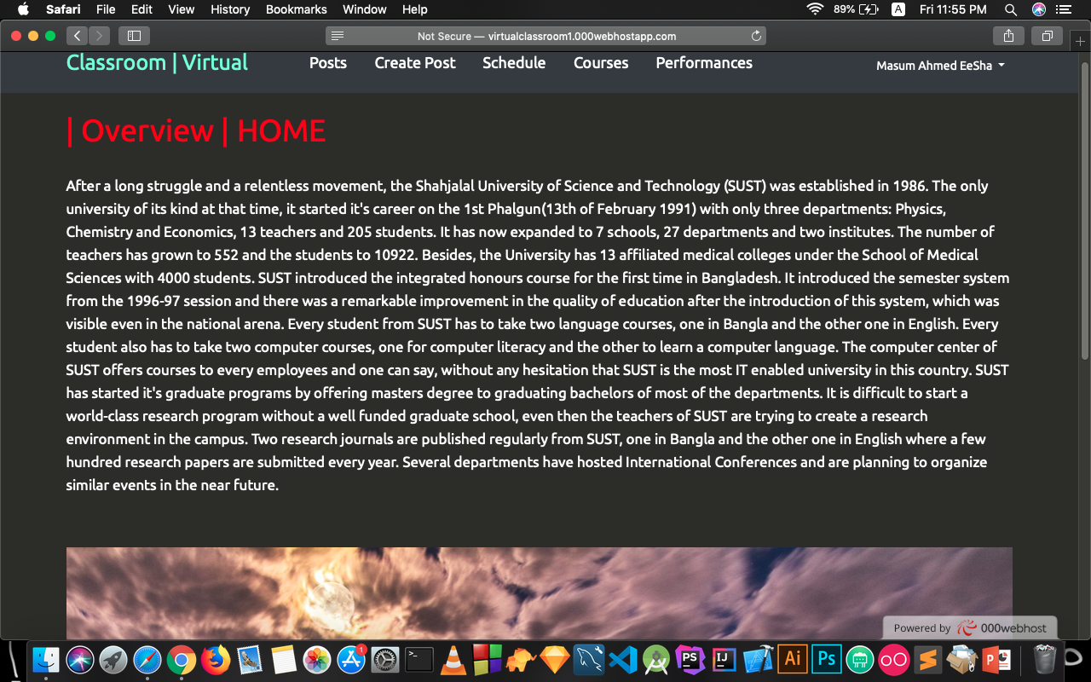
HOME PAGE

Slide 6
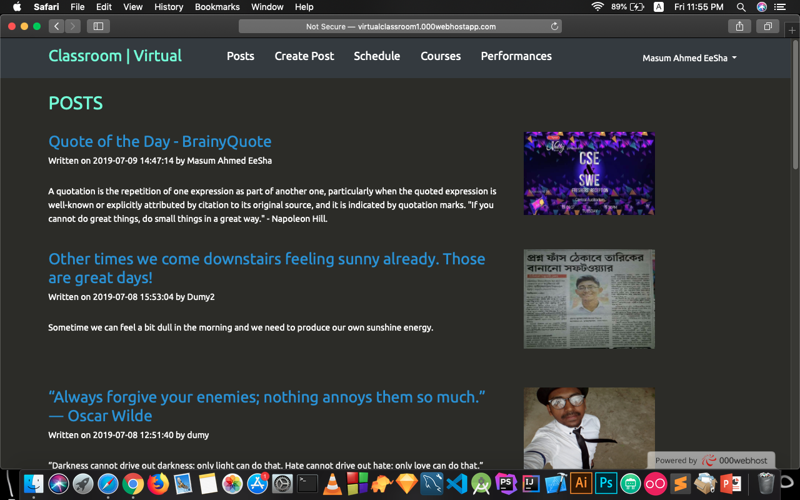
EMERGENCY POST PAGE

Slide 7
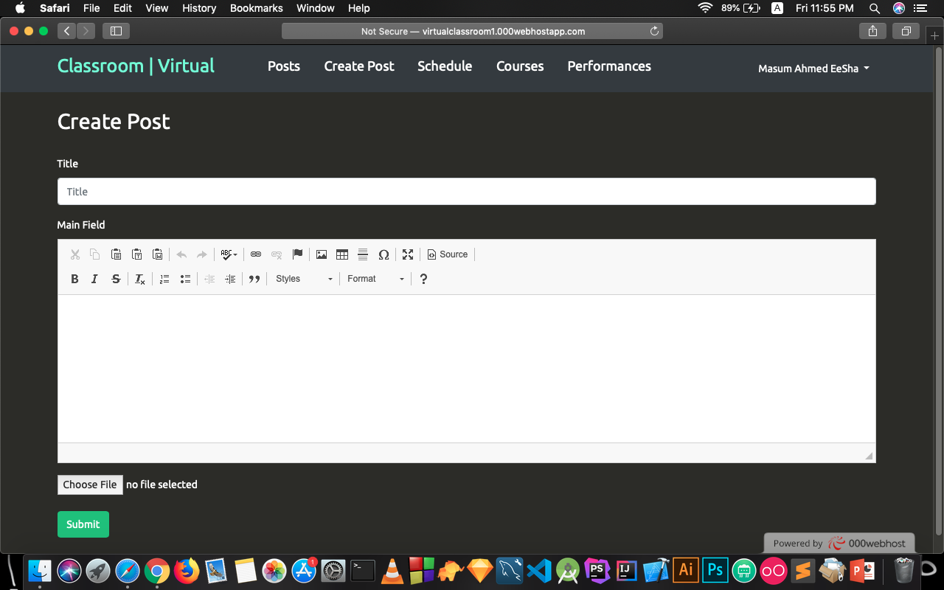
CREATE POST PAGE

Slide 8
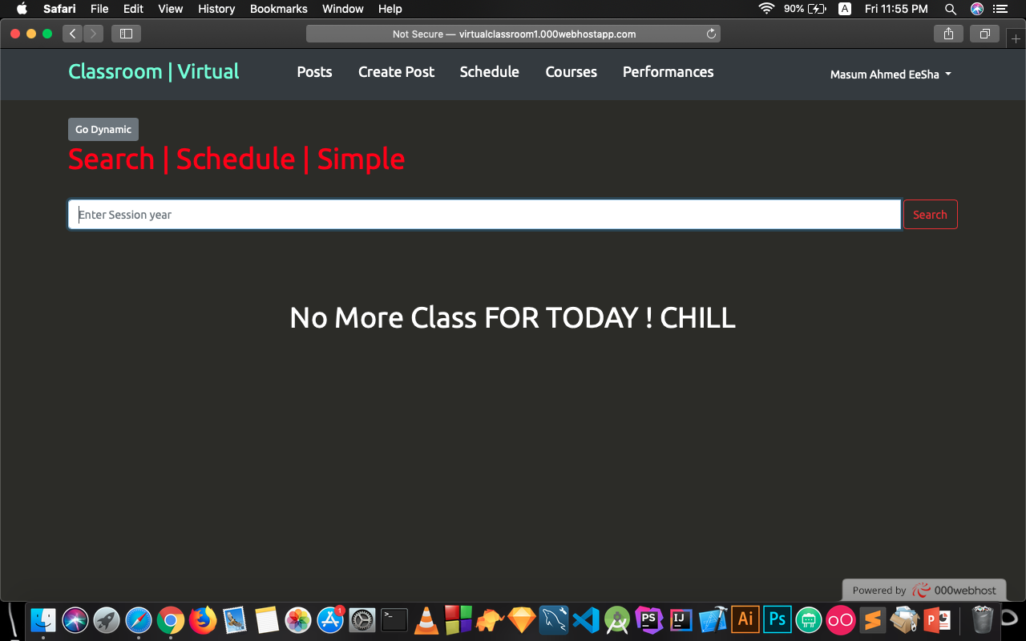
SCHEDULE (Dynamic using AJAX) PAGE

Slide 9
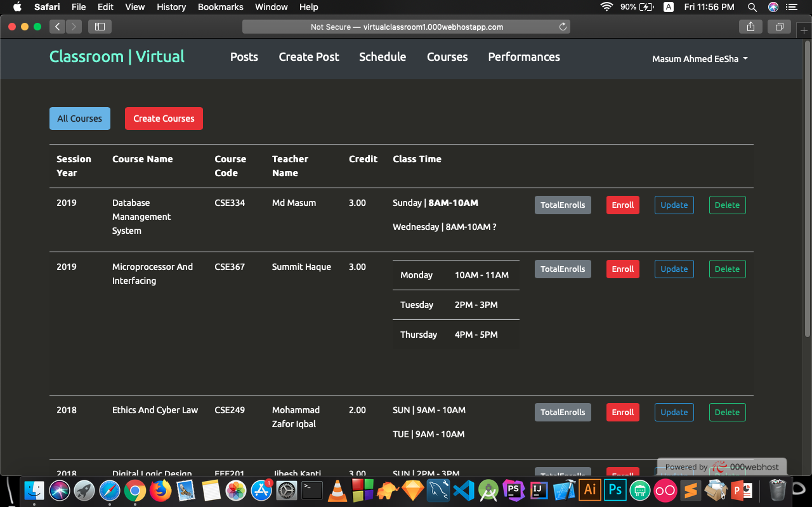
COURSES PAGE

Slide 10
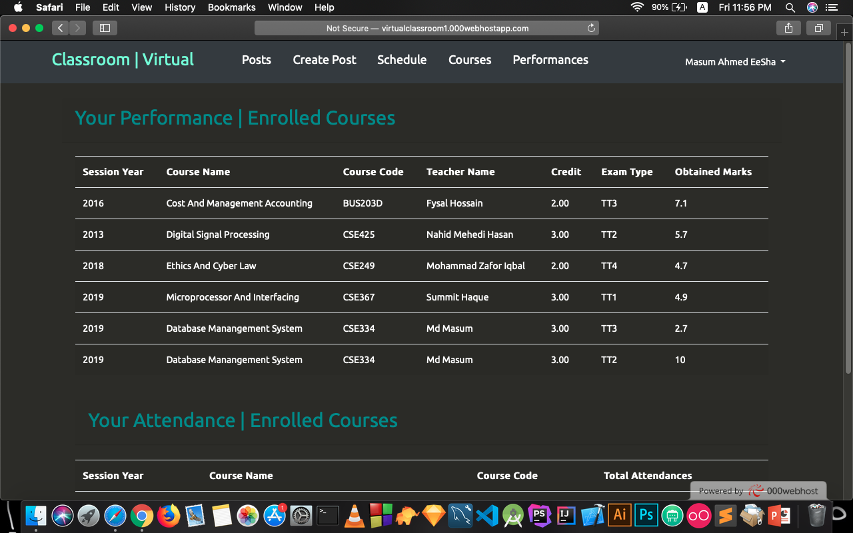
PERFORMANCES PAGE

Slide 11
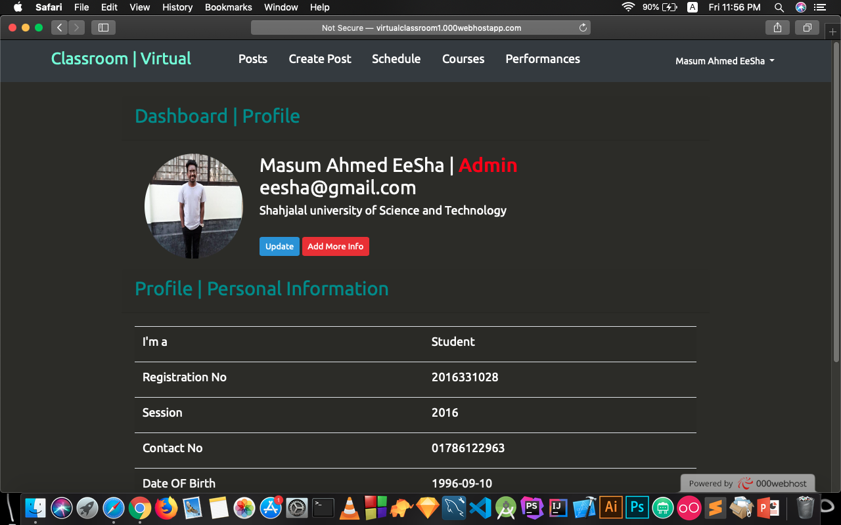
PROFILE PAGE

