Slide 1

A presentation on "Air Quality Index(AQI)"
By MASUM ISHTIAQ

Slide 2
What is AQI?
AQI(Air Quality Index) is a system used to measure and communicate the quality of the air in a specific area, indicating how clean or polluted the air is and what associated health effects might be a concern for the general population.

Slide 3
Scale of AQI
The AQI is usually reported on a scale from 0 to 500, with lower values indicating better air quality. Here’s a general breakdown of the scale: 0-50: Healthy 51-105: Moderate 150+: Unhealthy

Slide 4
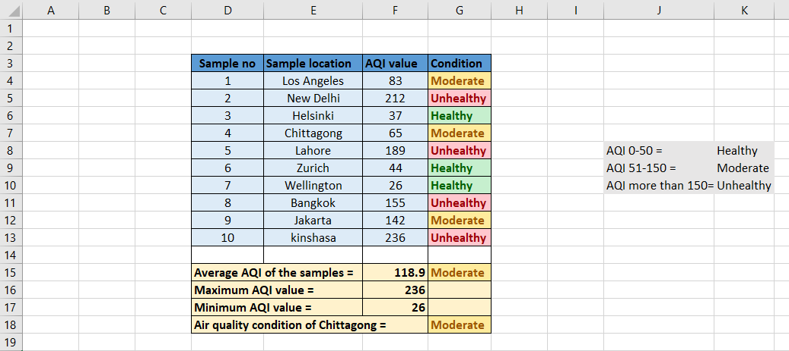
AQI of various city (table from excel)

Slide 5
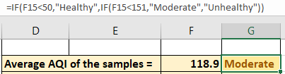
Average AQI

Slide 6

Maximum AQI

Slide 7

Minimum AQI

Slide 8

Finding out air quality condition of Chittagong

Slide 9

Air quality with applied conditional formating

Slide 10
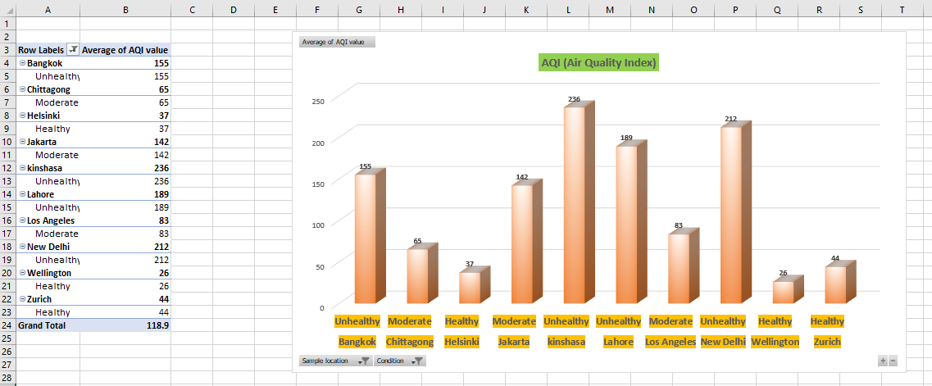
Bar diagram from PivotTable

Slide 11
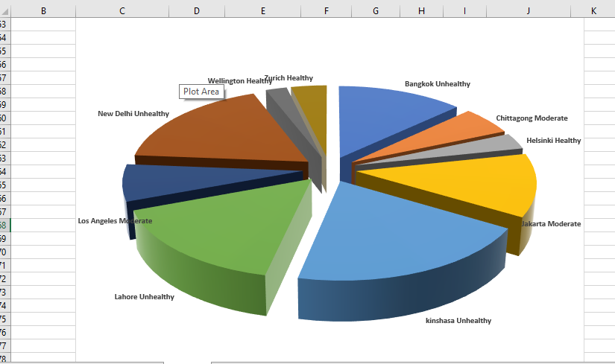
Pie Chart from PivotTable

Slide 12
Thank you

