Slide 1

CI/CD
Masum Mazid

Slide 2
Contents
Topics | Slides
DevOps | 3
DevOps Tools | 4
Docker and Kubernetes | 5-6
Prometheus and ELK | 7-8
JIRA or Trello | 9-10
use A/B testing and canary releases | 11-12
DevOps Culture | 13
DevOps Closing | 14-15

Slide 3
DevOps difference from traditional software development methodologies
DevOps is a cultural and technical approach to software development
efficiency and speed of delivering high-quality software by automation
Not as sequential as Waterfall, Spiral or agile methodology
DevOps helps to bridge the gap between development and operations
Continuous Integration (CI), Continuous Deployment (CD)
Common toolkit include: Git, Jenkins, and Ansible
Prevents Merge-hell

Slide 4
DevOp tools
Git is a version control system manages your code allows to update and merge with other collaborators.
Jenkins is an open-source automation server that can be used to automate various stages of the software development process, including building, testing, and deploying code. By using plugins and scripts, Jenkins can integrate with Git and other tools to automate tasks such as building, testing, and deploying code.
Ansible is an open-source automation platform that can be used to automate various IT tasks, including the deployment of applications. Ansible uses a declarative language to describe the desired state of a system and can be used to automate tasks such as installing packages, configuring services, and managing system configurations.
By using these tools together, teams can automate many of the manual tasks involved in software development and deployment, allowing them to focus on delivering new features and fixing problems more quickly. Additionally, the use of automation helps to reduce errors and ensure consistency, resulting in more reliable and predictable software releases.

Slide 5
How do you use containerization and orchestration technologies, such as Docker and Kubernetes, to improve scalability and reliability?
Containerization with Docker allows you to package your applications and dependencies into isolated containers, making them portable and easy to deploy across multiple environments. Kubernetes, on the other hand, is an orchestration platform that automates the deployment, scaling, and management of containers. By combining these technologies, you can achieve improved scalability and reliability for your applications
Kubernetes can manage the deployment and scaling of multiple containers, ensuring that your application has the resources it needs to function properly, even during high traffic periods. Additionally, Kubernetes can automatically manage the availability and resiliency of your containers by automatically restarting failed containers and moving containers between nodes in the event of hardware failures. This helps to minimize downtime and improve reliability.
In summary, using containerization and orchestration technologies like Docker and Kubernetes can help improve scalability and reliability by allowing you to package your applications into isolated containers, automate their deployment, scaling, and management, and manage the availability and resiliency of your application.

Slide 6
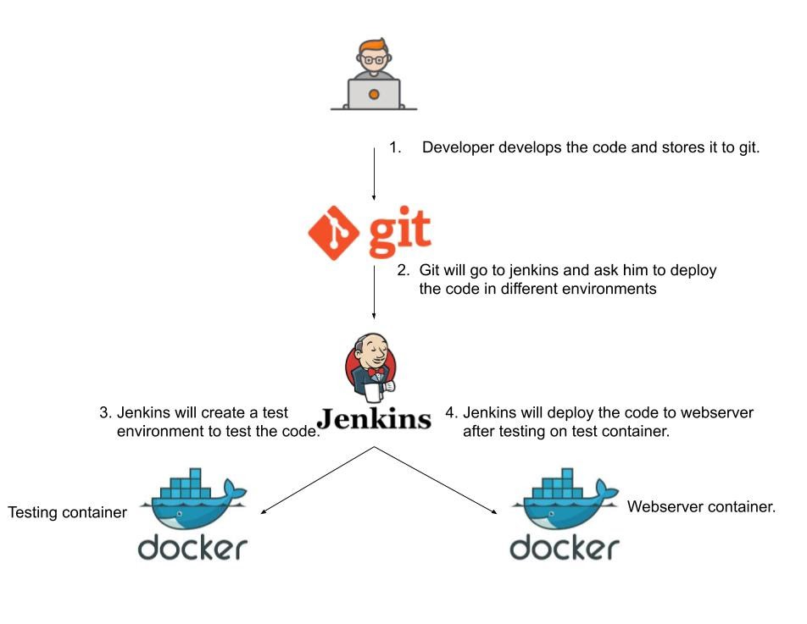

Slide 7
Can you explain how you use monitoring and logging tools, such as Prometheus and ELK, to improve visibility and troubleshoot issues in a production environment?
Monitoring and logging tools, such as Prometheus and the Elasticsearch, Logstash, and Kibana (ELK) stack, play an important role in improving visibility and troubleshooting issues in a production environment.
Prometheus is a monitoring tool that can collect and store time-series data and provides a query language to analyze this data. This information can be used to track key metrics such as resource usage, performance, and availability of your applications and infrastructure. By setting alerts based on these metrics, you can be notified of any potential issues and take action before they become major problems.
The ELK stack, on the other hand, is a logging solution that allows you to centralize and store log data from your applications and infrastructure. This data can then be analyzed and visualized using Kibana, providing a way to easily search, analyze, and visualize log data. This can be useful in troubleshooting issues as you can quickly search for and isolate relevant log entries to help identify the root cause of a problem.
By combining these tools, you can have a comprehensive view of your production environment, including both the performance and health of your applications, as well as the logs that can provide more detailed information about any issues that may arise. This helps you to identify and resolve problems more quickly and efficiently, leading to improved reliability and reduced downtime.

Slide 8
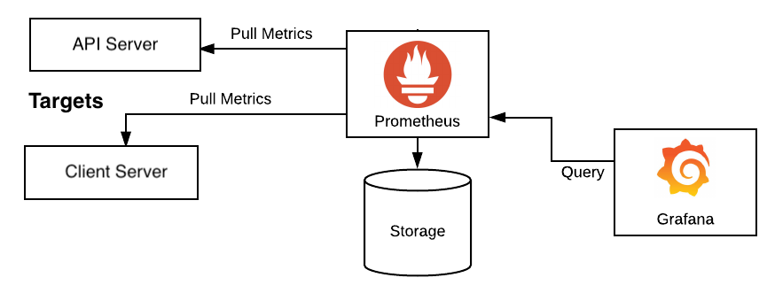

Slide 9
How do you handle and manage infrastructure as code using tools such as Terraform or CloudFormation?
Infrastructure as code (IaC) refers to the practice of managing and provisioning infrastructure resources, such as servers, storage, and network components, using code rather than manual processes. Tools like Terraform and AWS CloudFormation are used to automate and manage IaC.
With Terraform, you define your infrastructure using HashiCorp Configuration Language (HCL) in .tf files. Terraform then uses these files to create, modify, and delete resources on various cloud providers or on-premises environments. This allows you to version control your infrastructure and make changes in a repeatable and predictable manner.
AWS CloudFormation, on the other hand, provides a way to manage AWS resources using JSON or YAML templates. These templates define the desired state of your infrastructure and can be used to create, update, or delete resources in a predictable manner.
Both Terraform and CloudFormation provide a way to manage your infrastructure as code, allowing you to automate the provisioning and management of resources, enforce configuration best practices, and easily track changes to your infrastructure over time. Additionally, they can be integrated with other tools such as version control systems, CI/CD pipelines, and monitoring and logging tools to further improve the management and visibility of your infrastructure.

Slide 10
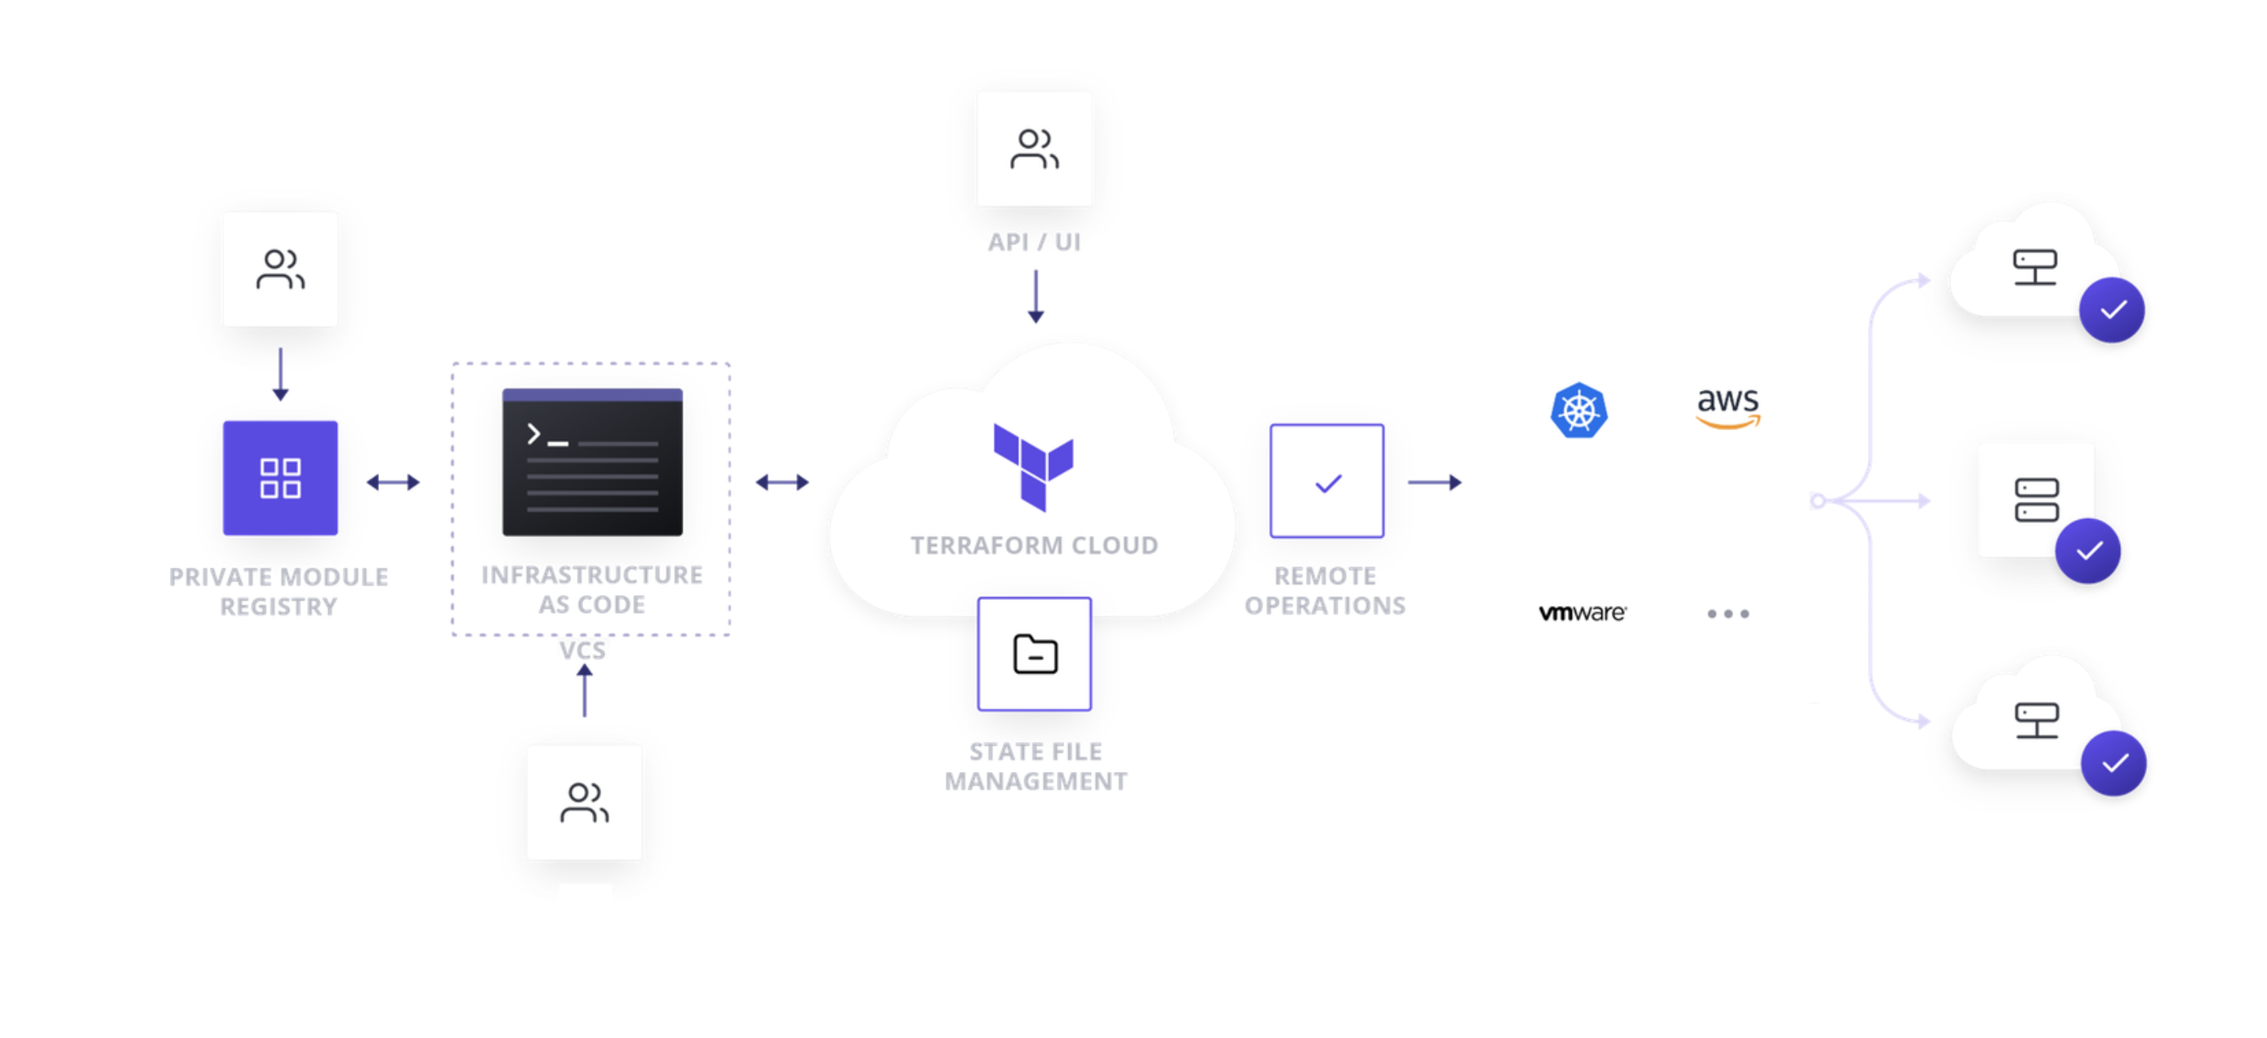

Slide 11
How do you use tools such as JIRA or Trello to manage and track work in a DevOps environment?
JIRA and Trello are both popular tools used to manage and track work in a DevOps environment. They can be used to organize and prioritize tasks, track the progress of work, and collaborate with team members.
JIRA is a comprehensive project management tool that provides a way to manage and track work items, such as bugs, features, and tasks, through a defined workflow. It allows you to organize work into projects and assign tasks to team members, set priorities, and track the progress of work. JIRA also provides robust reporting and dashboard capabilities, allowing you to gain insights into project progress and performance.
Trello, on the other hand, is a simple and flexible project management tool that uses a kanban-style board to visualize the progress of work. Work items, such as tasks and bugs, are represented as cards on the board, and they can be moved through different stages of a workflow, such as "to-do", "in progress", and "done". Trello also provides a way to collaborate with team members, attach files, and set deadlines, making it a good option for small teams or projects with simple workflows.
By using tools like JIRA or Trello, teams in a DevOps environment can better manage and track their work, improving collaboration and communication, and ensuring that work is delivered on time and to a high quality. These tools can also provide valuable insights into project performance and help teams to identify and address potential bottlenecks or roadblocks.

Slide 12
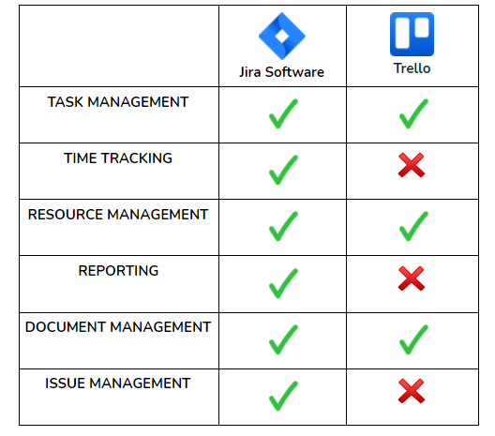

Slide 13
Can you explain how you use A/B testing and canary releases to minimize risk and improve the release process?
A/B testing and canary releases are two techniques used in software development to minimize risk and improve the release process.
A/B testing is a method of comparing two or more variants of a product or feature to determine which one performs better. In the context of software development, A/B testing can be used to evaluate the impact of changes to an application before deploying them to a production environment. This allows teams to test changes with a small subset of users, gather data, and make informed decisions about whether to proceed with a full rollout.
Canary releases, on the other hand, are a method of gradually rolling out changes to a production environment, starting with a small subset of users before gradually increasing the user base. This approach allows teams to validate changes in a live production environment and catch any potential problems early, before they affect the entire user base. Canary releases can also be combined with other techniques, such as feature flags and rollbacks, to provide a way to quickly roll back changes in the event of a problem.
By using A/B testing and canary releases, teams can minimize the risk of deploying changes to a production environment and improve the overall release process. These techniques allow teams to validate changes in a controlled and incremental manner, ensuring that they are reliable, performant, and meet the needs of users. This leads to more confident and efficient releases, reducing downtime and improving the overall quality of the software.

Slide 14
How do you foster a culture of collaboration, automation, and continuous improvement within a DevOps team?
Fostering a culture of collaboration, automation, and continuous improvement within a DevOps team requires a combination of organizational, process, and technical changes. Some ways to achieve this are:
Encourage Collaboration: DevOps is all about collaboration between teams, so it is important to create an environment where teams feel comfortable sharing information and working together. This can be achieved through regular team meetings, cross-functional training, and open communication channels.
Embrace Automation: Automation is a key aspect of DevOps, so it's important to embrace and encourage the use of automation tools and processes within your team. This can be achieved through regular training and knowledge sharing sessions, and by providing teams with the resources they need to automate processes effectively.
Encourage Continuous Improvement: DevOps is a journey, not a destination, and it is important to encourage teams to continuously look for ways to improve processes, tools, and systems. This can be achieved through regular retrospectives, experimentation and innovation, and by providing teams with the time and resources to experiment and learn.
Lead by Example: Finally, it is important to lead by example, and to model the values and behaviors that you want to see in your team. This means demonstrating a commitment to collaboration, automation, and continuous improvement, and creating a culture where these values are valued and encouraged.
By fostering a culture of collaboration, automation, and continuous improvement, you can create an environment where teams are motivated and empowered to work together effectively, delivering value to customers more quickly and efficiently.

Slide 15
