Slide 1

“HealthScope” – A Full-Lifecycle Public Health Analytics & Risk Dashboard
DATA SCIENCE (24AD3107) Project Review-2
^{16th September, 2026}
 | Under the Guidance of Mrs. Bonagani Prathusha Department of Computer Science and Engineering, KLH CSE Bowrampet Campus
Team Members Masuma Fathema – 2420030400 Ch. Bhargavi Devi - 2420030588 Dama Poojitha – 2420030697 P. Kavya Sai - 2420030322

Slide 2
PROBLEM STATEMENT
Healthcare datasets contain large amounts of information about individuals and their health conditions.
Identifying meaningful relationships between different health factors and disease outcomes can be difficult through manual analysis.
Important risk factors such as glucose, blood pressure, BMI, cholesterol, and age may interact with each other.
A simple dataset does not directly provide an understandable view of health trends and disease risk.
There is a need for a system that can:
  Analyze healthcare data efficiently
  Identify important risk factors
  Apply machine learning for risk prediction
  Present results through an interactive and user-friendly interface

Slide 3
OBJECTIVES
To collect and utilize publicly available healthcare datasets.
To preprocess and clean the healthcare data for analysis.
To perform Exploratory Data Analysis (EDA) and statistical analysis.
To identify important health and disease risk factors.
To perform feature engineering to prepare relevant features for machine learning.
To develop disease-risk prediction models using:
  Logistic Regression
  Decision Tree
  Random Forest
To evaluate and compare the performance of the developed models.
To develop an interactive dashboard for health analytics and individual risk prediction.

Slide 4
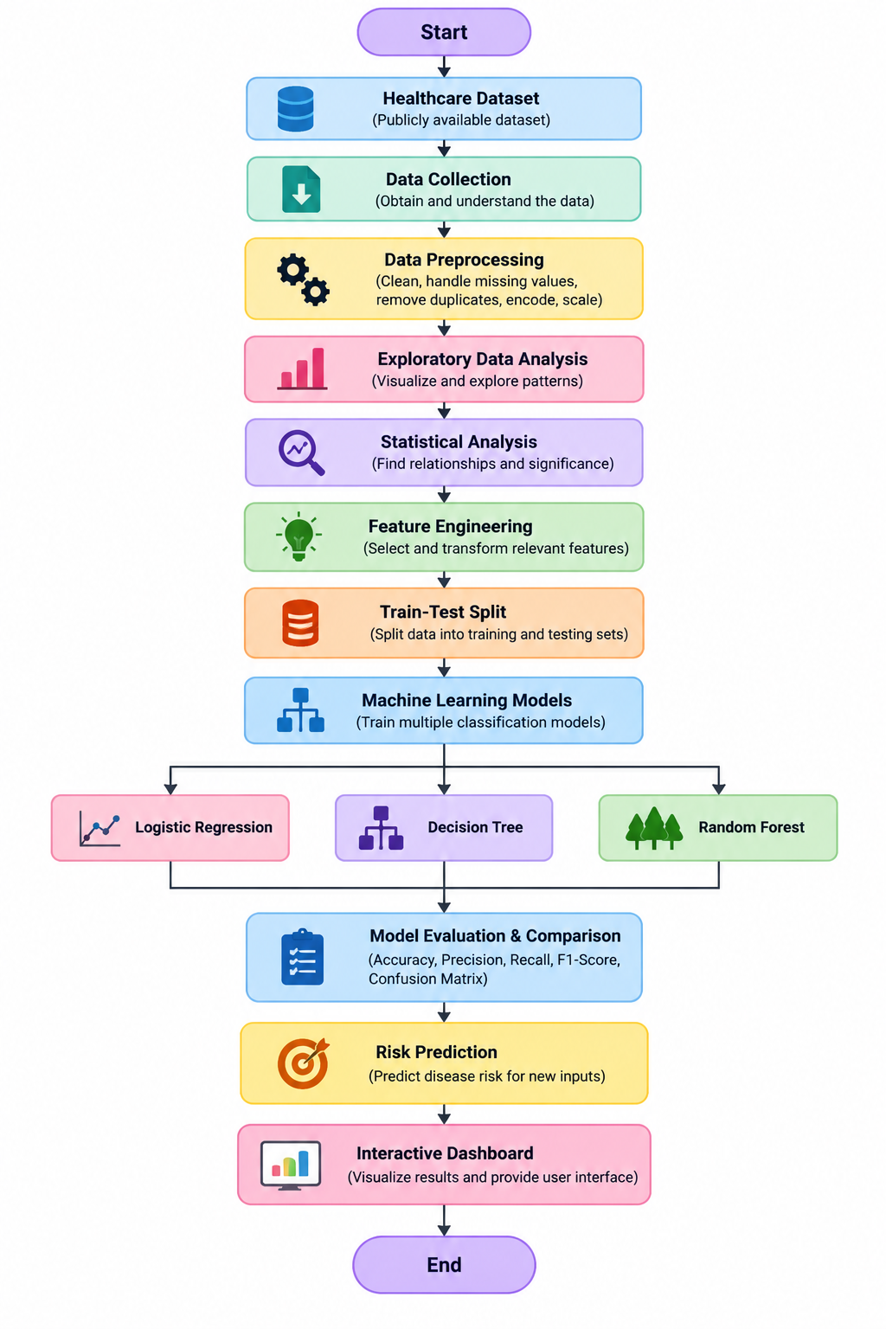
PROJECT DESIGN

Slide 5
METHODOLOGY
1. Data Collection
Use publicly available datasets related to diabetes or heart disease.
Select relevant health-related attributes and target disease outcome.
2. Data Preprocessing
Handle missing or inconsistent values.
Remove duplicate/unnecessary records.
Convert categorical variables where required.
Scale numerical features when required.
3. Exploratory Data Analysis
Analyze distributions of health variables.
Study relationships between risk factors and disease outcomes.
Use charts and statistical measures to identify patterns.

Slide 6
METHODOLOGY
4. Feature Engineering
Select relevant features.
Transform variables where necessary.
Prepare the final feature set for machine learning.
5. Model Development
Train and compare:
Logistic Regression
Decision Tree
Random Forest
6. Evaluation
Evaluate models using appropriate classification metrics.
7. Dashboard Development
Integrate analytics, visualizations, model results and individual risk prediction into HealthScope.

Slide 7
MACHINE LEARNING APPROACH
Model | Purpose
Logistic Regression | Provides a baseline classification model for disease-risk prediction
Decision Tree | Uses decision rules based on health features to classify risk
Random Forest | Combines multiple decision trees to improve classification performance
Model Evaluation
The models will be compared using:
Accuracy
Precision
Recall
F1-Score
Confusion Matrix
Model Selection
The models will be evaluated on the same test data, and their performance will be compared to determine the most suitable model for the final risk-prediction component.

Slide 8
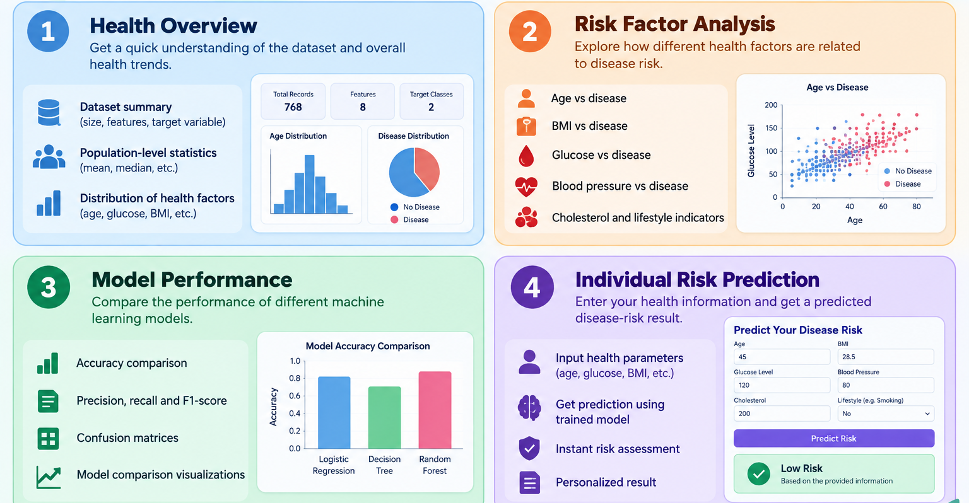
DASHBOARD DESIGN

Slide 9
TECHNICAL STACK
Area | Technology
Programming Language | Python
Data Processing | Pandas, NumPy
Data Visualization | Matplotlib, Seaborn / Plotly
Machine Learning | Scikit-learn
Dashboard | Streamlit
Model Storage | Joblib / Pickle
Dataset | Public Healthcare Dataset

Slide 10
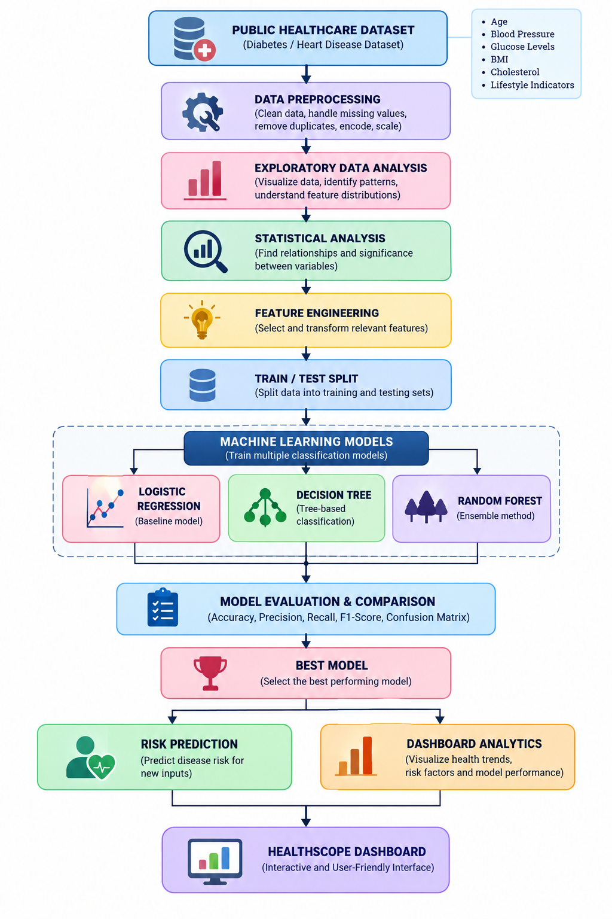
SYSTEM ARCHITECTURE

Slide 11
PROBLEM GAP IDENTIFICATION
S.No. | Research Paper Name | Problem | Gap Identification | Research Paper Link
1 | Classification and Prediction of Diabetes Disease Using Machine Learning Paradigm | Predict diabetes and identify significant diabetes risk factors using machine learning. | The study mainly focuses on diabetes classification and prediction; it does not provide an integrated analytics dashboard combining EDA, visualization, model comparison and individual prediction. | Research Paper – PubMed
2 | Accurate Diabetes Risk Stratification Using Machine Learning: Role of Missing Value and Outliers | Improve diabetes risk prediction by handling missing values and outliers. | Strong focus on preprocessing and classification, but the work does not integrate the complete data-science lifecycle into an interactive user-facing platform. | Research Paper – Springer
3 | Building Risk Prediction Models for Type 2 Diabetes Using Machine Learning Techniques | Develop ML models to predict Type 2 diabetes and identify associated risk factors using large survey data. | Multiple ML algorithms are compared, but the study is primarily focused on prediction rather than an integrated analytics and visualization dashboard. | Research Paper – CDC
4 | Diabetes Disease Detection and Classification on Indian Demographic and Health Survey Data Using Machine Learning Methods | Detect and classify diabetes using Indian demographic and health survey data and identify important risk factors. | Although Indian health data and several ML techniques are used, the study does not focus on presenting population analytics, model comparison and individual prediction together in a unified dashboard. | Research Paper – PubMed
5 | Comparative Analysis of Explainable Machine Learning Models for Cardiovascular Risk Stratification Using Clinical Data and SHAP | Predict cardiovascular risk while providing explanations for model predictions. | Adds explainability and a Streamlit interface, but focuses specifically on cardiovascular risk and does not cover the broader full-lifecycle public-health analytics workflow proposed by HealthScope. | Research Paper – ScienceDirect
6 | An Explainable Machine Learning Framework for Cardiovascular Risk Prediction Using Structured Health Data | Develop an interpretable ML pipeline for early cardiovascular-risk prediction using structured health data. | Existing approaches often optimize prediction performance or interpretability separately; the paper identifies the need for more interpretable and actionable risk-prediction systems. | Research Paper – Frontiers
7 | Predicting Type 2 Diabetes Using Logistic Regression and Machine Learning Approaches | Use statistical and ML methods to identify factors associated with Type 2 diabetes and predict disease risk. | Prediction and risk-factor analysis are addressed, but there is limited integration of these results with an interactive analytics layer for users. | Research Paper – PubMed
8 | Predictive Models for Diabetes Mellitus Using Machine Learning Techniques | Develop predictive models for diabetes using different machine-learning techniques. | The emphasis is on predictive performance rather than combining preprocessing, EDA, risk-factor visualization, model comparison and individual prediction into one platform. | Research Paper – PubMed
9 | Pima Indians Diabetes Mellitus Classification Based on Machine Learning Algorithms | Classify diabetes using the Pima Indians Diabetes dataset and evaluate different ML algorithms. | The research primarily addresses classification on a specific dataset, leaving scope for a broader system incorporating interactive analysis, visualization and multiple stages of the data-science lifecycle. | Research Paper – PMC
10 | Diabetes Prediction Using Machine Learning and Explainable AI Techniques | Develop diabetes prediction models and improve understanding of model decisions through explainable AI. | Focuses on prediction and explainability, while an integrated platform combining population-level analytics, EDA, risk factors, model comparison and interactive individual prediction remains an area for development. | Research Paper – PMC

Slide 12
INNOVATION, CREATIVITY & NOVELTY
Full-Lifecycle Approach: Combines the major stages of a data science workflow in one platform.
Multiple ML Models: Uses Logistic Regression, Decision Tree and Random Forest for comparative evaluation.
Risk-Factor Visualization: Converts analytical findings into understandable visual insights.
Interactive Risk Prediction: Allows health-related inputs to be used for individual risk estimation.
Unified Dashboard: Brings population-level analytics, risk factors, model performance and predictions together.
User-Friendly Presentation: Makes machine-learning results accessible through an interactive interface.

Slide 13
TECHNICAL SOUNDNESS
The project is technically feasible because:
The required healthcare datasets are publicly available.
Python provides established libraries for data science and machine learning.
Pandas and NumPy support efficient data preprocessing.
Scikit-learn provides implementations of the selected ML algorithms.
Standard classification metrics can be used to objectively evaluate models.
Streamlit can integrate the trained model with an interactive dashboard.
The proposed workflow can be developed and tested incrementally.
Expected Technical Output
Clean Dataset → EDA Results → Trained Models → Evaluation Results → Risk Prediction → Interactive Dashboard

Slide 14
PROJECT PLAN
Phase | Work
Phase 1 | Problem identification & literature survey
Phase 2 | Dataset collection & understanding
Phase 3 | Data preprocessing
Phase 4 | EDA & statistical analysis
Phase 5 | Feature engineering
Phase 6 | ML model development
Phase 7 | Model evaluation & comparison
Phase 8 | Dashboard development
Phase 9 | Integration & testing
Phase 10 | Documentation & final presentation

Slide 15
EXPECTED OUTCOME
A cleaned and analysis-ready healthcare dataset.
Identification of important health and disease-related patterns.
Visualization of major risk factors.
Trained Logistic Regression, Decision Tree and Random Forest models.
Comparative evaluation of the ML models.
A model capable of providing individual disease-risk predictions.
An interactive dashboard combining analytics and prediction.
A complete demonstration of a data-driven public health analytics workflow.

Slide 16
CONCLUSION
HealthScope aims to transform healthcare data into meaningful and actionable insights.
The project combines data preprocessing, EDA, statistical analysis, feature engineering and machine learning.
Multiple classification models will be evaluated for disease-risk prediction.
The results will be presented through an interactive dashboard.
The platform demonstrates how data science can support early risk identification and informed decision-making.

Slide 17
THANK YOU

