Slide 1

AEGIS LEARN – A Generative AI Personalized Learning Framework
SECTION: 7 CLUSTER – 3
Group - 5
2420030400 – Masuma Fathema
2420030467 – K V S Jaswanth
2420030521 – Madhav Ghattamaneni
2420030568 - Avinash Yarukala
Under the guidance of:
Dr.K.Swanthana

Slide 2
PROBLEM STATEMENT
Traditional e-learning platforms provide the same learning content to all students.
Students have different learning speeds, knowledge levels, and learning styles.
Existing AI tools may generate hallucinated or inaccurate information.
Most systems lack curriculum-specific and personalized learning support.
Limited support for coding examples, adaptive quizzes, and higher-order thinking skills.

Slide 3
OBJECTIVES
To develop a personalized AI learning framework.
To generate customized study notes using Generative AI.
To implement AI-based coding examples and explanations.
To generate adaptive quizzes based on learning levels.
To integrate Bloom's Taxonomy into learning assessment.
To optimize learning outcomes through personalization.

Slide 4
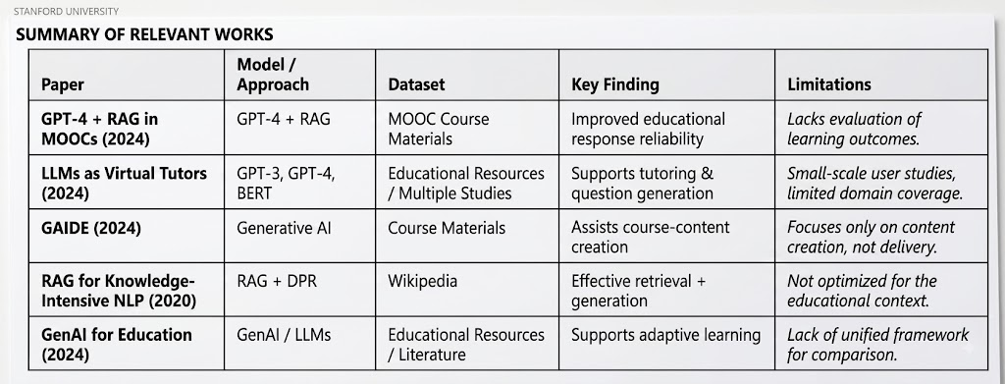
LITERATURE SURVEY
Observation
Existing research focuses on content generation or tutoring individually, with limited emphasis on personalized learning using RAG and Bloom's Taxonomy.

Slide 5
RESEARCH GAP
Existing systems lack:
Personalized learning based on student profiles.
Integration of RAG with educational content generation.
Bloom's Taxonomy-based assessments.
AI-generated coding practice.
Curriculum-aligned learning resources for undergraduate Computer Science students.

Slide 6
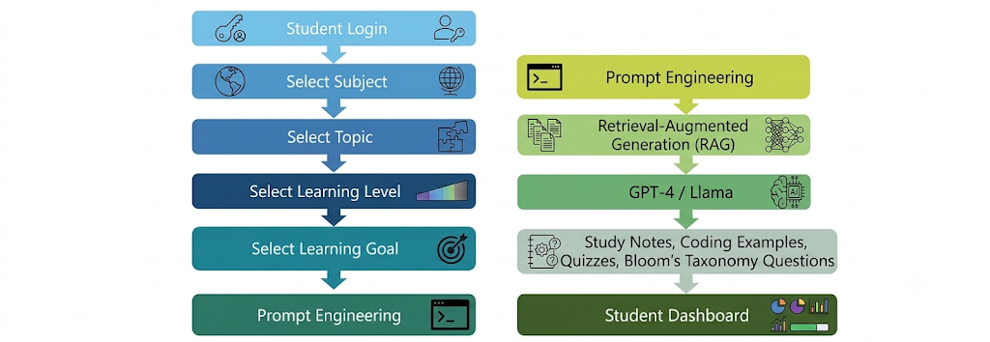
PROPOSED FRAMEWORK

Slide 7
INNOVATION
Personalized learning framework
Retrieval-Augmented Generation
Prompt Engineering
Curriculum-aligned content generation
Bloom's Taxonomy integration
AI-generated coding examples

Slide 8
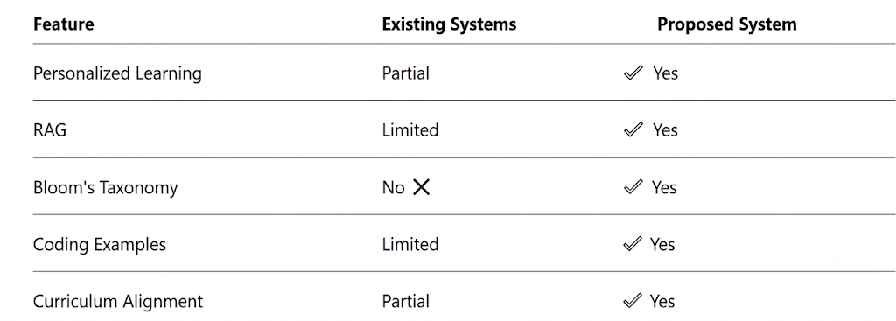

Slide 9
CREATIVITY & NOVELTY
Novelty
Combines Generative AI, RAG, Prompt Engineering, and Bloom's Taxonomy.
Generates personalized educational content based on student learning level.
Designed specifically for undergraduate CSE students
Creativity
Personalized study plans
Adaptive quizzes
Dynamic coding examples
Topic-specific learning
recommendations

Slide 10
FEASIBILITY
Technologies
Frontend - React.js
Backend - FastAPI
Database - MongoDB
Vector Database – FAISS
Embedding Model - Sentence Transformers
LLM - GPT-4 / Llama
Knowledge Sources – OpenStax, NCERT, Khan Academy

Slide 11
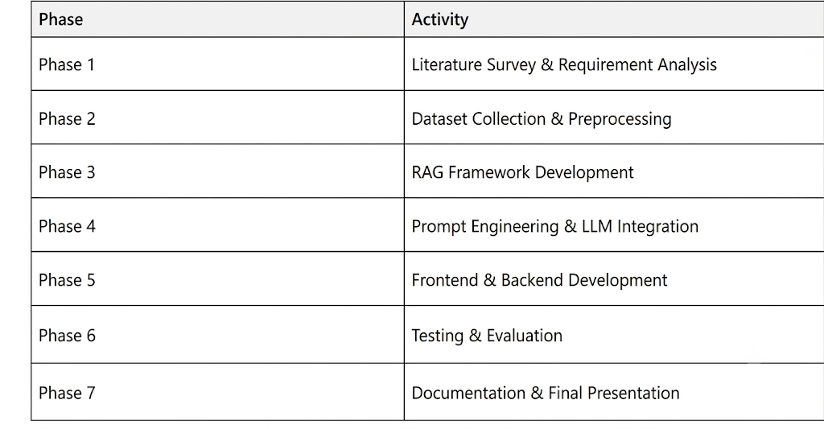
PROJECT PLAN

Slide 12
EXPECTED OUTCOME
Personalized study notes
AI-generated coding examples
Adaptive quizzes
Bloom's Taxonomy-based assessments
Improved learning experience
Enhanced conceptual understanding

Slide 13
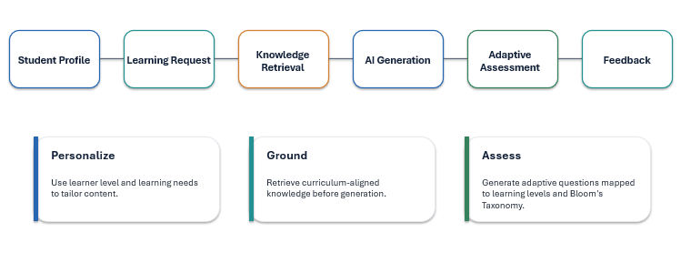
METHODOLOGY

Slide 14
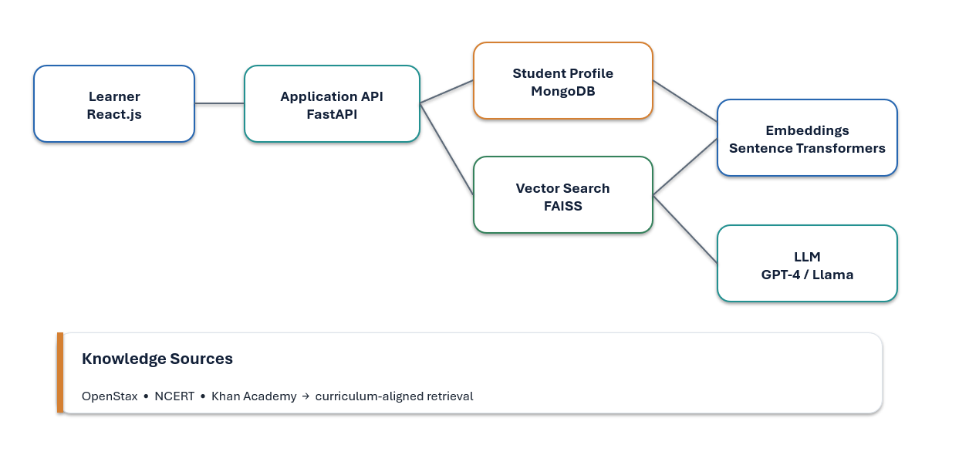
SYSTEM DESIGN

Slide 15
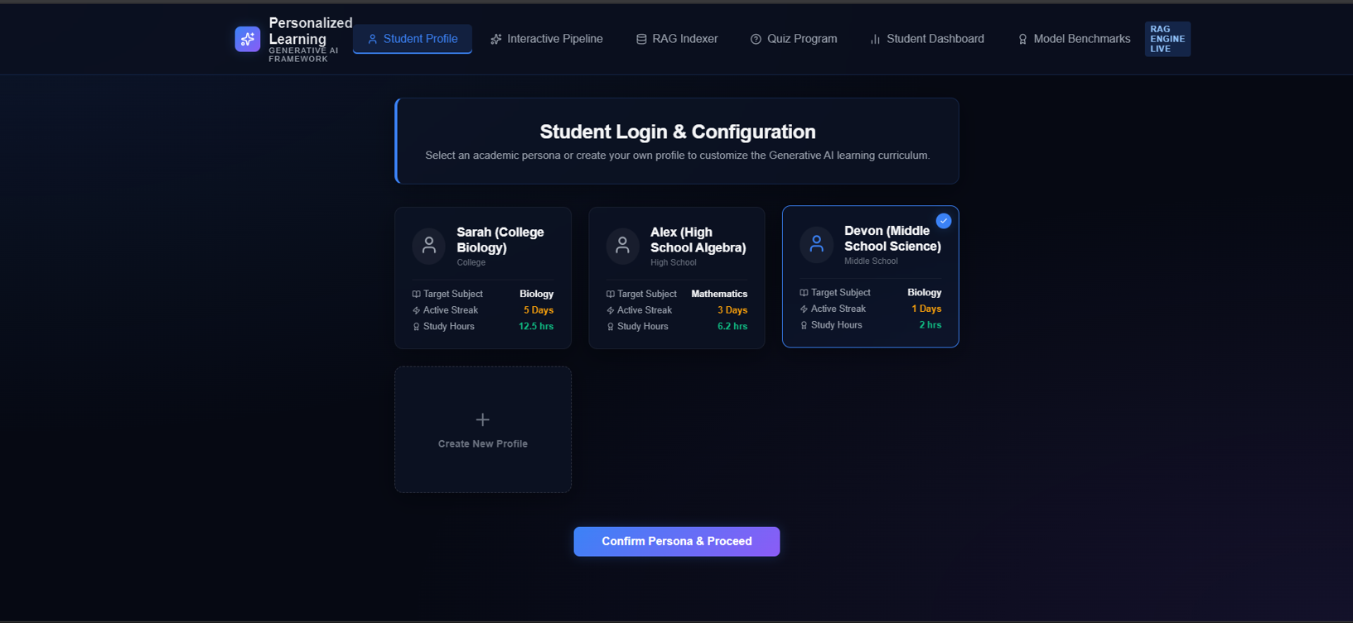
IMPLEMENTATION
FRONTEND

Slide 16
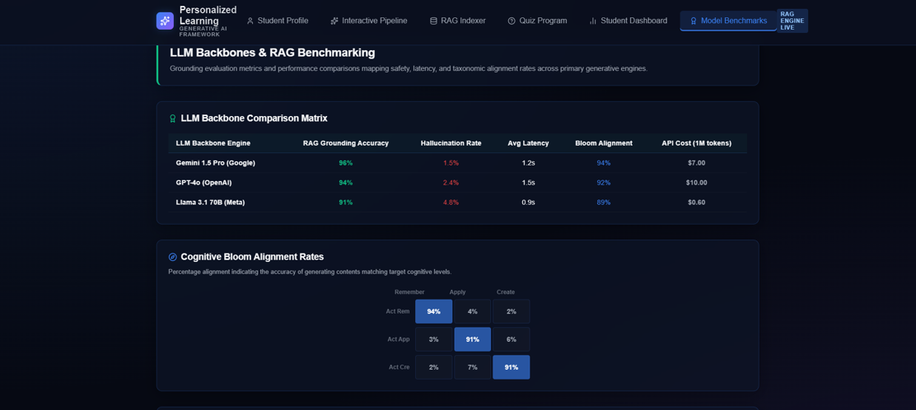
IMPLEMENTATION
FRONTEND

Slide 17
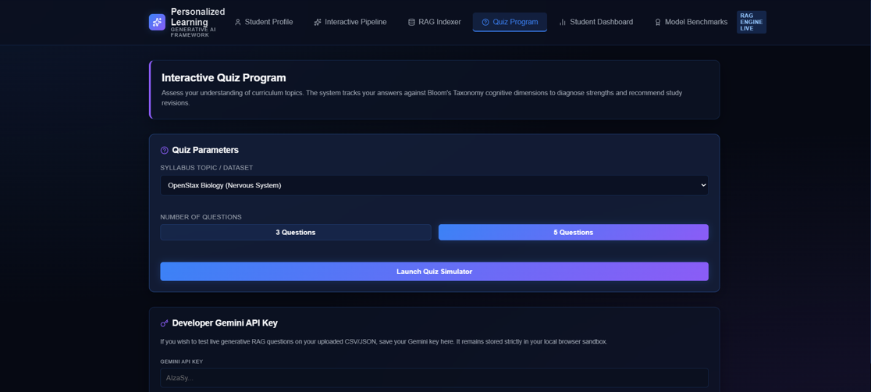
IMPLEMENTATION
FRONTEND

Slide 18
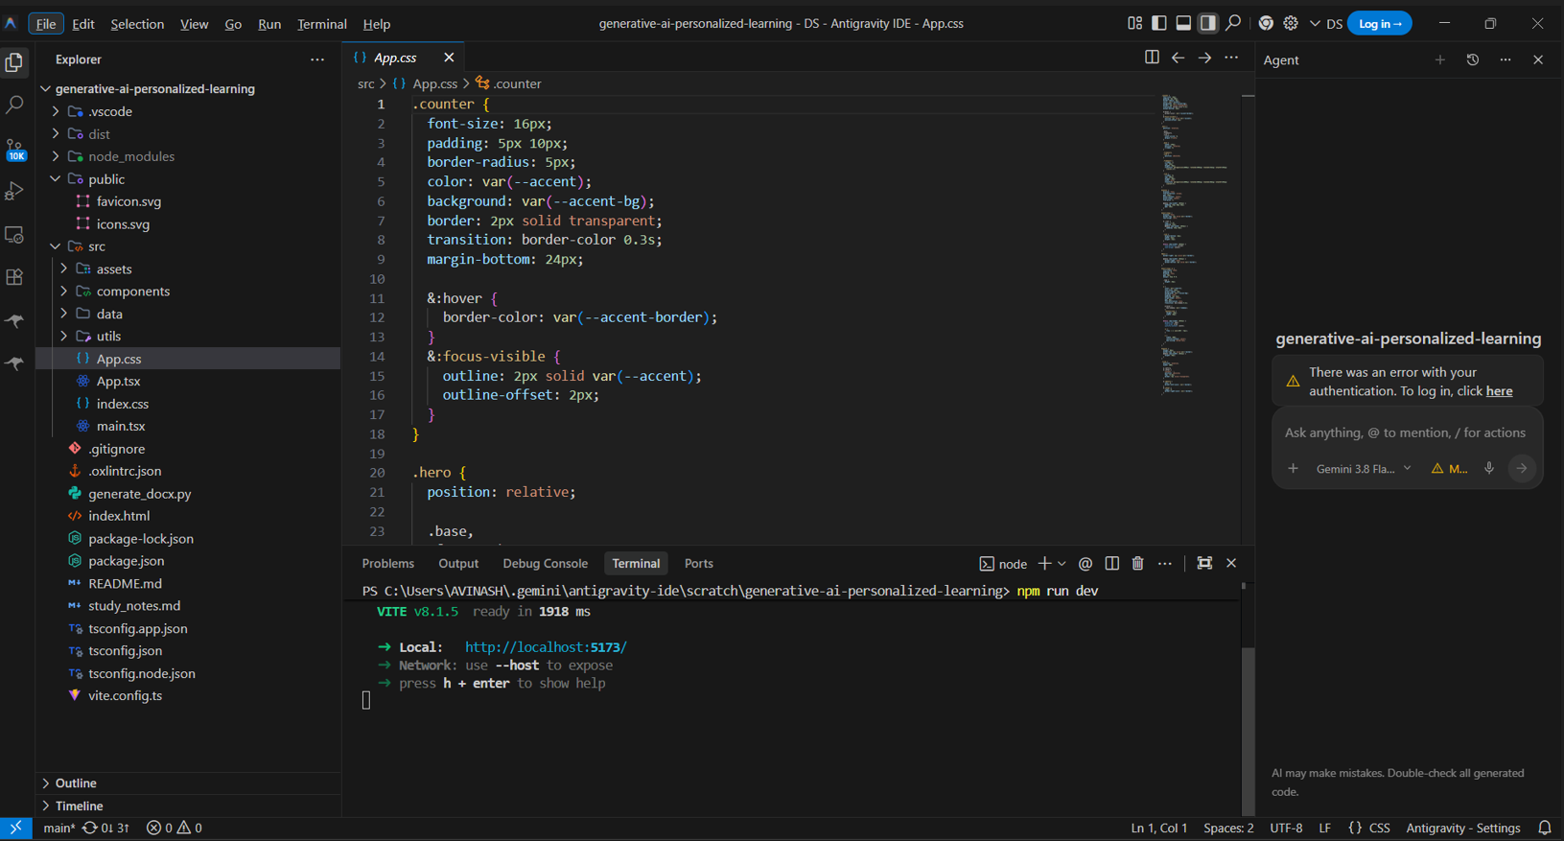
CODE

Slide 19
THANK YOU

