Slide 1

ReWear: Community-Based Clothing Exchange and Reuse Platform
SECTION: 10 CLUSTER – 3
Group - 14
2420030287 – Gorantla Divya Sree
2420030400 – Masuma Fathema
2420030568 – Avinash Yarukala
Under the guidance of:
G. Lavanya

Slide 2
ABSTRACT
ReWear is a web-based platform that promotes sustainable fashion by helping people exchange, donate, and reuse pre-owned clothing.
Users can register and upload clothing listings with images, category, size, condition, and availability.
Users can browse, search, and filter available items.
An exchange request feature helps users request items and track request status.
An admin dashboard supports listing moderation and user activity management.
The platform encourages clothing reuse, reduces textile waste, and makes clothing more accessible.

Slide 3
EXISTING MODEL
Current approach to clothing reuse:
Clothing exchanges often happen through informal groups or in-person networks.
Listings and item details may be scattered across different platforms.
Finding suitable sizes, categories, and item conditions can take time.
Requests and exchange arrangements may be tracked manually.
There may be limited tools for managing listings and reported content.

Slide 4
EXISTING MODEL
Limitations of the existing approach:
Scattered clothing listings
Time-consuming item discovery
Limited search and filtering
Manual exchange coordination
Difficult to track request status
Limited moderation of listings and user activity

Slide 5
PROPOSED MODEL & USES
ReWear provides a centralized platform for clothing exchange and reuse.
Uses:
Register and manage user accounts
Upload clothing listings with images and details
Browse, search, and filter available items
Send exchange requests and track statuses
Manage listings and reported content through an admin dashboard
Encourage sustainable consumption and reduce textile waste

Slide 6
KEY FEATURES OF REWEAR
1. User Accounts
2. Clothing Listings
3. Discover Items
• Register and log in
• Manage a personal profile
• Access listing and request features
• Upload item images
• Add category, size and condition
• Edit or remove listings
• Browse available clothing
• Search and filter listings
• View item details before requesting
4. Exchange Requests
5. Admin Management
• Send a request for an item
• Track request status
• Coordinate with the item owner
• Review reported content
• Manage listings and user activity
• Support a reliable community

Slide 7
METHODOLOGY
1: USER REGISTRATION & CLOTHING LISTING
Step 1: Create an account
Users register and access the platform.
Add a clothing listing with image, category, size, condition, and availability.
Store listing information in the MySQL database.
Save uploaded images in local image storage.
Output: Published clothing listing

Slide 8
METHODOLOGY
2: DISCOVERY & EXCHANGE REQUESTS
Step 2: Find suitable clothing
Browse available clothing listings.
Search and filter by relevant details such as category, size, and condition.
Open a listing to view its details.
Send an exchange request and track its status.
Request handling:
Store request information in MySQL.
Update the request status as it is processed.
Output: Organized clothing discovery and request tracking

Slide 9
METHODOLOGY
3: ADMINISTRATION & REUSE
Step 3: Platform management
Admin reviews listings and reported content.
Manage user activity to support a reliable platform.
Users coordinate exchanges through listing and request information.
Reuse existing clothing instead of discarding it.
Continuous improvement:
List → Discover → Request → Coordinate → Reuse
The platform supports community participation and more sustainable clothing habits.

Slide 10
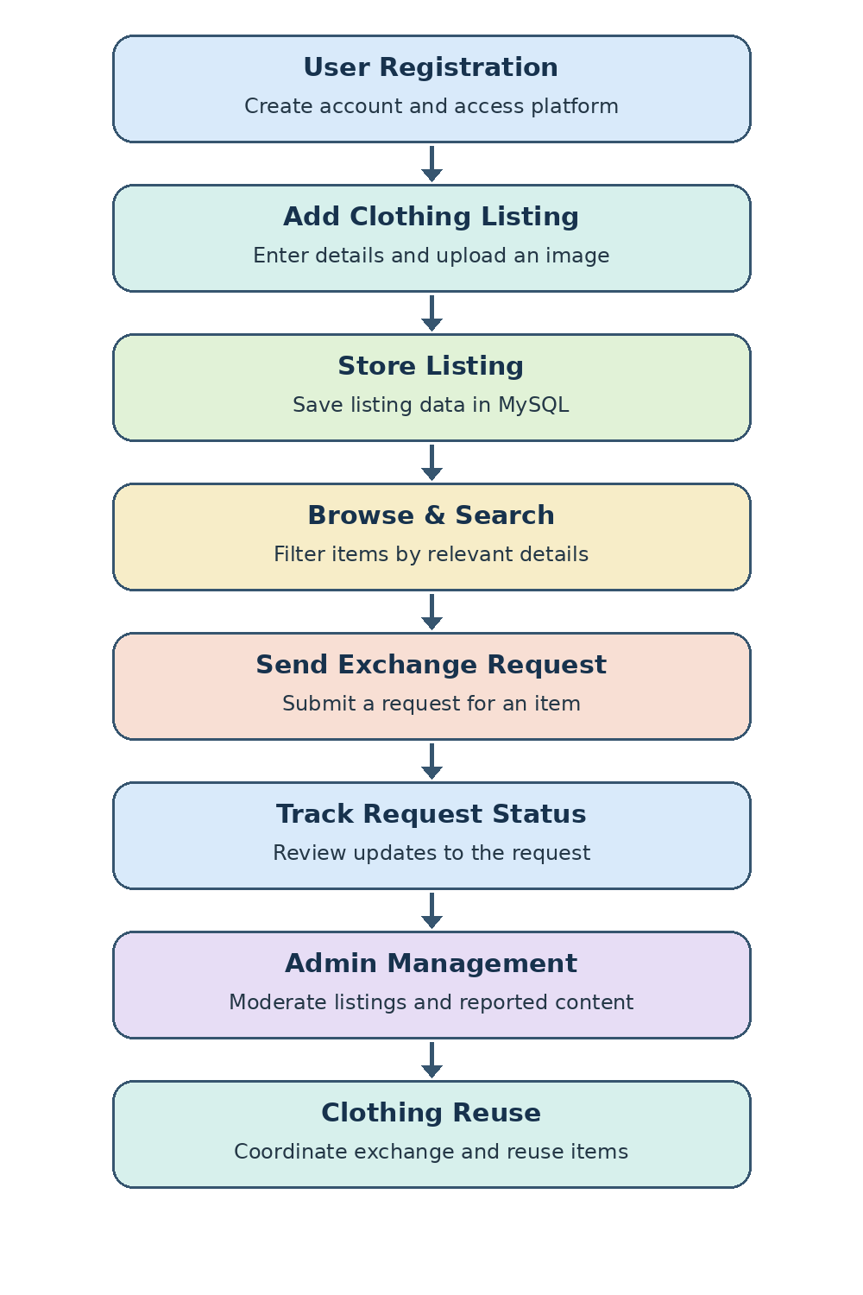
PROCESS MODEL

Slide 11
SYSTEM ARCHITECTURE
FRONTEND
HTML • CSS • JavaScript
BACKEND
Python Flask
DATABASE
MySQL
IMAGE STORAGE
Local uploaded images
Development & Version Control
Deployment
Git tracks code changes; GitHub hosts the project repository.
Render is the planned hosting platform for the web application.
User actions → Frontend → Flask routes → MySQL / local image files

Slide 12
TECHNICAL ASPECTS
CORE TECHNOLOGIES
HTML, CSS, JavaScript
Python Flask
MySQL
Git and GitHub
Render
FRONTEND
HTML
CSS
JavaScript
Responsive web pages
BACKEND
Python Flask
REST endpoints / routes
MySQL database
Local image storage

Slide 13
EXPECTED OUTCOMES & BENEFITS
Environmental Impact
Community Exchange
Encourages reuse of wearable clothing and helps reduce unnecessary textile waste.
Connects people who want to give, receive, or exchange pre-owned clothing.
Affordability & Access
Organized Coordination
Makes available clothing easier to discover through searchable listings.
Provides listing details and request statuses to help users manage exchanges.
Expected benefit: a simple digital platform that supports sustainable fashion and responsible reuse.

Slide 14
CONCLUSION
ReWear provides a centralized space for community clothing exchange and reuse.
Users can upload, discover, and request pre-owned clothing.
Search and filtering make item discovery easier.
Request tracking helps organize exchanges.
Administrative tools support listing and user management.
The platform promotes sustainable fashion and helps reduce textile waste.
Built using HTML, CSS, JavaScript, Python Flask, and MySQL.

Slide 15
THANK YOU

