Slide 1


EFFICIENT ENERGY CONSUMPTION
IN WSN
Dept of Electronics and Communication
Dayananda Sagar College of Engineering (An autonomous institution affiliated to Visvesvaraya Technological University)
BATCH : R-34
BY,
MASUMI PATEL 1DS16EC079 JANISH AHMED HASHEER AM 1DS16EC058 JAWAD ARSHAD KHAN 1DS16EC060 MANAV BAKSH 1DS16EC077
UNDER THE GUIDANCE OF:
Prof. TRUPTI TAGARE (B.E. ,M.Tech.)

Slide 2

CONTENTS
Overview of WSN
Objective of the project
Overview of the project execution
Literature Survey
Assumptions
Methodology
Basic Outline
Basic Block Diagram
Approaches Taken
Tabulated Result for Static Nodes
Tabulated Result for Dynamic Nodes
Graphical User Interface (GUI)
Observations
Conclusion and Future Work
References

Slide 3

1.OVERVIEW OF WIRELESS SENSOR NETWORK (WSN)
A WSN can be called a network of nodes that “senses and may control the environment, enabling interaction between humans or computers and the surrounding environment”.
Power is a major resource constraint in wireless sensor nodes.
Highly energy efficient algorithms are required for a reliable wireless sensor network in order to prevent individual node failures and prolonging the lifetime of the network.

Slide 4

2. OBJECTIVE OF THE PROJECT
Allocating the cluster head for transmitting sensed data to a base station amongst the nodes by selecting a cluster-head in a fair manner based on different algorithms.
Taking into account ,static as well as dynamic nodes.
Cluster head election is won in terms of the factors such as nearest distance of the node to the base station and the energy left in the node.
Considering the relative distance of nodes in the WSN to make energy consumption
more fair.
Arriving at an algorithm which is the combination of distance, energy and random walk parameters
Constructing a GUI which gives users the energy outputs for the given algorithm and where user can establish comparison between them.

Slide 5

3. OVERVIEW OF PROJECT EXECUTION
Compared the energy used values of the Direct Communication and Leach algorithm for nodes which are stationary in nature
Studied the energy consumption in different scenarios and established certain mathematical models(equations).
Using tools such as Matlab (Simulink) established the mathematical model of Direct communication and Leach algorithm
Established tabular comparison of the consumed Energy based on different parameters with different models.
Arrived at certain drawbacks and conclusions

Slide 6
3. Overview of project execution
Using distance based and levy-walk algorithm established energy comparisons for the nodes which are mobile.
Use distance and energy (initial and dynamic) as parameters to drain the energy in nodes uniformly
Using Simulink developed models for distance routing algorithm and levy-walk
Established tabular comparison of the consumed Energy based on different parameters and different models.
Arrived at certain observations and conclusions
Connected all the corresponding Simulink models and matlab code for GUI.
Using GUIDE wrote the code to build a GUI interface.

Slide 7
4. LITERATURE SURVEY
Wireless Sensor Networks Physical Layer Performance Investigation and Enhancement by Omar Nowfal Al Khayat Ministry of Higher Education and Scientific Research, University of Technology, Cairo, Egypt.
Protocol for Energy Efficient Cluster Head Election for Collaborative Cluster Head Elections by David Otu (2018). Technological University Dublin, School of Electrical and Electronic Engineering, Dublin, Ireland.
An energy efficient cluster head selection of LEACH protocol for WSN by Krishna Kumar A, Dr. Anuratha V
Introduction to Theory of LÉVY Flights by A.V. Chechkin, R. Metzler, J. Klafter, and V.Yu. Gonchar (2019). Institute for Theoretical Physics NSC KIPT, Akademicheskaya st.1, 61108 Kharkov, Ukraine.
Distance based Cluster Head Selection Algorithm for Wireless Sensor Network Bhawnesh Kumar Department of Computer Science & Engineering Mewar University Rajasthan, India. Vinit Kumar Sharma Department of Computer Science & Engineering Shamli Institute of Engineering & Technology, Shamli U.P.,India :
Chunyao Fu, Zhifang Jiang, Wei WEI and Ang WEI, “An Energy Balanced Algorithm of LEACH Protocol in WSN,” IJCSI International Journal of Computer Science Issues, Vol. 10, Issue 1, No 1, January 2013, pp. 354-359.

Slide 8
4. LITERATURE SURVEY
ETEEC: Enhanced Threshold Energy Efficient Clustering Algorithm for Dynamic Wireless Sensor Networks, Shashi Kiran B. N. 1, Sheela C., M.Tech, 4th Sem, Department of Electronics and Communication, The Oxford College of Engineering ,Bommanhalli, Bangalore, India.
An Evaluation of Various Clustering and Routing Protocols in Wireless Sensor Networks by J.Joselin,V.S.Anita Sofia.

Slide 9

5. ASSUMPTIONS
The approach neglects energy consumed by the sensing and processing unit.
Nodes are considered to be both static and dynamic based on the different approaches.
The distance from the node to the base station is assumed to be greater than the distance between the sensor nodes. Hence, the transmission between the nodes is at a cheaper cost than node to base station.
It is assumed each node has equal transceiver and processing capabilities, which transmit the sensed data every S seconds.
Each static node initially has energy of 2J (Battery) and 10J for dynamic nodes

Slide 10

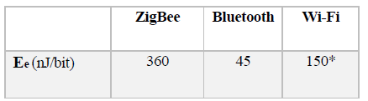
6. Methodology
The number of bit in a message is assumed to be fixed k, transmitted through a distance d
energy required for transmission can be expressed as:
ET = Ee. k + Ea.k (J) --(1)
Distance between node A and B, dAB, is given by:
dAB = √((𝑥𝐴 − 𝑥𝐵)2 + (𝑦𝐴 − 𝑦𝐵)2) -- (2)
Fig 1.Energy per bit for different technologies
For direct communication to the base station, cost is:
Energy consumed in direct communication = Ee. k + Ea .(d)2.k – (3)

Slide 11
7. BASIC OUTLINE OF PROJECT :
Communication of nodes to base station
Static nodes
Dynamic nodes
Direct Communication
LEACH
Distance Based Algorithm
Distance and Energy Based Algorithm

Slide 12
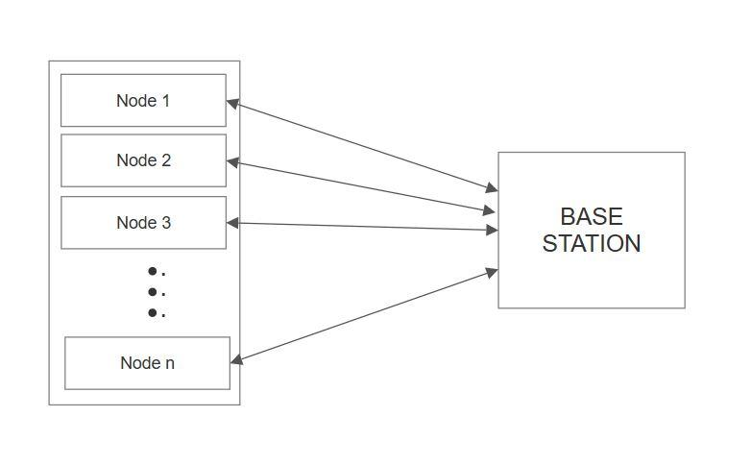
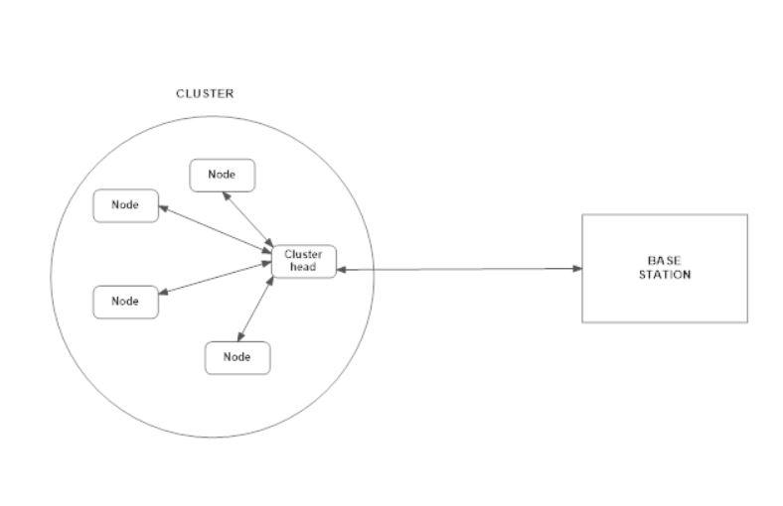
8. BASIC BLOCK DIAGRAM:
Block diagram 1
Block diagram 2
Direct communication
LEACH
Distance based
Distance energy algorithm

Slide 13
STATIC NODES
DIRECT COMMUNICATION METHOD
LEACH ALGORITHM

Slide 14
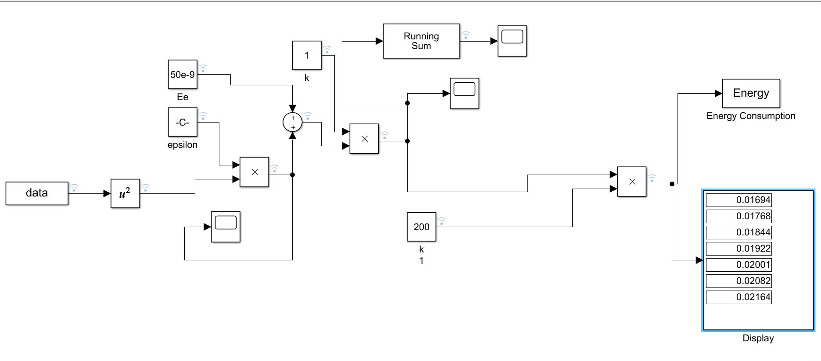
STATIC NODES:
a)Direct Communication :
Simulink model 1
From equation (3) Energy consumed in direct communication = Ee. k + Ea .(d)2.k
The simulation is run for 12000secs where the cumulative sum of energy spent is recorded.

Slide 15
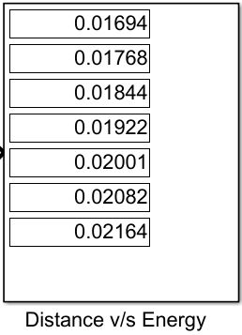
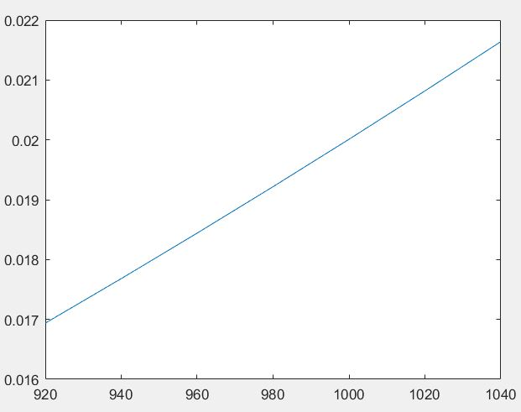
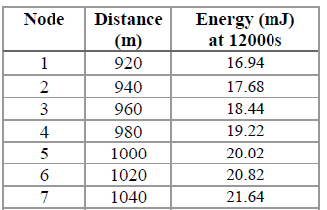
RESULT :
Graphical representation
E
N
E
R
G
Y
In
(J)
Distance in (m) ---->

Slide 16
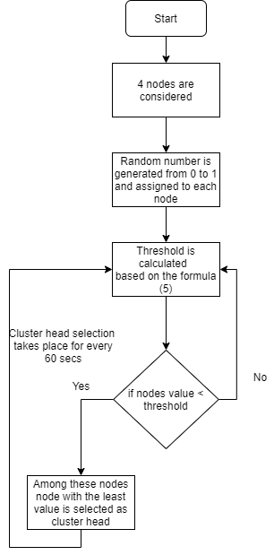
STATIC NODES:
b) LEACH Implementation
Flow Chart of LEACH algorithm

Slide 17
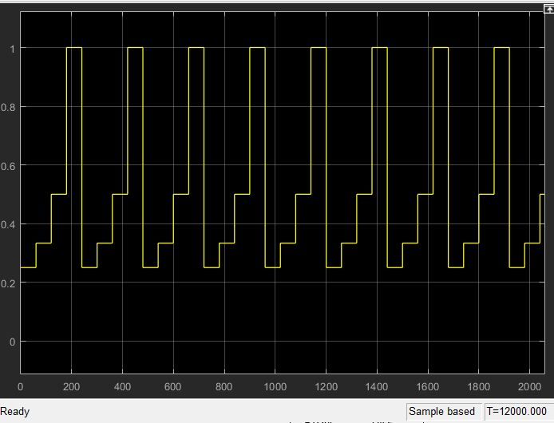
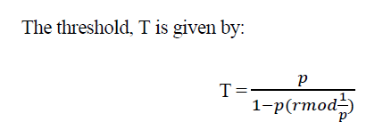
DEFINING THE THRESHOLD:
Y = {0, 𝑥 ≥ 𝑇
1, 𝑥 < 𝑇}
T
H
R
E
S
H
O
L
D
(T)
--(4)
TIME t in (sec) --->
Fig 2. Scope output for threshold function

Slide 18
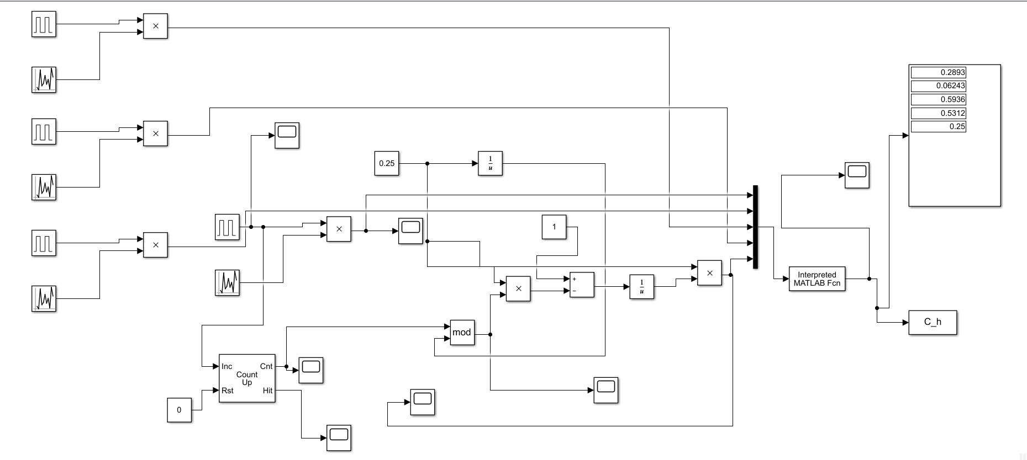
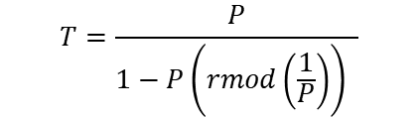
LEACH MODEL (SIMULINK) FOR 4 NODES :
NODE 1
NODE 2
NODE 3
NODE 4
Simulink model 2
$$T=\frac{P}{1−P\left(rmod\left(\frac{1}{P}\right)\right) }$$
From equation

Slide 19
RESULT:
NODE | DISTANCE (in m) | ENERGY REMAINING (in joules) | NO OF TIMES NODE BECOMES CH
1 | 920 | 1.996528‬ | 41
2 | 940 | 1.99779‬ | 25
3 | 960 | 1.9961217‬ | 42
4 | 980 | 1.99337‬ | 69
Tabulated output of energy left and number of times a node is made cluster head

Slide 20
Comparison of Energy used for Leach vs Direct
Energy spent for nodes is Direct communication is more compared to LEACH algorithm
DIRECT COMMUNICATION
LEACH ALGORITHM
NODE | DISTANCE (in m) | ENERGY REMAINING (in joules) | NO. OF TIMES NODE BECOMES CH
1 | 920 | 1.98306‬ | 200
2 | 940 | 1.98232 | 200
3 | 960 | 1.98156‬ | 200
4 | 980 | 1.98078‬ | 200
NODE | DISTANCE (in m) | ENERGY REMAINING (in joules) | NO OF TIMES NODE BECOMES CH
1 | 920 | 1.996528‬ | 41
2 | 940 | 1.99779‬ | 25
3 | 960 | 1.9961217‬ | 42
4 | 980 | 1.99337‬ | 69
Tabulated output of energy left and number of times a node is made cluster head
Tabulated output of energy left and number of times a node is made cluster head

Slide 21
DYNAMIC NODES
DISTANCE BASED ALGORITHM
DISTANCE AND ENERGY BASED ALGORITHM

Slide 22
RANDOM WALK PATTERNS
A random walk is a mathematical object that describes a path that consists of a succession of random steps on some mathematical space such as the integers.
Examples include the path traced by a molecule as it travels in a liquid or a gas, the search path of a foraging animal.
The price of a fluctuating stock and the financial status of a gambler: all can be approximated by random walk models
Some types of random walk include Brownian motion, diffusion, Levy flights etcetera.

Slide 23
LEVY WALK AROUND MODEL
This project makes use of Levy walk-around model to incorporate mobility of the nodes. Naturally, animals make moves in search of food in random directions and distances.
Levy walk is a type of random walk in which each move has a random direction and length and not depending on the previous move.
It has been demonstrated that people wandering around university campuses, Disney world and urban environment have a pattern very similar to Levy walk .
Levy walk is incorporated into the mobility of the nodes for accuracy and more realistic network simulation.
Animals and sharks also follow levy walk around matter when roaming in their natural habitat

Slide 24
LEVY WALK AROUND MODEL
A levy walk is a random walk in which the step-lengths have a probability distribution.
In this ,each successive move is chosen randomly and uninfluenced by any previous move.
The next step and the size of the step is predicted by the levy walk function which is totally generated at random
theta=rand*2*pi --(5)
x(n)=x(n-1)+f*cos(theta) --(6)
y(n)=y(n-1)+f*sin(theta) –(7)
Where f is levy walk function

Slide 25
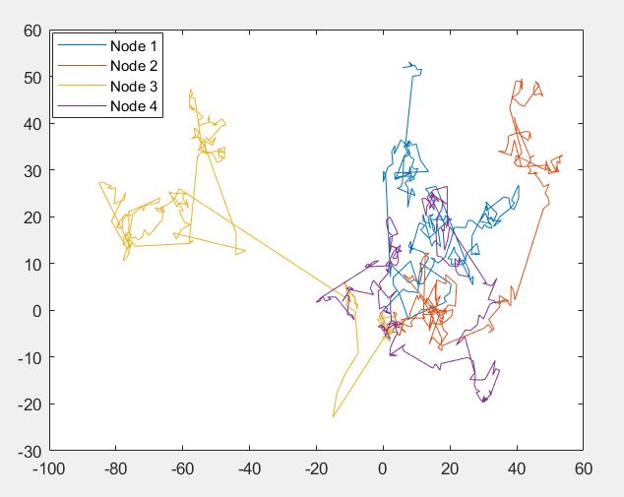
IMPLEMENTED LEVY WALK MODEL
The Levy walk model implemented for four nodes
Each mobile node walks 200 times, each time contains 1000 steps
Therefore each mobile nodes walks for about 200000 steps

Slide 26
(a)DISTANCE BASED CLUSTER HEAD ELECTION ALGORITHM
The goal here is to have the probability of becoming cluster-head for the nodes that are further away from the base station to be less than nodes closer to the base station.
The probability of the nodes becoming cluster-head is influenced by the nodes distance from the base station.
The nodes near to the base station are expected to become the cluster head .
We have assumed that all nodes start from (0,0) and the base station is located at (500,500)

Slide 27
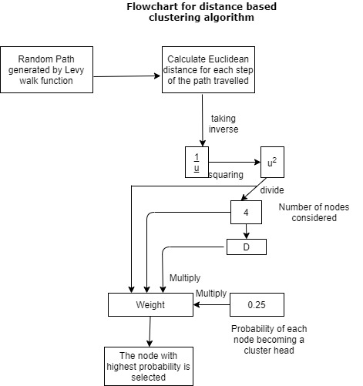
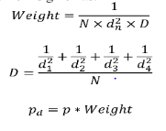
--(8)
--(10)
--(11)
Where,
N =number of nodes(here it is 4)
dn= distance of nth node from the base station
p = probability of every node becoming cluster head

Slide 28
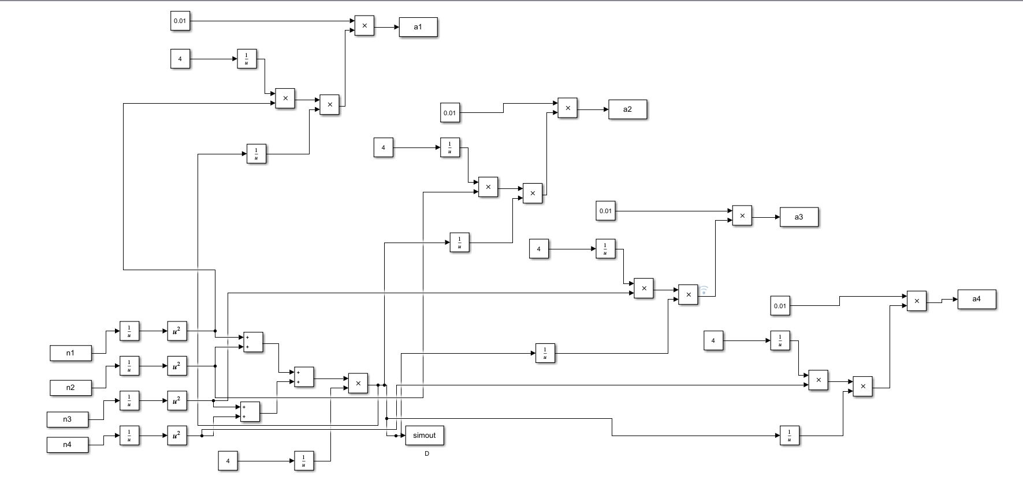
DISTANCE BASED CLUSTER HEAD ELECTION MODEL(SIMULINK) FOR 4 NODES
Simulink model 3

Slide 29


RESULTS OBTAINED
1)No. of times the mobile node became a cluster head
2)The total energy remaining in each node

Slide 30
OBSERVATIONS
From the results obtained we observe that
Continual use of the same node leads to its draining of energy faster than that of the other nodes.
Uneven energy draining in the mobile nodes
New parameter must be taken into consideration for better performance of the wireless sensor network system

Slide 31
(b)DISTANCE AND ENERGY BASED CLUSTER HEAD ELECTION ALGORITHM
The goal here is to consider the energy remaining in the mobile node along with the distance of the distance of the mobile node from the base station.
The probability of the nodes becoming a cluster head is influenced by the parameter termed as the DE factor which is given by the formula
DE=E_{rem}
(d_{mean})²
Where E_{rem} is the energy remaining in the mobile node after previous cluster head election
d_{mean} is the mean of the distances of all the four mobile nodes to the base station
The mobile node with the highest DE factor value is considered as the cluster head during that round of election.
-(11)

Slide 32
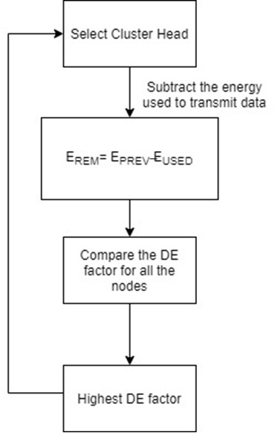
Flowchart for energy based clustering algorithm

Slide 33
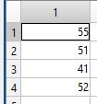
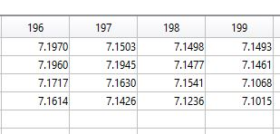
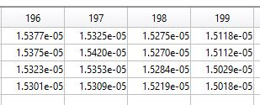
RESULTS OBTAINED
1)No. of times the mobile node was a cluster head
2)The DE factor based on which cluster head is elected
3)The total energy remaining in each node

Slide 34
11. TABULATED RESULTS FOR DYNMAIC NODES
DISTANCE BASED ALGORITHM
DISTANCE AND ENERGY BASED ALGORITHM
NODE | ENERGY LEFT (in joules) | CLUSTER HEAD
1 | 9.2104 | 16
2 | 3.1921 | 137
3 | 7.7171 | 46
4 | 9.9501 | 1
NODE | ENERGY LEFT (in joules) | CLUSTER HEAD
1 | 7.4750 | 47
2 | 7.5230 | 47
3 | 7.2533 | 56
4 | 7.4716 | 50
Tabulated output of energy left and number of times a node is made cluster head
Tabulated output of energy left and number of times a node is made cluster head

Slide 35
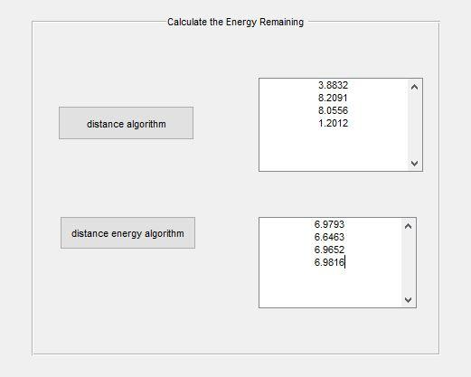
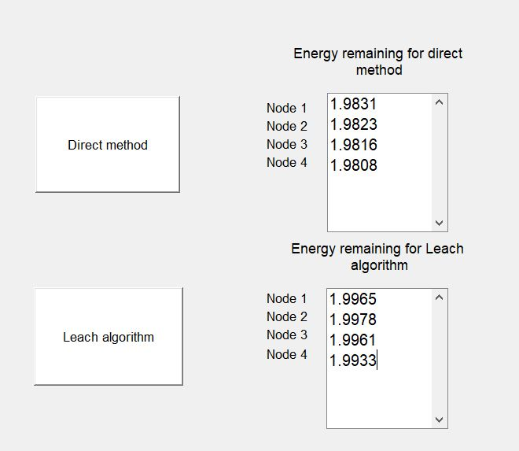
12. GRAPHICAL USER INTERFACE OUTPUT
GUI output for static nodes
GUI output for dynamic nodes

Slide 36
13. OBSERVATIONS
When nodes are static in nature
In direct communication method each node communicates directly with the base station. The energy in all the nodes drains out together but they last for a shorter period of time
In leach algorithm since there is cluster head election, the energy in the nodes is utilized efficiently and they last for a longer period of time. However, the chances that energy in all the nodes drains out together are quite thin.
When nodes are dynamic in nature
In distance-based cluster head election algorithm, the distance between nodes and base station is an important factor. The result observed is very similar to leach which is that all the nodes utilize their energy efficiently but the all drain unequally depending on the path taken by each node.
In distance and energy-based cluster head algorithm, both distance and energy remaining in the node is considered. This algorithm makes sure that the energy remaining in the nodes is utilized efficiently and that all the nodes drain out almost together. This is one of the main advantages of this method that it does both efficient energy utilization and energy of all nodes is drained uniformly.

Slide 37
14. CONCLUSION AND FUTURE SCOPE
Based on our observations we conclude that,
For static nodes ,Leach algorithm is more efficient for communications as they last for a longer time than direct communication method
For dynamic nodes ,Distance and Energy based algorithm is more efficient than the algorithm where distance of the node from the base station is the only parameter
Future scope for the project:
Event-driven cluster head election algorithm can be implemented for the nodes.
Emergency-driven cluster head election algorithm can be implemented for the nodes.

Slide 38
15. REFERENCES
BRÖRING, “A. et al. New generation sensor web enablement.” Sensors, 11, 2011, pp.26522699. ISSN 1424-8220. Available from: doi:10.3390/s110302652
X. Lai, Q. Liu, X. Wei, W. Wang, G. Zhou, and G. Han, “A survey of body sensor networks,” Sensors, vol. 13, no. 5, pp. 5406–5447, 2013.
R. Silva, Z. Zinonos, J. S. Silva, and V. Vassiliou, “Mobility in WSNs for critical applications,” in Proceedings of the 16th IEEE Symposium on Computers and Communications, , pp. 451–456, Corfu, Greece, June 2011.
W. R. Heinzelman, A. Chandrakasan, and H. Balakrishnan, “Energy- efficient communication protocol for wireless microsensor networks,” in Proceedings of the 33rd Annual Hawaii International Conference on System Sciences, vol. 2, Jan. 2000, p. 10.
] Injong Rhee, Minsu Shin, Seongik Hong, Kyunghan Lee, Seong Joon Kim and Song Chong, “On the Levy-Walk Nature of Human Mobility,” IEEE/ACM Transactions On Networking, vol. 19, no. 3, June 2011, pp. 630-643
Chunyao Fu, Zhifang Jiang, Wei WEI and Ang WEI, “An Energy Balanced Algorithm of LEACH Protocol in WSN,” IJCSI International Journal of Computer Science Issues, Vol. 10, Issue 1, No 1, January 2013, pp. 354-359.
Chunyao Fu, Zhifang Jiang, Wei WEI and Ang WEI, “An Energy Balanced Algorithm of LEACH Protocol in WSN,” IJCSI International Journal of Computer Science Issues, Vol. 10, Issue 1, No 1, January 2013, pp. 354-359.
Enhanced Threshold Energy Efficient Clustering Algorithm for Dynamic Wireless Sensor Networks, Shashi Kiran B. N. 1, Sheela C. , M.Tech, 4th Sem, Department of Electronics and Communication, The Oxford College of Engineering ,Bommanhalli, Bangalore, India

Slide 39
THANK YOU

