Slide 1
CampusGuard
Members:
Ashley Mthemba – u25072235
Tebello Mohohoma –
Navela Hlungwani –

Slide 2
System Description
CampusGuard is an emergency-response coordination platform designed for a large university campus. The system facilitates the efficient and decoupled interaction between various emergency units—including campus security, medical responders, and access control systems—through a central mediator. It manages the lifecycle of incidents via state transitions and standardizes emergency response workflows using predefined template methods and executable commands, ultimately allowing operators to seamlessly trigger, coordinate, and undo critical emergency actions.

Slide 3
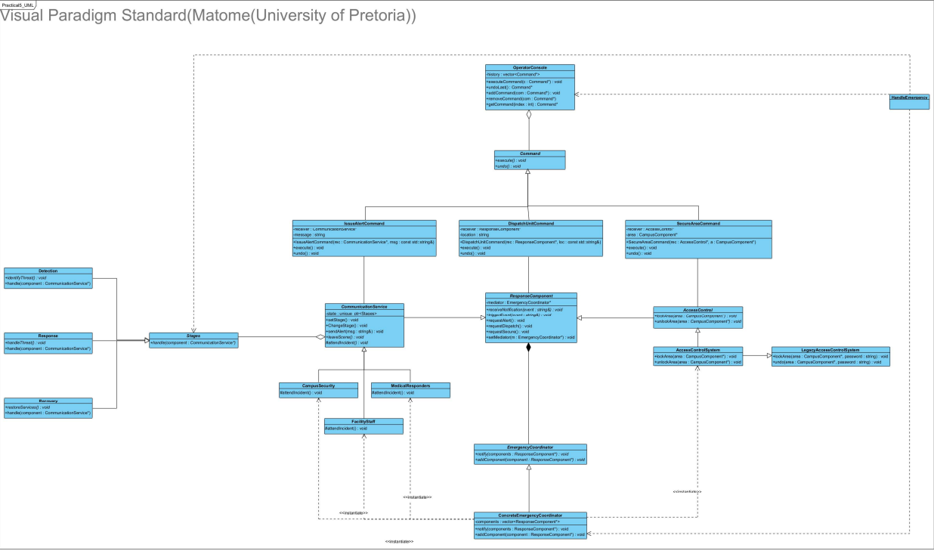
UML

Slide 4
GoF Participant Mapping
Command
Command: Command (Interface)
ConcreteCommand: DispatchUnitCommand, SecureAreaCommand, IssueAlertCommand
Invoker: OperatorConsole
Receiver: Various ResponseComponent subclasses (e.g., CommunicationService, AccessControlSystem)
Mediator
Mediator: EmergencyCoordinator
ConcreteMediator: ConcreteEmergencyCoordinator
Colleague: ResponseComponent
ConcreteColleague: CommunicationService, AccessControl, CampusSecurity, MedicalResponders

Slide 5
GoF Participant Mapping
Adapter
Target: AccessControl
Adapter: AccessControlSystem
Adaptee: LegacyAccessControlSystem (External/Legacy Service)
Facade
Facade: HandleEmergency (Acts as the high-level entry point orchestrating subsystems)
Subsystems: OperatorConsole, ConcreteEmergencyCoordinator, and Stages (State context).

Slide 6
GoF Participant Mapping
State
Context: CommunicationService
State: Stages
ConcreteState: Detection, Response, Recovery
Template Method
AbstractClass: CommunicationService
Template Method: triggerEvent()
PrimitiveOperations: attendIncident(), leaveScene()
ConcreteClass: CampusSecurity, MedicalResponders, FacilityStaff

Slide 7
Justification for the Two Team-Selected Patterns
State Pattern
Problem Solved: The scenario requires registering incidents and dynamically changing their operational status over time. Why it's better: Without State, the CommunicationService would require massive conditional statements (e.g., switch or if/else) to check if the incident is in detection, response, or recovery mode before allowing specific actions. The State pattern encapsulates state-specific behavior, allowing the component's behavior to change cleanly at runtime based on the incident's current operational phase.
Template Method
Problem Solved: Different emergency response teams (e.g., Security, Medical, Facilities) have a shared overarching workflow for handling incidents, but the specific implementation details of assessing and attending the scene differ. Why it's better: Instead of having each response unit duplicate the workflow logic, the Template Method enforces a strict sequence of operations (attendIncident(), leaveScene()) in the base CommunicationService via the triggerEvent() method. Subclasses only override the specific steps, reducing code duplication and enforcing a standardized protocol.

Slide 8
Behavioural Diagrams

Slide 9
Behavioural Diagrams

Slide 10
Behavioural Diagrams

Slide 11
Design and Ownership Rationale
Decoupling via Mediator: Direct dependencies between response units are eliminated by forcing all cross-component communication through the ConcreteEmergencyCoordinator.
Command Encapsulation: Actions are decoupled from execution. The OperatorConsole dynamically manages a history of commands, making undo() operations trivial without needing to know the specifics of the ResponseComponent.
Memory Management & Ownership: All polymorphic base classes define virtual destructors to prevent resource leaks during deletion. The Mediator maintains non-owning pointers to Colleagues, while the OperatorConsole owns the Command objects dynamically allocated to its history list. std::unique_ptr is utilized to strictly own the Stages (State pattern) within the CommunicationService, ensuring clean and deterministic memory cleanup.

Slide 12
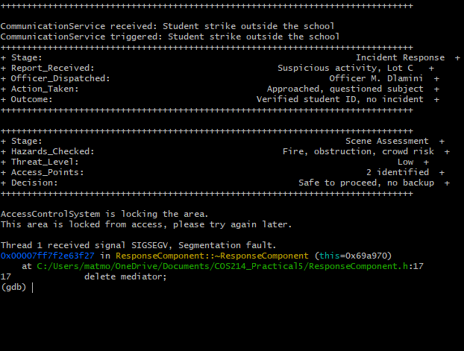
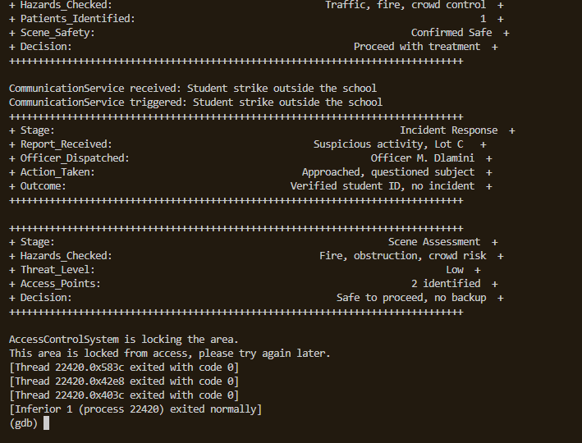
GDB Investigation

Slide 13
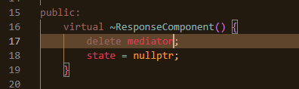
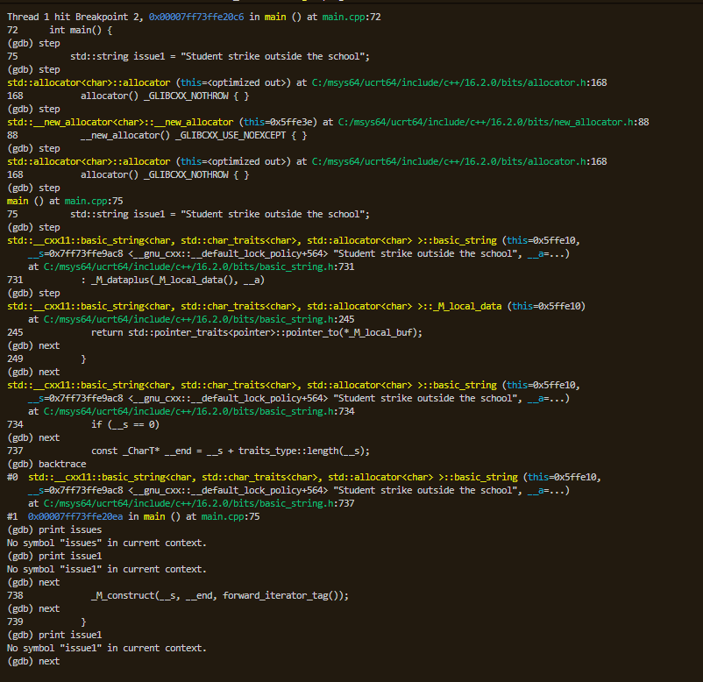
GDB Investigation

Slide 14
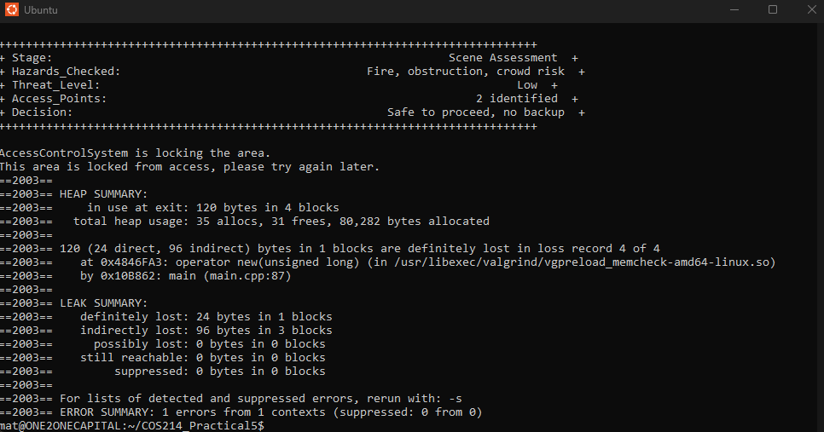
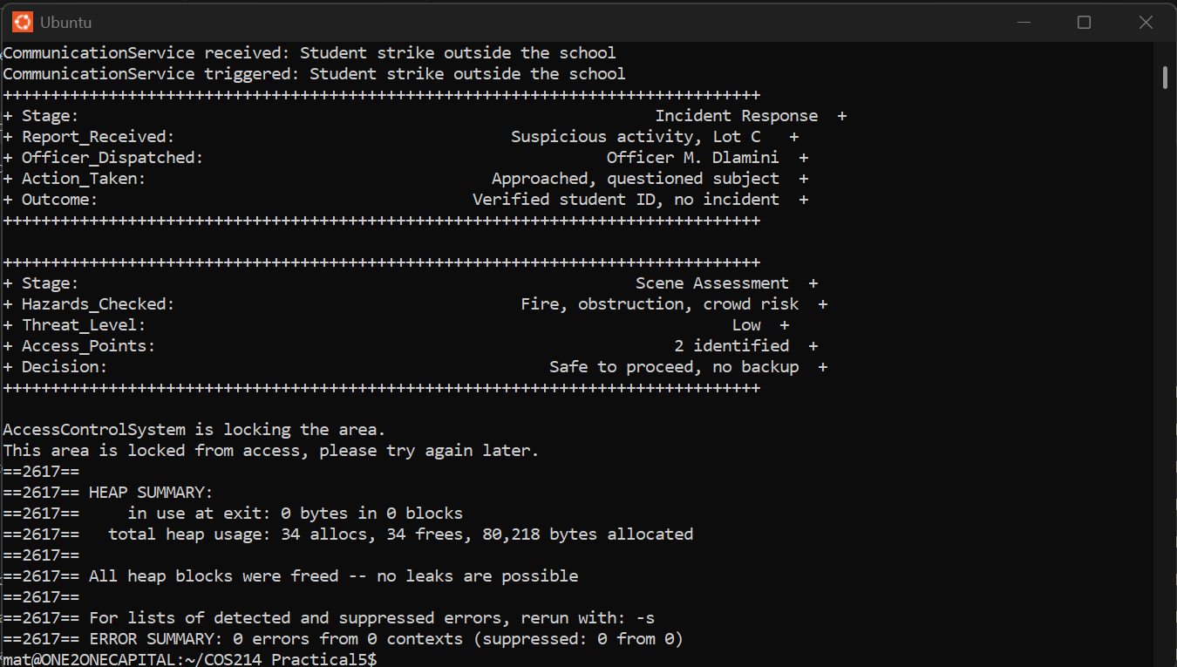
Valgrind Evidence
Before vs After

Slide 15
Docker and Execution Instructions
Dockerfile
FROM gcc:11
WORKDIR /app
COPY . .
RUN make clean && make
CMD ["./CampusGuard"]
docker-compose.yml
version: '3'
services:
campusguard:
build: .
image: campusguard_app
To build and run the complete application inside Docker for the demonstration, run the following command in the root directory:
docker compose up --build

Slide 16
GitHub Repository Link and Collaboration Reflection
Repository Link:
https://github.com/Mat6577/COS214_Practical5
Collaboration Reflection:
We began communicating as soon as the practical was released, which allowed us to divide the work equally. As a result, every member contributed to each component: writing code, designing the UML diagrams, and using a developer tool.

Slide 17
Team Contribution Statements
Ashley:
Tebello: I worked on the main, Façade, and adapter, which explains the large gap between my commits and my teammates commits. The work was however, split equally, and each member implemented at least one pattern.
Navela

