Slide 1
Predicting conflict clusters in Africa
A spatiotemporal ACLED pipeline idea
Names: …
June 2026

Slide 2
Today’s focus
1. Conflict clustering as a spatial question
2. What ACLED data contains
3. Turning events into a grid-cell monthly panel
4. Hypotheses: local persistence and spatial diffusion
5. Modeling and validation strategy
6. Reproducible pipeline and next steps

Slide 3
The core idea: conflict risk moves through space and time
Instead of predicting “conflict in Africa” as one continent-wide number, the project treats conflict as a local and time-varying process.
Africa is divided into comparable geographic grid cells, observed month by month.
The key question is whether recent conflict in and around a cell helps predict conflict in that cell in the next month.
This is designed as an early-warning and risk-mapping project, not as a claim that the model has proven causality.

Slide 4
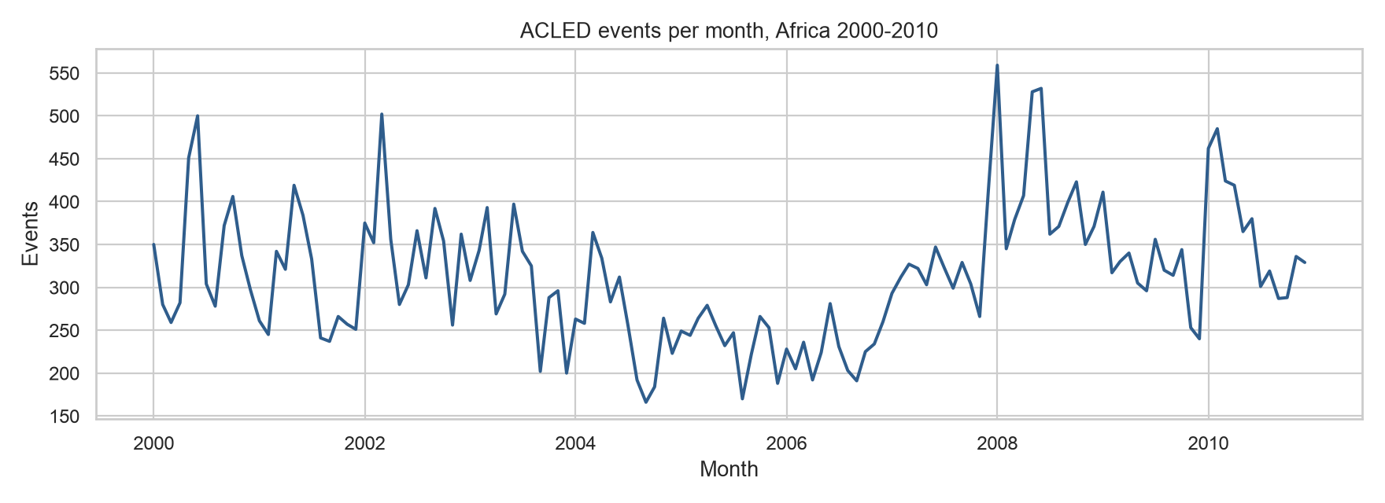
ACLED data planned to be used
Source: ACLED event data
Period: January 2000 to December 2010
Spatial scope: African countries in the file
Events: 41,299 reported events
Countries: 48
Core fields: date, coordinates, event type, actors, fatalities
Use here: input data for grid-cell monthly prediction
Survey response by municipality type
Distribution and response rates across Swedish municipality categories
 | Total municipalities | Responded (n) | Did not respond (n) | Response rate (%)
Mindre städer/tätorter och landsbygdskommuner (C) | 134 | 62 | 72 | 46.3
Storstäder och storstadsnära kommuner (A) | 46 | 24 | 22 | 52.2
Större städer och kommuner nära större stad (B) | 110 | 44 | 66 | 40.0
Chi-square test: χ² = 2.15, df = 2, p = 0.341

Slide 5
What one ACLED row tells us
Each row is a reported political violence or disorder event.
The row includes a date, latitude and longitude, country and administrative location, event and sub-event type, involved actors, fatalities, and source notes.
The raw row is not yet the unit of prediction. It is an observation that can be aggregated into a consistent space-time panel.
This matters because the model needs comparable units: the same places, observed repeatedly through time, including months with no reported conflict.

Slide 6
Research question and hypotheses
Research question: do conflict clusters spread over time?
H₁ Local persistence: a cell with recent conflict is more likely to experience conflict again in the following month.
H₂ Spatial diffusion: conflict in nearby cells raises risk in the focal cell, even after accounting for the focal cell’s own history.
H₃ Scale robustness: the same broad pattern should be visible when the grid is made smaller (50 x 50km) or larger (200 x 200km).

Slide 7
From reported events to a prediction table
1. Start with point events: latitude, longitude, date, and event attributes.
2. Assign each event to an approximate 100 × 100 km grid cell.
3. Count events and fatalities by cell and month.
4. Add explicit rows for cell-months with zero reported events.
5. Shift the outcome forward: use earlier information to predict conflict next month.

Slide 8
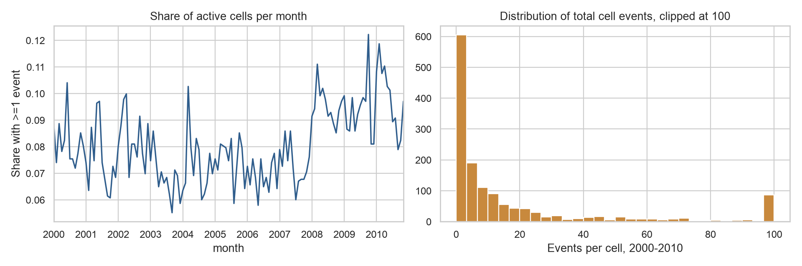
The 100 km grid-cell monthly 2000-2010 panel
Grid: 100 × 100 km cells
Rows: 187,592 cell-months
Cells: 1,432 geographic cells
Months: 131 modeled months after target shift
Outcome: any conflict in the next month
Outcome frequency: about 8% positive cell-months
Purpose: a structured map-time table for prediction
Survey response by municipality type
Distribution and response rates across Swedish municipality categories
 | Total municipalities | Responded (n) | Did not respond (n) | Response rate (%)
Mindre städer/tätorter och landsbygdskommuner (C) | 134 | 62 | 72 | 46.3
Storstäder och storstadsnära kommuner (A) | 46 | 24 | 22 | 52.2
Större städer och kommuner nära större stad (B) | 110 | 44 | 66 | 40.0
Chi-square test: χ² = 2.15, df = 2, p = 0.341

Slide 9
What the model is allowed to know
Only information available before the prediction month is used.
Local history: whether the same cell had conflict in the last 1, 3, 6, or 12 months.
Intensity history: recent event counts and fatality counts, summarized over rolling windows.
Neighbor history: recent conflict in nearby grid cells, used to test spatial diffusion.
Context controls: month and country patterns, plus event-type histories where useful.

Slide 10
Modeling strategy
The models compare increasingly informative explanations of next-month conflict risk.
Baseline: broad place and time patterns.
Local-history model: adds what happened in the same cell recently.
Neighbor model: adds what happened around the cell recently.
Extended model: adds richer event-type and intensity information.
Logistic regression keeps the design interpretable; random forests test whether flexible patterns add predictive value.

Slide 11
How we avoid fooling ourselves
Time is split chronologically, not randomly, because the real task is forecasting future months.
Model development uses 2000-2005; validation uses 2006-2010.
The later 2011-2020 period is held back for a separate out-of-sample phase.
The main grid is 100 km × 100 km, with 50 km and 200 km robustness checks.
Evaluation should ask whether high-risk cells are useful and calibrated, not only whether a single threshold looks good.

