Slide 1
Predicting conflict clusters in Africa
A spatiotemporal ACLED pipeline idea
Names: …
June 2026

Slide 2
Today’s focus
1. Conflict clustering as a spatial question
2. What ACLED data contains
3. Turning events into a grid-cell monthly panel
4. Hypotheses: local persistence and spatial diffusion
5. Modeling and validation strategy
6. Reproducible pipeline and next steps

Slide 3
Core idea: conflict risk moves through space and time
Instead of predicting “conflict in Africa” as one continent-wide number, the project treats conflict as a local and time-varying process.
Africa is divided into comparable geographic grid cells, observed month by month.
The key question is whether recent conflict in and around a cell helps predict conflict in that cell in the next month.
This is designed as an early-warning and risk-mapping project, not as a claim that the model has proven causality.

Slide 4
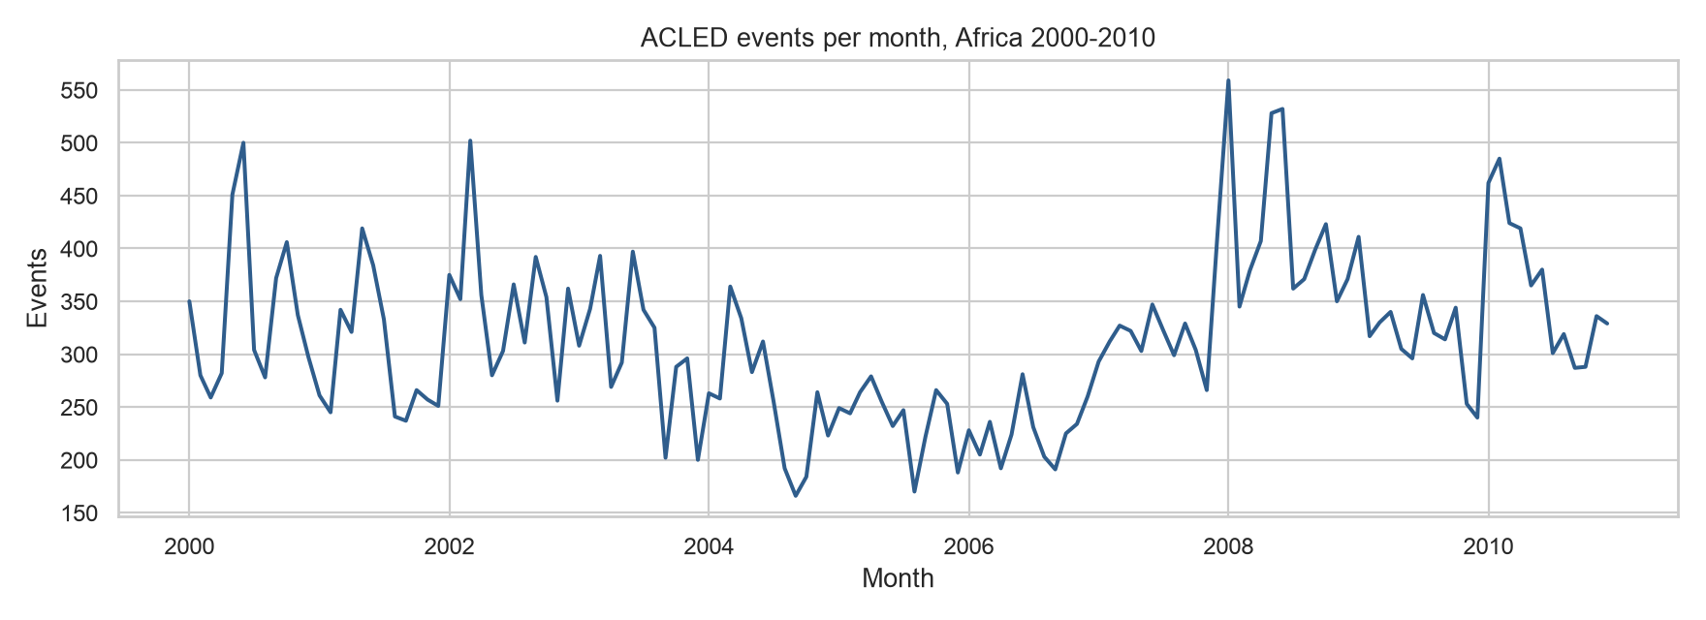
ACLED data planned to be used
Source: ACLED event data
Period: January 2000 to December 2010
Spatial scope: African countries in the file
Events: 41,299 reported events
Countries: 48
Core fields: date, coordinates, event type, actors, fatalities
Use: input data for grid-cell monthly prediction
Survey response by municipality type
Distribution and response rates across Swedish municipality categories
 | Total municipalities | Responded (n) | Did not respond (n) | Response rate (%)
Mindre städer/tätorter och landsbygdskommuner (C) | 134 | 62 | 72 | 46.3
Storstäder och storstadsnära kommuner (A) | 46 | 24 | 22 | 52.2
Större städer och kommuner nära större stad (B) | 110 | 44 | 66 | 40.0
Chi-square test: χ² = 2.15, df = 2, p = 0.341

Slide 5
What one ACLED row tells us
- Each row is a reported political violence or disorder event.
- The row includes a date, latitude and longitude, country and administrative location, event and sub-event type, involved actors, fatalities, and source notes.
- The raw row is not yet the unit of prediction. It is an observation that can be aggregated into a consistent space-time panel.
- This matters because the model needs comparable units: the same places, observed repeatedly through time, including months with no reported conflict.

Slide 6
Research question and hypotheses
Research question: do conflict clusters spread over time?
H1 Local persistence: a cell with recent conflict is more likely to experience conflict again in the following month.
H2 Spatial diffusion: conflict in nearby cells raises risk in the focal cell, even after accounting for the focal cell’s own history.
H3 Scale robustness: the same broad pattern should be visible when the grid is made smaller (50 x 50km) or larger (200 x 200km).

Slide 7
Pipeline: From reported events to a prediction table
1. Start with point events: latitude, longitude, date, and event attributes.
2. Assign each event to an approximate 100 × 100 km grid cell.
3. Count events and fatalities by cell and month.
4. Add explicit rows for cell-months with zero reported events.
5. Shift the outcome forward: use earlier information to predict conflict next month.

Slide 8
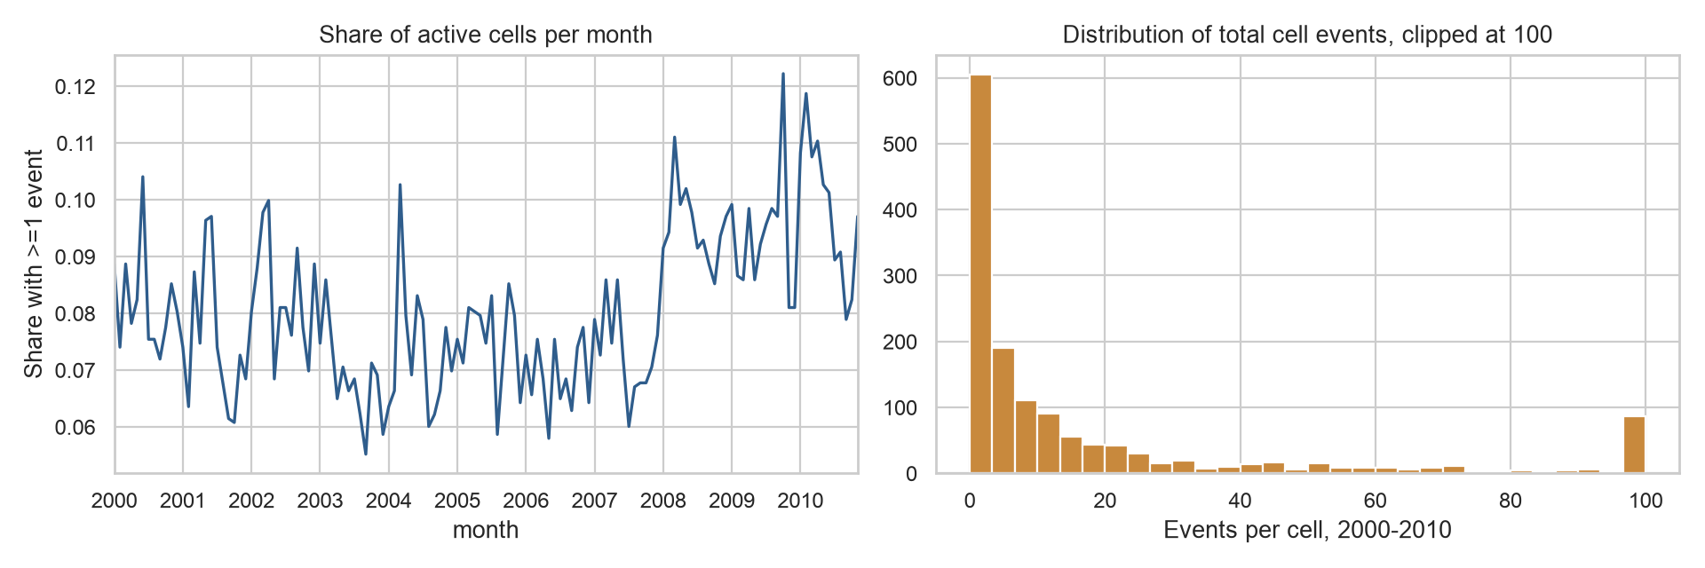
The 100 km grid-cell monthly 2000-2010 panel
Grid: 100 × 100 km cells
Rows: 187,592 cell-months
Cells: 1,432 geographic cells
Months: 131 modeled months after target shift
Outcome: any conflict in the next month
Outcome frequency: about 8% positive cell-months
Purpose: a structured map-time table for prediction
Survey response by municipality type
Distribution and response rates across Swedish municipality categories
 | Total municipalities | Responded (n) | Did not respond (n) | Response rate (%)
Mindre städer/tätorter och landsbygdskommuner (C) | 134 | 62 | 72 | 46.3
Storstäder och storstadsnära kommuner (A) | 46 | 24 | 22 | 52.2
Större städer och kommuner nära större stad (B) | 110 | 44 | 66 | 40.0
Chi-square test: χ² = 2.15, df = 2, p = 0.341

Slide 9
What the model is allowed to know
Only information available before the prediction month is used.
Local history: whether the same cell had conflict in the last 1, 3, 6, or 12 months.
Intensity history: recent event counts and fatality counts, summarized over rolling windows.
Neighbor history: recent conflict in nearby grid cells, used to test spatial diffusion.
Context controls: month and country patterns, plus event-type histories where useful.

Slide 10
Modeling strategy
The models compare increasingly informative explanations of next-month conflict risk.
Baseline: broad place and time patterns.
Local-history model: adds what happened in the same cell recently.
Neighbor model: adds what happened around the cell recently.
Extended model: adds richer event-type and intensity information.
Logistic regression keeps the design interpretable; random forests test whether flexible patterns add predictive value.

Slide 11
Planned validation strategy
Time should be split chronologically, because the real task is forecasting future months.
First phase: build and explain the model using the 2000-2010 ACLED data.
Second phase: add 2011-2020 as a later out-of-sample test period.
The main grid is 100 km × 100 km, with 50 km and 200 km robustness checks.
Evaluation should ask whether high-risk cells are useful and calibrated, not only whether a single threshold looks good.

