Slide 1

Human Data Analytics – Project Project Name
Matteo Ciprian, Tommy Azzino
Prof. Michele Rossi
Dept. of Information Engineering, University of Padova, Italy
matteo.ciprian.1@studenti.unipd.it
tommy.azzino@studenti.unipd.it
July, 12, 2018

Slide 2
Outline
Introduction
Vector Quantization
LBG algorithm
Performance analysis
Random & Splitting
Pyramidal Initialization
Conclusions

Slide 3
Introduction
Why do we need compression?
Lossless vs Lossy
Scalar vs Vector Quantization
Fundamental steps for VQ

Slide 4

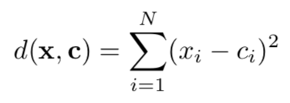
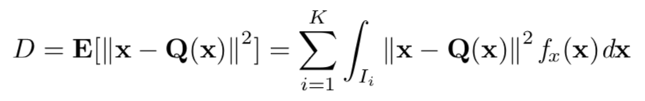
Vector Quantization
Quantization of a group of samples
Codebook and decision regions
Distortion measure

Slide 5
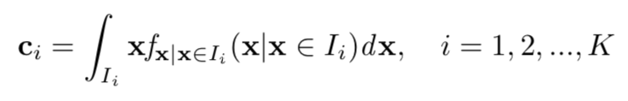
Vector Quantization
Nearest Neighbor condition
Centroid condition

Slide 6
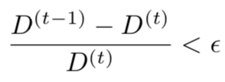
LBG algorithm
Compute the initial codebook
Identify the decision regions according to:
Compute the new codevectors
Evaluate the distortion
Check the terminate condition:
If terminate condition is not met, restart from 2

Slide 7
LBG algorithm
Initialization techniques
Random
Splitting
Empty cell problem
Region with highest cardinality
Or region with highest distortion

Slide 8






Performance analysis: SPLITTING
Ep = 0.1 PSNR = 30.331
Ep = 0.01 PSNR = 30.593
Ep = 0.001 PSNR = 30.824
Ep = 0.1 PSNR = 24.868
Ep = 0.01 PSNR = 24.991
Ep = 0.001 PSNR = 25.269

Slide 9






Performance analysis: RANDOM
Ep = 0.1 PSNR = 30.167
Ep = 0.01 PSNR = 30.565
Ep = 0.001 PSNR = 30.898
Ep = 0.1 PSNR = 24.861
Ep = 0.01 PSNR = 25.041
Ep = 0.001 PSNR = 25.35

Slide 10
Performance analysis: Ep = 0.1

Slide 11
Performance analysis: Ep = 0.01

Slide 12
Performance analysis: Ep = 0.001

Slide 13


Performance Analysis: Pyramidal
Build image’s pyramid through Gaussian filtering
Codebook randomly initialized from small set
Ep = 0.001 PSNR = 31.685
Ep = 0.001 PSNR = 25.431

Slide 14
Conclusions
With smaller Epsilon performance does not increase considerably
The difference in performance between random and splitting initialization is minimal
Visible artifacts when using blocks of dimension 16, but higher compression

Slide 15
Conclusions
Pyramidal initialization has almost the same performance but with faster convergence
It would be interesting to study this technique with larger codebooks

