Slide 1
Image Classification
(Face Recognition)
Memo Ghazi

Slide 2
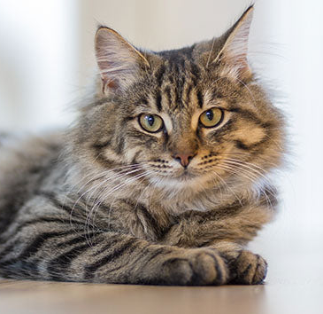
Image Classification
Airplane
Car
Bird
Dog
Cat
Frog

Slide 3
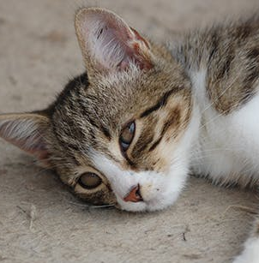
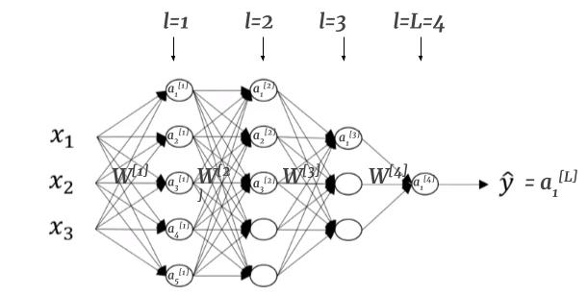
Image Classification with simple Neural Network
How many parameters do we have in the first layer of NN if we want the output with the size of 1000?
Size = 1000*1000*3
What is the drawback of simple NN?
Number of parameters
Overfitting
Volume of calculation

Slide 4
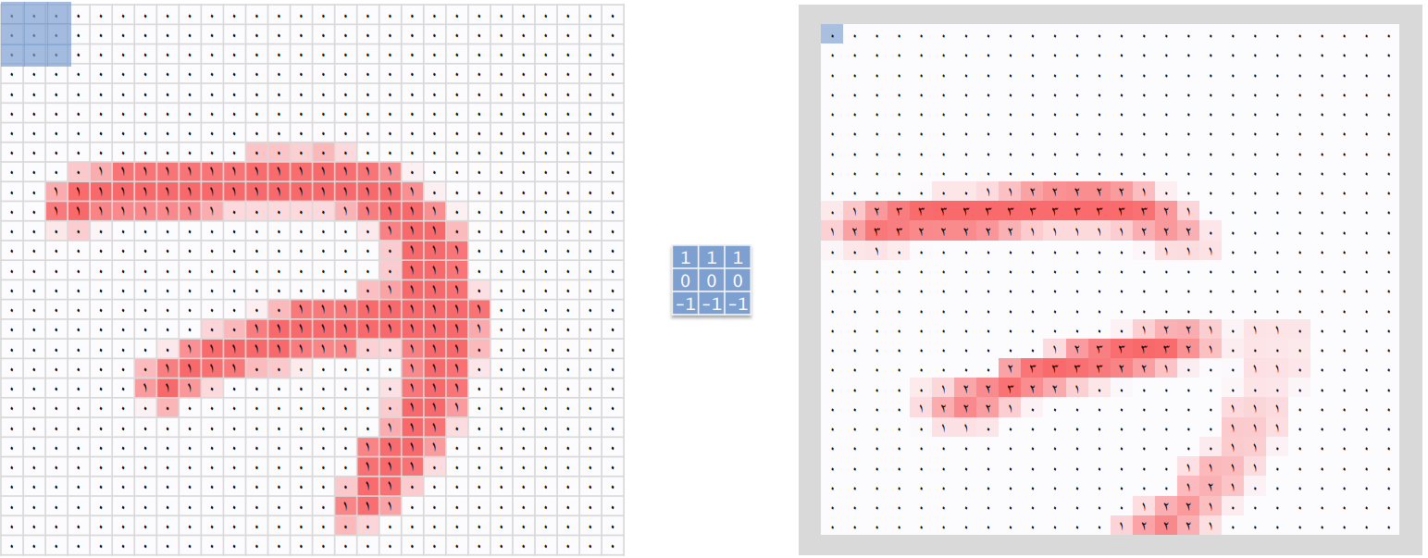
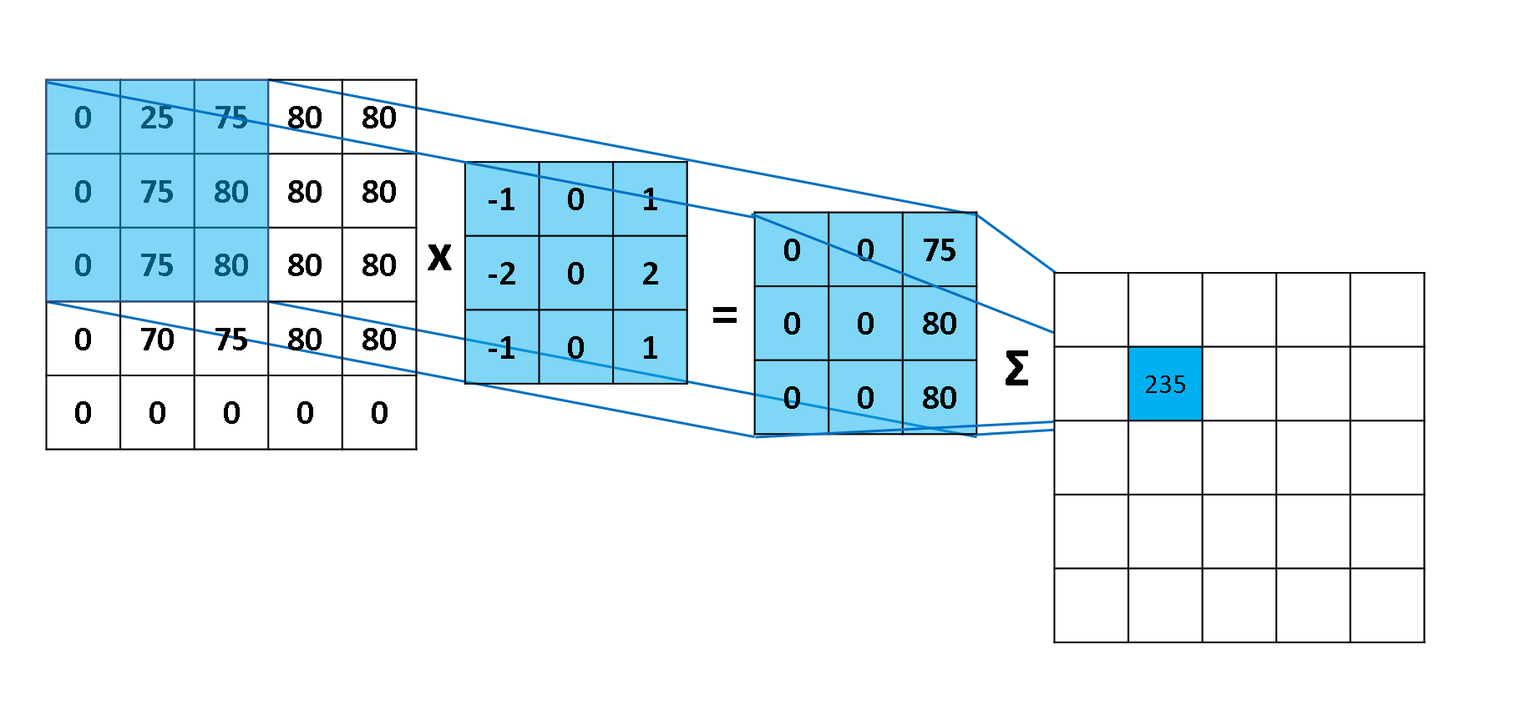
Kernel (filter)
Edge detection filter (horizontal, vertical)
https://setosa.io/ev/image-kernels/

Slide 5
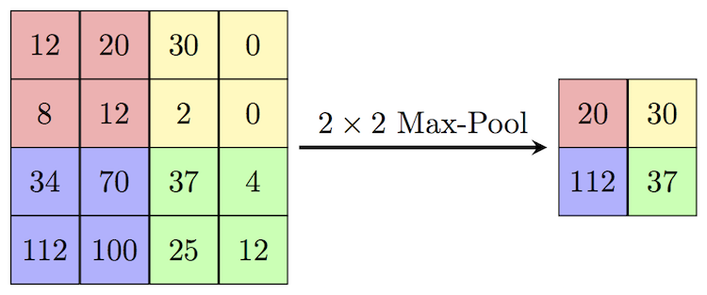
Pooling

Slide 6
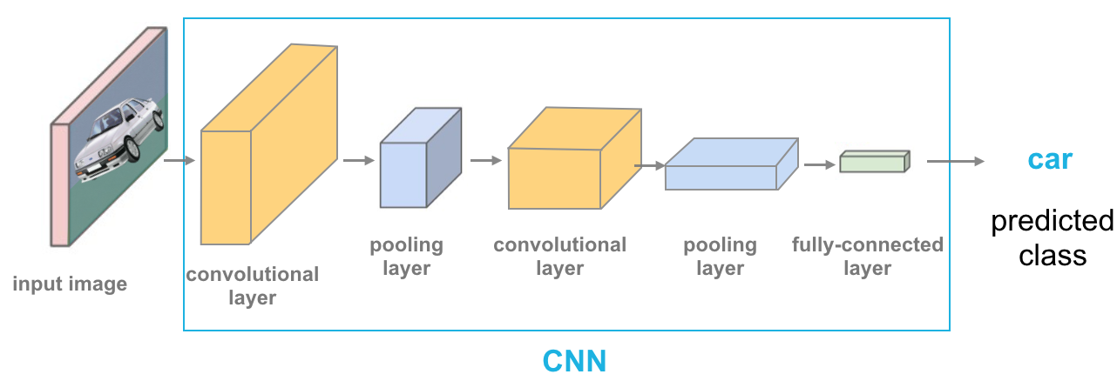
Convolutional Neural Network

Slide 7
Image Classification
Face recognition
We have a numerous class
Limited number of sample for each class
Siamese Network
Triple loss function

Slide 8
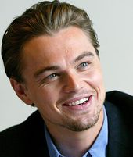
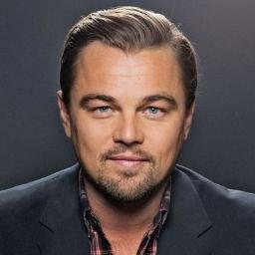
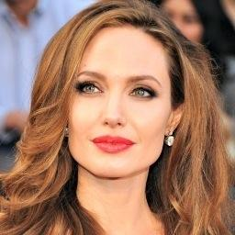
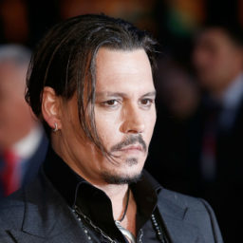

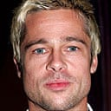
Single shot classification or limited shots

Slide 9
Learning the similarity factor
Distance function → get two images and give a number
D( , ) > Շ
D( , ) ≤ Շ
Goal: Try to make this function in a way that images related
to one person has the low distance to each other.
0.1
9
3
6

Slide 10
Triple loss function
anchor positive anchor negative

Slide 11
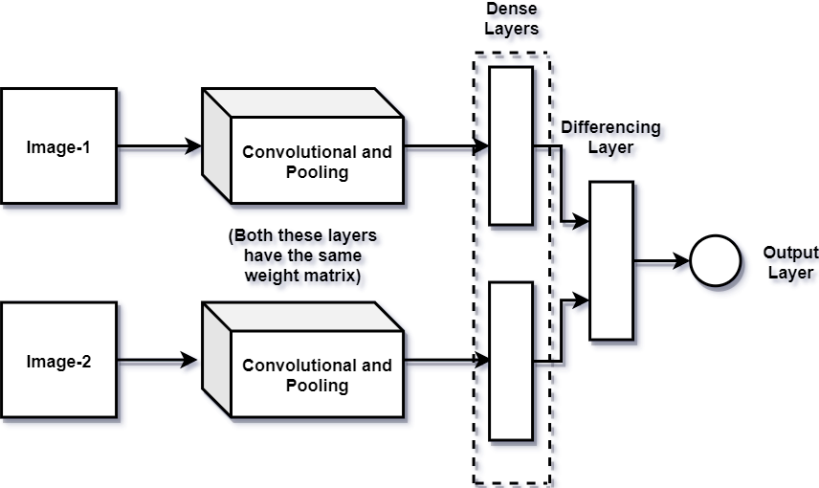
Siamese Networks
Siamese Networks are a class of neural networks capable of one-shot learning.
we stop with the dense layers
only one network for all images

Slide 12
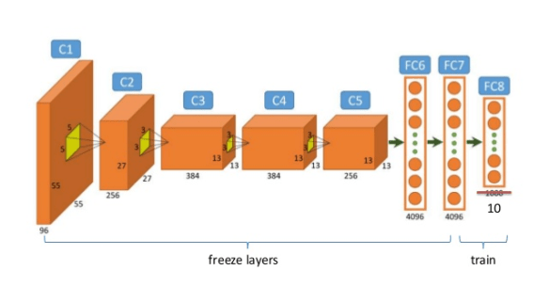
Transfer learning

Slide 13
Implementation
Database of faces Provide by AT&T Laboratories Cambridge on Kaggle
There are 400 different images of each of 40 distinct subjects.
For some subjects, the images were taken at different times, varying the lighting, facial expressions

