Slide 1
WA Module System
Daniel Delannes-Molka

Slide 2
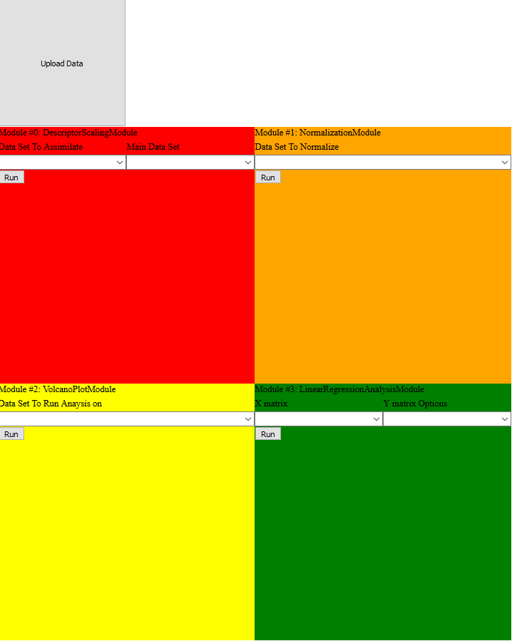
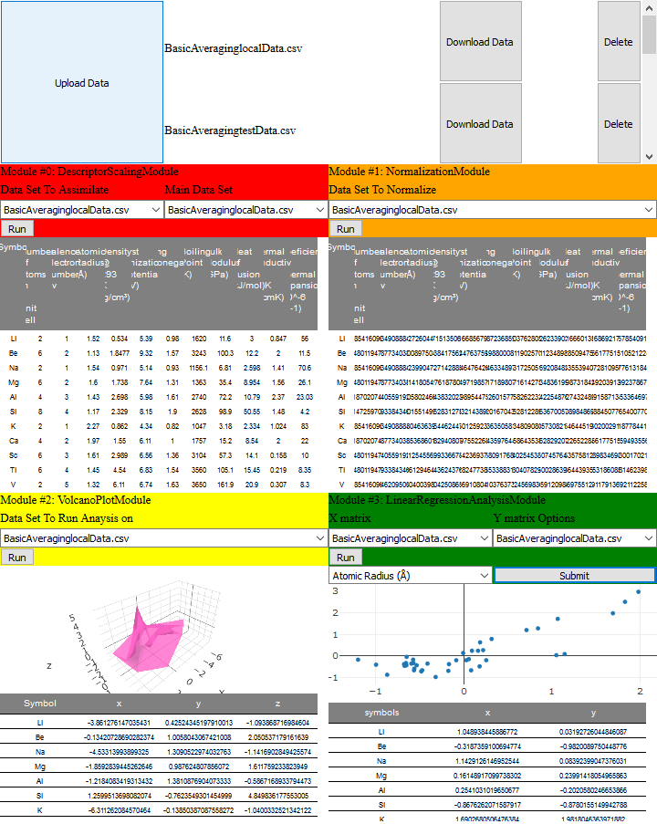
Function
This is a JavaScript program that is design to be placed in any HTML page.
It allows users to put in csv files and run mathematical modules on them and then download the results.
It uses the plotly.js, numeric.js and math.js libraries.

Slide 3
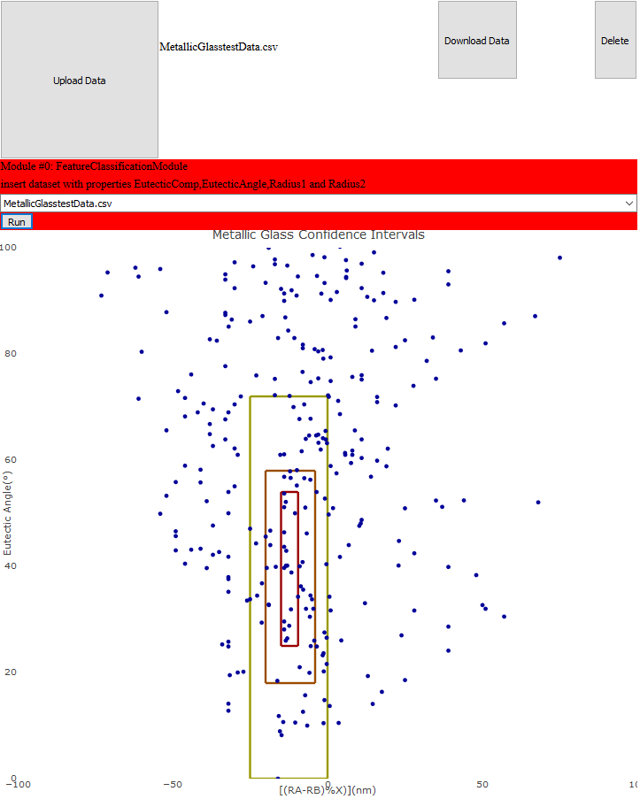
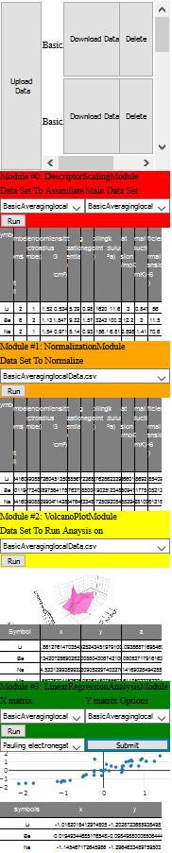
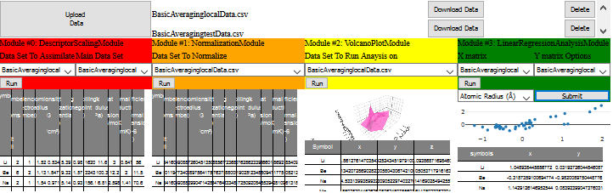
Abilities
Its height, width, amount of rows and amount of columns can be varied.
Any Module or set of modules can be put in the system.

Slide 4
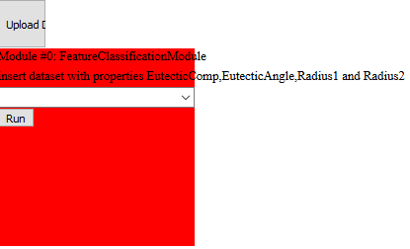
Limitations
Making the system smaller then (about) 250x250px will start causing formatting issues.
Javascript is not designed with heavy computation or recursion in mind resulting in more compacted modules taking time to run.
Currently works on Firefox, Chrome, but not Edge.

Slide 5
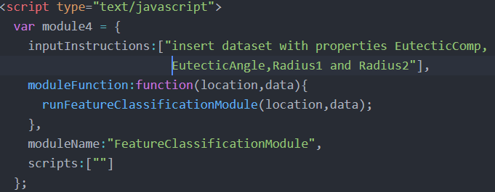
How to use:
First, add module folders and WASystem.js to project
Second put the script location in the header
Third, create a JavaScript object with the following properties:
inputInstructions: Array of instructions for each input
moduleFunction: function that calls the module
moduleName: name of the module
scripts: names of additional scripts in the module folder that needs to be called for the module to function.

Slide 6

How to use:
Forth, run the following command with the following properties:
Id of parent html object
Width in px
Height in px
List of module objects

Slide 7

Creating a module
The module need to be in a folder with a .js file of the same name inside.
The .js file needs to contain a method to start the module and if any html objects are added, it needs to be to the location object specified in the argument.
If the module only needs initial inputs to produce an output the it must return an object with a data property and an file name property.
If it requires additional inputs then the start method should return null and return and an object with a data property and an file name property need to be sent to the createDataSlot when additional analysis is complete.
There is a template provided to make this easier.

