Slide 1
Dictionary
Is a kind of list with the advantage thats we can call the specific value of the list with a key that we give to the list
monthConversion = {
“jan”: 1,
“feb”: 2,
}

Slide 2
If Statements
if it’s hot
I’ll bring sunglasses
2. if it’s hot
I’ll bring sunglasses
otherwise
I’ll wear warm clothes
3. If it’s hot
I’ll put sunglasses
otherwise if it’s rainy
I’ll bring an umbrella
otherwise
I’ll wear warm clothes

Slide 3
If Statements with OPERATORS Conditional
if it’s hot and sunny
I’ll bring sunglasses
2. if it’s hot or sunny
I’ll bring sunglasses
otherwise
I’ll wear warm clothes
3. If it’s not hot and cloudy
I’ll wear warm clothes

Slide 4
If Statements with OPERATORS Comparison
if temperature is greater than 30
I’ll bring sunglasses
2. if temperature is less than 10
I’ll wear warm clothes
3. If temperature is equal to 15
I’ll wear warm clothes
3. If temperature not equal to 15
I’ll wear warm clothes

Slide 5
While loop
Allow us to loop through and execute tasks multiple times as long as the condition is true
while condition:
then

Slide 6
For loop
Allows us to loop over different collections or ítems
For each element in the list:
Do something

Slide 7
Functions
Lines of code that we use to perform a task
Most of the time we want that the function return something or gives un answer of the task that performs

Slide 8
Error handling
Sometime we need to continue tasks even if sometimes we get errors in the execution of a task

Slide 9
Modules and Packages
List of functions ready to use
MODULE
FUNCTION 1
FUNCTION 2
FUNCTION 3
FUNCTION 4

Slide 10
Packages
List of modules created for specific taks or domains
PACKAGE
MODULE 1
MODULE 2
MODULE 3
MODULE 4

Slide 11
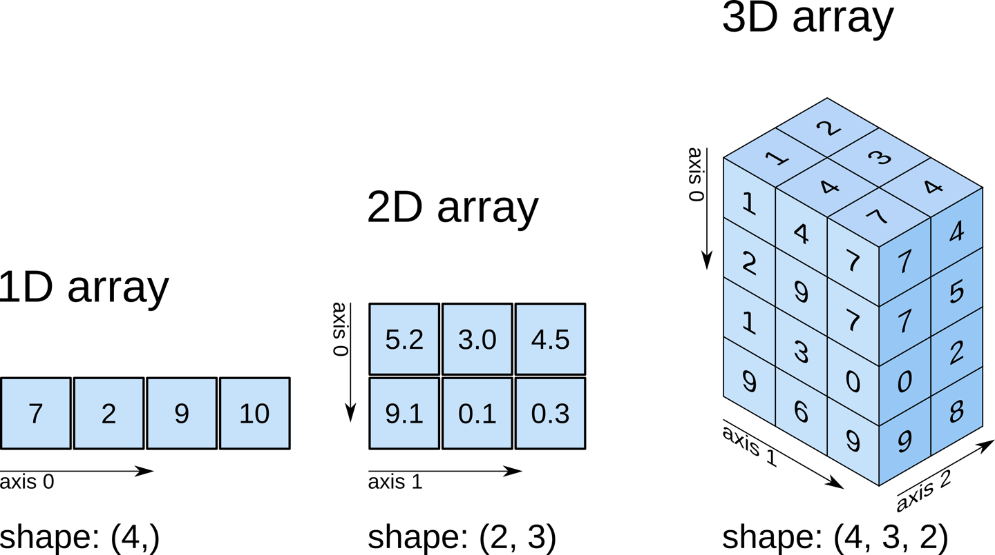
BASIC DATA SCIENCE – Pandas Numpy
Numpy
We can work with multudimensional data

Slide 12
BASIC DATA SCIENCE – Numpy
Useful for :
Multivariate Analysis (ACP, KNN, FCA)
Machine Learning
CNN, LSTM
Language Processing (Word2Vec…)
Image Processing (black& White or Color-RGB)

