Slide 1














Project presentation
Module2

Slide 2
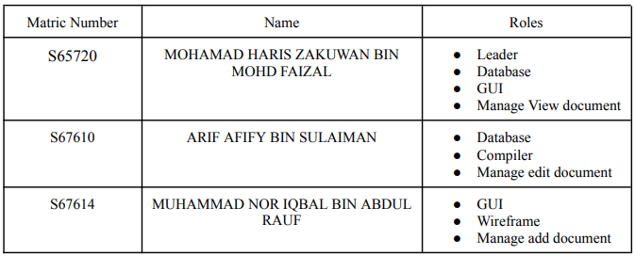
GROUP MEMBER

Slide 3
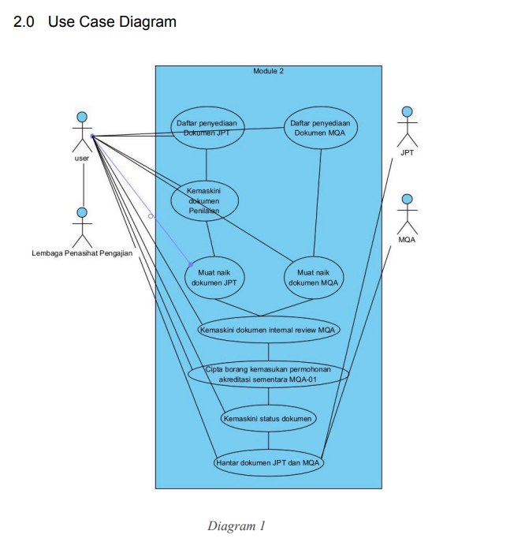
USECASE DIAGRAM

Slide 4
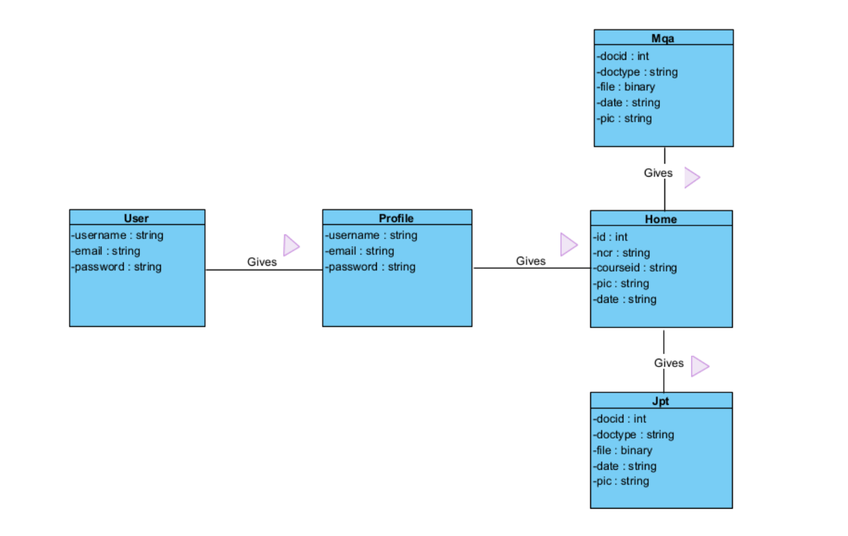
CLASS DIAGRAM

Slide 5
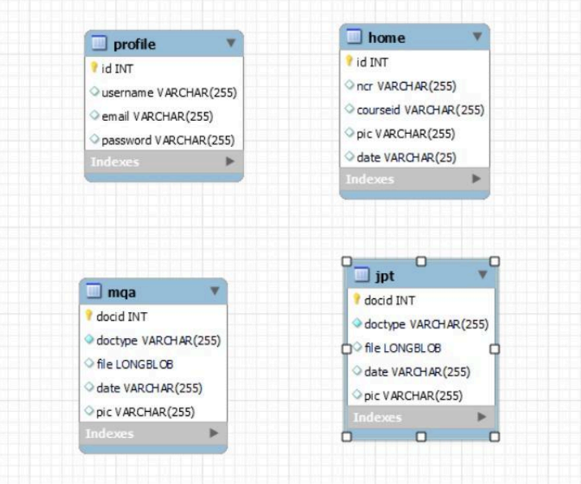
Entity Relationship Diagram (ERD)

Slide 6
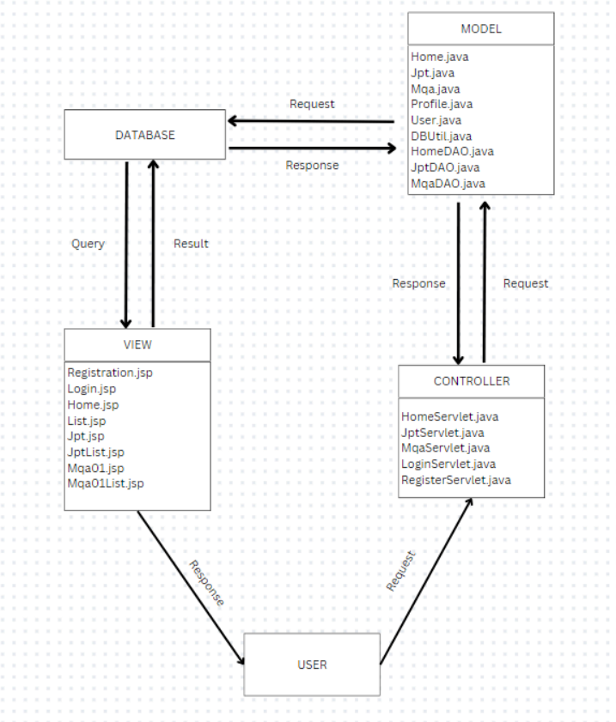
MVC Model

Slide 7
Thank you very much!

