Slide 1
PHYS465: Statistical Data Analysis in Physics
Week 2: Hypothesis Testing, Common distributions, Model testing
Dr. Mathew Smith
mat.smith@lancaster.ac.uk
Physics Building; C46

Slide 2
Module Structure
‘model testing’: does our data agree with our model?
Week 11: Fitting a model to data; estimating parameters
Week 12: Hypothesis testing; the likelihood; estimating uncertainties
Week 13: Posterior sampling; Bayesian statistics
Week 14: Clustering and Classification algorithms
Week 15: Machine learning techniques
‘data driven’: what does our data tell us?

Slide 3
Week 12: Previous session
Last week we learnt:
  Our measurements drawn from an underlying continuous distribution
    The shape of this distribution is dependent on our experiment
    The probability of our data can be described through a PDF
  Given a model we can find the best-fit parameters using least-squares fitting
  This is generalised to $χ^{2}$-fitting in the presence of gaussian uncertainties
  A good model will have $χ_{red}^{2}∼1$
    Where $χ_{red}^{2}=χ^{2}/n_{dof}$
    $χ_{red}^{2}>1$ suggests the need for more complicated models; $χ_{red}^{2}<1$ is the reverse
  Our knowledge of model parameters is expressed through confidence intervals
  Question: how do we measure a confidence interval or parameter uncertainty?

Slide 4
Week 12: Learning aims
Today we will introduce
  Probabilities and how they relate to measurements
  The Null Hypothesis
    And how to test it
  How our experiment will change how the data is distributed
  How to test which distribution is correct
  How do we estimate confidence intervals?
  How to select which model is most likely
Practical examples on Friday!

Slide 5
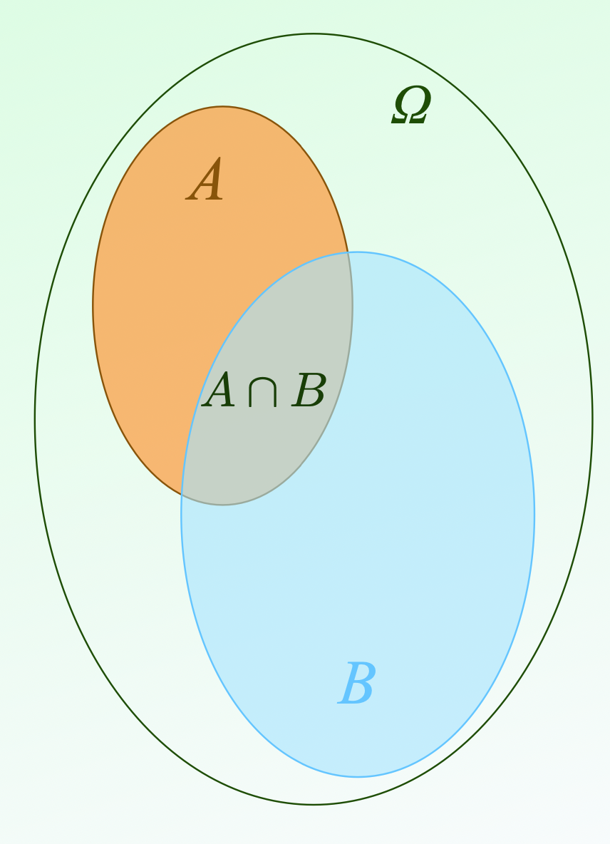
Revision: Probabilities
Given an experiment:
  $Ω$is the list of all possible outcomes
$$Ω$$
$$\text{A}$$
Axioms:
  $$0≤P(A)≤1$$
  $$P(Ω)=1$$
  $$P(A_{1}∪A_{2}∪A_{3}...)=P(A_{1})+P(A_{2})+P(A_{3})+...$$
$$\text{A}∩\text{B}$$
Consequences:
  $$P(A)+P(A^{c})=1$$
  $$P(A∪B)=P(A)+P(B)+P(A∩B)$$
  $P(A∩B)=P(A)×P(B)$ if $A,B$ are independent
$$\text{B}$$

Slide 6
Conditional Probabilities
$$P(A|B)=\frac{P(A∩B)}{P(B)}$$
$$Ω$$
$$\text{A}$$
The probability of $A$ given $B$ (an event or condition)
$$\text{A}∩\text{B}$$
when $θ$ is a model, or parameter
$P(A|θ)$ is called the likelihood: $L(θ|A)$
$$\text{B}$$
“the likelihood of obtaining the data ‘A’ given the model”
Plenty more on this with Bayesian statistics next week

Slide 7
Hypothesis testing
How good is the model?
Fundamental question: Is the model that we are testing a good fit to our measured data?
Is there a more likely alternative?
Null Hypothesis:
Our starting assumption
Can be either parameter values or choice of model
In practice:
Compares our assumption (or prediction) with experimental measurements
e.g. does the luminosity distribution of galaxies match a Schechter function?
Outcome:
Make a statement on the probability of obtaining our result
(see confidence level slides).

Slide 8
Null Hypothesis testing
e.g. Given a model $f(θ)$, with parameter $θ$, is the value of $θ$ in a set of possible values $Θ_{0}$?
$H_{0}$ : The Null Hypothesis: $θ∈Θ_{0}$
$H_{1}$ : An Alternative Hypothesis:
    $θ∈Θ_{1}$ where $Θ_{0}∩Θ_{1}=0$
Outcome
$H_{0}$ not rejected
$H_{0}$ rejected
Type $I$ error
$α$ : threshold of rejection (e.g. 0.05)
Probability of
this: $1-α$
Will happen $α$ %
of the time
$H_{0}$ is true
With new observations $X$, such that $p(X,θ)$
reject $H_{0}$ and accept $H_{1}$
Truth
$$p(X)<α$$
Type $II$ error
(N.B. This is does not mean accept another model)
$P_{H_{1}}(H_{0}\text{is rejected})$
$=β$
$H_{1}$ is true
Happens $1-β$ %
of the time
$$p(X)>α$$
no evidence to reject $H_{0}$
(N.B. This is not the same as accepting $H_{0}$)
A good experiment is defined around these requirements

Slide 9
Confidence Intervals
Given a probability threshold, what is the allowed range of the parameter:
Interpretation: if we repeat our experiment, how often will $P_{0}$ be within our quoted range
$$\overset{̂}{p}-δp≤P_{0}≤\overset{̂}{p}+δp$$
For multiple variables $(A,B)$:
An error ellipse containing $δp$
of the probability
$$A$$
Typical values are 68%, 90%, 95%.
$$B$$

Slide 10
Key Assumption:
The probability, $p$, needed for Hypothesis testing and confidence intervals depend on how the data and model are distributed
Are they both drawn from a Gaussian distribution?

Slide 11
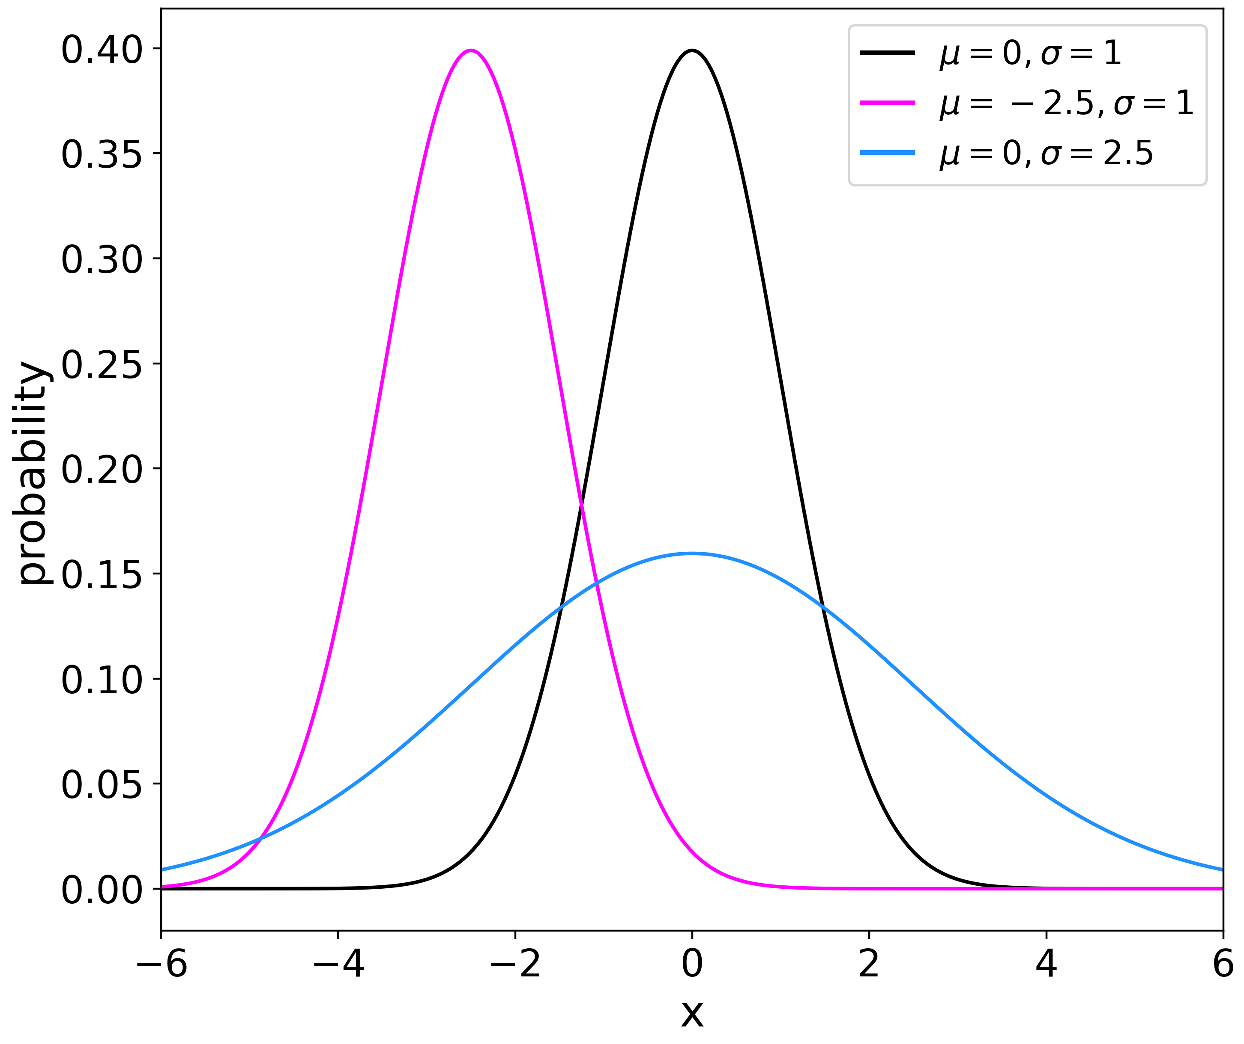
Key Distributions: Gaussian
Aka a normal
$$P(x)=\frac{1}{σ\sqrt{(}2π)}exp\{-(x-μ)^{2}/2σ^{2}\}$$
The limiting case ($→∞$) of most other distributions
Expectation value:
$$\text{mean}=μ$$
Variance:
$$σ^{2}=σ^{2}$$
Common assumption across physics
$$P(-tσ<x_{0}<tσ)=\frac{1}{\sqrt{2}}∫_{-t}^{t}e^{-z^{2}/2}dz$$

Slide 12
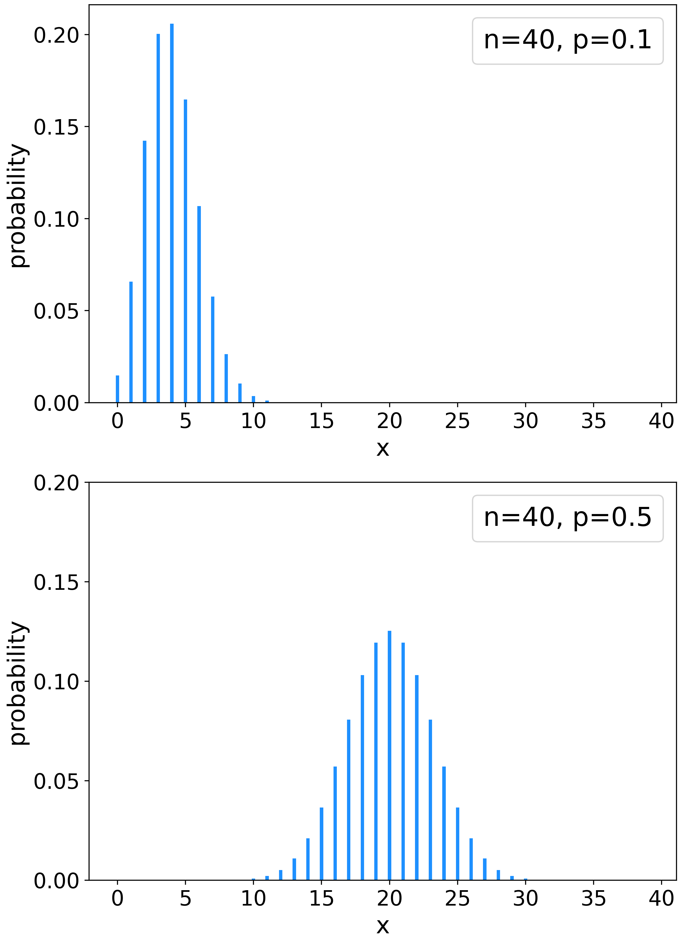
Key Distributions: Binomial
Fixed number of outcomes
$$P(X=k)=\left({n \atop k}\right)p^{k}(1-p)^{n-k}$$
draw $n$ events from $k$ possibilities each with probability $p$
Expectation value:
$$\text{mean}=np$$
Variance:
$$np(1-p)$$
=> Gaussian distribution as $N→∞$
Example: coin tossing

Slide 13
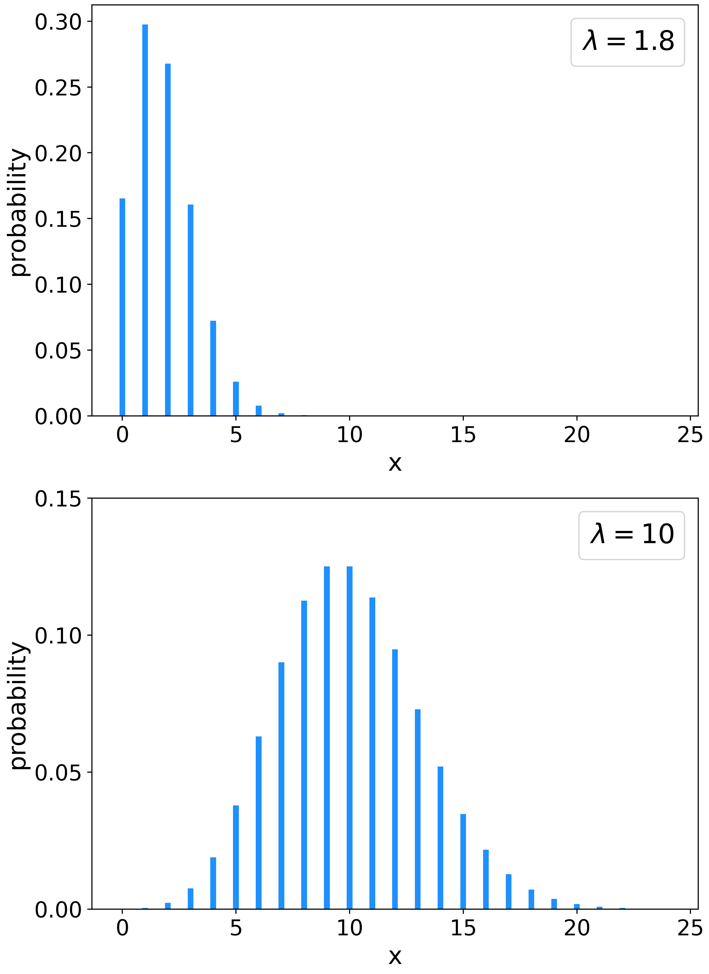
Key Distributions: Poisson
NB: Other common distributions include ‘uniform’, ‘gamma’, ‘log-normal’…
The counting distribution
$$P(X=k)=\frac{λ^{k}e^{-λ}}{k!}$$
observe $k$ events drawn from $λ$ possibilities
Expectation value:
$$\text{mean}=λ$$
Variance:
$$σ^{2}=λ$$
=> Gaussian distribution as $k→∞$
Example: histogram (or photon) counting

Slide 14
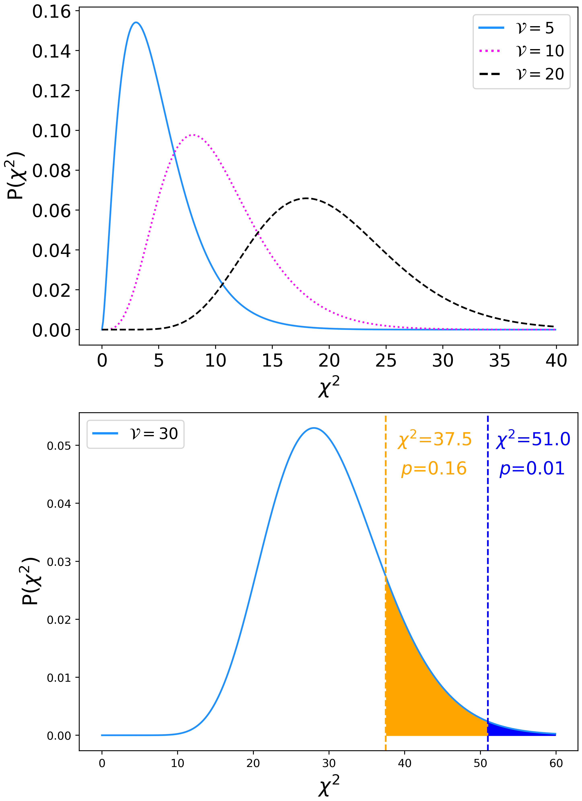
Key Distributions: $χ^{2}$
Related to the Gamma distribution
$$P∝(χ^{2})^{\frac{ν-2}{2}}exp(-χ^{2}/2)$$
$ν$ is the number of degrees of freedom
Expectation value:
$$\text{mean}=ν=N-p$$
Variance:
$$σ^{2}=2ν$$
i.e. if the model is correct then we expect $χ^{2}∼ν±\sqrt{(2ν)}$
$$χ^{2}/ν∼1$$

Slide 15
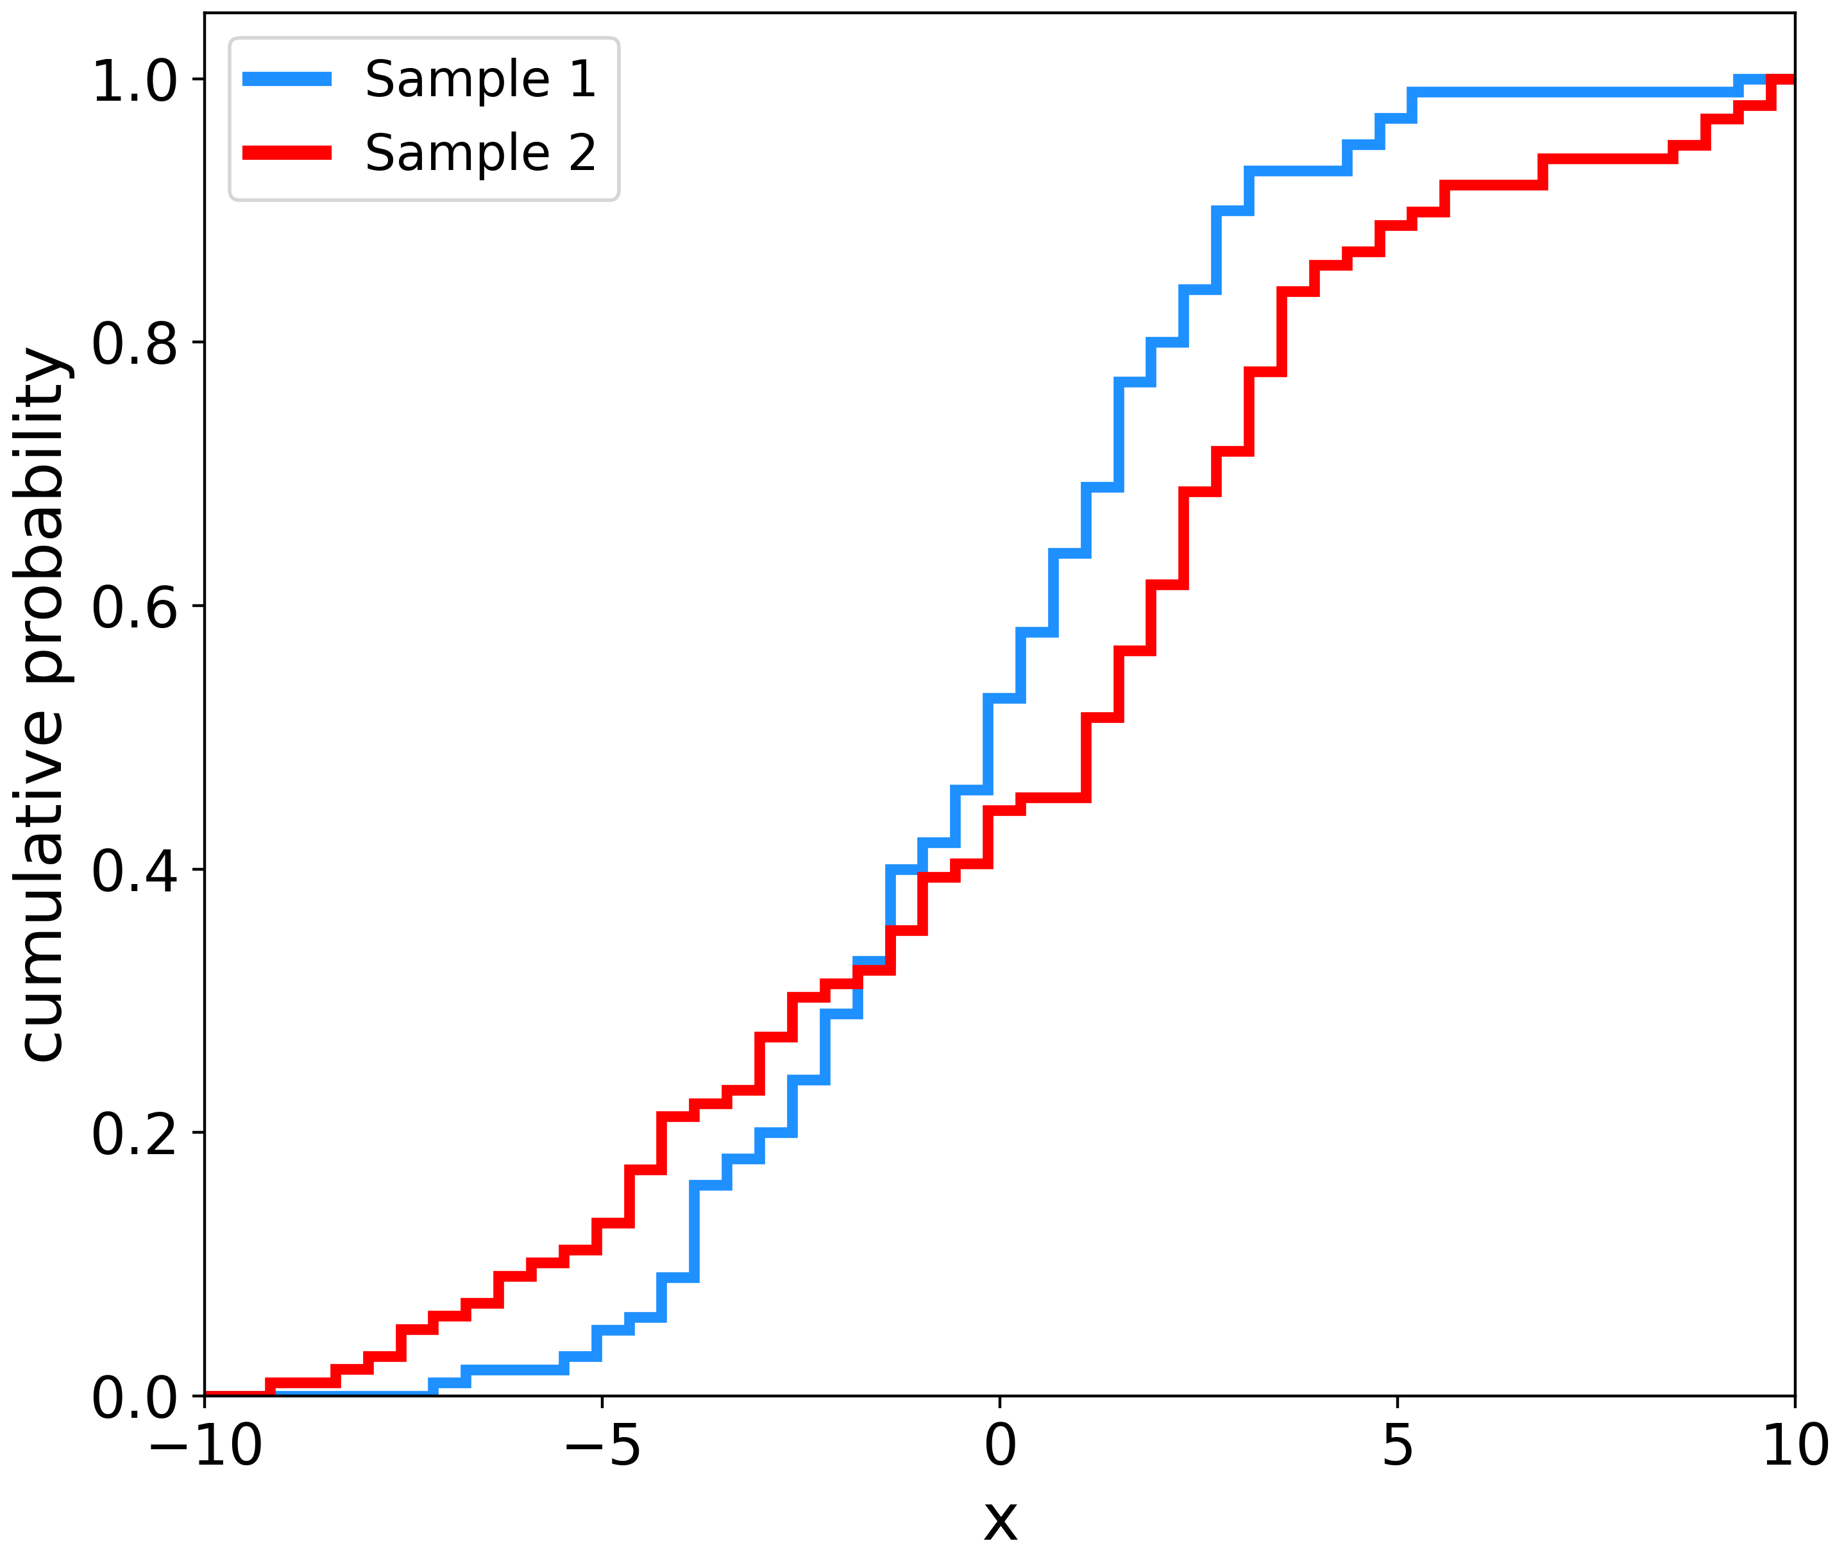
Common in data-science
Finding the Distribution
Kolmogorov-Smirnov (KS) testing
Null hypothesis: the two distributions are the same
The maximal distance between
Cumulative Density Functions (CDF)
D
$$D=\underset{-∞<x<∞}{\text{max}}|S_{N}(x)-F(x)|$$
Recall: a CDF is a rank-ordered PDF.
No assumptions about the underlying distribution
NB: See also Anderson-Darling test

Slide 16
Testing for Correlations
Spearman’s Rank (SR)
Testing whether two variables are related
Compares the ordered rankings (R) of two datasets
$$p_{s}=1-\frac{∑_{i=1}^{N}[R(x_{i})-R(y_{i})]^{2}}{N(N^{2}-1)}$$
Output will be a value between -1 and 1.
Null Hypothesis: the two variables are uncorrelated
NB: A non-parametric version of the Pearson test

Slide 17
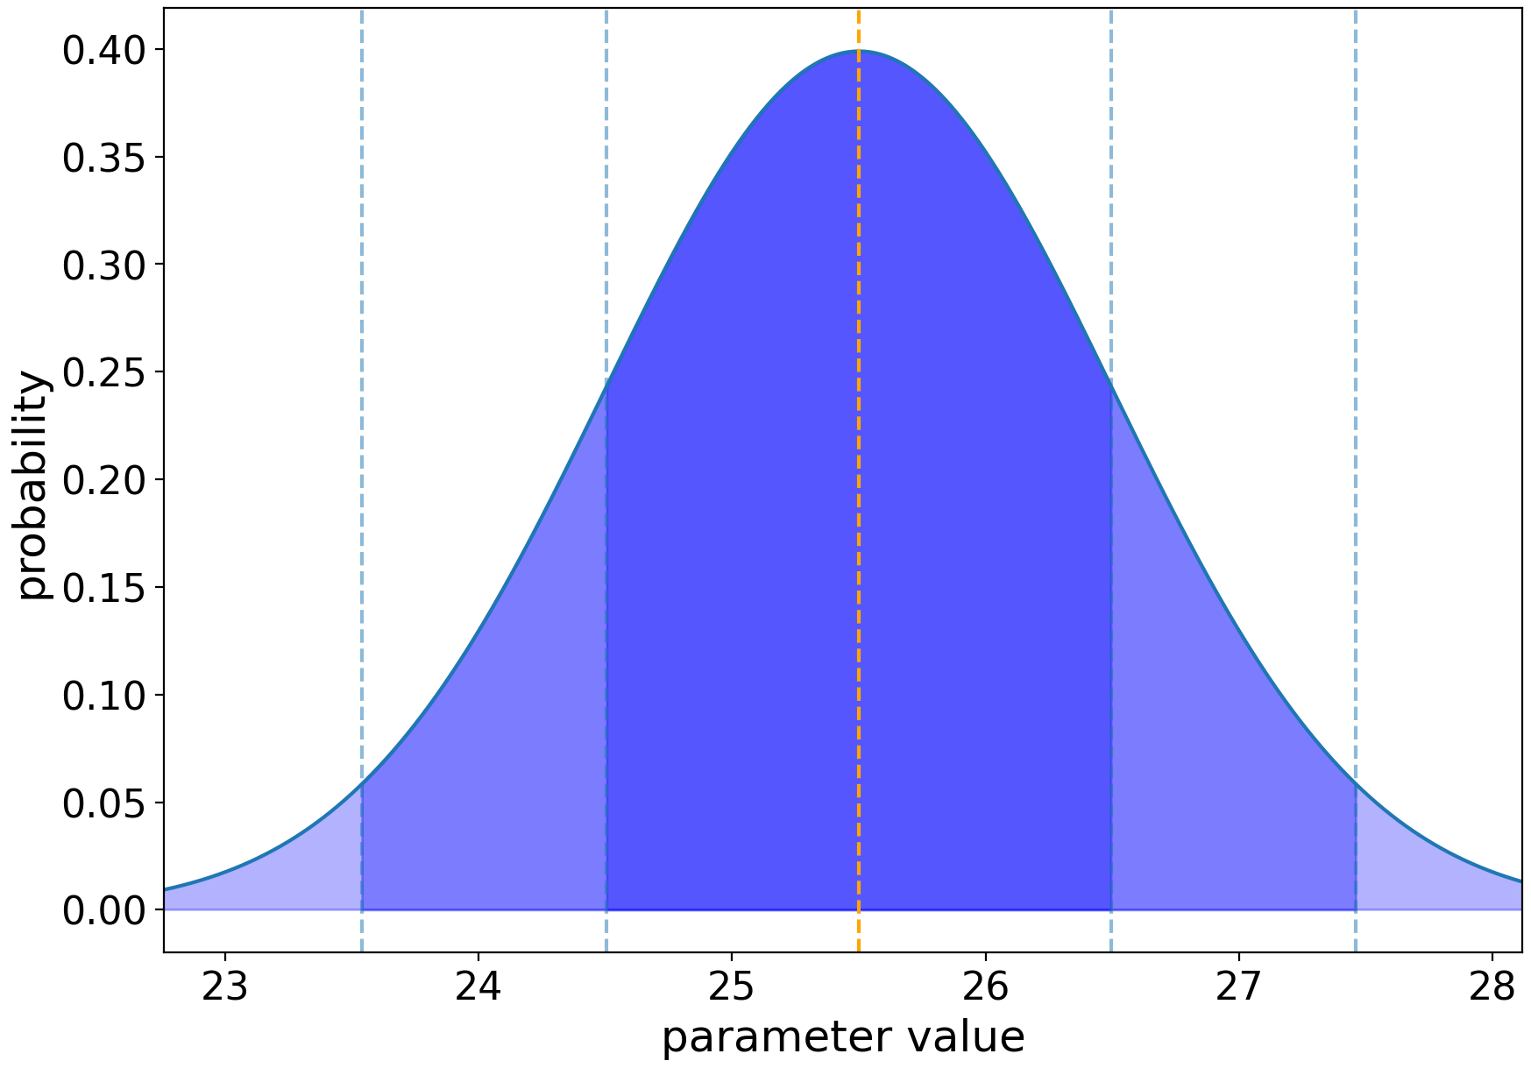
Gaussian Distribution: probabilities
area containing 68% of the probability
Recall
$$P(x)=\frac{1}{σ\sqrt{(}2π)}exp\{-(x-μ)^{2}/2σ^{2}\}$$
$$P(-t<x_{0}<t)=\frac{1}{\sqrt{2}}∫_{-t}^{t}e^{-z^{2}/2}dz$$
1$σ$ : contains 68.3% of the probability
2$σ$ : contains 95.5% of the probability
3$σ$ : contains 99.7% of the probability
5$σ$ : contains 99.99994% of the probability
WARNING: This process knows nothing about physics: beware of unphysical regions

Slide 18
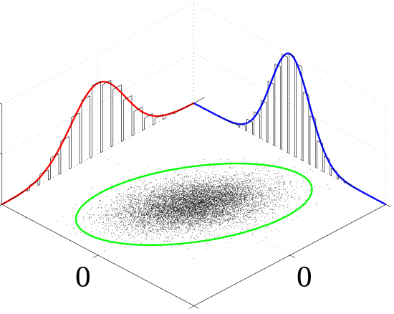
Multiple parameters: Marginalisation
Distributions are often NOT the function of 1 parameter
$$p(x,y)$$
NB: Coursework 1: is ‘happiness’ a function solely of GDP?
The probability of $x$ is calculated by integrating over $y$
$$p(x)=∫p(x,y)dy$$
NB: We wanted to measure $p(\text{happiness}|\text{GDP})$, but we measured $p(\text{happiness},\text{country}|\text{GDP})$
$p(\text{happiness}|\text{GDP})=p(\text{happiness},\text{UK}|\text{GDP})+p(\text{happiness},\text{France}|\text{GDP})+p(\text{happiness},\text{Spain}|\text{GDP})+...$

Slide 19
An aside: Covariance
Common across physics
When two measurements are not independent, we call them covariant
For two connected variables ($z=x+y$):
$$σ_{z}=\sqrt{σ_{x}^{2}+σ_{y}^{2}}$$
if $x$ is related to $y$
$$σ_{z}=\sqrt{{\left(\frac{∂z}{∂x}σ_{x}\right)}^{2}+{\left(\frac{∂z}{∂y}σ_{y}\right)}^{2}+2\frac{∂z}{∂x}\frac{∂z}{∂y}cov(x,y)}$$
$$cov(x,y)=\frac{1}{N-1}∑(x-\overset{̂}{x})(y-\overset{̂}{y})$$
NB: Parameter transformations (e.g. $y=log(x)$) change the functional form of the distribution

Slide 20
An aside: Covariance
Often expressed in matrix form:
$$\left(\begin{matrix}σ_{x}^{2} & σ_{xy} \\ σ_{xy} & σ_{y}^{2}\end{matrix}\right)$$
Variance in the diagonal terms; covariance in the off-diagonals

Slide 21
Likelihoods
Given a set of measurements $x=(x_{1},x_{2},...)$
$$L(θ|x)=\overset{N}{\underset{i=0}{∏}}P(x_{i}|θ)$$
the likelihood:
Best-fit value:
The value that maximises $L$
Plausible values:
Determined by the width of $L$
Uncertainty:
For a Gaussian distribution $1σ$

Slide 22
Log Likelihoods
Given a set of measurements $x=(x_{1},x_{2},...)$
$$ℓ(θ)=lnL(θ)=\overset{N}{\underset{i=0}{∑}}P(x_{i}|θ)$$
the log-likelihood:
Much easier to maximise
Best-fit value:
The value that maximises $ℓ$
Plausible values:
Determined by the width of $ℓ$
Uncertainty:
$ℓ=ℓ_{\text{max}}-0.5$
NB: Assumes Gaussianity

Slide 23
Assumes that our measurements are uncorrelated
Log Likelihoods: the Gaussian case
$$p(x_{i})=\frac{1}{\sqrt{2π}σ_{i}}exp\left(-\frac{(x_{i}-μ_{i}(θ))^{2}}{2σ_{i}^{2}}\right)$$
Given a set of measurements $x=(x_{1},x_{2},...)$
$$L(θ|x)=p(x_{1}|θ)*p(x_{2}|θ)*...$$
$$L(θ|x)=e^{-χ^{2}/2}*\overset{N}{\underset{i=1}{∏}}\frac{1}{σ_{i}}×(2π)^{(-N/2)}$$
$$-2lnL(θ|x)=χ^{2}+2\overset{N}{\underset{i=1}{∑}}lnσ_{i}+Nln(2π)$$
Maximising $L(θ|x)$ is equivalent to minimising $χ^{2}$

Slide 24
Confidence levels & $χ^{2}$
Note: $χ^{2}$ not $χ_{red}^{2}$
$$χ^{2}<χ_{\text{min}}^{2}+1$$
If our best-fit value has $χ^{2}=χ_{\text{min}}^{2}$:
Contours of equal probability are defined by
$$χ^{2}=χ_{\text{min}}^{2}+Δ$$
$$N_{\text{params}}$$
1
2
3
68%
95.4%
99.7%
1$σ$
2$σ$
3$σ$
1.0
4.0
9.0
2.30
6.17
11.8
3.53
8.02
14.2
CI
WARNING: This process knows nothing about physics: beware of unphysical regions

Slide 25
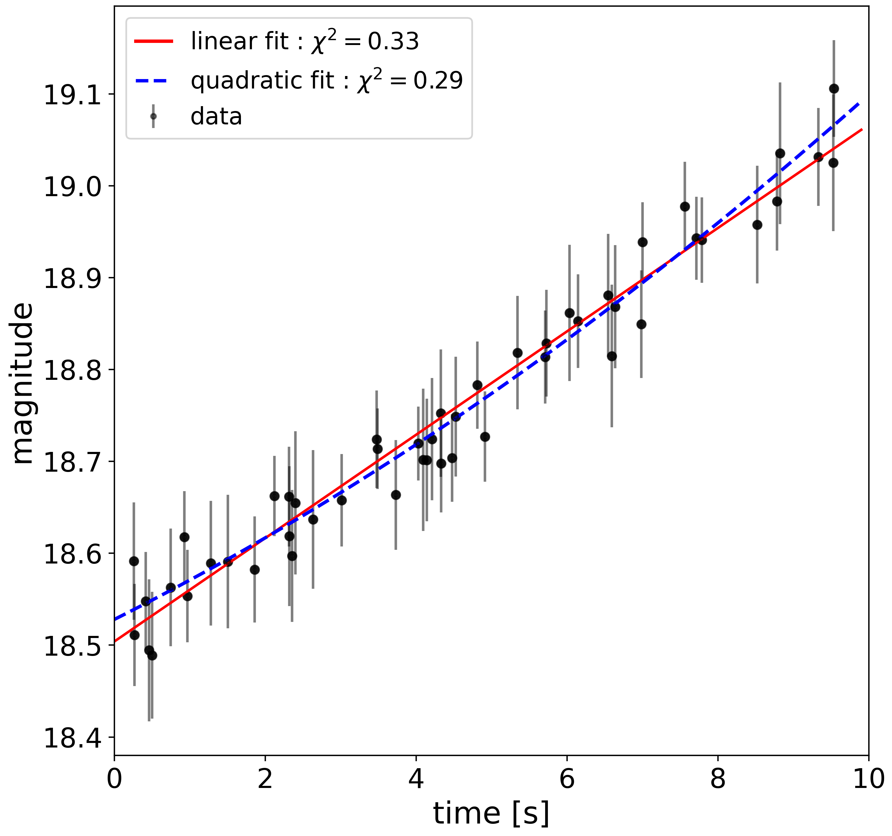
See Week 13 for the optimum way to do this
Model Selection
Given two models $M_{1},M_{2}$ how do we know which one to choose?
Recall that for a good fit, we expect: $\text{min}(χ_{\text{red}}^{2})∼1$
Akaike Information Criteria (AIC)
$$\text{AIC}=-2ln(L(θ))+2p$$
Bayes Information Criteria (BIC)
$$\text{BIC}=-2ln(L(θ))+plogN$$
($p=N_{\text{params}}$ ; $n=N_{\text{data}}$)

Slide 26
$χ^{2}$ : estimating uncertainties : bootstrapping
Resampling the data with replacement
(For a dataset with $N$ measurements)
For each of $k$ samples:
> Randomly select $N$ values
> Calculate the $χ^{2}$
Calculate the mean, and variance on $χ^{2}$
Does not assume a functional form for the distribution
NB: Can also sample from uncertainties : ‘MonteCarlo’

Slide 27
Week 12: Learning outcomes
Today you have learnt
  How to relate probabilities to measurements: the likelihood
  How to define a null hypothesis
    How to use probabilities to test our hypothesis
  Three key distributions in Physics
  Key tests of whether our hypothesis (assumptions) are correct
    Distributions: KS test
    Correlations: Spearman’s Rank
  Goodness-of-fit metrics: calculating likelihoods
    Selecting a model given a likelihood
Practical examples on Friday!

