Slide 1
PHYS465: Statistical Data Analysis in Physics Week 1: Introduction, Model fitting
Dr. Mathew Smith
mat.smith@lancaster.ac.uk
Physics Building; C46

Slide 2
General information
This is the first year that this module has been taught
Combines resources from PHYS412 combined with real-world problems
Assessment is 100% by coursework, which is built on workshop exercises
Comments/suggestions are very welcome
Office hour: C46 Physics
Fridays, 1pm
Open door policy
In person in my office
Online via Teams/email
Notes:
BDS: minor formatting/grammar edits (most obvious is I took the bullet point off the office hour text because the other entries don’t have bullets)

Slide 3
Course Structure
Weekly lectures
Monday @ 9am
Introduce key statistical concepts
Weekly workshops
Thursday @ 3pm
Problem sheets introducing key python libraries, with practical examples
Coursework problem sheets will extend this knowledge
Feedback sessions
Work through coursework solutions
Moodle quizzes based on lecture content

Slide 4
Assessment: key dates
Coursework deadlines:
Mon 20th Jan @ 4pm : week 11 content
20% of overall grade; feedback session on Fri 24th Jan
Mon 27th Jan @ 4pm : week 12 content
20% ; feedback session Fri 31st Jan
Mon 3rd Feb @ 4pm : week 13 content
20% ; feedback session Fri 7th Feb
Mon 17th Feb @ 4pm : week 14 and 15 content
40% ; summative assessment
Submission through Moodle:
Computer code and short summary of results : see Thursday / Moodle for details

Slide 5
What is the aim of this module?
This course aims to introduce and provide you with experience in using the key techniques used to analyse datasets in physics.
All of these techniques are transferable!
The focus of the module is to develop practical skills.
the theory behind the statistical concepts are complex
key concepts will be introduced.
additional reading is available to develop fundamental understanding

Slide 6
Setting the scene : what is data analysis?
The process of analysing experimental data to validate (or disfavour) a hypothesis or theory
The experimental data, and its uncertainties, have already been collected
Requires the application of statistical tools
This course will introduce the main concepts and statistical tests
The relevance of Physics:
Physics (in particular astro and particle) involve the collection of extremely large sets of data
Requires complex analysis techniques
Notes:
BDS: very minor grammar edits in the first part (commas in “experimental data, and its uncertainties” plus “it’s” —> “its”)

Slide 7
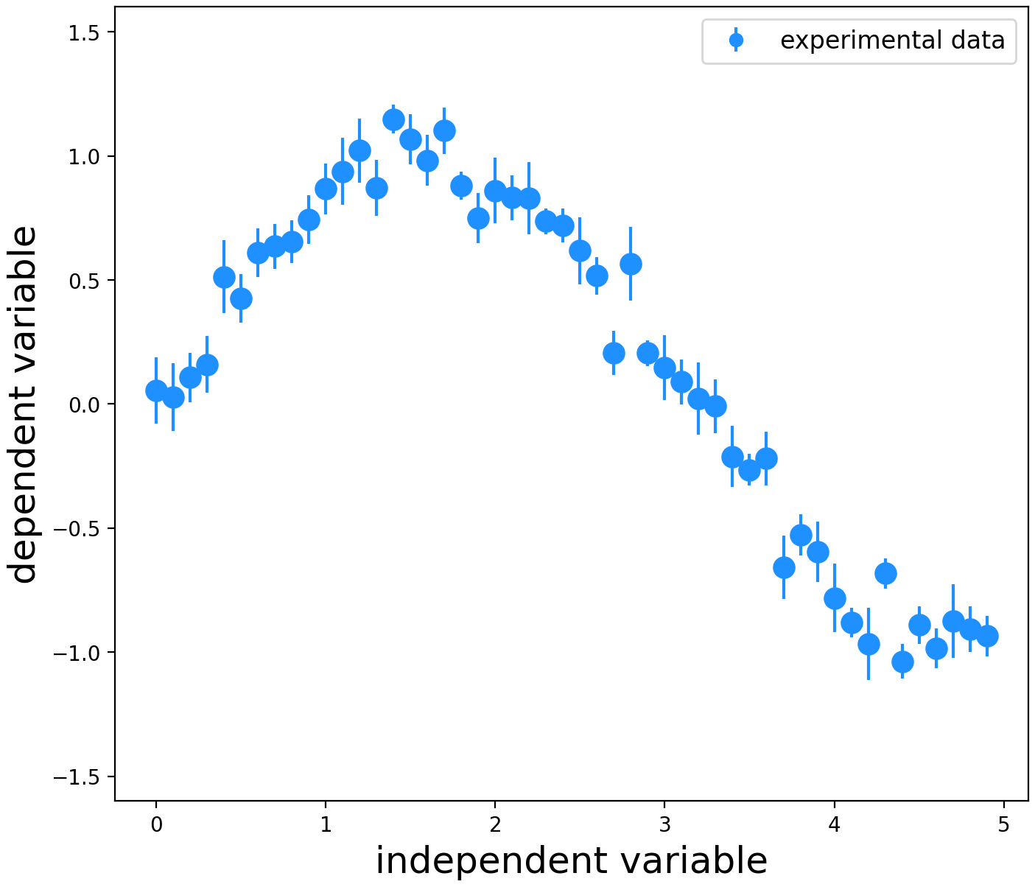
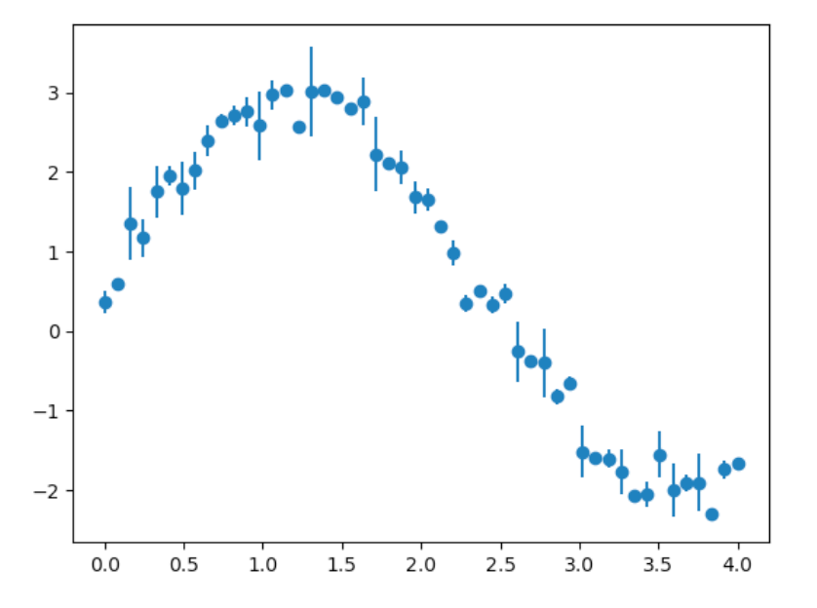
Week 11: Explaining data with models
(1) Model fitting, (2) parameter estimation and (3) hypothesis testing

Slide 8
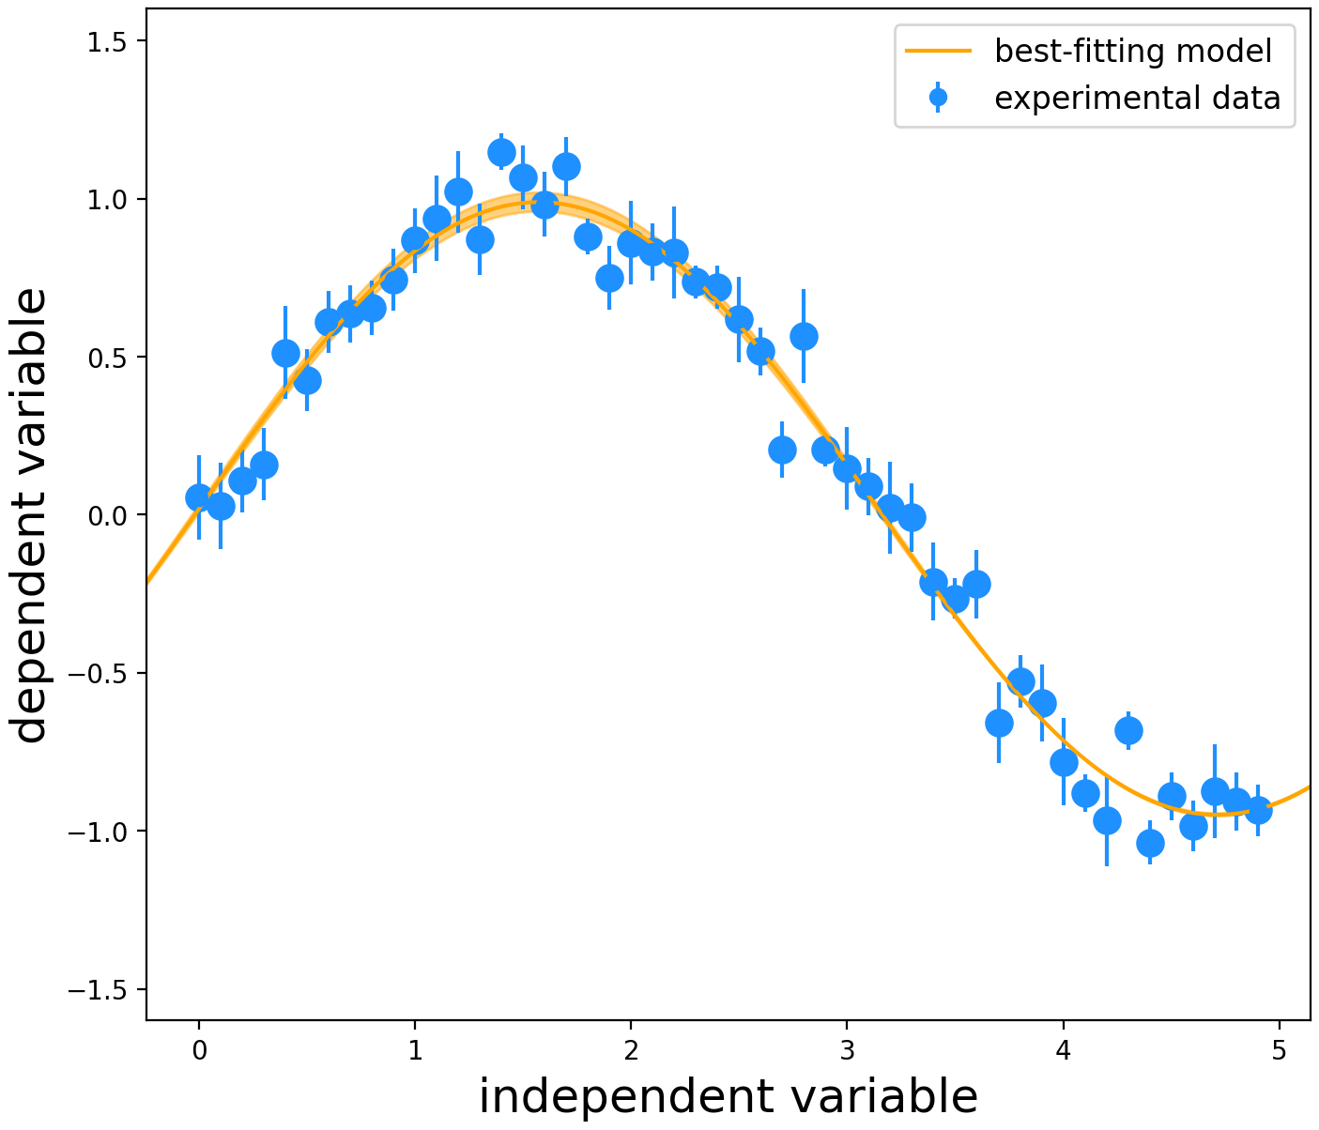
Week 11: Explaining data with models
(1) Model fitting, (2) parameter estimation and (3) hypothesis testing

Slide 9
(1) Model fitting
Given some experimental data (and measured uncertainties) compare to a defined model
Use data to deduce the relevant laws (parameters) for our experiment.
Two main foci:
Parameter estimation: Determine the numerical value of a physical quantity
Hypothesis testing: Test whether a theory is consistent with our measured data
Notes:
BDS edit: “focuses” —> “foci”
I would be delighted if “focuses” is actually a word because plurals like “foci” have always struck me as silly, but I think we have to use it

Slide 10
(2) Parameter estimation
Use the data to determine a model parameter AND its associated uncertainty in an efficient and unbiased manner.
i.e. Use data to calculate/obtain a value for a free (unknown) parameter
e.g. given a set of astrophysical distances what is the amount of matter in the Universe?
—
Unbiased = the planned method will, on average, give the correct result
Efficient = Matching the experimental data and model to the analysis method.
Intricate and expensive methods are only necessary for complex models and datasets.
Notes:
BDS edit: moved the last sentence on the slide into its own line

Slide 11
(3) Hypothesis testing
Determine whether our data is consistent with a specific hypothesis
Is the data we obtain in our experiment consistent with a given theory?
e.g. how does the measured energy spectrum compare with the prediction
—
Does not take the form of a simple “yes/no” answer.
Answer will be yes or no accompanied by a statement of confidence.
Given multiple models, determine the model that best describes our measurements
In the coming weeks we will explore several methods for hypothesis testing and parameter estimation.

Slide 13
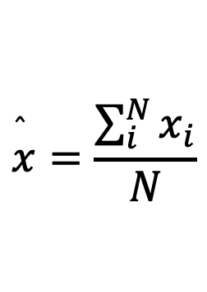

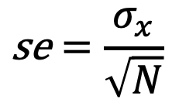
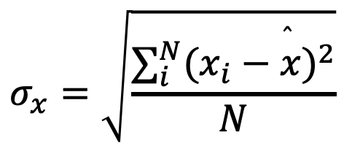
Getting started: What is a measurement?
Repeating an experiment doesn’t always give the same result. Variation in the experiment will produce a distribution of answers.
$$x=[26,24,26,28,23,24,25,24,26,25]$$
In previous years, you have learnt that multiple measurements can be summarised through:
$$\overset{̂}{x}=\frac{\sum_{i}^{N}{x_{i}}}{N}$$
$$σ_{x}=\sqrt{\frac{∑_{i}^{N}(x_{i}−\overset{̂}{x})^{2}}{N}}$$
$$\text{se}=\frac{σ_{x}}{\sqrt{N}}$$
mean: ‘most likely value’
standard deviation: ‘dispersion’
standard error on mean
As we are testing physical systems there is a ground-truth. The values we measure are drawn from an underlying distribution.
There are many different distributions (see next week) depending on what is being tested and how

Slide 14
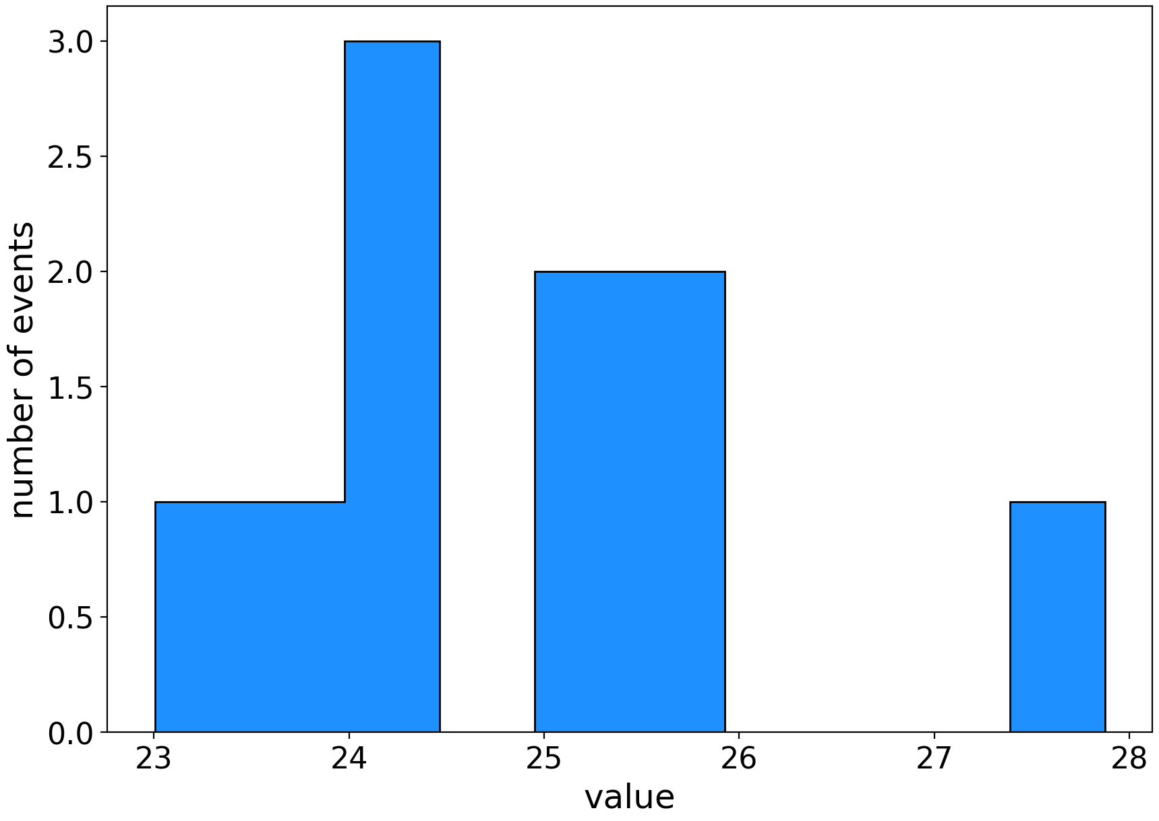
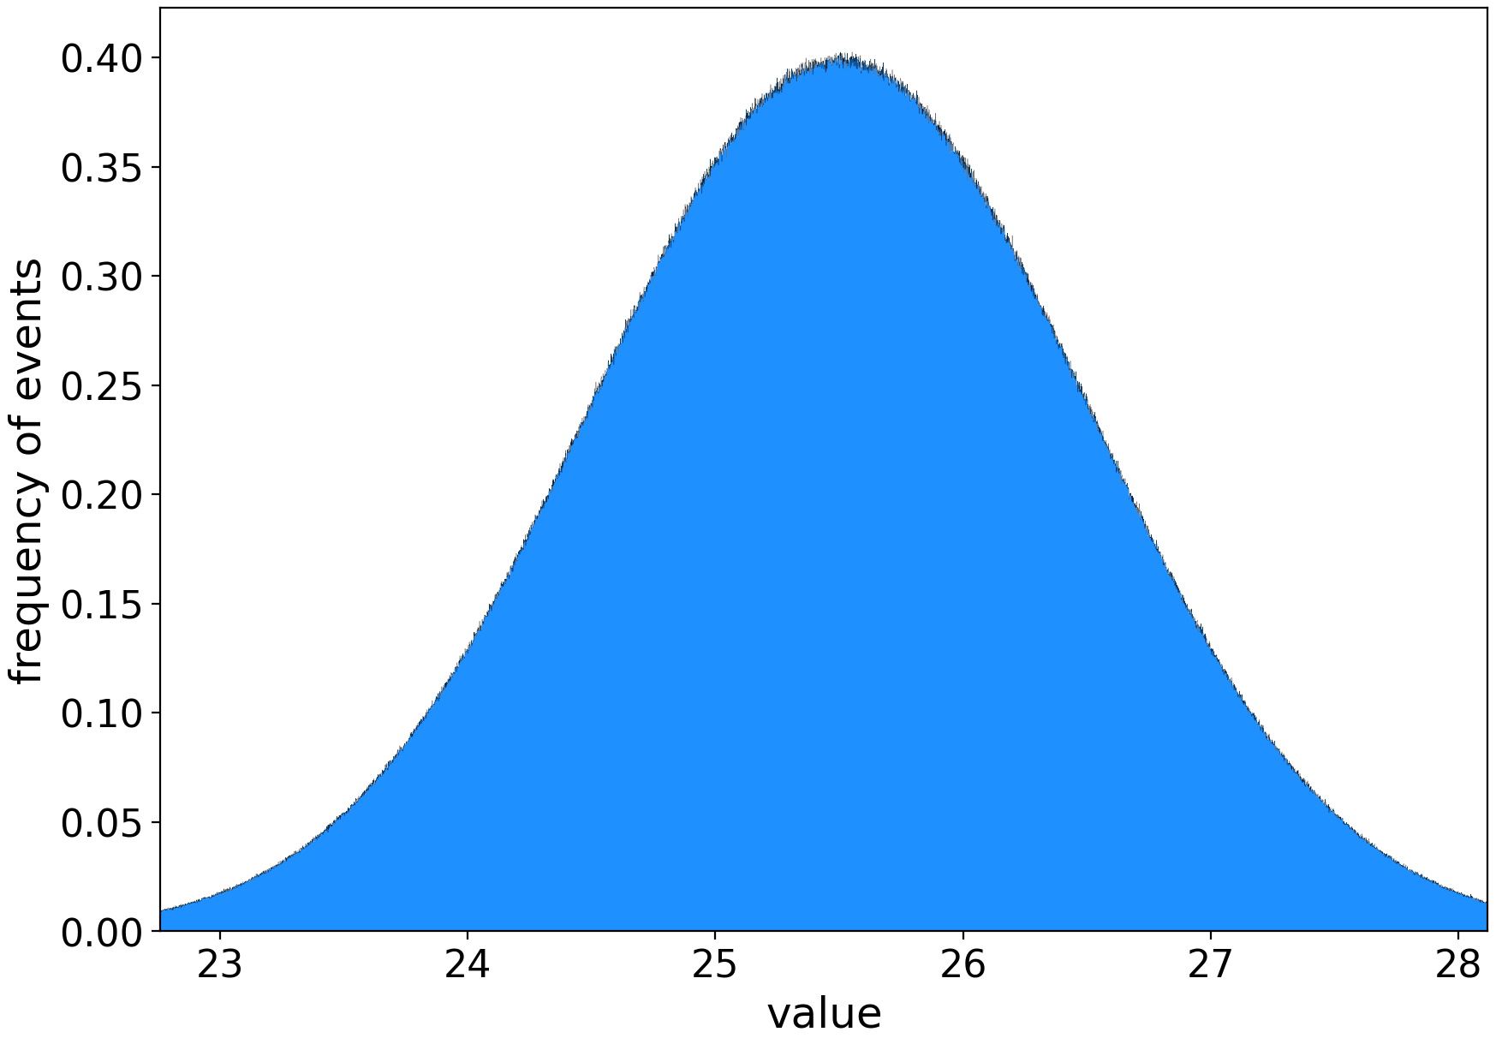
Distributions
In physics, values and functions are rarely discrete, they are continuous
counts = number of measurements in each bin
frequency = fraction of measurements in each bin
area under the curve sums to total(counts)
area under the curve sums to 1
Notes:
BDS note: frequency isn’t labelled on the plot where its meaning is described in text, and the description isn’t obviously consistent with the values on the y-axis of the plot that does have that label.

Slide 15
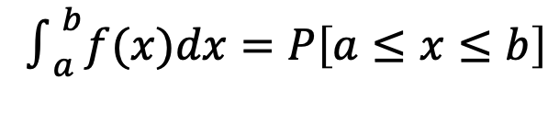

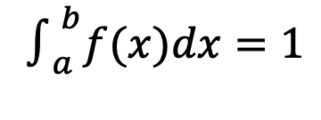
Probability density function (pdf)
Consider a continuous function $f(x)$
The probability density function is defined as the probability that the variate has a given value $x.$
This is often expressed as the integral between two points
The function must be normalised such that
$$∫_{a}^{b}f(x)dx=P\left[a≤x≤b\right]$$
A normalised histogram approaches the PDF
when the variable is continuous
$$∫_{a}^{b}f(x)dx=1$$
We use the PDF to estimate the probability
that a variable falls in a given range

Slide 16
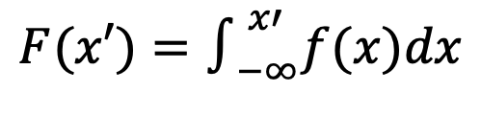
Cumulative density function (cdf)
Tells us the percentile that a parameter value represents
$$F(x′)=∫_{−∞}^{x′}f(x)dx$$
i.e. $F(x′)=0.6$ means that 60% of the probability lies $≤x′$
So the CDF returns the expected probability of observing a value less than or equal to the given value

Slide 17
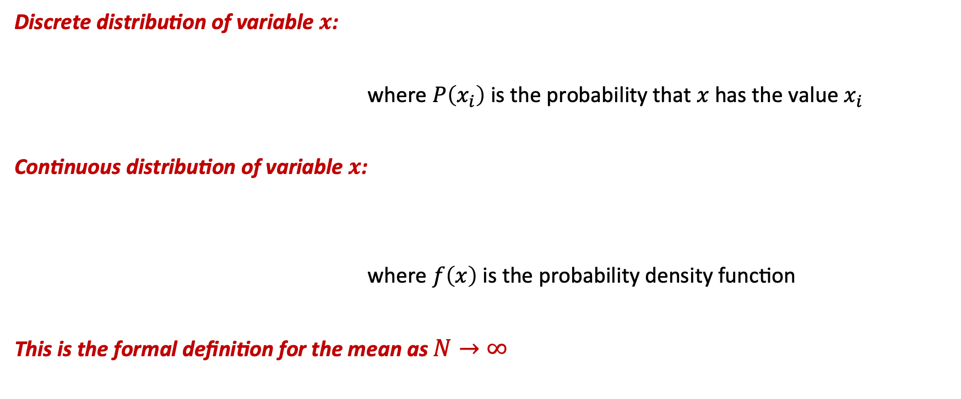
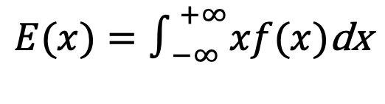
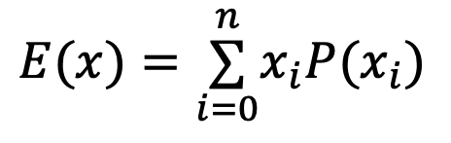
Expectation values
$$E(x)=\overset{n}{\underset{i=0}{∑}}x_{i}P(x_{i})$$
Discrete distribution of variable $x$:
where $P\left(x_{i}\right)$ is the probability that $x$ has the value $x_{i}$
Continuous distribution of variable $x$:
where $f\left(x\right)$ is the probability density function
This is the formal definition for the mean as $N→∞$
$$E(x)=∫_{−∞}^{+∞}xf(x)\text{dx}$$
Notes:
BDS note: what’s capital X? (second equation)

Slide 18
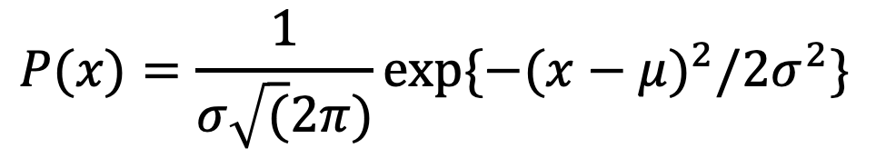


Gaussian distribution
aka a normal distribution
$$P(x)=\frac{1}{σ\sqrt{(}2π)}exp\{−(x−μ)^{2}/2σ^{2}\}$$
Expectation value:
$$E(x)=μ$$
Standard deviation:
$$σ_{x}=σ$$
A Gaussian distribution is the “high-N” limit for the Binomial and Poisson distributions (see Week 12)
The central limit theorem: states if the average is taken of variables drawn many times for ANY probability distributions, the resulting average will follow a Gaussian.
Practically, if we take a lot of data (N>30), our sample will resemble a normal distribution
Notes:
BDS note: the word “practically” has been used twice in quick succession and I’m just noting it to check it’s intentional :)

Slide 19
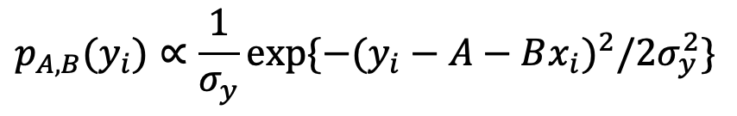
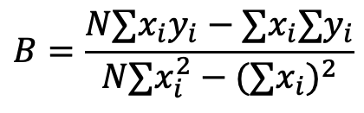

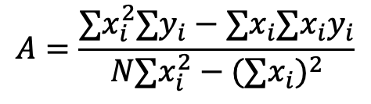
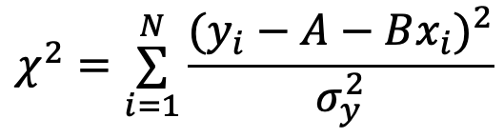
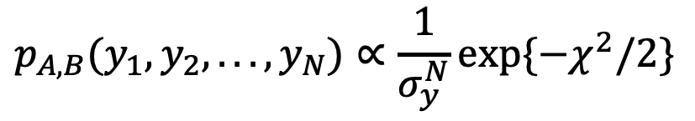
(2). Parameter estimation : least squares
NB: for straight-line model ($y=A+Bx$), this is known as ‘linear regression’
For one measured data point $(x_{i},y_{i})$ that is drawn from a Gaussian distribution:
$$p_{A,B}(y_{i})∝\frac{1}{σ_{y}}exp\{−(y_{i}−A−Bx_{i})^{2}/2σ_{y}^{2}\}$$
Over the entire data set:
$$p_{A,B}(y_{1},y_{2},...,y_{N})∝\frac{1}{σ_{y}^{N}}exp\{−χ^{2}/2\}$$
$$χ^{2}=\overset{N}{\underset{i=1}{∑}}\frac{(y_{i}−A−Bx_{i})^{2}}{σ_{y}^{2}}$$
‘Least-squares’ : $p_{A,B}$ is maximised when $χ^{2}$ is smallest
$$A=\frac{∑x_{i}^{2}∑y_{i}−∑x_{i}∑x_{i}y_{i}}{N∑x_{i}^{2}−(∑x_{i})^{2}}$$
$$B=\frac{N∑x_{i}y_{i}−∑x_{i}∑y_{i}}{N∑x_{i}^{2}−(∑x_{i})^{2}}$$
Linear equation:

Slide 20
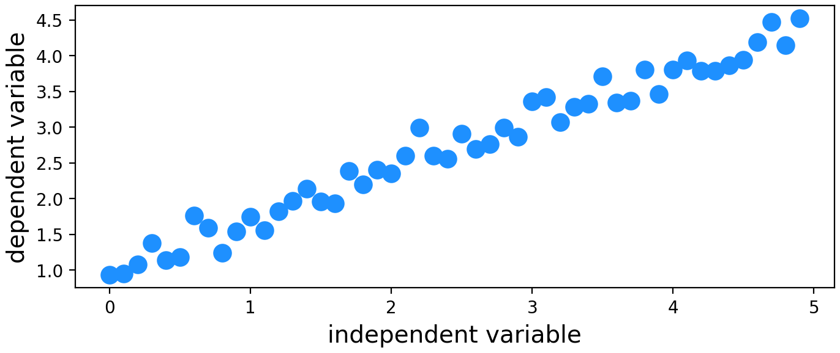
Considering uncertainties
The least-squares formula does not consider uncertainties
Most sciences do not measure uncertainties : e.g. population studies, medical diagnoses, clime science
uncertainties can be inferred through the variance of the data
Most physics experiments do have uncertainties:
Identical for every point (e.g. systematic): homoscedastic
(see Week 12)
Different for every point (e.g. statistical): heteroscedastic
Notes:
BDS note: I anticipate lots of questions about what is heteroscedastic

Slide 21
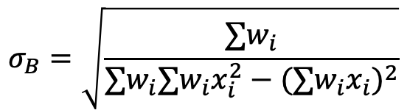

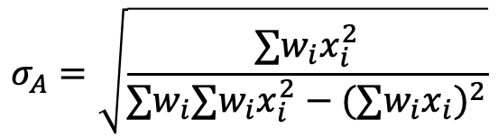
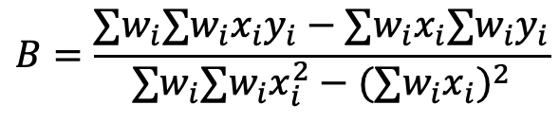
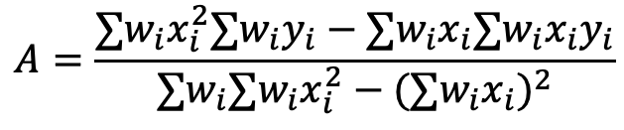
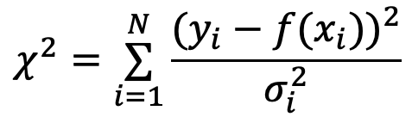
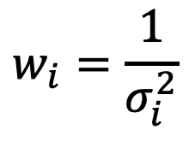
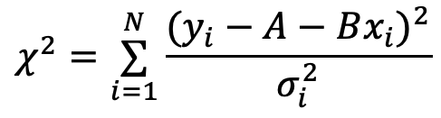
Including uncertainties
$$w_{i}=\frac{1}{σ_{i}^{2}}$$
Uncertainties can be re-purposed as weights:
“inverse variance”
$$χ^{2}=\overset{N}{\underset{i=1}{∑}}\frac{(y_{i}−A−Bx_{i})^{2}}{σ_{i}^{2}}$$
$$χ^{2}=\overset{N}{\underset{i=1}{∑}}\frac{(y_{i}−f(x_{i}))^{2}}{σ_{i}^{2}}$$
Minimising the $χ^{2}$ :
or
This is a solved problem for linear relationships : for complex functions we need to use minimising techniques
$$A=\frac{∑w_{i}x_{i}^{2}∑w_{i}y_{i}−∑w_{i}x_{i}∑w_{i}x_{i}y_{i}}{∑w_{i}∑w_{i}x_{i}^{2}−(∑w_{i}x_{i})^{2}}$$
$$B=\frac{∑w_{i}∑w_{i}x_{i}y_{i}−∑w_{i}x_{i}∑w_{i}y_{i}}{∑w_{i}∑w_{i}x_{i}^{2}−(∑w_{i}x_{i})^{2}}$$
$$σ_{A}=\sqrt{\frac{∑w_{i}x_{i}^{2}}{∑w_{i}∑w_{i}x_{i}^{2}−(∑w_{i}x_{i})^{2}}}$$
$$σ_{B}=\sqrt{\frac{∑w_{i}}{∑w_{i}∑w_{i}x_{i}^{2}−(∑w_{i}x_{i})^{2}}}$$
Notes:
BDS note: I anticipate lots of questions about what is heteroscedastic

Slide 22
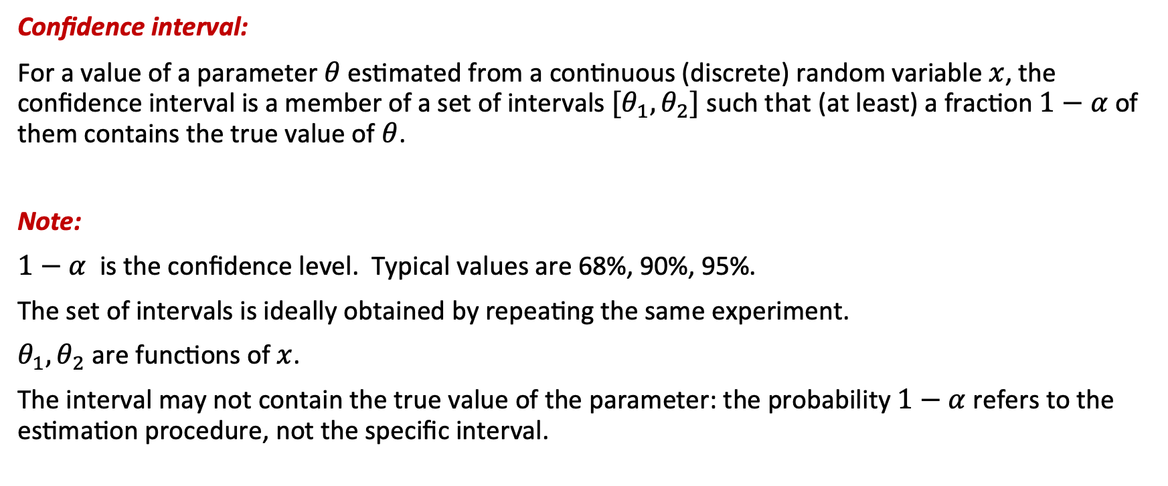
Confidence interval
The range of parameter values that are plausible given our dataset
Confidence interval:
For a value of a parameter $θ$ estimated from a continuous (discrete) random variable $x$, the confidence interval is a member of a set of intervals $[θ_{1},θ_{2}]$ such that (at least) a fraction $1−α$ of them contains the true value of $θ$.
Note:
$1−α$ is the confidence level. Typical values are 68%, 90%, 95%.
The set of intervals is ideally obtained by repeating the same experiment.
$θ_{1},θ_{2}$ are functions of $x$.
The interval may not contain the true value of the parameter: the probability $1−α$ refers to the estimation procedure, not the specific interval.
If we repeat an experiment millions of times, the will result in X% CI, X% of the time
Notes:
BDS: minor, changed 1st line “parameters values” —> “parameter values”

Slide 23
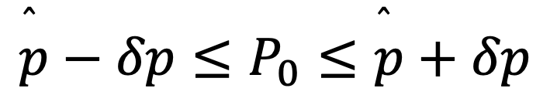
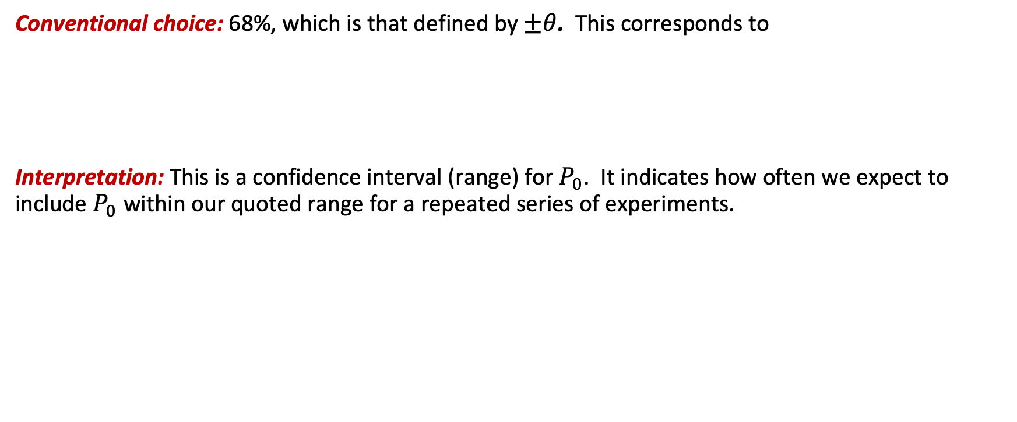
Confidence Interval
Conventional choice: 68%, which is that defined by $±θ$. This corresponds to
Interpretation: This is a confidence interval (range) for $P_{0}$. It indicates how often we expect to include $P_{0}$ within our quoted range for a repeated series of experiments.
$$\overset{̂}{p}−δp≤P_{0}≤\overset{̂}{p}+δp$$

Slide 24

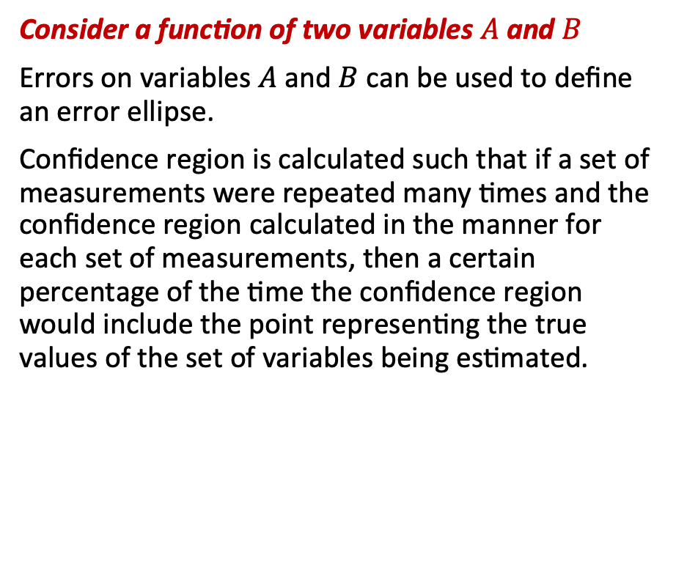

Confidence levels – more than one variable
Consider a function of two variables $A$ and $B$
Errors on variables $A$ and $B$ can be used to define an error ellipse.
Confidence region is calculated such that if a set of measurements were repeated many times and the confidence region calculated in the manner for each set of measurements, then a certain percentage of the time the confidence region would include the point representing the true values of the set of variables being estimated.
$$σ_{1}$$
$$σ_{2}$$

Slide 25
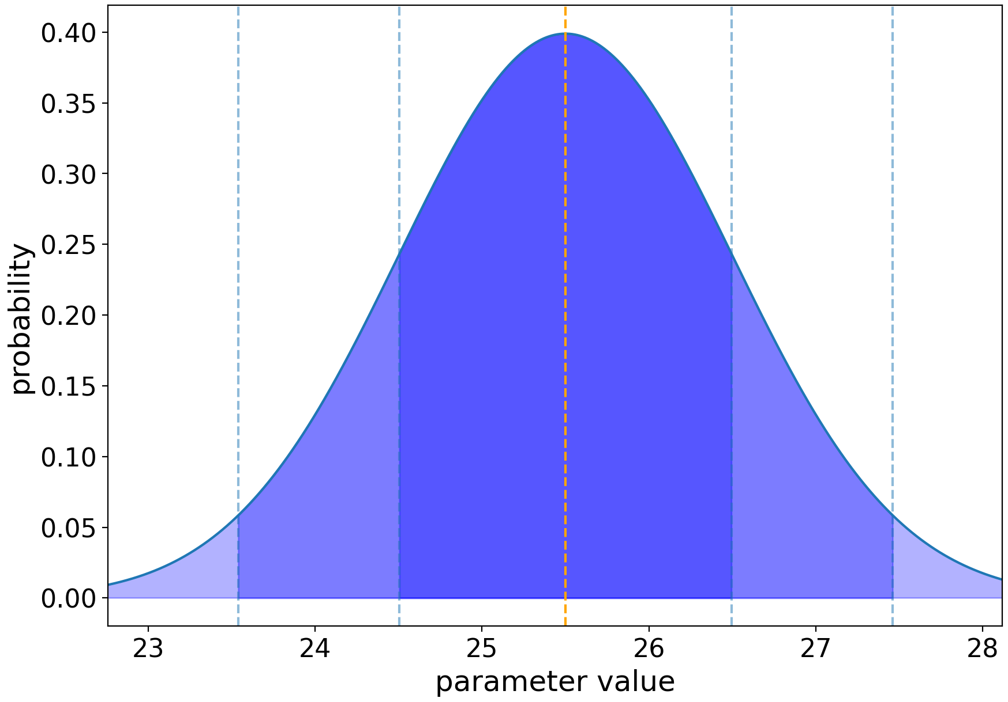

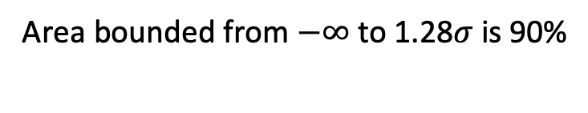



Confidence levels and sigma
area containing 68% of the probability
Commonly used values:
1$σ$ : area bounded from -1$σ$ to +1$σ$
contains 68.3% of the probability
2$σ$ : area bounded from -2$σ$ to +2$σ$
contains 95.5% of the probability
3$σ$ : area bounded from -3$σ$ to +3$σ$
contains 99.7% of the probability
5$σ$ : “discovery threshold” : 99.99994%!
Area bounded from $−∞$ to 1.28$σ$ is 90%

Slide 26






Confidence levels & $χ^{2}$
$$χ^{2}<χ_{\text{min}}^{2}+1$$
If our best-fit value has $χ^{2}=χ_{\text{min}}^{2}$:
Contours of equal probability are defined by
$$χ^{2}=χ_{\text{min}}^{2}+Δ$$
$$N_{\text{params}}$$
1
2
3
68%
95.4%
99.7%
1$σ$
2$σ$
3$σ$
1.0
4.0
9.0
2.30
6.17
11.8
3.53
8.02
14.2
CI

Slide 27
(3) Hypothesis testing
Plenty more on hypothesis testing next week
How good is the model?
Fundamental question: Is the model that we are testing a good fit to our measured data?
Is there a more likely alternative?
Null Hypothesis:
Our starting assumption
Can be either parameter values or choice of model
In practice:
Compares our assumption (or prediction) with experimental measurements e.g. does the luminosity distribution of galaxies match a Schechter function?
Outcome:
Make a statement on the probability of obtaining our result (see confidence level slides).

Slide 28
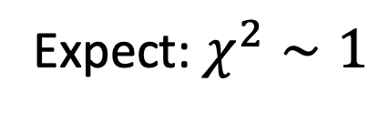


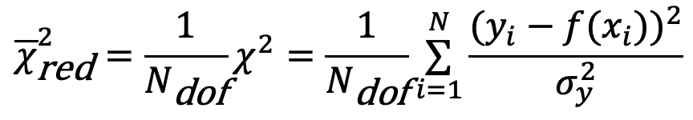
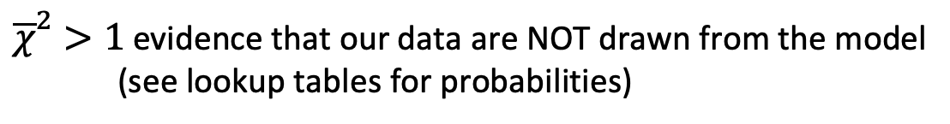
Goodness-of-fit: Reduced $χ^{2}$ test
Plenty more on hypothesis testing next week
To determine if our fitted model is a good match to the data we apply a $χ^{2}$-test:
$${\overline{χ}}_{\text{red}}^{2}=\frac{1}{N_{\text{dof}}}χ^{2}=\frac{1}{N_{\text{dof}}}\overset{N}{\underset{i=1}{∑}}\frac{(y_{i}−f(x_{i}))^{2}}{σ_{y}^{2}}$$
$$N_{\text{dof}}=N_{\text{data}}−N_{\text{params}}$$
Recall (slide 21) that to determine the best-fit in the least-squares process we minimised $χ^{2}$
Interpretation:
If our data points are drawn from the model and follow a normal distribution
${\overline{χ}}^{2}>1$ evidence that our data are NOT drawn from the model
(see lookup tables for probabilities)
Expect: $χ^{2}∼1$
${\overline{χ}}^{2}<1$ evidence that the model has too much freedom
Notes:
BDS note: is it worth throwing in a reference to the previous slides on chi^2?

Slide 29
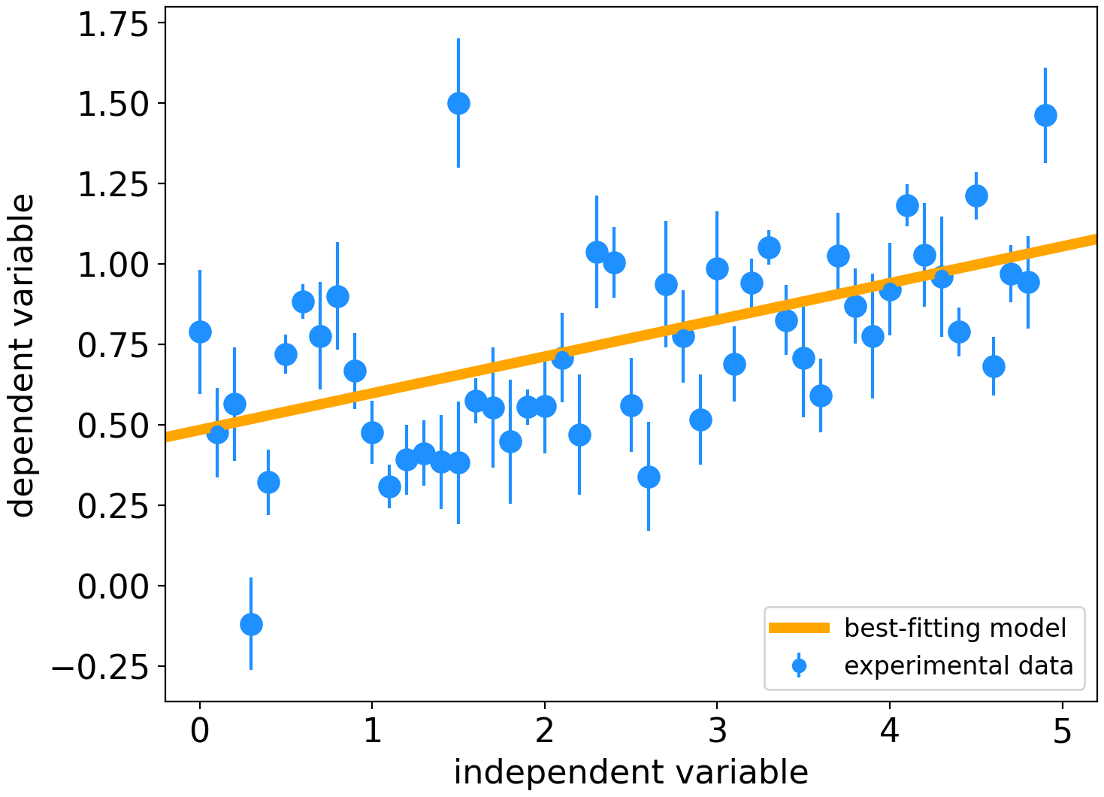


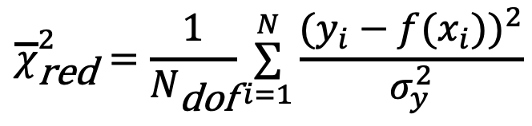

The $χ^{2}$ test : practical implications
$$σ_{y}$$
$$y_{i}−f(x_{i})$$
$${\overline{χ}}_{\text{red}}^{2}=\frac{1}{N_{\text{dof}}}\overset{N}{\underset{i=1}{∑}}\frac{(y_{i}−f(x_{i}))^{2}}{σ_{y}^{2}}$$
A measure of the averaged normalised distance to the best-fit model
Notes:
BDS: made plot bigger

Slide 30
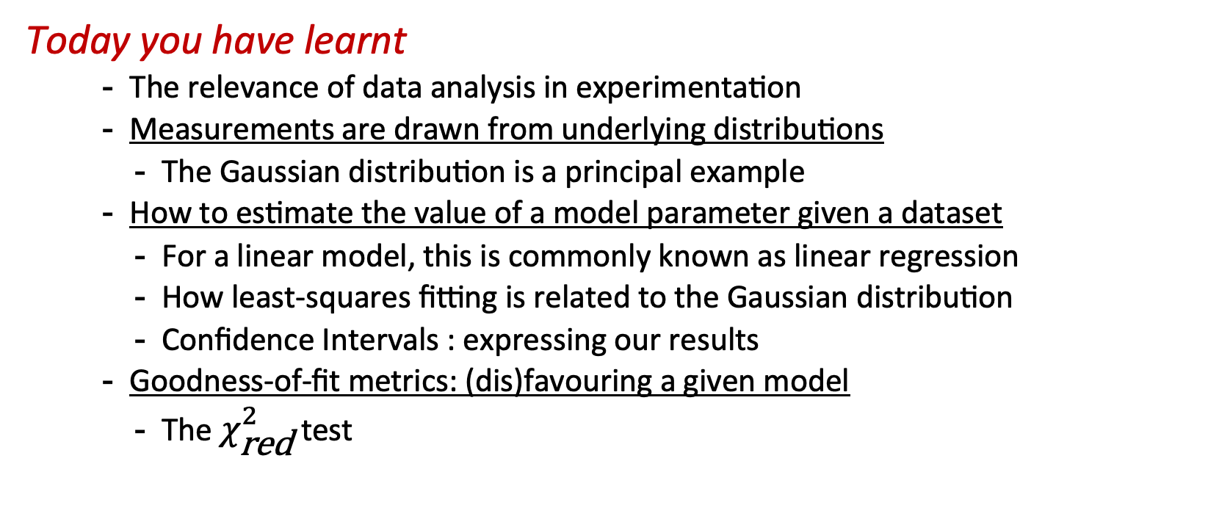
Week 11: Learning outcomes
Today you have learnt
The relevance of data analysis in experimentation
Measurements are drawn from underlying distributions
The Gaussian distribution is a principal example
How to estimate the value of a model parameter given a dataset
For a linear model, this is commonly known as linear regression
How least-squares fitting is related to the Gaussian distribution
Confidence Intervals : expressing our results
Goodness-of-fit metrics: (dis)favouring a given model
The $χ_{\text{red}}^{2}$ test
Practical examples on Thursday!
Notes:
BDS: minor, capitalised Gaussian the second time

