Slide 1
PHYS465: Statistical Data Analysis in Physics Week 2: Hypothesis Testing, Common distributions, Model testing
Dr. Mathew Smith
mat.smith@lancaster.ac.uk
Physics Building; C46

Slide 2
Week 12: Learning aims
Today we will introduce
Probabilities and how they relate to measurements
The Null Hypothesis
And how to test it
How our experiment will change how the data is distributed
How to test which distribution is correct
How to select which model is most likely
Practical examples on Thursday!
Notes:
BDS: minor, capitalised Gaussian the second time

Slide 3
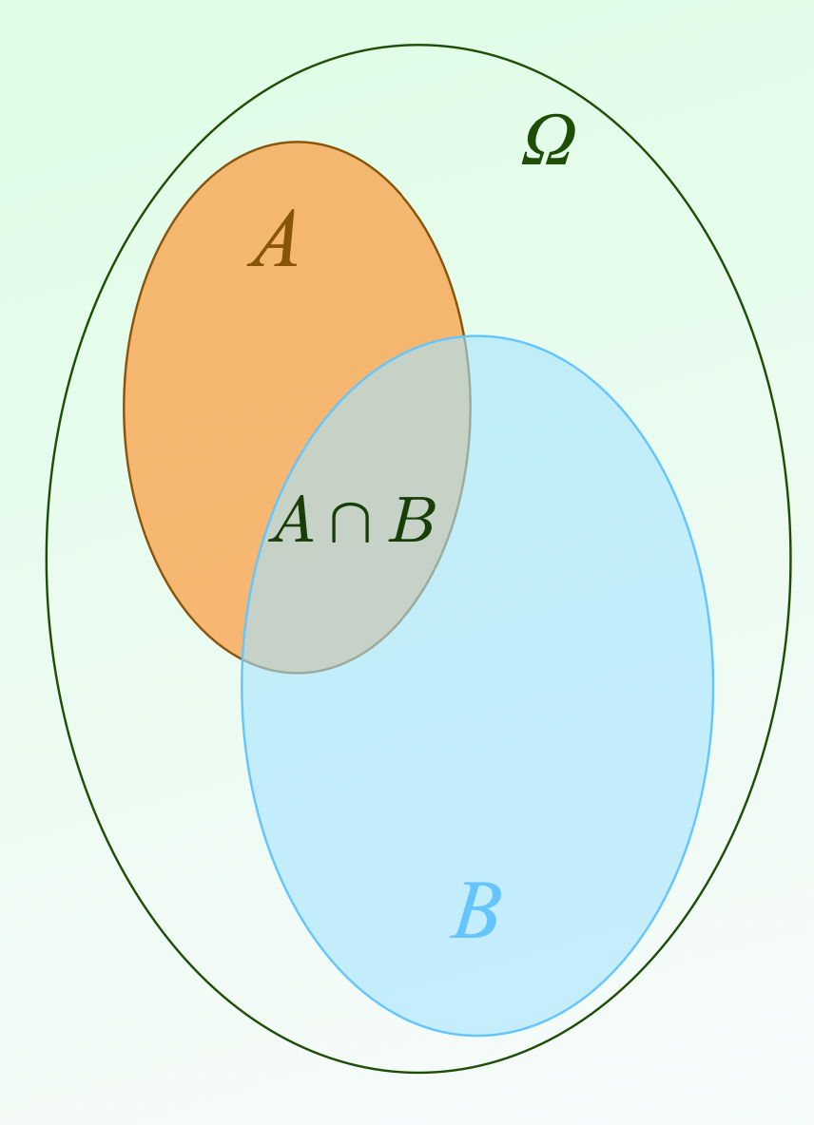




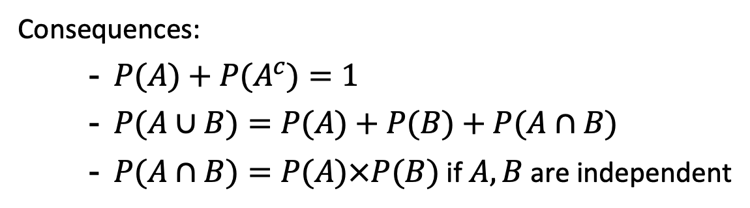
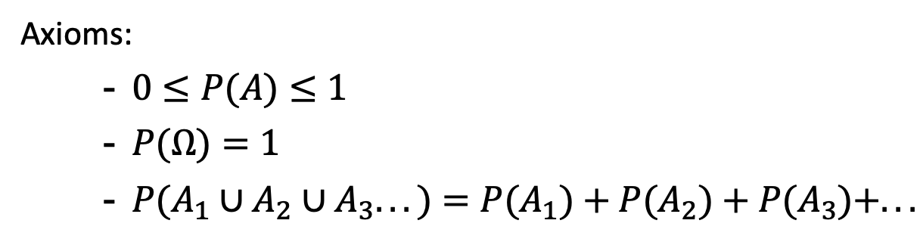

Revision: Probabilities
Given an experiment:
$Ω$is the list of all possible outcomes
$$Ω$$
$$\text{A}$$
Axioms:
$0≤P(A)≤1$
$P(Ω)=1$
$P(A_{1}∪A_{2}∪A_{3}...)=P(A_{1})+P(A_{2})+P(A_{3})+...$
$$\text{A}∩\text{B}$$
Consequences:
$P(A)+P(A^{c})=1$
$P(A∪B)=P(A)+P(B)+P(A∩B)$
$P(A∩B)=P(A)×P(B)$ if $A,B$ are independent
$$\text{B}$$

Slide 4
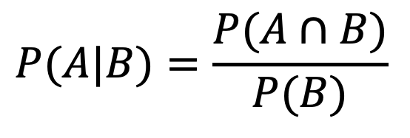

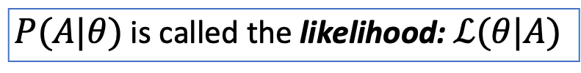
Conditional Probabilities
$$P(A|B)=\frac{P(A∩B)}{P(B)}$$
$$Ω$$
$$\text{A}$$
The probability of $A$ given $B$ (an event or condition)
$$\text{A}∩\text{B}$$
when $θ$ is a model, or parameter
$P(A|θ)$ is called the likelihood: $ℒ(θ|A)$
$$\text{B}$$
“the likelihood of obtaining the data ‘A’ given the model”
Notes:
Conditional probabilities will come with Bayes

Slide 5
Hypothesis testing
How good is the model?
Fundamental question: Is the model that we are testing a good fit to our measured data?
Is there a more likely alternative?
Null Hypothesis:
Our starting assumption
Can be either parameter values or choice of model
In practice:
Compares our assumption (or prediction) with experimental measurements e.g. does the luminosity distribution of galaxies match a Schechter function?
Outcome:
Make a statement on the probability of obtaining our result (see confidence level slides).

Slide 6


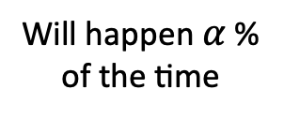



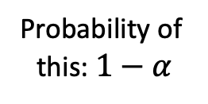


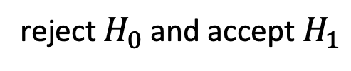



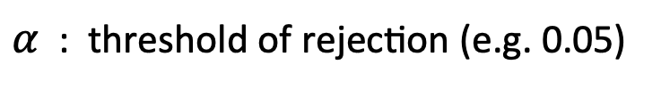

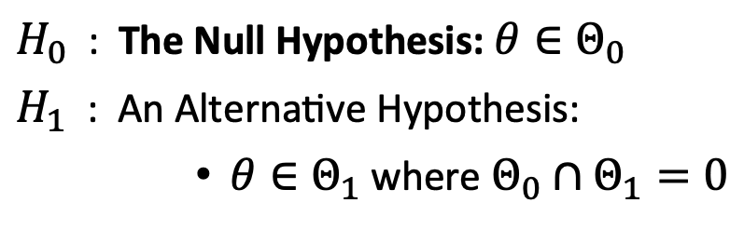
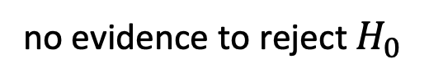

Null Hypothesis testing
e.g. Given a model $f(θ)$, with parameter $θ$, is the value of $θ$ in a set of possible values $Θ_{0}$?
$H_{0}$ : The Null Hypothesis: $θ∈Θ_{0}$
$H_{1}$ : An Alternative Hypothesis:
$θ∈Θ_{1}$ where $Θ_{0}∩Θ_{1}=0$
Outcome
$H_{0}$ not rejected
$H_{0}$ rejected
Type $I$ error
$α$ : threshold of rejection (e.g. 0.05)
Probability of
this: $1−α$
Will happen $α$ %
of the time
$H_{0}$ is true
With new observations $X$, such that $p(X,θ)$
Truth
reject $H_{0}$ and accept $H_{1}$
Type $II$ error
$$p(X)<α$$
$P_{H_{1}}(H_{0}\text{is} \text{rejected})$
$=β$
$H_{1}$ is true
Happens $1−β$ %
of the time
$$p(X)>α$$
no evidence to reject $H_{0}$
(N.B. This is not the same as accepting $H_{0}$)
Notes:
Note that p<X does not mean accept another model
We can design our experiment around this requirement

Slide 7

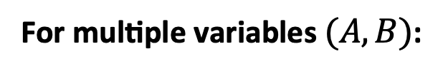
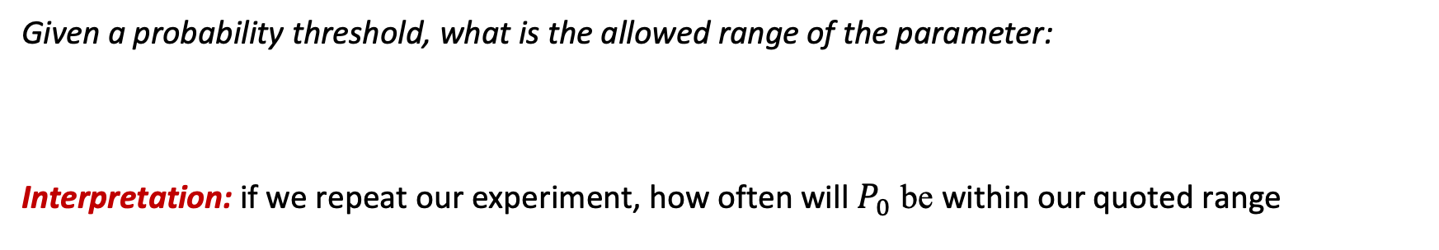
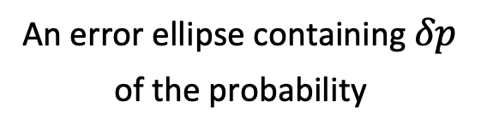


Confidence Intervals
Given a probability threshold, what is the allowed range of the parameter:
Interpretation: if we repeat our experiment, how often will $P_{0}$ be within our quoted range
For multiple variables $(A,B)$:
An error ellipse containing $δp$
of the probability
$$A$$
Typical values are 68%, 90%, 95%.
$$B$$

Slide 8

Key Assumption:
The probability, $p$, needed for Hypothesis testing and confidence intervals depend on how the data and model are distributed
Are they both drawn from a Gaussian distribution?

Slide 9
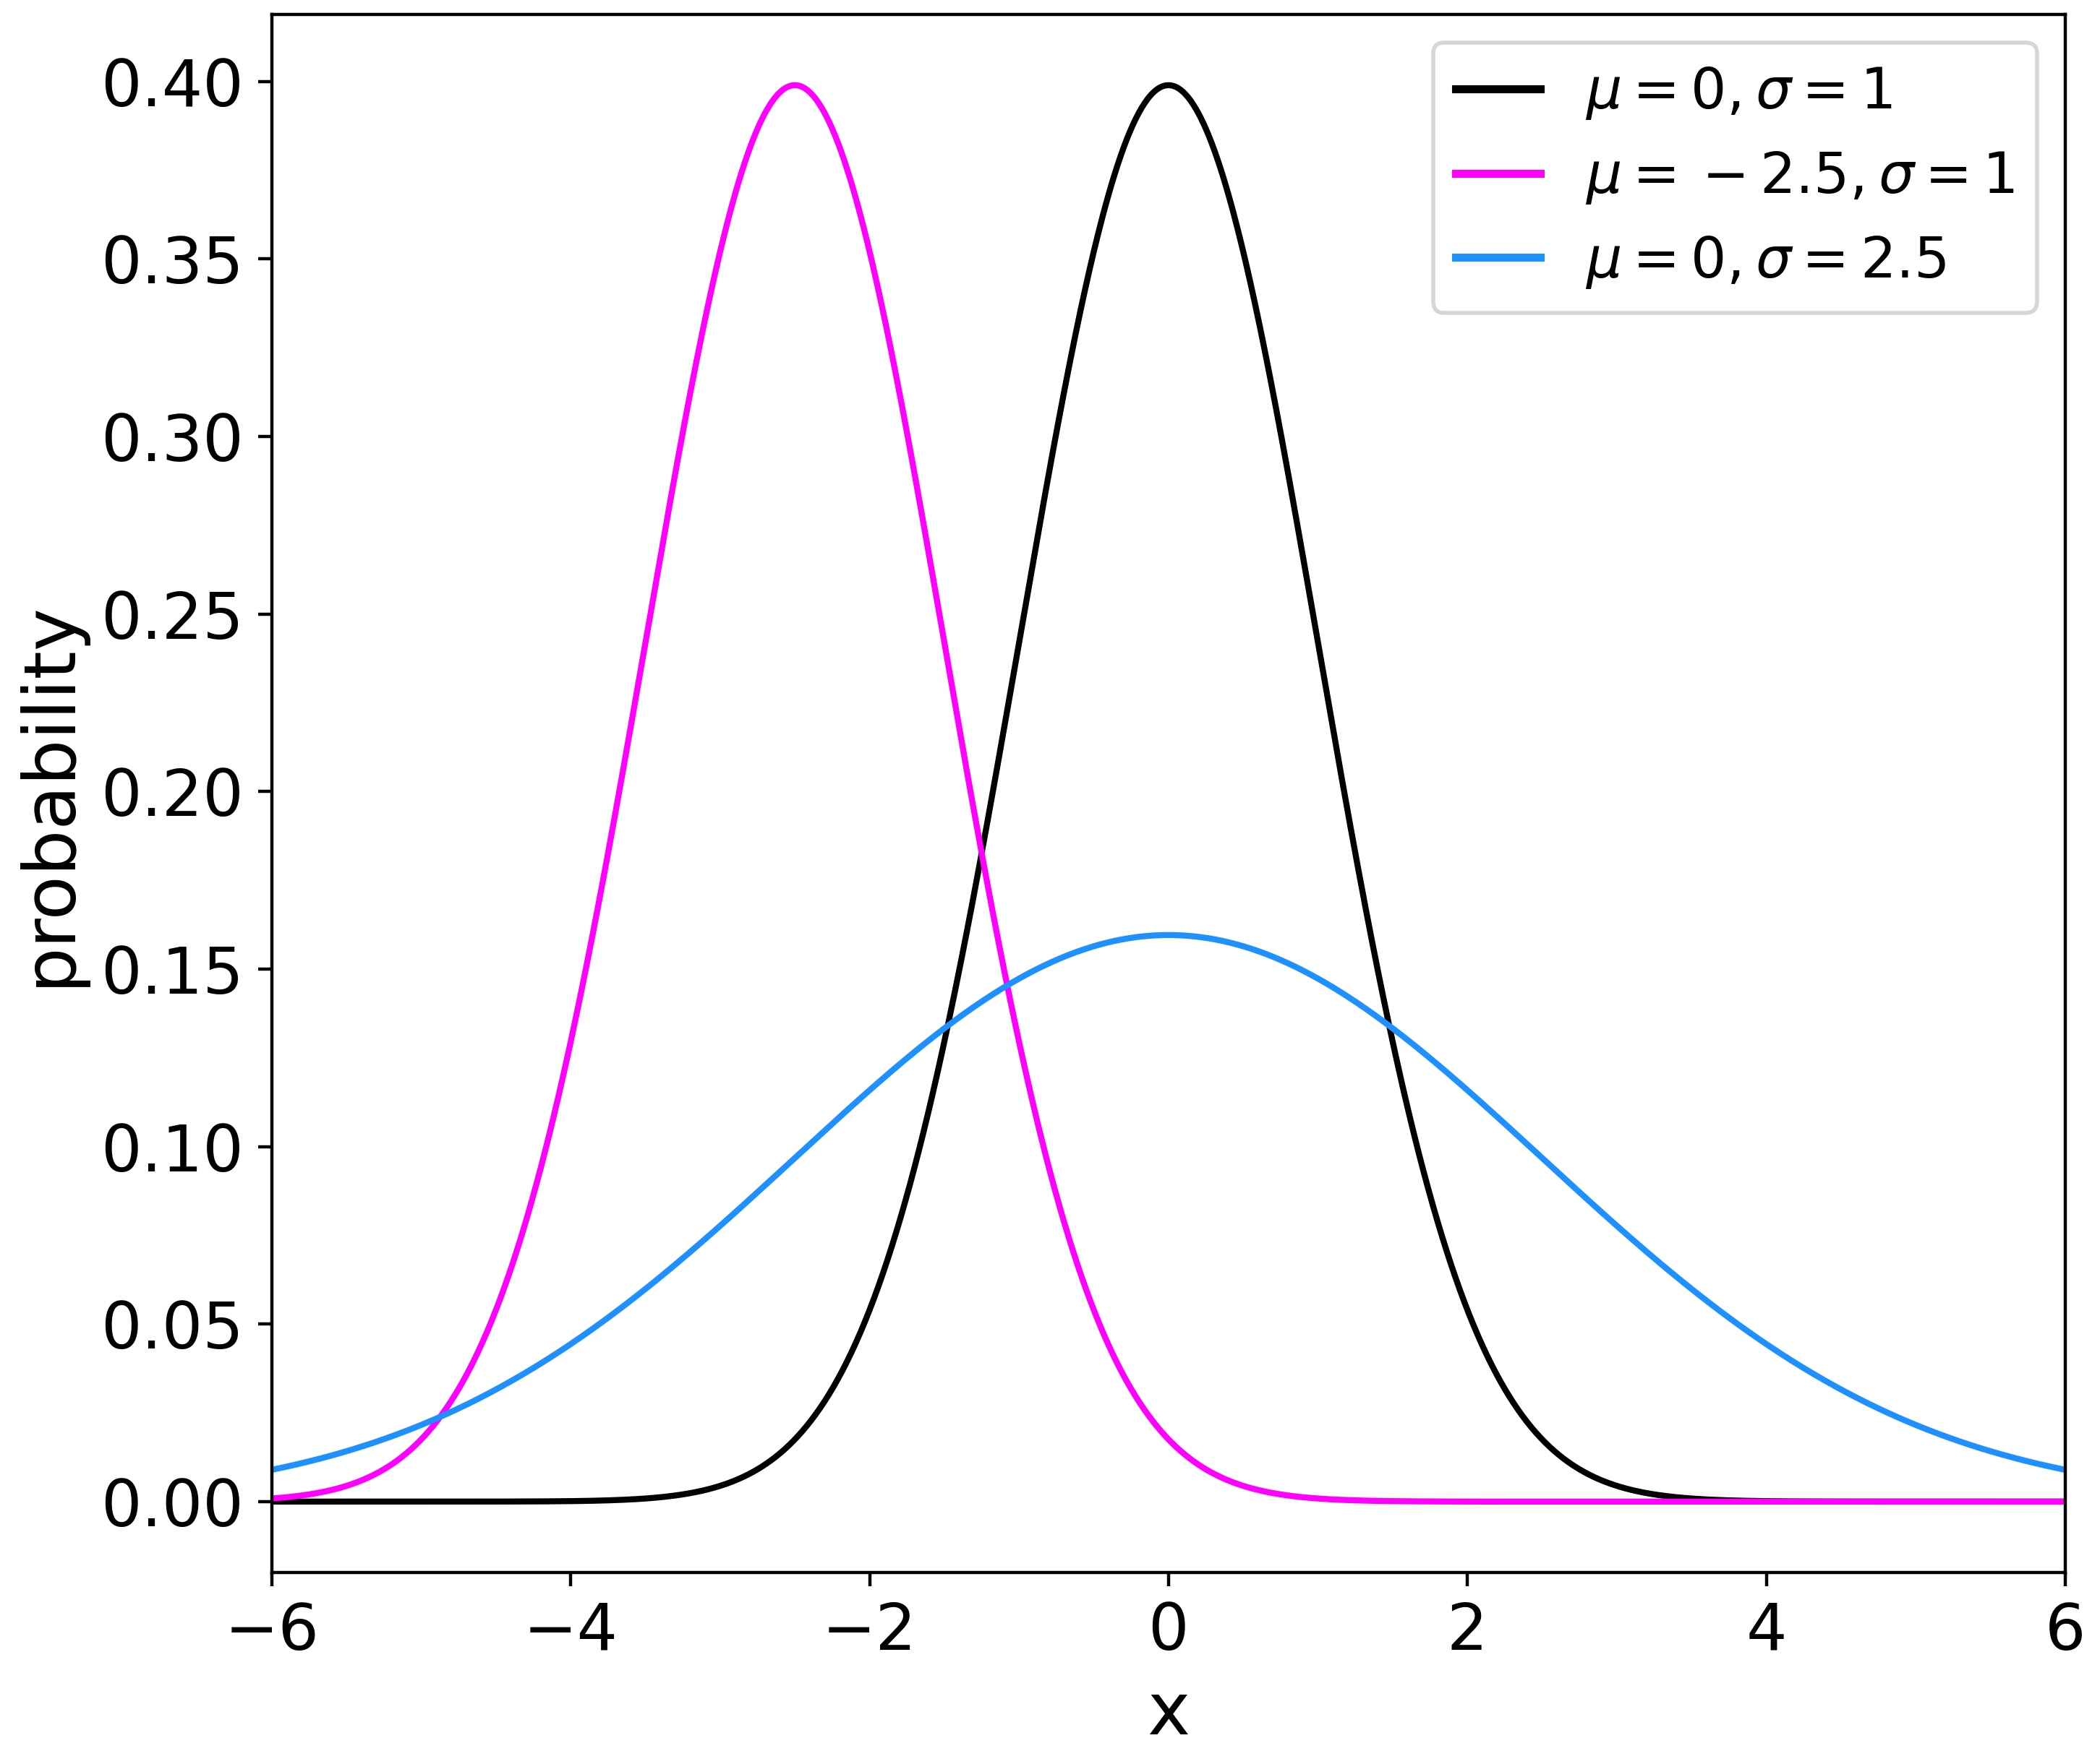

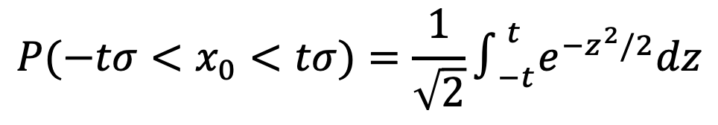
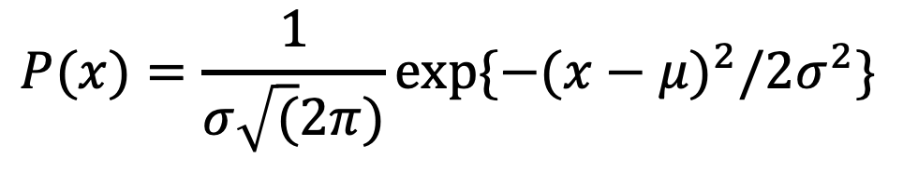


Key Distributions: Gaussian
Aka a normal
$$P(x)=\frac{1}{σ\sqrt{(}2π)}exp\{−(x−μ)^{2}/2σ^{2}\}$$
The limiting case ($→∞$) of most other distributions
Expectation value:
$$\text{mean}=μ$$
Variance:
$$σ^{2}=σ^{2}$$
Common assumption across physics
$$P(−tσ<x_{0}<tσ)=\frac{1}{\sqrt{2}}∫_{−t}^{t}e^{−z^{2}/2}dz$$

Slide 10
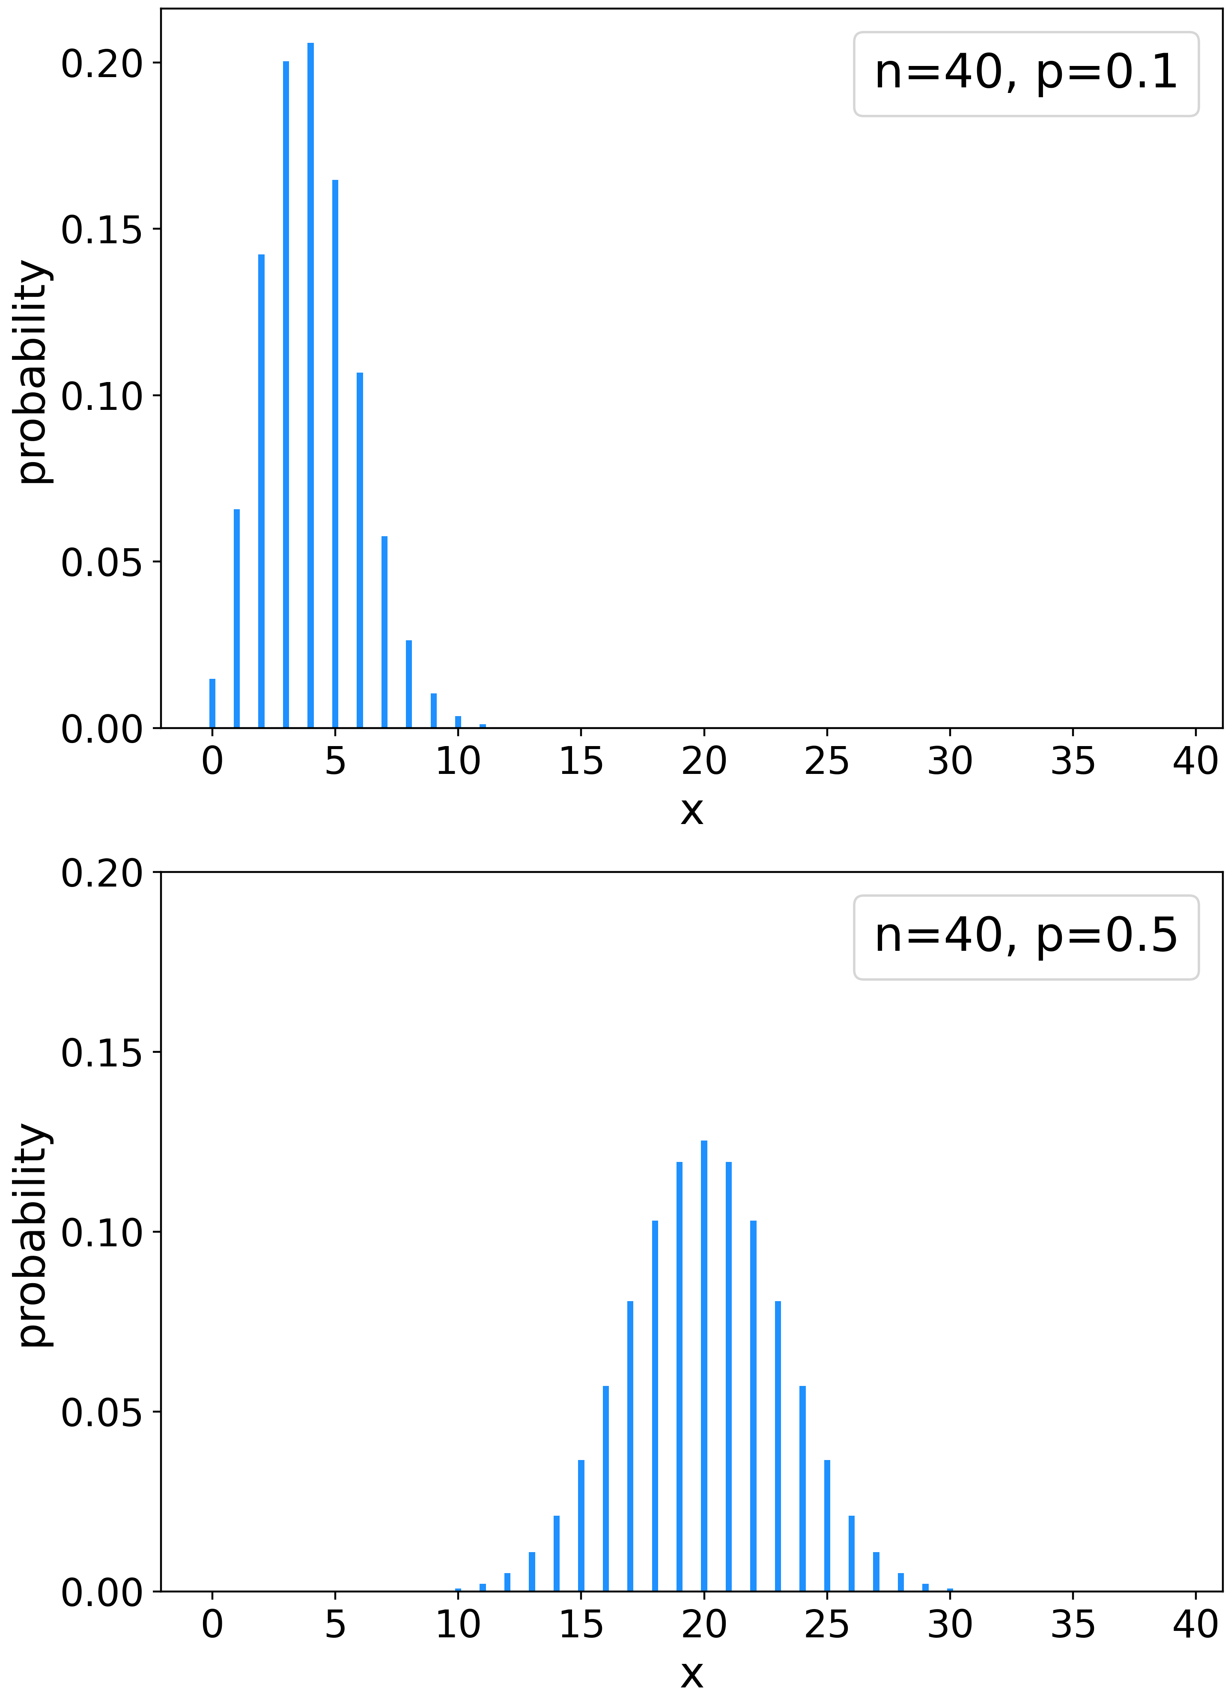


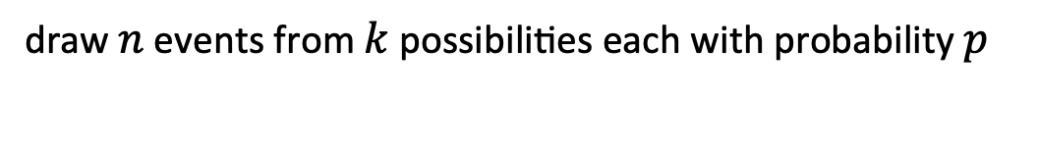

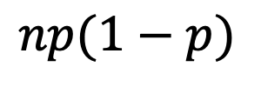
Key Distributions: Binomial
Fixed number of outcomes
draw $n$ events from $k$ possibilities each with probability $p$
Expectation value:
$$\text{mean}=np$$
Variance:
$$np(1−p)$$
=> Gaussian distribution as $N→∞$
Example: coin tossing

Slide 11
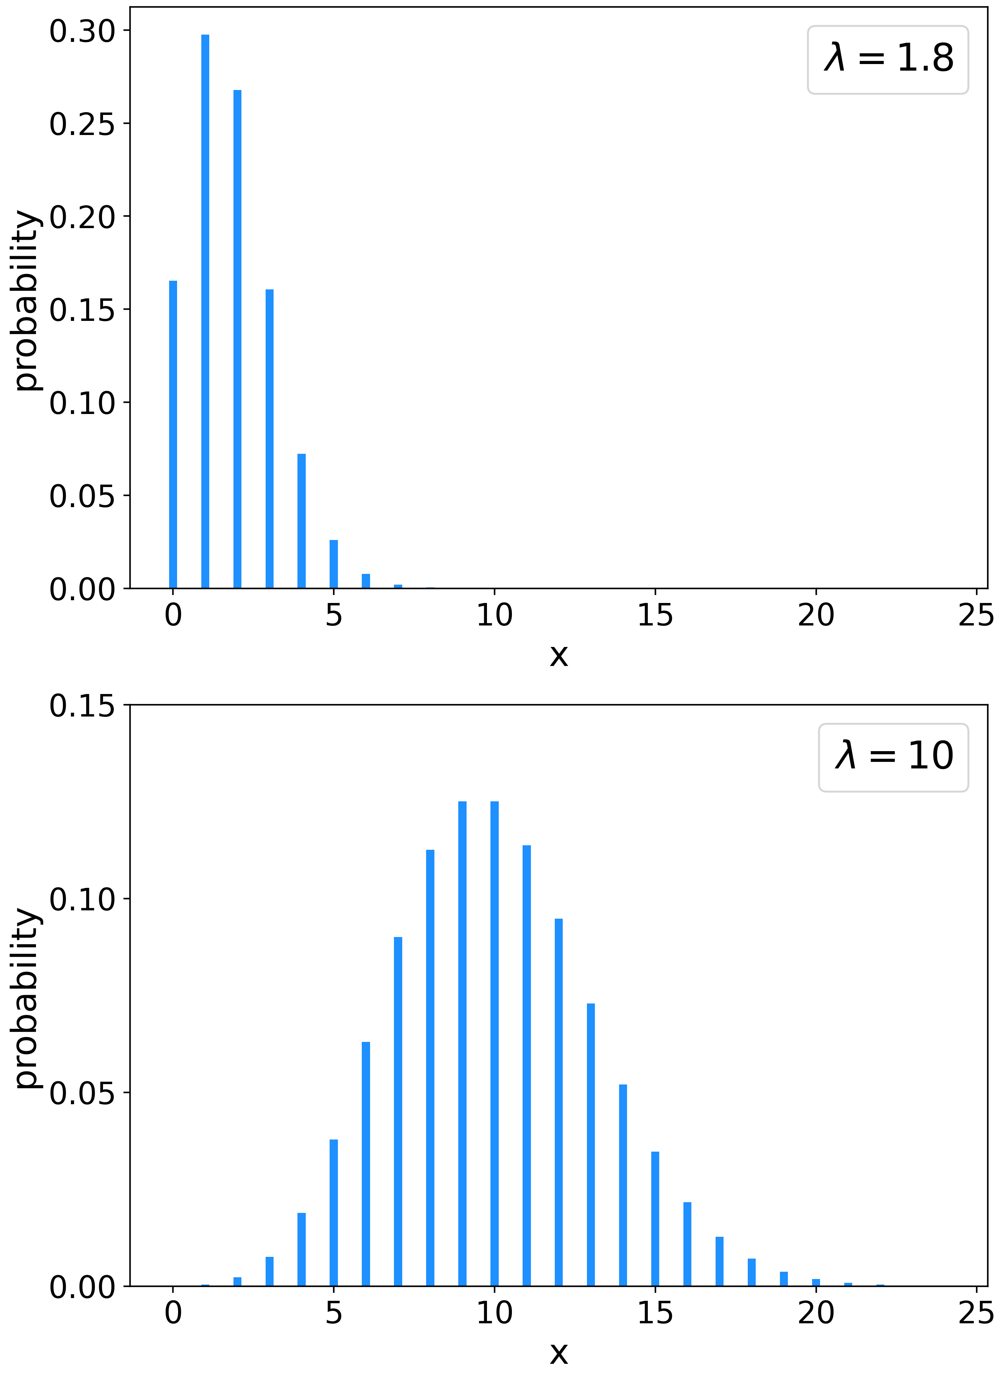
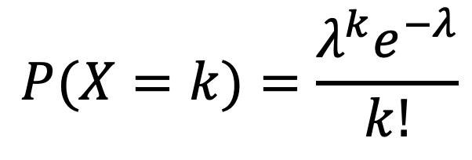




Key Distributions: Poisson
NB: Other common distributions include ‘uniform’, ‘gamma’, ‘log-normal’…
The counting distribution
$$P(X=k)=\frac{λ^{k}e^{−λ}}{k!}$$
observe $k$ events drawn from $λ$ possibilities
Expectation value:
$$\text{mean}=λ$$
Variance:
$$σ^{2}=λ$$
=> Gaussian distribution as $k→∞$
Example: histogram (or photon) counting

Slide 12
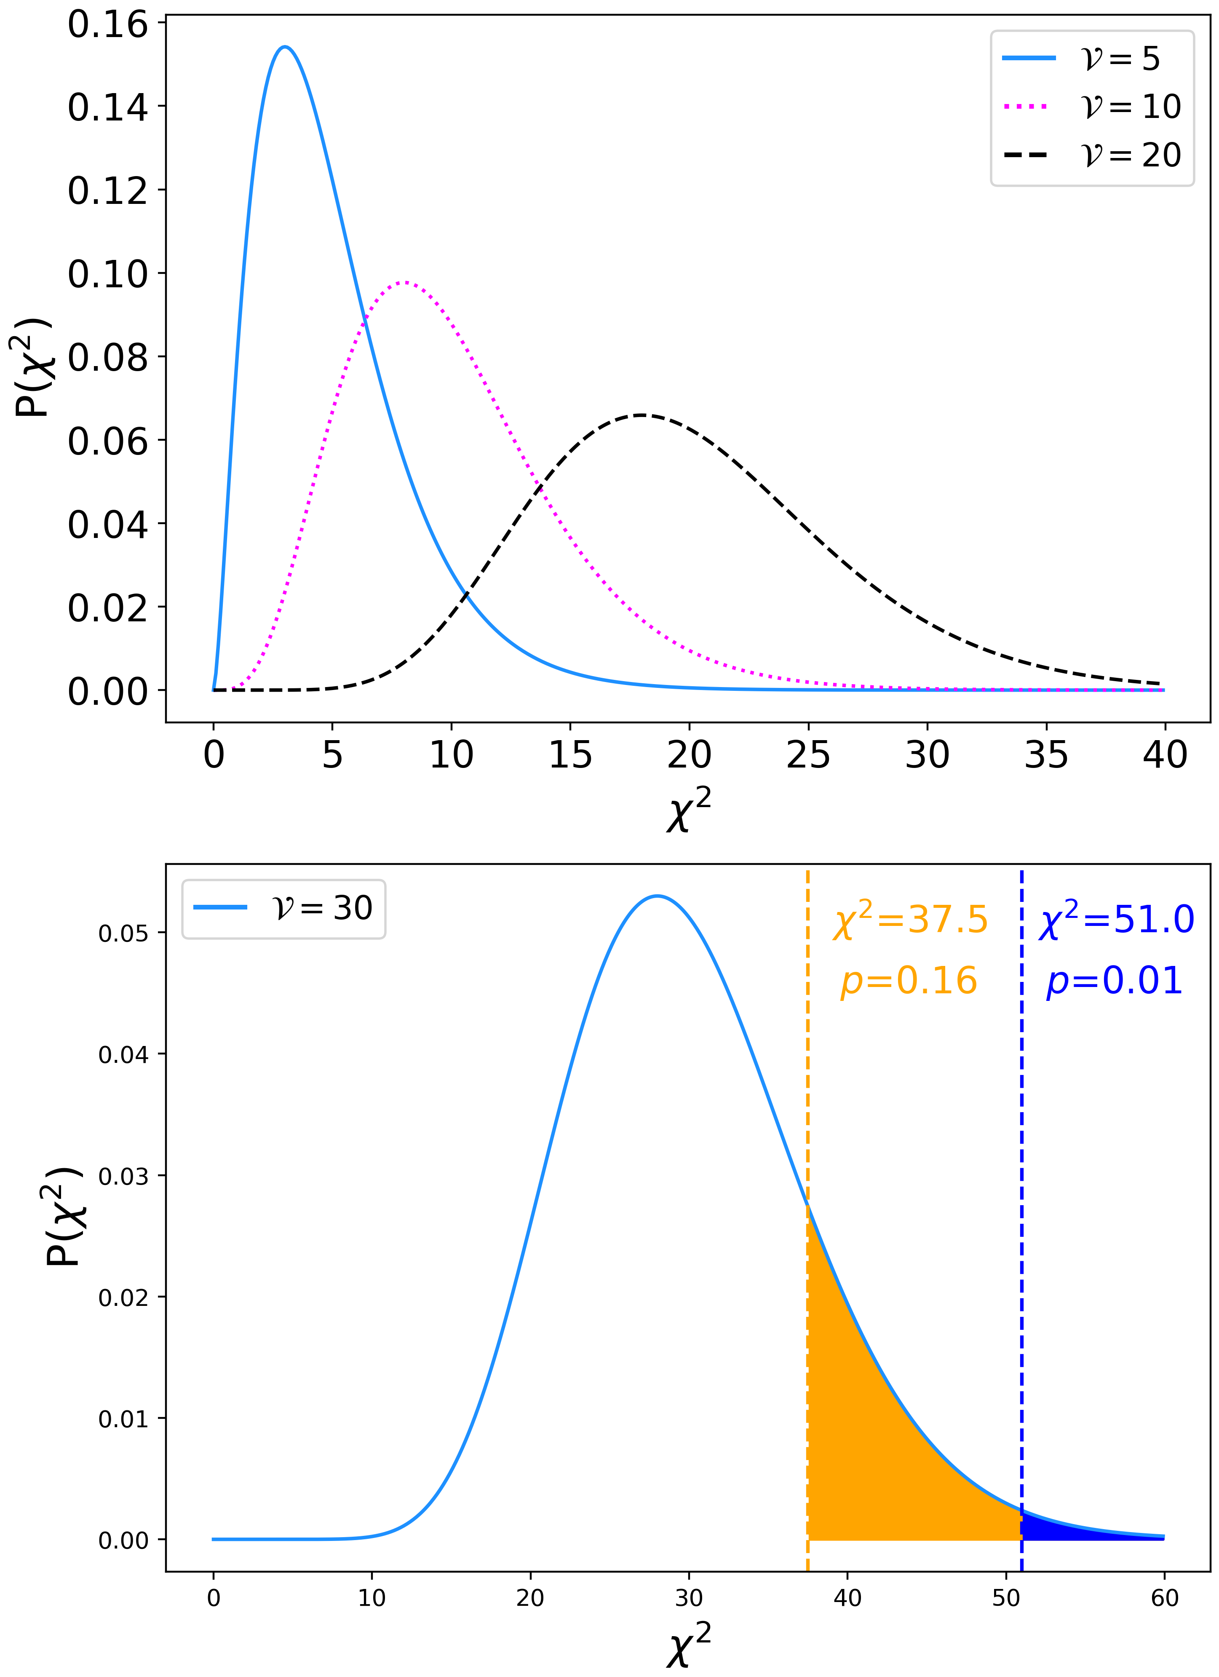




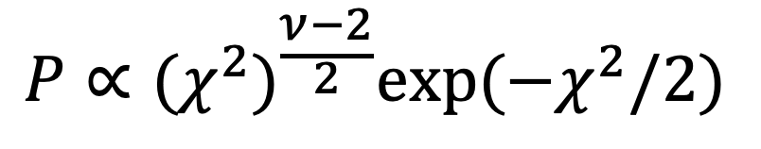

Key Distributions: $χ^{2}$
Related to the Gamma distribution
$$P∝(χ^{2})^{\frac{ν−2}{2}}exp(−χ^{2}/2)$$
$ν$ is the number of degrees of freedom
Expectation value:
$$\text{mean}=ν=N−p$$
Variance:
$$σ^{2}=2ν$$
i.e. if the model is correct then we expect $χ^{2}∼ν±\sqrt{(2ν)}$
$$χ^{2}/ν∼1$$

Slide 13
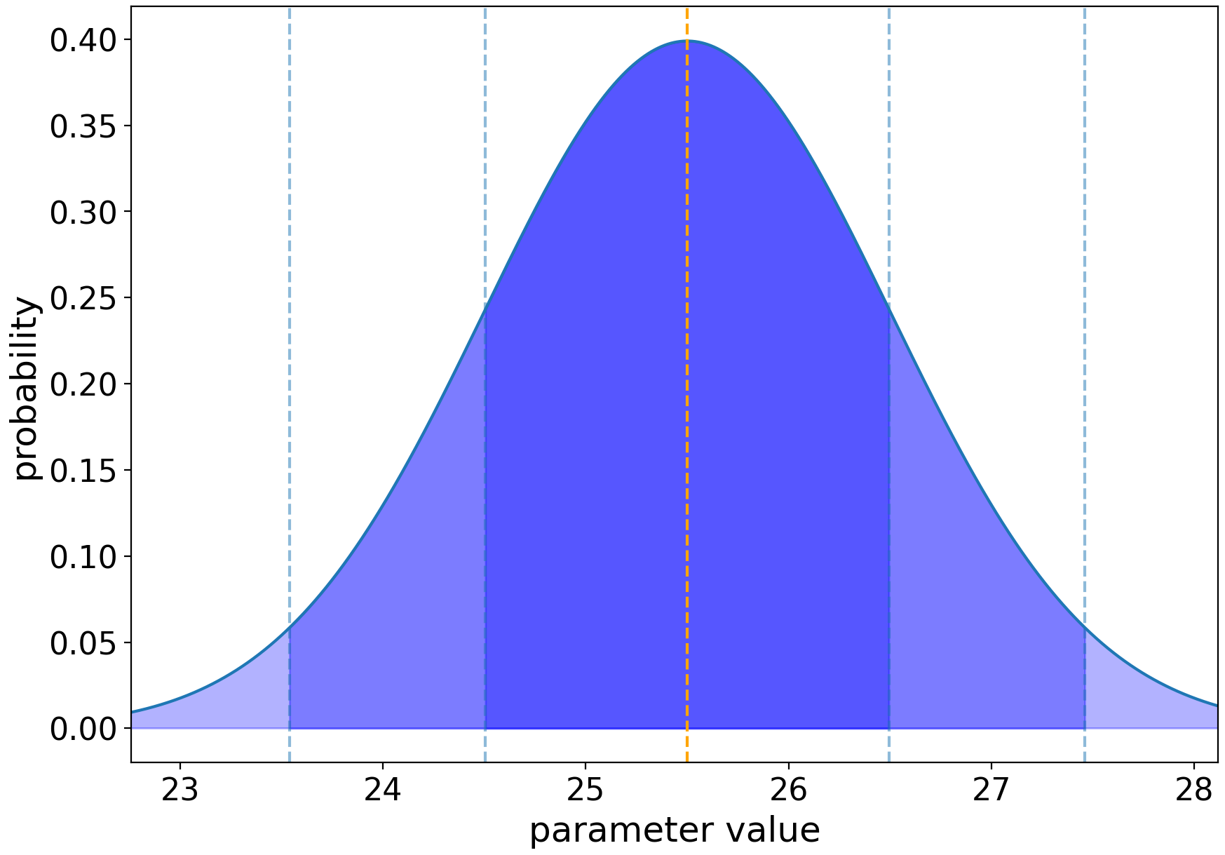
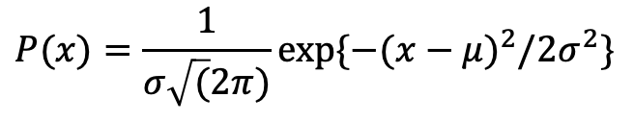
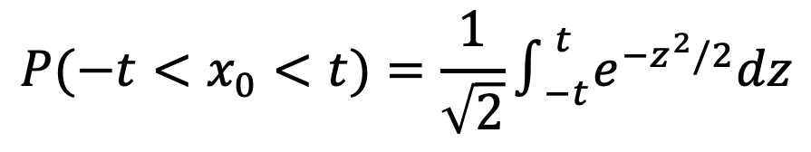




Gaussian Distribution: probabilities
area containing 68% of the probability
Recall
$$P(x)=\frac{1}{σ\sqrt{(}2π)}exp\{−(x−μ)^{2}/2σ^{2}\}$$
$$P(−t<x_{0}<t)=\frac{1}{\sqrt{2}}∫_{−t}^{t}e^{−z^{2}/2}dz$$
1$σ$ : contains 68.3% of the probability
2$σ$ : contains 95.5% of the probability
3$σ$ : contains 99.7% of the probability
5$σ$ : contains 99.99994% of the probability
WARNING: This process knows nothing about physics: beware of unphysical regions
Notes:
BDS note: the word “practically” has been used twice in quick succession and I’m just noting it to check it’s intentional :)

Slide 14
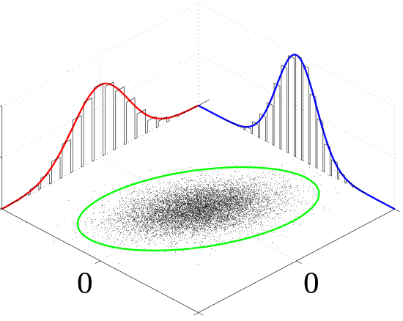
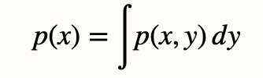
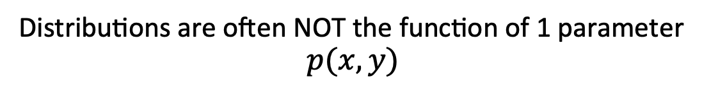
Multiple parameters: Marginalisation
Distributions are often NOT the function of 1 parameter
$$p(x,y)$$
NB: Coursework 1: is ‘happiness’ a function solely of GDP?
The probability of $x$ is calculated by integrating over $y$
NB: We wanted to measure $p(\text{happiness}|\text{GDP})$, but we measured $p(\text{happiness},\text{country}|\text{GDP})$
$p(\text{happiness}|\text{GDP})=p(\text{happiness},\text{UK}|\text{GDP})+p(\text{happiness},\text{France}|\text{GDP})+p(\text{happiness},\text{Spain}|\text{GDP})+...$

Slide 15
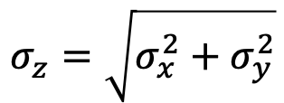
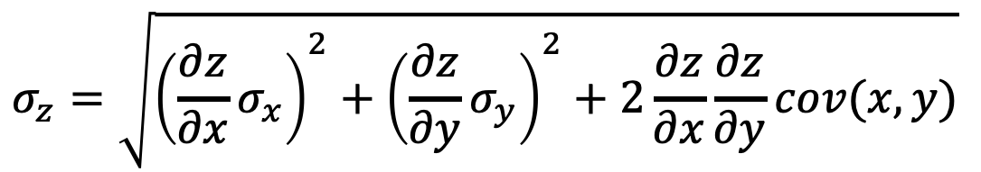
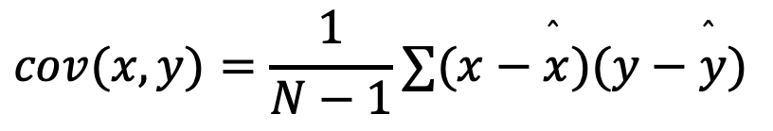
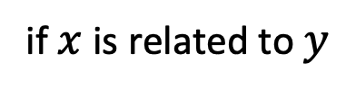
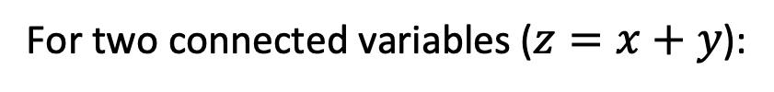
An aside: Covariance
Common across physics
When two measurements are not independent, we call them covariant
For two connected variables ($z=x+y$):
$$σ_{z}=\sqrt{σ_{x}^{2}+σ_{y}^{2}}$$
if $x$ is related to $y$
$$σ_{z}=\sqrt{{\left(\frac{∂z}{∂x}σ_{x}\right)}^{2}+{\left(\frac{∂z}{∂y}σ_{y}\right)}^{2}+2\frac{∂z}{∂x}\frac{∂z}{∂y}cov(x,y)}$$
$$cov(x,y)=\frac{1}{N−1}∑(x−\overset{̂}{x})(y−\overset{̂}{y})$$
NB: Parameter transformations (e.g. $y=log(x)$) change the functional form of the distribution

Slide 16
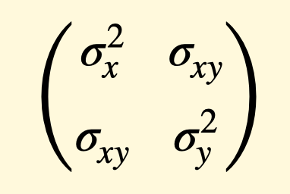
An aside: Covariance
Often expressed in matrix form
Variance on the diagonal terms; covariance in the off-diagonals

Slide 17
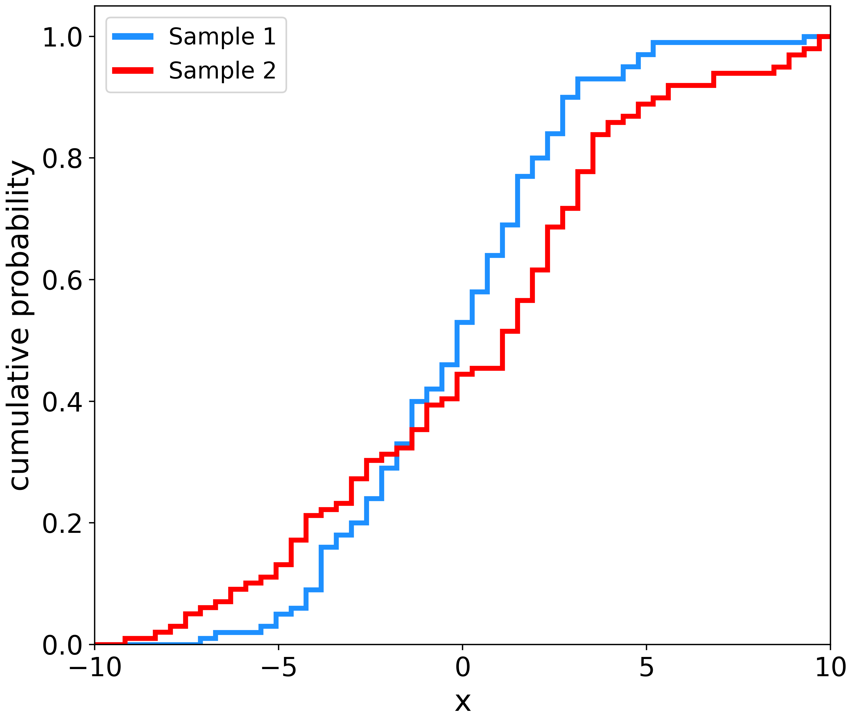
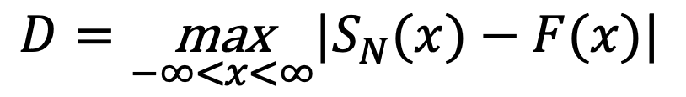
Common in data-science
Finding the Distribution
Kolmogorov-Smirnov (KS) testing
Null hypothesis: the two distributions are the same
The maximal distance between
Cumulative Density Functions (CDF)
D
$$D=\underset{−∞<x<∞}{\text{max}}|S_{N}(x)−F(x)|$$
Recall: a CDF is a rank-ordered PDF.
No assumptions about the underlying distribution
NB: See also Anderson-Darling test

Slide 18
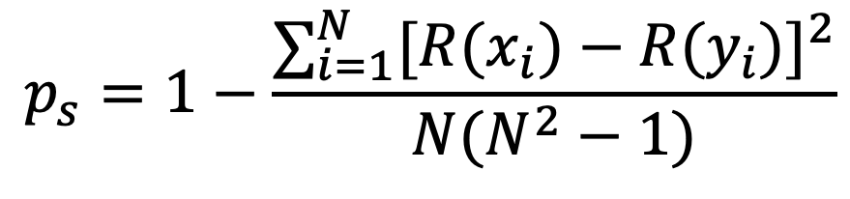
Testing for Correlations
Spearman’s Rank (SR)
Testing whether two variables are related
Compares the ordered rankings (R) of two datasets
$$p_{s}=1−\frac{∑_{i=1}^{N}[R(x_{i})−R(y_{i})]^{2}}{N(N^{2}−1)}$$
Output will be a value between -1 and 1.
Null Hypothesis: the two variables are uncorrelated
NB: A non-parametric version of the Pearson test

Slide 19
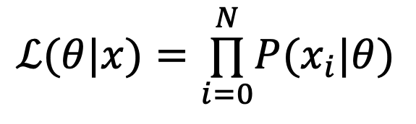

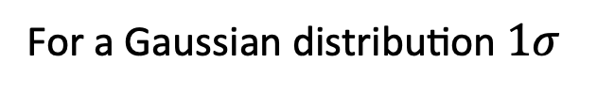
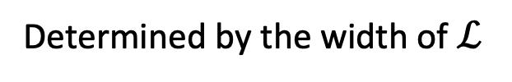

Likelihoods
Given a set of measurements $x=(x_{1},x_{2},...)$
$$ℒ(θ|x)=\overset{N}{\underset{i=0}{∏}}P(x_{i}|θ)$$
the likelihood:
Best-fit value:
The value that maximises $ℒ$
Plausible values:
Determined by the width of $ℒ$
Uncertainty:
For a Gaussian distribution $1σ$

Slide 20
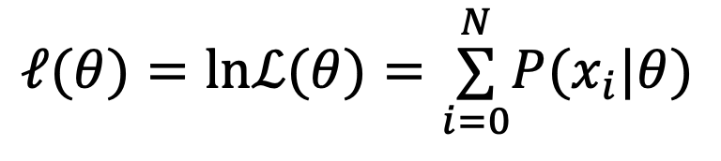

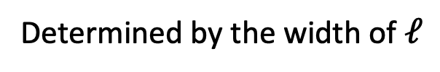

Log Likelihoods
Given a set of measurements $x=(x_{1},x_{2},...)$
$$ℓ(θ)=lnℒ(θ)=\overset{N}{\underset{i=0}{∑}}P(x_{i}|θ)$$
the log-likelihood:
Much easier to maximise
Best-fit value:
The value that maximises $ℓ$
Plausible values:
Determined by the width of $ℓ$
Uncertainty:
$ℓ=ℓ_{\text{max}}−0.5$
NB: Assumes Gaussianity

Slide 21
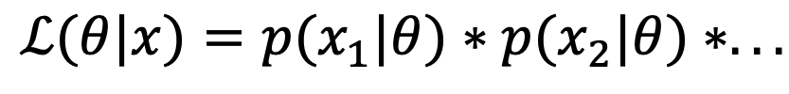
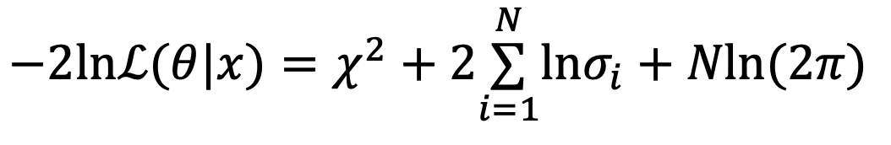
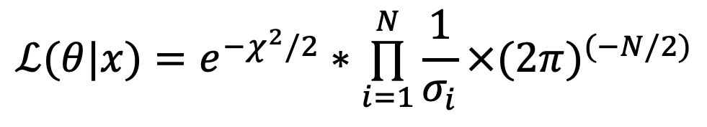
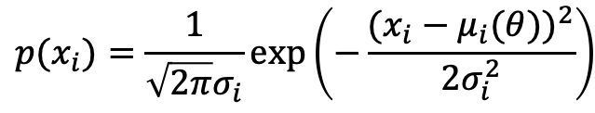
Log Likelihoods: the Gaussian case
$$p(x_{i})=\frac{1}{\sqrt{2π}σ_{i}}exp\left(−\frac{(x_{i}−μ_{i}(θ))^{2}}{2σ_{i}^{2}}\right)$$
Given a set of measurements $x=(x_{1},x_{2},...)$
$$ℒ(θ|x)=p(x_{1}|θ)∗p(x_{2}|θ)∗...$$
$$ℒ(θ|x)=e^{−χ^{2}/2}∗\overset{N}{\underset{i=1}{∏}}\frac{1}{σ_{i}}×(2π)^{(−N/2)}$$
$$−2lnℒ(θ|x)=χ^{2}+2\overset{N}{\underset{i=1}{∑}}lnσ_{i}+Nln(2π)$$
Maximising $ℒ(θ|x)$ is equivalent to minimising $χ^{2}$

Slide 22






Confidence levels & $χ^{2}$
$$χ^{2}<χ_{\text{min}}^{2}+1$$
If our best-fit value has $χ^{2}=χ_{\text{min}}^{2}$:
Contours of equal probability are defined by
$$χ^{2}=χ_{\text{min}}^{2}+Δ$$
$$N_{\text{params}}$$
1
2
3
68%
95.4%
99.7%
1$σ$
2$σ$
3$σ$
1.0
4.0
9.0
2.30
6.17
11.8
3.53
8.02
14.2
CI
WARNING: This process knows nothing about physics: beware of unphysical regions

Slide 23






$χ^{2}$ : estimating uncertainties : bootstrapping
Resampling the data with replacement
(For a dataset with $N$ measurements)
For each of $k$ samples:
> Randomly select $N$ values
> Calculate the $χ^{2}$
Calculate the mean, and variance on $χ^{2}$
Does not assume a functional form for the distribution
NB: Can also sample from uncertainties : ‘MonteCarlo’

Slide 24




See Week 14 for the optimum way to do this
Model Selection
Given two models $M_{1},M_{2}$ how do we know which one to choose?
Recall that for a good fit, we expect: $\text{min}(χ_{\text{red}}^{2})∼1$
Akaike Information Criteria (AIC)
$$\text{AIC}=−2ln(ℒ(θ))+2p$$
Bayes Information Criteria (BIC)
$$\text{BIC}=−2ln(ℒ(θ))+plogN$$
($p=N_{\text{params}}$ ; $n=N_{\text{data}}$)

Slide 25
Week 12: Learning outcomes
Today you have learnt
How to relate probabilities to measurements: the likelihood
How to define a null hypothesis
How to use probabilities to test our hypothesis
Three key distributions in Physics
Key tests of whether our hypothesis (assumptions) are correct
Distributions: KS test
Correlations: Spearman’s Rank
Goodness-of-fit metrics: calculating likelihoods
Selecting a model given a likelihood
Practical examples on Thursday!
Notes:
BDS: minor, capitalised Gaussian the second time

