Slide 1
Interposer Design Flow

Slide 2
Outline
Packaging Physical Design
  Interposer Design
    Netlist
  Substrate Design

Slide 3
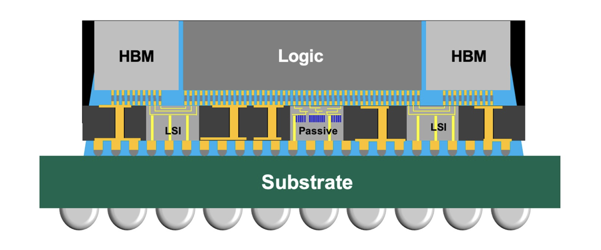
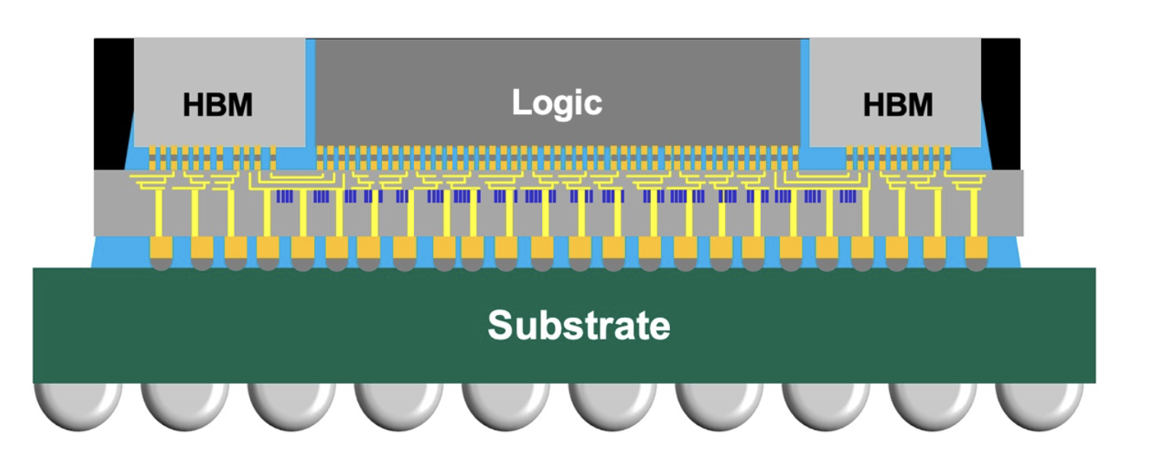
Explanation of LSI
CoWoS-S
CoWoS-L

Slide 4
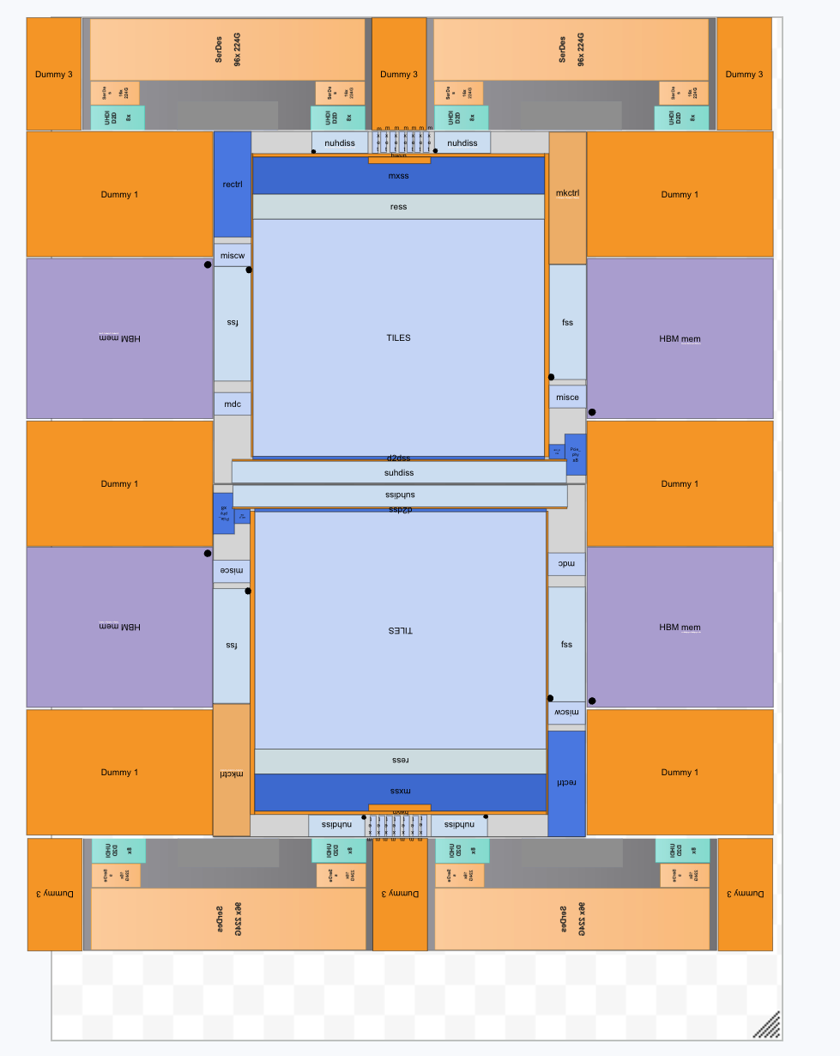
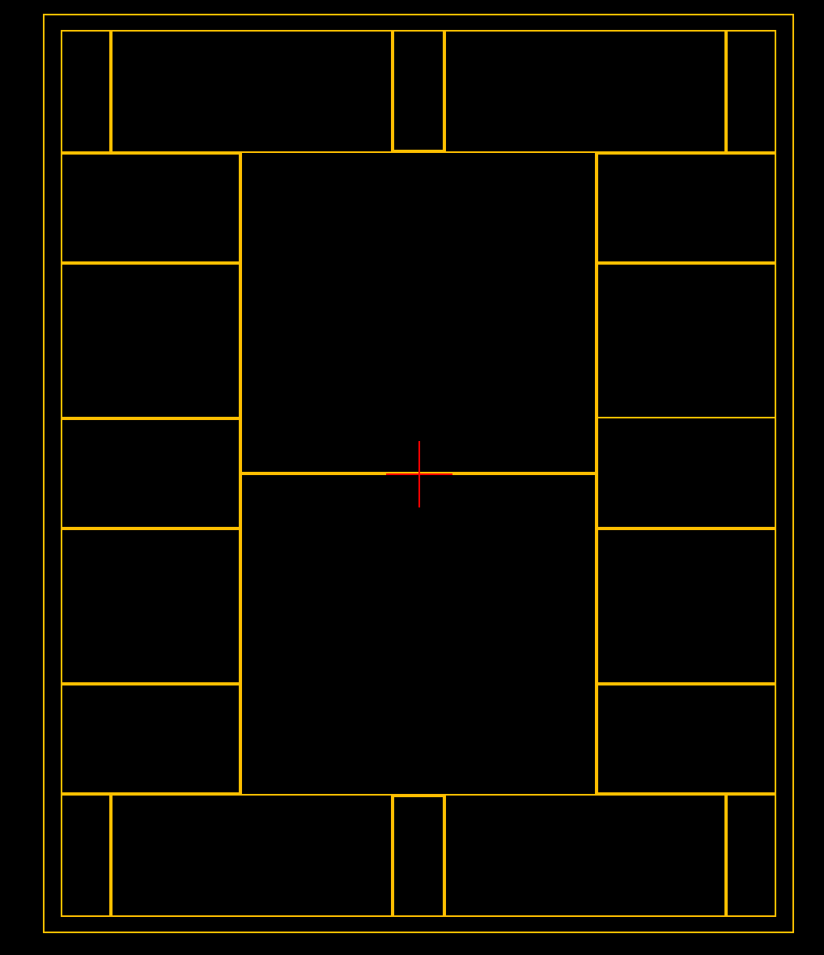
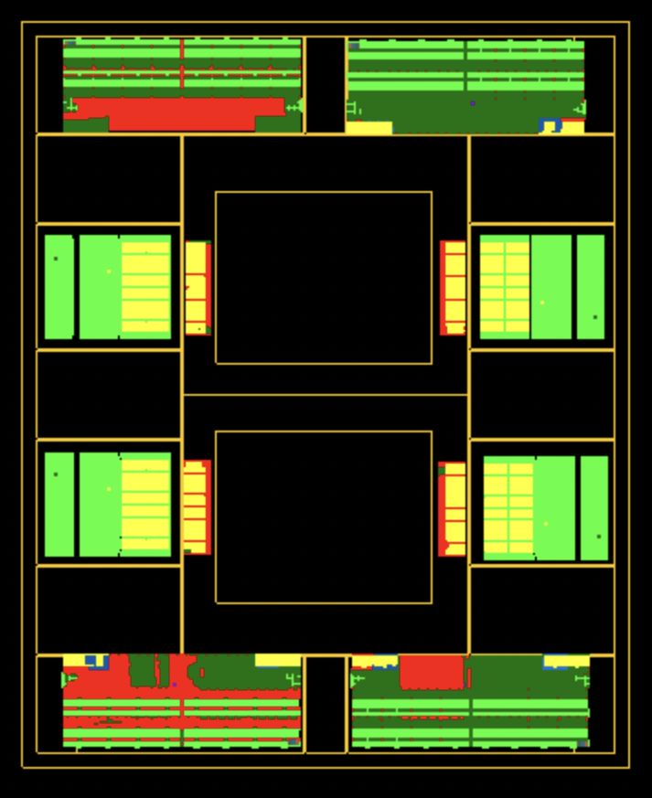
Floor Plan

Slide 5
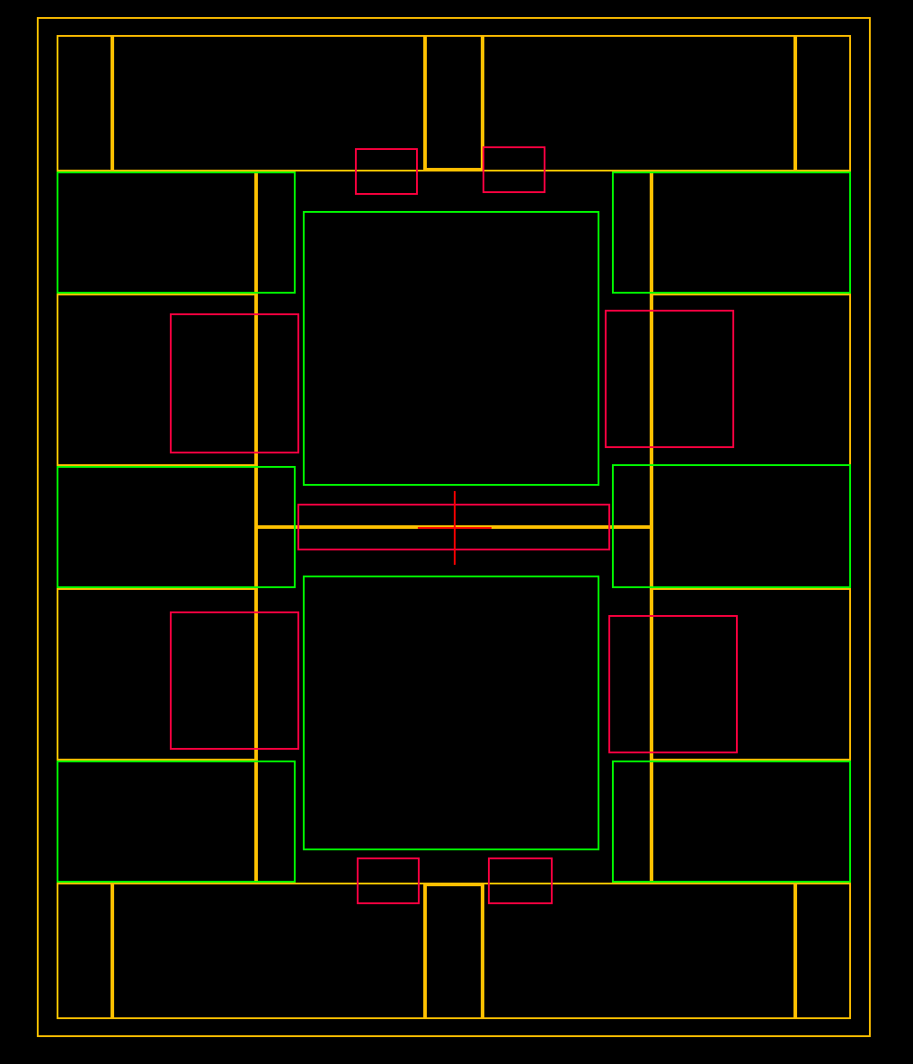
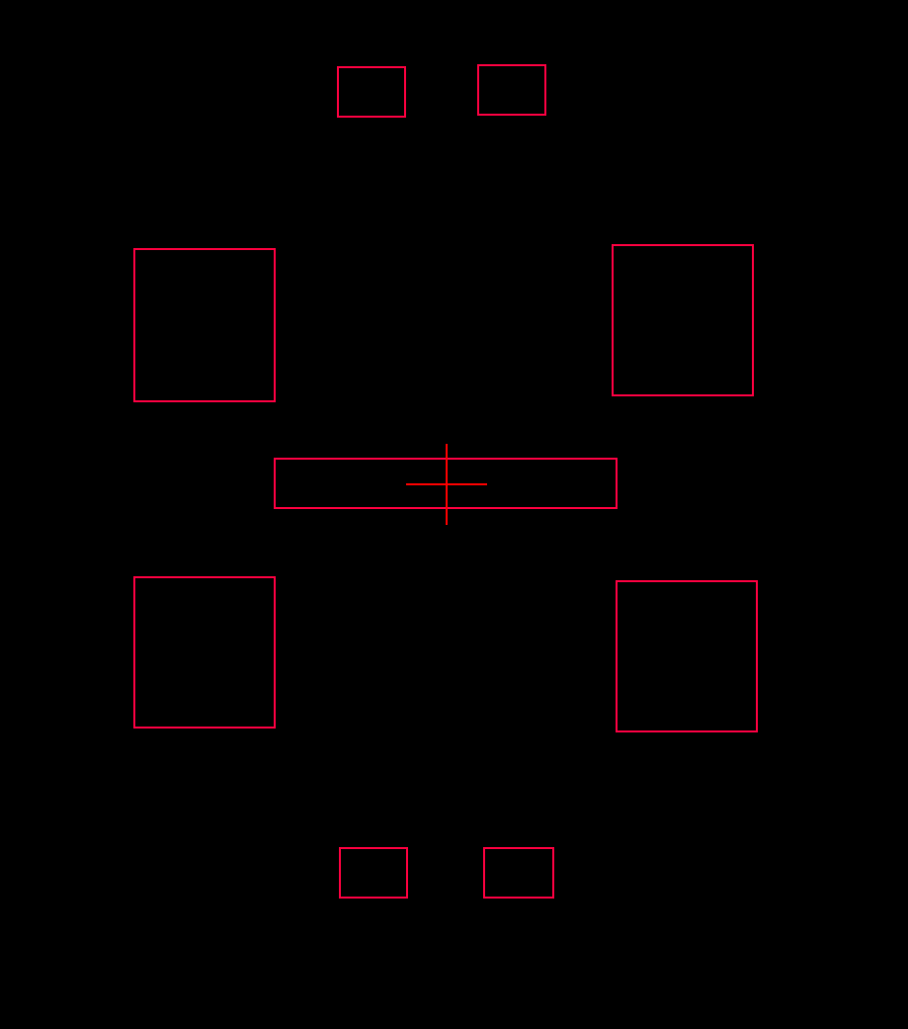
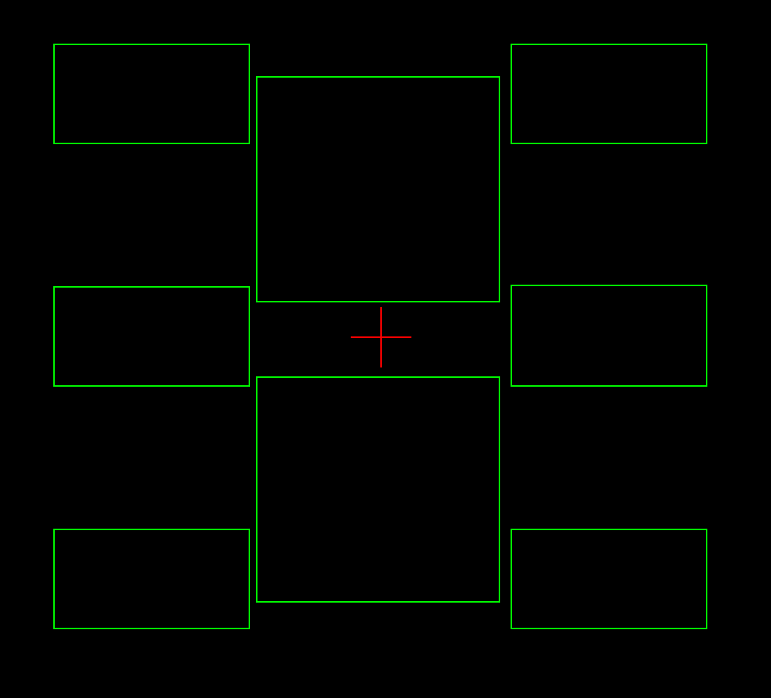
Interposer Floorplan with LSI

Slide 6
Task Definition
Interposer Plan Assebmly
Bill of material | number | Ownership of delivery
i/o chiplet | 4 | 3rd Party
computetop | 2 | Alchip
HBM | 4 | 3rd Party
Dummy die / IPD die | 12 | Alchip
interposer substrate (RDL) | 1 | Alchip
LSI (functional) | 9 = 4 + 4+ 1 | Alchip
LSI_PI | 8 | Alchip
LSI has 4 flavors:
  LSI-1 (io chiplet) *4
  LSI-2 (HBM4) *4
  LSI-3 (D-2-D)*1
  LSI-EDTC (8)

Slide 7
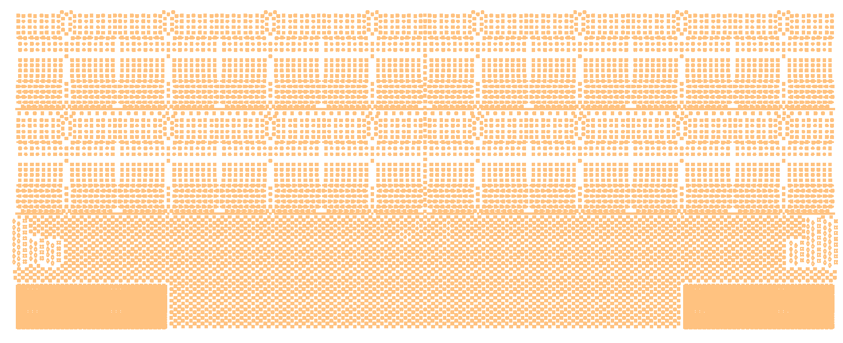

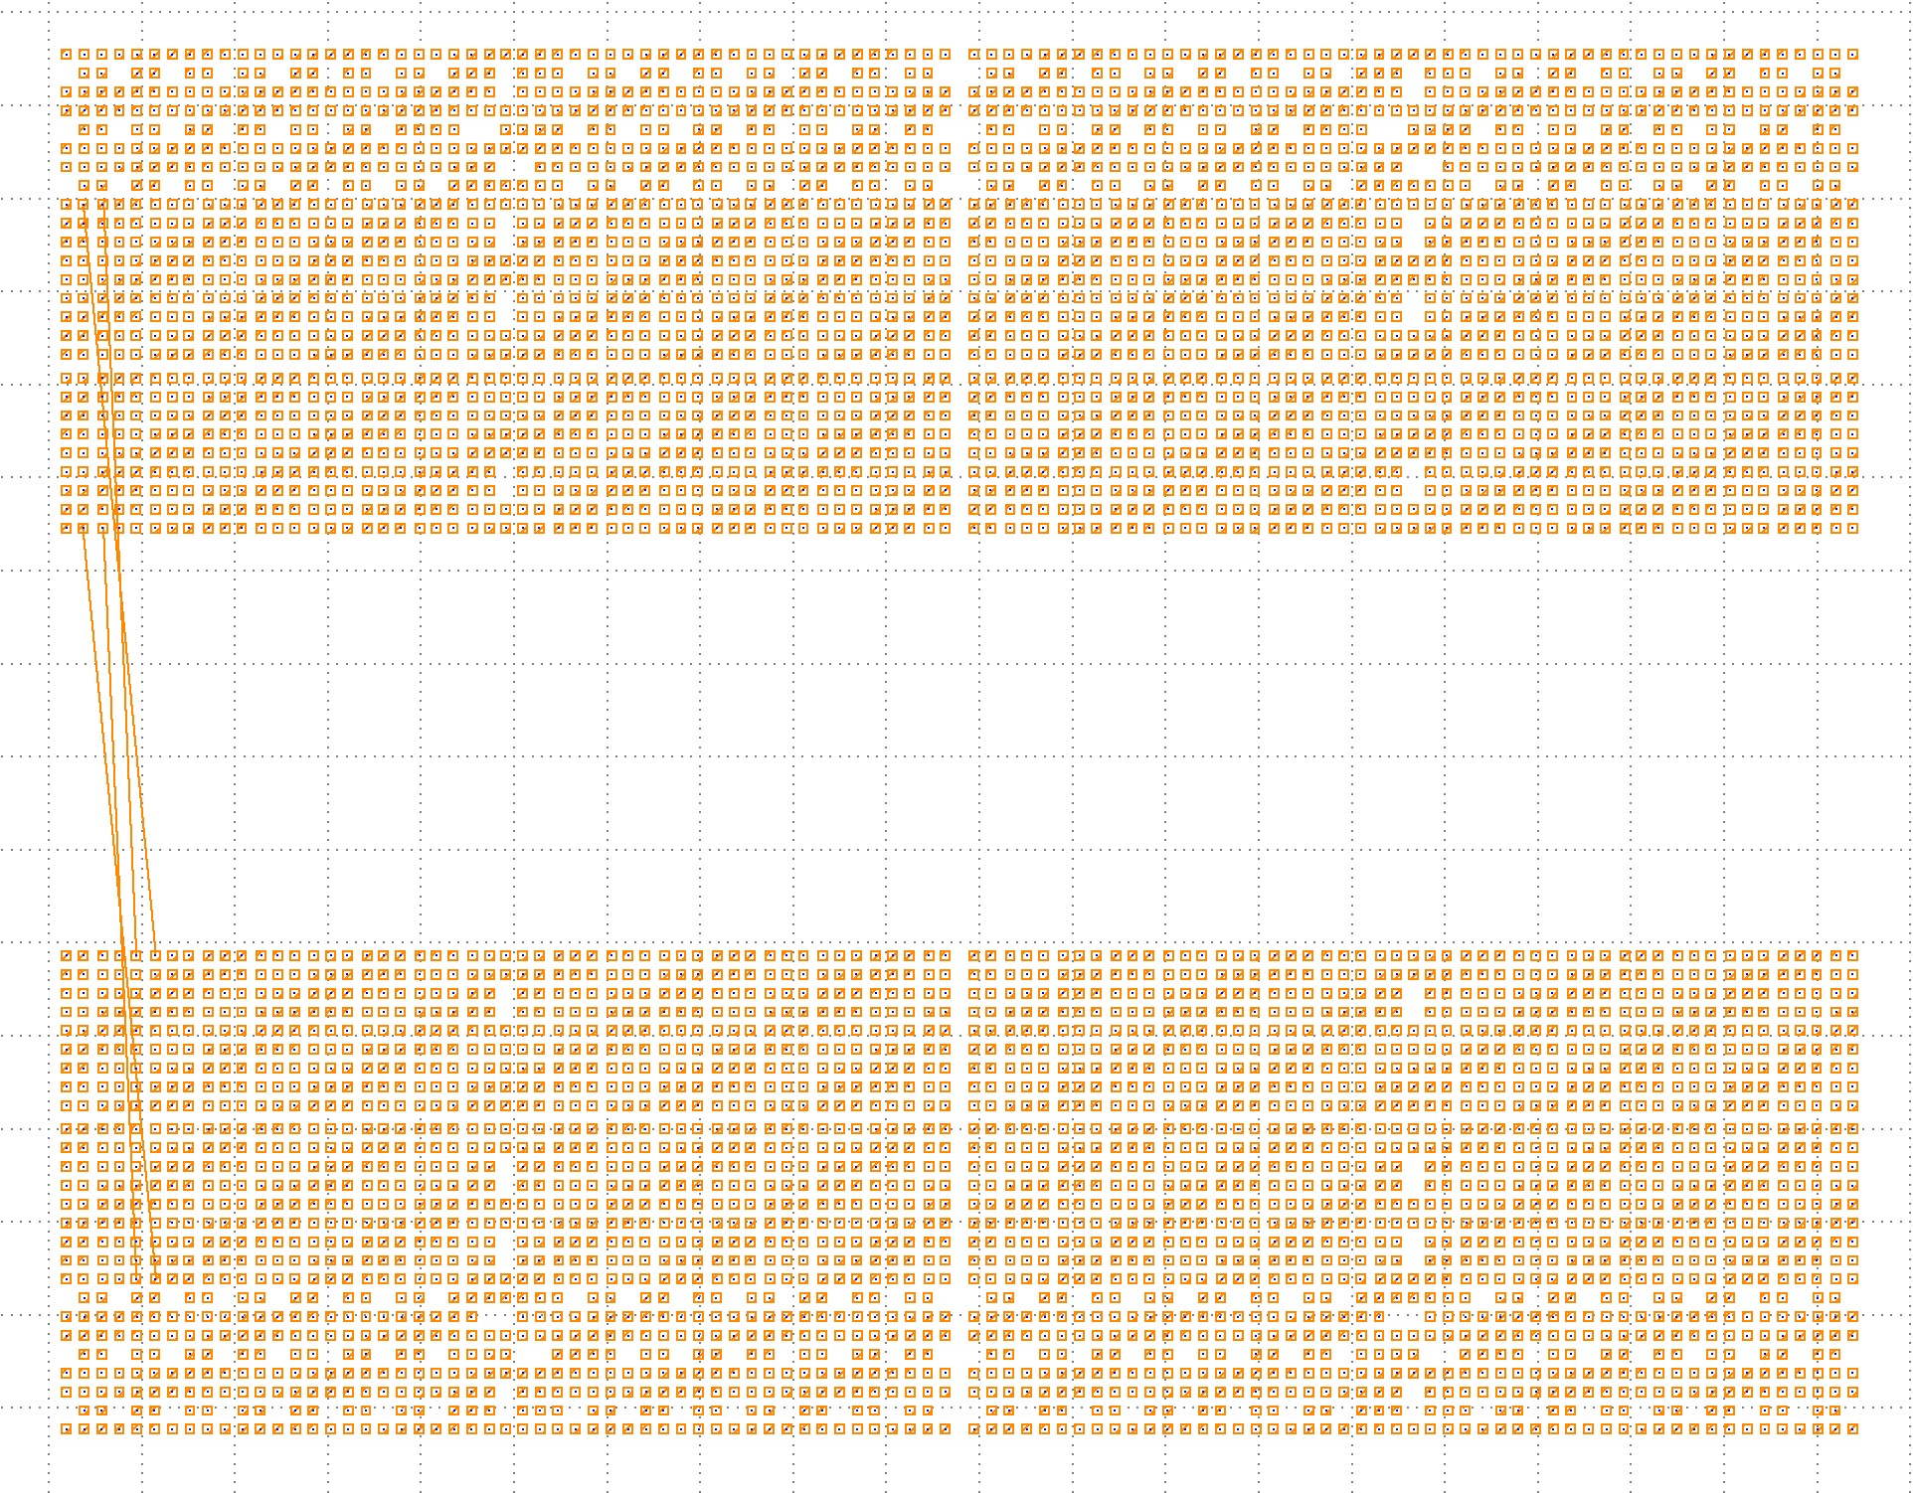
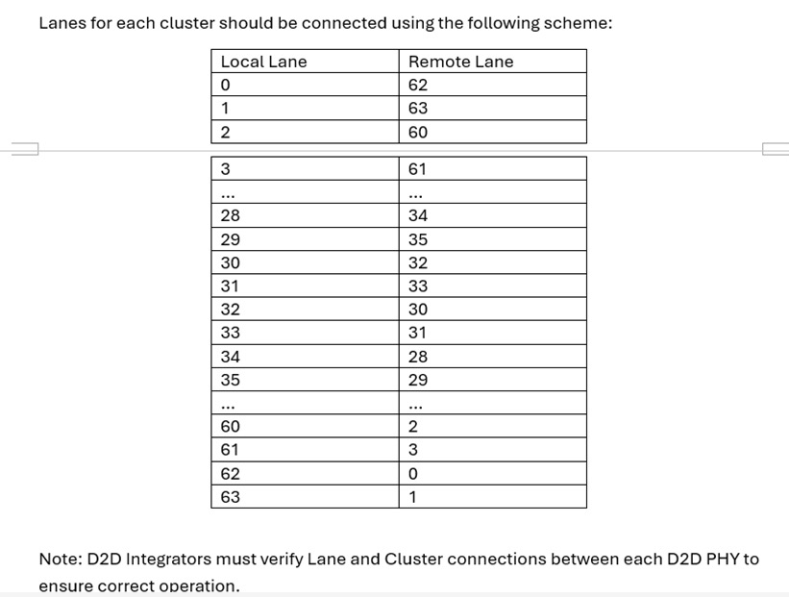
Signal Connection Back-Annotation

Slide 8
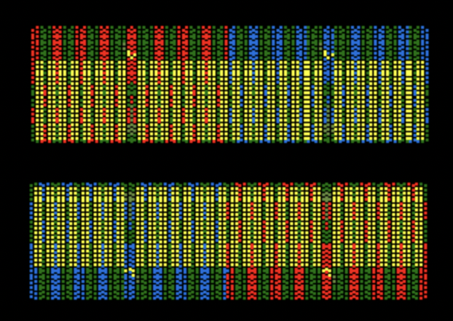
Channel Re-Order After Rotation
1 | 2 | 3 | 4 | 5 | 6 | 7
7 | 6 | 5 | 4 | 3 | 2 | 1

Slide 9

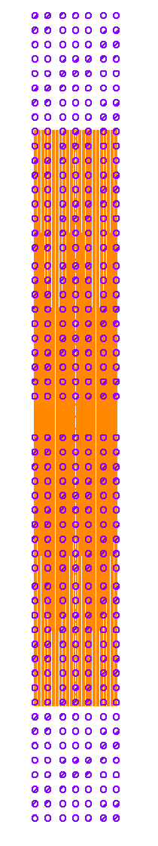
Achievenment: Verified 64-bit Routing

Slide 10
Netlist
Excel sheet / Verilog
Database

Slide 11
Process Definition
Global uBump Map (xlsx, LEF)
C4 Bump Map (xlsx, csv)
Netlist; Connectivity (signal & power), signal types, IP?
SPEC; LSI, power, signal back-annotation from IP provider etc.
input
Interposer Design Process
Intererposer design
  RDL design (*1)
  LSI design (*3)
output

Slide 12
Netlist
Global uBump Map (xlsx, LEF)
C4 Bump Map (xlsx, csv)
Netlist; Connectivity (signal & power), signal types, IP?
SPEC; LSI, power, etc.
input
Connectivity break down :
RDL , LSI-I, LSI-2, LSI-3 & LSI_EDTC
Design Process
RDL substrate
LSI-1 (i/o chiplet <-> computetop)
LSI-2 (HBM4 <-> computetop)
LSI-3 (computetop <-> computetop twin)
Intererposer design
  RDL design (*1) -- mcm file
  LSI design (*3) -- gds file
output

Slide 13
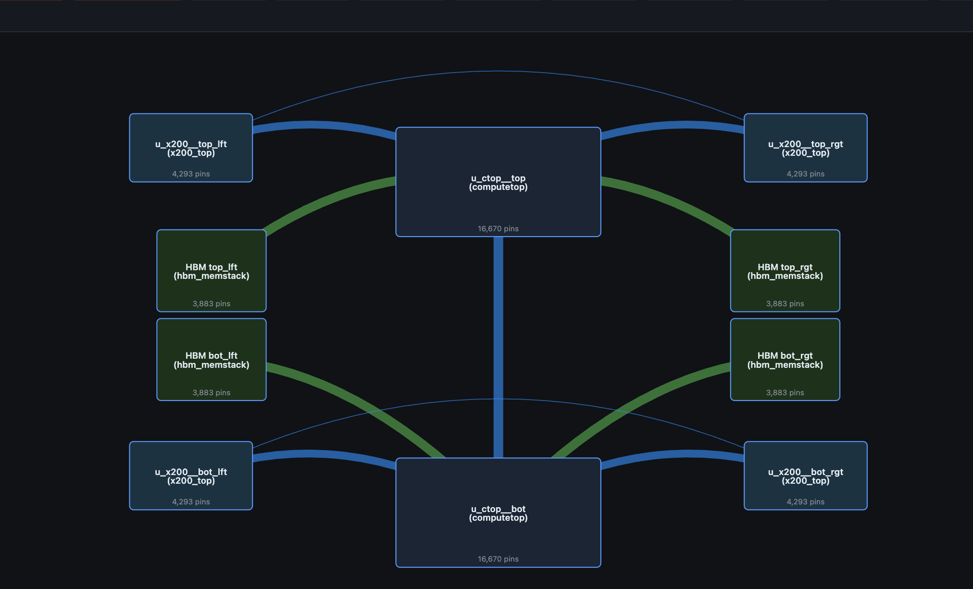
Interposer Netlist

Slide 14
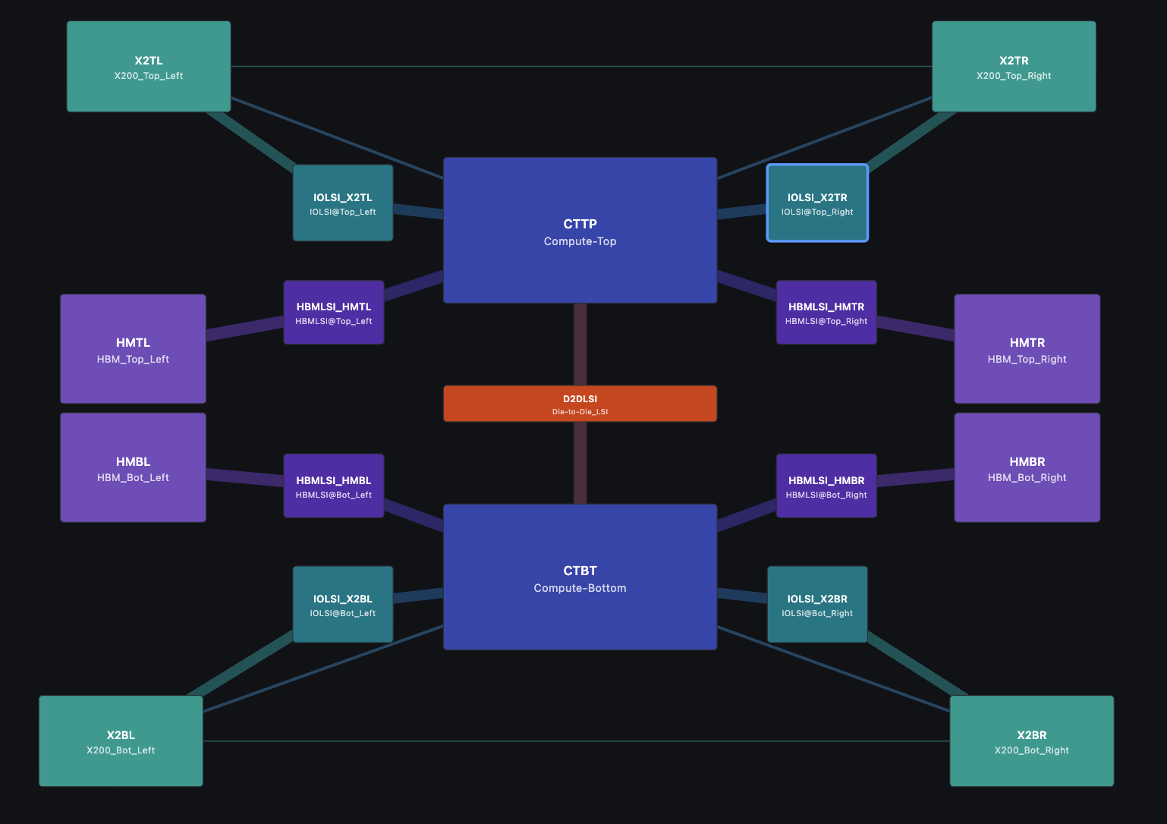

Slide 15

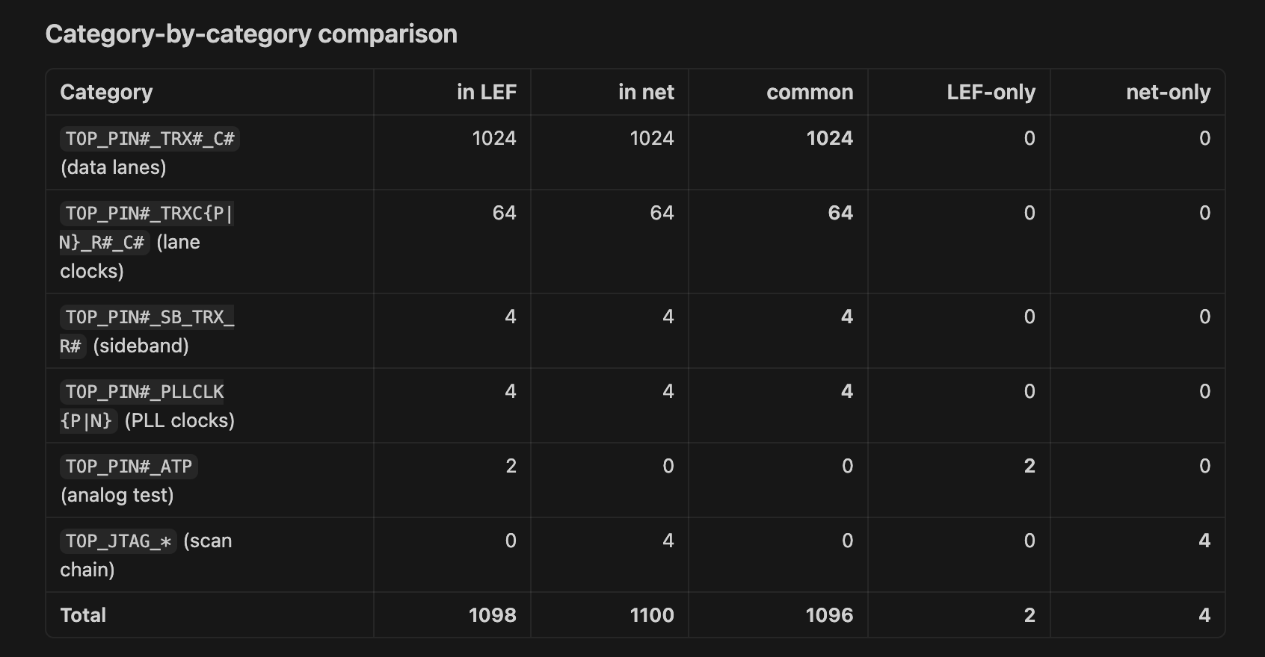

Slide 16
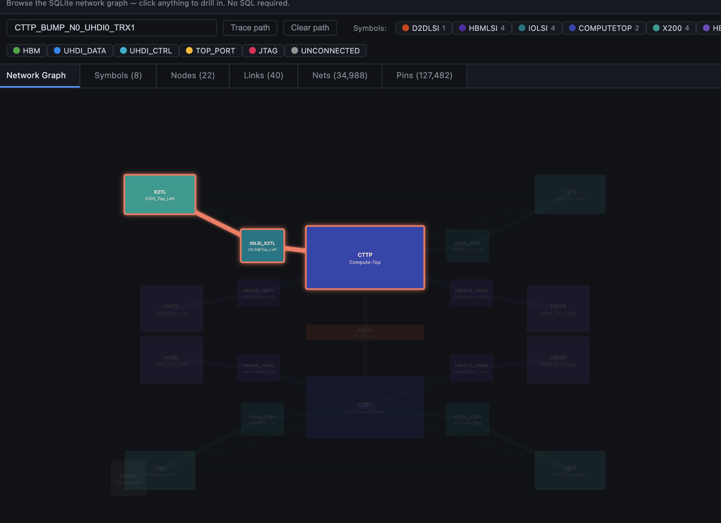
Query Dabase Query

Slide 17
Backup

Slide 18
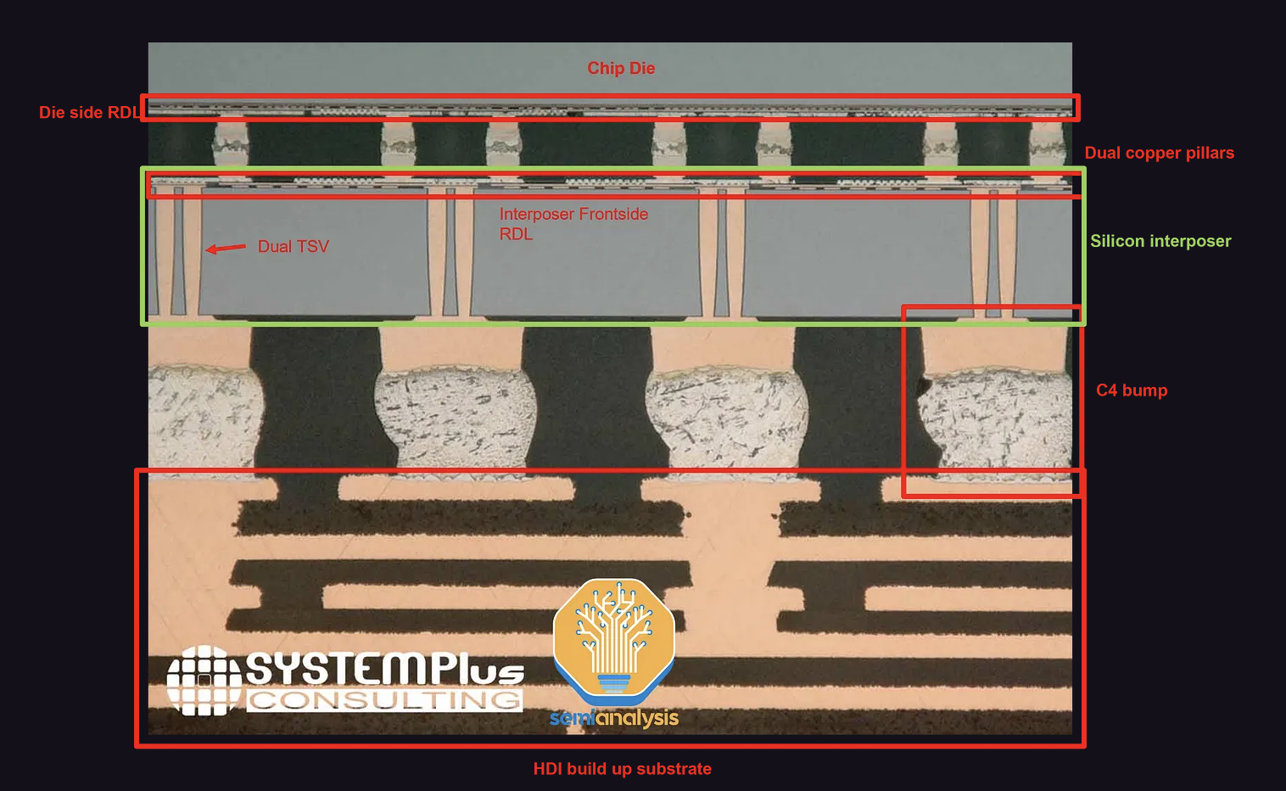
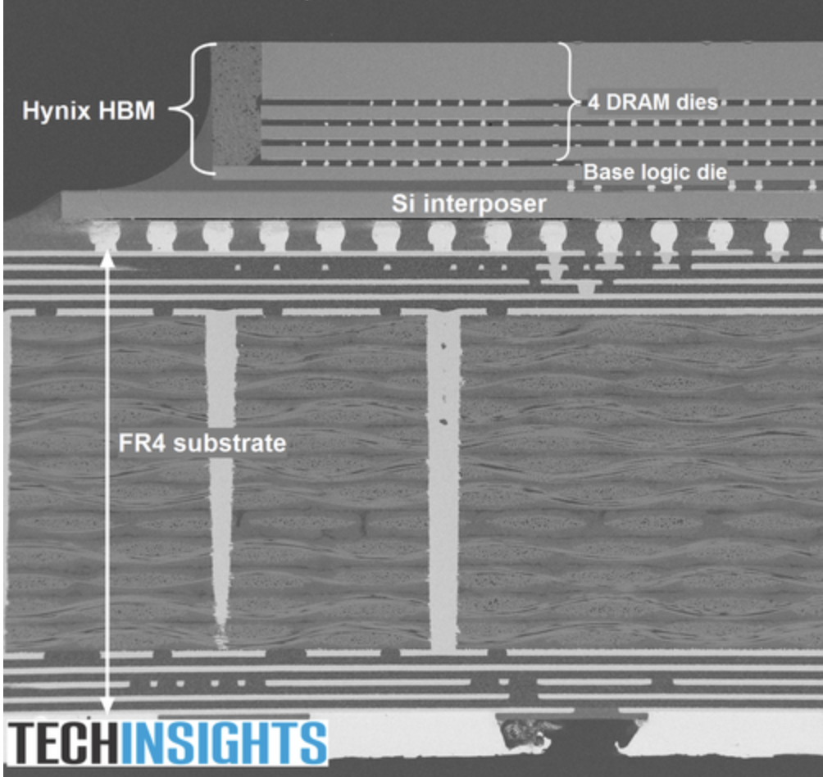
What Is an Interposer?
a thin slice of silicon that is between a chip package-substrate
connecting multiple chips together
ref. 1: https://newsletter.semianalysis.com/p/ai-expansion-supply-chain-analysis
ref. 2: https://www.eetimes.com/emerging-packaging-tech-the-relentless-pursuit-of-small/4/

Slide 19
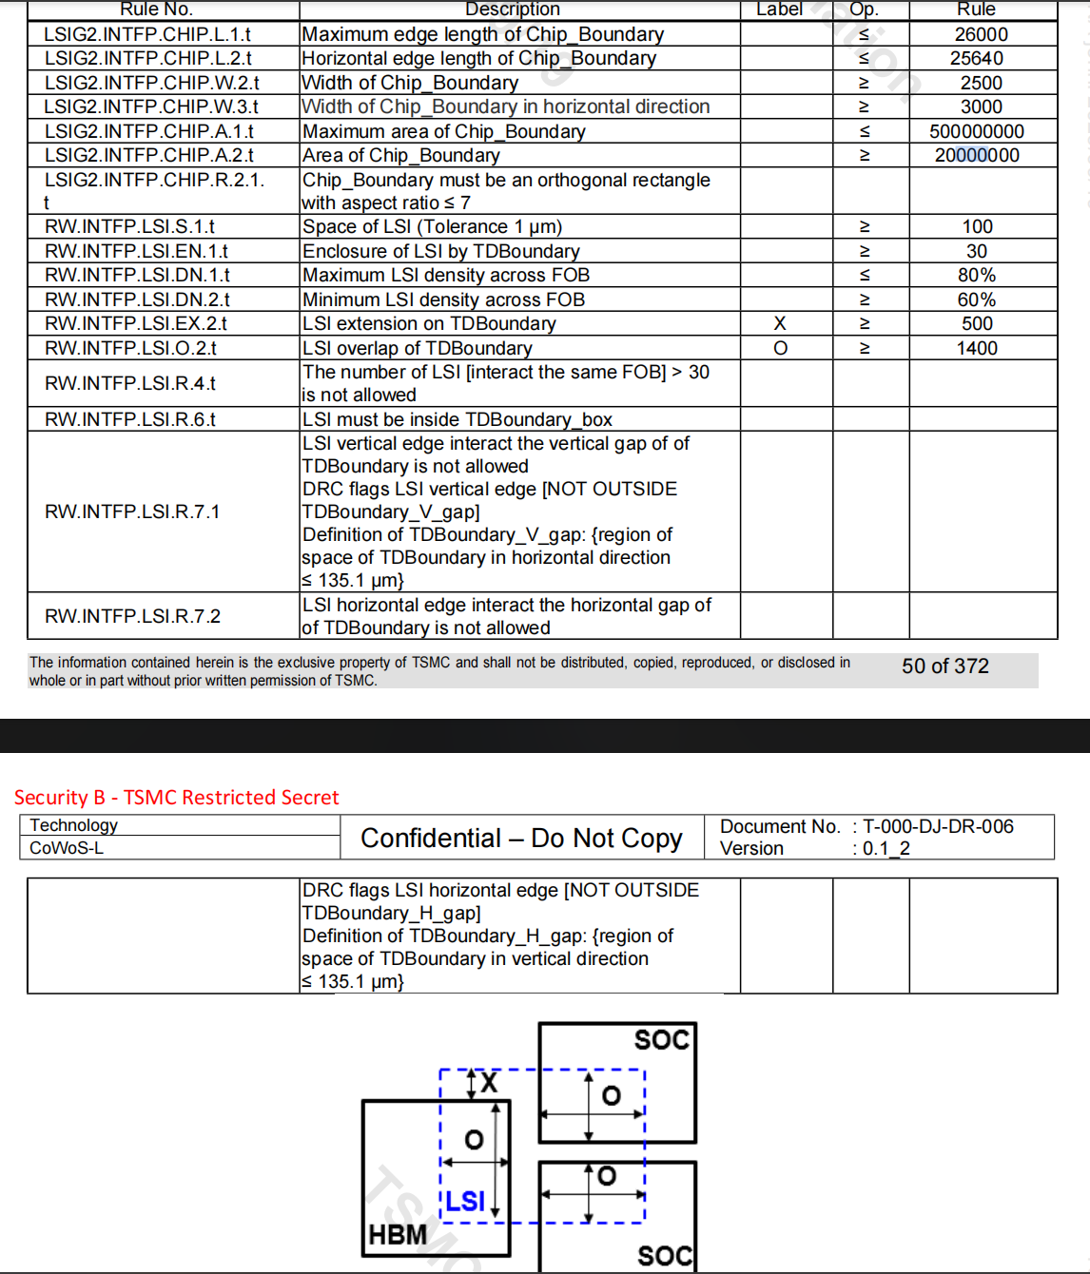
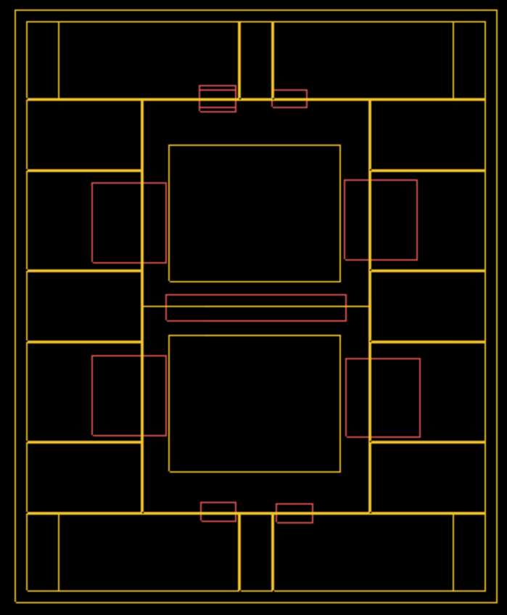

Slide 20
Benefit of Using Database -I
1. The database captures the concepts of symbol (module) and instantiation
The original CSV is a flat list of wires
  every row repeats the module name, the instance name, and the pin name as plain strings.
  There's no notion of "X200 is a chiplet type with 2,192 pins, and X2TL, X2TR, X2BL, X2BR are four copies of that type."
The database makes this distinction first-class.
  A symbol (e.g. X200) is the symbol (template)
  A component (e.g. X2TL) is one instance of that template

Slide 21
Benefit of Using Database -II
2. The database records what each LSI bridge actually connects internally
The CSV only tells you which signals enter and leave a bridge — it has nothing to say about which input pin is wired to which output pin inside IOLSI / HBMLSI / D2DLSI. That information lives in the third-party *_Pin_Connect.csv files, but you have to load them manually and cross-reference everything by hand.
The database loads those files at build time into a dedicated lsi_pin_map table (1,096 IOLSI + 9,353 HBMLSI + 1,092 D2DLSI pairs). That's how the explorer's "Export Edges" button knows what to export, and it's how the path-tracer can walk a signal end-to-end through the bridge. It also lets us catch real design questions cleanly — for example, the JTAG correction we just did (TCK / TMS / TRSTN / TDI / TDO routed past the bridge, not through it) is recorded as a small, code-documented transform; with a CSV-only flow, that correction would have to be reapplied by every consumer of the data, every time.

Slide 23
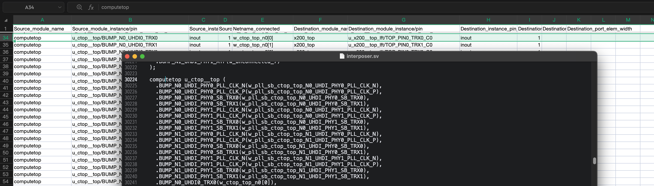

Slide 24
