Slide 1

Neuroscience Spike Detection Project
Detecting, Characterizing, and Visualizing Neural Spikes
Matan Goldenberg | 30.1.25

Slide 2
Introduction
Objective: Analyze neural signals to detect action potentials (spikes).
Key Objectives:
Signal Processing: Band-pass filtering (300 Hz to 10,000 Hz) for noise removal.
Spike Detection: Utilizing FDR-based thresholding for significant spikes.
Refractory Period Enforcement: Applying physiological constraints to minimize false positives.

Slide 3
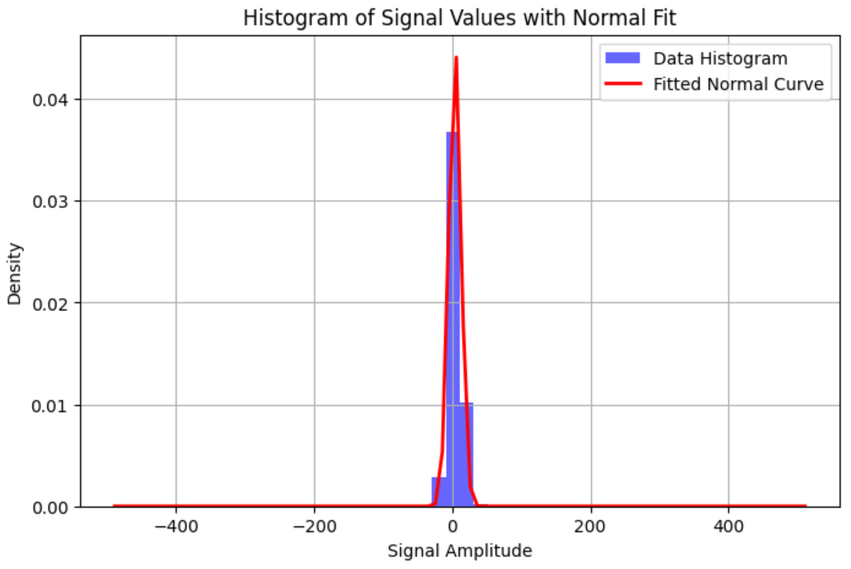
Descriptive statistic

Slide 4
Methods
Preprocessing
Band-pass filtering ensures clean data for spike detection.
Spike Detection
False Discovery Rate (FDR) thresholding: Alpha = 0.05.
Positive and negative thresholds calculated.
Refinement:
Refractory period to ensure meaningful spikes.
Spike characterization: Amplitude and unique patterns.

Slide 5
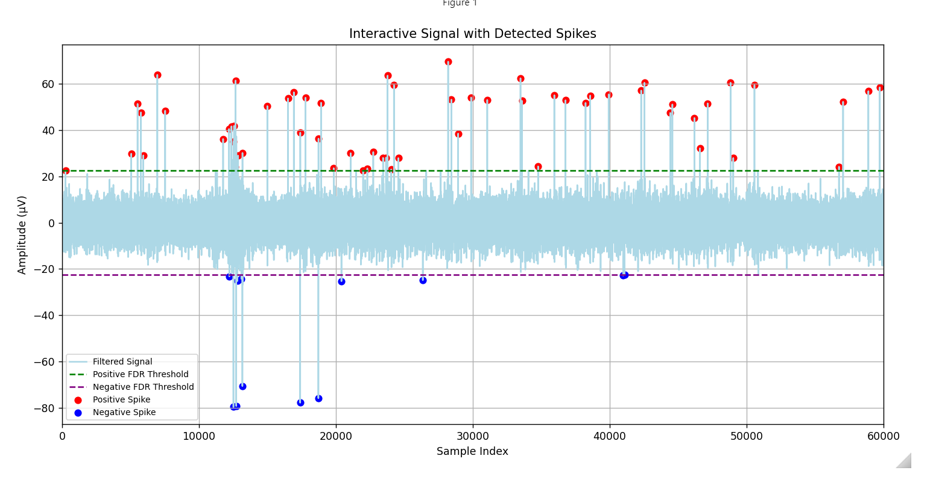
plot

Slide 6
Results and Discussion
Noise Reduction:
Band-pass filtering effectively cleaned the signal.
Spike Identification:
FDR-based thresholding accurately identified
Interactive Visualization:
Enabled detailed exploration of spike dynamics.
Future Directions:
Apply advanced signal processing (second-order derivatives) for peak detection.
Leverage machine learning for classification and threshold optimization.

Slide 7

Thank You
Questions?

