Slide 1
Retail Demand Forecasting & Inventory Planning
Business review · numbers as of run 20260818T095823Z-fdcd09 (2026-08-18)
A Streamlit application that analyses historical sales, uses one global machine-learning model to predict how many units each active product will sell next month, converts the forecast into a recommended target inventory using safety stock derived from out-of-sample forecast errors, and lets users evaluate product forecasts, model performance and the trade-off between stockouts and excess inventory.
Team & roles (PRD §54)
Member | Role
Daniel B. Fogel | App lead · PM / QA / docs — platform, Streamlit, CI, presentation
Matan Hillel | Data & EDA lead · Flow lead — cleaning, panel, EDA, contract, Flow
Dor Hll | ML lead — features, models, evaluation, sigma, inventory policy
Run status: success · mode no-llm · Provenance: 10 input table(s) are not listed in this run's artifact map, so they were carried forward from an earlier run and record run id(s) 20260816T130627Z-674246, 20260817T143811Z-85257f, 20260818T075922Z-deb02f of their own.
Numbers as of run 20260818T095823Z-fdcd09 (2026-08-18) · Online Retail II (UCI, CC BY 4.0), Chen (2019) · generated by scripts/build_presentation.py
Notes:
One sentence on what we built: a Streamlit application that forecasts next month's unit demand per product and turns that forecast into a recommended target inventory. Every number in this deck was computed by the pipeline in run 20260818T095823Z-fdcd09 and read from an artifact file; nothing was typed by hand. Note the provenance line at the bottom: it says which input tables this run itself wrote and which were carried forward.

Slide 2
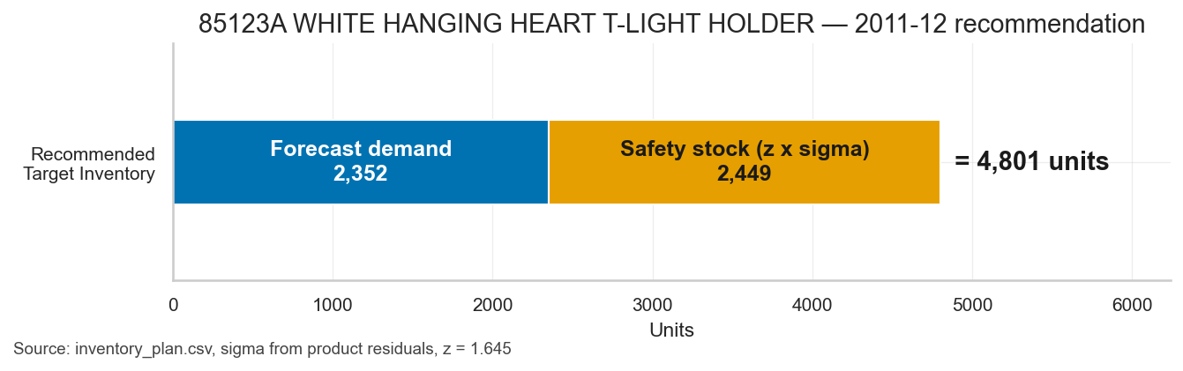
The business problem
Two risks, one balance — and a recommendation a planner can act on
• Stockouts: less inventory than demand: lost sales, lower customer satisfaction, emergency replenishment.
• Overstock: more inventory than needed: capital tied up, storage cost, obsolescence.
• The product turns history into one actionable line per product: expected demand, the safety stock its uncertainty requires, and the target inventory level.
• The dataset holds no on-hand or on-order position, so the output is a Recommended Target Inventory — a level to hold, not an amount to buy (PRD §7).
Numbers as of run 20260818T095823Z-fdcd09 (2026-08-18) · Online Retail II (UCI, CC BY 4.0), Chen (2019) · generated by scripts/build_presentation.py
Notes:
Thousands of products, wildly different patterns. Too little stock loses the sale; too much ties up cash and ages on the shelf. The chart is a real product from this run's inventory plan, not an illustration: the blue bar is the demand the model expects next month, the orange bar is the safety stock its forecast uncertainty requires, and the sum is the level we recommend holding. We recommend a level, never a purchase order — the data has no inventory position to subtract.

Slide 3
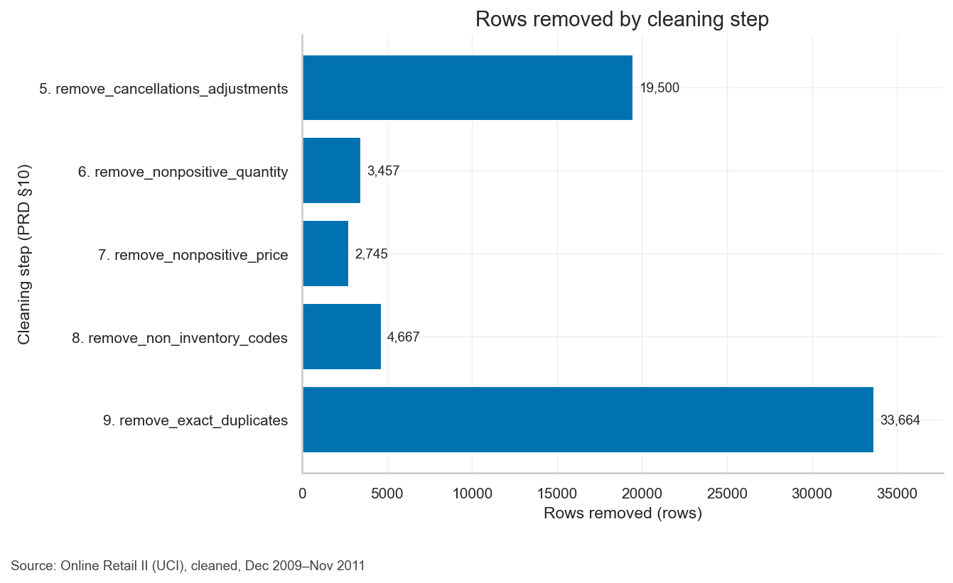
Data & cleaning waterfall
Online Retail II (UCI) — every row removed is counted, and the count is reproducible
• 1,067,371 raw sales lines, 5,131 stock codes, 2009-12 to 2011-12.
• 1,003,338 lines survive cleaning (94.0 % of raw) across 10 audited steps.
• Exact duplicates are 3.22 % of rows and 1.87 % of units — above the configured warning thresholds, so it is reported, not hidden.
• 27 non-inventory codes (postage, carriage, manual adjustments) are excluded by an explicit, reviewed list.
• 2011-12 is partial (226,334 units to the 9th): shown as a hatched actual, never scored. Last full month is 2011-11.
Numbers as of run 20260818T095823Z-fdcd09 (2026-08-18) · Online Retail II (UCI, CC BY 4.0), Chen (2019) · generated by scripts/build_presentation.py
Notes:
Two years of a UK online retailer's transactions. Cleaning is a waterfall: every step records how many rows and units it removed and why, so the count is auditable and any two runs agree. Cancellations and returns are removed as rows but never subtracted from demand — the stock still had to be on the shelf to fill the original order. December 2011 stops on the 9th, so we show it hatched and never score a model on it.

Slide 4
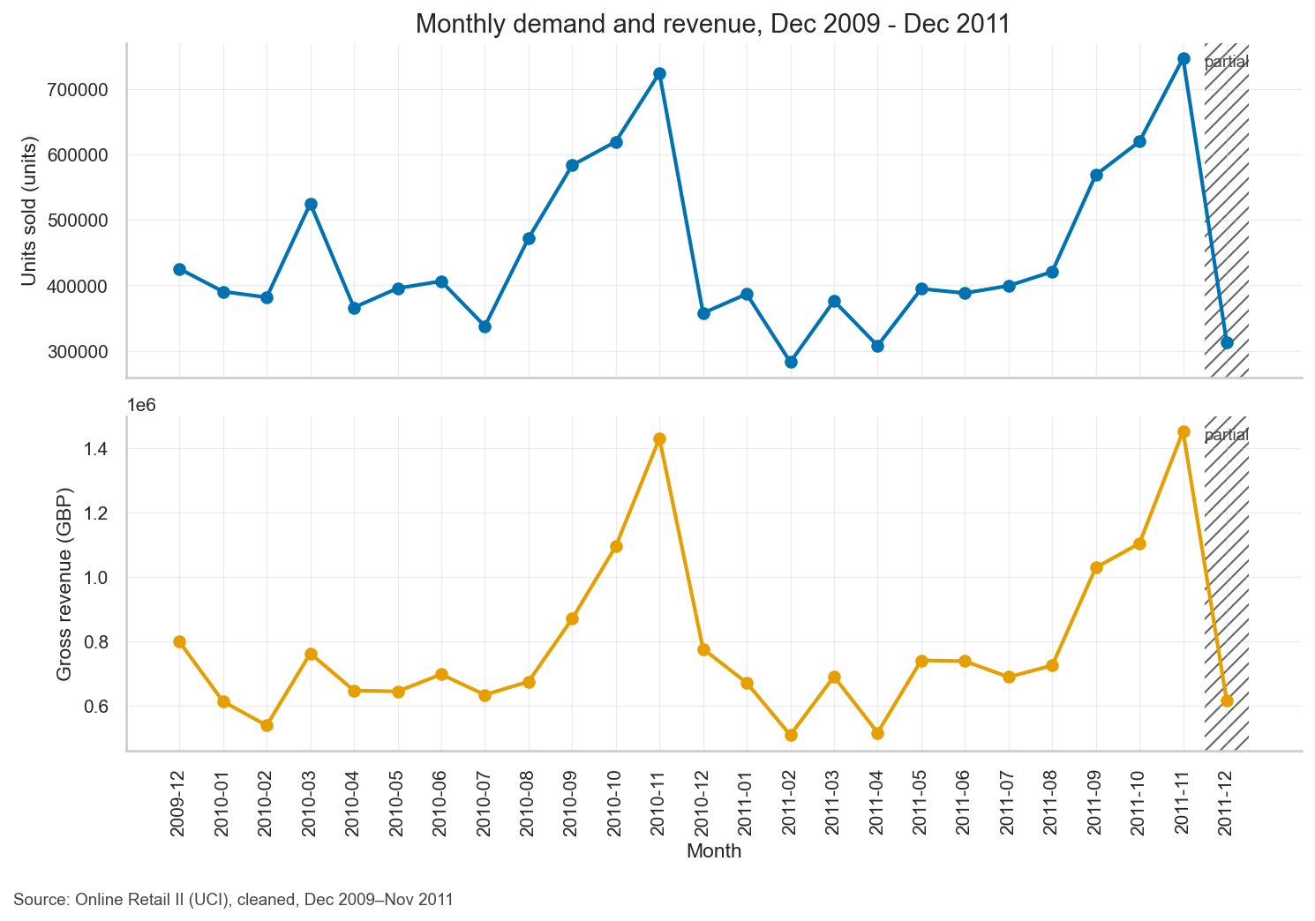
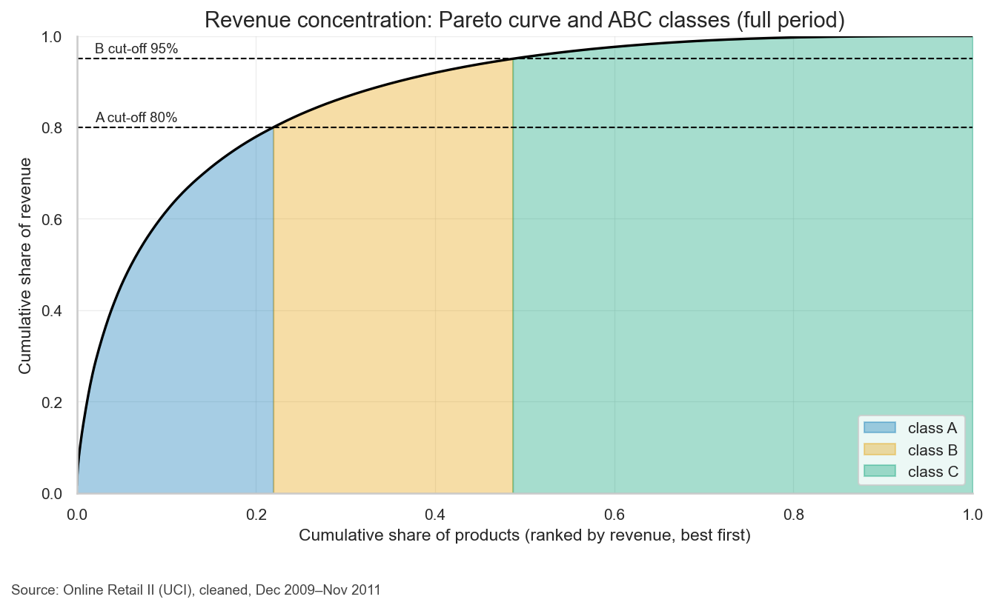
What happened in the data
Seasonality, concentration, lifecycle — the three facts that shaped every decision
• Seasonality — September to November carries 35.5 % of the year's units — so the hold-out window deliberately covers the peak — a model validated only on quiet months would be scored on data unlike the months that matter...
• Concentration — Class A is 21.9 % of the catalogue and 80.0 % of revenue — so accuracy on a small head of products decides the result, and the safety-stock fallback groups products by that same class when a product has too...
• Lifecycle — 24.4 % of products sell in 6 months or fewer, and the median product sells in 14 months — so long history is the exception; the feature set leans on short lags rather than assuming two years of it (§18.1).
Numbers as of run 20260818T095823Z-fdcd09 (2026-08-18) · Online Retail II (UCI, CC BY 4.0), Chen (2019) · generated by scripts/build_presentation.py
Notes:
Three findings drove the design. Autumn is when the money is made, so the test window covers it rather than the quiet months. Revenue is concentrated in a fifth of the catalogue, so we report accuracy by ABC class and not only in total. Most products have short lives, so the model leans on recent months rather than assuming two years of history. Each sentence comes from a computed table in the EDA report.

Slide 5
Research question & two-layer design
One question, answered in two layers that are never mixed
How many units of each product are expected to be sold in each month (and, by aggregation, in each quarter), based on historical sales data — and what target inventory level is required according to that forecast in order to reduce both stockouts and excess inventory?
• Layer 1 — forecasting (machine learning): one global model predicts units sold per active product for the next month. It never predicts inventory.
• Layer 2 — inventory policy (a deterministic rule): target inventory = ceil(max(0, forecast + z x sigma)), computed after the forecast, in code a planner can read.
• Active product: at least one sale in the 6 months before the target month. Forecast origin is month t-1; features may use months <= t-1 only.
• Split is temporal, never shuffled: train targets 2010-03 to 2011-05, hold-out 2011-06 to 2011-11.
• Quarters are the sum of three one-step-ahead monthly forecasts, so quarterly error is not an independent three-month-ahead result (PRD §31-§32).
Numbers as of run 20260818T095823Z-fdcd09 (2026-08-18) · Online Retail II (UCI, CC BY 4.0), Chen (2019) · generated by scripts/build_presentation.py
Notes:
The research question has two halves and we answer them with two different tools. How much will sell is a prediction problem, so a machine-learning model does it. How much to hold is a policy decision, so a transparent formula does it — forecast plus a safety buffer sized from the model's own past errors. Keeping them apart is what lets us change the service level without retraining anything, and it is why the model is never asked to predict inventory.

Slide 6
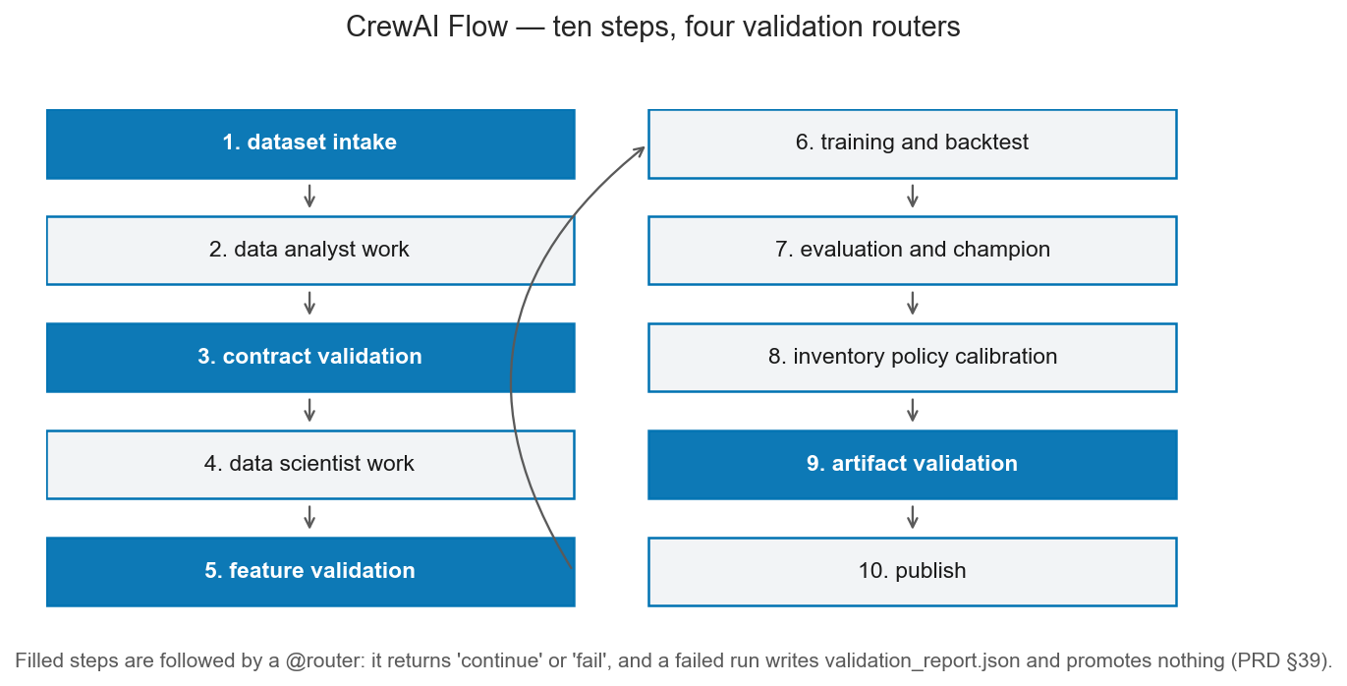
CrewAI Flow architecture
Ten steps, four validation routers, two crews of three agents — and no agent computes a number
Data Analyst Crew (§35)
• Data Quality Analyst
• Data Preparation Analyst
• Business & EDA Analyst
Data Scientist Crew (§36)
• Feature Engineering Specialist
• Forecasting Model Scientist
• Model Evaluation & Inventory Scientist
• The Flow runs the deterministic tools itself; agents read the output and write prose.
• Every narrative is checked against the computed tables before it is accepted (§38).
• --no-llm and LLM runs produce numerically identical artifacts.
Numbers as of run 20260818T095823Z-fdcd09 (2026-08-18) · Online Retail II (UCI, CC BY 4.0), Chen (2019) · generated by scripts/build_presentation.py
Notes:
The pipeline is a CrewAI Flow: ten steps from raw file to published app, with four checkpoints that can stop the run. A failed run writes a validation report and leaves the previous results untouched — it can never half-overwrite good output. Six agents in two crews review and explain, but none of them calculates anything: every number comes from code, and an agent's text is rejected if it states a number no table contains.

Slide 7
Model comparison
Hold-out 2011-06 to 2011-11 — wMAPE and Bias, always together (§23)
Model | wMAPE | Bias | Rows scored | vs B2_ma3 (points) | Note
B1_last_month | 55.7 % | -8.5 % | 19,968 | -0.97 | reference only, partial coverage
B2_ma3 | 54.7 % | -17.4 % | 19,968 | - | reference only, partial coverage
B3_seasonal_naive | 89.6 % | 35.0 % | 16,529 | -34.85 | reference only, partial coverage
M1_linear | 56.0 % | -18.1 % | 19,968 | -1.29 | reference only, partial coverage
M2_gbm_poisson (champion) | 52.6 % | 0.7 % | 19,968 | +2.15 | reference only, partial coverage
M3_gbm_squared | 54.3 % | 1.5 % | 19,968 | +0.41 | reference only, partial coverage
M4_gbm_absolute | 50.2 % | -25.8 % | 19,968 | +4.57 | reference only, partial coverage
• wMAPE = total absolute error / total actual demand (lower is better). Bias = total (forecast - actual) / total actual: negative means we systematically under-forecast.
• The split is temporal and the back-test uses rolling origins, so no model ever saw the month it is scored on (§21-§22).
• All models are scored on identical rows; B3_seasonal_naive is reference only, because it has no month t-12 for every product.
Numbers as of run 20260818T095823Z-fdcd09 (2026-08-18) · Online Retail II (UCI, CC BY 4.0), Chen (2019) · generated by scripts/build_presentation.py
Notes:
Read two columns together. wMAPE is the total error as a share of total demand — how far off we are. Bias is whether the misses cancel out or lean one way; a model that is accurate but always low would quietly cause stockouts. The lowest wMAPE in the table is not automatically the winner, and the next slide shows why: a strongly biased model is disqualified before accuracy is even considered.

Slide 8
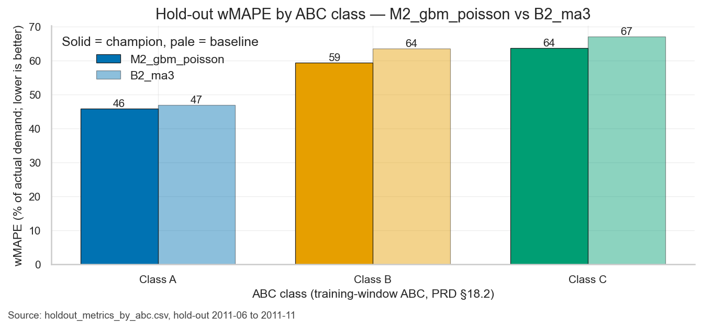
Champion decision & results by ABC
Chosen by fixed rules in code (PRD-v1.3-section20), not by preference
• Gate 1 — bias: |Bias| must be <= 10 %. 4 of 7 candidates failed: B2_ma3 (Bias -17.4 %), B3_seasonal_naive (Bias 35.0 %), M1_linear (Bias -18.1 %), M4_gbm_absolute (Bias -25.8 %).
• Gate 2 — accuracy: lowest wMAPE among the survivors. Winner: M2_gbm_poisson at 52.6 %, Bias 0.7 %.
• Gate 4 — meaningful improvement: M2_gbm_poisson beats the best gate-passing baseline (B1_last_month) by +3.12 wMAPE points — a meaningful improvement by the configured threshold.
• Baselines are judged by the same gates. A baseline winning would be a legitimate result and would be reported as one.
Numbers as of run 20260818T095823Z-fdcd09 (2026-08-18) · Online Retail II (UCI, CC BY 4.0), Chen (2019) · generated by scripts/build_presentation.py
Notes:
The champion is picked by rules written down before the results existed. First the bias gate: any model that leans systematically high or low is out, however accurate it looks. Then the lowest error among what is left. Then a check that the winner beats the simple baseline by enough to be worth the complexity. The chart shows the same comparison split by ABC class, because the head of the catalogue is where accuracy pays.

Slide 9
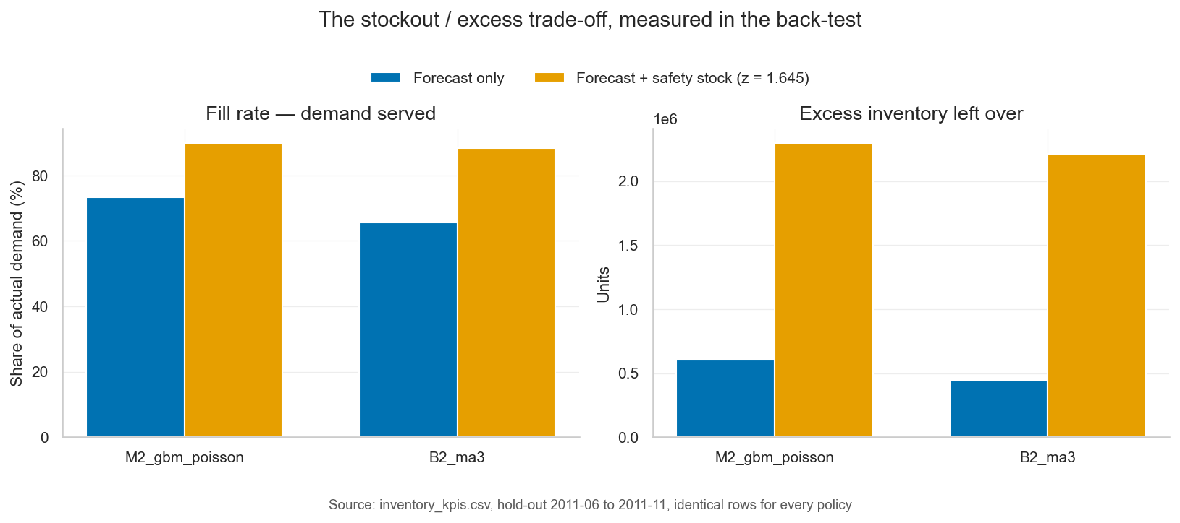
Inventory policy & back-test KPIs
Safety stock = z x robust sigma, z = 1.645; measured, not assumed
• M2_gbm_poisson + safety stock: fill rate 89.9 % (from 73.3 % on the forecast alone), 221,840 units short, 2,295,561 units excess.
• B2_ma3 + safety stock: fill rate 88.3 %, 256,271 units short, 2,210,581 units excess.
• Excess is concentrated: 42.2 % of it sits in the top 5 % of product-months, so it is a short list to manage, not a spread problem.
• z is a slider in the app: 1.28, 1.645, 2.05.
• z = 1.645 does not guarantee a 95% fill rate; the achieved fill rate is measured in the back-test (PRD §25)
Numbers as of run 20260818T095823Z-fdcd09 (2026-08-18) · Online Retail II (UCI, CC BY 4.0), Chen (2019) · generated by scripts/build_presentation.py
Notes:
This is the slide the business cares about. Fill rate is the share of real demand the recommended inventory would have covered; excess is what would have been left over. Adding safety stock buys a large jump in fill rate and costs excess units — the trade-off, priced. Two warnings: the multiplier does not guarantee a service level, we measure what it actually achieved; and the excess sits in a few product-months.

Slide 10
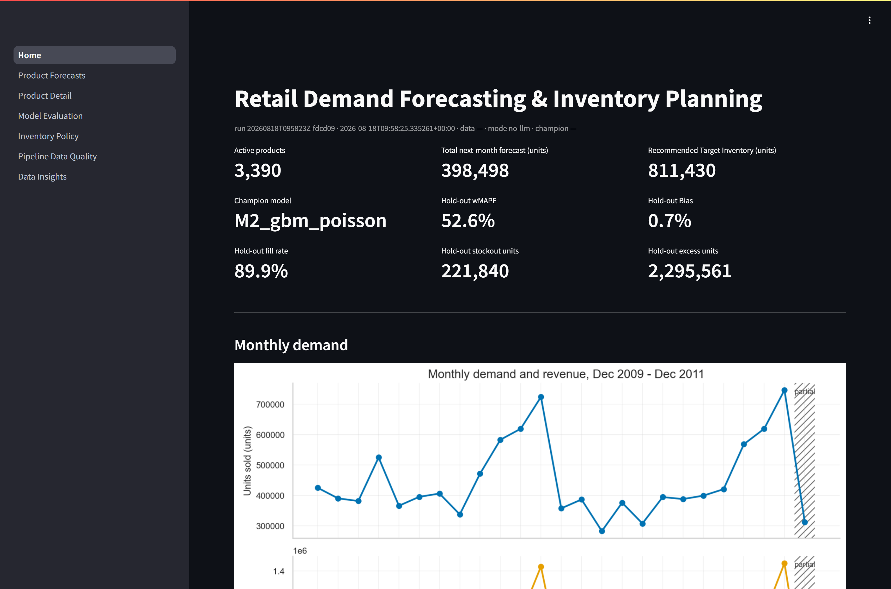
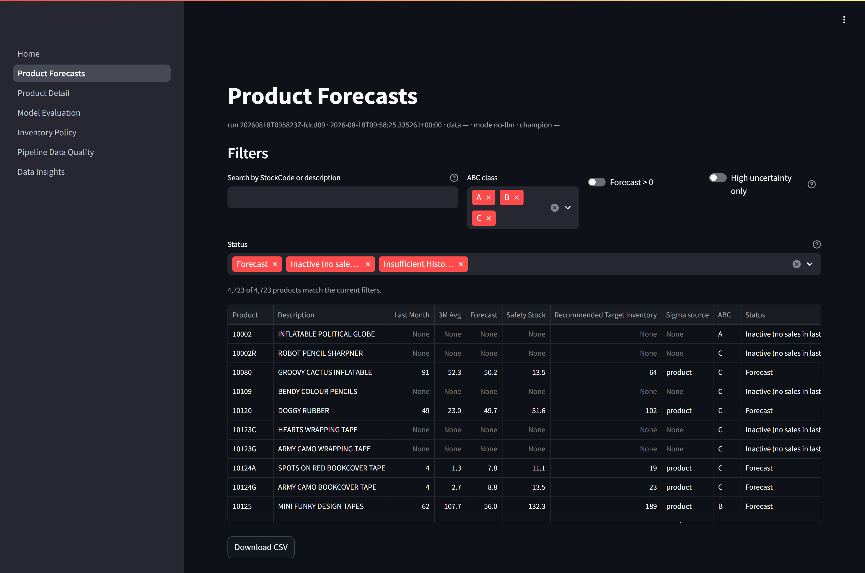
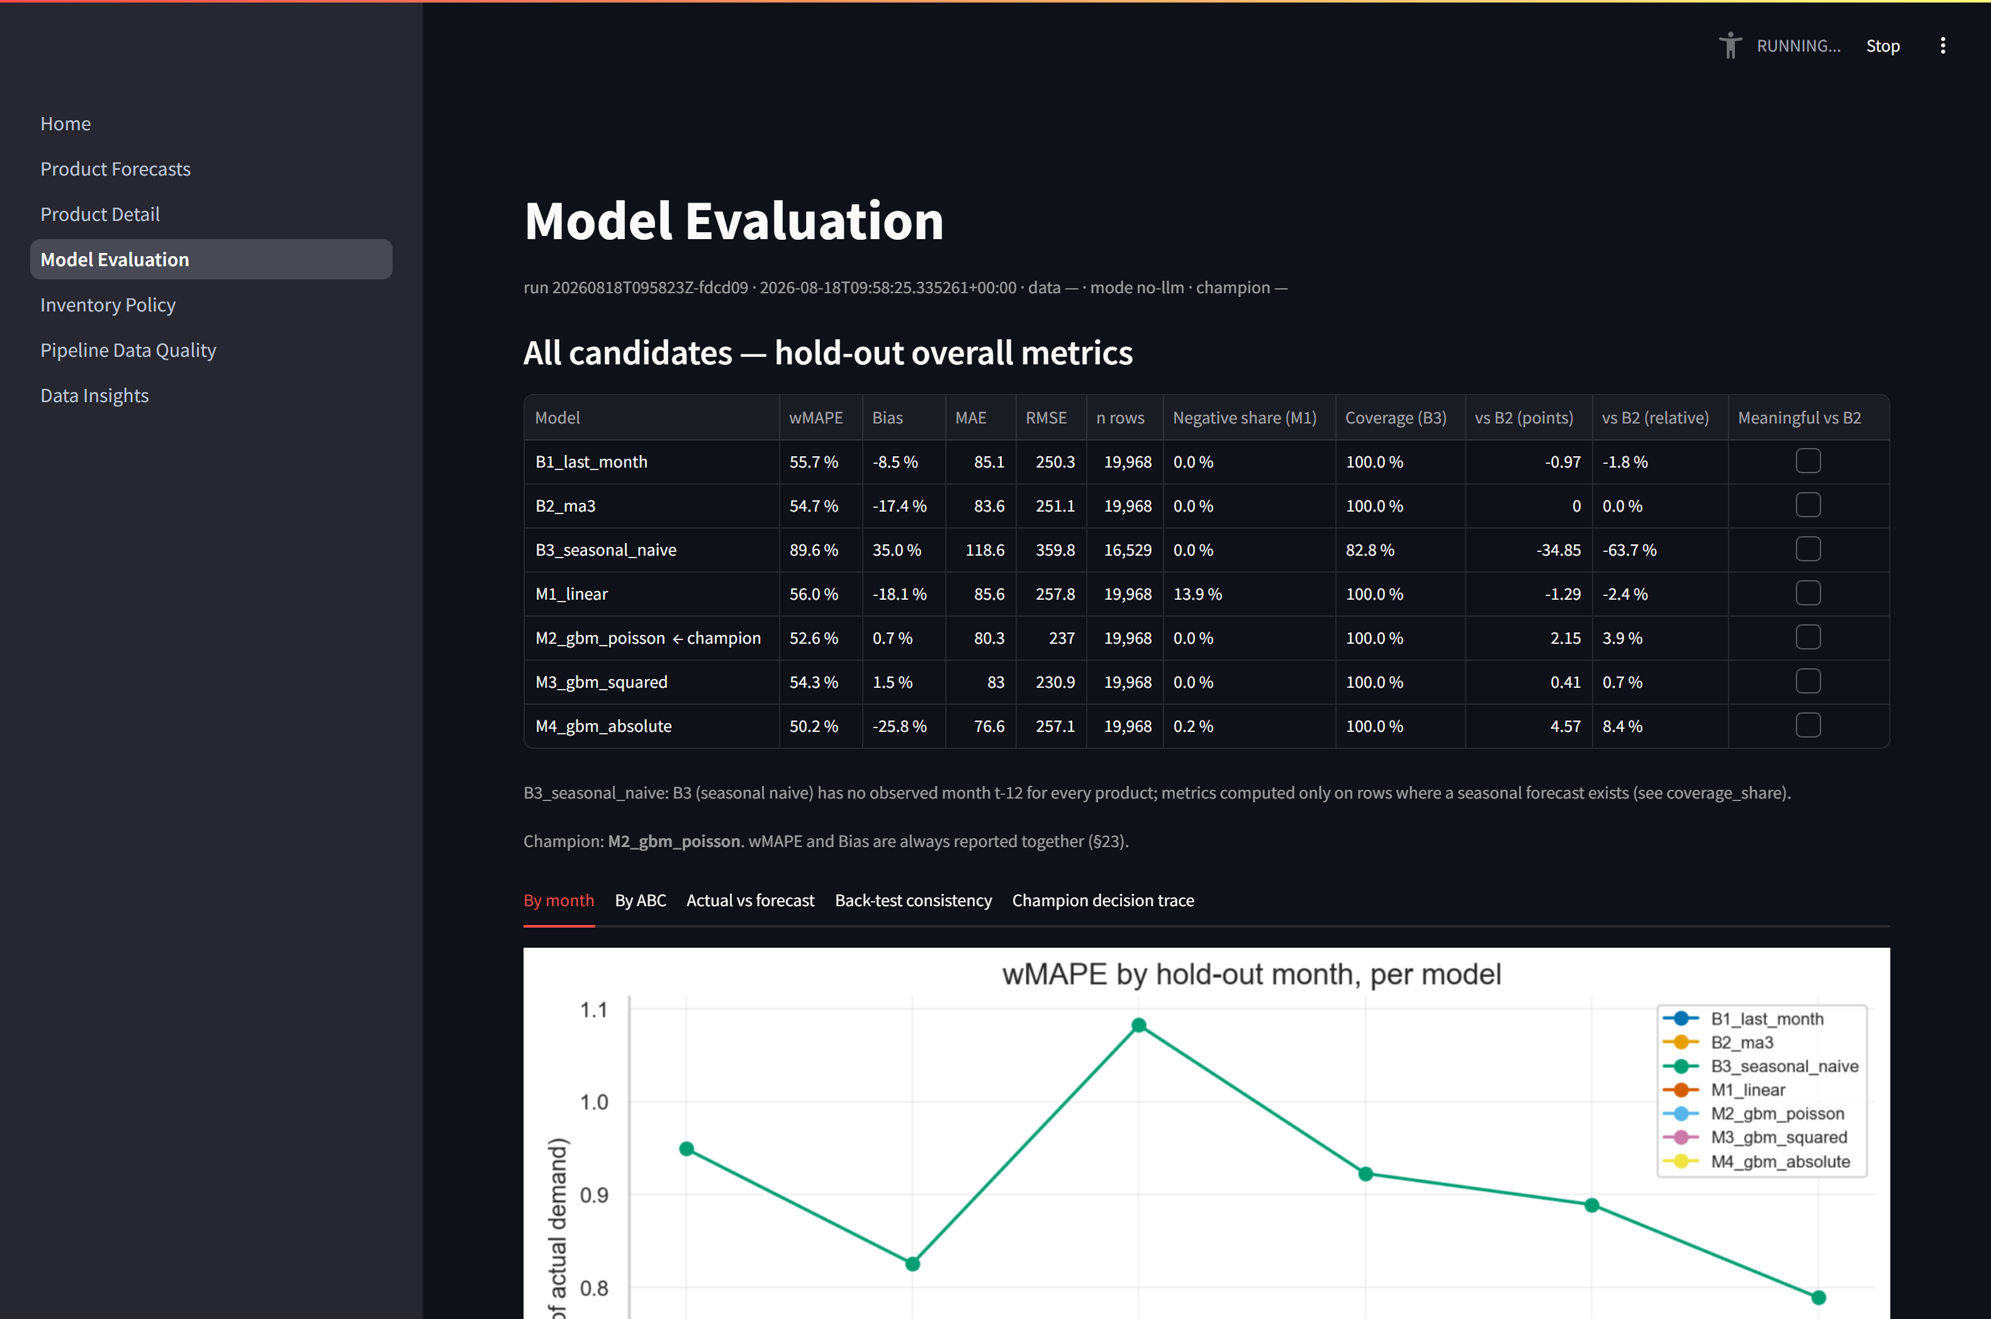
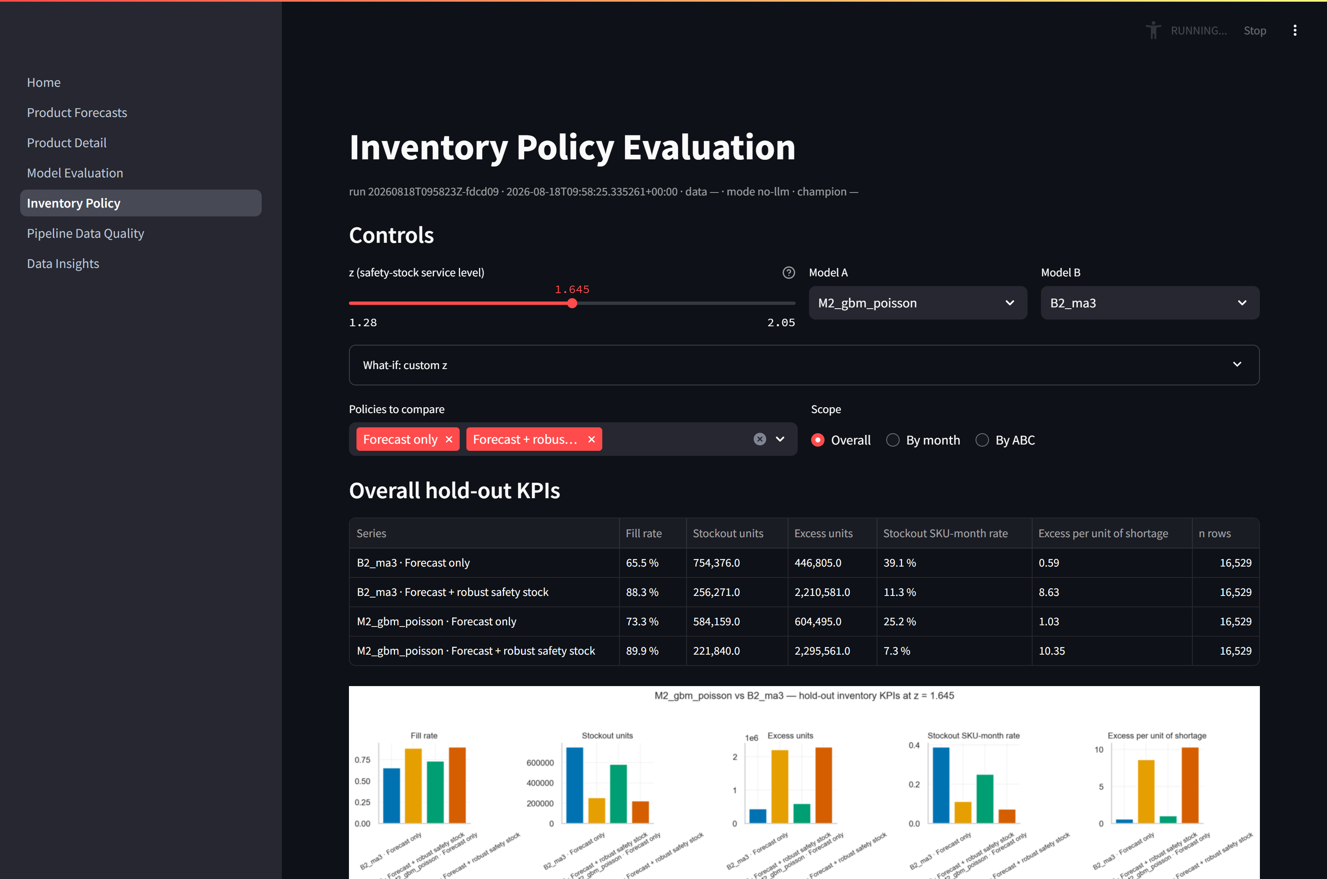
The product
Seven Streamlit screens; the planner never sees a model, only a recommendation
1 — Executive dashboard
2 — Product forecasts & CSV export
4 — Model evaluation
5 — Inventory policy & z slider
Numbers as of run 20260818T095823Z-fdcd09 (2026-08-18) · Online Retail II (UCI, CC BY 4.0), Chen (2019) · generated by scripts/build_presentation.py
Notes:
These are screenshots of the running application, not mock-ups. The dashboard answers 'what should I hold next month' in one screen. The forecast table filters by class and exports to CSV, so a planner can work in the tool they already use. The evaluation and policy screens are the honesty layer: every metric behind the recommendation, and a slider that shows what a different service level would cost.

Slide 11
Limitations & ethics
Straight from the model card — the same text ships with the artifacts
Limitations (§47)
Ethics & licensing (§48)
• Twenty-four months of history only. The dataset runs 2009-12 to 2011-11 complete; there is no earlier history to validate longer seasonal cycles.
• December 2011 is partial (2011-12) — shown as a partial actual, never scored, and it is the target of the latest operational forecast only.
• No on-hand or on-order inventory data. The output is a Recommended Target Inventory, never an order quantity (PRD §7).
• Cold start. A product with no observed month at or before the forecast origin gets no model forecast and no invented history (status Insufficient History / New...
• Extreme orders. A handful of very large wholesale lines exist in the data; safety stock uses a robust spread measure (median absolute deviation) rather than a...
• Gross demand, not net of returns. The target is units sold on positive sales lines; cancellations and adjustments are never subtracted, because inventory was...
• Left-censoring. Products already selling in the first observed month may be older than the data shows.
• Service-level disclaimer: z = 1.645 does not guarantee a 95% fill rate; the achieved fill rate is measured in the back-test (PRD §25)
• No decisions about individuals. This model forecasts aggregate product demand; it never scores, ranks or makes a decision about a person.
• Customer ID is never a feature. Rows without a Customer ID are kept (the sale still happened and still needed stock), and the identifier itself is...
• Anonymised data. The underlying dataset carries no names, addresses or other direct identifiers — only a numeric customer id, country and transaction detail.
• Residual risks: Blind reliance — a planner treating the forecast or the recommended inventory as certain rather than an estimate with a measured error and fill...
• Scope of the recommendation. Every number here relies only on the historical sales recorded in this dataset.
• Licensing and attribution. Source: UCI Online Retail II (CC BY 4.0); Kaggle mirror mashlyn/online-retail-ii-uci. Citation: Chen, D. (2019).
Numbers as of run 20260818T095823Z-fdcd09 (2026-08-18) · Online Retail II (UCI, CC BY 4.0), Chen (2019) · generated by scripts/build_presentation.py
Notes:
What this system cannot do. Twenty-four months means one prior season, so month-of-year effects rest on a single observation. There is no inventory data, so we recommend a level and not an order. New products have no history to learn from. On ethics: no decision is made about a person, customer identifiers are not used as features, and the dataset licence requires the attribution shown on every slide.

Slide 12
Version 2 roadmap
What we would build next, in the order it would pay off (PRD §50)
→ Quantile regression (p50 / p90 / p95 as direct inventory levels)
→ Direct multi-horizon models (t+1, t+2, t+3) for start-of-quarter planning
→ Cold-start rule from the first 14 days
→ Real inventory data (on hand, on order, backorders, lead times) → order quantities
→ Cost optimisation (holding vs. stockout cost, margin)
→ Demand capping / wholesale-order flags in evaluation
Numbers as of run 20260818T095823Z-fdcd09 (2026-08-18) · Online Retail II (UCI, CC BY 4.0), Chen (2019) · generated by scripts/build_presentation.py
Notes:
Three of these change the answer rather than polish it. Quantile regression would give inventory levels directly instead of a forecast plus a symmetric buffer. Real inventory data would let us recommend an order amount rather than a level. Cost optimisation would replace a chosen service level with the level that actually minimises money — holding cost against lost margin. The rest is coverage: multi-horizon models, a cold-start rule, and flagging wholesale orders in evaluation.

