Slide 1
Project to Predict the Temperature
Project submitters:
Dor sadan - 316018456
Matan malki - 208427419

Slide 2
Research Question?
Can we predict the temperature based on relevant features?

Slide 3
Libraries Used
Pandas
Requests (for API)
Json
Sklean
Category Encoder
Seaborn
Time

Slide 4
Stages of the project
Stage 1: Read the Data
Stage 2: Data Preparation
Stage 3: Split the data into Train and Test
Stage 4: Implement the Model

Slide 5
Stage 1: Reading the data
Called through data from a website through API
Website : https://openweathermap.org/
Made a student account and got a personal key to call the API
Convert JSON Format data into a Pandas Dataframe

Slide 6
Stage 1: Reading the Data from the following citties
Tel Aviv
Timrat
Yavne
Eilat
Haifa
Shelomi
Jerusalem
Dolev
Jaffa
Urim

Slide 7
Stage 2: Data Preparation
Prepared and combined the data into pandas dataframe.
Features in the dataframe:
Pressure
Humidity
Minimum Temperature
Maximum Temperature
Wind Speed
Wind Degree
City
Temperature (Target Variable)

Slide 8
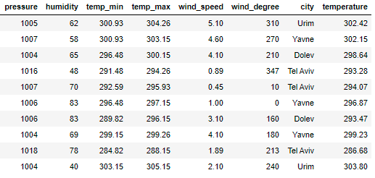
Stage 2: Data Preparation:
Data Preview:

Slide 9
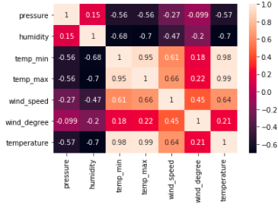
Stage3 3: Train and Test Data
Verified the Co relation between Features:

Slide 10

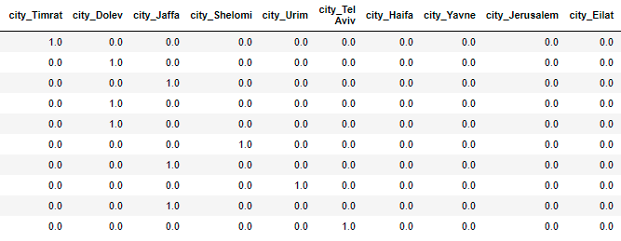
Stage3 3: Train and Test Data
Encoded city as it is a category variable
Before: After:

Slide 11
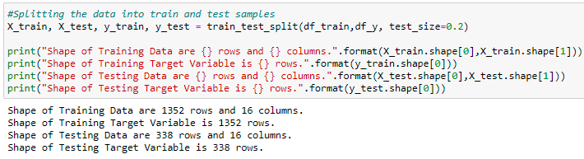
Stage 3: Train and Test Split
Splitted the data into train and testing with 80% - 20% respectively

Slide 12

Stage 4: Fitting the Model
Establishing Baseline Mean Absolute Error which my model is supposed to beat using the mean of the target variable

Slide 13
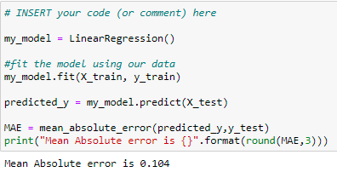
Stage 4: Fitting the model
Fitting the data into Linear Regression

Slide 14
Evaluation
Mean absolute error generated by model is 0.104 which is better than the baseline mean absolute error
The model provides excellent result and can be further used to predict Temperature based on relevant features.
The model will predict the temperature with a slight margin of error of plus or minus 0.104

Slide 15
Thank You!

