Slide 1
Project to Predict the Temperature
Project submitters:
Dor sadan - 316018456
Matan malki - 208427419

Slide 2
Research Question?
Can we predict the temperature based on relevant features?

Slide 3
Libraries Used
Pandas
Requests (for API)
Json
Sklean
Category Encoder
Seaborn
Time

Slide 4
Stages of the project
Stage 1: Read the Data
Stage 2: Data Preparation
Stage 3: Split the data into Train and Test
Stage 4: Implement the Model

Slide 5
Stage 1: Reading the data
Called through data from a website through API
Website : https://openweathermap.org/
Made a student account and got a personal key to call the API
Convert JSON Format data into a Pandas Dataframe

Slide 6
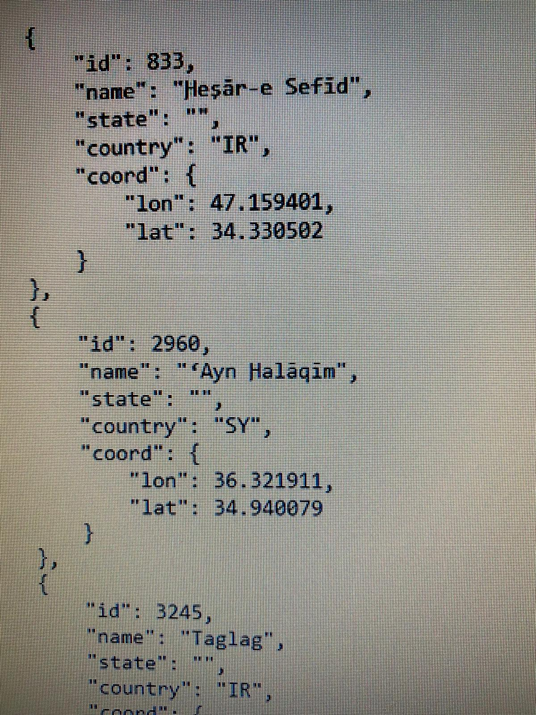
Stage 1: getting a json file with all cities id
For example, cities in Syria and Iran and their city id from the website.

Slide 7
Stage 1: Reading the Data from the following cities
Tel Aviv
Timrat
Yavne
Eilat
Haifa
Shelomi
Jerusalem
Dolev
Jaffa
Urim

Slide 8
Stage 2: Data Preparation
Prepared and combined the data into pandas dataframe.
Features in the dataframe:
Pressure
Humidity
Minimum Temperature
Maximum Temperature
Wind Speed
Wind Degree
City
Temperature (Target Variable)

Slide 9
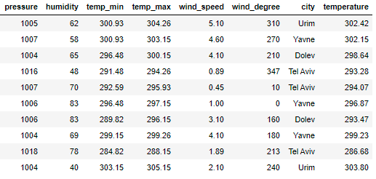
Stage 2: Data Preparation:
Data Preview:

Slide 10
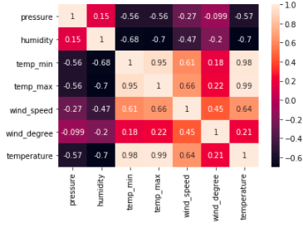
Stage3 3: Train and Test Data
Verified the Co relation between Features via “HeatMap”:

Slide 11
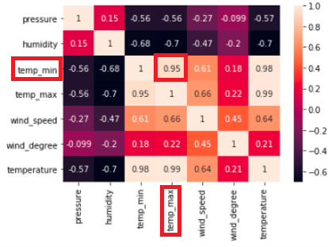
Stage3 3: “heat map”
For example, we can see that when the maximum temperature is higher’ the minimum temperature is higher, so their Co relation close to 1.

Slide 12

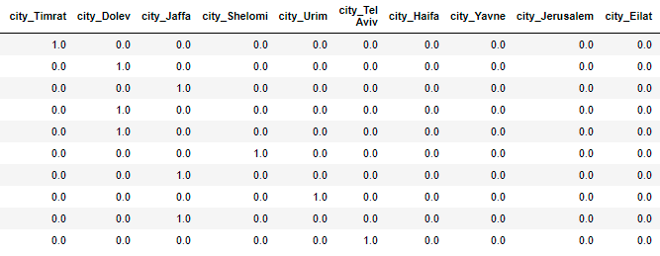
Stage3 3: Train and Test Data
Encoded city as it is a category variable
Before: After:

Slide 13
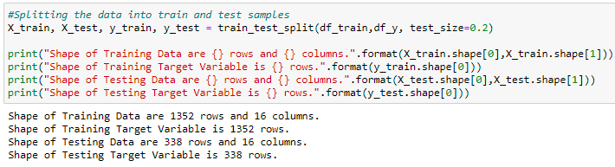
Stage 3: Train and Test Split
Split the data into train and testing with 80% - 20% respectively

Slide 14

Stage 4: Fitting the Model
Establishing Baseline Mean Absolute Error which my model is supposed to beat using the mean of the target variable

Slide 15
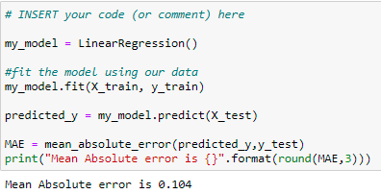
Stage 4: Fitting the model
Fitting the data into Linear Regression because our values are numeric and not categorical.

Slide 16
Limitations and struggles
The data capacity in the begging was 14,000 – we add more cities to get 29,000 .
The temperature was in “Kelvin” – if we want in “Celsius” we need to pay to the website for this kind of data.
Picking values for the predict the temperature and get a good result.
Machin learning test – we don’t get good result because the data was listed by names of the cities, so we need to random all the data to get a good result.

Slide 17
Evaluation
Mean absolute error generated by model is 0.104 which is better than the baseline mean absolute error
The model provides excellent result and can be further used to predict Temperature based on relevant features.
The model will predict the temperature with a slight margin of error of plus or minus 0.104

Slide 18
Thank You!

