Slide 1
Engineering status report
January 10, 2024

Slide 2
Overview
3.1.49-1220 - in production
3.1.50-1228 - first build of the “50” series, in QA
Engageli captions
Quick polls
Duplicate classes (copy data from old class when creating a new one)
Ability to start in “TCP-only mode” on a per-class basis (can be applied to site config as well)
A special link that leads to a separate “test page” that does not require login
Removed inappropriate emojis
Support for WSLP parameter for Linode (get around firewall deficiencies)
Ability to save PDFs shared in class (will appear in content management)

Slide 3

Notes:
###{"0": "Drinking diet coke", "1": "Eating Haagen-Dazs ice cream", "2": "Smoking cigarettes and drinking alcohol", "3": "Don't organize the kitchen as you were told to do"}###

Slide 4
Overview
Next 3.1.50 version
Fix for Engageli captions, remove duplicates
Cover more cases for bad data in playback attendance
Admin portal - fix for class filters in class management
Word cloud - admin portal should show the same cloud as in-class
Disappearing merged gallery
Clients get overloaded in large class with thousands of chat messages

Slide 5
Overview (continued)
Current focus - Bug fixing across the board
Multi-stack support - ability to auto-route different rooms to different stacks to increase concurrency
Work on testing multi-stack and single stack concurrency limits
Class-details page improvements
Continuing effort - fix missing engagements in older data and enhance code that produces them
API - architecture rework to support “lectures” and “student progress” data
V2 API - caching live attendance, pre-computing “engagement vectors” on 5m intervals
Quick polls - AI-generated polls
Setting firewall-related settings semi-automatically (WSLP/Tcp-only flags)
Continuous auto adjustment of LBW/HBW/Normal modes based on network and CPU performance
Moving mergers and recorders to Linode
76 issues, 30 in progress/review not counting mobile, 19 low priority (similar to last week)
54 story tickets, 13 in review/progress

Slide 6

QA
3.1.49 - Widely deployed by now
3.1.50-20240116 - In QA as of a couple hours ago
DalRae, Vika, Ana, Anton B, Marlon
Smoketest in progress
Scale Testing
Warren
Testing 3.1.50 - Robots doing polls, Robots doing chat
Tools and Automation
Lead Adam
Ana Secondary
Anton, Cecilia, Marlon initial contributions
Introduced “doChat” option for load test robots, demonstrated system overloading with sufficient numbers of robots chatting. Waiting to test Matan’s fix in next tag.
Adam working on a version of the engageli-mic-activity-tracker UI component to operate on the global audio output stream. This new component will facilitate testability of audio stream functionality at scale.

Slide 7

DevOps
3.1
k8s robot init speed up and cost improvements in progress
Multi-stack implementation support
Gcore CDN implementation
Hiring process
Frenchification of marketing contents
Devry media manager and backend1 troubleshooting
Data warehouse support
Dev support

Slide 8
Integrations and accessibility
A11y/UI:
Wrapping up on working on integrating CRN into analytics in Admin Portal
Stride a11y bugs
LTI/Misc:
Playback attendance intermediate data saved in db for faster attendance: in review
Bugfix: recording edit, investigating
LTI deeplink “hang” fixed in 50

Slide 9
Authentication, authorization and data
Working on engagement API rate limiter
Working on cache attendance report

Slide 10
Engageli Media Server
Auto-scaling of EMS Routers, allowing rapid increase/decrease in number of concurrent users - merged to master branch
Improving handling of WSLP mode - merged to master branch
Improving robustness of Akamai/Linode EMS:
Automatic detection of issues (outages, capacity limits, etc)
Automatic fallback or routing of excess load to AWS
Working on supporting merger/recorder/SIP instances in Akamai/Linode - another phase in review

Slide 11
Frontend and Backend Services
Anton, Lisa, Oleksii, Max
New Class Details Page:
Sessions page -> activities table
Poll results preview modals
Analytics page
Allow “adding to calendar” schedule (from a link, not only ics file)
Quick polls adjustments:
UI improvements
Bug fixes
Engagements
Socket events performance

Slide 12
Frontend and Backend Services
Anton, Lisa, Oleksii, Max
Modules:
Youtube slide creation
General:
Pin Q&As
Marking class as demo class
Misc UI adjustments (tooltips, scroll + zoom pdf, etc)

Slide 13
Frontend and Backend Services
Stas, Ben
Multi-Stack:
Allow adding super-admins from master stack to all stacks
Creating “Canvas mock” for load testing - allowing us to test the system without being dependent on the canvas environment
Tenant default class configuration sync
Scanning Tags from PDFs using more stable libraries
Engageli docs final tests
Chat fixes
Onboarding Sean

Slide 14
Frontend and Backend Services
Sean
Onboarding
Automatically change destination in chat when moving from room mode to table mode (and if you are in a table)

Slide 15
Frontend and Backend Services
Nikita, Rotem
Hiding sub-rooms feature
Working on storing playback meetings in DB
Fix recording when the class is directed to Table View
Allow instructor(s) to change the “correct” answer in playback room
Allow instructor(s) to view poll answers in playback even if results were not shared
Pre select verified answer for the instructor in playback
Preparing documents for the APIs specs

Slide 16
Frontend and Backend Services
Yonatan
Implementing 2 dbs approach - engagements db and production db
Create a job that triggers “delta” insertion - takes the info from the ended meeting from the OLTP database and puts it in the engagements db (other db)
Create a similar job that is being called every X hours that takes all non-meeting related engagements and inserts them into the engagements db (other db)

Slide 17
Frontend and Backend Services
Dima, Alex
Low/Mid/High Bandwidth mode UI adjustments
Update sharing modes UI (text vs video sharing mode)
Recordings page
Fixing the “devtools” rendering issues (css reflow)

Slide 18
Frontend and Backend Services
Matan
Chat performance fixes
Poll performance updates
Passing live engagements using memory based queue to prevent extreme network load on clients
Updating whisper modals for better transcription (+ using VAD in the offline transcription) (w/ Oleksii)

Slide 19
Frontend and Backend Services
Paul (iOS), Antonio (iOS) Sasha (Android), Anton (QA)
iOS:
3.1.2 release
Refactor producer stream handling
Fix issues around “disable auto unmute raise hands”
Added support for individual mic block
Update logic around network recovery for producer
Update WebRTC and Mediasoup libraries

Slide 20
Frontend and Backend Services
Paul (iOS), Antonio (iOS) Sasha (Android), Anton (QA)
Android:
Add "block microphone of learners" support
Support quick polls
Update logic for chromebooks
fix crashes

Slide 21
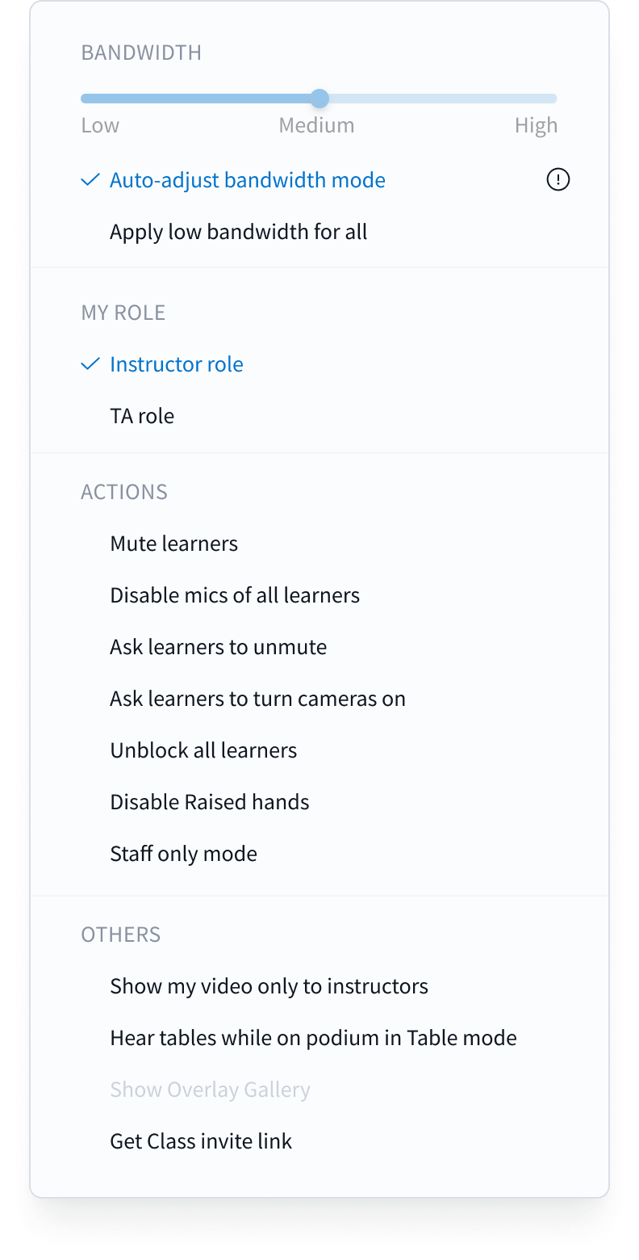
Design team
Bandwidth mode
addings

Slide 22
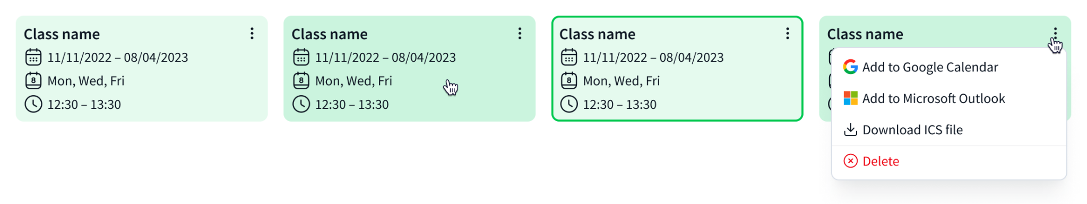
Design team
Calendar integration

Slide 23
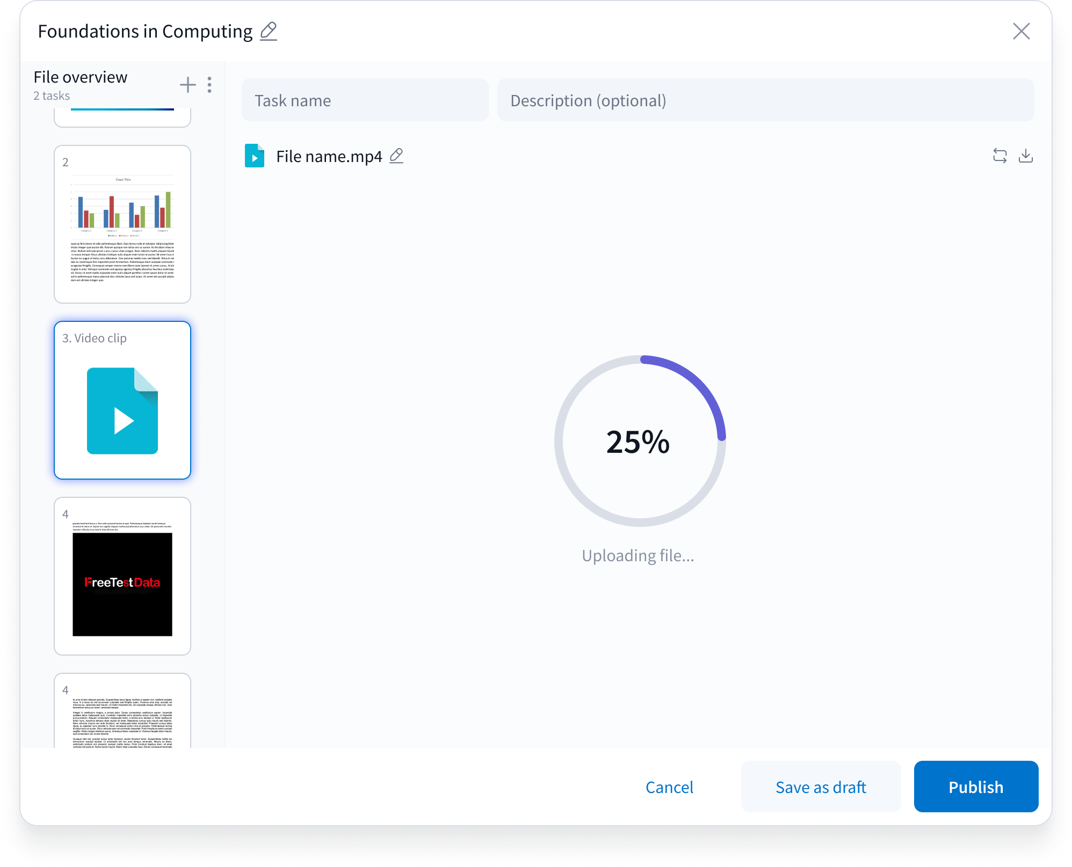
Design team
Tags Polls improvements

Slide 24
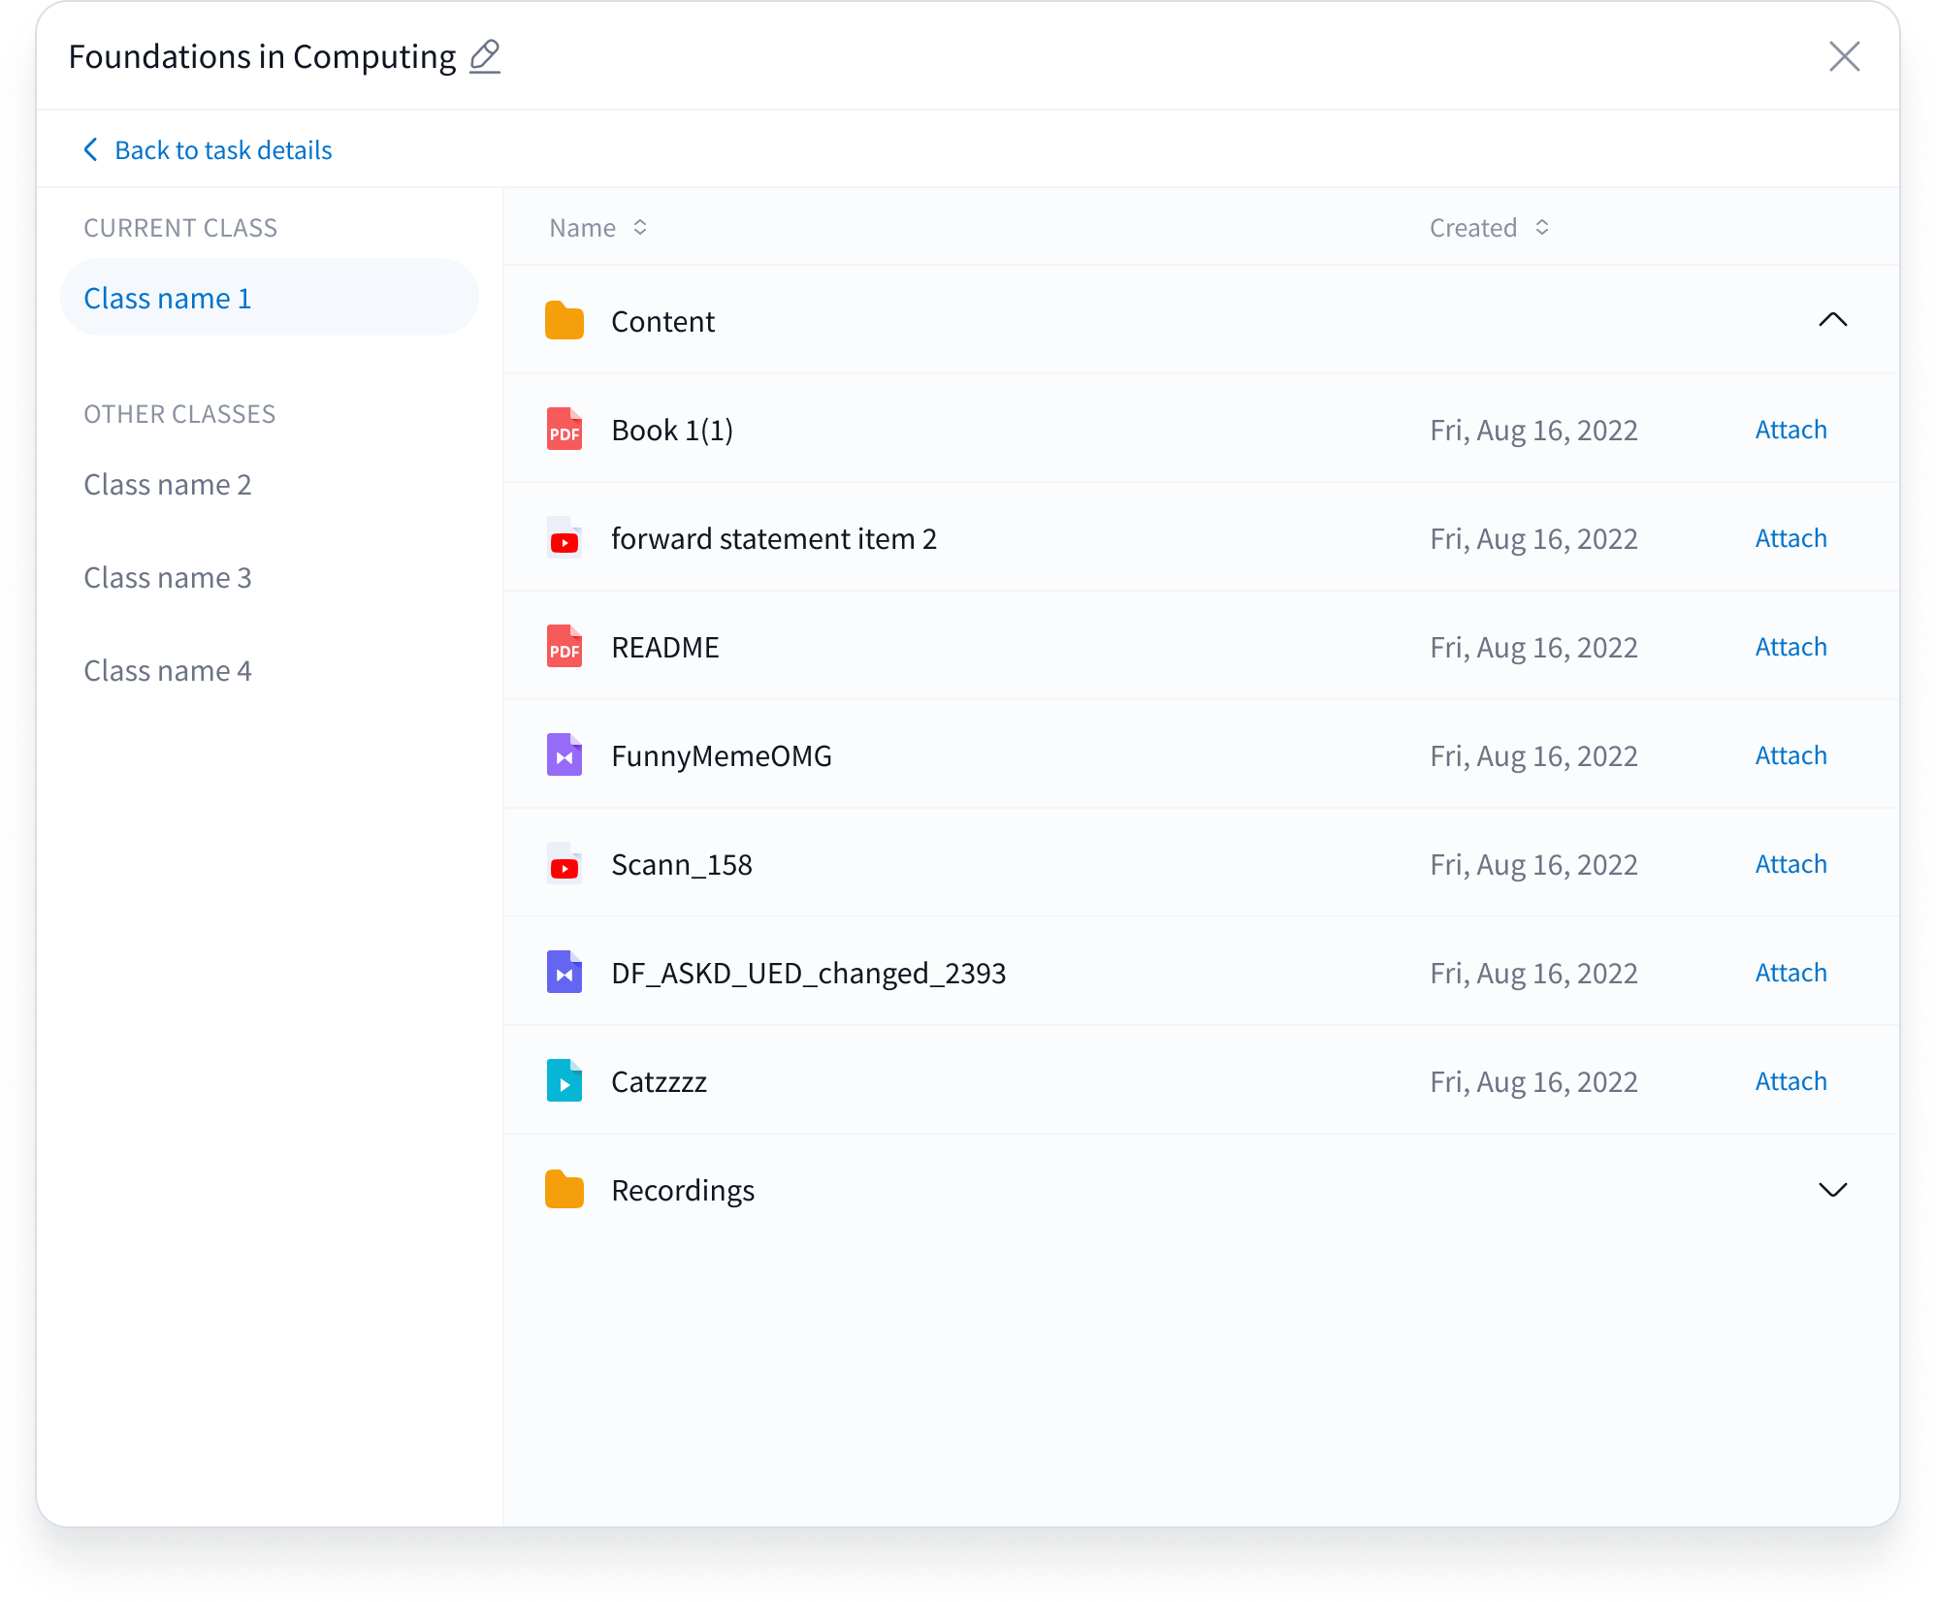
Design team
Content browser finishes

Slide 25
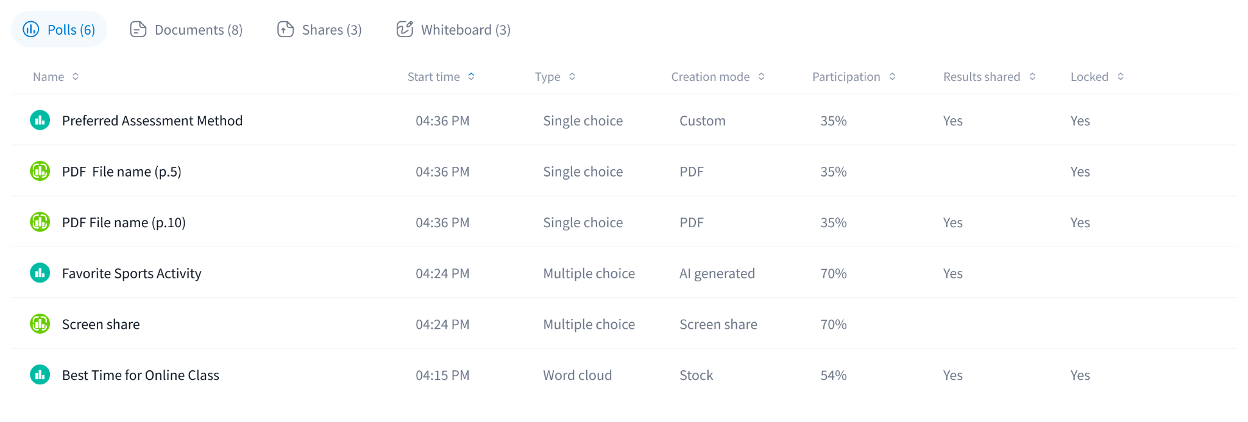
Design team
Polls tab combined (portal)

Slide 26
Design team
Many portal improvements
Portal prototype improvements
“Share results” on polls solutions
“Polls on playback recording” concepts
Playback - inactivity message/timer
Class ver 4 definition
Many new wallpapers (virtual background gallery)
Virtual background icon changes
Polls section definition on portal
Design reviews
Design system fixes
Minor fixes

Slide 27

What is more dangerous?
Drinking diet coke
Eating Haagen-Dazs ice cream
Smoking cigarettes and drinking alcohol
Don't organize the kitchen as you were told to do

