Slide 1
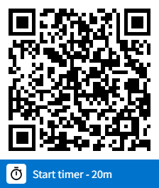

Engineering progress over 2023

Slide 2



Progress during 2023
Major Releases
Performance / Infrastructure
Enhancements
Students in class – increase from 300 to 2,000
Concurrent students on stack – increase from 1,200 to 10,000
Move to Kubernetes architecture: - Full containerization - Automatic scaling up and down - Centralized logging
EMS Servers can run on a low-cost provider (Linode)
Full dial-in support
Faster, more resilient attendance calculations/APIs
Initial support for hybrid environments (several locations of several people each)
Android and iOS native apps
Release 3.0 in January 2023
Release 3.1 in August 2023
Switched to more incremental releases
3.1.41 – September 8
3.1.46 – October 23
3.1.48 – November 21
3.1.49 – December 26
Goal – incremental release every month
Engageli, Inc. Strictly confidential, all rights reserved. © 2023

Slide 3

Progress during 2023 - continued
Usability Improvements
for better customer experience
Accommodate Key User Workflows
Support for two web-based instructors (no need for separate instructor app anymore)
Ability to hide either one of web-based instructors
Temp promote of student to instructor/TA role
Improved ability of instructor to control what students are viewing at each moment
Instructors can annotate shared screen and PDF (will be shown in the recording/playback room as well)
Initial support for hybrid environments (several locations of several people each)
Record gallery instead of full-screen instructor face (toggle)
Better use of real estate
Simplification of UI
Show who is speaking
“Side gallery” – show together with shared screen
Meeting vs Lecture modes
Instructor can direct students to a specific screen
Engageli, Inc. Strictly confidential, all rights reserved. © 2023

Slide 4
AI@Engageli features (shipped)
Summary
Deliver lecture summary at the end of each class, based on transcript and on shared material
Assistant
Integration of ChatGPT as a virtual TA in chat
Polls
Suggest questions/answers (correct & incorrect) based on recently presented PDF material (in next tag)
Speech recognition
Automatic live captions during the class
Automatic transcription of recordings
Search based on transcriptions
ML-based noise reduction
Engageli, Inc. Strictly confidential, all rights reserved. © 2023

Slide 5
Progress during 2023 - continued
Workflows
Simplify customer experience
Async Modules
New self-service workflow to support PLG
Improved flow from registration to login to tour
Simplified login (reduce number of necessary clicks)
Skipping the lobby
“virtual students” that join the classroom
Staff and student personalized landing pages
List of relevant classes
Instructor does not need admin portal to manage class
Management of assignments
Progress tracking
Search/filtering when there are many classes
Playback rooms
Asking staff for help
Support for public playback rooms
Full-res PDF viewing
Large (more than 10) person rooms
Creation of async modules
Upload materials (clips, PDFs, polls)
Ability to restrict order
Ability to enforce “work alone” rules
Access through regular playback room
View all the assigned modules
Show my progress
Navigate (unless restricted)
Ability to collaborate while viewing (unless restricted)
Tracking
PDF pages read
Videos viewed
Polls answered (including all answers)
Engageli, Inc. Strictly confidential, all rights reserved. © 2023

Slide 6
Progress during 2023 - continued
Customizations and
Customer-specific features
Discipline-related features
Staff-restricted mode
Disallow interactions if instructor is not present
Disable personal chat messages
Filter out inappropriate chat messages
Block microphones of misbehaving students
Auto-generation of attendance reporting files
Support Capella-specific process of assigning instructors to classes at the last moment through LTI
Automatic pass-back of attendance data to Canvas (live/playback/combined)
Engageli, Inc. Strictly confidential, all rights reserved. © 2023

Slide 7
What is coming next
Major UI rework (based on customer feedback)
Smart adjustment to network conditions/packet loss (e.g., allocate more bandwidth for instructor streams)
AI Features
Search materials using natural language queries
Identify lecture topics, with per-topic summary
Auto generation of poll questions/answers
Pre-populate Q&A
Async
Support for Microsoft PowerPoint files
Auto-insertion of polls into the PPT files
Simplified upload of materials
Improved navigtion
New APIs V2
Much faster
Incremental
Less load on the Database
Provide pre-calculated engagement data (per 5m intervals)
Provide completion/attendance progress over time
Raw data in data warehouse
Integrations
Provide files with attendance-related events (Stride)
Provide files with recording metadata after transcoding (Stride)
Integration with Degreed
API to get “recently terminated classes”
API to hide/unhide recordings
API to get lists of recordings across whole sandbox
API to get attendance of a set of classes
Ability to pass “session identifier” from LTI
Chat improvements
Granular control – who can chat with whom and when matrix
Ability to send screenshots to chat
Voting on messages
“recorded chat” in playback – only “to everybody” messages
Multi-stack
Ability to split single customer across many stacks
Practically unlimited concurrency
Notes improvements
Formatted text, like engageli docs
Voice notes, including “last X seconds of podium/prof”
Sharing
Engageli, Inc. Strictly confidential, all rights reserved. © 2023

Slide 8
What is coming next
Engageli docs
Role Based Access Control
Support for table-level captions (limited # of tables)
Ability to hide your own video
Calculate and show cumulative engagements
Portal improvements
Get permanent playback room link w/o opening playback room
Participate in Q&A from portal
Analytics, content and tag library, etc. – move to portal (goal - no need for admin portal for non-admins)
End-of-class analytics summary
Lecture-based access
Automatic grading of assignments
Engageli, Inc. Strictly confidential, all rights reserved. © 2023

Slide 9
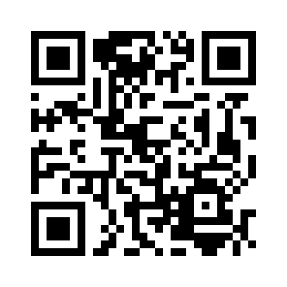
Title
Content

