Slide 1
$nelnerds Nelnet Hackathon Team #1
Matanya Loewenthal Leah Lai Eric Zhou Cole Nelson

Slide 2
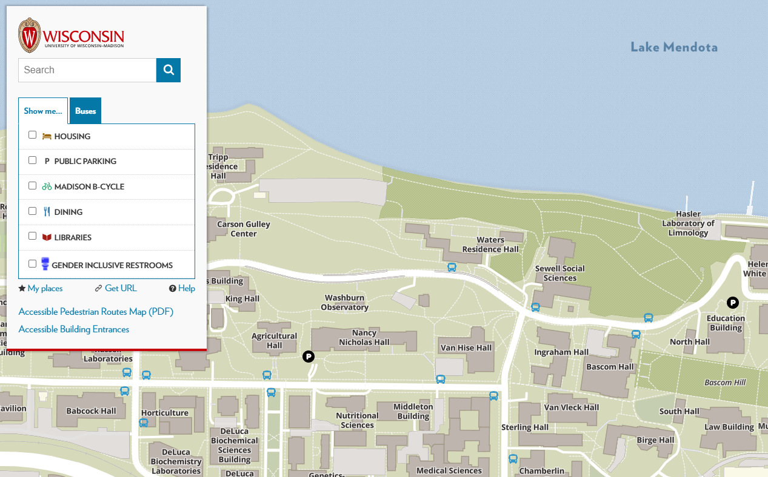
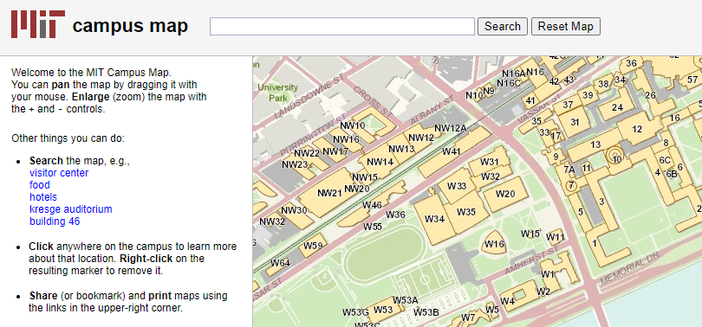
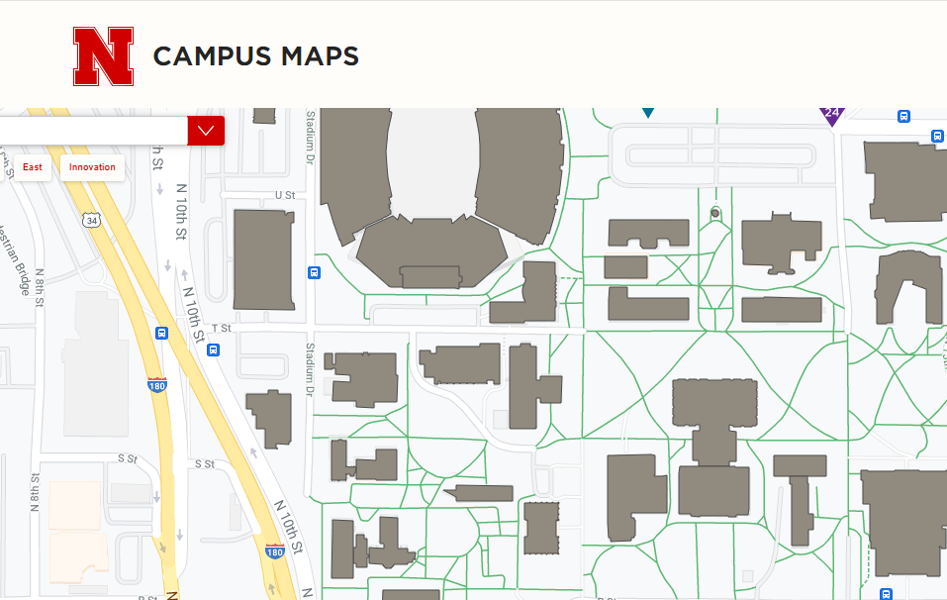
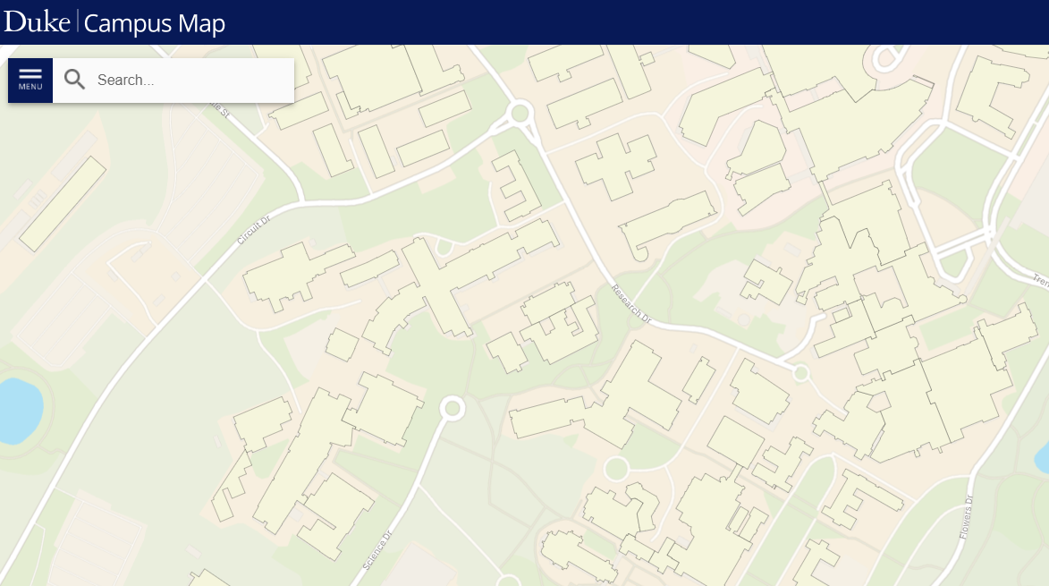
What's wrong with these campus maps?

Slide 3

campus map =
geography
+
people

Slide 4
Students that participate in campus events are more likely to graduate & have a positive college experience than their peers.
"The Relation between College Student Involvement and Satisfaction" Anderson University, 2007.
"Strategies for Improving Student Retention" Hanover Research, 2014.

Slide 5
Recommend events through artificial intelligence & machine learning.
Gamify participation.

Slide 6
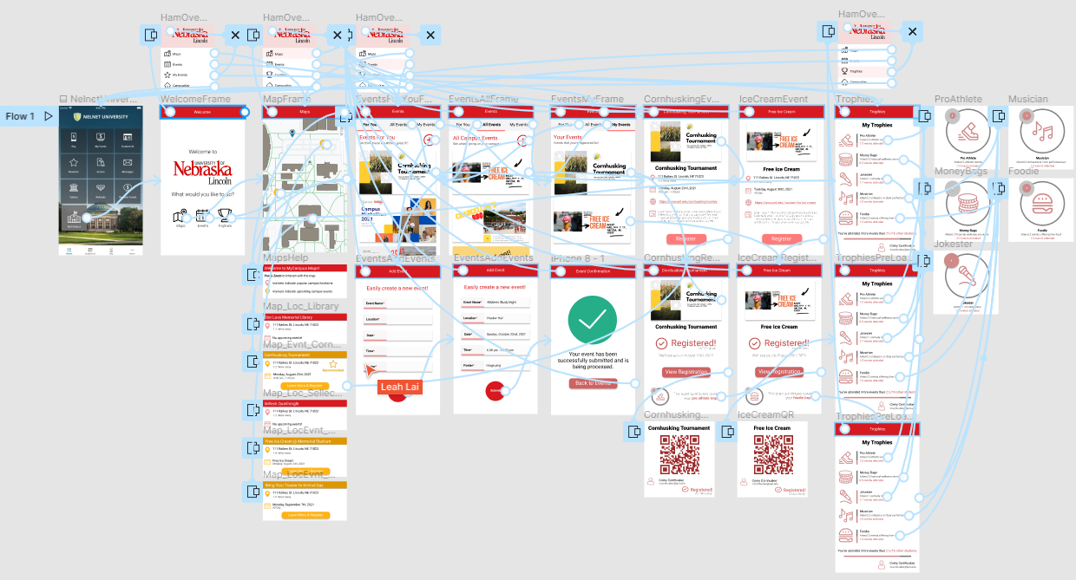
Prototype Demo

Slide 7
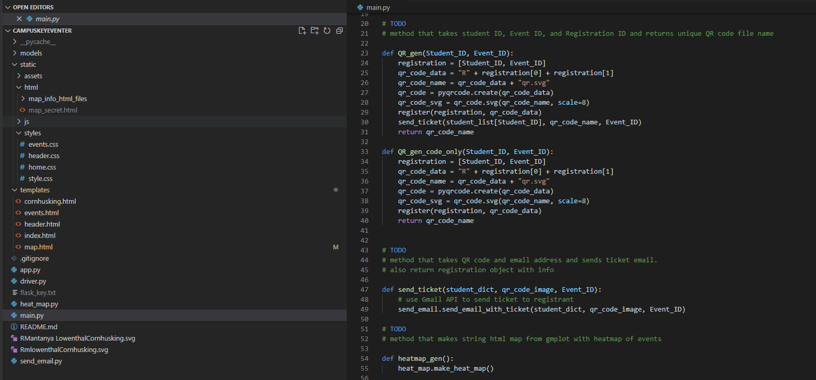
Functional Demo

Slide 8
References
Images provided through Flaticon via..
Freepik
Pixel Perfect
Smashicons
Good Ware
Becris
dmitri13

