Slide 1

Bacchus Wine
Team “TarDisFlo”: Alexander Shegstad,, Sabrina taucan, luis padilla, and tiffany suratt

Slide 2
Case Study
After Stan and Davis Bacchus inherited their winery from their father, George, three years ago upon his retirement. Their father put in a lot of hard work into the business, they are anxious to incorporate new business methods to help them improve their products and customer service. The new owners are deciding to keep all existing personnel in place. Bacchus Winery grows several grapes that are needed to make a Merlot, a Cabernet, a Chablis, and a Chardonnay.

Slide 3
Yearly “Snapshot” of the Business
Order Timeliness Report
Are all suppliers delivering on time?
Is there a large gap between expected delivery and actual delivery?
A month by month report should show problem areas?

Slide 4
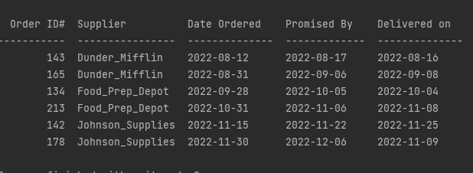
Order Timeliness Report
Information regarding both our “orders” and “suppliers”
Orders shown date back to August, these have been completed
Information included in the report:
The order ID#
The name of the supplier
The date on which the order was placed
The date on which delivery was promised
The actual date of delivery

Slide 5
Yearly “Snapshot” of the Business
Wine Distribution Report
In regards to the wine distribution, are all wines selling as they thought?
Is one wine not selling?
Which distributor carries which wine?

Slide 6
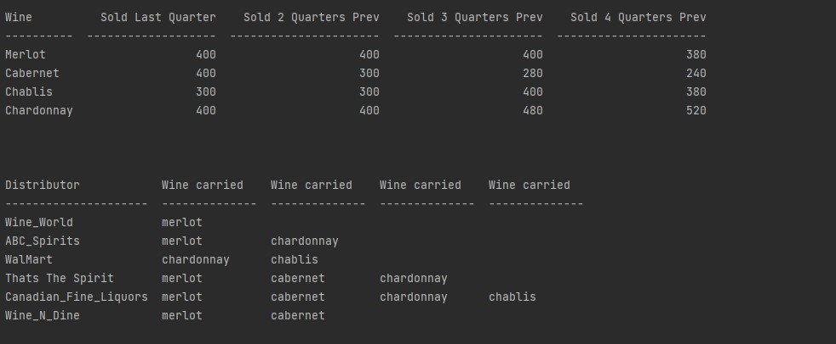
Wine Distribution Report
First Table Displays
Results of types of wine being sold and how many units of wine
Results on how many units have been sold in each 3-month quarter
Results can go back 4 quarters resulting in the last year
Allowing the company to see trends
Second Table Displays
Results of which Bacchus Winery products are actually carried by which distributors
Space allowing for 4 different selections of wine to be carried
If one of the entries in the distributor list does not carry all four members of the Bacchus family, then the remaining spots in the table are left blank

Slide 7
Yearly “Snapshot” of the Business
Employee Pay Report
In reference the employee time, during the last four quarters, how many hours did each employee work?

Slide 8
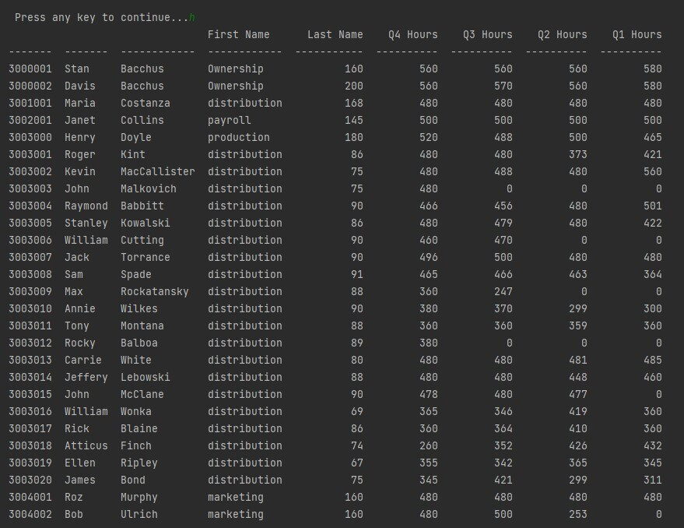
Employee Pay Report
Information regarding every single employee in the company:
Department they work in
How many hours they have worked per quarter
Results in the table:
Employee ID#
First Names
Last names
Total hours worked (divided by quarter)

Slide 9
Assumptions
A Merlot grape does not have to be associated with each product. Not all grapes produced are used in each product.
A Cabernet grape does not have to be associated with each product. Not all grapes produced are used in each product.
A Chardonnay grape can be used in two different products but does not have to be used in every product.

Slide 10
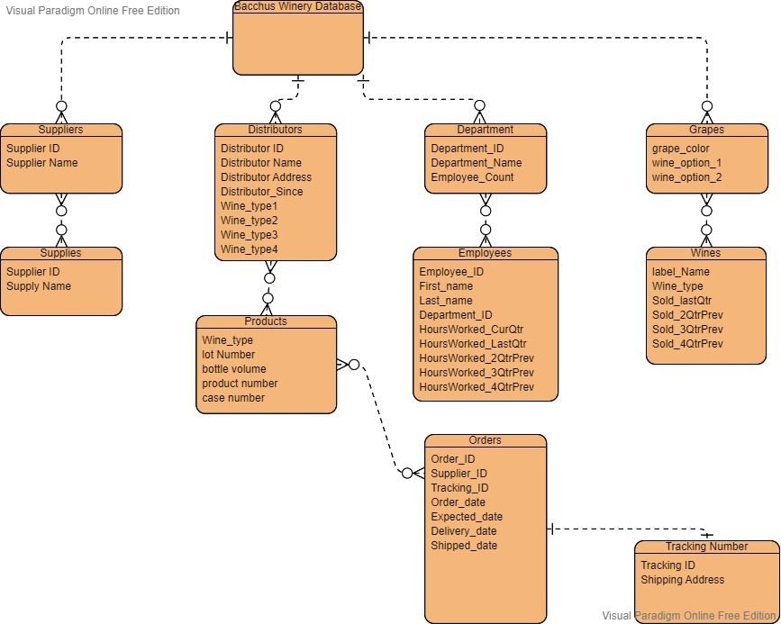
ERD

Slide 11

Thank You

