Slide 1
Speech Recognition
EQ2341, May 2022

Slide 2
Presenter
Name: Matay Mayrany
Occupation: Software Engineer
Masters: Masters in ICT Innovation, Autonomous Systems track
Participated in EQ2341 in 2020, have labs left
Contact: mayrany@kth.se, https://www.linkedin.com/in/matay-mayrany/

Slide 3
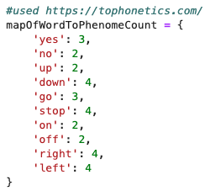
Model Choice
HMM
Used in previous assignments
One model per word
# of states in model = # of phonemes in the word it models
Classified class belongs to model producing highest logprob of sequence after training

Slide 4
Data Collection
Used dataset given from kaggle
Split labeled data in train into test and train sets (10% test) after extracting features
Also kept all training and testing features in one file in case Cross Validation will be performed later.

Slide 5
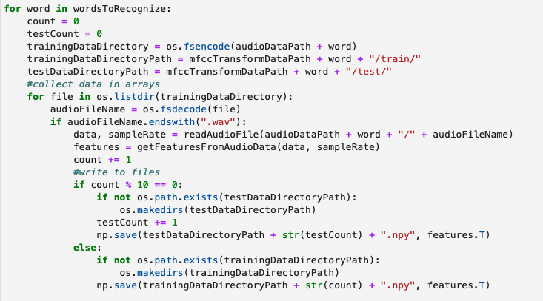
Data Collection - Code Snippet

Slide 6
Feature Extraction
Used recommended feature extraction scheme from Assignment 2 (MFCCs for speech) 1s convert audio waves to 13 mfcc coefficients
Motivated by human hearing which interprets different pitches in voice rather than a continuous wave data
Not ideal for distinguishing details like emotion, accents, tone

Slide 7
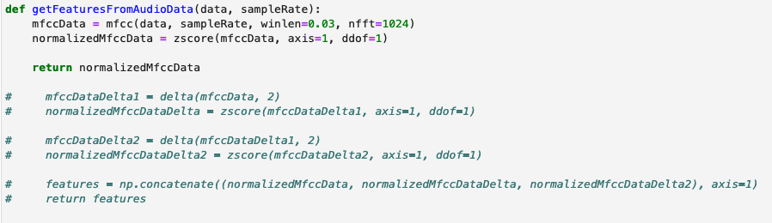
Feature Extraction - Code Snippet

Slide 8
Training Model
Use baum welch + forward and backward algorithm from other assignments to estimate model parameters
Start with initial guess of the model
Even distribution overall states except exit states in Q
Even transition probabilities between states, except the exist state only one transition made possible
Same output GaussD for all states
Iterate over baum welch algorithm 10 times to improve initial estimate
Store final Q, A and B from the HMM of every word, so that they can be loaded into an HMM when testing.

Slide 9
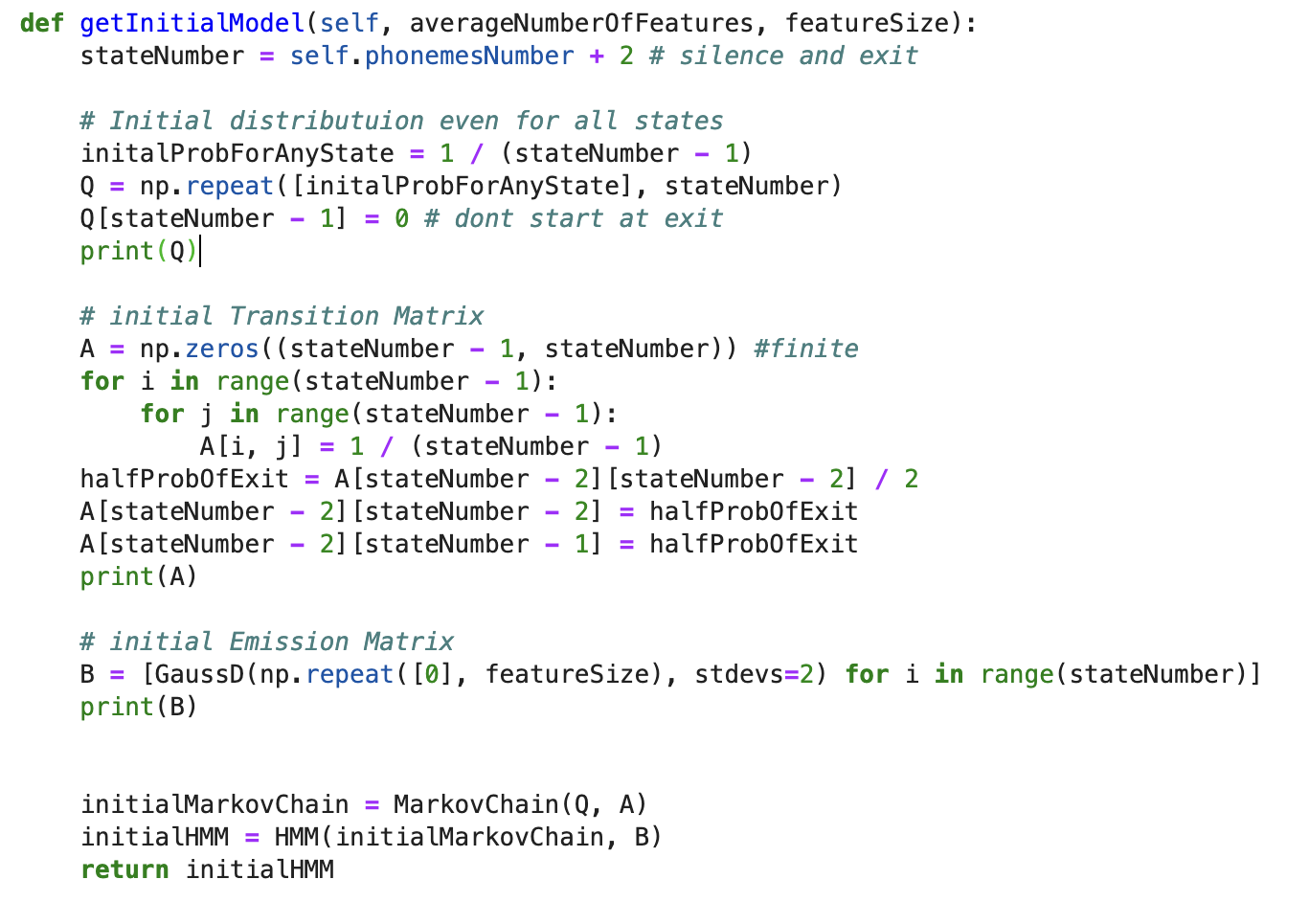
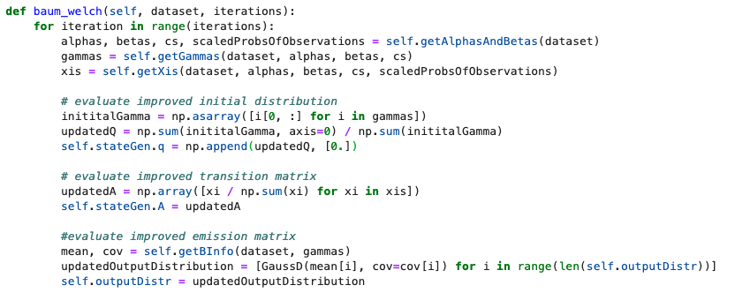
Training Model - Code Snippets

Slide 10
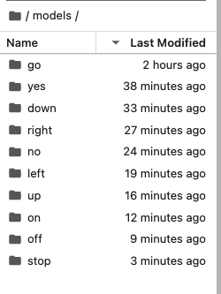
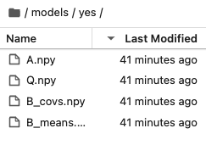
Training Model - Result

Slide 11
Test Model
10% of data (200 recordings for each word) was used to evaluate model
Load model for each word and find the probability produced by HMM for each test datapoint
Model with highest value classifies the datapoint
Store true and predicted label of datapoint
Track correct and incorrect classifications of each datapoint
Use sklearn to get accuracy and confusion matrix given true and predicted labels
Notes:
I actually made a mistake here it is not exactly 10% because theres 2000 training data and 200 test, so its 10% of training not the total

Slide 12
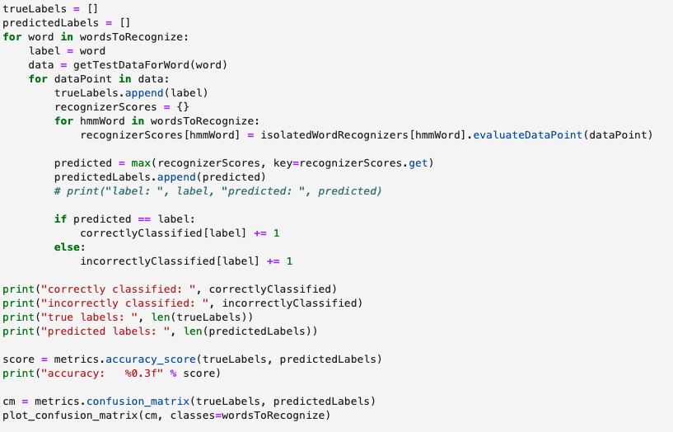
Test Model - Code Snippet
Notes:
I actually made a mistake here it is not exactly 10% because theres 2000 training data and 200 test, so its 10% of training not the total

Slide 13
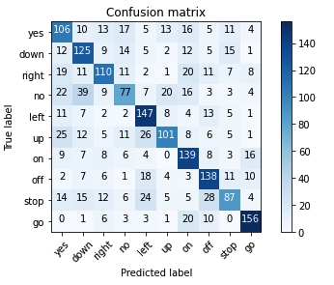
Test Model - Results
Notes:
I actually made a mistake here it is not exactly 10% because theres 2000 training data and 200 test, so its 10% of training not the total

Slide 14
Limitations and Possible Improvements
Include dynamic features to improve accuracy
Prepare data better, remove bad samples from training / test data
K fold cross validation
Better initial estimation to get a better local maximum
More Iterations
Different model (DNN vs HMM)

Slide 15
Thank You :)

