Slide 1
Project Scope
Generate a list of suppliers for sales outreach by leveraging internal customer transaction data and external web data.
Data Sources
Internal (Data Provided)
External (Web Scraped Data)
Processes / Methodologies
Data processing pipeline
API and Database Operations
Filtering Criteria
Exploratory Data Analysis
Deliverable
Ranking of suppliers
Reasoning for using method
Notes:
Peyton

Slide 2
Steps Performed (Overview)
Obtained the primary data from github.
Using the data, created a Python script to scrape APIs, taking turns attempting to pull and, overall, getting a feeling for how to scrape data and share it over github.
We gathered, and built a database using all the data gathered from everyone, ensuring consistency.
Together, created a database and explored it using different methods, primarily SQL/Python
Trimmed down invalid or missing data.
We then built different models using different methods based on observed data, questions asked about the data, and discussions among one another.
It’s important to remember: There was no necessarily “wrong” method to do this.
Each method was based upon logic, what information we’re given, and real world situations.
After discussion, we settled on one model. Each one has their own weights and we can spot similarities between them.
Our detailed results are in the next few slides.

Slide 3
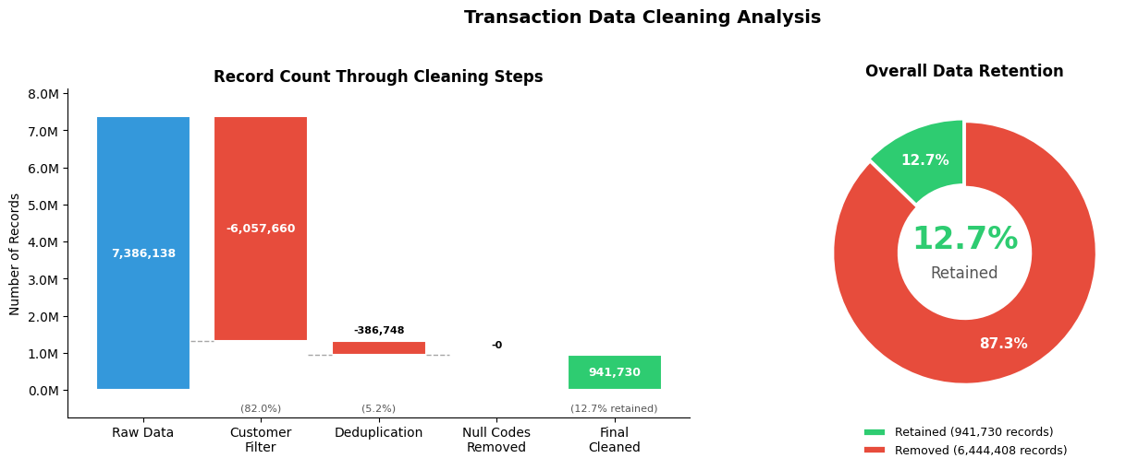
Data Processing Pipeline
Load & validate the data, then clean the raw transactions and customer data before sampling
Valid Code Lengths: 11-14 numeric characters
Notes:
Initial Transaction count before cleaning: 7,386,138
Initial Customer Records: 30,903
Customer cleaning steps:
Drop unused customer columns
Strip whitespace from ORG ID
Removed approximately 70 NA/Duplicate ORG IDs
Transaction cleaning steps:
Keep only transactions that have customer details associated with them
Remove all non-digit characters
Null out duplicate codes with leading zeros removed, since a code with a 0 in front is treated the same as a code without the zero when retrieving data for it from the itemdb
Filter out any product codes that aren’t 11-14 digits in length.
Drop any duplicates remaining
After the transaction cleaning we go back and filter out any customers that now have 0 transactions
After Cleaning counts:
Transactions 941,740 (approx 88% reduction)
Organizations 6,433
At this time, missing annual revenue values were filled from the industry median available, and revenue ranges calculated based on annual revenue values, as well as filling any missing Industry SPS, Industry Vertical, and Industry Segment values with ‘Unknown’

Slide 4
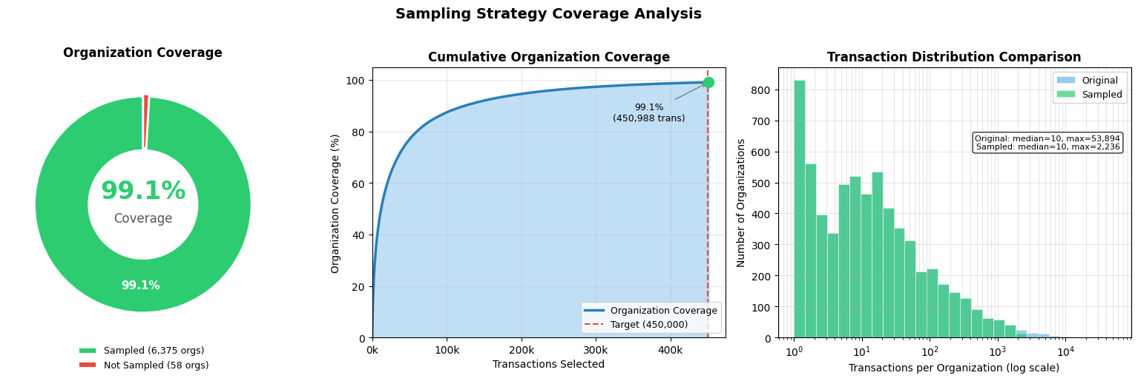
Final 450K Sample
Total Organizations to sample from: 6,433
Total Transactions across those organizations: 941,740
Notes:
Due to time/api limits we set a target of 450,000 items to collect data from the ItemDB api for. This presents a sampling problem where we wanted to maximize the number of organizations we could cover while still staying within our target limit of api calls we’d have to make.
By starting with organizations with the lowest number of transactions and adding more organizations until we hit our target limit, we were able to achieve about 99% coverage of all the organizations we had cleaned transaction data for.
This 450k sample is what we used for making the api calls.

Slide 5
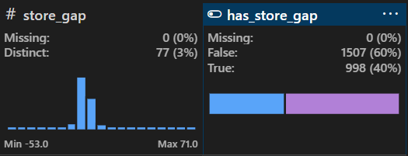
Modeling and Exploration
Overview:
Feature Engineering and Log Transformations
Exploratory Data Analysis
Ranking Approach
Store_gap = customer_unique_store_count - customer_total_retailers
Customer_unique_store_count (Scraped count of connections)
Customer_total_retailers (SPS provided count of connections)
Notes:
We will be focusing on the modeling and exploration of our data for the rest of the presentation. First well go over some engineered features and log transformations. Then our Exploratory Data Analysis and lastly our ranking approach.
Before jumping into rest of our feature engineering I want to explain the store_gap feature because you’ll hear that label a lot.
So, “Store_gap” determines if SPS has missed opportunities within the organizations they service.
We calculated this by taking the variables “customer_unique_store_count” (which was pulled from our API calls) and subtracting that from“customer_total_retailer_connections” which was provided by SPS.
if unique store count is greater than SPS’s known total retailer then we have evidence that there are missed connections with that organization.
We then used that Store_gap variable and converted it to a boolean called has_store_gap,
If Store_gap is greater than or equal to 1 then the Boolean is True. If less than or equal to 0 it is false.
Key points of graph

Slide 6
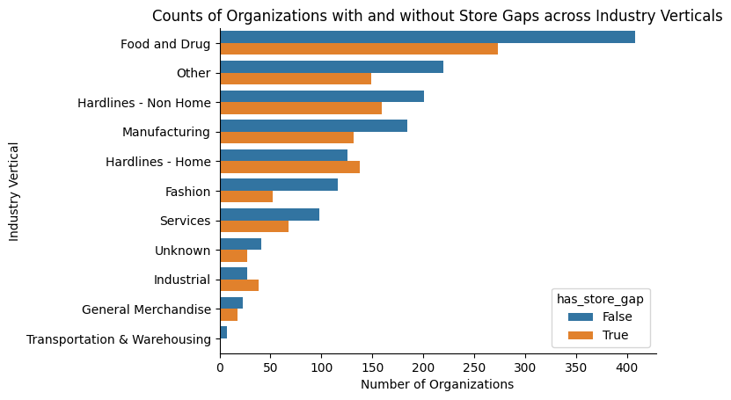
Exploratory Data Analysis
Org store gap distribution is relatively consistent across industry verticals
Dominant Vertical
Food and Drug
Potential weak points
Hardlines-Home
Industrial
Notes:
JO-
Here we analyzed the number of organizations with and without store gaps by industry verticals.
At the top you can see Food and Drug dominates industry vertical in terms of quantity. Nearly 30% of all ogranizations are of the food and drug vertical
Another thing to note is that “Hardlines - Home” and “Industrial” seem to have “weak points” where the number of orgs with store gaps is larger than those without store gaps.
Overall, a majority of vertices have more organizations without store_gaps than with store_gaps.

Slide 7
Explored Ranking Methods
Method 1:
Calculate derived performance metrics
Store Gap = unique stores − retailer connections
Velocity per Store = total transactions / retailer connections
Doc Flow per Store = avg doc flow / retailer connections
Normalized each metric
Apply weighted scoring formula
Store Gap - 45%
Doc Flow per Store - 25%
Transaction Velocity - 15%
Years with SPS - 15%
Generate final opportunity score
Weighted sum of all normalized metrics
Higher = greater opportunity / priority
Method 2:
Filter based on UPCs
Identify store gap based on unique stores and connections
Focuses more on total UPC counts + Doc Flow
Normalized each metric
Apply weighted scoring formula using linearity
Doc Flow per Store - 45% (X1)
Valid UPC counts - 40% (X2)
Years with SPS - 5% (X3)
Annual Revenue - 2% (X4)
Generate final opportunity score
Using a linear matrix formula X1+X2+X3+X4 = Score
General targeted areas highlighted in next slide
Notes:
Throughout the analysis, we tested various ranking and modeling approaches to determine the strongest method for selecting our top 10 customers. On this slide, we highlight two of the ranking strategies we experimented with. On the following slide, we walk through why we ultimately shifted to our final approach.
For Method 1, we constructed a weighted scoring system using the key performance metrics. These metrics included:
Store Gap
Velocity per Store, calculated as total transactions divided by retailer connections
Document Flow per Store, calculated as average document flow divided by retailer connections
Years with SPS
Each metric was normalized, and then weighted according to importance:
45% Store Gap, 25% Document Flow, 15% Velocity, and 15% Years of Service.
After applying the weights to the normalized values, we calculated a final opportunity score for each customer, which produced the ranked list.

Slide 8

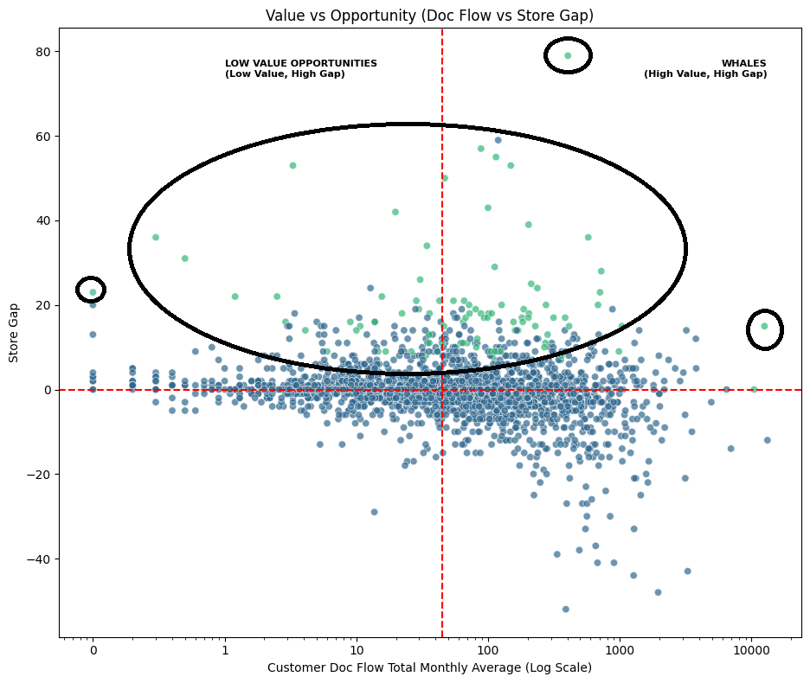
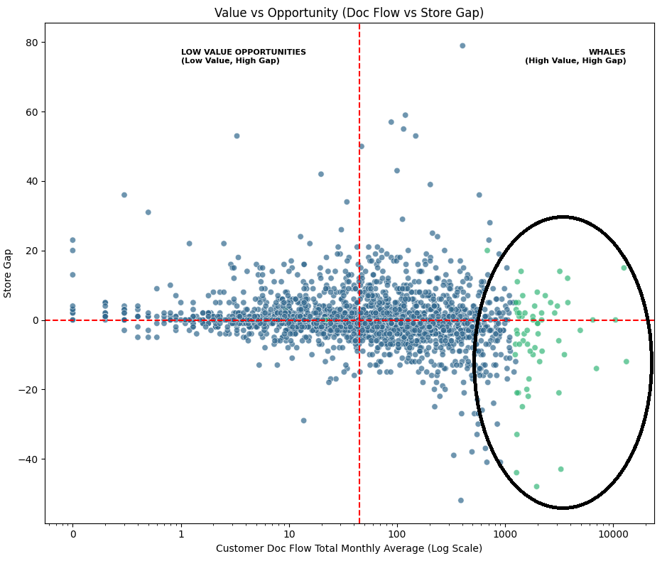
Explored Ranking Methods - Graphs
Method 1:
Method 2:
Notes:
This slide visualizes the customers selected by both ranking methods. On the left plot, the Y-axis represents Store Gap our measure of missed opportunity while the X-axis represents Document Flow, which we defined as our high-value opportunity metric.
With Method 1, the selected customers shown in green cluster heavily along the top of the graph, in Quadrants 1 and 2. This indicates that Method 1 strongly prioritized high Store Gap, at the expense of balancing the Document Flow.
In contrast, Method 2 produced a spread of customers across Quadrants 1 and 4, showing that this approach placed more emphasis on high Document Flow and less on Store Gap.
This comparison helped us understand the tradeoffs and informed our decision to refine our final method.

Slide 9
Final Ranking Approach
Rank key metrics using percentile ranks
Flow Rank: Percentile rank of monthly average document flow
Gap Rank: Percentile rank of the store gap metric
Compute composite score
40% Document Flow Rank
60% Store Gap Rank
Filter and select top targets
Only include orgs where store_gap > 0
Top 100 organizations by highest composite score
Notes:
We chose this approach because it focuses on Doc flow and Store Gap, which give the clearest insight into where there’s both growth opportunity and profit potential. By combining these two factors, it highlights customers who can deliver the biggest impact. The resulting ranking balances opportunity with profitability.

Slide 10
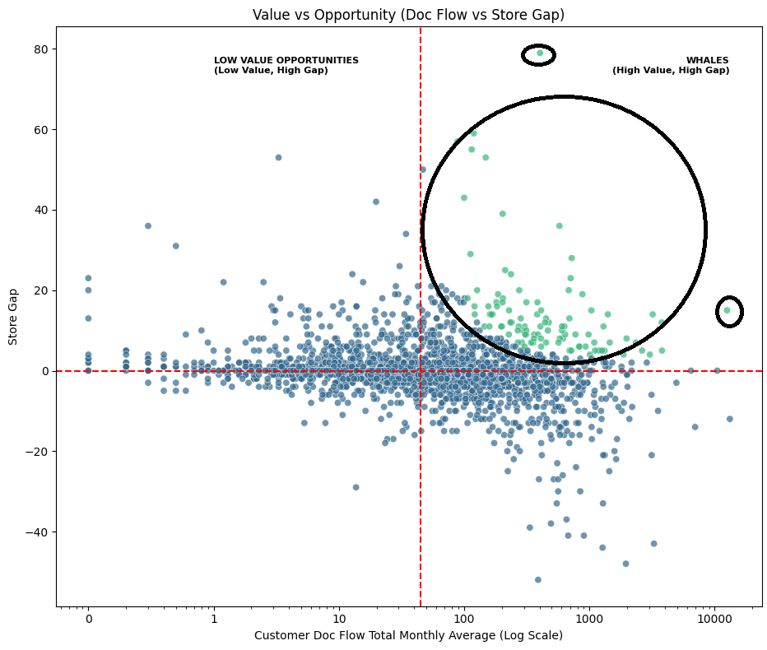
Final Ranking Approach - Graph

Slide 11
Problems Encountered
For the future, we have to account for emojis of all things as this messed up our python scripts when trying to name things automatically.
All data pulled should also be verified. There are some UPCs that didn’t get named properly, though they are accounted for as far as a UPC for that organization.
Unifying the data between not just people, but groups is very difficult. Not to mention, ensuring that no problems occur when transferring data.
Some products pulled have a max value of 0 and a min value of 0. These could be discontinued or generally not sold to the public and probably shouldn’t be considered, but it would take more scripting and work to eliminate these from the weights than time allows.

Slide 12
Future Considerations
With the advancement of technology and, given more time, AI could be used to investigate more potential customer contacts. (Keras can be used to spot potential outliers, for example.)
While we had a lot of information from the company itself, we don’t have data regarding successful or failure of outreaches. If we had results from previous years and how successful their outreaches have been for instance, we can much better weigh the top opportunities.

