Slide 1

TSI Telematics (Scheduled on 2025-06-19)

Slide 2
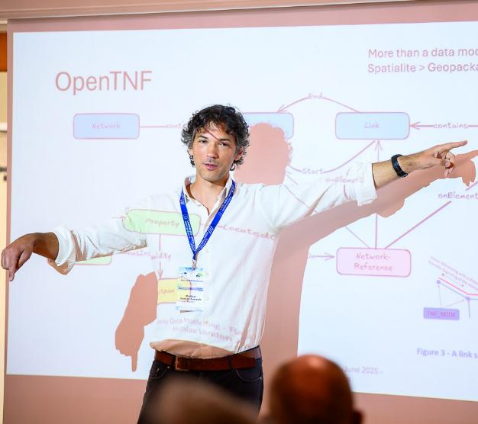
Introductions
Mathias Vanden Auweele
Railway data freelancer
Company: MatData
15 years doing data at Infrabel
Freelance since 2025 :
At BaneNOR, working on the DIM knowledge graph
At ERA working on the Telematics ontology
At Certifer as ENE certification expert

Slide 3

Module Learning Objectives
This module is an introduction to the TSI TAF/TAP, soon to be known as TSI telematics.
At the end of this session, you will have learned:
The basics of railway telematics
The legal framework around railway telematics & the upcoming TSI
Implementation status of the TSI
Why RDF is the superior data technology
Key differences between data models such as Transmodel, OSDM and GTFS

Slide 4
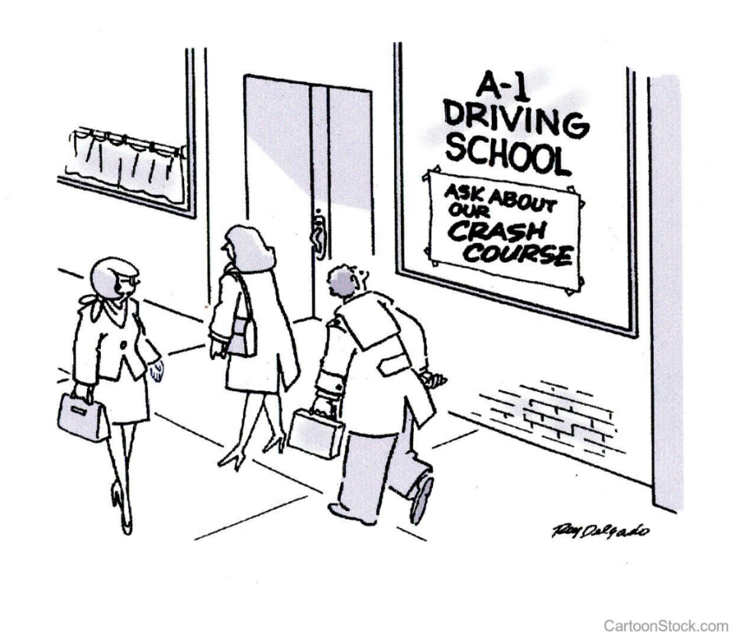

Slide 5

Module Agenda
General overview
  Interoperability
  Telematics basics
  Legal framework
  Stakeholders
  Implementation status
  The data
    Data technologies
    Data modelling
    Telematics data models
  Hands on with XSD files
  In depth: capacity allocation process
In depth

Slide 6

1
Interoperability

Slide 7
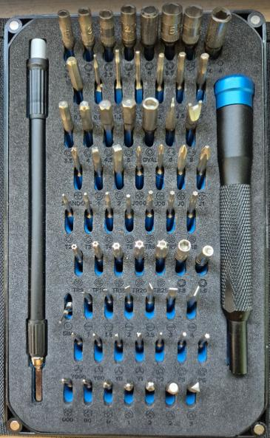
Why do we need interoperability?
Historically every country develops their own railway system.
Compatibility issues become very noticeable when dealing with cross border traffic, mainly freight and high speed. Changing trains, drivers and locomotives, ...
Aim: making smooth European rail transport possible. The term "interoperability" is born.

Slide 8
Legal interoperability framework
1996: high speed
  Directive 96/48/EC of 23 July 1996 on the interoperability of the trans-European high-speed rail system
2001: conventional rail
  Directive 2001/16/EC of 19 March 2001 on the interoperability of the trans-European conventional rail system
=> Both directives contain a number of technical solutions, known as "Technical Specifications for Interoperability"
The abbreviation TSI is born!

Slide 9
Legal interoperability framework
The directives were amended two times to cover the whole conventional European rail network in order to meet requirements for opening-up the rail market.
  Directive 2004/50/EC of 29 April 2004
  Directive 2007/32/EC of 1 June 2007
Both replaced with a unified directive (Interoperability directive)
  Directive 2008/57/EC of 17 June 2008
Which was amended by
  Directive 2009/131/EC of 16 October 2009
  Directive 2011/18/EU of 1 March 2011
And finally replaced with (the "Fourth Railway Package")
  Directive (EU) 2016/797 of 11 May 2016

Slide 10
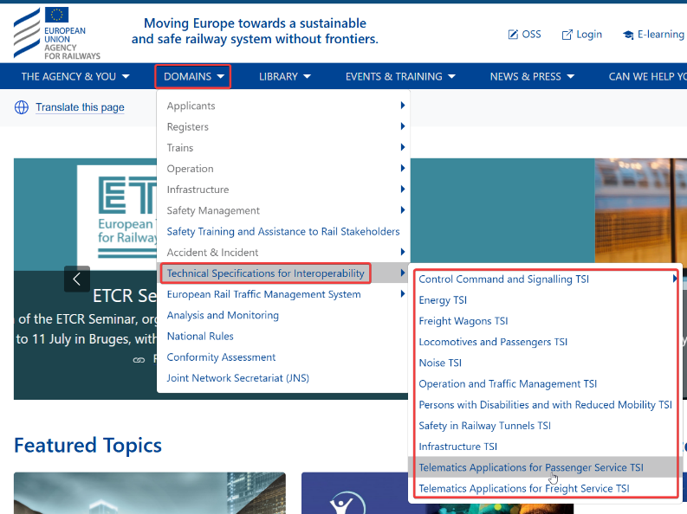
Legal interoperability framework
The TSI’s evolve through EC regulations:
2023/1694 for ENE, INF, LOC&PAS
2023/1695 for CCS
Latest status can be found at on the ERA website.

Slide 11
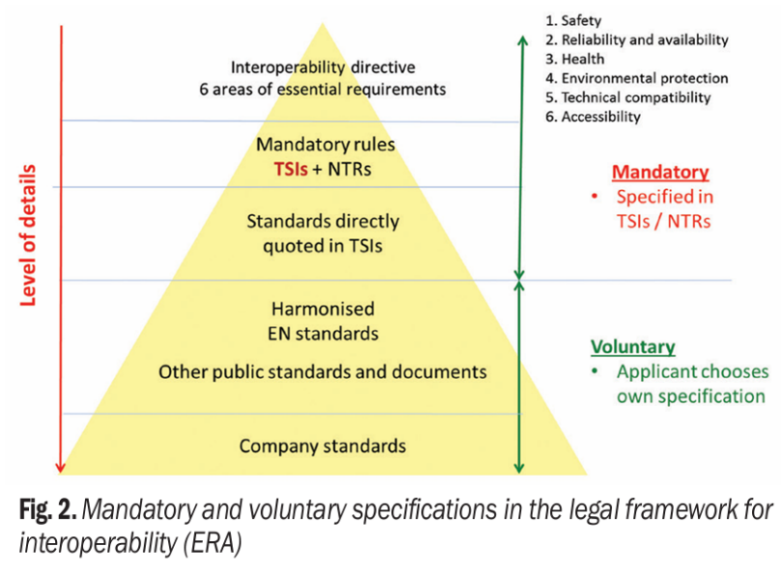
Directives <- TSI’s <- Standards
According to ERA, the number of NTRs was reduced:
From 14.312 in 2016
To 1.026 in 2019

Slide 12
Essential requirements
Safety
Reliability and availability
Health
Environmental protection
Technical compatibility
Accessibility

Slide 13
Structure of a TSI
Chapter 1
Introduction
Chapter 2
Definition of subsystem & scope
Chapter 3
Essential requirements
Chapter 4
Characteristics of the subsystem
Chapter 5
Interoperability constituents (none defined for TAF/TAP)
Chapter 6
Conformity assessment
Chapter 7
Implementation

Slide 14
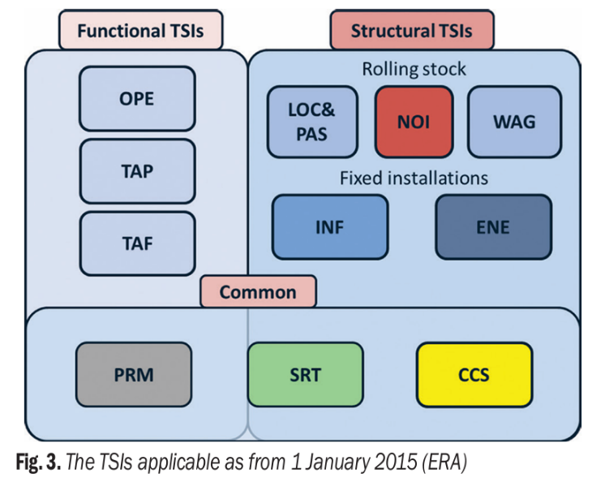
Categories of TSIs
Structural TSI's have notified bodies, functional don't. ERA can certify compliance for functional
Example: send an XML file to ERA and ask them if it's complying with the TSI TAF rules

Slide 15
Module Agenda
General overview
  Interoperability
  Telematics basics
  Legal framework
  Stakeholders
  Implementation status
  The data
    Data technologies
    Data modelling
    Telematics data models
  Hands on with XSD files
  In depth: capacity allocation process
In depth

Slide 16
❷
Telematics basics

Slide 17
Why standardised communication?
Increase efficiency and coordination in rail transport
Common data formats to increase IT system efficiency
Making rail transport faster and more reliable
Quicker and better (real-time) information delivery
Transparent products / no black box
Economies of scale

Slide 18

What is standardised communication?
When to communicate
Who is the sender and the receiver
What is the content of the communication
How should the communication be sent

Slide 19

Use cases covered by TSI telematics: the WHEN
Capacity allocation
Preparation information (train composition)
Real-time information (I'm here)
Forecasted information (I will be there, then)
Service disruptions
Timetabling
Fares
Ticketing
Reservations
Consignment notes
No tariffs!

Slide 20
Railway actors: the WHO?
IMs (Infrastructure managers)
RUs (Railway undertakings)
WKs (Wagon keepers)
SMs (Station managers)
Terminal managers
Ticket vendors (intermodal operators)
Freight customers

Slide 21

Splitting the problem
TAF => Freight
TAP => Passengers

Slide 22
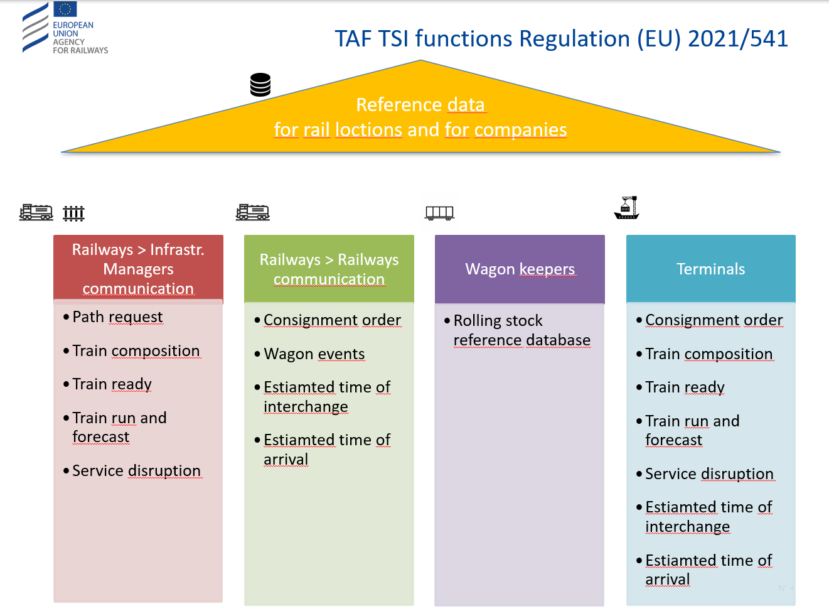

Slide 23
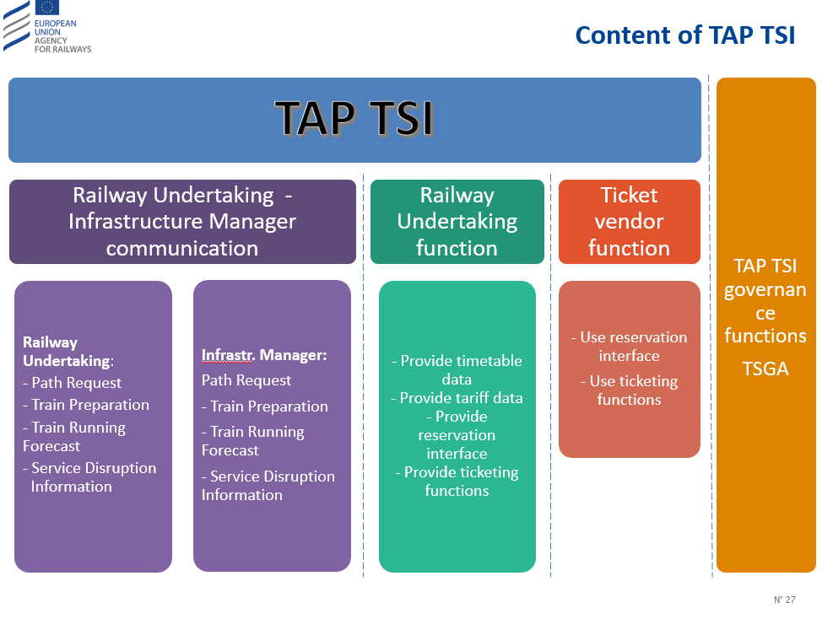

Slide 24
But HOW does it work?
Through an exchange of electronic standardised messages
Following a standardized process
With the help of basic requirements

Slide 25
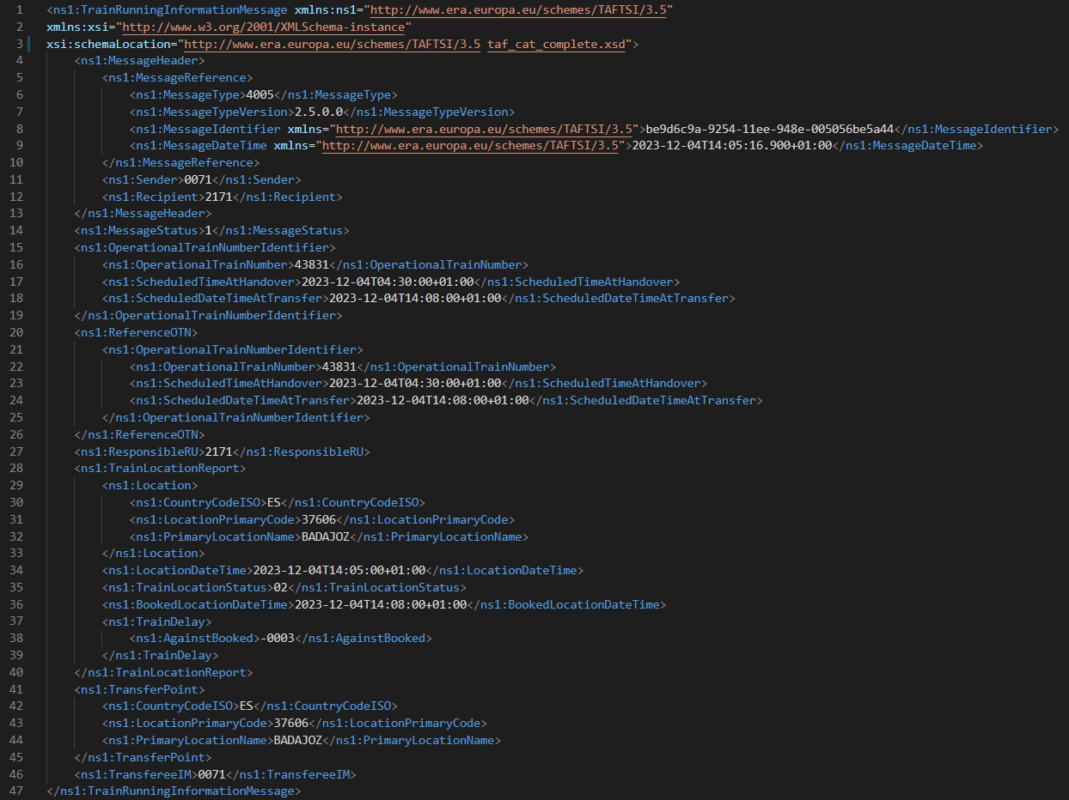
Standardised messages

Slide 26
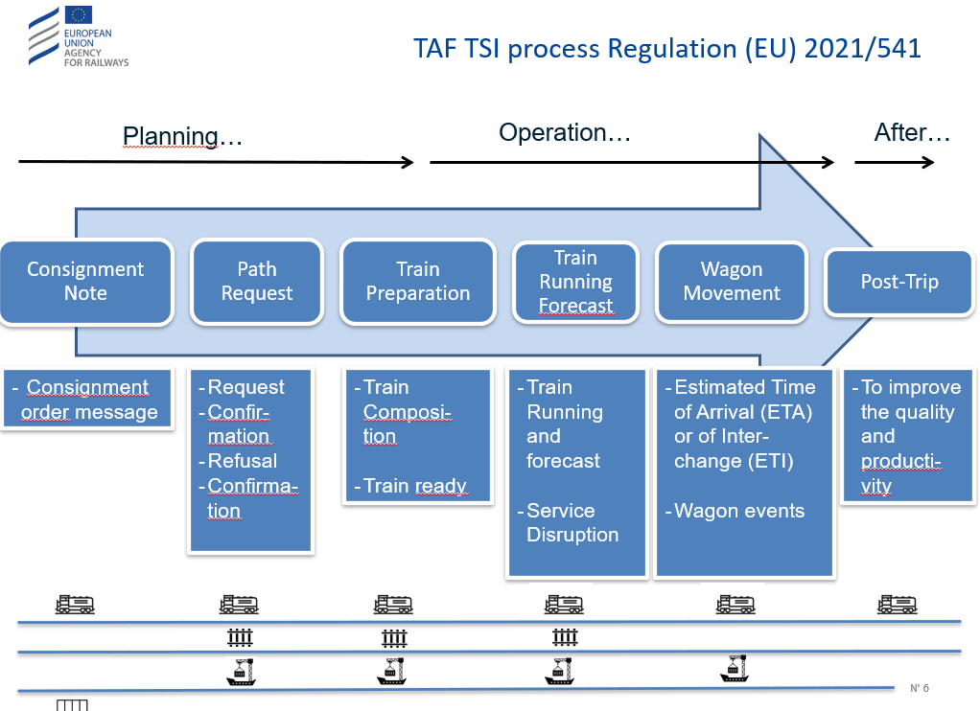
Standardised process (1)

Slide 27
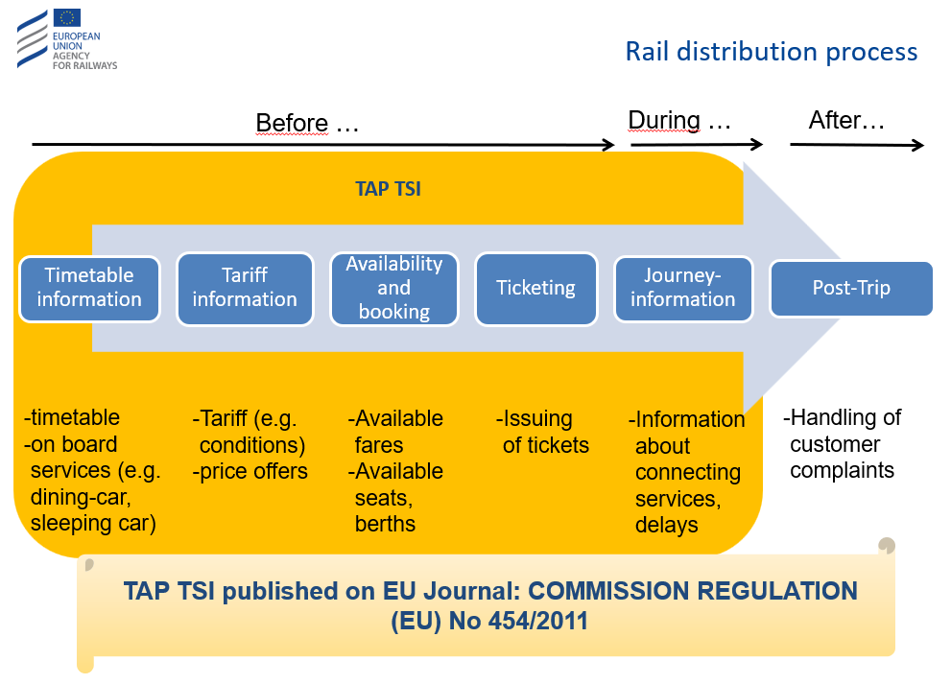
Standardised process (2)

Slide 28
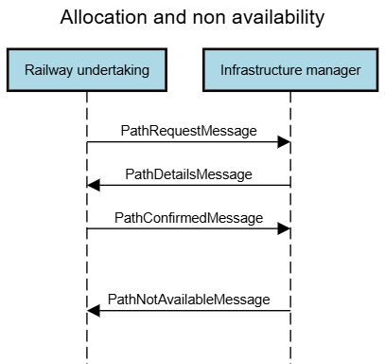
Standardised process (3)

Slide 29
Basic requirements (1): reference data
References for...
Companies
Example: 0088 = Infrabel and SCSM = NMBS
Process to request company code ask ERA (used to be through RNE or UIC)
Locations
PLC primary location code
SLC subsidiary location code (more or less a GPS coordinate)
Lookup: https://teleref.era.europa.eu/
I accidently asked a company code for MatData (yes, it is THAT easy...): BZK3

Slide 30
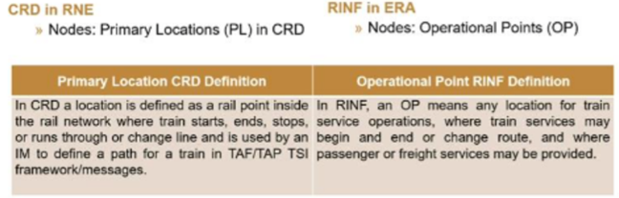
About the PLC...
Is it the same concept as the Operational Point?

Slide 31
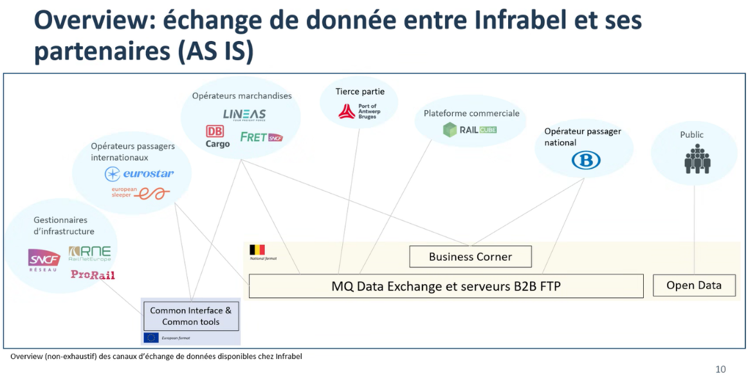
Basic requirements (2): common interface
* Communication between Infrabel and SNCB is entirely out of the scope of TAF/TAP (backdoor solution for national RU's)

Slide 32

Time for a break!
Please be back
at 10:45!

Slide 33
Module Agenda
General overview
  Interoperability
  Telematics basics
  Legal framework
  Stakeholders
  Implementation status
  The data
    Data technologies
    Data modelling
    Telematics data models
  Hands on with XSD files
  In depth: capacity allocation process
In depth

Slide 34
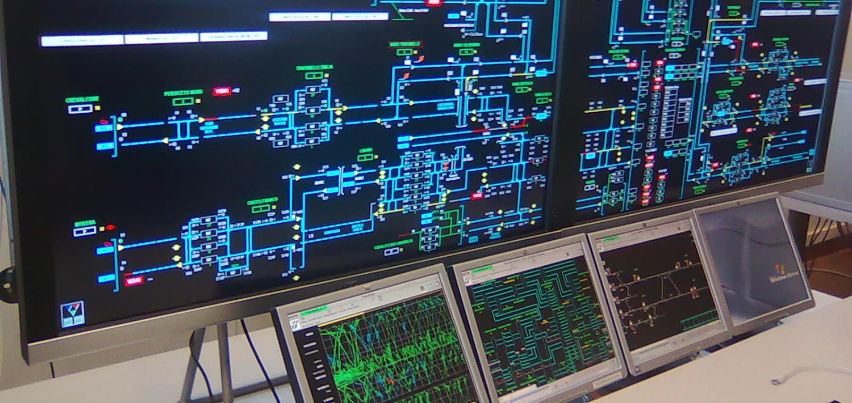
❸
Legal framework of TSI Telematics

Slide 35
History: TAF
2006: first TAF TSI
Introduced the "common interface", mandatory for RU's and IM’s
Commission Regulation (EC) No 62/2006 of 23 December 2005 concerning the technical specification for interoperability relating to the telematic applications for freight subsystem of the trans-European conventional rail system
Replaced with:
Commission Regulation (EU) No 1305/2014 of 11 December 2014 on the technical specification for inter operability relating to the telematics applications for freight subsystem of the rail system in the European Union and repealing the Regulation (EC) No 62/2006. OJ L 356, 12.12.2014

Slide 36
History: TAP
In 2009:
ERA agreed with UIC to transfer the UIC leaflets as ERA technical documents B.1, B.2, ... B.10.
Copy train movement messages from TAF TSI into B.30
No single data format is used. Format depends on use case.
2011:
Commission Regulation (EU) No 454/2011 of 5 May 2011 on the technical specification for interoperability relating to the subsystem ‘telematics applications for passenger services’ of the trans-European rail system. OJ L 123, 12.5.2011
Amended by
- Commission Regulation (EU) No 665/2012 of 20 July 2012 amending Regulation (EU) No 454/2011 on the technical specification for interoperability relating to the subsystem ‘telematics applications for passenger services’ of the trans-European rail system. OJ L 194, 21.7.2012
- Commission Regulation (EU) No 1273/2013 of 6 December 2013 amending Regulation (EU) No 454/2011 on the technical specification for interoperability relating to the subsystem ‘telematics applications for passenger services’ of the trans-European rail system. OJ L 328, 7.12.2013

Slide 37
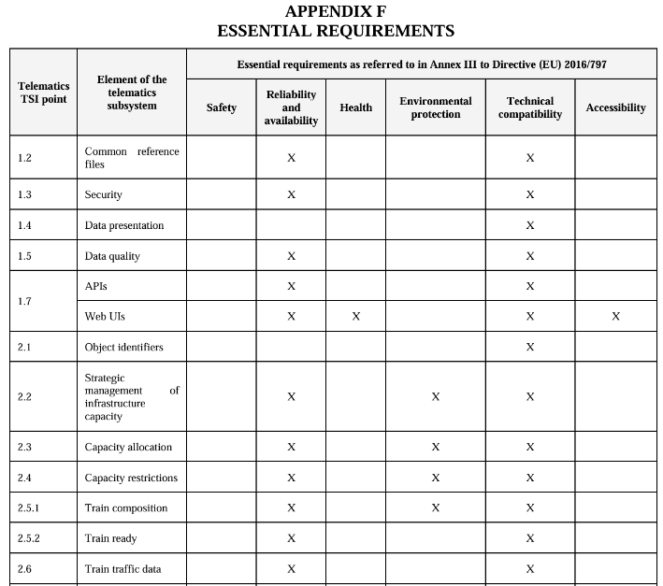
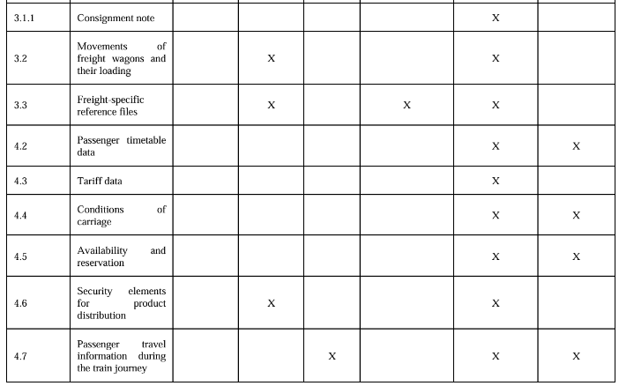
Link with essential requirements
* According to TSI Telematics under review

Slide 38
The new TSI...
Led by the European Commission (DG Move). Normally ERA takes the lead. But there is a history..
Result will be one single TSI/regulation for passenger and freight telematics
In 2023, the European Commission (EC) launched consultations for a new TSI "Telematics", combining TSI TAP and TSI TAF. The new TSI will increase the scope of standardized data exchange. The EC aims to:
Boost the implementation on the side of the RU.
Increase the standardization for capacity allocation on the side of the IM's.
Really put the common interface in the center of the data exchange.
Standardize the management of wagons on the European level.
Harmonize ticketing/tariff data exchange towards passengers.
Public data for timetable (including minimum connection time)
ERA as system authority
Fixed deadlines for the implementation
71 comments (some copy/paste) after public review.

Slide 39

Main pain points
Implementation deadline (December 2026 is too short 'even for Infrabel’)
RDF / ERA ontology
Reference train ID (is a core element in many applications)
New capacity allocation and capacity reduction rules
System certification instead of message certification
TCRs in RINF
Open data also for commercial activities?

Slide 40
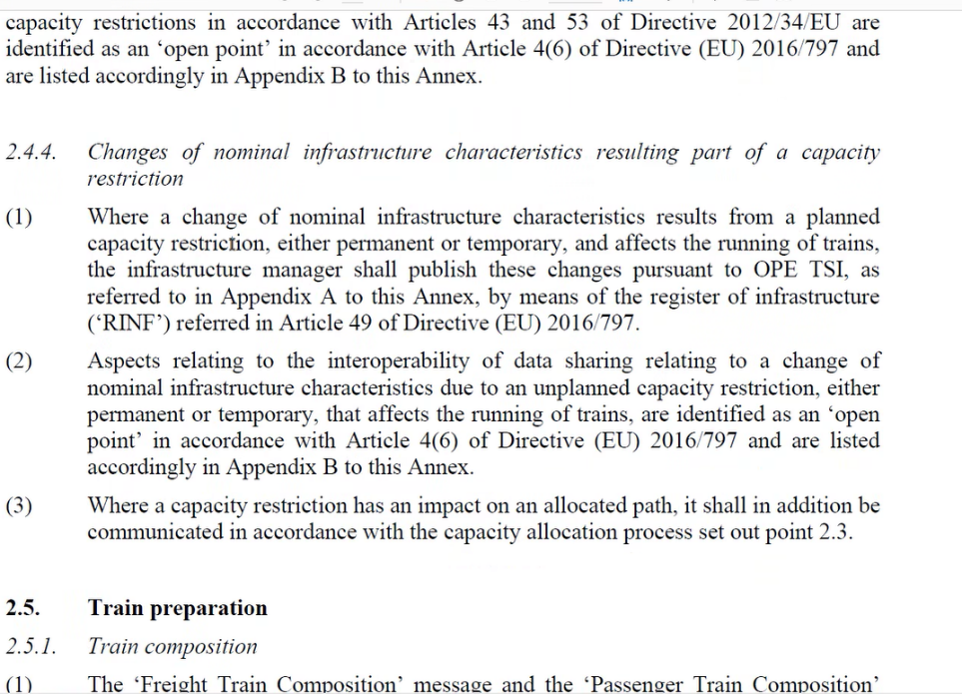
TCR in RINF??
Response from Yann Seimandi:
TCR messages are not required to be in RINF and shall NOT be in RINF (but in TCR tool by RNE).
Point 2.4.4 only remind the requirements of OPE TSI now enable with last RINF Guide i.e. temporary (i.e. not nominal) values of infrastructure characteristics shall be in RINF, notably for RCC and Route Book purposes. Those values are contained as part of TCR messages and shall be made available in RINF accordingly.
Implementation would be either by IMs extracting manually temporary values of infra characteristics from TCR messages and uploading them into RINF, or by IMs requiring this to be automatically done through the RNE’s TCR Tool. For the last, RNE has been contracted to develop the TCR tool accordingly.

Slide 41
Public review, some extracts (1)
Hamburg Port Authority A.ö.R. (Germany)
However, we do have strong concerns that making such data *public* will help rail freight but instead will make internal company production structures visible to competitors.
We feel that the implementation timeframes are too short.
SŽ Infrastruktura, d.o.o. (Slovenia)
its implementation plan appears overly ambitious
the regulation does not provide sufficient detail on who will oversee conflicts regarding data sharing

Slide 42
Public review, some extracts (2)
Joint CER, EIM, ERFA and UIP points
Risk of non-compliance, the implementation deadlines set in the text are not realistic and consistent.
Risk of discouraging the sector, the proposed measures represent a paradigm change and eradicate most of the efforts and investments done so far
Investment stop (Paralysis risk), uncertainties about the new requirements
Risk of reversed modal shift: currently no freight transport operator of any mode is required to make their traffic data publicly available
Risk of burdening the sector economically

Slide 43
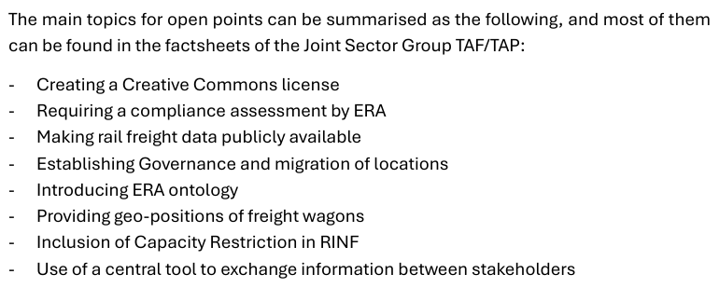
Public review, some extracts (3)

Slide 44
Public review, some extracts (4)
SNCB (Belgium)
[Very negative opening]
A particularly critical issue in passenger services is the lack of recognition of the well-developed Open Sales and Distribution Model (OSDM)
No realistic implementation plan with clear financial assessment has been provided
the current TSI draft mandates the use of the alternative NeTEx standard, which is not commonly used for long-distance rail distribution in most of Europe.
Copy/pasted feedback (NS, Benerail, SNTFC, SNCF, CER, SZ, UIC, ..)
ERA published the TAF/TAP recommendations in January 2022 after 4 years of work by the ERA TAF and TAP working parties according to the TSI revision mandate (decision 2017/1474) and traceability of the modifications in the ERA CCM Revision tool. DG MOVE did not support the recommendations. Instead to grant an updated mandate to ERA, DG MOVE took over a large redrafting of the TAF/TAP TSI from mid-2023 with a completely new approach and without mandate.
Since 2 years and after 7 versions of the Telematics TSI, the sector does not see any significant improvements with the new unjustified measures

Slide 45
Public review, some extracts (5)
Eress (Norway)
In order to be able to correctly link Energy Metering Data coming from on-board Energy Measurement Systems (EMS) with the correct train and thus with the correct consumer, Infrastructure Manager shall know the European Vehicle Numbers (EVN) of the Traction Units part of the train run. This is possible by making the Train Composition Messages mandatory as proposed in this Commission Implementing Regulation
Swedish Cycling Advocacy Organization (Sweden)
Until all rail operators have bicycle spaces, it should be easier to find the ones that already have it and plan trips with these operators.

Slide 46
Public review, some extracts (6)
Entur AS (Norway)
The commissions initiative on technical specifications for rail interoperability is an important step towards a more integrated public transport network in Europe, especially with regards to ticketing.
We have proven that it is possible to create a coherent and integrated public transport sector based on open data in NeTEx and other Transmodel-based protocols. Not only is it possible, it is also a highly efficient way to facilitate a more open and innovative public transport sector.
Transmodel as the underlying data model, since this is the data model that forms the basis for the specifications in MMTIS.
Telematics, in its current form, sets necessary requirements for data exchange that support MMTIS and facilitates good public transport solutions across modalities in Europe. This is not a measure against OSDM but a regulation for a greater degree of open and accessible data in the railway sector.
The main competitor for public transport is of course the privately owned car, so we need the sector to collaborate more in order to shift travellers from car to public transport (or shared mobility). For this to succeed, the railway needs to be a more integrated part of the public transport network, and not stand alone as a separate subsystem. A common data reference model for the entire sector is a solid foundation on which to proceed.

Slide 47
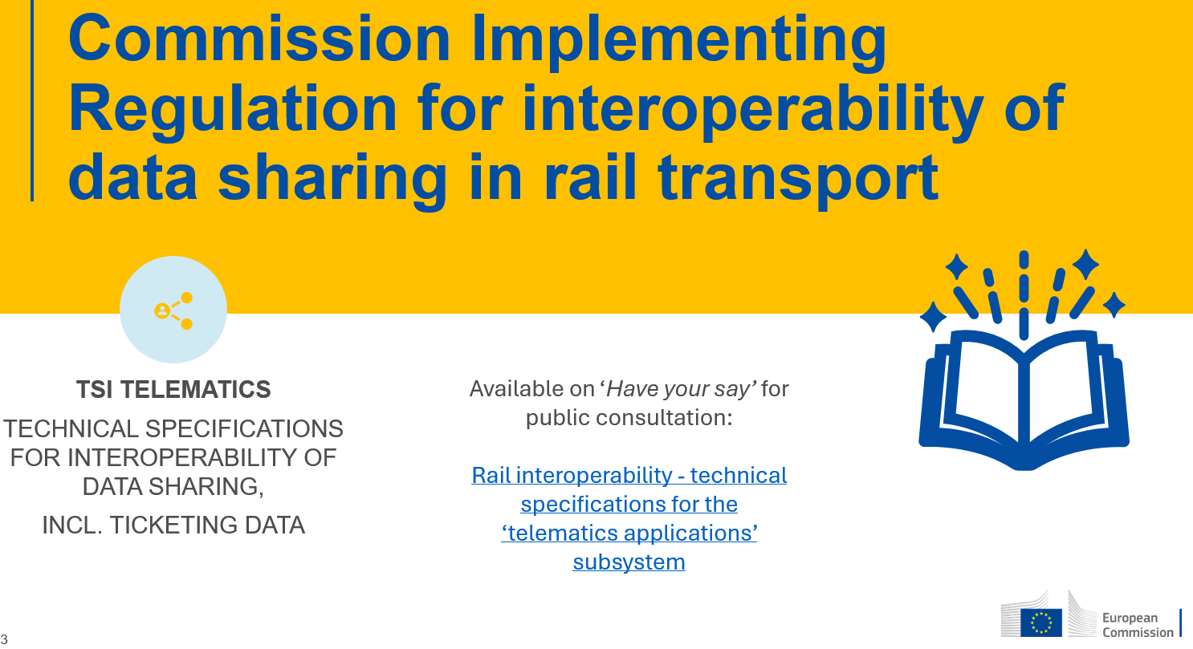
DG Move at RDF 2025 (1)

Slide 48
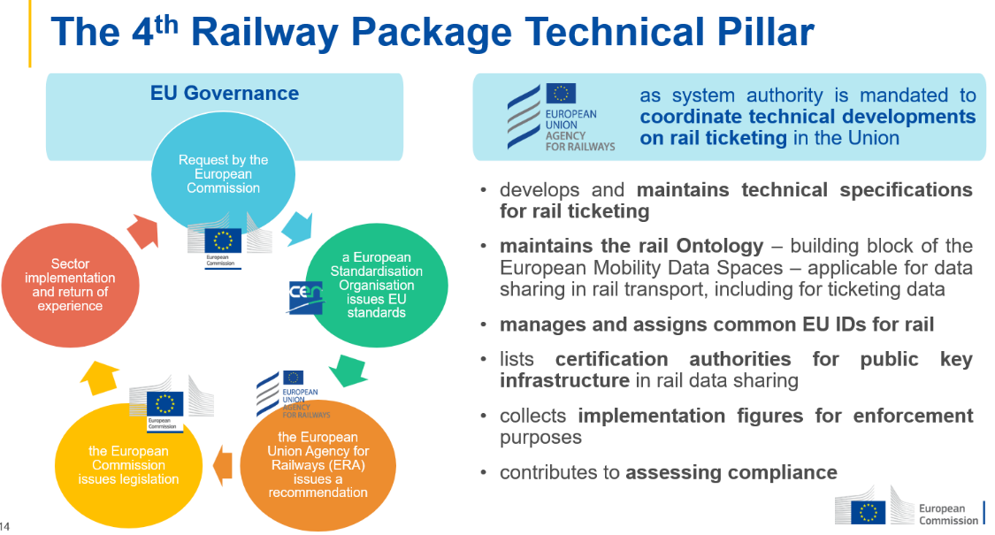
DG Move at RDF 2025 (2)

Slide 49
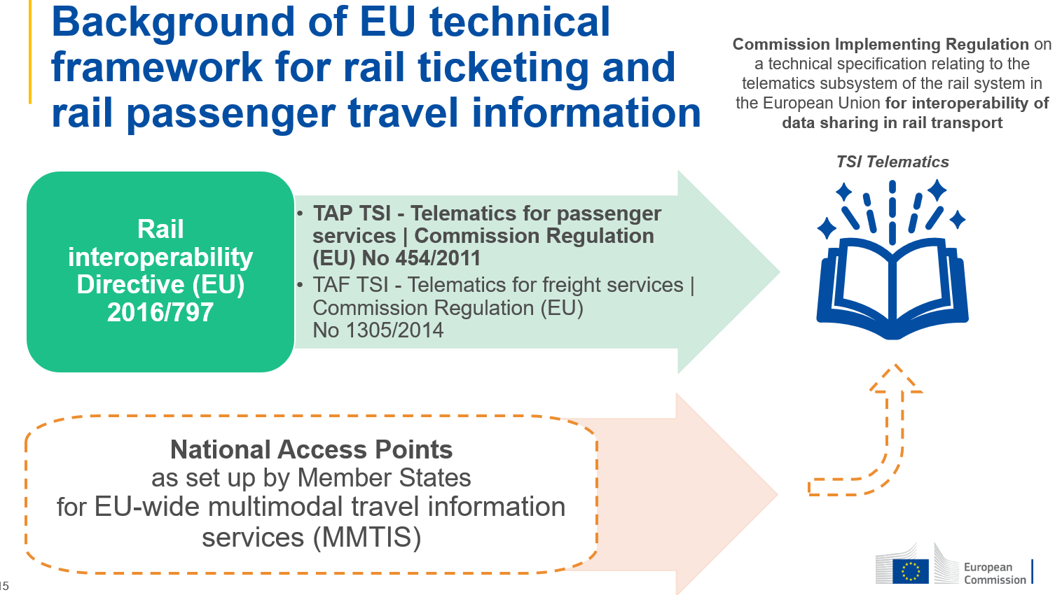
DG Move at RDF 2025 (3)

Slide 50
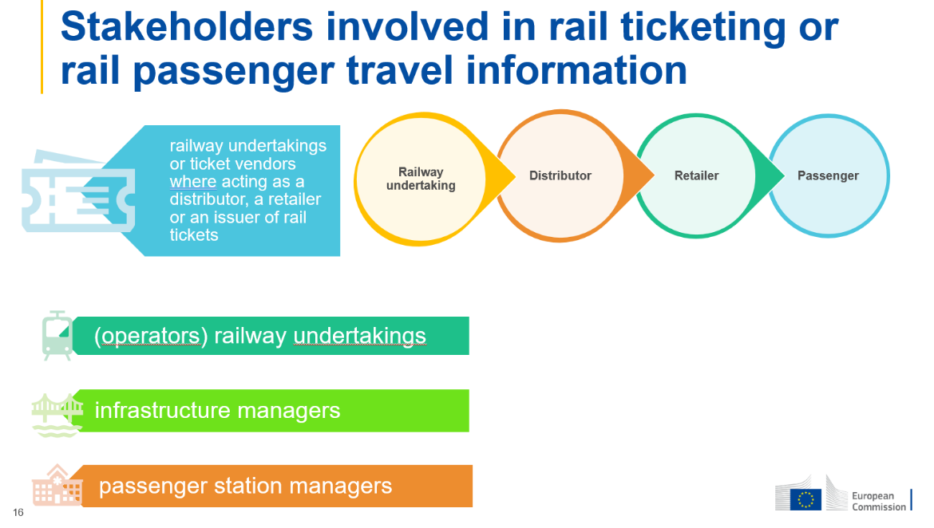
DG Move at RDF 2025 (4)

Slide 51
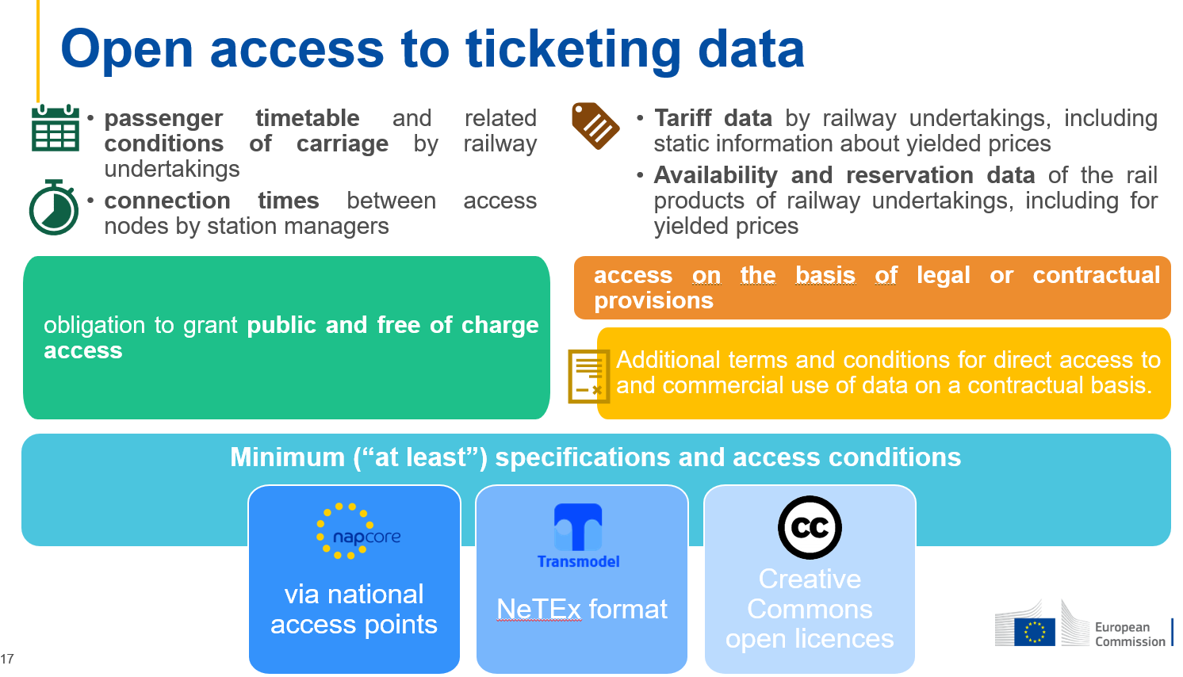
DG Move at RDF 2025 (5)

Slide 52
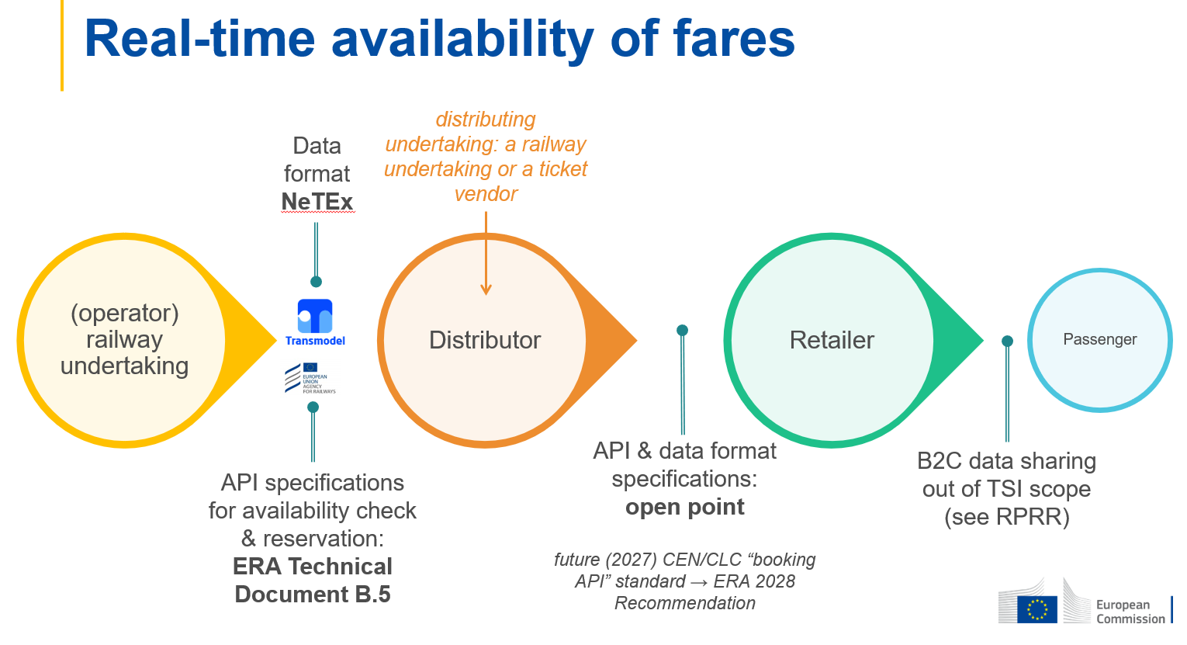
DG Move at RDF 2025 (6)

Slide 53
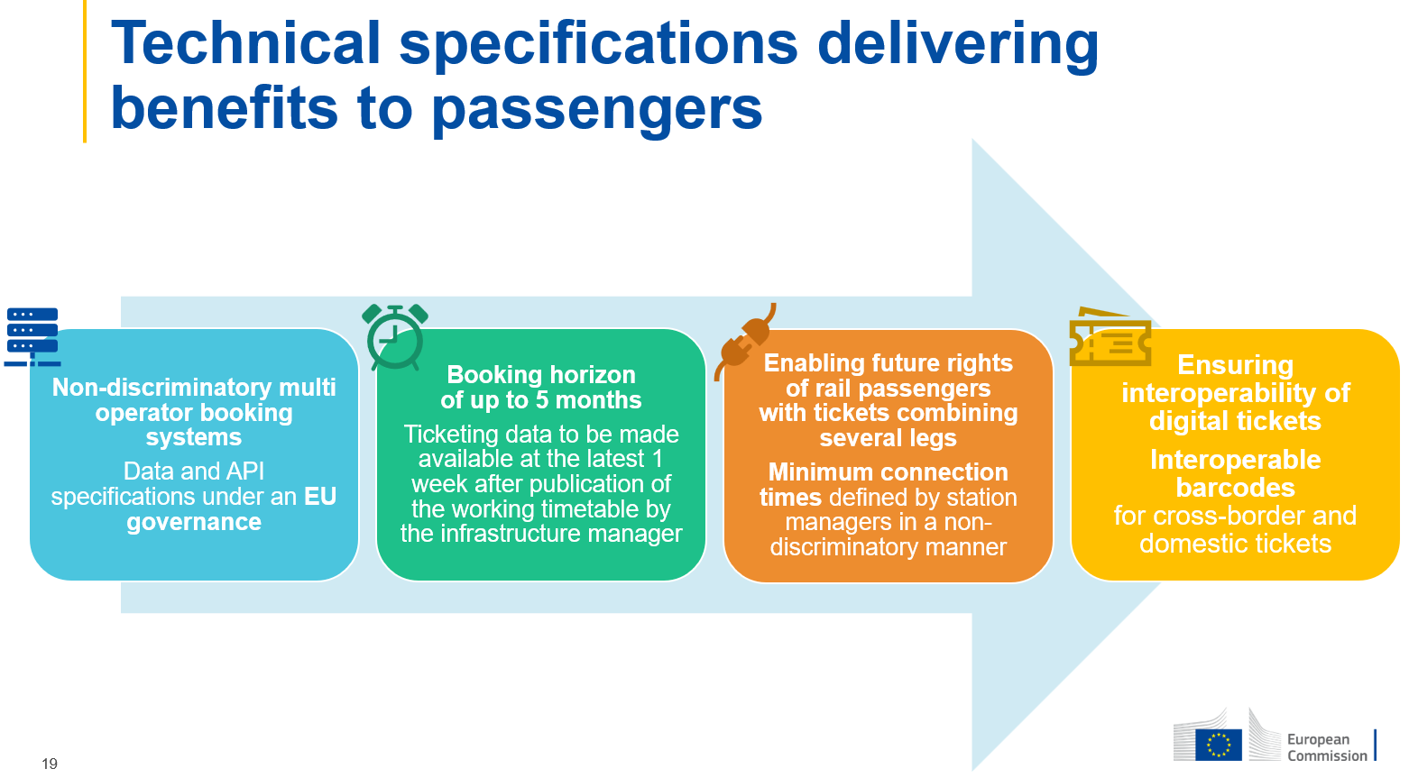
DG Move at RDF 2025 (7)

Slide 54

Other important legal texts (1)
There is always a bigger fish

Slide 55
Other important legal texts (2)
Multimodal travel information act (MMTIS)
eFTI act
European rail passengers rights act (RPRR)
GDPR
Open data act
Data act
Interoperable Europe act
AI act
Infrastructure for spatial information in Europe (INSPIRE)
Multimodal digital mobility services regulation (MDMS)
Single digital booking and ticketing regulation (SDBTR)

Slide 56
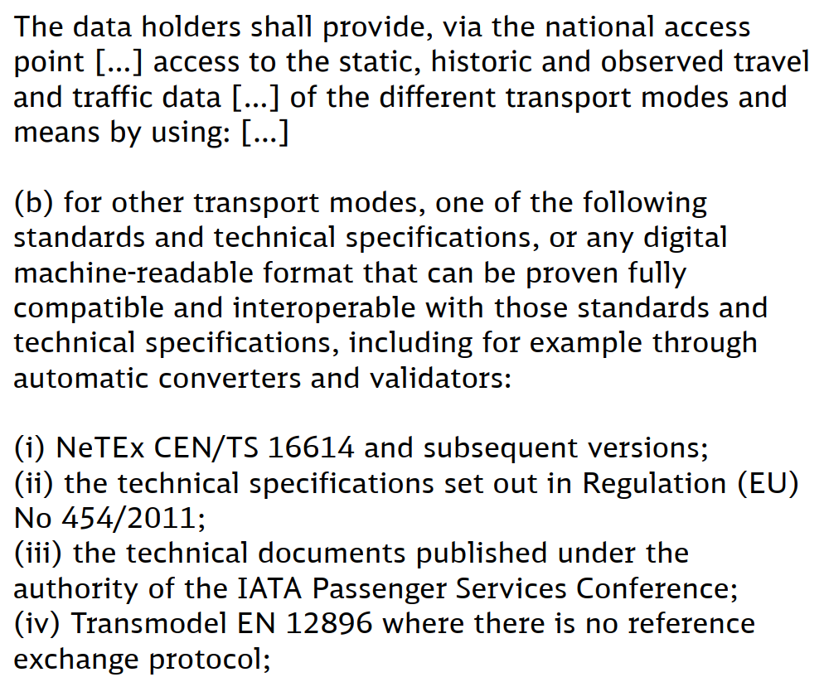
MMTIS
Delegated regulation EU 2017/1926
Amended by delegated regulation 2024/490
Which have implemented National Access Points provide their Multimodal Travel Information using Transmodel-based formats.

Slide 57
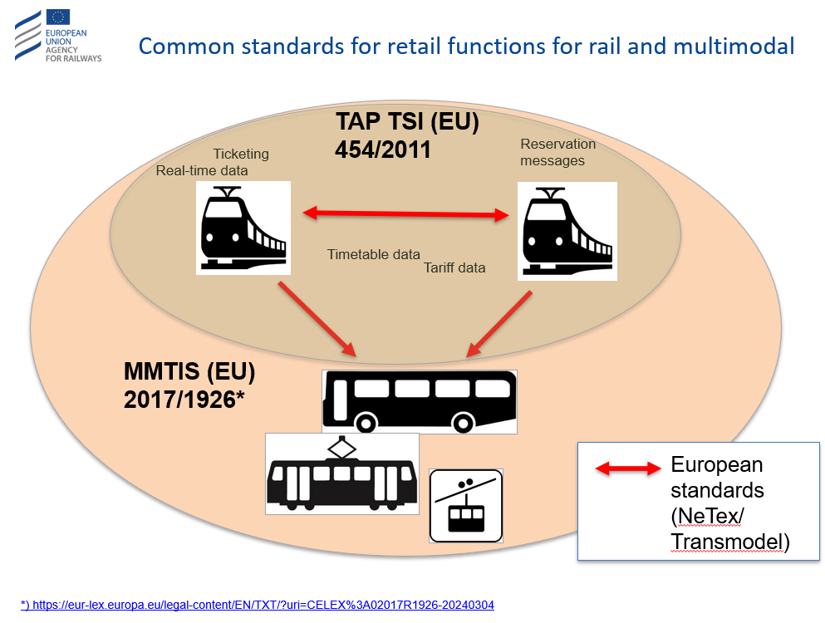
MMTIS

Slide 58
eFTI
Impact on the consignment note
Regulation (EU) 2020/1056
The eFTI Regulation - European Commission:
It will reduce administrative burdens for operators and authorities, enhance data security, and ensure compliance with EU and national freight regulations. Authorities in all EU Member States will be required to accept electronic data when shared by businesses via e-FTI compliant platforms.
Broader than e-CMR: includes permits, certificates, and other regulatory documents.
Key barriers for digital consignment note
Investment
Wide variety between countries on legal acceptance of electronic notes
Some government imposes paper documentation / refuse electronic consignment notes
Not everything is standardized, waiting to invest in order not to change later (chicken & egg)
eFTI certified platforms exist
- Edisoft eFTI Platform Provider: Seamless Compliance & Connectivity

Slide 59
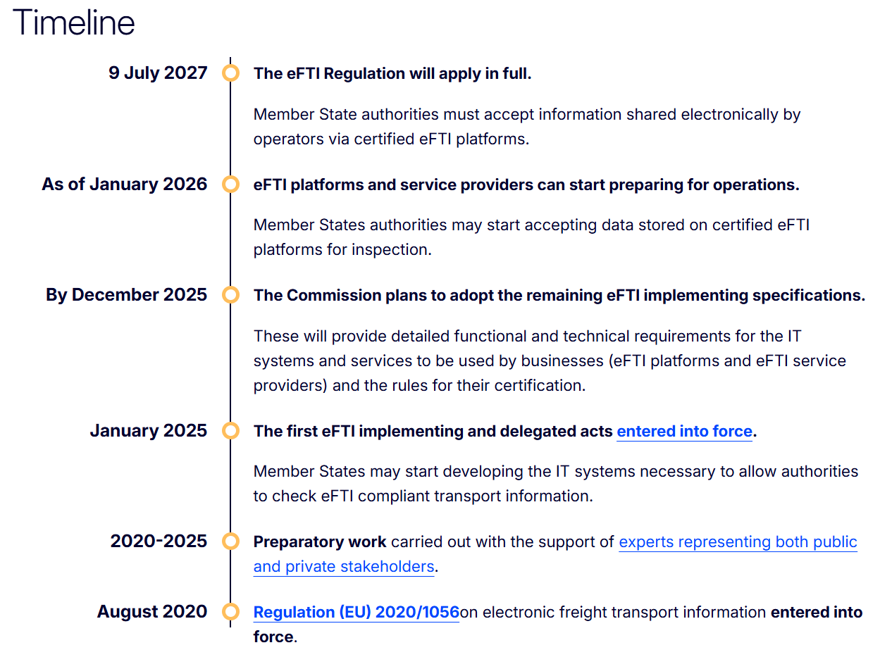
eFTI timeline

Slide 60
RPRR / GDPR / Open data / Cybersecurity
European rail passengers’ rights act (RPRR):
Regulation (EU) 2021/782 of the European Parliament and of the Council of 29 April 2021 on rail passengers’ rights and obligations (recast) (Text with EEA relevance)
Impact on TAP
GDPR
Regulation (EU) 2016/679 of the European Parliament and of the Council of 27 April 2016 on the protection of natural persons with regard to the processing of personal data and on the free movement of such data, and repealing Directive 95/46/EC
Impact on TAP
Open data:
Directive (EU) 2019/1024 of the European Parliament and of the Council of 20 June 2019 on open data and the re-use of public sector information
Mostly impact on TAP TSI
Cybersecurity:
Regulation (EU) 2019/881 of the European Parliament and of the Council of 17 April 2019 on ENISA (the European Union Agency for Cybersecurity) and on information and communications technology cybersecurity certification and repealing Regulation (EU) No 526/2013 (Cybersecurity Act)
Impact on both TSIs

Slide 61
AI / INSPIRE
AI act
Regulation (EU) 2024/1689 of the European Parliament and of the Council of 13 June 2024 laying down harmonised rules on artificial intelligence and amending Regulations (EC) No 300/2008, (EU) No 167/2013, (EU) No 168/2013, (EU) 2018/858, (EU) 2018/1139 and (EU) 2019/2144 and Directives 2014/90/EU, (EU) 2016/797 and (EU) 2020/1828 (Artificial Intelligence Act)
Not only about LLMs.. Can impact Telematics
INSPIRE
Directive 2007/2/EC of the European Parliament and of the Council of 14 March 2007 establishing an Infrastructure for Spatial Information in the European Community (INSPIRE)
Impacts models such as Transmodel

Slide 62
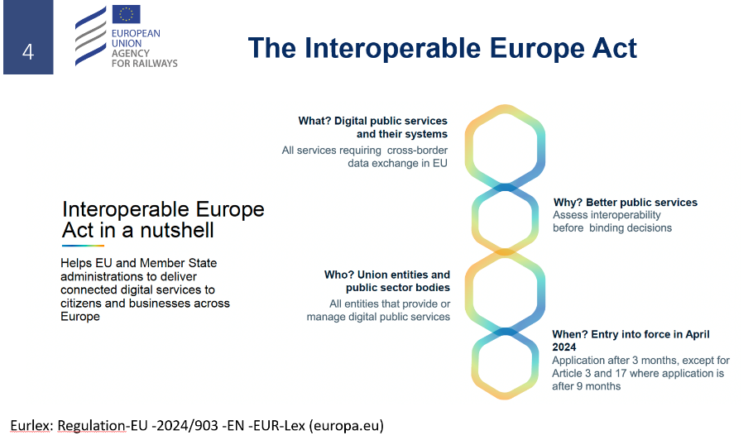
Interoperable Europe act
Regulation (EU) 2024/903 of the European Parliament and of the Council of 13 March 2024 laying down measures for a high level of public sector interoperability across the Union (Interoperable Europe Act)

Slide 63
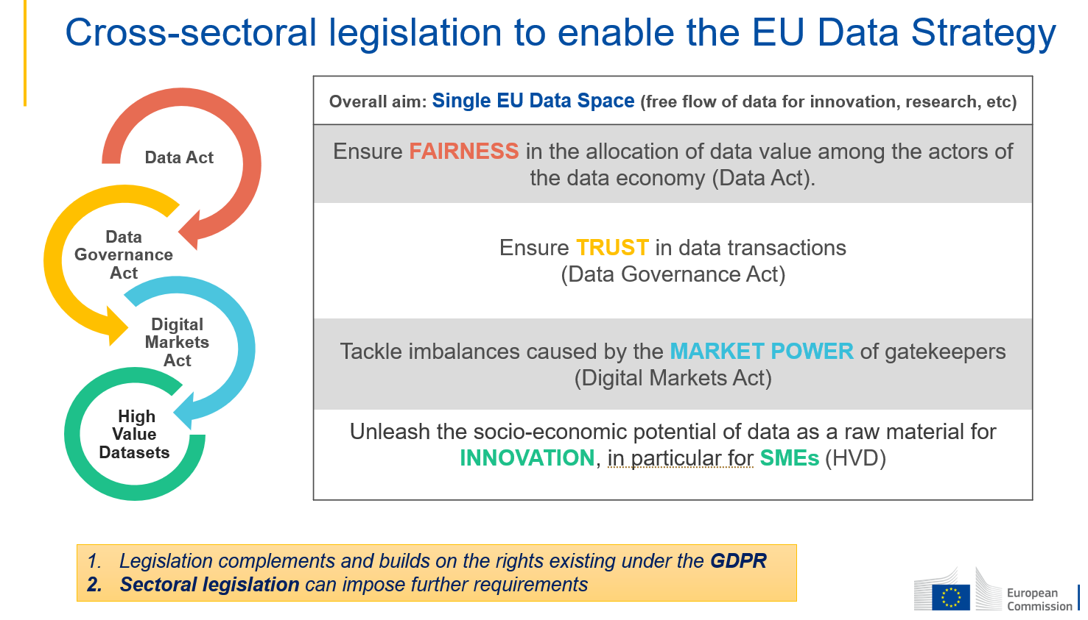
Data act (new)

Slide 64
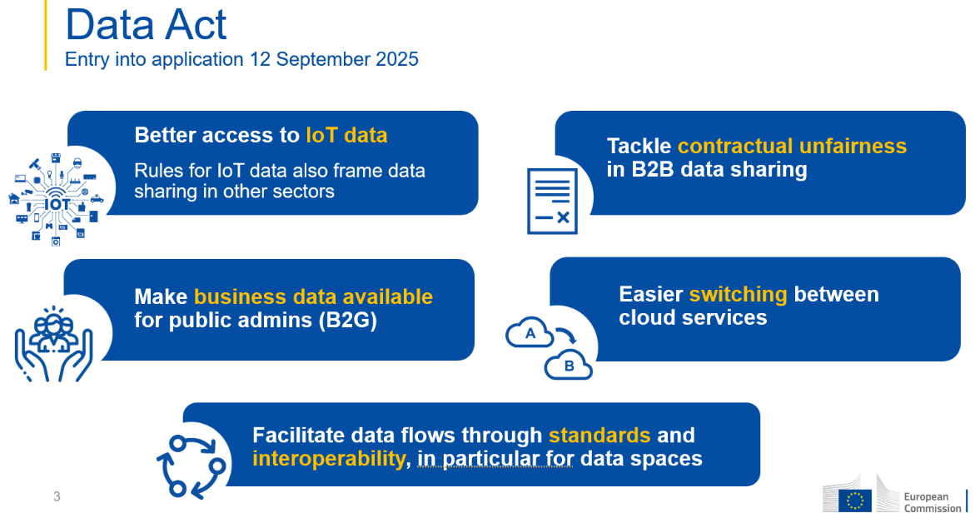
Data act (new) (2)

Slide 65
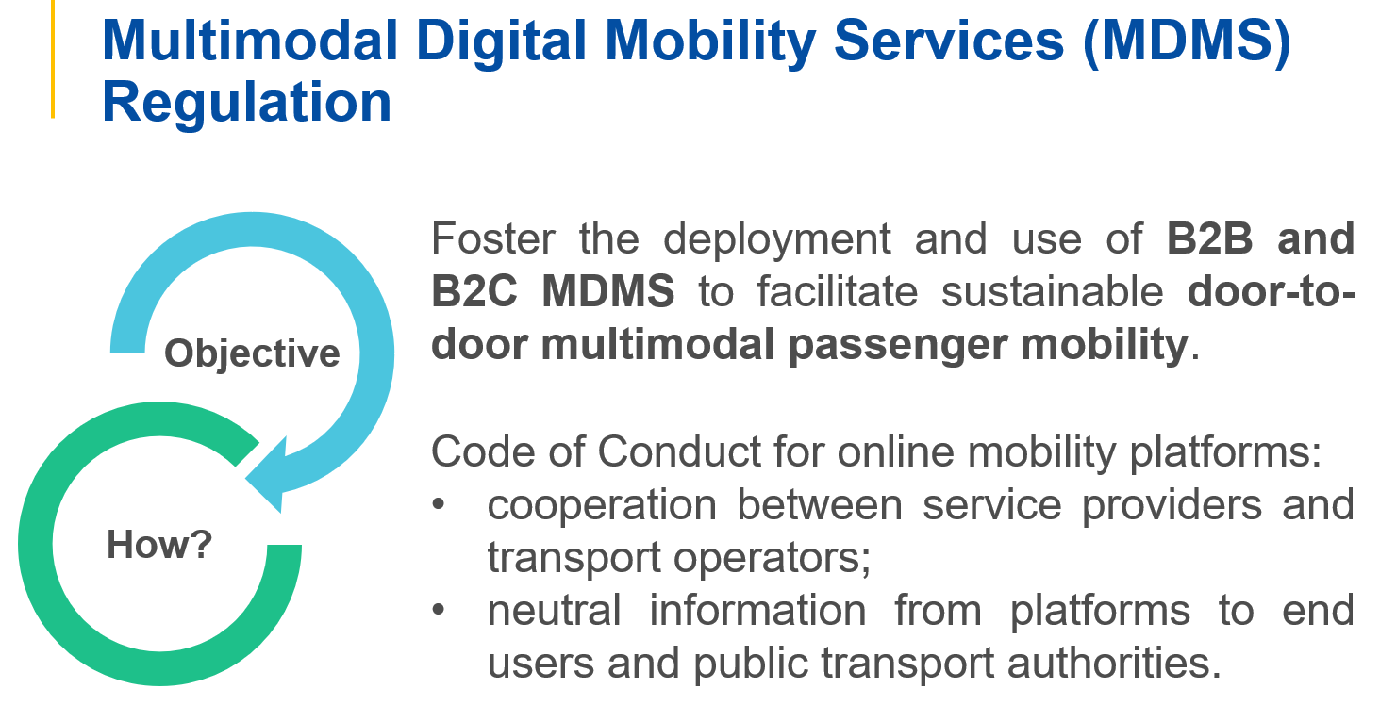
MDMS (upcoming)

Slide 66
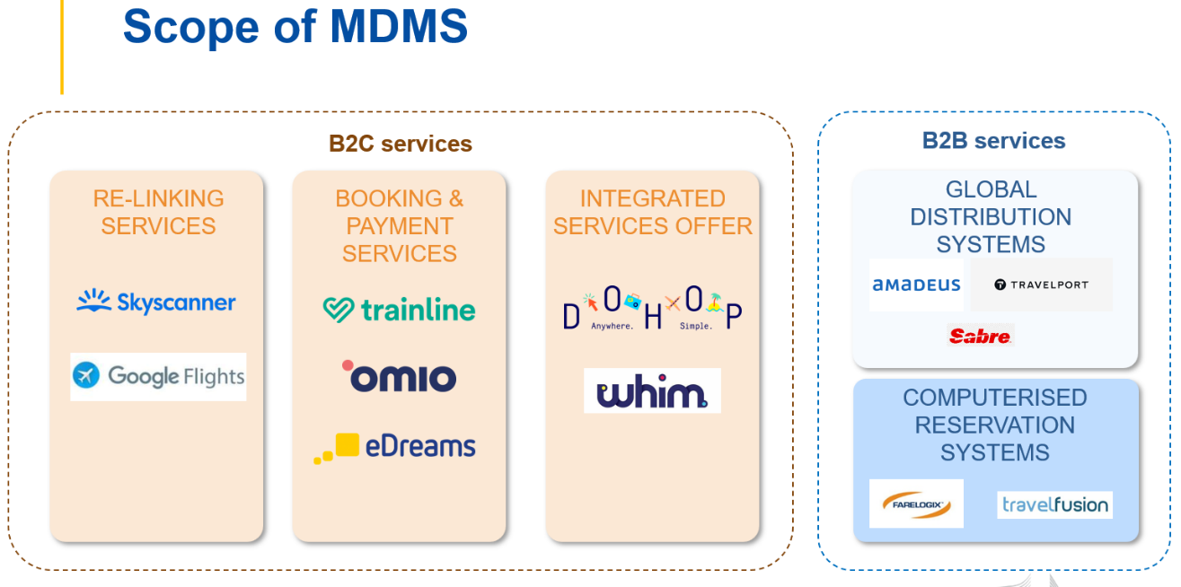
MDMS (upcoming)

Slide 67
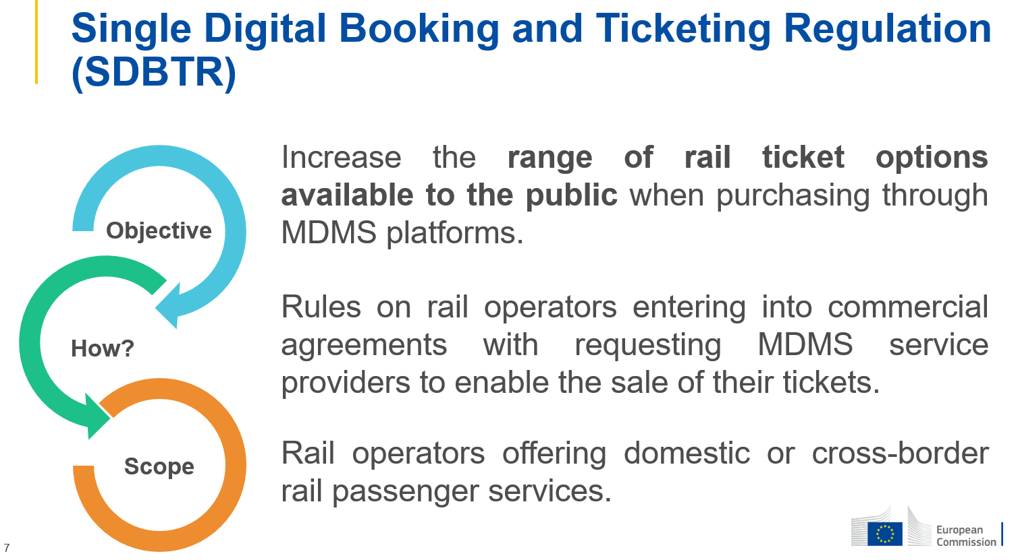
SDBTR (upcoming)

Slide 68
Module Agenda
General overview
  Interoperability
  Telematics basics
  Legal framework
  Stakeholders
  Implementation status
  The data
    Data technologies
    Data modelling
    Telematics data models
  Hands on with XSD files
  In depth: capacity allocation process
In depth

Slide 69

❹
Stakeholders

Slide 70
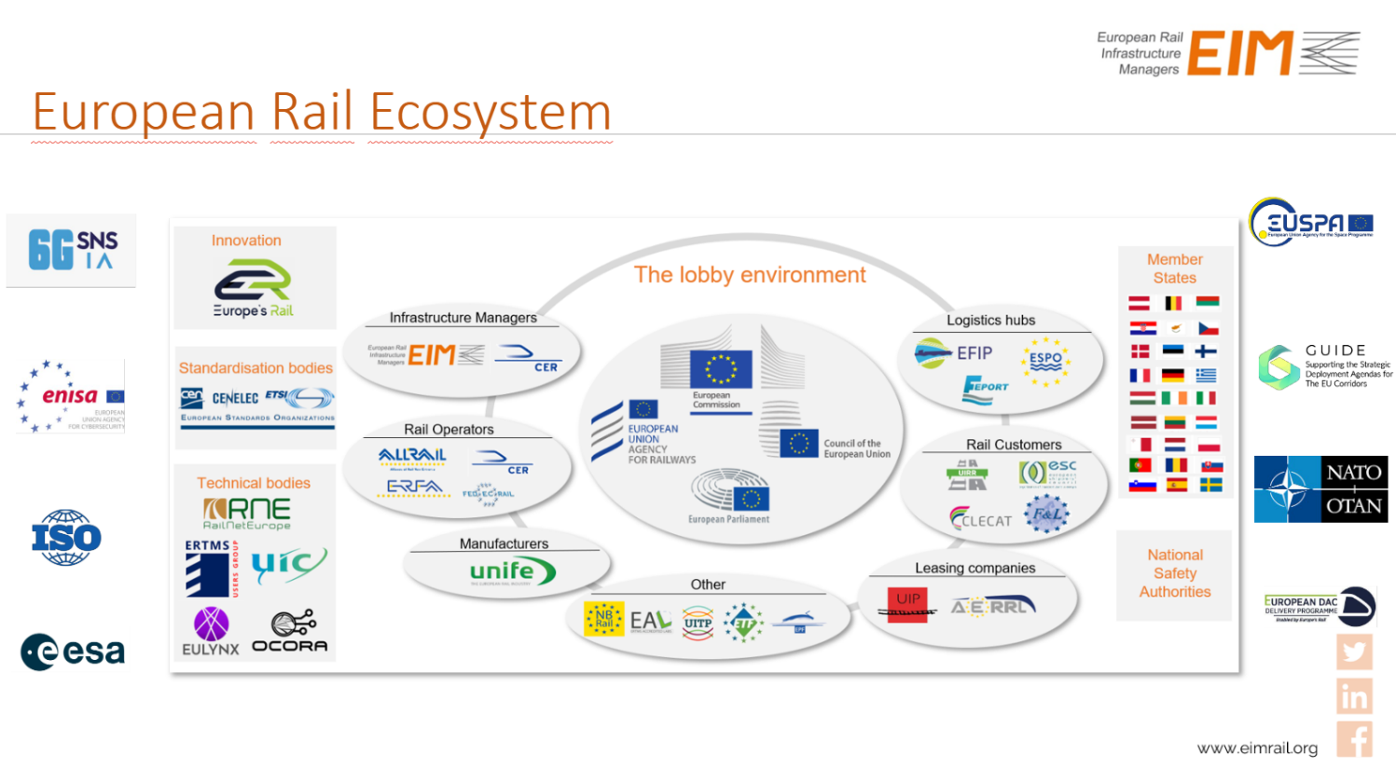
Sector overview

Slide 71


DG MOVE
European commission responsible for EU policy on mobility and transport
Mobility and Transport - European Commission
Rail interoperability and safety:
  Yann Seimandi
Fidel Santiago

Slide 72
ERA
European Railway Agency
Set up by means of Regulation (EC) No 881/2004 of 29 April 2004 (in the first railway package) with the aim of improving the interoperability and safety of the EU rail network. The agency itself has no decision-making powers, but it helps the Commission to draw up proposals for decisions in the area of the European rail network and in setting common safety targets.
Organisation | European Union Agency for Railways

Slide 73
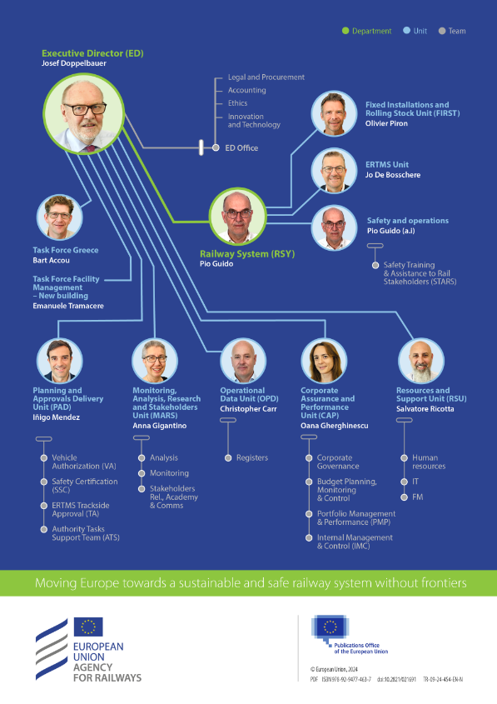
(outdated image)
Oana Gherghinescu is now Executive director, taking the place of Josef Doppelbauer.
Telematics is inside OPD, the data unit led by Christopher Carr

Slide 74


ERA
Telematics experts at ERA:
Stefan Jugelt
Mickael Varga

Slide 75
IM & RU groups
EIM - EIM
EIM represents the interests of the European rail infrastructure managers.
CER
The Community of European Railway and Infrastructure Companies (CER) brings together close to 70 railway undertakings, their national associations as well as infrastructure managers and vehicle leasing companies.

Slide 76
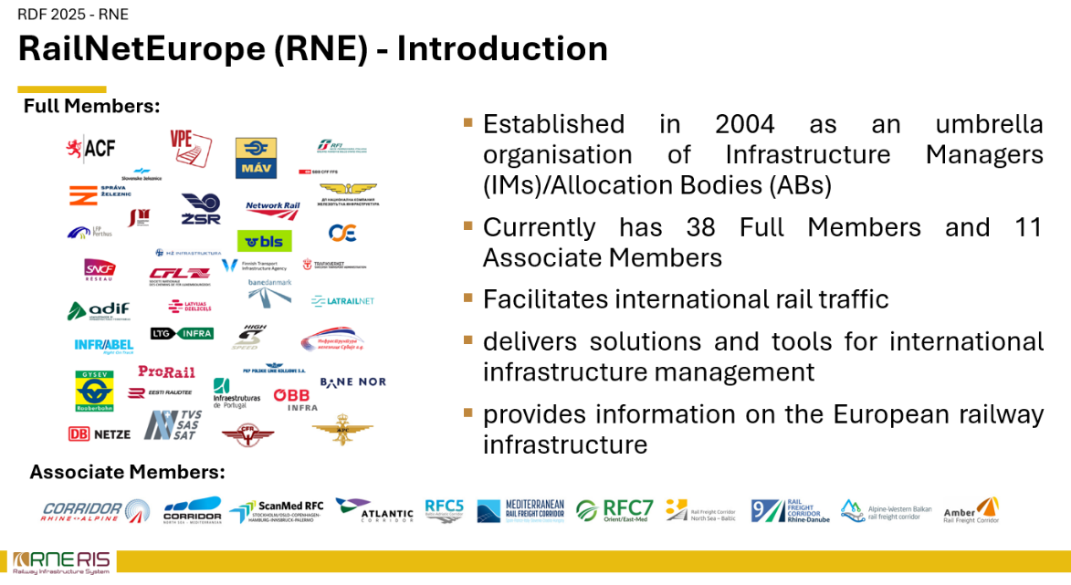
RNE

Slide 77

RNE
A mandate to coordinate the IMs within the TAF/TAP TSI framework was given to RNE by its General Assembly in May 2008 and renewed in May 2012. Since that time, RNE has been providing strong support by coordinating and organising the implementation of the TAF & TAP.
https://rne.eu/it/taf-tap-tsi/
Develop telematics tooling such as:
CCS, PCS, TIS
Harald Reisinger

Slide 78
UIC
Union International des Chemins de Fer
The worldwide professional association representing the railway sector and promoting rail transport
Develop telematics tooling under the umbrella of Raildata
Started standardization of TAP telematics before 2006
https://uic.org/
They govern the OSDM data model

Slide 79

UIRR
International Union for Road-Rail Combined Transport
Sector association for Combined Transport
UIRR

Slide 80
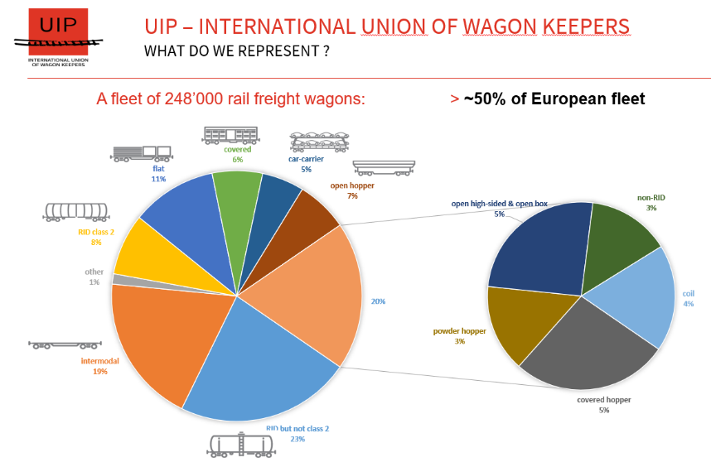

UIP
International Union of Wagon Keepers
Gilles Peterhans

Slide 81

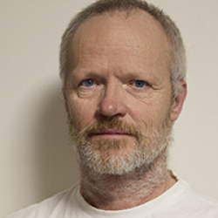
ENTUR
Entur is a state-owned technology company working to make it easier to choose public transport in Norway.
Established in 2016
Norwegian example on how MMTIS can be implemented on a European scale. They are very active in the TSI Telematics domain and are pro Netex.
Brede Dammen
Einar Bjørkevoll

Slide 82
railML
The railML.org initiative was founded in early 2002 in response to the background of the constant challenges of connecting different railway IT applications.
railML.org
Coordinator: Vasco Paul Kolmorgen
They govern the data model railML.

Slide 83
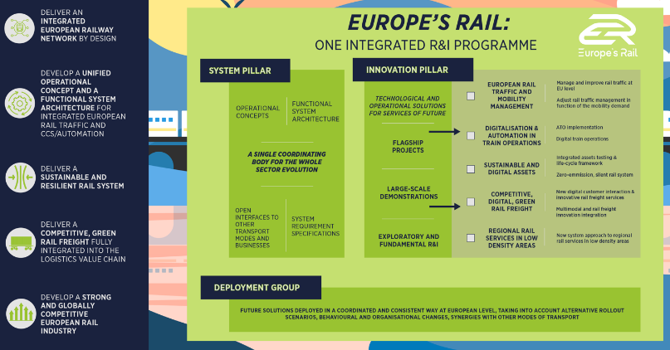
Europe’s Rail
Europe’s Rail Joint Undertaking (EU-Rail) is the European partnership on rail research and innovation established under the Horizon Europe programme (2020-2027) and the universal successor of the Shift2Rail Joint Undertaking.
Previously: ERJU
https://rail-research.europa.eu/

Slide 84
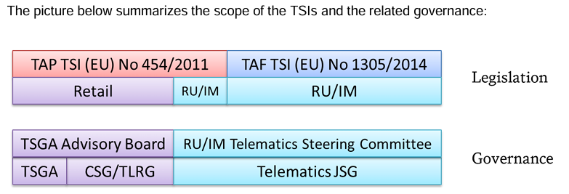
Telematics governance bodies (1)
The link between retail and RU/IM is ensured by cross-attendance of representatives of CSG and JSG as well as between TSGA Advisory Board and RU/IM Telematics Steering Committee.

Slide 85
Telematics governance bodies (2)
JSG
Set up in October 2012 as a voluntary organisation. Now supported by 14 European Associations
Common sector position towards European Union Agency for Railways (ERA) and Directorate-General for Mobility and Transport (DG MOVE) whenever required.
Involved in the CCM working party for TAF/TAP TSI for change requests.
=> Very useful TAF/TAP documentation on their website!
TSGA
TAP Services Governance Association
Its purpose is to ensure that the regulated services exist, in accordance with the TAP TSI Regulatory Services, in a manner that allows regulatory obligations to be met by railways and regulatory rights to be enjoyed.
CSG
Rail sector’s mirror group for matters related to the statutory ERA Working Parties and Cooperation Groups as well as for other official TAP TSI bodies.
TRLG
At the beginning of 2017, a TAP Retail Liaison Group was established. It is constituted of the CSG and representatives of the Ticket Vendor associations ECTAA and ETTSA. The initial purpose of this new group is to align Railway and Ticket Vendor positions vis-à-vis the retail provisions in the ERA TAP CCM process.

Slide 86
NCP
A network of National Contact Points (NCPs) has been set up to provide information on the implementation of the TSI provisions and to relay any difficulties encountered on the ground to the European level. The Federal Public Service Mobility and Transport is the NCP for Belgium.
=> Not to be confused with NAP (National Access Point)

Slide 87
Module Agenda
General overview
  Interoperability
  Telematics basics
  Legal framework
  Stakeholders
  Implementation status
  The data
    Data technologies
    Data modelling
    Telematics data models
  Hands on with XSD files
  In depth: capacity allocation process
In depth

Slide 88

Time for the lunch!
Please be back
at 13:00!

Slide 89
❺
Implementation Status

Slide 90
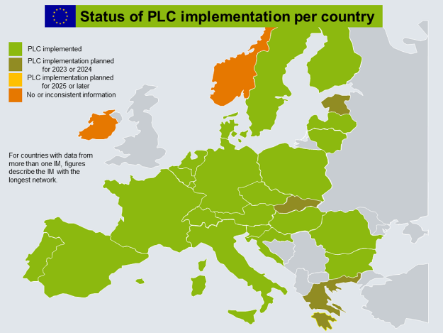
Global status
Many actors don’t even do the basic requirements yet!
Exec summary 2020

Slide 91
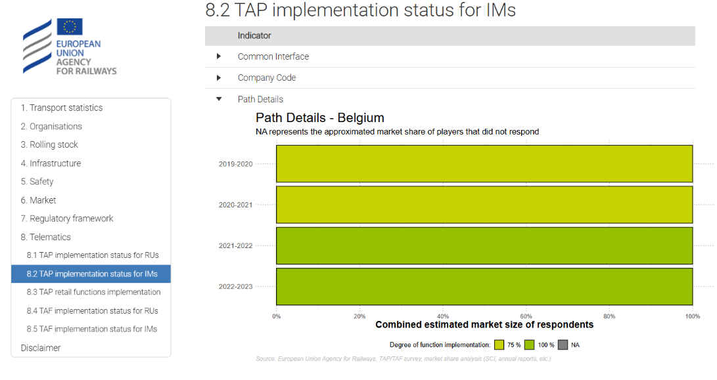
Hands on with statistics!
https://www.era.europa.eu/content/era-railway-factsheets

Slide 92
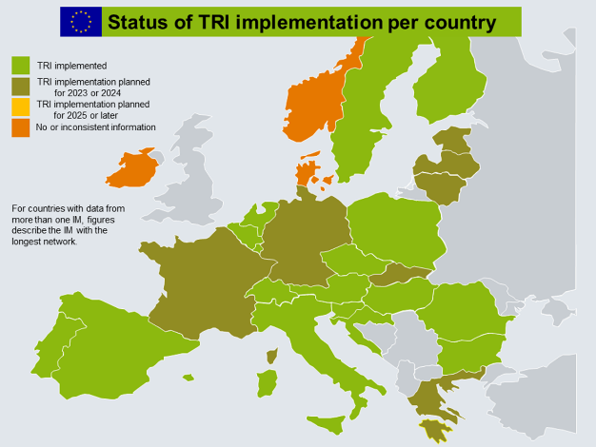
Train information message
Exchanging train information messages is “Pretty easy” to implement
RNE TIS:
https://tis-prod.rne.eu/
(Demo)

Slide 93
Capacity allocation
Much harder to implement given the legacy systems inside the IM and RU.

Slide 94
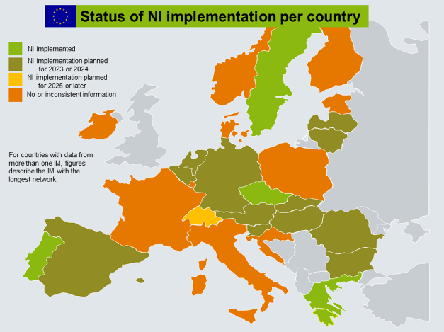
New train identifier
Pain point!
A EU wide unique train number

Slide 95
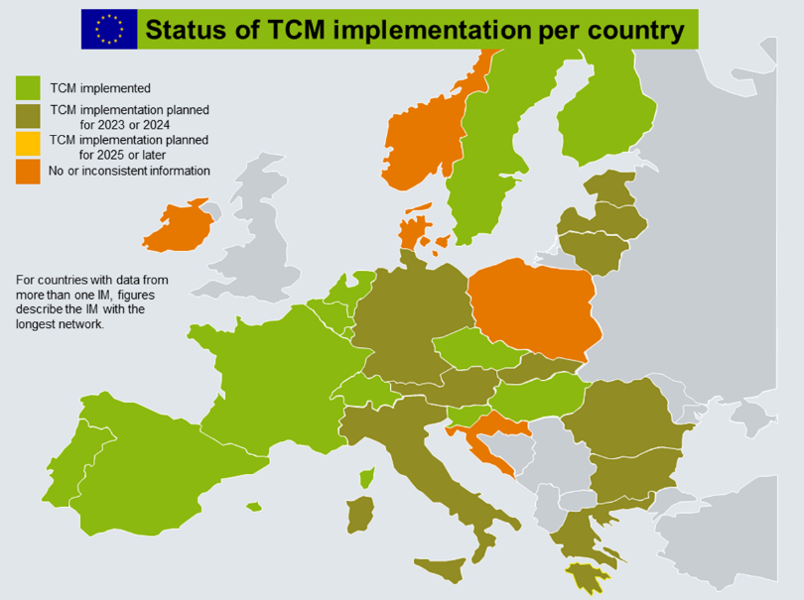
Train composition message

Slide 96
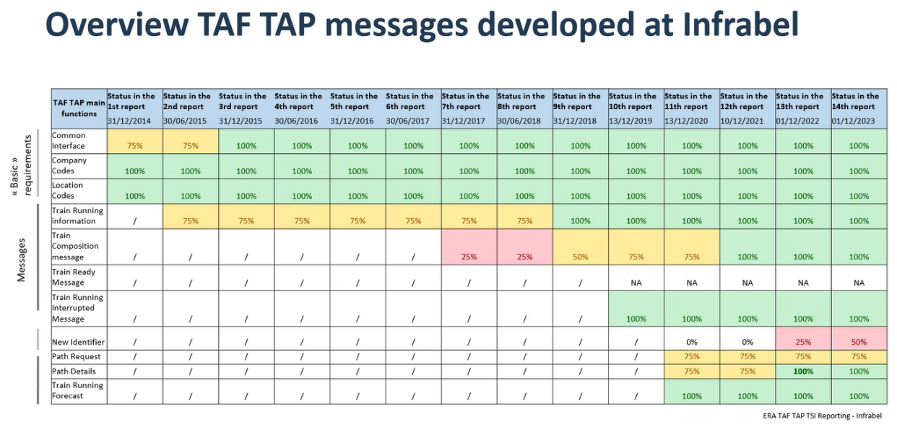
What about Infrabel?

Slide 97

What about Infrabel?

Slide 98
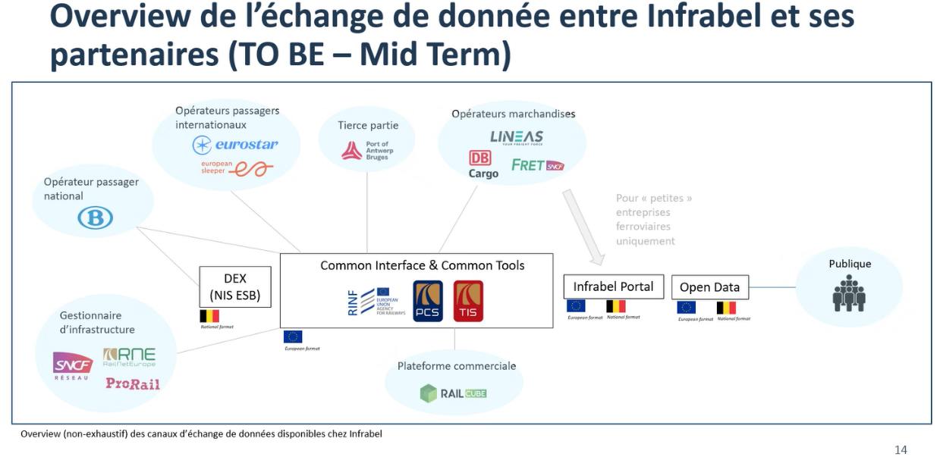
What about Infrabel?

Slide 99

Tools

Slide 100
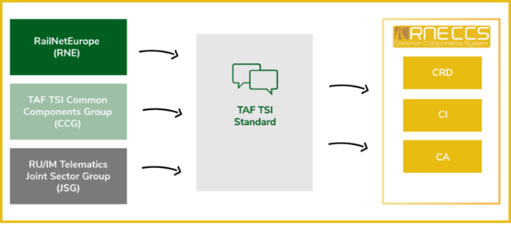
RNE CCS
Target group: all
https://rne.eu/it/products/ccs/what-is-ccs/
The basic requirements (codes & common interface)
Common components

Slide 101

RNE TIS
Target group: IM's & Rail freight customers
Train running information
Video: https://tis-prod.rne.eu/login
Actual position (not a GPS position) of a train

Slide 102

RNE PCS
Path coordination system
Target group: IM’s
Capacity allocation
Infrabel would like to migrate to this application
The Path Coordination System (PCS) is an international path request coordination system for Path Applicants, Infrastructure Managers (IMs,) Allocation Bodies (ABs) and Rail Freight Corridors (RFCs). The internet-based application optimises international path coordination by ensuring that path requests and offers are harmonised by all involved parties.

Slide 103
Other applications following TSI telematics
Raildata Orpheus
Target group: RU’s
Wagon consignment notes
Raildata ISR
Target group: RU’s
Wagon movement
UIP RSRD
Target group: wagon keepers
Goal is full compliance for wagon keepers
Hitrail Heros
Target group: IM’s & freight customers
Capacity allocation & Train running information

Slide 104

Statistics!

Slide 105
Sector frustrations about implementation
No international train number (-> changing national train numbers lead to visibility loss)
Terminal Operator readiness to exchange data with IMs/RUs is very low
Focused information exchange for terminals (not e-mails for all status updates)
Data quality
Align users on latest versions of interfaces
One price must be communicated by data provider through different channels to the user
Data definitions are not clear and interpretable per user

Slide 106
Module Agenda
General overview
  Interoperability
  Telematics basics
  Legal framework
  Stakeholders
  Implementation status
  The data
    Data technologies
    Data modelling
    Telematics data models
  Hands on with XSD files
  In depth: capacity allocation process
In depth

Slide 107
❻
The Data

Slide 108

Data technologies
CSV
Excel
XML
API
RDF

Slide 109


Data formats matter...

Slide 110
CSV
1 object type per file
Everything is a string?
Reference using IDs to other files is possible, but very loosely... zip?

Slide 111

Excel
Very much like CSV (1 object type per sheet)
But less problems with keeping object types together and referencing

Slide 112

XML
Multiple object types per file
Tree based structure
Standardized schema language (XSD) (validation of constraints)

Slide 113

XML example

Slide 114
(JSON) API
API stands for Application Programming Interface.
It allows different software applications to communicate with each other.
APIs define methods and data formats that applications can use to request and exchange information.
They enable integration between different systems, platforms, and services.
APIs can be public or private depending on their intended use.
Commonly used in web development to connect front-end and back-end services.
Very relevant for real time communication

Slide 115

RDF (Resource Description Framework)

Slide 116


Why, why... Why?
Our reality is infinitely connected
Nature is much like a rail network
Digital infrastructure is definitely a network
Everyone knows someone that knows someone that knows someone that knows someone that knows someone that knows someone that knows someone that knows someone that knows someone that knows someone that knows someone that knows someone
But we persist in structuring data in tables!

Slide 117
RDF (4)
Imagine a world where data integration is a fact

Slide 118
RDF is about data standardisation
How to identify data => Hyperlinks!
How to structure data => RDF
How to give meaning to data => Ontology
How to define constraints => SHACL, RDFS

Slide 119
1. What is Linked Data
Standardising...
Brussel-Centraal is a station in Belgium.
Brussel-Centraal = http://data.europa.eu/949/.../operationalPoints/BEFBCL
Station = http://data.europa.eu/949/.../op-types/rinf/10
Belgium = http://publications.europa.eu/resource/authority/country/BEL
Brussel-Centraal is a station.
Brussel-Centraal lies in Belgium.
Let’s agree on using ERA vocabulary!
Type of operational point = http://data.europa.eu/949/opType
In country = http://data.europa.eu/949/inCountry
How to identify data entities
Use IRI’s (or URI’s or URL’s)
How to structure data
Use RDF
How to define the meaning of data
Use ontologies / vocabulaires
StationId | Name | Location
123 | Brussel-Centraal | Belgium
Notes:
IRI is a broader term for URI which is a broader term for URL which is also known as hyperlinks on a website.
IRIs = Internationalized Resource Identifiers (http://example.org/مرحبا)
URI = Uniform Resource Identifier (http://example.com/page.html, urn:isbn:0-486-27557-4, mailto:user@example.com)
URL = Uniform Resource Locators (http://www.example.com/index.html)
IRI accepts more characters than URI’s (international character sets)
URI’s include other protocols besides http:// or https://

Slide 120
1. What is Linked Data
Station
http://data.europa.eu/949/.../op-types/rinf/10
Railway example
Type of OP
http://data.europa.eu/949/opType
Brussel-Centraal is a station in Belgium.
Becomes:
http://data.europa.eu/949/.../operationalPoints/BEFBCL http://data.europa.eu/949/opType http://data.europa.eu/949/.../op-types/rinf/10 .
http://data.europa.eu/949/.../operationalPoints/BEFBCL http://data.europa.eu/949/inCountry http://publications.europa.eu/resource/authority/country/BEL .
Brussel-Centraal
http://data.europa.eu/949/.../operationalPoints/BEFBCL
Belgium
http://publications.europa.eu/resource/authority/country/BEL
In country
http://data.europa.eu/949/inCountry

Slide 121


Notes:
List of prefix definitions is behind the screenshot of the data

Slide 122
SPARQL
SPARQL = Query language for RDF data
ERA has many examples as data stories
SPARQL Wiki

Slide 123
RDF vs XML
 | XML | RDF
Data model | Tree based, branches are possible | Graph based (trees, branches but also networks)
Identifiers | Identifiers are typically unique within the document but not outside | IRIs as global identifiers
Extensions | Schema modifications are required for extensions | Easy to extend outside the scope of the model
Reasoning and inferencing | No standardised reasoning / inference | Build-in
Closed structure | Every file is a closed element, splitting a file is not possible without specialized logic | Every triple is a closed element, a file can be split or merged without any issues

Slide 124
JSON API vs SPARQL Endpoint
 | JSON API | SPARQL Endpoint
Setup | mostly custom development | mostly works out of the box
Data model | mostly custom | from the data itself, no manipulation
Querying | custom endpoints | SPARQL over HTTP
Response completeness | depends on the API endpoint, can be what you need, too much or not enough | exactly what you requested
Federated query | impossible | standardized available

Slide 125
RDF and the railway sector
ERA ontology for RINF and all ERA registers (ERATV, ...)
All IM's will need to supply RINF data in RDF by 04/2026
Europe's rail develops data models by extending ERA ontology
UIC SFERA 3.0 will be converted into ontology
The telematics schema files will be converted into RDF (ontology, SHACL, SKOS)
railML is converting their XSD schema into an ontology
BaneNOR is building a knowledge graph as a backbone of their data stores and to produce the RINF
Even NMBS does it, but they probably don't know. ODASE project for ticket fare calculation.
Ontorail for model mapping
...

Slide 126
RDF and the rest of the world
Netflix: Model Once, Represent Everywhere: UDA (Unified Data Architecture)
IKEA’s Knowledge Graph and Why It Has Three Layers | by Katariina Kari | Flat Pack Tech | Medium
"What is Data-Centric" Dave McComb
The Future of Knowledge Graphs in a World of Large Language Models, Denny Vrandečić
How to Build a Corporate Knowledge Graph – from the bottom up, Tony Seale
'UBS Knowledge Graph — Connecting The Banks Data' by Gregor Wobbe
Linked Data Service (english version)
European Data on Rails, the Linked Data Project
Lotico - Data Shapes in Action, Synergies of computational linguistics and RDF - YouTube
Ora Lassila, Amazon - Will Knowledge Graphs Save Us From the Mess of Modern Data Practice
Knowledge Graphs for Target Discovery and Precision Oncology at AstraZeneca, Krishna Bulusu
Dan Carey, EDW 2023: "Ontologies and Knowledge Graphs A 7 Year and Counting Success Story"
Knowledge Graphs for Target Discovery and Precision Oncology at AstraZeneca, Krishna Bulusu
Estes Park Group 05/04/2023 - SPARQL Anything
Dan Carey, EDW 2023: "Ontologies and Knowledge Graphs A 7 Year and Counting Success Story"

Slide 127

RDF allows to work with the reality

Slide 128
Time for a break!
Please be back
at 14:30!

Slide 129
Module Agenda
General overview
  Interoperability
  Telematics basics
  Legal framework
  Stakeholders
  Implementation status
  The data
    Data technologies
    Data modelling
    Telematics data models
  Hands on with XSD files
  In depth: capacity allocation process
In depth

Slide 130

Data modelling

Slide 131

Data modelling (1)
Data modelling is ...
Use Case Driven
Telematics?
Multimodal problem
Freight AND passengers
“But... Silos make things easier”
(Yes... at the start... Untill you need to integrate => INTEROPERABILITY!)

Slide 132
Data modelling (2)
All models are wrong, but some are useful

Slide 133
Data modelling (3)
If you want to go fast, go alone. If you want to go far, go together

Slide 134

Data modelling (4)
In general: the more complex a data model, the better the fit with the use case. The reality is complex.

Slide 135
Exercise: What is the platform length?
Let’s model the platform length. Tell me how to define this.
First think about the use case!!!
Length of the platform for asset management (real physical length)?
Length of the platform available for passenger transport?
Available length for food carts?
Why the ‘usable’ (for passenger transport) platform length is not just 1 number but depends on the railway infrastructure and train route: https://link.excalidraw.com/p/readonly/S6nQcY35SuYVFAhjhEUv

Slide 136
Module Agenda
General overview
  Interoperability
  Telematics basics
  Legal framework
  Stakeholders
  Implementation status
  The data
    Data technologies
    Data modelling
    Telematics data models
  Hands on with XSD files
  In depth: capacity allocation process
In depth

Slide 137

data models relevant for Telematics

Slide 138
Data models: Transmodel (1)
History:
  1991: birth of Transmodel from a project called Cassiope (Computer Aided System for Scheduling Information and Operation of Public Transport in Europe, 1989-1991)
  1996: Telematics Applications Programme project TITAN continued to improve Transmodel (1996-1998) (v4.1)
  1997: chosen as experimental norm ENV 12896 (v5.0)
  1999: The Système d'Information pour le Transport Public (SITP) project added UML, v5.1
  2005: birth of SIRI as CEN EN 15531-x
  2006: v5.1 was adopted as CEN EN 12896 standard.
  2011: v6.0, widespread use
  2014: birth of NeTEx as CEN TS 16614-x

Slide 139

Data models: Transmodel (2)

Slide 140
Data models: Transmodel (3)
The conceptual model, further implemented by
Netex for the planned data (XML file) (CEN/TS 16614)
SIRI for the real time data (API)
OpRA for the observed data
OJP as open API
Hands on with https://github.com/NeTEx-CEN/NeTEx

Slide 141
Data models: Transmodel (4)
Use cases
Passenger information
Schedule building
Operations planning
Fleet management
Data preparation
Fares, ticketing and reservations
Operations monitoring & control
Public transport network (reference data)
Statistics
Alternative routes

Slide 142
Remember the bigger fish

Slide 143
Data models: Transmodel (5)
Why so many standards? (NeTex, SIRI, ...)
Conceptual model remains the same
Functional scope
  People/systems have their own specialty, their own functional scope
Technology needs
  Different technologies are needed to handle the real-time and dynamic aspects of a system as opposed to the static aspects: bulk exchange of static data vs dynamic APIs for small data elements
History / prioritization / inheriting standards

Slide 144
Data models: OSDM (1)
OSDM

Slide 145
Data models: OSDM (2)
UIC IRS 90918-10
History
Started in 2020
Combination of forces of two legacy models (‘New tariff model’ and ‘Full service model’)
Two systems
Offline, XML
Online, API

Slide 146
Data models: OSDM (3)
Use cases
Multimodal ticket sales
Reservations
https://transmodel-cen.eu/wp-content/uploads/2024/07/CER-UITP-Factsheet_OSDM-Transmodel.pdf
CER and UITP support leaving the choice to stakeholders to use either Transmodel or OSDM as an interoperable standardised sector solution for regional, long distance rail and multimodal operators and ticket vendors part of the Single European Railway Area (SERA)

Slide 147
Data models: GTFS (1)
GTFS

Slide 148
Data models: GTFS (2)
https://gtfs.org/
Google played an important role in the development
History: started in 2005
Use cases
Passenger information (trip planning & real time updates)
Two systems
GTFS schedule is like Netex but in CSV
GTFS realtime is like SIRI
CSV based...
Hands-on time with GTFS google example set: https://developers.google.com/transit/gtfs/examples/gtfs-feed

Slide 149
Data models: GTFS (3)
Comparison Netex vs GTFS: https://transmodel-cen.eu/wp-content/uploads/2024/06/2024-June_DATA4PT_GTFS-NeTEx-Mapping_vf.pdf
All use cases of GTFS (and GTFS Realtime) are covered by Netex (and SIRI)
There are conferences organized to discuss conversion and compatibility between GTFS and Transmodel:
https://www.linkedin.com/posts/mobilitydata_mobilitydata-gtfs-mmtis-activity-7333637238196514817-JVHx?utm_source=share&utm_medium=member_desktop&rcm=ACoAAAKKd58BEfDZGWnrZkWE4HOAh8OvCGIGbK8

Slide 150
Data models: ERA ontology
Website with many features to experience the model: Data interop ERA
Map with RINF data
Route compatibility check
SPARQL endpoint
Data stories
...
Source code & development environment: Gitlab
History: started ~2021 Leveraging semantic technologies for digital interoperability in the European railway domain
Governed by ERA with a CCM board
Technology: RDF
Hands on with vocabulary ERA Ontology. Version 3.1.1

Slide 151

Data models: ERA ontology
Use cases
RINF Search RINF
Other ERA registers such as #ERATV
Route compatibility check RCC
Digital routebook
Statistics
Reference register for use cases such as TCR/TSR, train statistics, ...
Regulatory compliance
Future: all use cases of telematics (so will become the biggest fish)

Slide 152

Data models: railML (1)
ISO/TS 4398 "RailDax"
Website: railML.org
History:
2002: started initiative
2005: first schema, v2.0 published
2017: v3.0 released
2024: v3.3 released
Governed by the company railML which is a nonprofit with industry sponsors/members
Technology: XML
Conversion to RDF ongoing : railML ontology

Slide 153

Data models: railML (2)
Use cases:
Interlocking
Network statement
RINF reporting
Timetable simulation
Schematic track plan
TMS
ETCS data prep
Passenger information
Run time calculation
Long term circulation planning
Possession management
Hands on with XSD schema

Slide 154
Data models: SFERA
Not to be confused with SERA
SFERA: Smart communications for efficient rail activities | UIC - International union of railways
History:
2017: project started
2020: publication of IRS
UIC IRS 90940

Slide 155
Data models: SFERA
Use cases:
Driver advisory systems (DAS)
Automatic train operation (ATO)
(Integration with traffic management systems TMS)
Technology: XML based, but conversion to RDF is ongoing
Infrabel is involved because of their Digiform project/application

Slide 156
Module Agenda
General overview
  Interoperability
  Telematics basics
  Legal framework
  Stakeholders
  Implementation status
  The data
    Data technologies
    Data modelling
    Telematics data models
  Hands on with XSD files
  In depth: capacity allocation process
In depth

Slide 157
❼ ❾
Hands on with TAF/TAP XSD

Slide 158
XSD files
TSI TAF
https://github.com/EU-Agency-for-Railways/TSI_TAF
TSI TAP
https://github.com/EU-Agency-for-Railways/TSI_TAP

Slide 159
Module Agenda
General overview
  Interoperability
  Telematics basics
  Legal framework
  Stakeholders
  Implementation status
  The data
    Data technologies
    Data modelling
    Telematics data models
  Hands on with XSD files
  In depth: capacity allocation process
In depth

Slide 160
❽ ❿
Capacity Allocation Process

Slide 161

Ideal path request

Slide 162

Delayed path request

Slide 163
Allocation followed by non availability

Slide 164

Allocation followed by cancellation

Slide 165
Module Agenda
General overview
  Interoperability
  Telematics basics
  Legal framework
  Stakeholders
  Implementation status
  The data
    Data technologies
    Data modelling
    Telematics data models
  Hands on with XSD files
  In depth: capacity allocation process
In depth

Slide 166

Do you have questions?

Slide 167
In case of questions later
Tech support: ERA TAF_TSI@era.europa.eu
Administrative support: national NCP taftap@mobilit.fgov.be
You are also free to contact me:
mathias@matdata.eu https://www.linkedin.com/in/mathiasvda/

Slide 168

Quiz!

Slide 169
Question 1
What are the 6 essential requirements specified in the railway directives?
Safety, Speed, Health, Environmental protection, Technical compatibility, Accessibility
Safety, Reliability and availability, Health, Environmental protection, Technical compatibility, Accessibility
Safety, Reliability and availability, Health, Efficiency, Technical compatibility, Accessibility
Safety, Reliability and availability, Security, Environmental protection, Technical compatibility, Accessibility
Notes:
Correct answer: nr 2

Slide 170
Question 2
What does PLC stand for in telematics?
Primary Location Code
Public Location Code
Path Location Code
Primary Line Code
Notes:
Correct answer: Primary Location Code

Slide 171
Question 3
What is eFTI about?
European freight tracking interface for real-time train position monitoring across borders
Electronic freight transport information regulation requiring digital consignment notes and freight documents by July 2027
Electronic freight tariff integration system for standardized pricing between railway operators
European freight terminal information database for capacity allocation and booking
Notes:
Correct answer: nr 2

Slide 172
Question 4
What is one of the main pain points regarding the new TSI Telematics implementation?
Too many data formats
Implementation deadline too short
Lack of standards
Missing governance structure
Notes:
Correct answer: Implementation deadline too short

Slide 173
Question 5
What makes RDF a more suitable data technology for working with data?
It allows to link data in trees, branches and networks
It allows to represent the complex reality
It standardises identity, semantics and constraints
It allows merging and splitting of files and databases without messing with file structures or schemas
Notes:
Correct answer: all.. Of course

Slide 174
Question 6
Which data model is the bigger fish?
railML
GTFS
Transmodel
OSDM
Notes:
Correct answer: Transmodel

Slide 175
Question 7
What do you think about this course?
Really bad!
Bad
OK
Good
Really good!

Slide 176


ThankS for your attention!

