Slide 1

2-3 October 2025 Madrid, Spain
How to get started with Railway Linked Data Mathias Vanden Auweele

Slide 2


How to get started with Railway Linked Data
Mathias Vanden Auweele
Railway data freelancer @ MatData
Innovative railway data freelancer with over 16 years of experience developing user-centered and data-centric IT systems. Starting from business idea and going all the way to a solution in production and beyond.
Working with Bane NOR, ERA, Certifer, Kapernikov, CogniZone, Transurb, Infrabel, railML, PwC
mathias@matdata.eu
https://matdata.eu

Slide 3
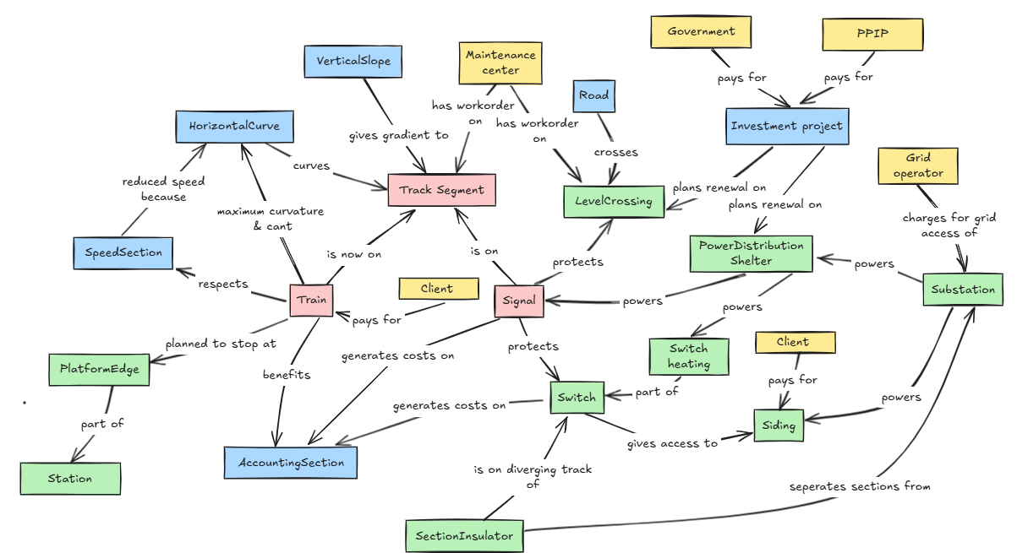
Notes:
This is part of the reality of our railway world
And we’ve shatter it into pieces

Slide 4
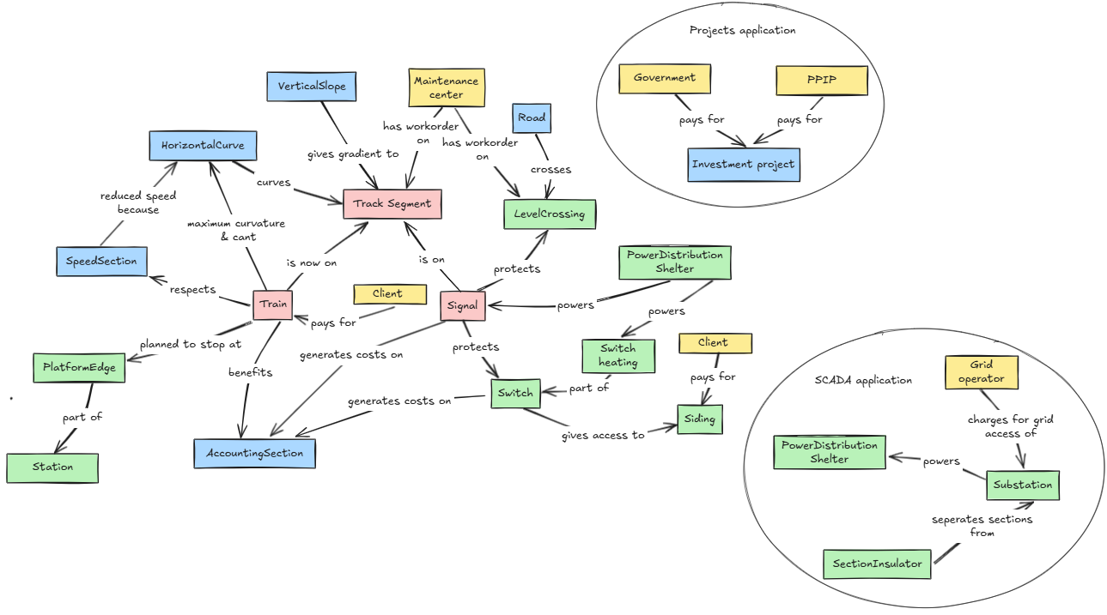
Notes:
We call these pieces “use cases” and built specific applications for them, generally disregarding the bigger picture in favour of less complexity
But how do we get out of this? How do we glue these pieces back together? How do we break down data silos?

Slide 5
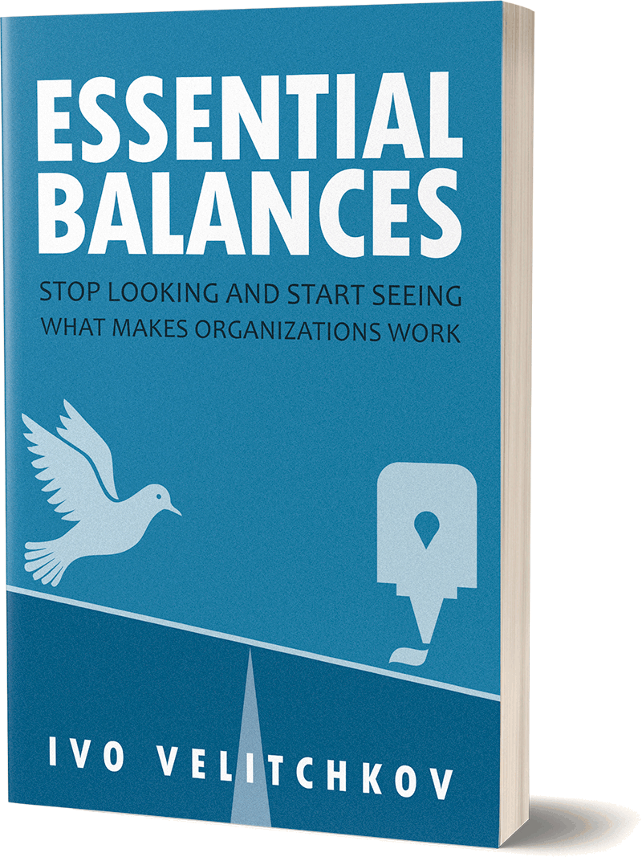
How do we glue the pieces back together?
If there is not enough autonomy in an organization, it will be ineffective, and slow to adapt. But with too much autonomy and not enough cohesion, the organization will not be efficient. It will grow silos that will pursue their own continuation and growth at the expense of the organization.
Can you have freedom and keep everything working together at the same time?
Notes:
Societies, organizations, they create rules to make that cohesion happen. Think about driving your car. You are allowed to do that, there is autonomy. But you need to respect traffic rules. That’s creating cohesion. Magic away those traffic rules and
Track design... You create curves and slopes according to the environment. But you need to respect standards in order to form a coherent whole.
Standards... Why don’t we have more standards in railway data?

Slide 6


Linked data = standardisation
If data was a physical asset used in a 25 kV AC railway power station, “Linked Data” would be described in EN50xxx.
Instead… data is more of an IT thing and thus “Linked data” is described in W3C standards.

Slide 7
What does it standardise?
How to identify data entities
Use IRI’s (or URI’s or URL’s)
How to structure data
Use RDF
How to define the meaning of data
Use ontologies / vocabulaires
Brussel-Centraal is a station in Belgium.
Brussel-Centraal = http://data.europa.eu/949/.../operationalPoints/BEFBCL
Station = http://data.europa.eu/949/.../op-types/rinf/10
Belgium = http://publications.europa.eu/resource/authority/country/BEL
Brussel-Centraal is a station.
Brussel-Centraal lies in Belgium.
Let’s agree on using ERA vocabulary!
Type of operational point = http://data.europa.eu/949/opType
In country = http://data.europa.eu/949/inCountry
StationId | Name | Location
123 | Brussel-Centraal | Belgium
Notes:
Notice the reuse of the instance identifiers (Brussels-Central, Belgium, ...) and of the classes and properties. Nothing of the data model is invented but it is reused.

Slide 8
Why does it help?
Semantic technologies help create data integration because:
Balances autonomy and cohesion
The framework is built to be LINKED. Built for REUSE. It will intuitively push developers towards integration.
Identifiers are GLOBALLY unique and provide context.
Ontologies are meant to be reused
...
But you can still mess it up! Don’t reinvent the wheel, reuse ontologies and identifiers!
Notes:
Semantic technologies add standardisation to “doing data”. Therefor adding cohesion while supporting autonomy.
The very core principle of linked data is the ‘linked’ aspect. The entire standardisation behind it aims to easy data integration. So are identifiers not some integer in some column of some table of some schema of some database of some host in some network of some company... But they are hyperlink like. You can send it to someone, and they are able to click it and use that link in their own data.

Slide 9
Rail data forum 2025 – Cluj
Linnea Olsen Bane NOR
Class Count
gsp:Geometry 96169
rtm:NetEntity 84485
rtm:GeometricCoordinate 71482
rtm:SpotLocation 63545
railml3:Designator 29642
era:InfrastructureElement 27194
rtm:IntrinsicCoordinate 18226
rtm:AssociatedNetElement 15969
railml3:GradientCurve 14392
rtm:LinearLocation 12560
era:LinearElement 9113
rtm:AssociatedPositioningSystem 9113
Class| Count
rtm:RTM_NetElement 9113
era:Track 8084
rtm:Relation 7894
railml3:Length 7789
railml3:Track 7789
era:KilometricPost 7774
era:Signal 7061
era:LevelCrossing 3267
railml3:SwitchIS 2984
railml3:SignalIS 2585
railml3:SignalConstruction 1765
railml3:HorizontalCurve 1679
Class Count
era:PlatformEdge 924
railml3:BufferStop 622
railml3:OperationalPoint 522
railml3:LevelCrossingIS 506
rdfs:Container 357
time:Instant 158
bno:BaneSubnetwork 33
rtm:AreaLocation 26
railml3:Level 3
railml3:ElementState 2
rtm:GeometricPositioningSystem 2
railml3:Network 1
Notes:
Here’s an overview of the state of the Bane NOR knowledge graph as presented by Linnea Olsen on the railway data forum in Cluj before summer. It has evolved a great deal since then and the font has had to be decreased a couple of points to make it all fit. So I just reuse this one. The point I want to make is very simple, these are a count of class instances by class. How many instances are not of a class from another ontology? I mean, how much new classes did Bane NOR had to create?

Slide 10

Data models / ontologies
Which one to use? The story of the bigger fish...
More use cases covered
-> Bigger fish
-> More complexity
-> More usefulness
-> More integration
And is there proof?
Notes:
Which is your weapon of choice? Part 1: ontologies

Slide 11

Use cases
Transmodal
Passenger information
Schedule building
Operations planning
Fleet management
Data preparation
Fares, ticketing and reservations
Operations monitoring & control
Public transport network (reference data)
Statistics
Alternative routes
OSDM
Multimodal ticket sales
Reservations
GTFS
Passenger information (trip planning & real time updates)
Notes:
The more use cases supported by a data model / ontology, the higher the level of data integration will be

Slide 12
Use cases
ERA Ontology
RINF Search RINF
Other ERA registers such as #ERATV
Route compatibility check RCC
Digital routebook
Statistics
Reference register for use cases such as TCR/TSR, train statistics, ...
Regulatory compliance
Future: all use cases of telematics (so will become the biggest fish)
railML
Interlocking
Network statement
RINF reporting
Timetable simulation
Schematic track plan
TMS
ETCS data prep
Passenger information
Run time calculation
Long term circulation planning
Possession management

Slide 13
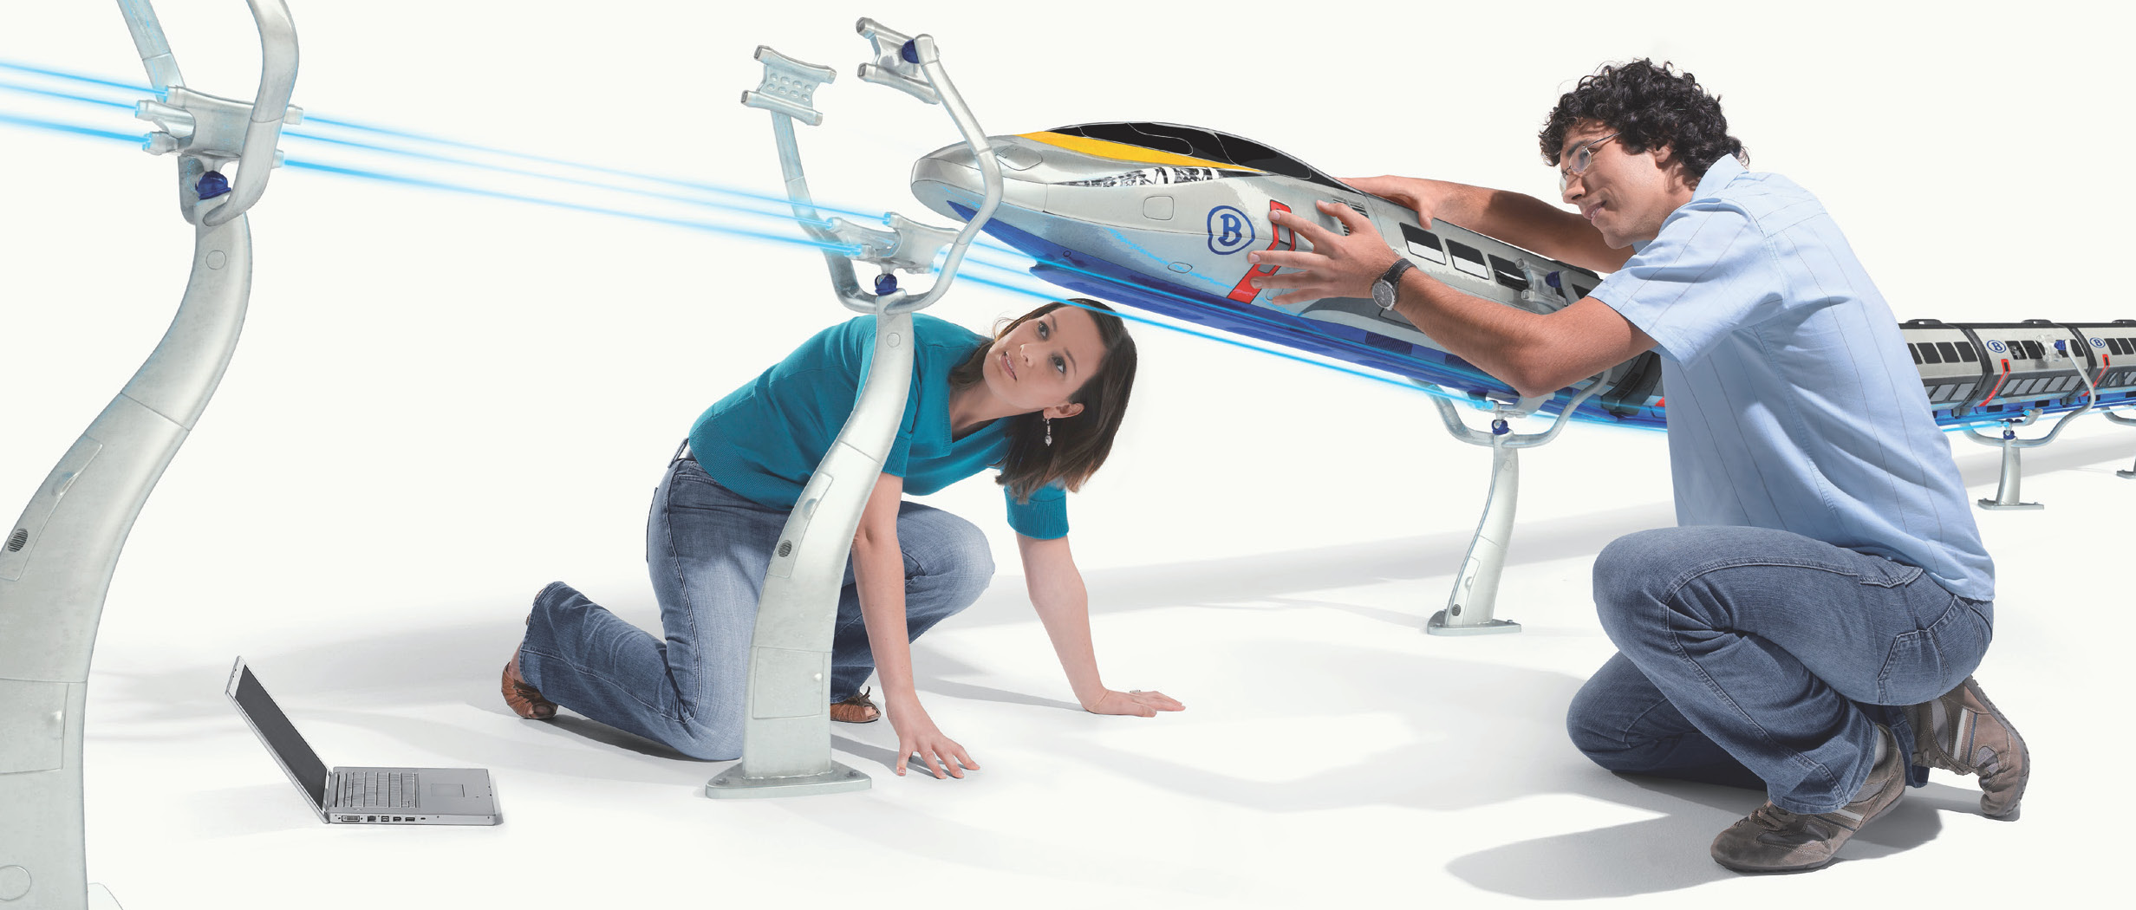
The proof of the pudding is in the eating
Notes:
Data models can say they support a use case, but are they really? Find applications that use them, test the models for yourself, ask questions...

Slide 14
Exercise
Let’s model the platform length. Tell me how to define this.
First think about the use case!!!
Length of the platform for asset management (real physical length)?
Length of the platform available for passenger transport?
Available length for food carts?
Why the ‘usable’ (for passenger transport) platform length is not just 1 number but depends on the railway infrastructure and train route: https://link.excalidraw.com/p/readonly/S6nQcY35SuYVFAhjhEUv

Slide 15
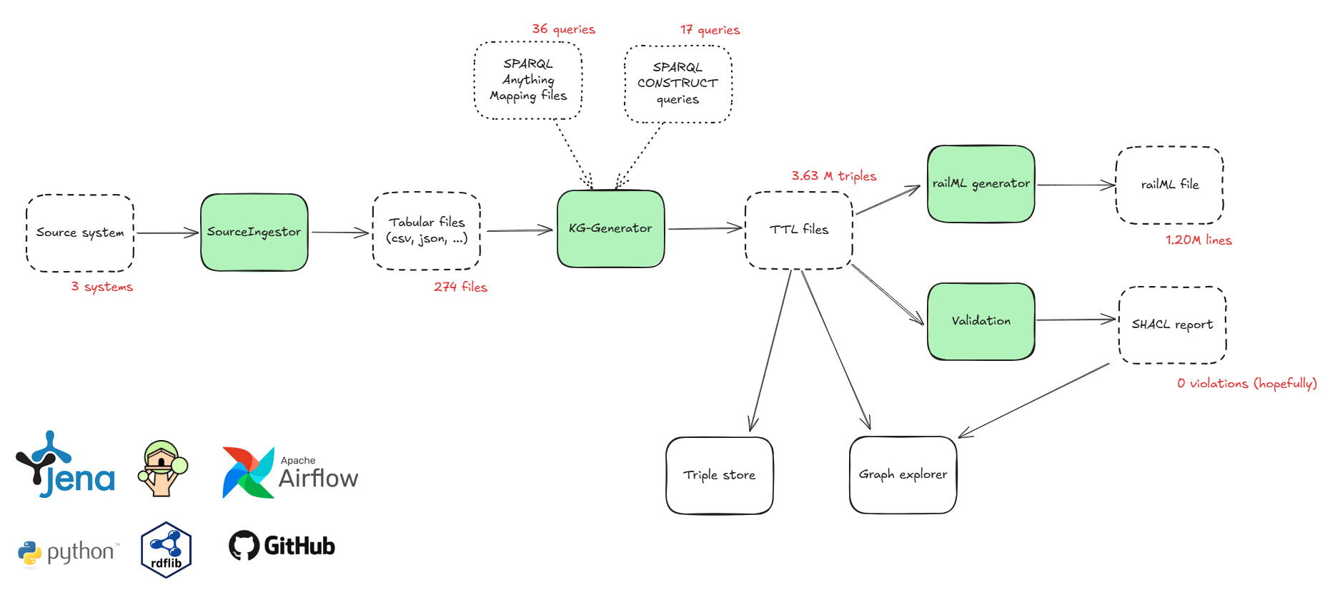
How do we do this?

Slide 16
Imagine a world where data integration is a fact
Use URIs as identifiers
LINK!
Use RDF
Reuse ontologies
Reuse identifiers

