Slide 1
Why you should be Linking your Data now!
How it fits into the data strategy at Infrabel
Mathias Vanden Auweele
Infrabel Operations – Data & Digital
18/06/2024

Slide 2
Linked data is...
I could say: linked data is structured data which is interlinked with other data so it becomes more useful through semantic queries. (Wikipedia)
But it is actually much, much more simple...
Linked data is all about smart standardisation
Notes:
I was asked to give an executive summary on what Linked data is. I was told to keep it as simple as possible.

Slide 3


Linked data is a set of standards...
If data was a physical asset used in a 25 kV AC railway power station, “Linked Data” would be described in EN50xxx.
Instead… data is more of an IT thing and thus “Linked data” is described in W3C standards.
Notes:
Pretty quickly you learn that in Railway, there are a lot of standards. They are made by many smart people and the standards are well thought through and Solid. You learn that the question shouldn’t be “why are you using standards” but “why are you not using standards”? The same can be said for Linked data.

Slide 4
Linked data standardises...
Verona Porta Nuova is a station in Italy.
Verona Porta Nuova = http://data.europa.eu/949/functionalInfrastructure/operationalPoints/IT02430
Station = http://data.europa.eu/949/.../op-types/rinf/10
Italy = http://publications.europa.eu/resource/authority/country/ITA
Verona Porta Nuova is a station.
Verona Porta Nuova lies in Italy.
Let’s agree on using ERA vocabulary!
Type of operational point = http://data.europa.eu/949/opType
In country = http://data.europa.eu/949/inCountry
How to identify data entities
Use URI’s !
How to structure data
Use RDF !
How to define the meaning of data
Use ontologies / vocabulaires !
StationId | Type | Country
Verona Porta Nuova | Station | Italy

Slide 5
Now some cool things about Linked data
Wikidata
SPARQL Endpoint >>> JSON API
Merging 2 datasets = copy/paste
Real federated query
SPARQL Anything
SHACL & Form generation
...
Notes:
Standardisation is the boring management stuff. Managers like it when things keep running with little effort so standardisation is a good thing. But for data artists, people that enjoy the spar with queries and entities, I will now dedicate two slides and a free additional attached slideshow to the topic of how cool linked data actually is for the data engineer. Managers can now pick up their phone and start playing some fruit ninja.

Slide 6





Everything is data, yes everything!
Let’s consume data... “You know nothing”
The Linked data way
Can I please have the endpoint of your data store? (in case you couldn’t follow your nose...)
I can use a standardised way to question anything I need. I can ask about the model of the data or the data itself. And best of all, I can let my machine do the work for me.
=> Machine readability
The “other” way (conventional API)
Can I please have:
The endpoints of your API
The structure used to query the endpoints
The structure used to respond to the queries
I need to manually read and interpret the documentation in order to write my questions specifically for this API. I can’t let a machine do it for me.
Not standardised,
lots of manual work

Slide 7
What’s happening at Infrabel?
Started building an Enterprise ontology (using ERA vocabulary, RSM, Eulynx, RailML and other international standard models)
3 courses on Linked data for >60 employees (general course, sparql & shacl)
We are building a data centric software architecture based on Linked data.
Linked data is used in data analysis between IT application and a first Linked data dedicated IT application project was launched.
Notes:
For the managers that are still playing, please revert your attention back to the slideshow as this might be of interest to you.

Slide 8
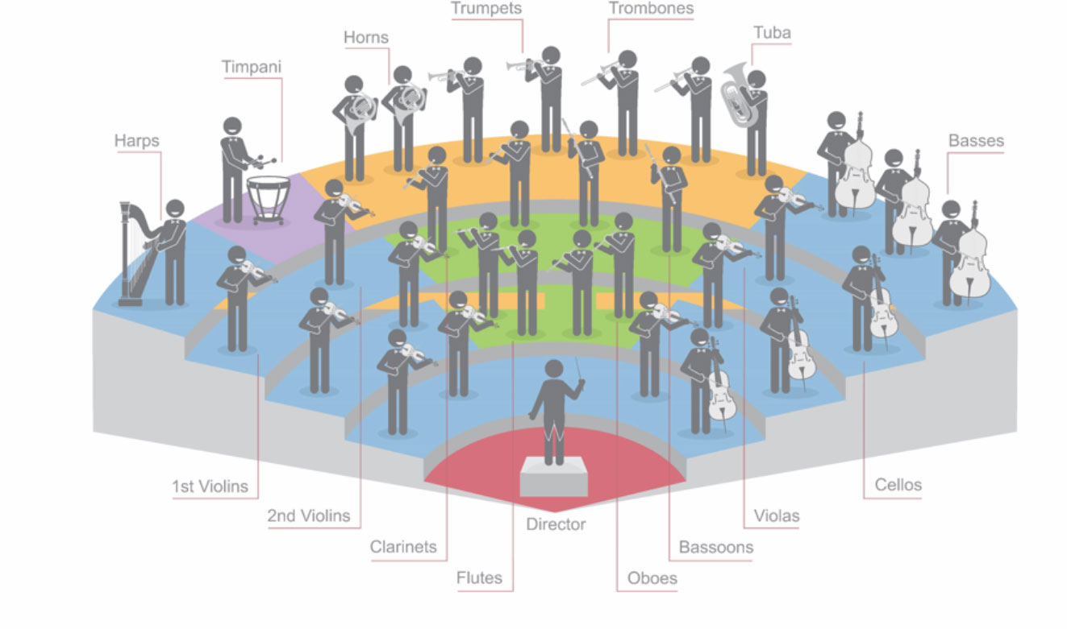
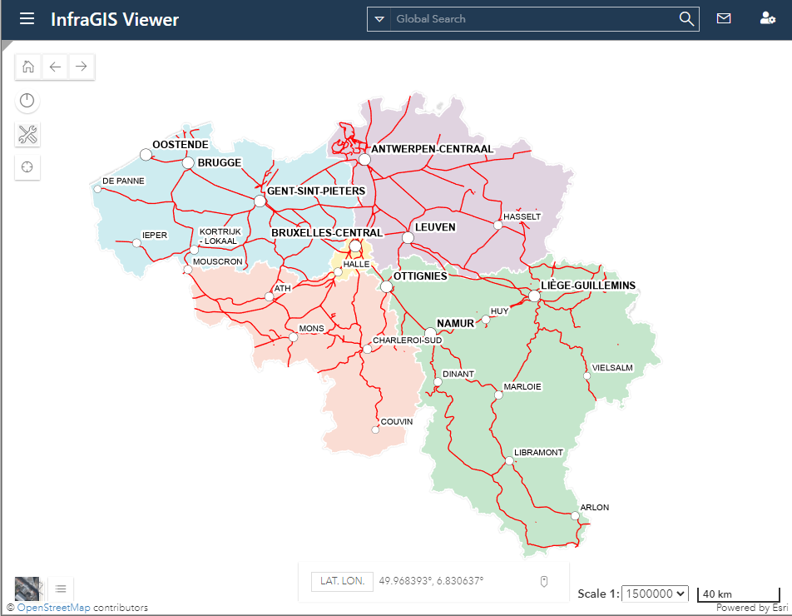





BIM
Maintenance works planning
Ticketing
Asset Repository
HR data
RINF RDF/TTL
Transactional data
Financial data
ERA Ontology
Semantic Vocabulary
Capacity allocation
Operations centre
OWL RDFS SKOS GeoSPARQL...
Notes:
Our long term vision is to get rid of our internal use case specific databases and move towards a Linked data ecosystem where data is suitable for all use cases, one of them the publication of the RINF.

Slide 9
The data strategy @ Infrabel operations
THE PROCESSES
Data pipelines
Manage the data aspect in your business processes
The data producer publishes structured data at the right time in the right model
Manage the context in which data changes
THE DATA
Enterprise data model (EDM)
Know what you are talking about
Semantics, relations, constraints
Enterprise Ontology
Standardise
THE TECHNOLOGY
THE PEOPLE
Data centric platform
Data modelled according to the EDM
Generic data functions
Knowledge graph
Golden record
Enterprise data helpdesk
Help employees with data questions
Build an enterprise competence center
Documentation is OK, helping is better
Notes:
The strategy to reach the long term goal

Slide 10
Questions?
Good reads:
The Data-Centric Revolution (ISBN: 978-1634625401)
https://ontola.io/blog/what-is-linked-data
https://tdan.com/the-data-centric-revolution/18780
https://en.wikipedia.org/wiki/FAIR_data
What is a knowledge graph - Pokémon edition | Pieter Heyvaert

