Slide 1
Data strategy at Infrabel
The importance of the RailML ontology
Mathias Vanden Auweele
Infrabel
08/11/2023

Slide 2

Cost of data management
Visible:
People managing data
Applications
Infrastructure (servers, ..)
Invisible:
Interfaces
Data cleansing
Data integration projects
Same or similar data leading to different applications

Slide 3

The spaghetti

Slide 4
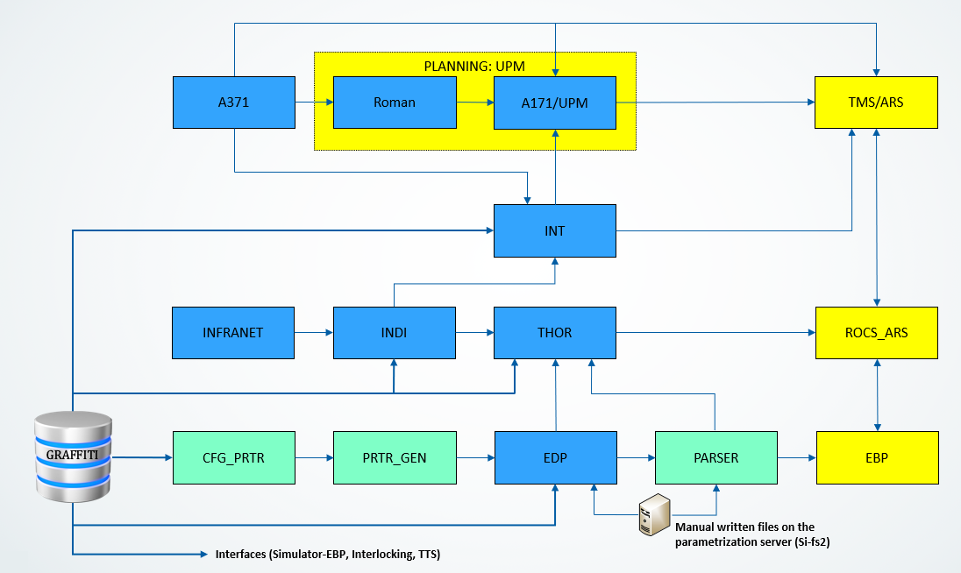

Slide 5
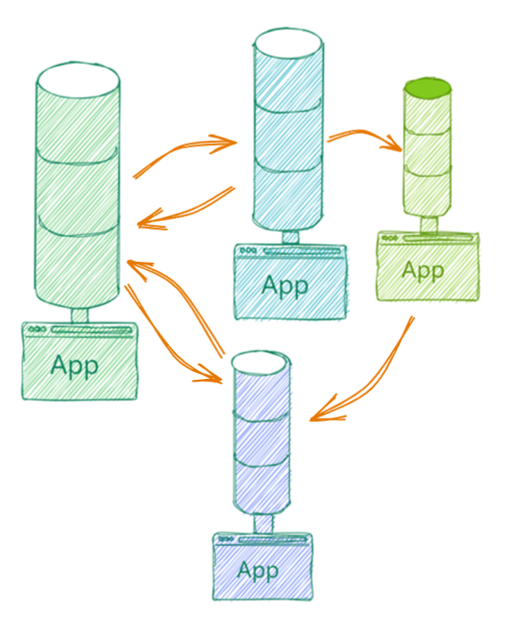
Application centric
The application is owner of the data
Every application comes with its own data model and you need to adapt to it.
Integration is expensive
Too many different data concepts
Illustration credits: Ivo Velitchkov

Slide 6
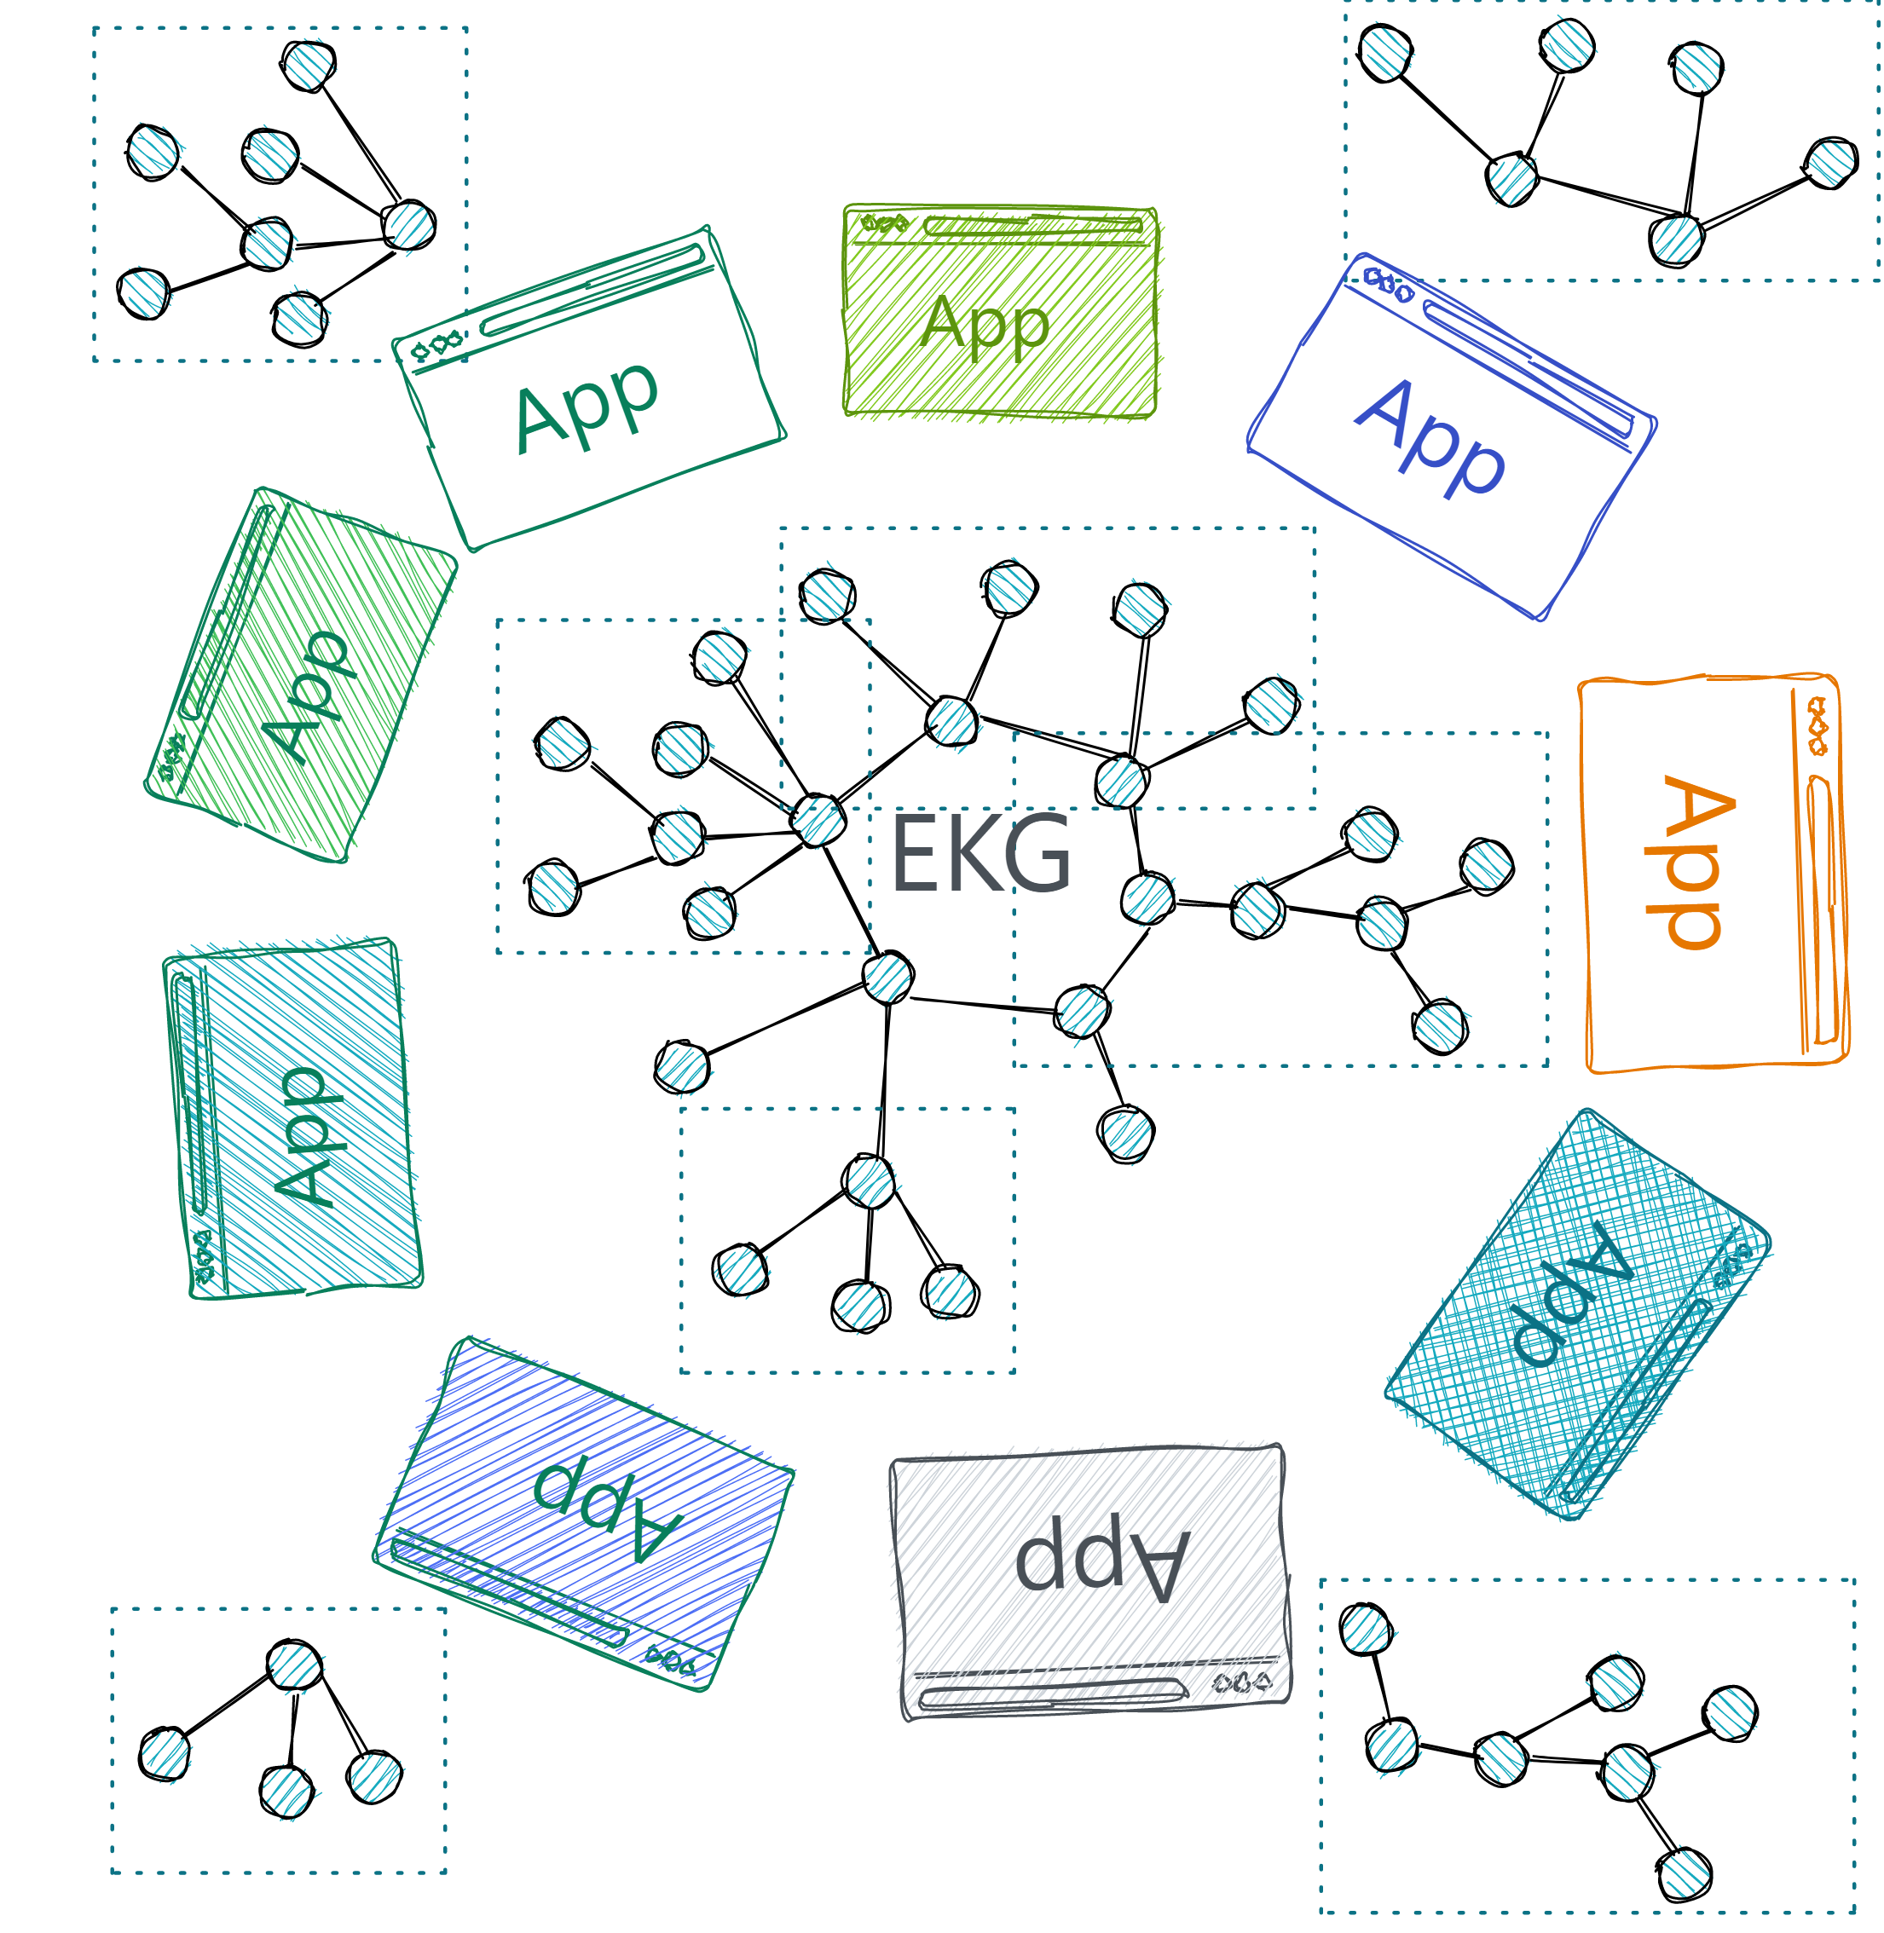
Data centric
The data is independent of the application. Applications come and go, but the data remains.
1 common data model
Shared data functionalities
Integration is a fact
Illustration credits: Ivo Velitchkov

Slide 7
Play with the parts
App 1
App 2
App 1
GUI
GUI
GUI
App logic
App logic
App logic
Authentication
Authentication
Authentication
App 3
Rules
Rules
Rules
GUI
Data model
Data model
Data model
App logic
...
...
...
App 2
DB
DB
DB
GUI
App logic
Application centric
Data centric

Slide 8

How?
In the end, data centricity is about “sharing the same [data/model/code/spaghetti]”.
Data centricity is best achieved using Linked data technologies. Because Linked data is better at sharing. It is better at enabling reuse then conventional data technologies.

Slide 9
Linked data is...
Linked data is all about smart standardisation
Identity – Structure – Meaning
Notes:
I was asked to give an executive summary on what Linked data is. I was told to keep it as simple as possible.

Slide 10
Linked data standardises...
Brussel-Centraal is a station in Belgium.
Brussel-Centraal = http://data.europa.eu/949/.../operationalPoints/BEFBCL
Station = http://data.europa.eu/949/.../op-types/rinf/10
Belgium = http://publications.europa.eu/resource/authority/country/BEL
Brussel-Centraal is a station.
Brussel-Centraal lies in Belgium.
Let’s agree on using ERA vocabulary!
Type of operational point = http://data.europa.eu/949/opType
In country = http://data.europa.eu/949/inCountry
How to identify data entities
Use URI’s
How to structure data
Use RDF
How to define the meaning of data
Use ontologies / vocabulaires

Slide 11
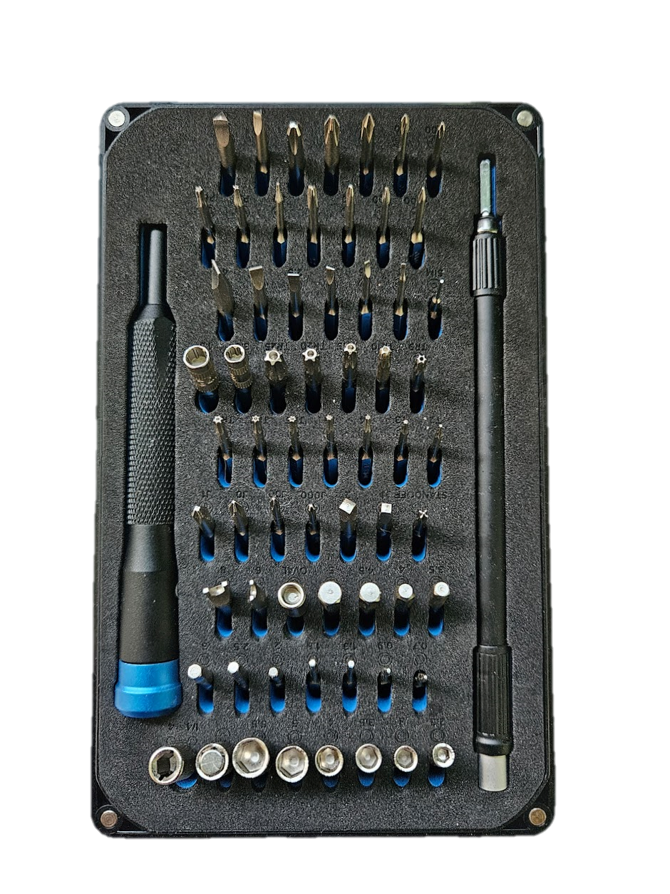
Why is Linked data a good idea?
Removes ambiguity
Machine reabability, everything is data
Enables interoperability (of models, data ánd software)
Enables reuse (of models, data ánd software)
Allows easy model extension
Just uses HTTP

Slide 12
What’s happening at Infrabel?
Started building an Enterprise ontology (using ERA vocabulary, RTM/RSM, Eulynx, RailML and other international standard models).
Started 3 courses on Linked data for >60 employees.
Started building a data centric software architecture based on Linked data.

Slide 13
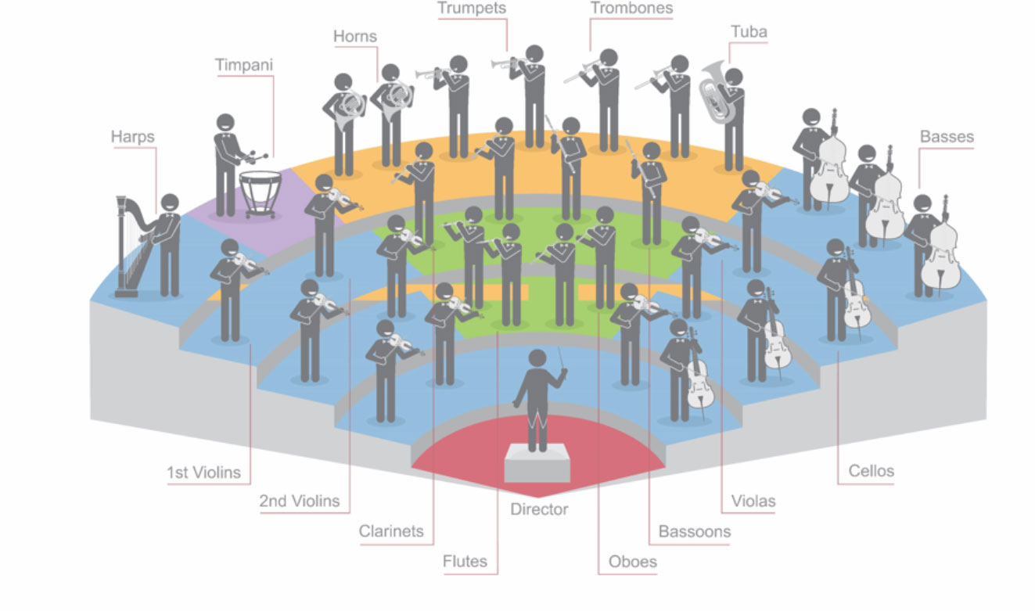
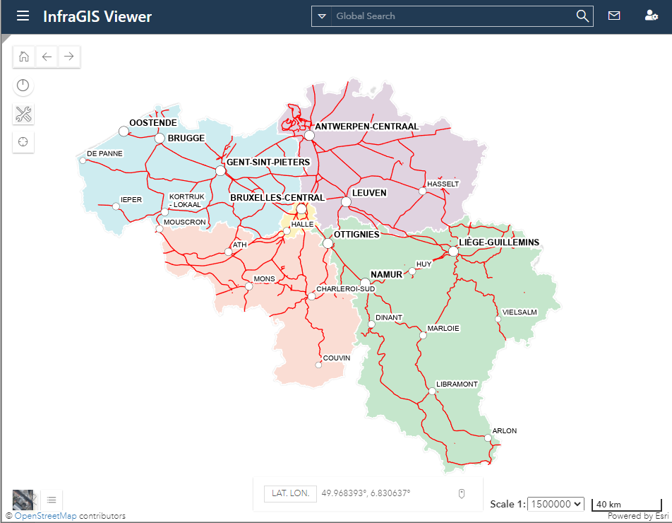
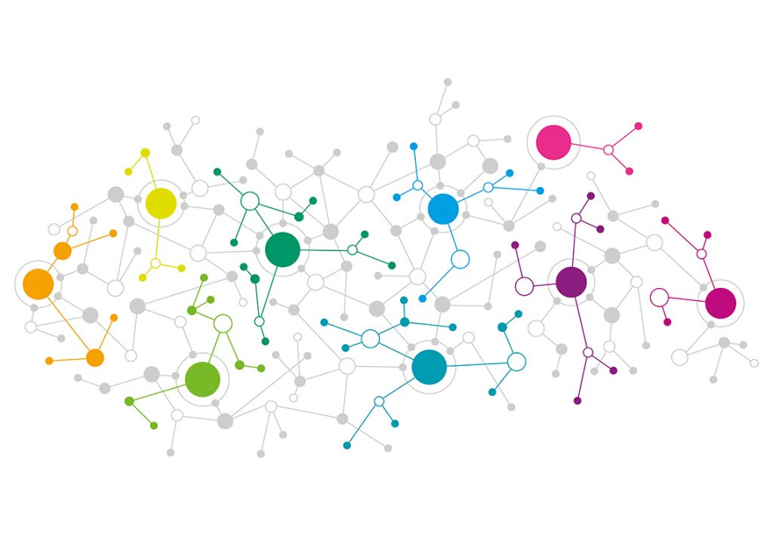

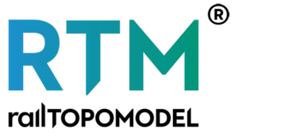


BIM
Maintenance works planning
Ticketing
Asset Repository
HR data
RINF RDF/TTL
Transactional data
Financial data
ERA Ontology
Semantic Vocabulary
Capacity allocation
Operations centre
OWL RDFS SKOS GeoSPARQL...

Slide 14
Summary
The importance of the RailML ontology for Infrabel
Infrabel will increase efficiency by evolving towards a data centric enterprise.
Data centricity is best achieved using Linked data standardisation.
Linked data needs ontologies to express the meaning of data.
Industry ontologies, such as RailML and ERA vocabulary, are a solid basis to make sure the enterprise ontology supports many use cases.
RailML ontology will become part of the Infrabel enterprise ontology. Data will be modelled directly according to RailML ontology.

Slide 15
Questions?
Good reads:
The Data-Centric Revolution (ISBN: 978-1634625401)
https://tdan.com/the-data-centric-revolution/18780
https://en.wikipedia.org/wiki/FAIR_data
What is a knowledge graph - Pokémon edition | Pieter Heyvaert

