Slide 1
Cool things about Linked Data!
Data mineurs
Mathias Vanden Auweele
Infrabel
14/11/2023

Slide 2
Table of content
What is Linked Data
Wikidata
SPARQL Endpoint >>> JSON API
Federated query
Merging 2 datasets
SPARQL Anything
SHACL & Form generation

Slide 3
1. What is Linked Data
Linked data is...
I could say: linked data is structured data which is interlinked with other data so it becomes more useful through semantic queries. (Wikipedia)
But it is actually much, much more simple...
Linked data is all about smart standardisation

Slide 4
1. What is Linked Data
Linked data standardises...
Brussel-Centraal is a station in Belgium.
Brussel-Centraal = http://data.europa.eu/949/.../operationalPoints/BEFBCL
Station = http://data.europa.eu/949/.../op-types/rinf/10
Belgium = http://publications.europa.eu/resource/authority/country/BEL
Brussel-Centraal is a station.
Brussel-Centraal lies in Belgium.
Let’s agree on using ERA vocabulary!
Type of operational point = http://data.europa.eu/949/opType
In country = http://data.europa.eu/949/inCountry
How to identify data entities
Use URI’s
How to structure data
Use RDF
How to define the meaning of data
Use ontologies / vocabulaires
StationId | Name | Location
123 | Brussel-Centraal | Belgium

Slide 5
1. What is Linked Data
Station
http://data.europa.eu/949/.../op-types/rinf/10
Railway example
Type of OP
http://data.europa.eu/949/opType
Brussel-Centraal is a station in Belgium.
Becomes:
http://data.europa.eu/949/.../operationalPoints/BEFBCL http://data.europa.eu/949/opType http://data.europa.eu/949/.../op-types/rinf/10 .
http://data.europa.eu/949/.../operationalPoints/BEFBCL http://data.europa.eu/949/inCountry http://publications.europa.eu/resource/authority/country/BEL .
Brussel-Centraal
http://data.europa.eu/949/.../operationalPoints/BEFBCL
Belgium
http://publications.europa.eu/resource/authority/country/BEL
In country
http://data.europa.eu/949/inCountry

Slide 6
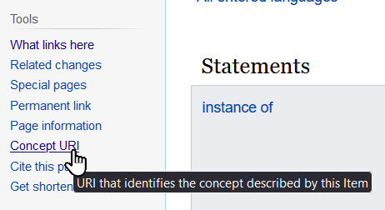
2. Wikidata
Wikidata
Wikipedia Charleroi click on link to wikidata
A page generated from a RDF dataset about Charleroi. You can see the data behind using:

Slide 7
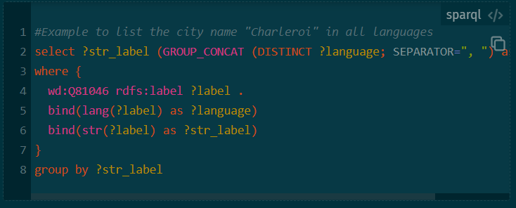
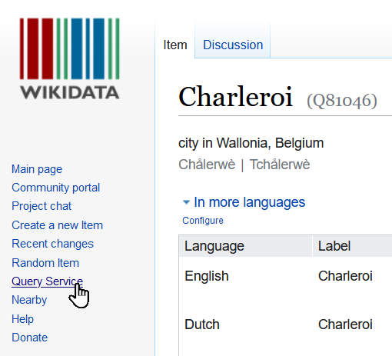
2. Wikidata
Wikidata
Wikipedia Charleroi click on link to wikidata
And query the data using:
Access this query from: https://w.wiki/896n

Slide 8





3. SPARQL vs JSON API
Everything is data, yes everything!
Let’s consume data... “You know nothing”
The Linked data way
Can I please have the endpoint of your data store? (in case you couldn’t follow your nose...)
I can use a standardised way to question anything I need. I can ask about the model of the data or the data itself. And best of all, I can let my machine do the work for me.
=> Machine readability
The “other” way (conventional JSON API)
Can I please have:
The endpoints of your API
The structure used to query the endpoints
The structure used to respond to the queries
I need to manually read and interpret the documentation in order to write my questions specifically for this API. I can’t let a machine do it for me.
Not standardised,
lots of manual work

Slide 9
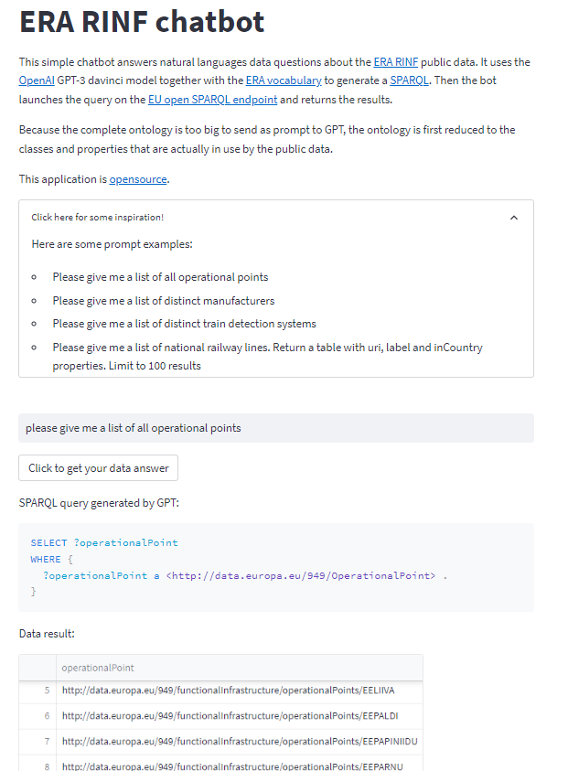
3. SPARQL vs JSON API
ERA chatbot link

Slide 10
3. SPARQL vs JSON API
If we want to be more complete
 | SPARQL endpoint | JSON API
Work setting it up | Works out of the box on a triple store. Needs translation from another dataset (ex. SQL) | Custom development
Data model/structure | From the graph, RDF | Custom
Querying | SPARQL language over HTTP | Custom over HTTP GET/POST/PUT/...
Response completeness | Exactly what you requested | Can be to much or to little, depends on how the endpoint was setup.
Federated query | Supported by the W3C SPARQL standard | Impossible

Slide 11
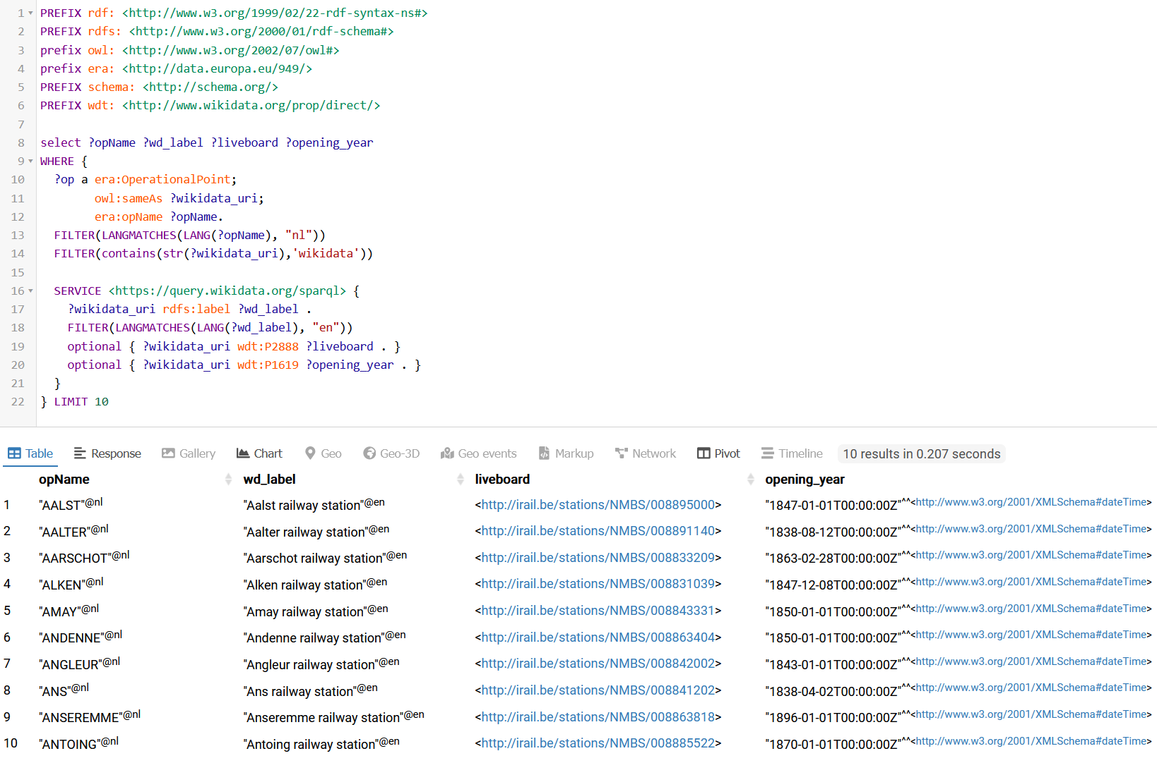
4. Federated query
Real federated query
https://api.triplydb.com/s/dwrlYPclx
Query data from different triple stores.
In this case: get opName from Infrabel dataset and combine with data from Wikidata

Slide 12
5. Merging 2 datasets
Merging 2 datasets = copy & paste
Demo in vcode using:
Infrabel opendata set with operational points and soon to be public dataset of platform heights
RML language with RML Mapper (tool for conversion)
Sparql notebook amazing extension of vcode to query SPARQL endpoints or local RDF files
Point of demo: while JSON, XML and other data structures are “file complete”, RDF is “line complete”. This means that you can copy one line from 1 RDF dataset into another dataset to merge this information. Just.. By.. Copy.. Paste..
Opensource demo: https://gitlab.com/mathias.vanden.auweele/infrabel-opendata-to-rdf

Slide 13
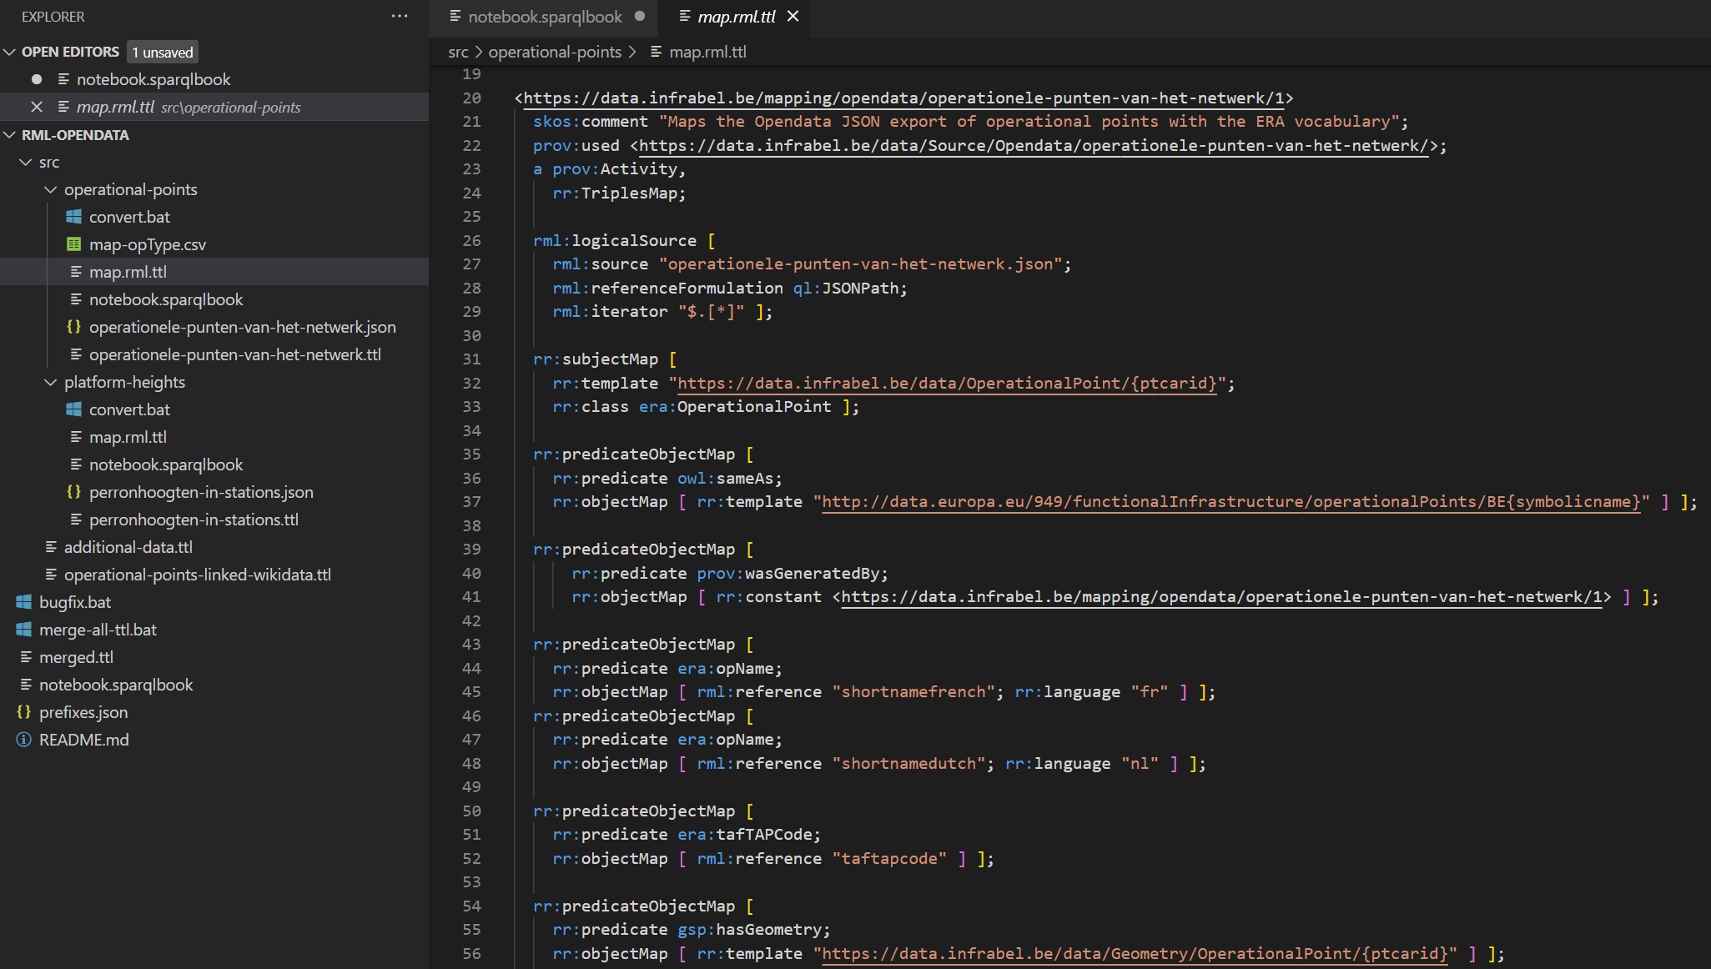

Slide 14
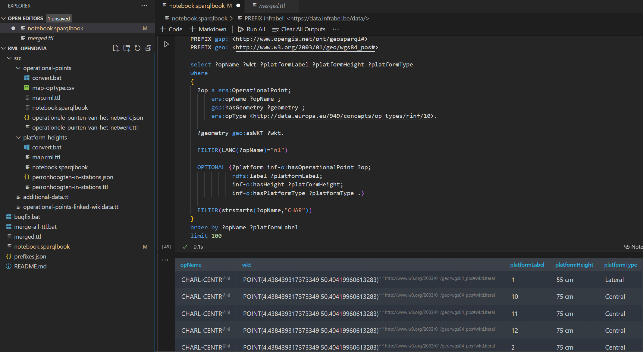

Slide 15
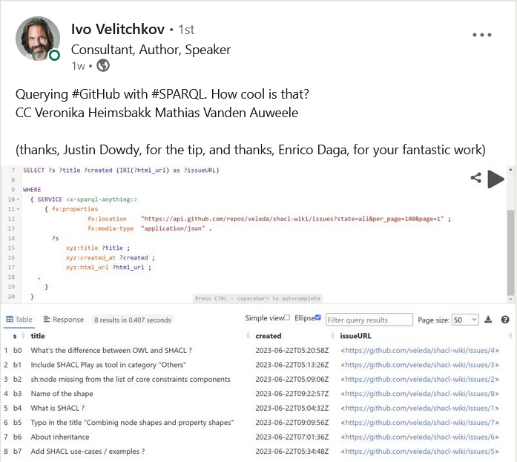
6. SPARQL Anything
Anything to RDF using SPARQL
Github of SPARQL-Anything
Opensource demo: https://gitlab.com/mathias.vanden.auweele/sparql-anything-demo
Link to post

Slide 16
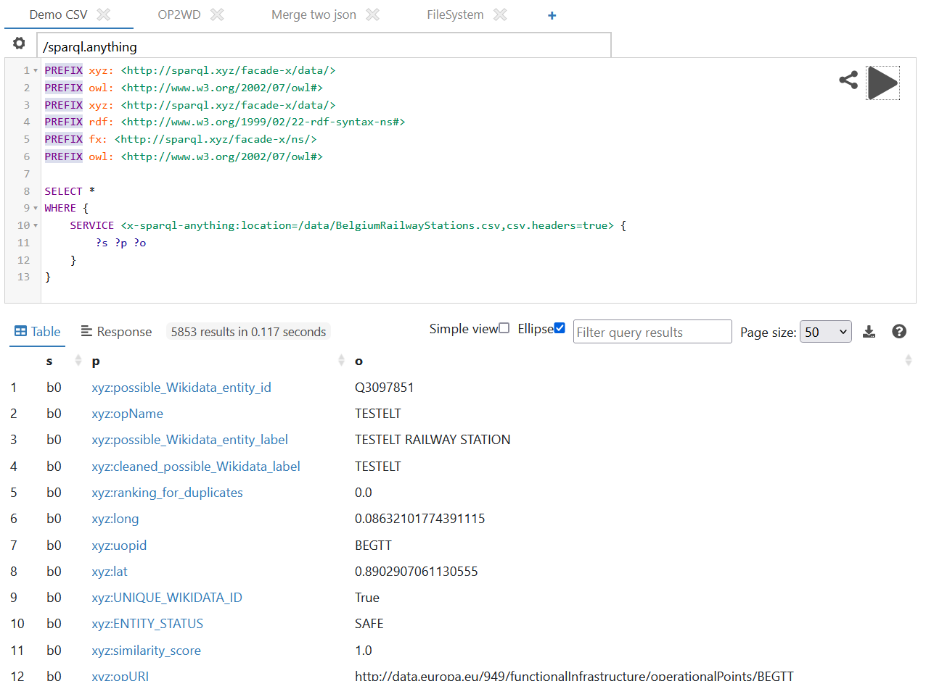

Slide 17
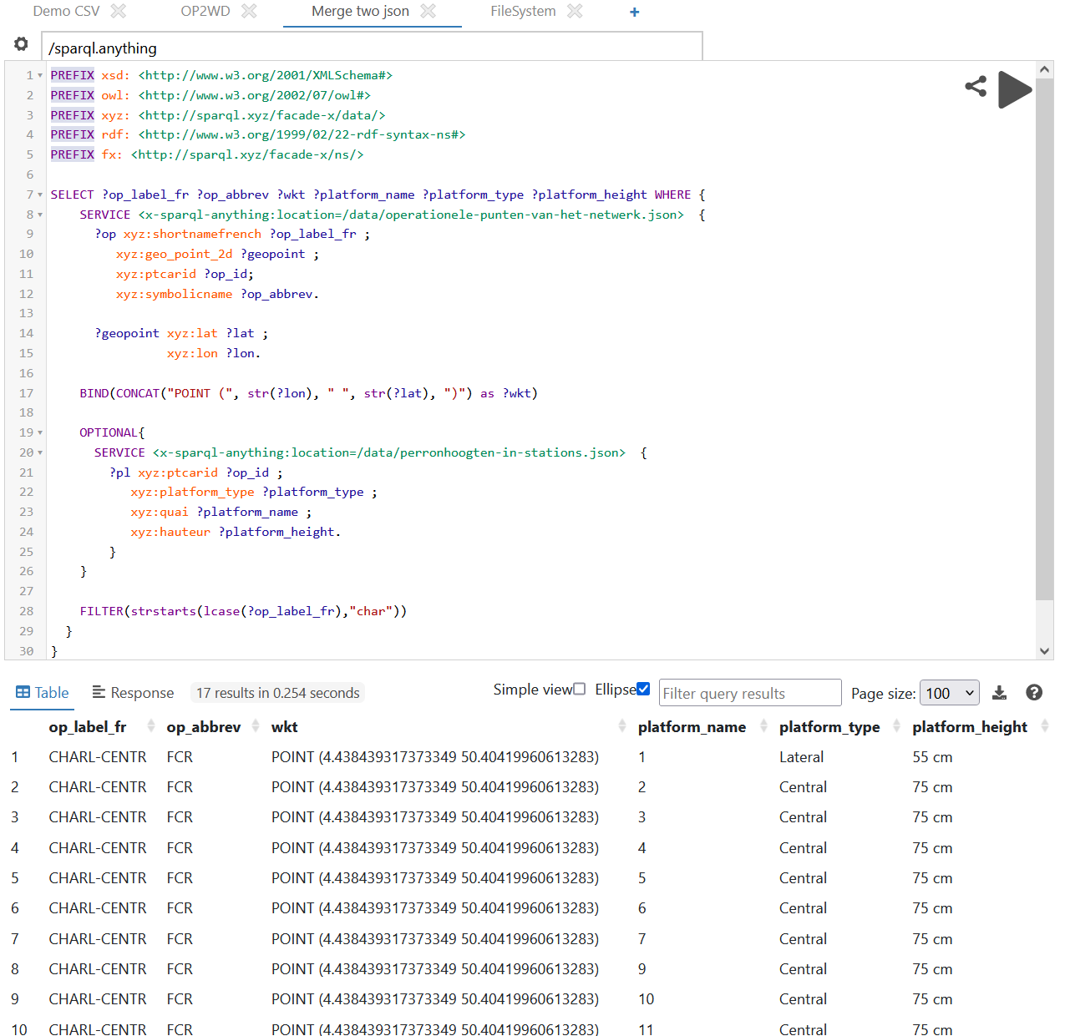

Slide 18
7. SHACL & Form generation
Data validation & form generation
Shapes Constraint Language (SHACL) is a W3C standard language for describing RDF graphs.
Some of the use cases of SHACL:
Data validation
Form generation
Business rules
Code generation
Demo using: https://forms.hypermedia.app/playground/

Slide 19
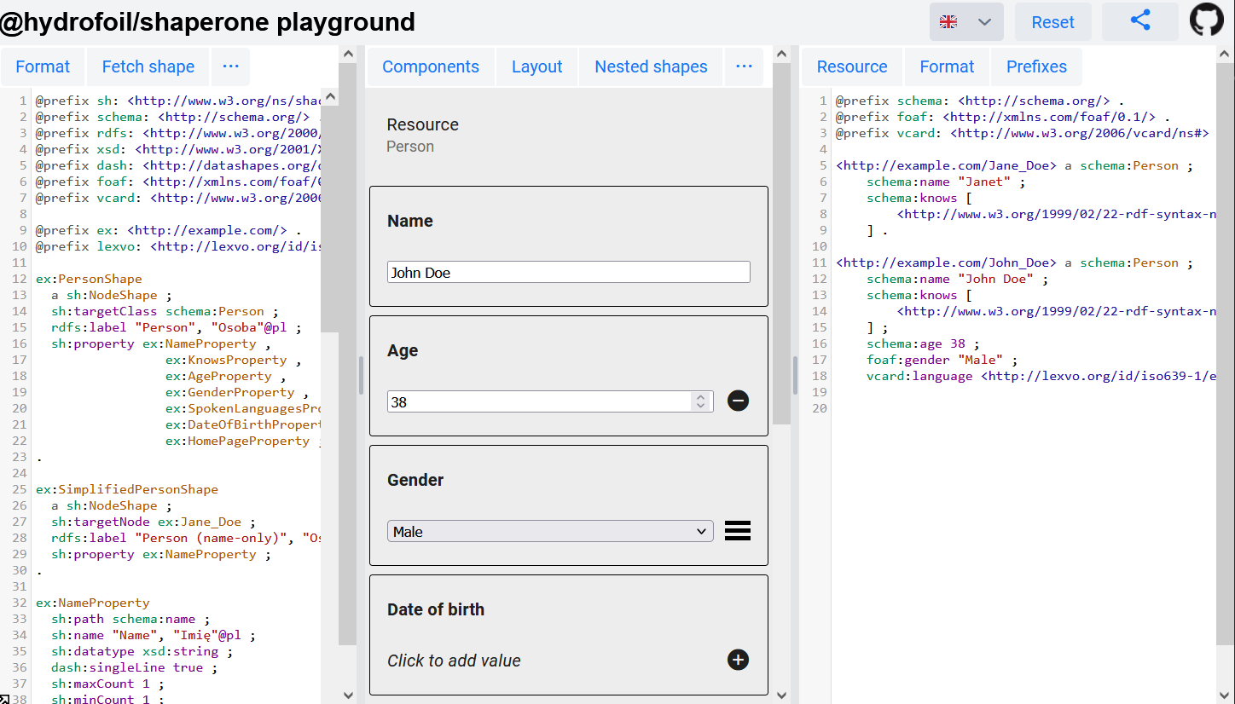

Slide 20
Table of content
What is Linked Data
Wikidata
SPARQL Endpoint >>> JSON API
Federated query
Merging 2 datasets
SPARQL Anything
SHACL & Form generation
Notes:
I was asked to give an executive summary on what Linked data is. I was told to keep it as simple as possible.

Slide 21
Questions?
Good reads:
The Data-Centric Revolution (ISBN: 978-1634625401)
https://tdan.com/the-data-centric-revolution/18780
https://en.wikipedia.org/wiki/FAIR_data
What is a knowledge graph - Pokémon edition | Pieter Heyvaert

