Slide 1
Level up Asset Management at Infrabel
Image recognition, AI & IOT projects
Mathias Vanden Auweele
Project lead, Infrabel, I-AM.2

Slide 2
Overview
Infrabel
Smart projects overview
How to locate an infrastructure problem using GPS stamped data?

Slide 3

Infrabel
We manage, maintain and modernise
the Belgian railway infrastructure
We coordinate rail traffic
on the Belgian network
~11k employees FTE
~800k passengers daily
~6500 km main track
~5800 km electrified
~4k switches
And we do it ourselves..

Slide 4
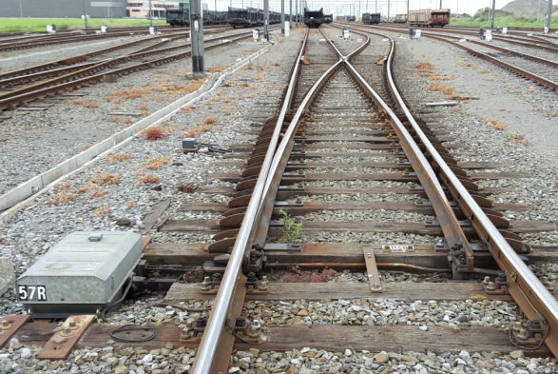
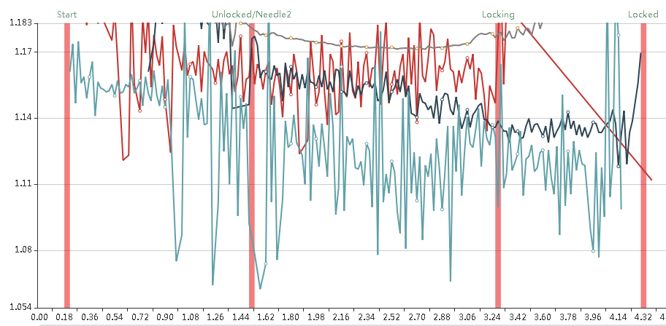
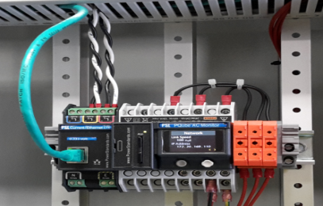
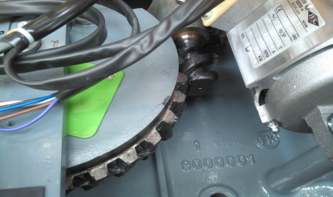
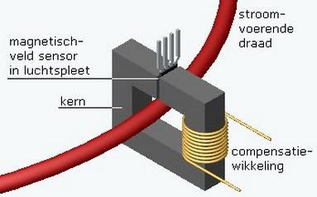
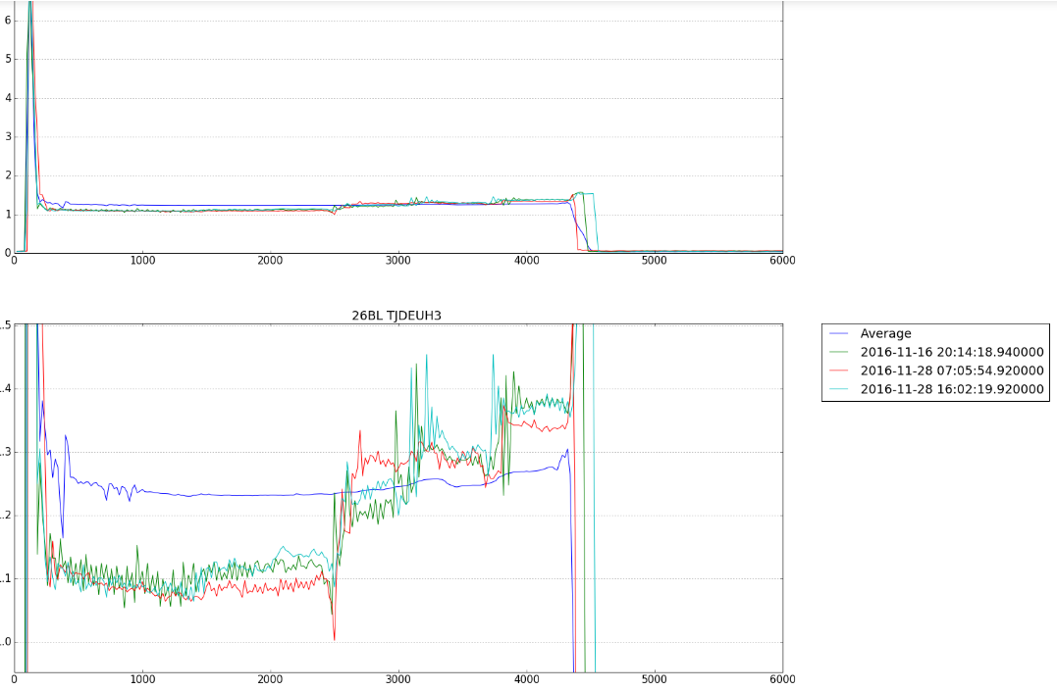
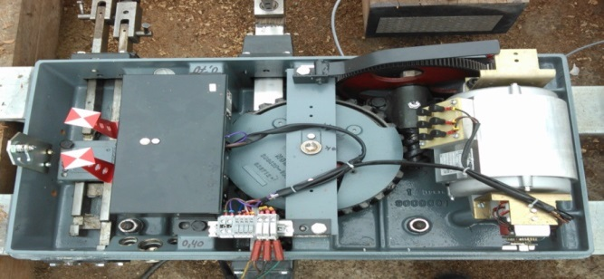
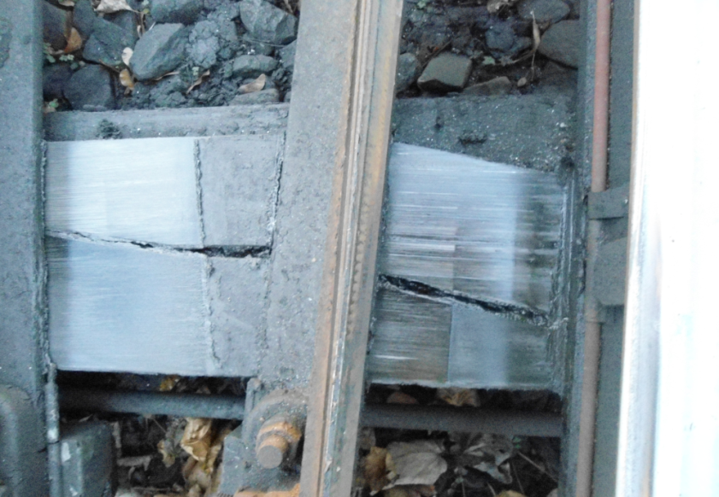
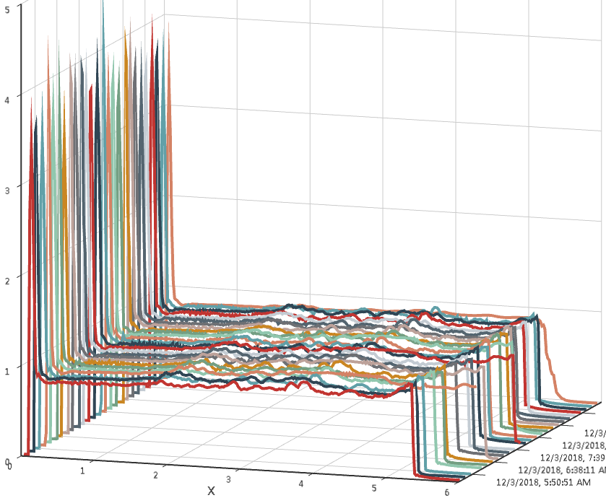
Switch
IoT on point machines. Real time monitoring of condition of turnout / railway switch
Worm gear
Bad alignment
Wear on
Sliders
-> 400 switches equipped
-> Predictive maintenance
-> 75% of mechanical failures predicted
-> Link with train routes traffic control
Real-time data to diagnostics system and processing by Operation Center

Slide 5
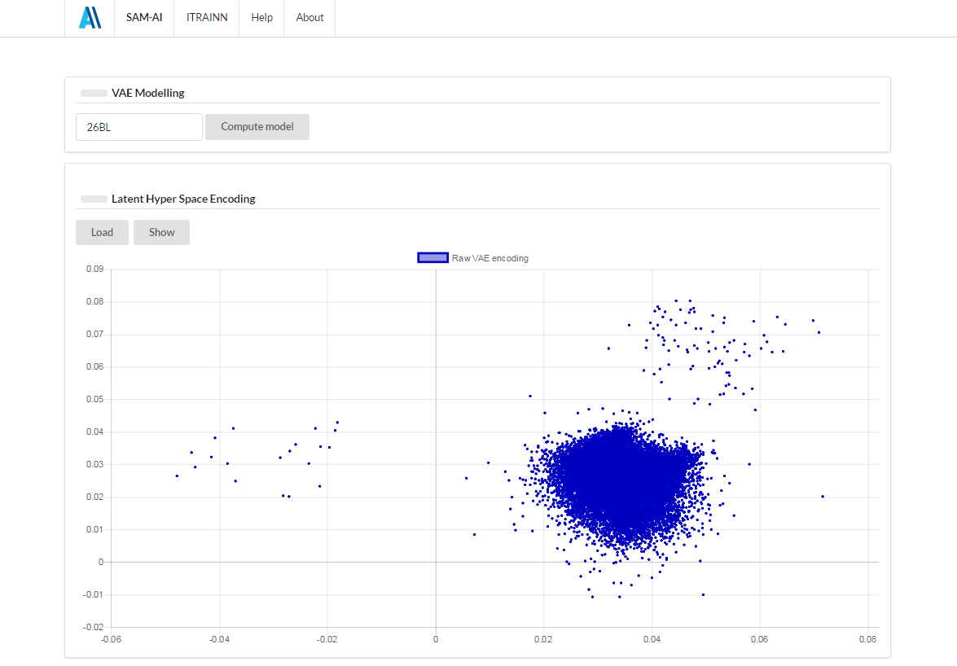
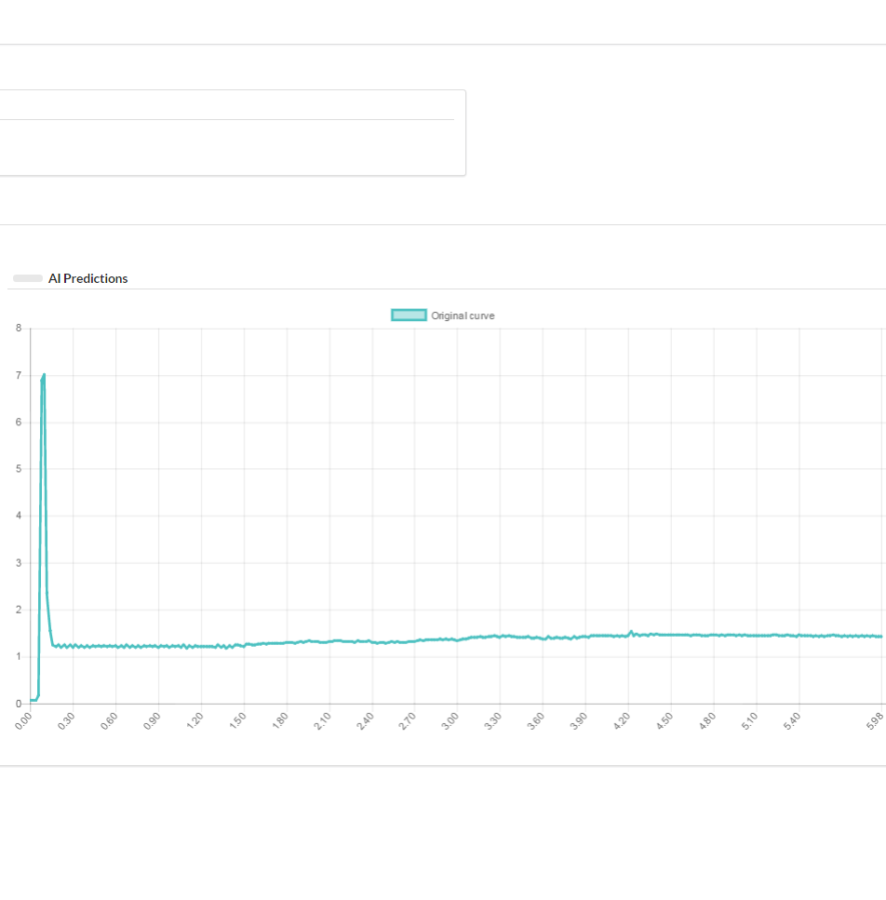
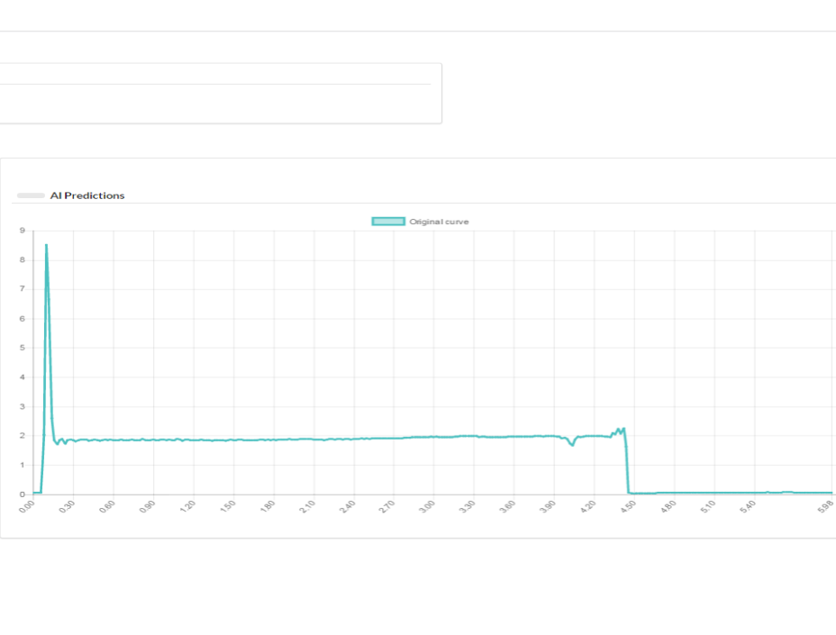
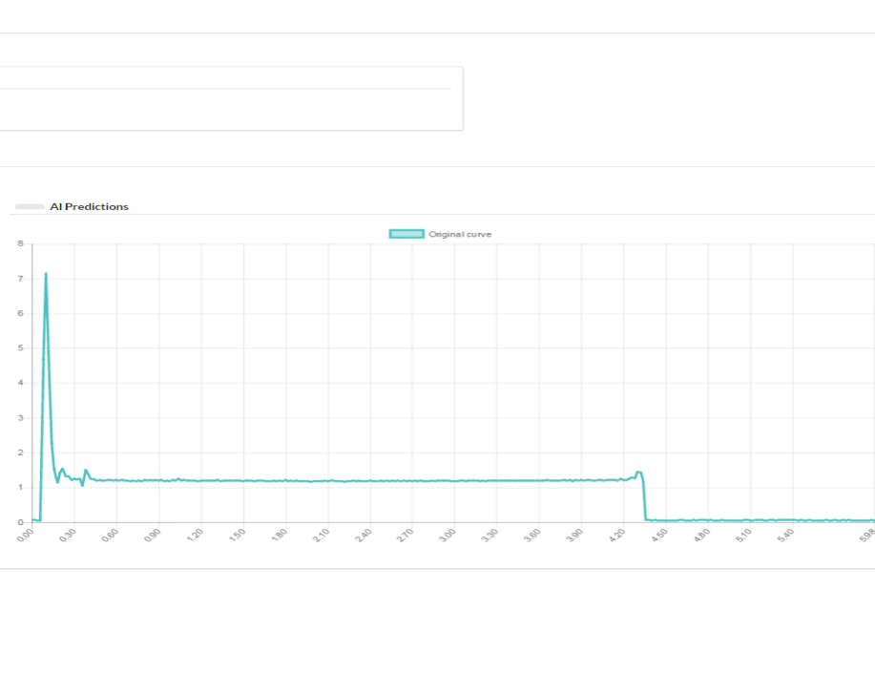
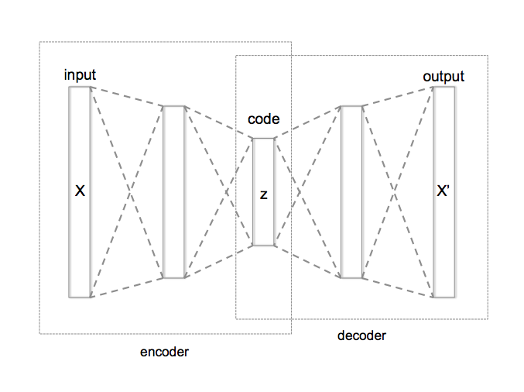
Switch
IoT on point machines. Real time monitoring of condition of turnout / railway switch
Over Current
Normal data
Not locking
-> AI
-> Deep learning / machine learning
-> Unsupervised-learning -> Dimensionality reduction using neural networks

Slide 6
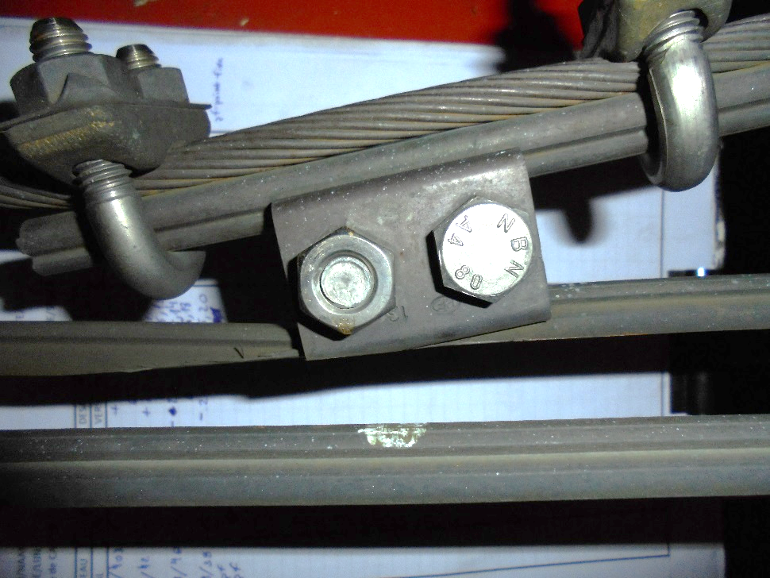
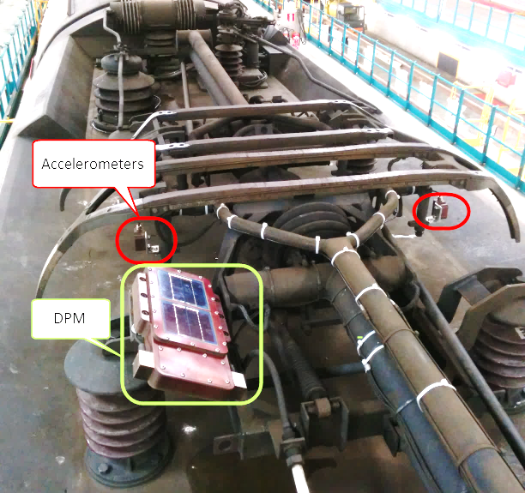
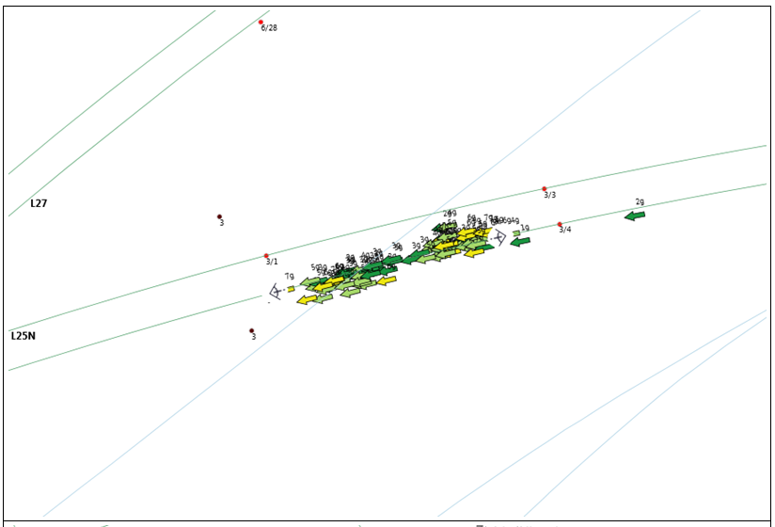
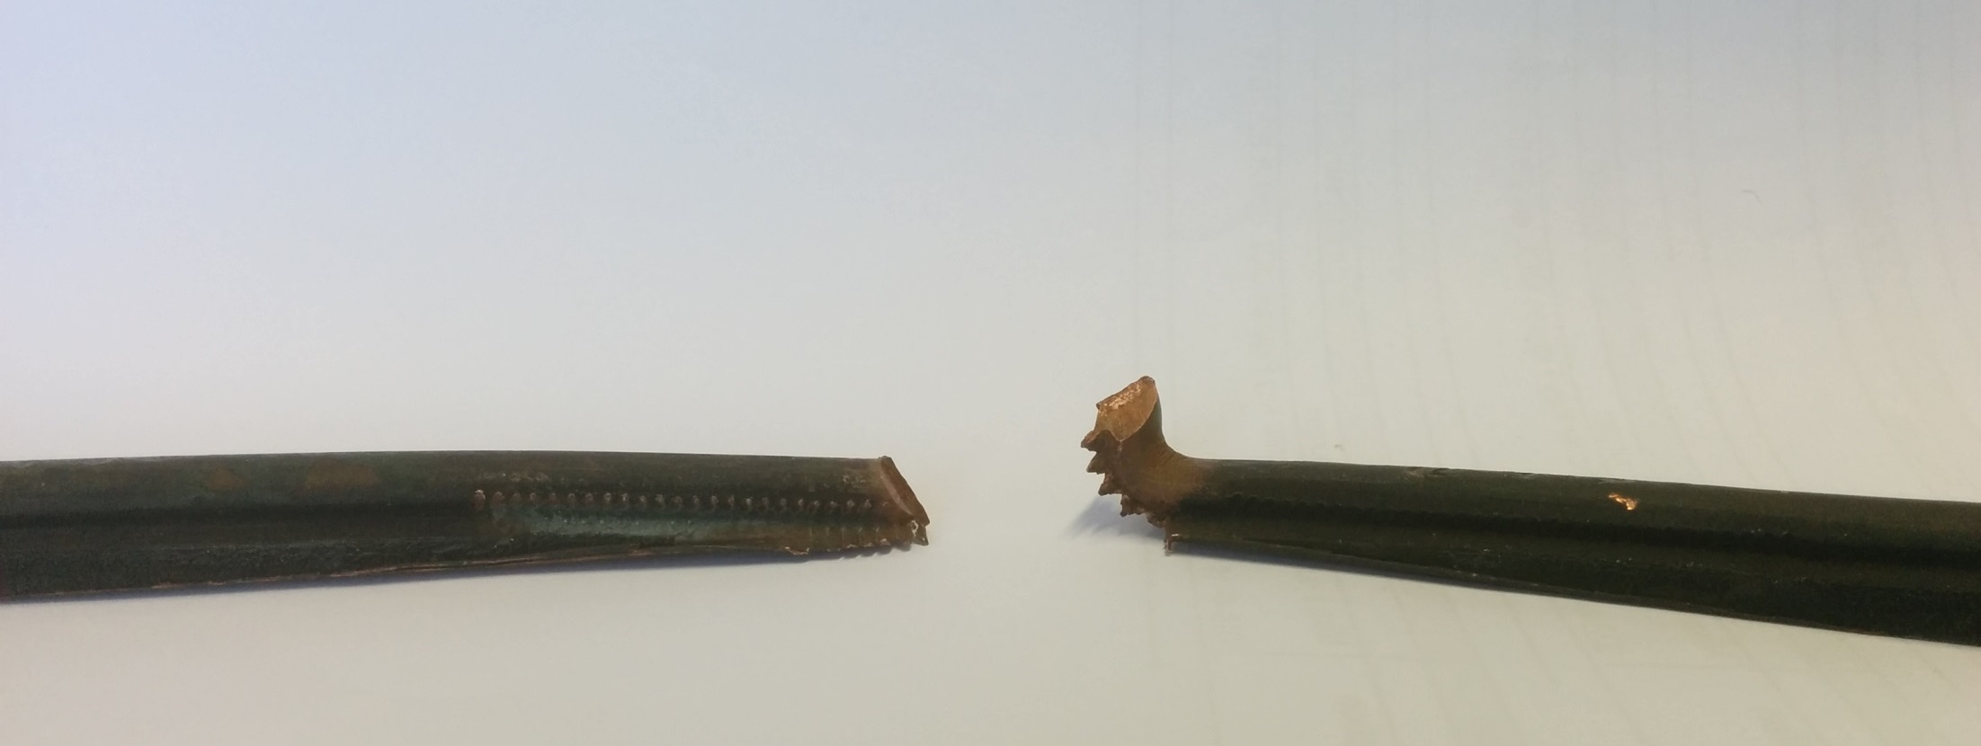
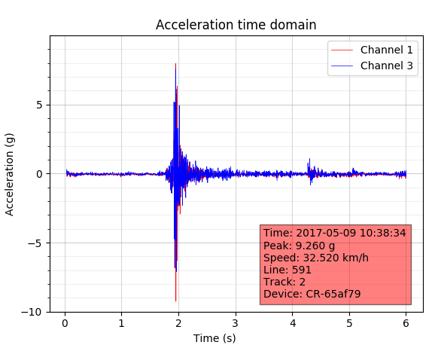
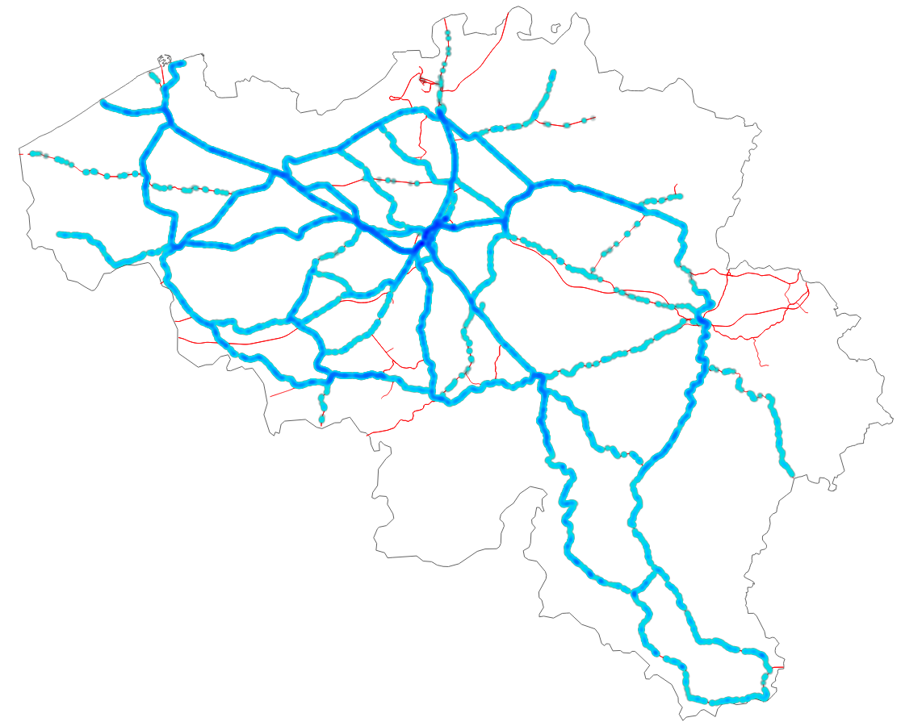
Pantograph shock detection
IoT on commercial trains. Real time detection of catenary problems.
For 2018:
-> 11 commercial vehicles
-> More than 1M km inspected
-> 261k shock alerts received
-> Grouped to 22k locations
-> 472 workorders created
Fully automated from alert to workorder

Slide 7
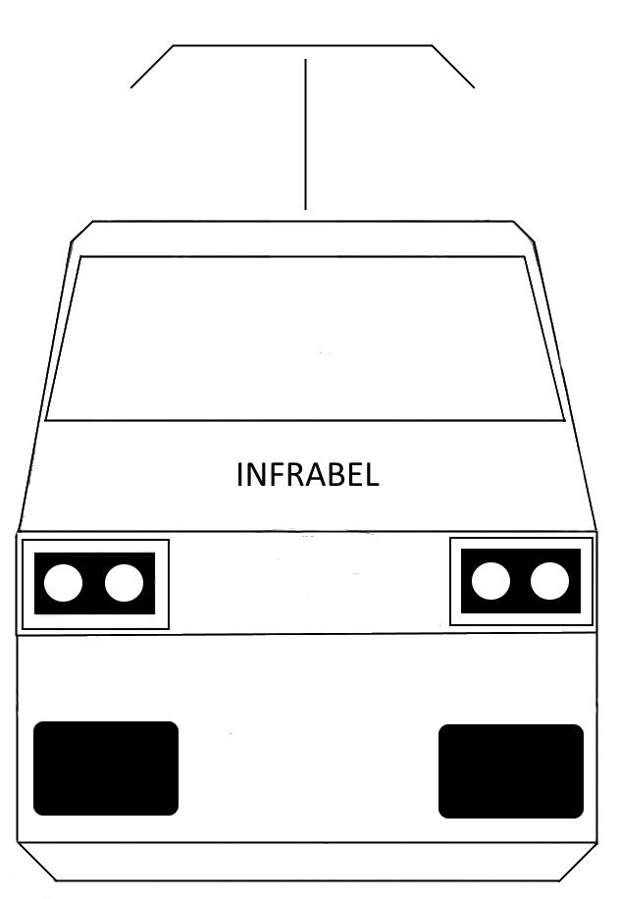
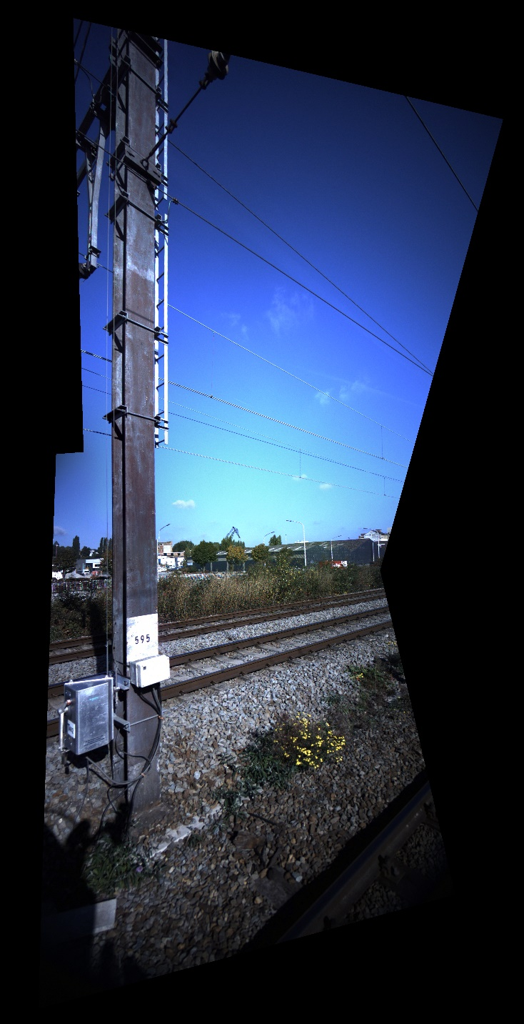
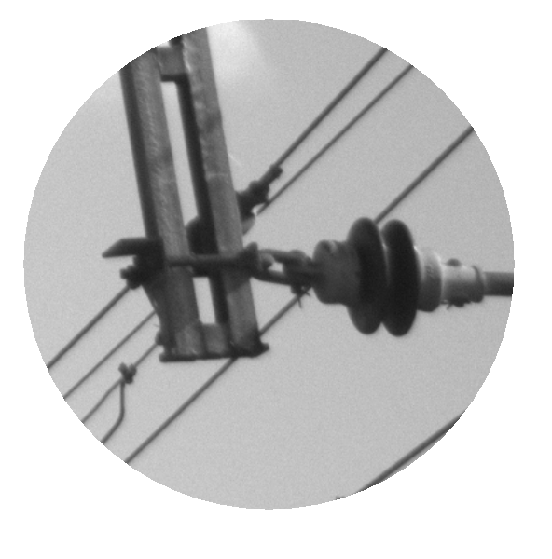
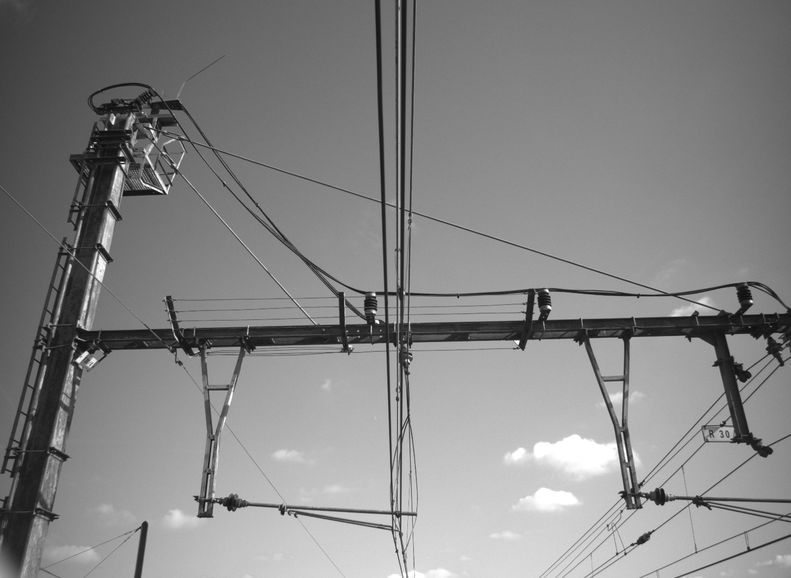
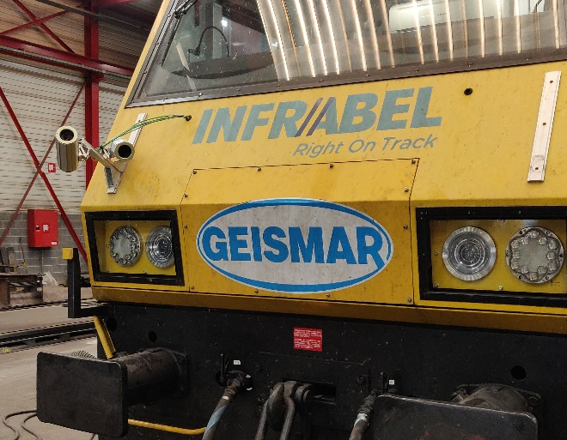
CatVision
Home made vision systems for catenary applications

Slide 8
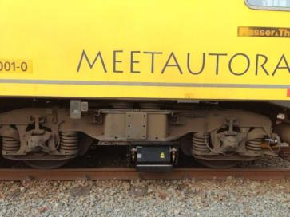
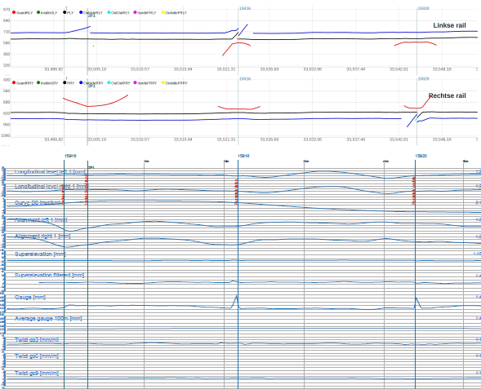
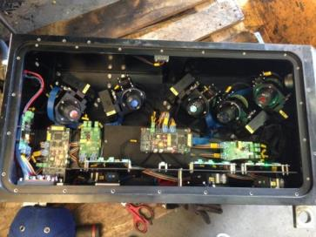
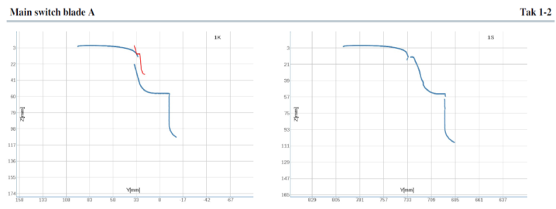
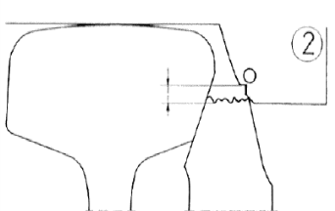
Switch
Measuring train : Automated measuring and visual inspection of condition of turnout / railway switch
-> target : 4000 switches
-> 1 automated control / year
-> data cel defect verification
-> laser measurements
-> HD video from different angles
5 cameras associated with 3 lasers per rail

Slide 9
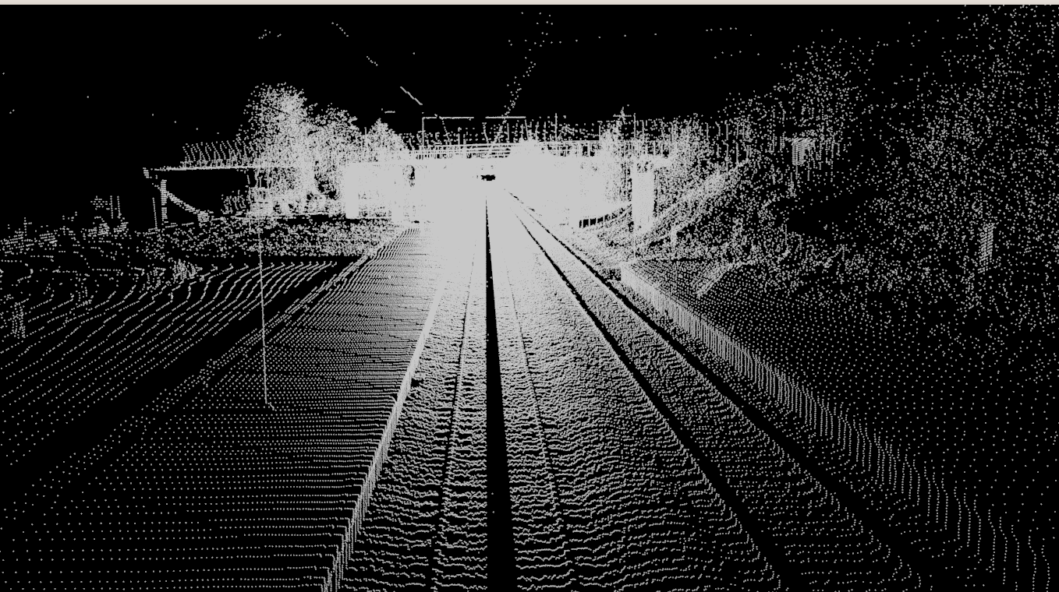
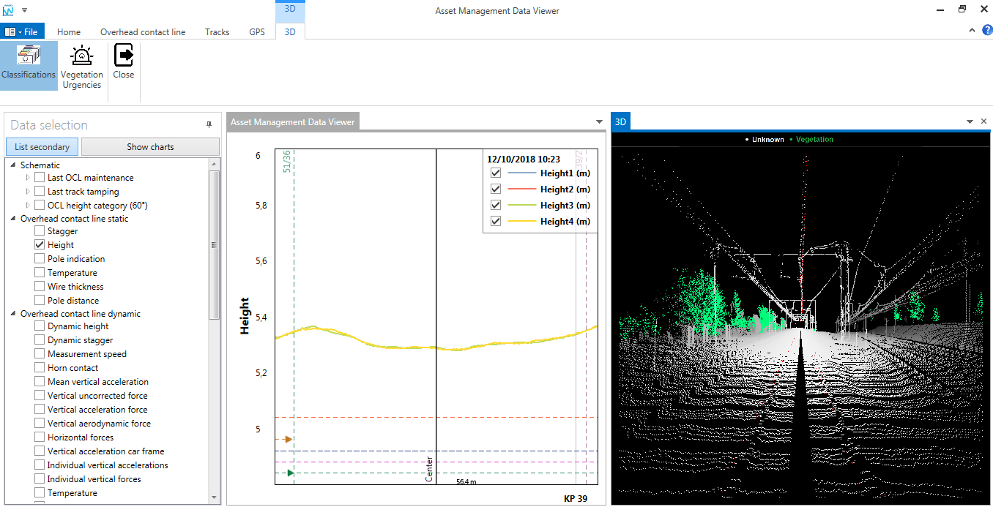
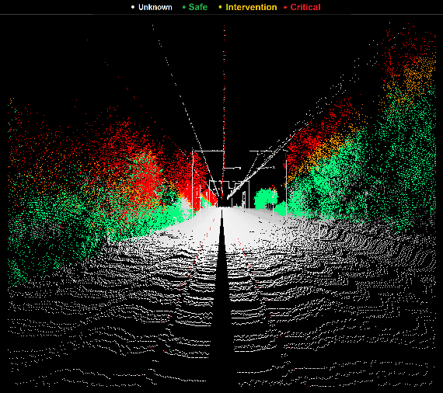
Lidar vegetation detection
Raw lidar measurement on train
4 sweeps / meter
1001 measurements / sweep
About 2 data collections per year
Detect vegetation in point cloud
Classify vegetation according to distance and height

Slide 10
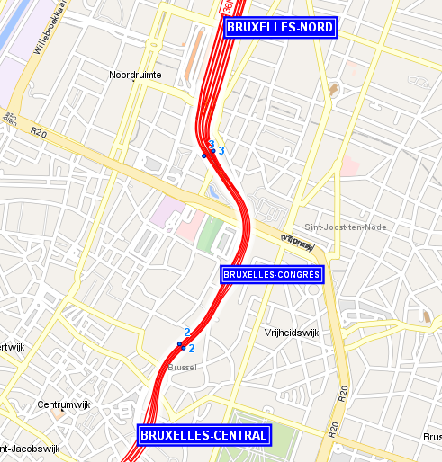
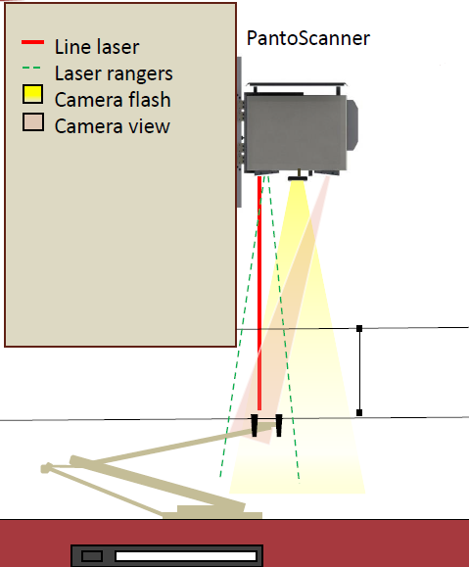
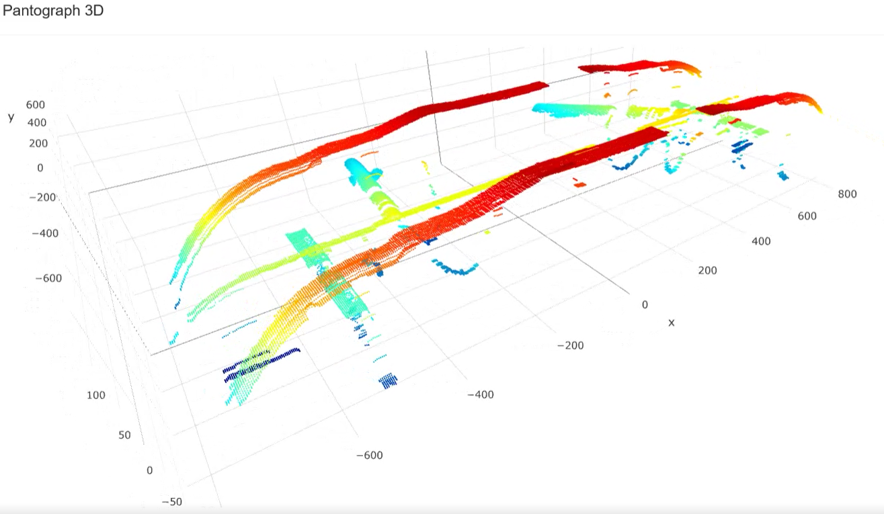
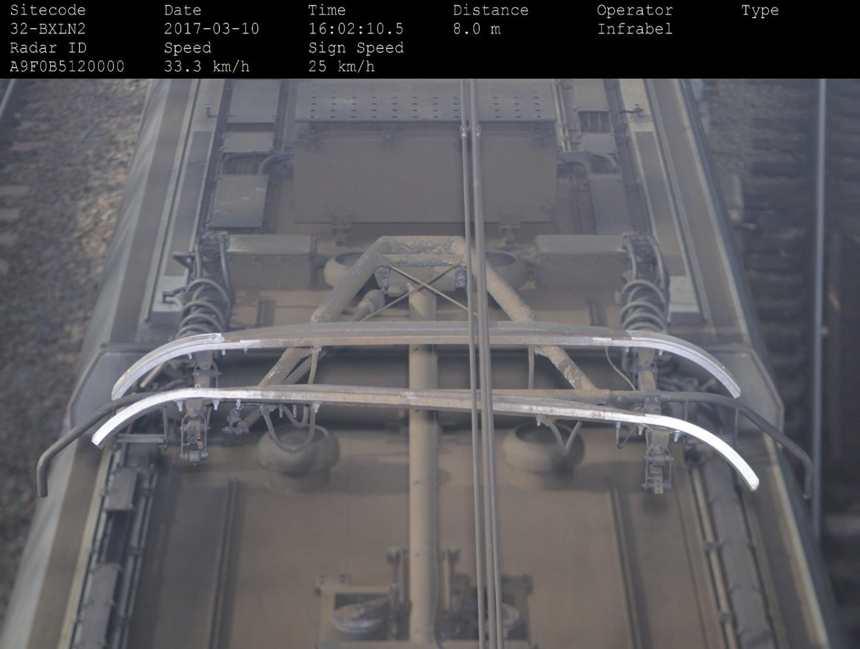
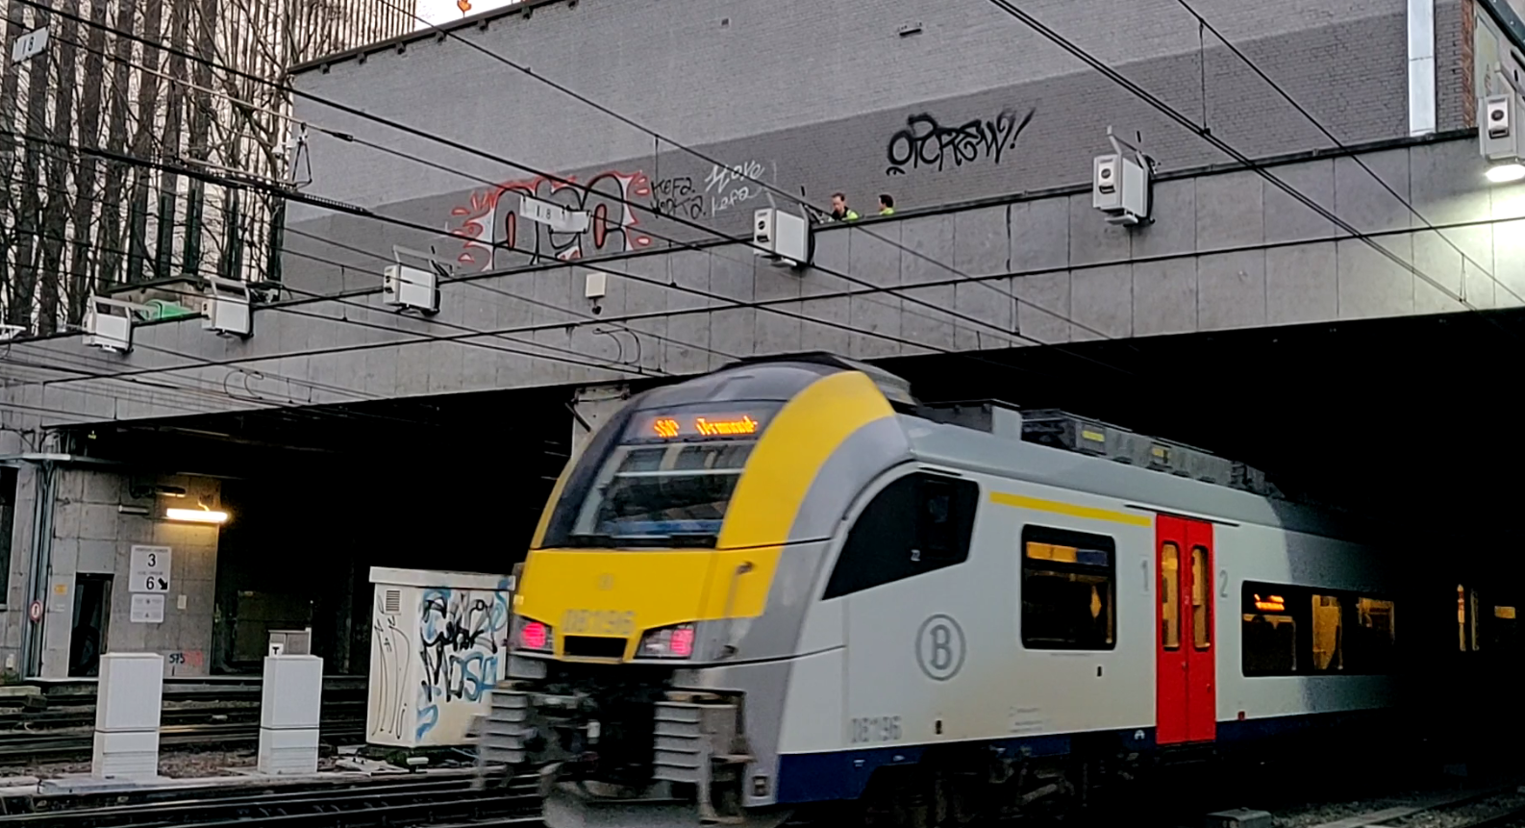
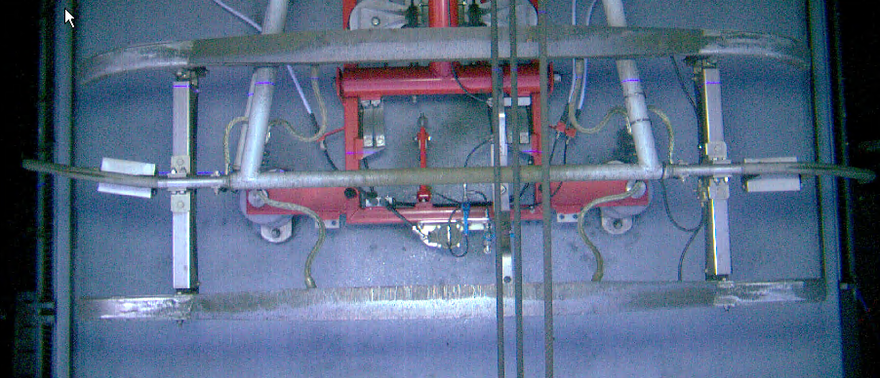
Train monitoring system
Currently for one type pantograph:
3mm accurate carbon thickness
10% false/positive & false/negative
Deformation check

Slide 11

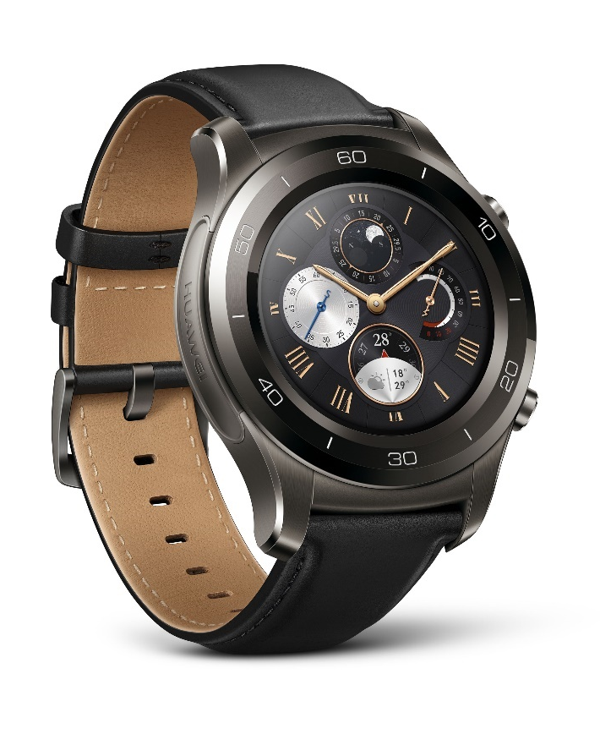
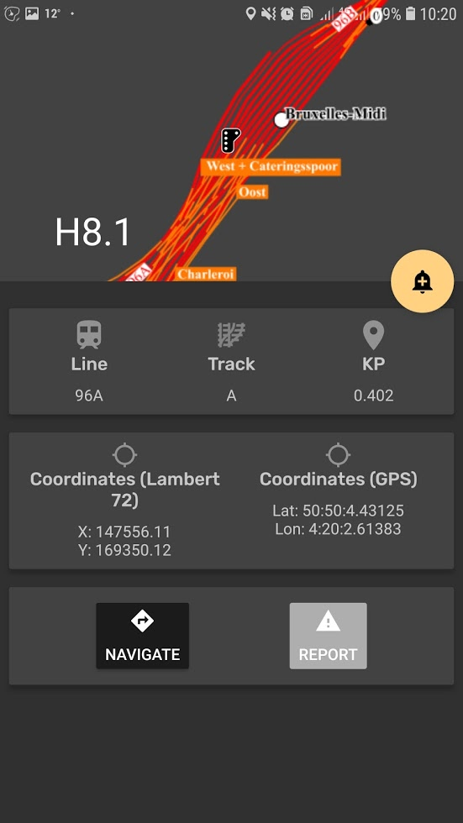


SpadWatch
IoT for worktrain/crane drivers and guides.
Improve safety on the network.
The watch warns the worktrain driver when he approaches a signal limiting his workzone.

Slide 12
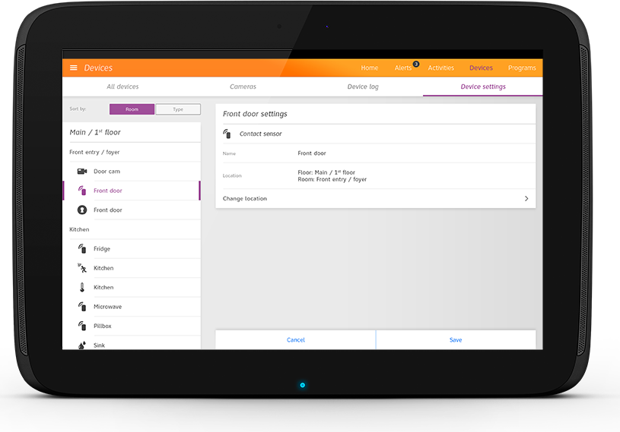

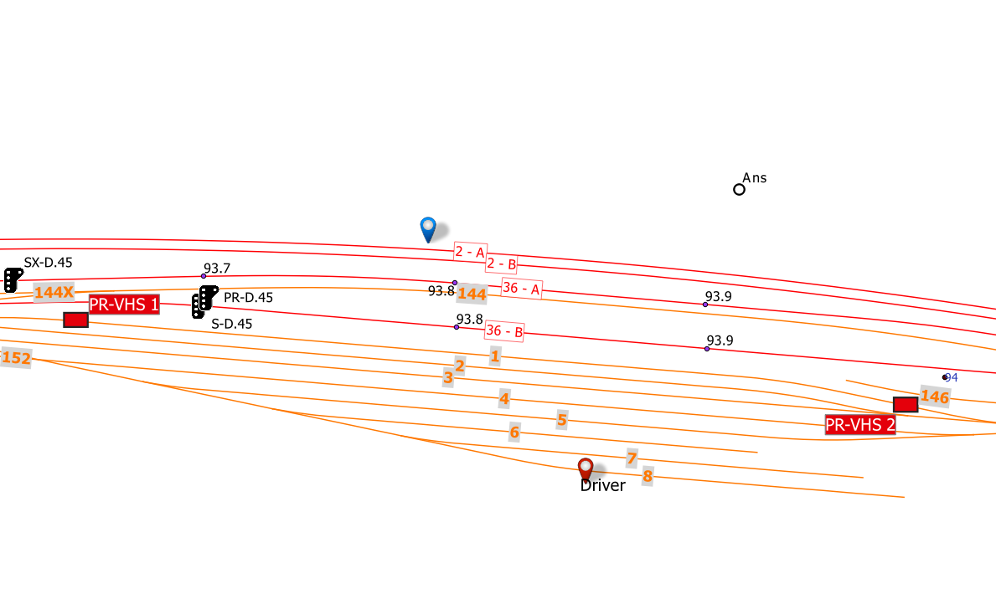
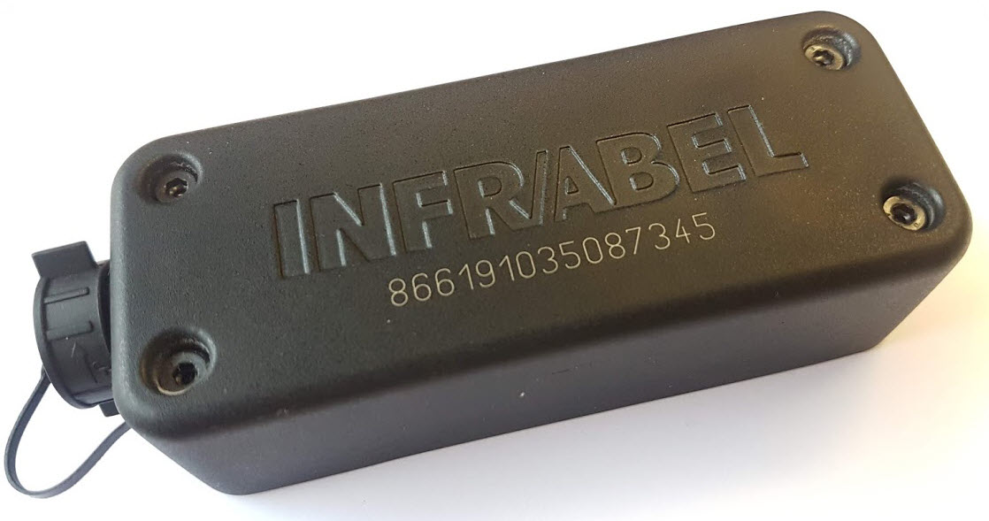
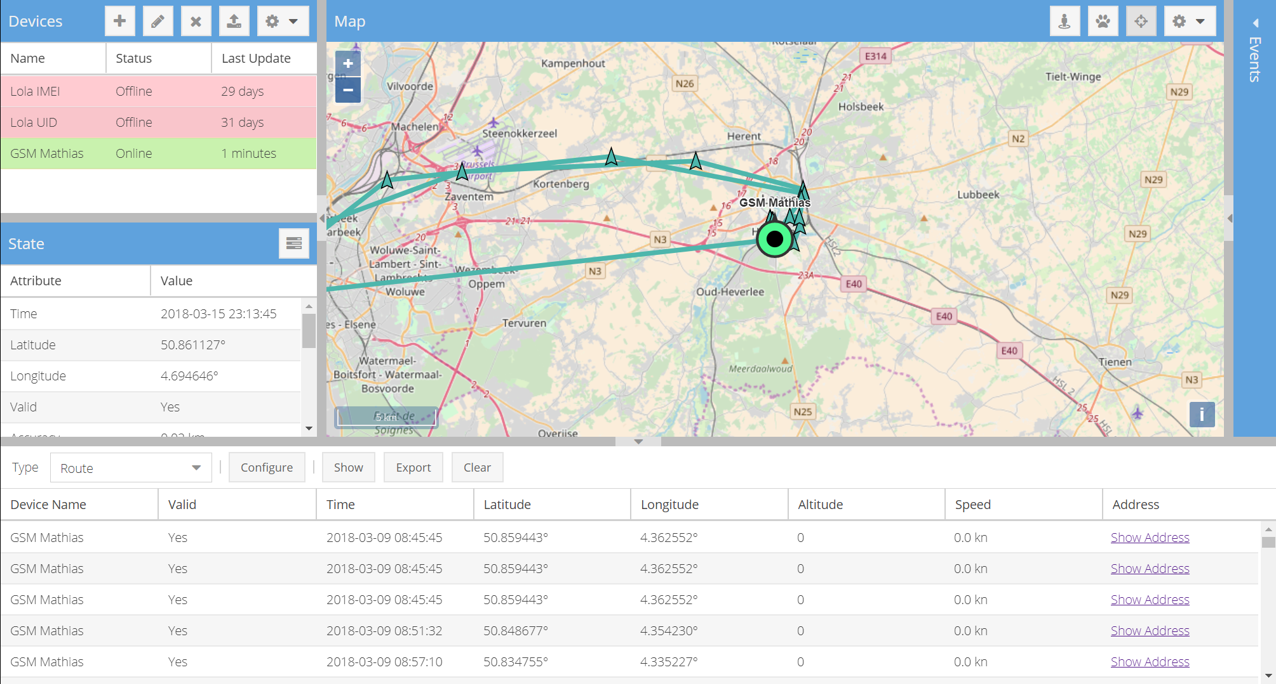
Tracking red mobile signals
GPS trackers are added to red mobile signals
IoT for worksite management and regulation enforcement.

Slide 13
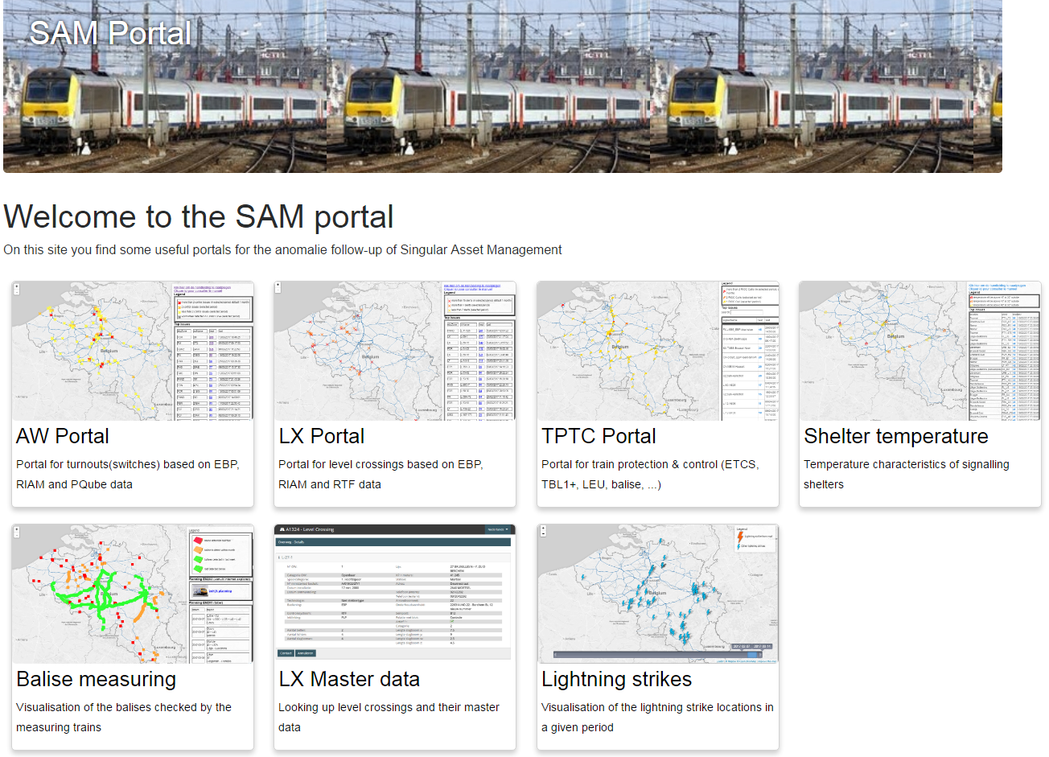
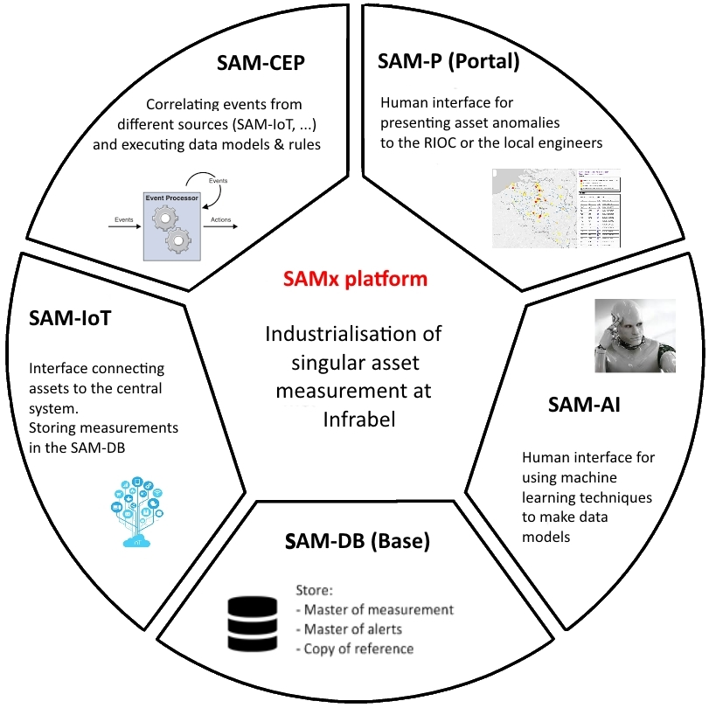
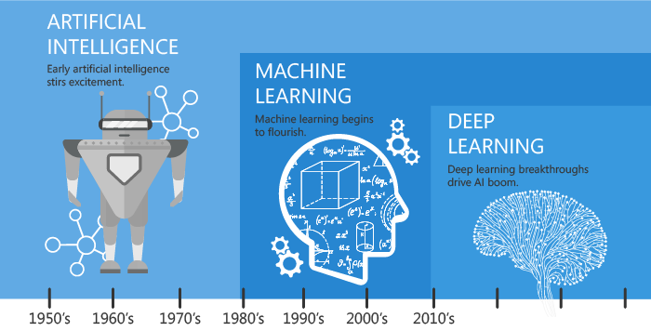


SAM Platform
SAM-IoT : Incoming data from devices
SAM-CEP : Event / time-series correlation
Measuring train input
SAM-P : Portal, webservices
SAM-DB : Storage and dataservices
SAM-AI: Deep- and
machine learning,
Video recognition

Slide 14








AMDM
(Mobile)
Intranet webapps
Cloud apps
AMDx is an in-house developed software suite aiming to:
Manage linear asset measurement data
Automatically check business rules, create alerts and interact with work management system (RIAM…)
Offer a user friendly measurement analysis interface

Slide 15
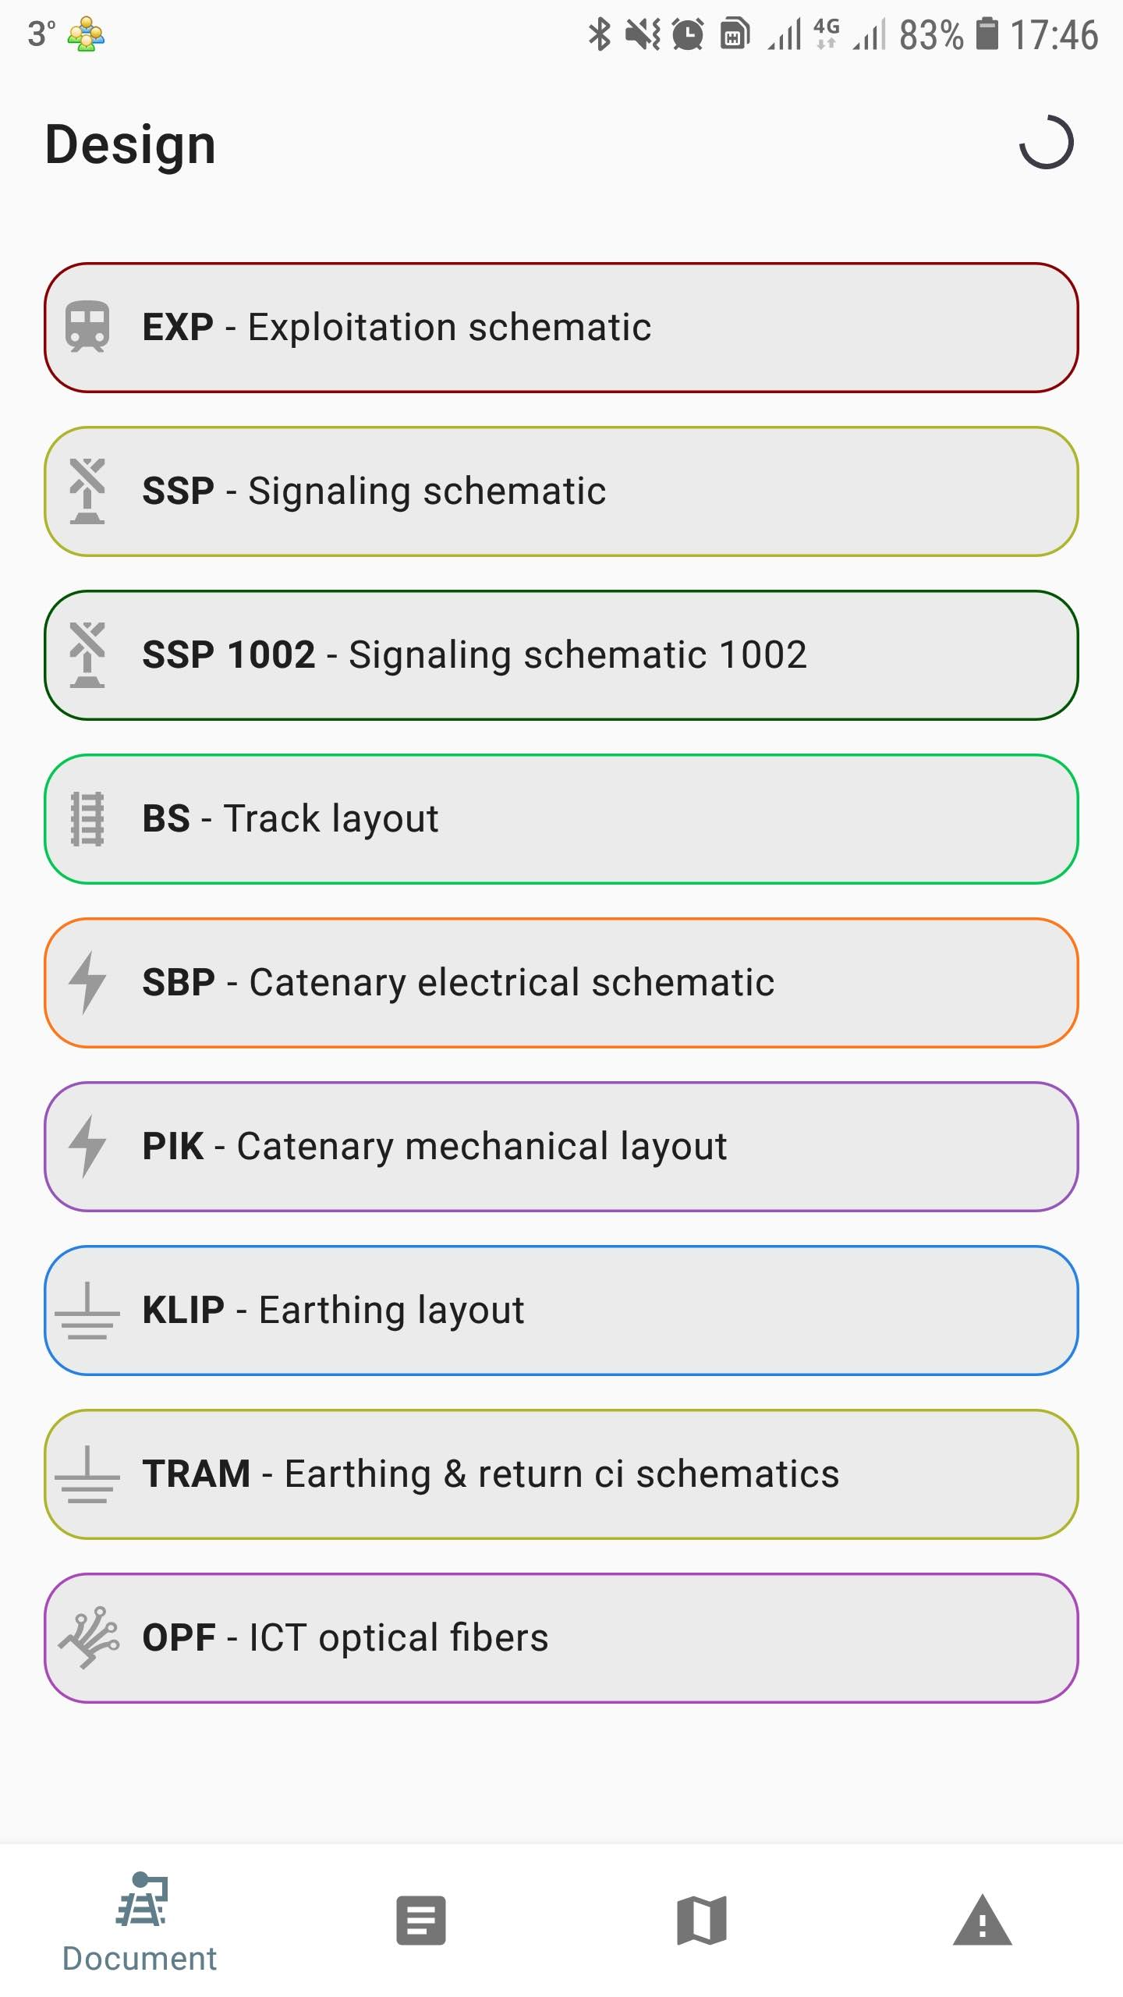

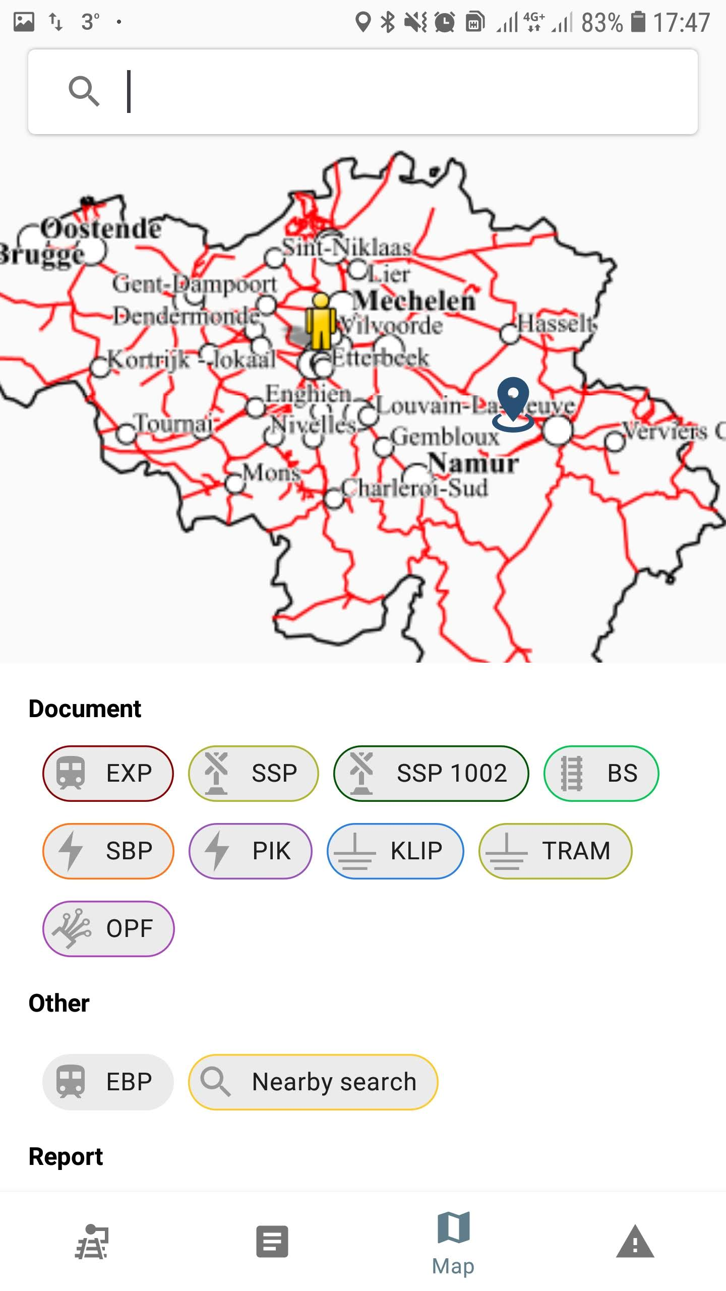

AMDM
Cloud app with useful tools for technicians
>1500 users, estimated 20 men days budget

Slide 16
The linear location problem
Location of OCL problem

Slide 17

The linear location problem

Slide 18
The linear location problem
Antenne error: difference between pantograph and GPS antenna position
Depends on specific installation, orientation of vehicle and direction of travel
Error ~ 7m only in sense of travel
How to improve: implement an IMU (to know vehicle orientation) and correct for distance (using a time based method)
GPS error: uncertainty of GPS position
Depending on environment, weather (variable in time) and antenna position
Error ~3m over all direction
How to improve: implement an IMU to form a INS.
Sync error: synchronisation between GPS position and shock measurement
Depending on travel speed
Error ~ 4m (~100ms sync error) in approximate direction of travel
How to improve: improve synchronisation algorithm

Slide 19
The linear location problem
Then multiply this by the number of vehicle equipped with the measurement system..
Simplified location algorithms are OK for simple track layout where 27m uncertainty is fine (no switches, single track, …). But..
Advise:
Determine alert groups based on possible error margins for a unique vehicle
Then group the groups and take a smart average

Slide 20


Questions?

