Slide 1
Digitalisation in maintenance (Big Data) @ Infrabel
Image recognition, AI & IOT projects
Pieter Verlinden
Lead Of Data Science@Infrabel.be

Slide 2
Overview
Infrabel
Asset management information flow @ Infrabel
Smart projects overview

Slide 3

Infrabel
We manage, maintain and modernise
the Belgian railway infrastructure
We coordinate rail traffic
on the Belgian network
~11k employees FTE
~800k passengers daily
~6500 km main track
~5800 km electrified
~4k switches
And we do it ourselves..

Slide 4
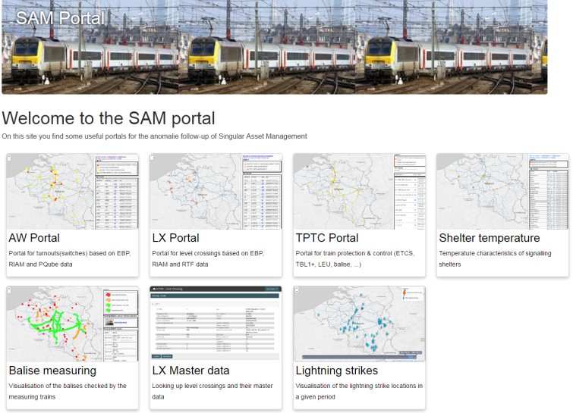
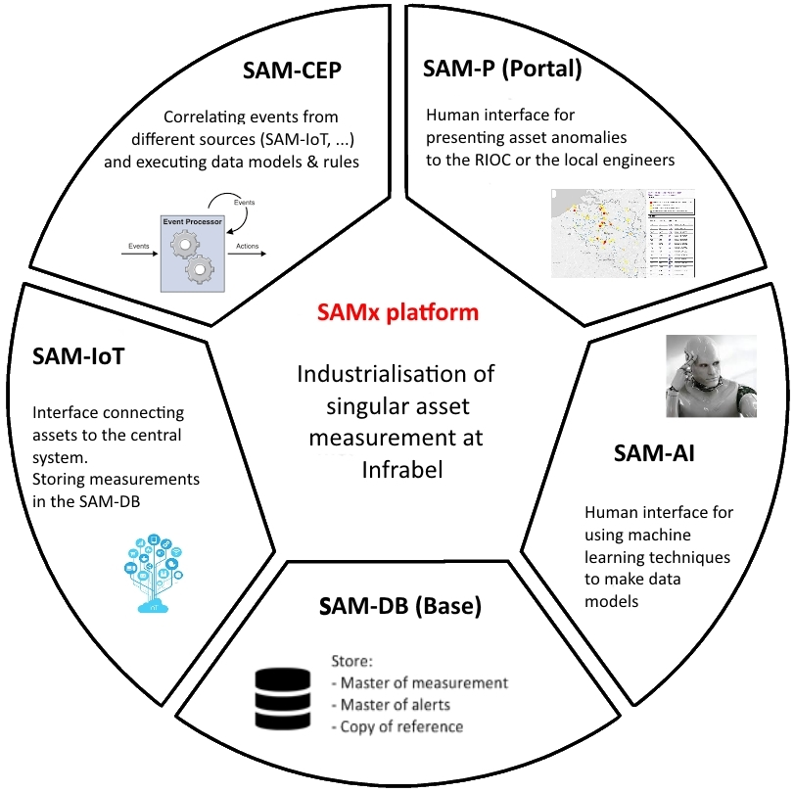
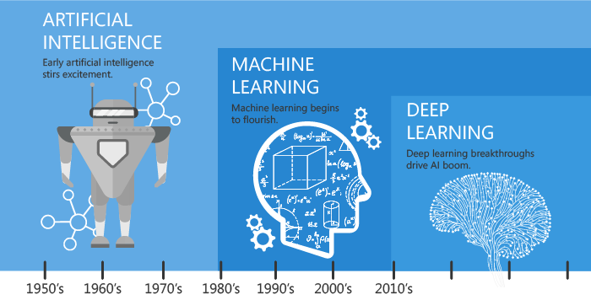


SAM Platform
SAM-IoT : Incoming data from devices
SAM-CEP : Event / time-series correlation
Measuring train input
SAM-P : Portal, webservices
SAM-DB : Storage and dataservices
SAM-AI: Deep- and
machine learning,
Video recognition

Slide 5








AMDM
(Mobile)
Intranet webapps
Cloud apps
AMDx is an in-house developed software suite aiming to:
Manage linear asset measurement data
Automatically check business rules, create alerts and interact with work management system (RIAM…)
Offer a user friendly measurement analysis interface

Slide 6
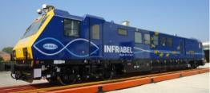


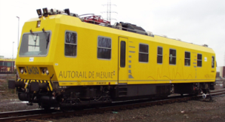



Asset Management Information Flow
Asset owner (expert) + data scientist
Technician
Measurement
Data
Portal
Intervention
Malfunction
Incident
Train Control
Computer
Interlocking
Computer
logs
SAMx
AMDx
Big data platform
Model
Verified measurement results
Predictive notifications
SAP EAM
Assets checked by
Measurement trains
Assets to be maintained
Planner
Asset Master data

Slide 7
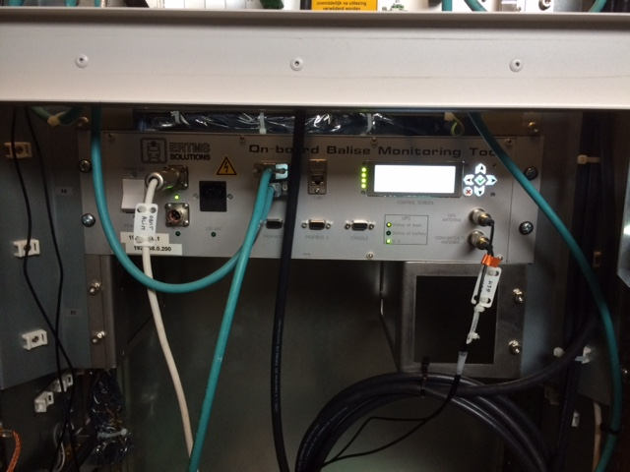
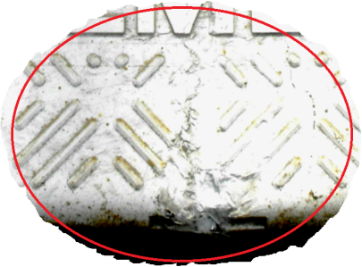
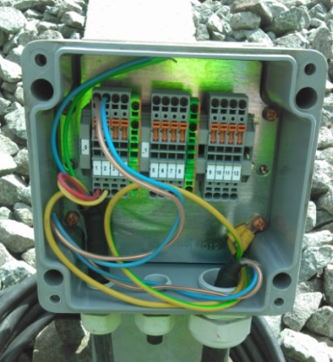
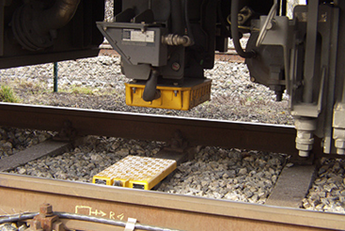
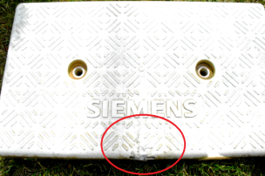
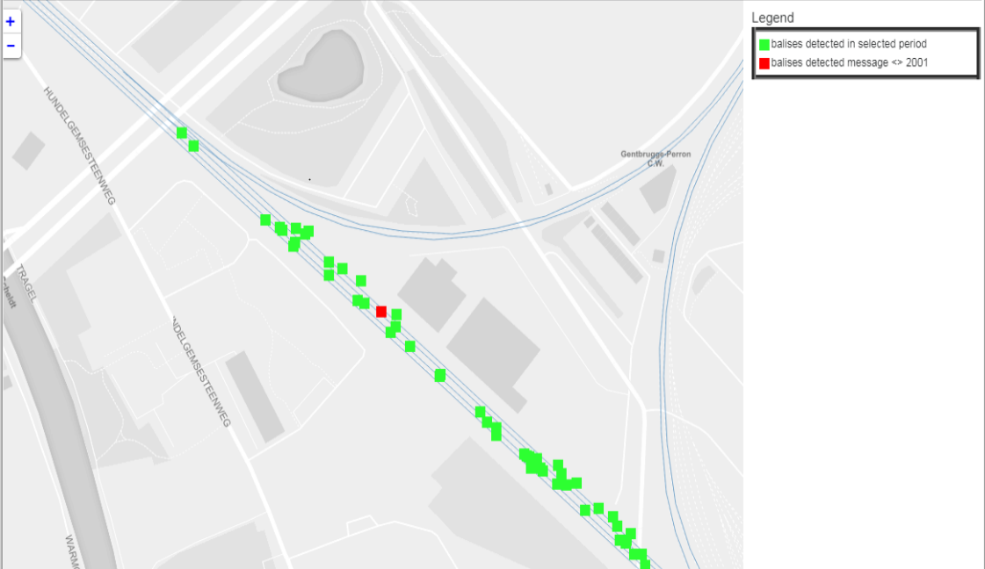
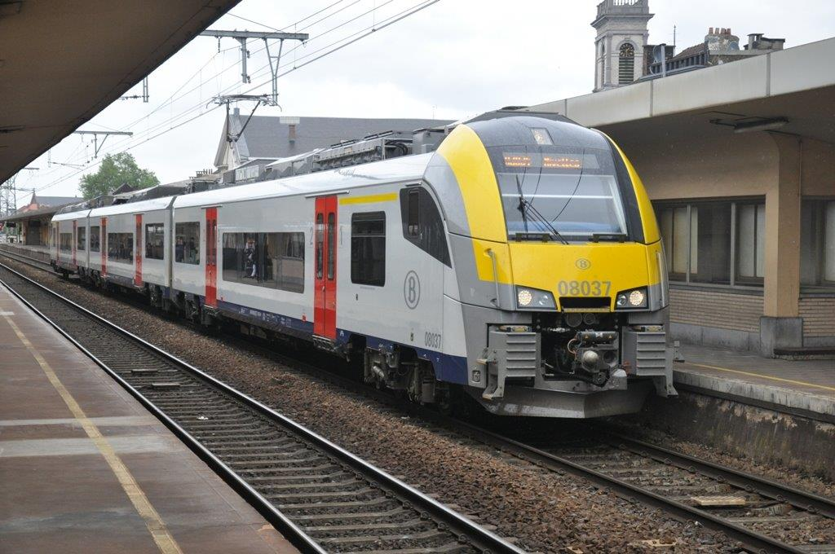
OBMT
IoT on commercial trains. Real time detection of ETCS equipment (LEU and eurobalise)
Connection
problem
Damaged balise
MVB bus
GPS
antenna
GSM antenna
For 2018:
-> 3 commercial vehicles
-> 25000/30000 balises inspected
-> saves 25000 man hours / year
For 2019:
-> 20 commercial vehicles
Real-time data to diagnostics system and processing by Operation Center

Slide 8
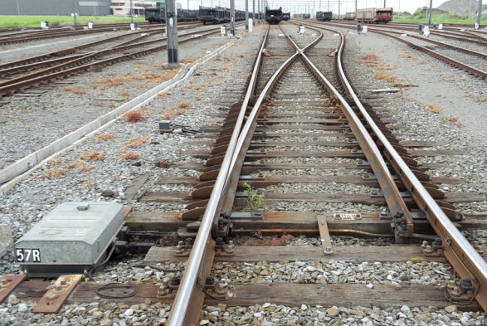
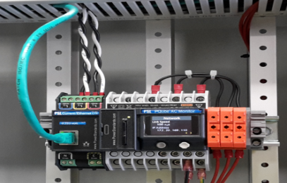
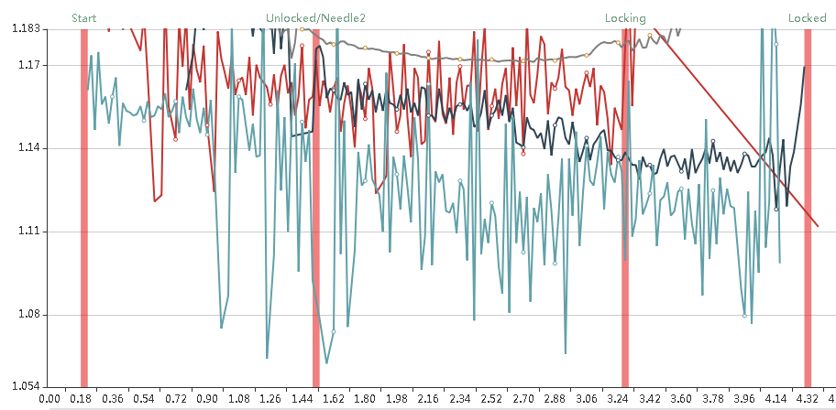
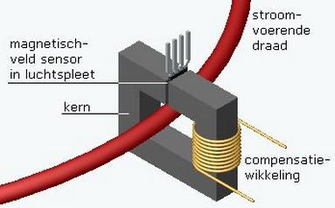
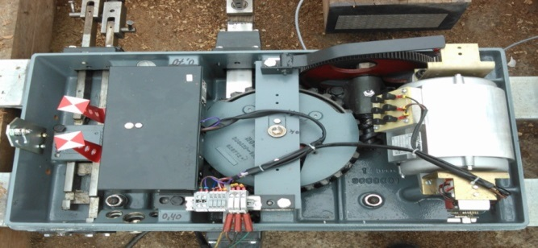
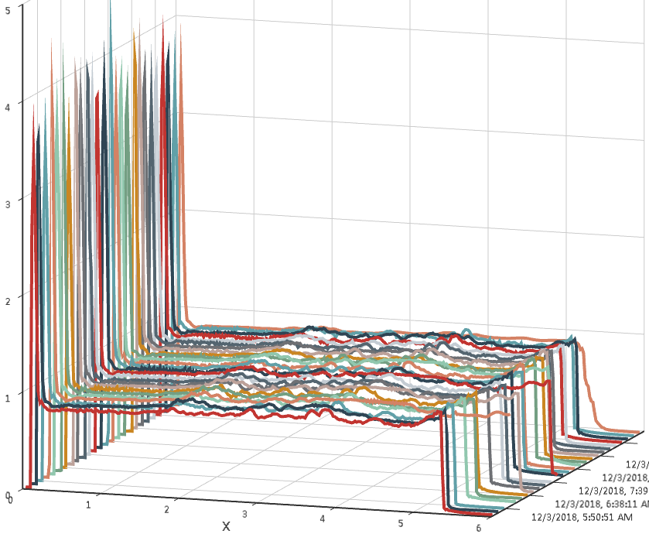
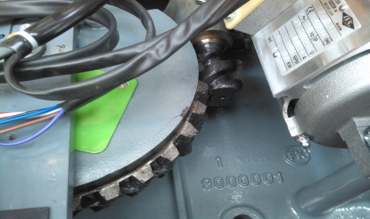
Switch
IoT on point machines. Real time monitoring of condition of turnout / railway switch
Worm gear
Bad alignment
-> 400 switches equipped
-> Predictive maintenance
-> 75% of forecasts fail
-> Link with train routes traffic control
-> 50% of mechanical failures predicted
Real-time data to diagnostics system and processing by Operation Center

Slide 9
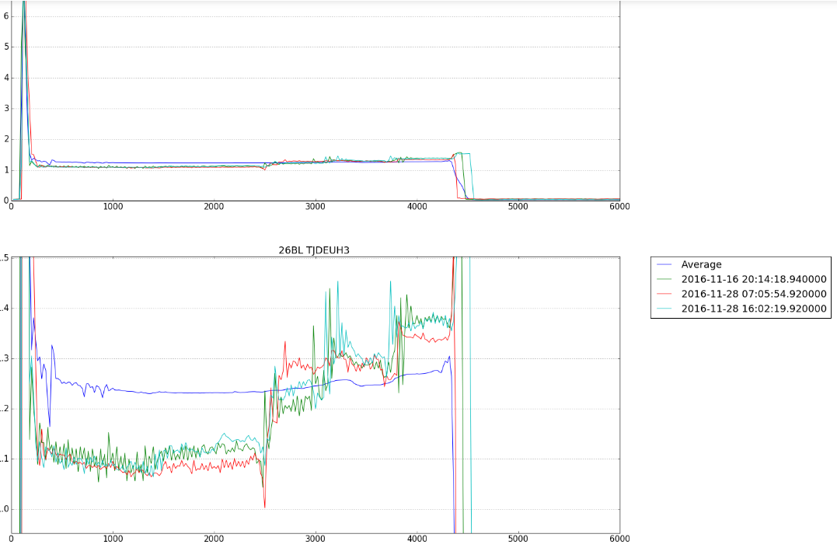
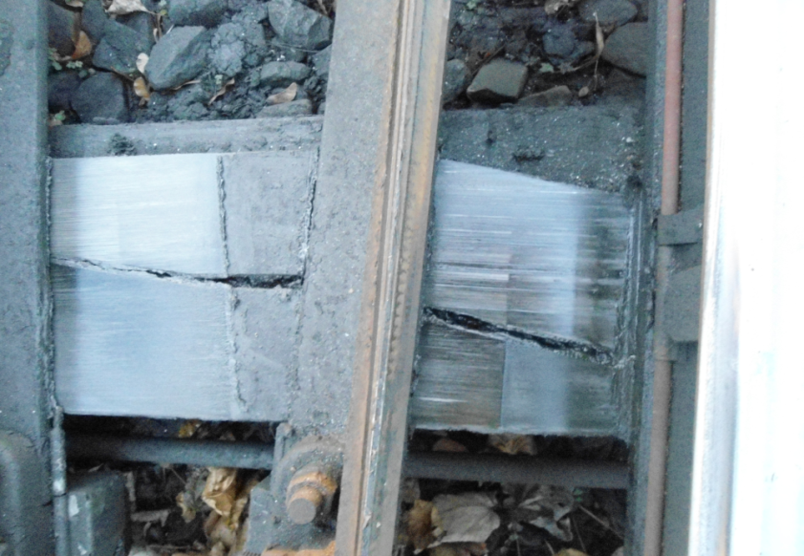
Switch
IoT on point machines. Real time monitoring of condition of turnout / railway switch
Wear on
Sliders
-> 400 switches equipped
-> Predictive maintenance
-> 75% of forecasts fail
-> Link with train routes traffic control
-> 50% of mechanical failures predicted
Real-time data to diagnostics system and processing by Operation Center

Slide 10
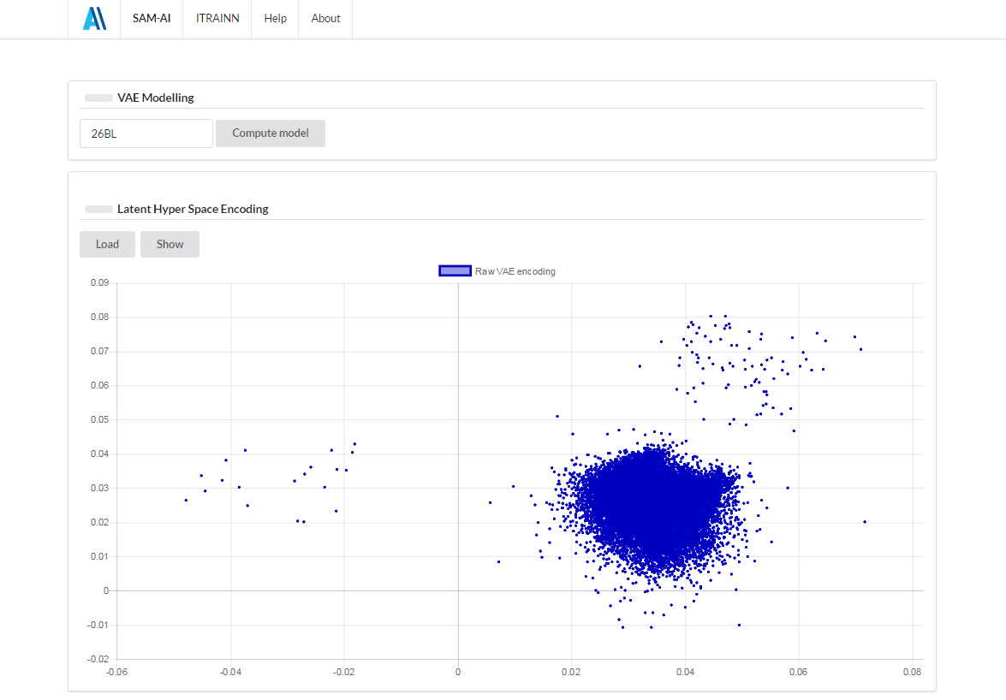
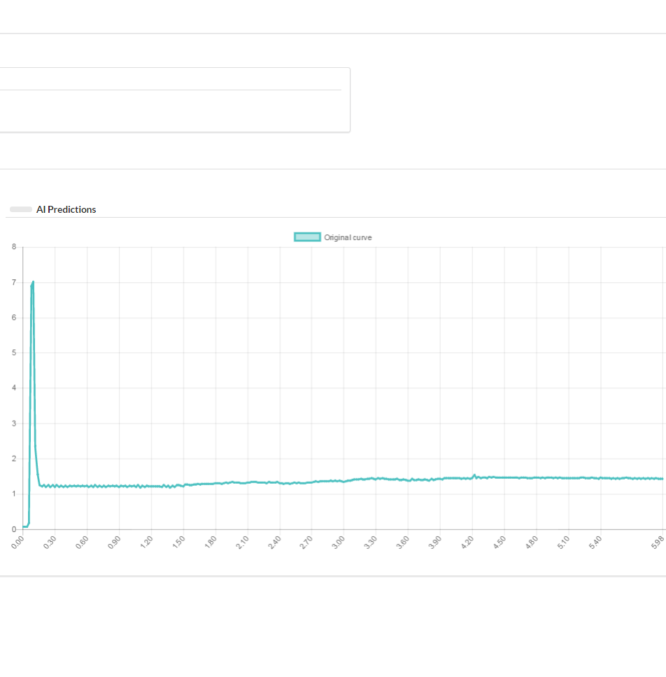
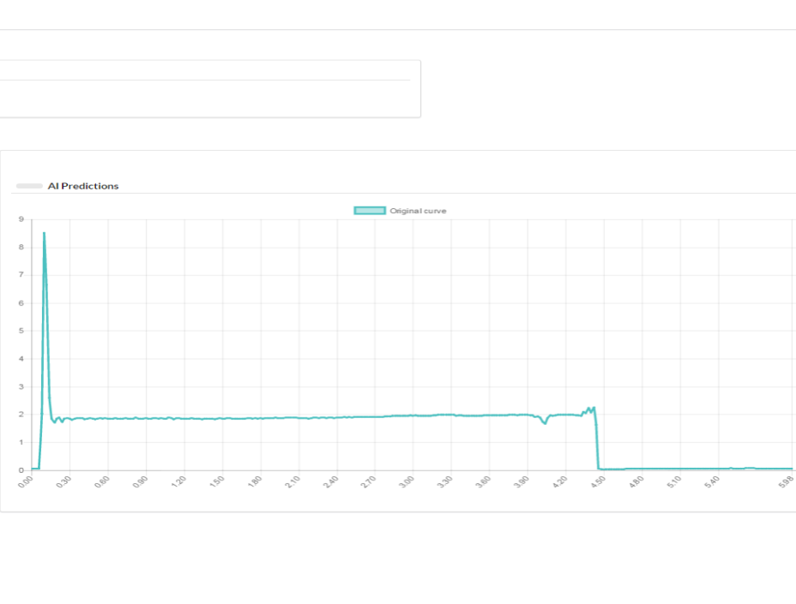
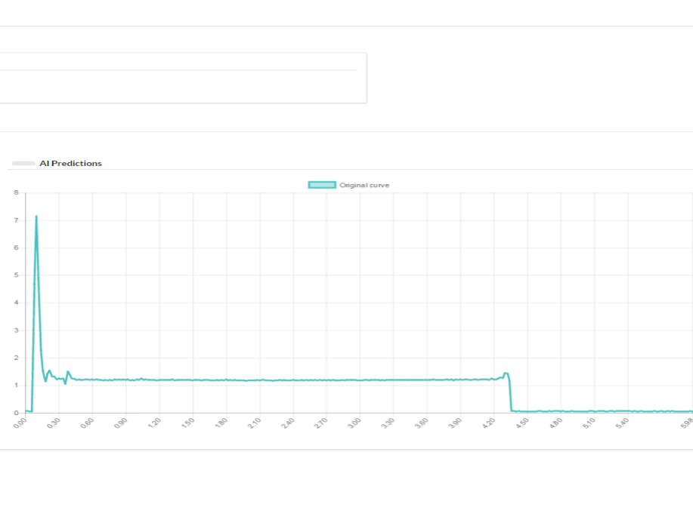
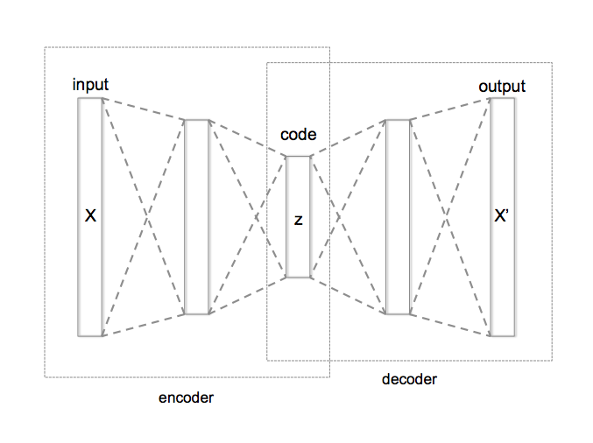
Switch
IoT on point machines. Real time monitoring of condition of turnout / railway switch
Over Current
Normal data
Not locking
-> AI
-> Deep learning / machine learning
-> Unsupervised-learning -> Dimensionality reduction using neural networks

Slide 11
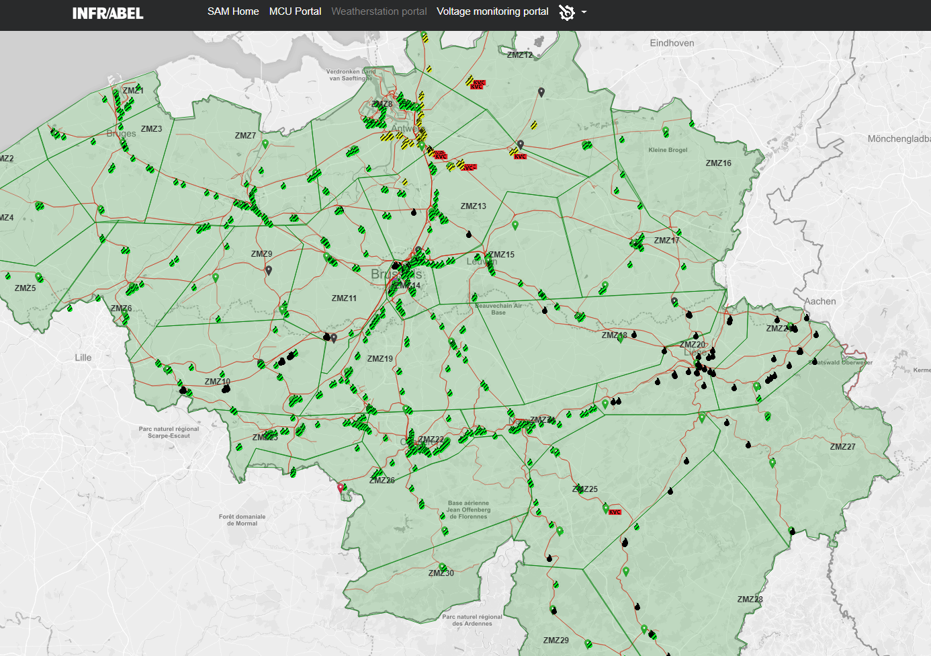
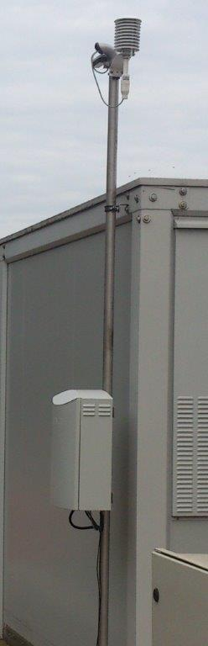
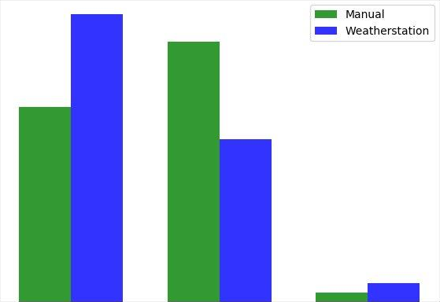
Switch
IoT on point machines. Real time monitoring of condition of turnout / railway switch
-> 70 weather stations
-> Measuring weather
-> Environment characteristics
air and rail temperature
humidity and precipitation
(also the type , eg: snow)
predictions
Estimated savings
20 % on turnout energy bill
20% less
heating
AI : Automatic change heating level by trained neural network
Off Medium High

Slide 12
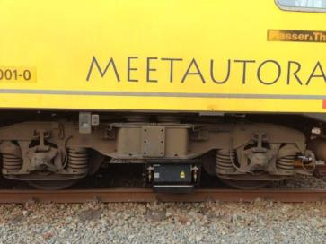
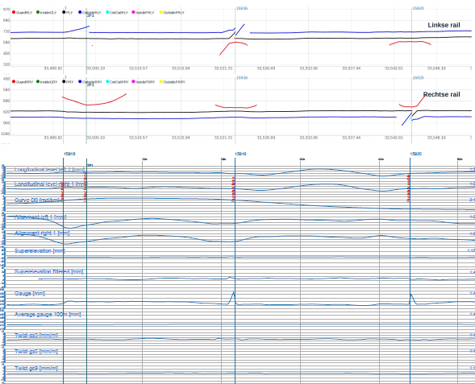
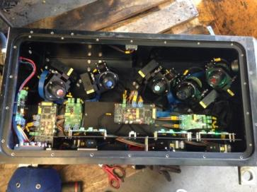
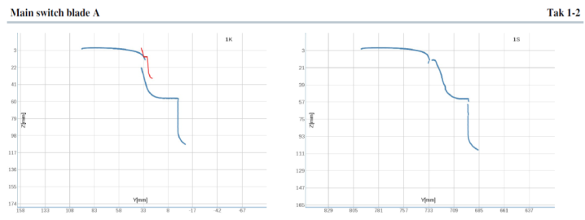
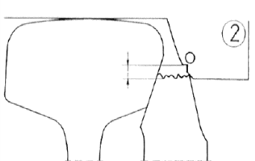
Switch
Measuring train : Automated measuring and visual inspection of condition of turnout / railway switch
-> target : 4000 switches
-> 1 automated control / year
-> data cel defect verification
-> laser measurements
-> HD video from different angles
-> saves 20000 man hours / year
5 cameras associated with 3 lasers per rail

Slide 13
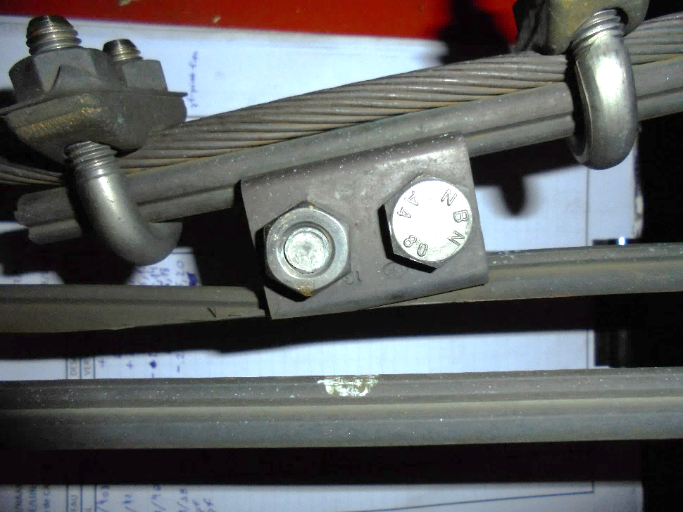
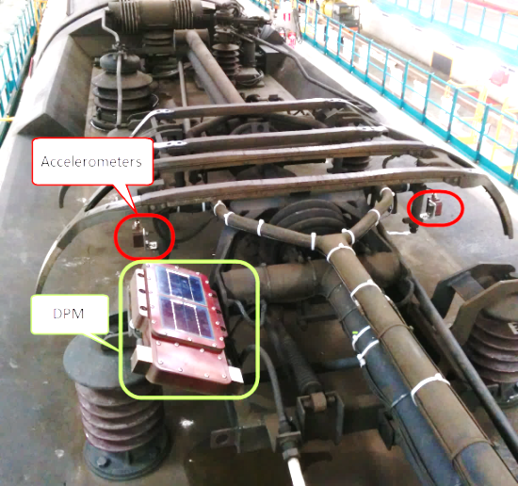
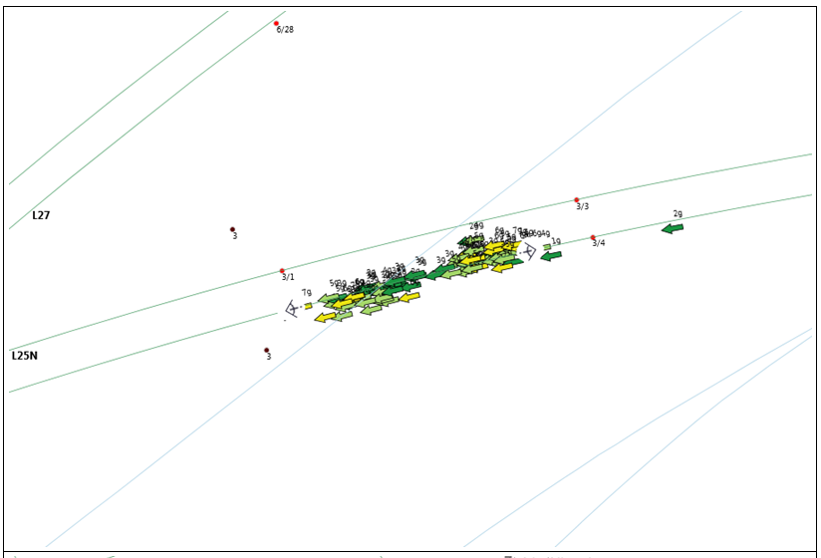
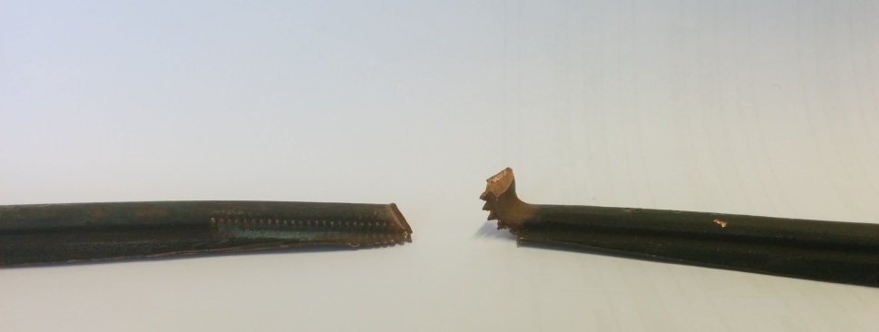
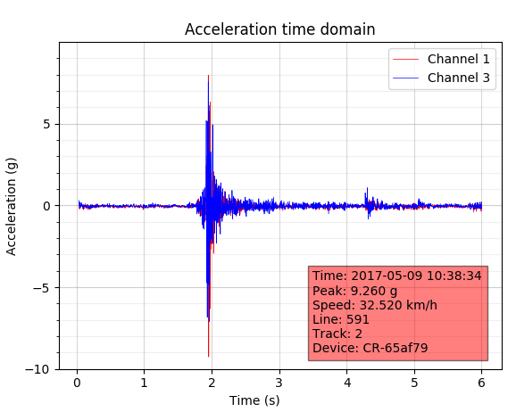
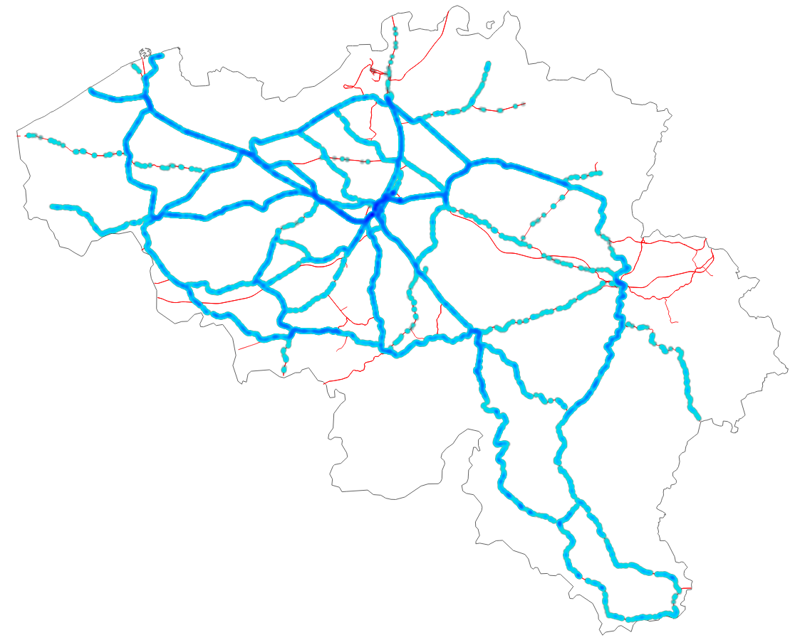
Pantograph shock detection
IoT on commercial trains. Real time detection of catenary problems.
For 2018:
-> 11 commercial vehicles
-> More than 1M km inspected
-> 261k shock alerts received
-> Grouped to 22k locations
-> 472 workorders created
Fully automated from alert to workorder

Slide 14
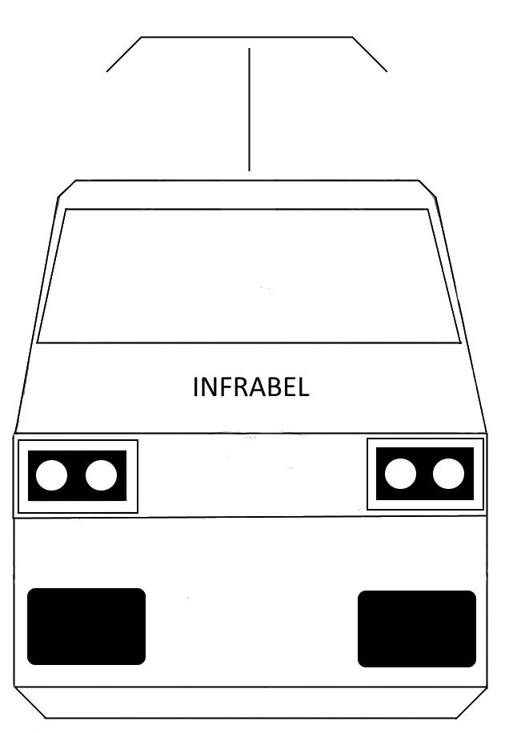
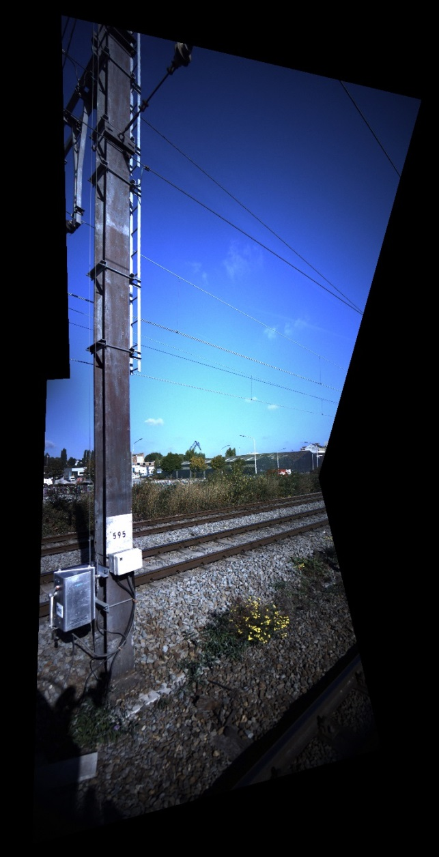
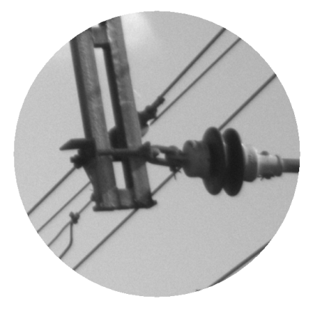
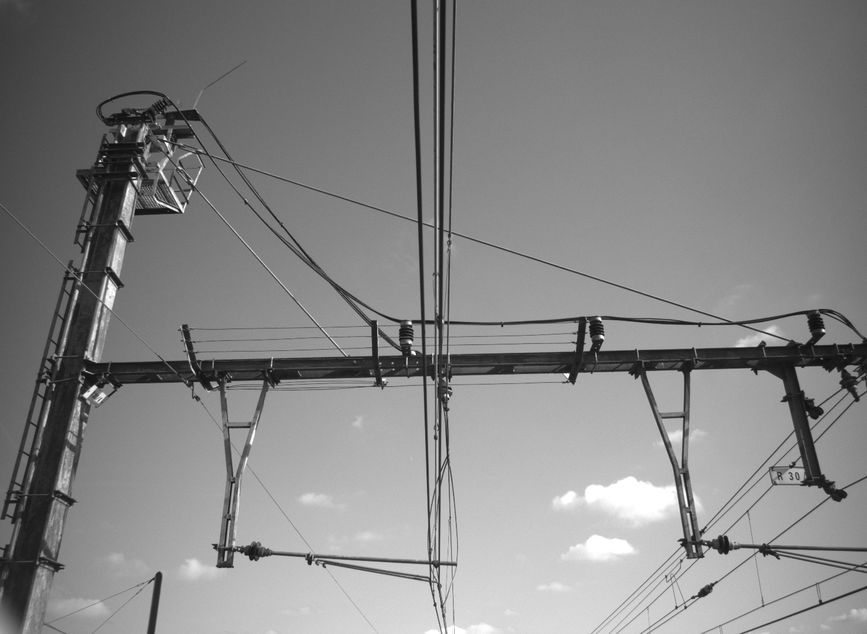
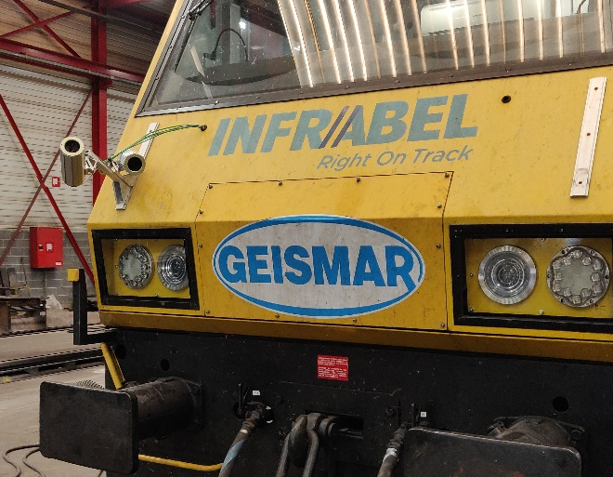
CatVision
Home made vision systems for catenary applications

Slide 15
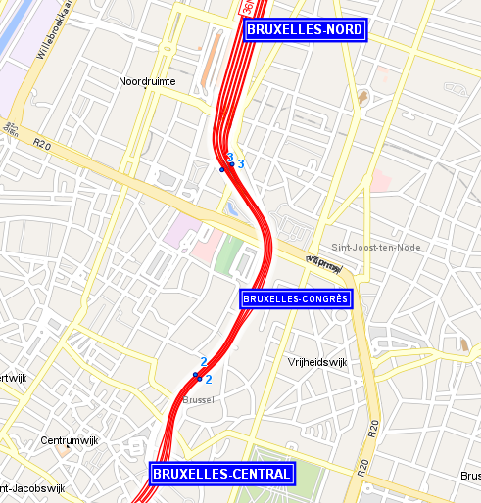
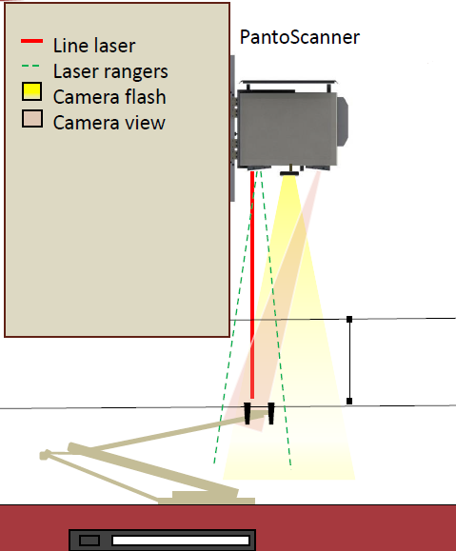
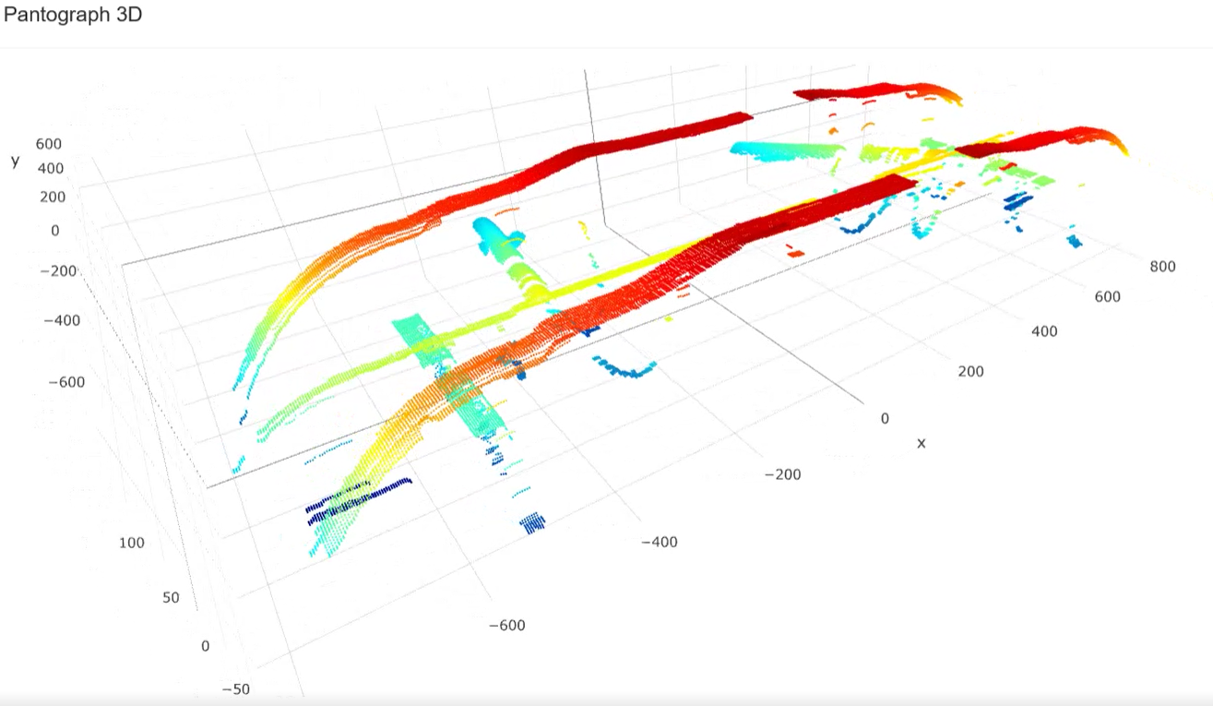
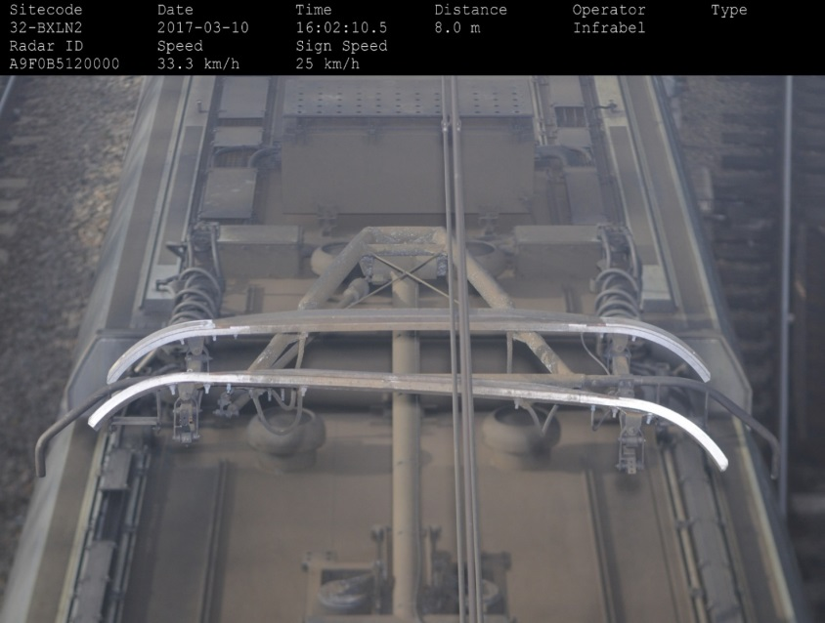
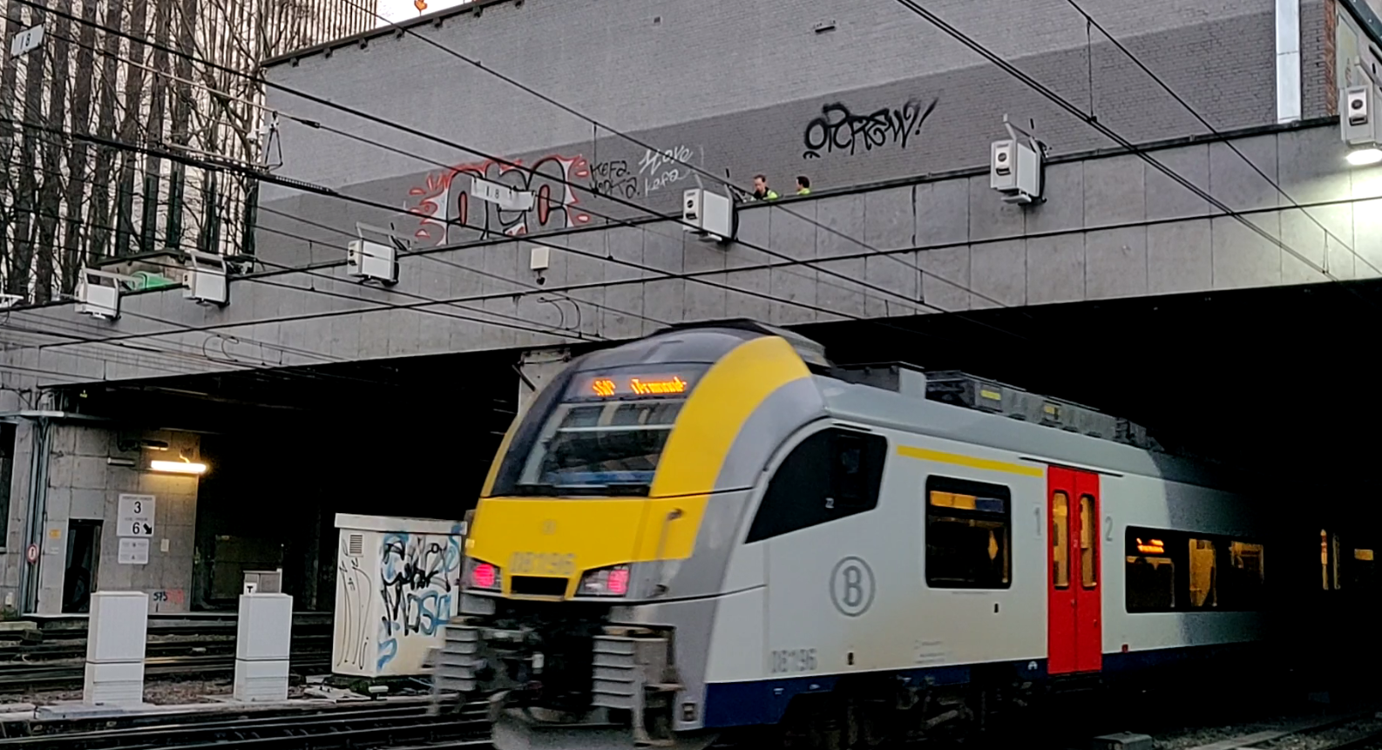

Train monitoring system
Currently for one type pantograph:
3mm accurate carbon thickness
10% false/positive & false/negative
Deformation check

Slide 16





SpadWatch
IoT for worktrain/crane drivers and guides.
Improve safety on the network.
The watch warns the worktrain driver when he approaches a signal limiting his workzone.

Slide 17




AMDM
Cloud app with useful tools for technicians
>1500 users, estimated 20 men days budget

Slide 18


Questions?

