Slide 1
Kovta project network Presentation
Made by Palkó Máté and Toms Krisztián József

Slide 2
Introduction
The network was made for the imaginary Kovta kft.
We are network-designers and we felt that we could be suitable for the job.

Slide 3
Teamwork
Palkó Máté
Toms Krisztián József
01 – Network designer, builder
01 – Network designer, builder
02– Project manager
02– Tester
03 – Documentation writer
03 – Test video creator
04 – Presentation maker

Slide 4
The aim of the network
Price-value
Redundancy
For the budget, we chose the best hardware and software components.
We implemented redundant elements like more routers and switches if one of them fails.
Security
Adaptability
Security is really important, that's why we used the likes of VPN, firewall, and ACLs.
We used OSPF and IPv6 addresses, for the company to be able to improve in the future.

Slide 5
Areas of application
The network was made for a larger company with many buildings and offices.
The structure was specifically designed to suit the needs of a larger business. However, the basic configurations can be used elsewhere.

Slide 6
How does the network work?
The network consists of three buildings (A, B, C). Each of them has different functions.
The backbone of the network is the server room, which controls the flow of data.
Every building is capable of communicating with each other.

Slide 7
Used technologies and protocols
DHCP, DNS, HTTP, FTP, IOT
SSH
VLAN
OSPF, Static routing
ACL
Static, Dynamic NAT
VPN
IPv6,IPv4

Slide 8
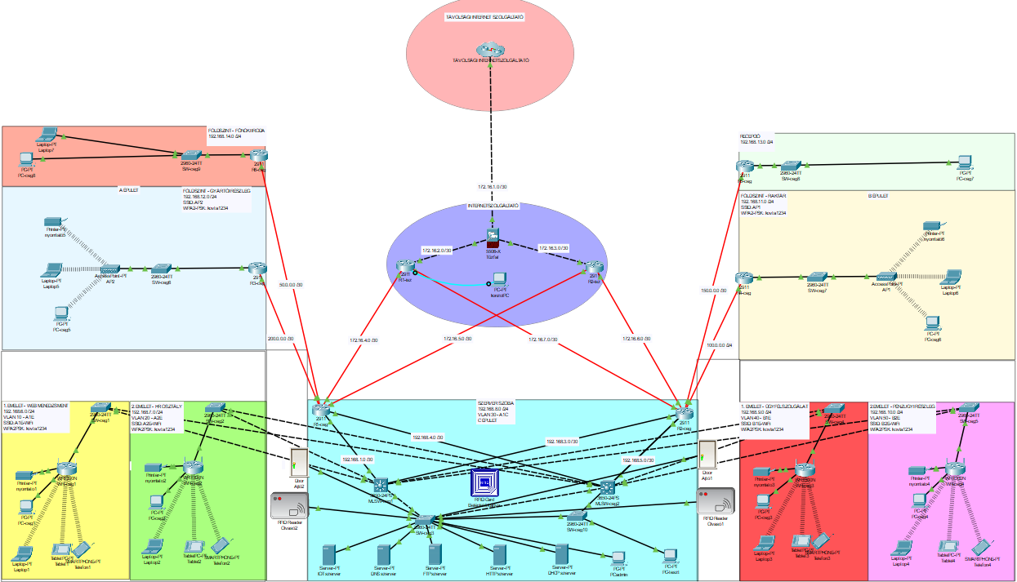
Hálózati topológia
Network Topology

Slide 9
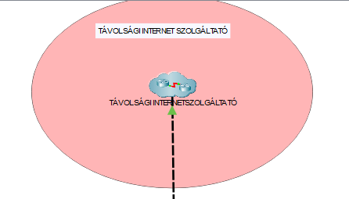
Remote network provider
It's located far from the company, therefore it's connected to the local network provider.
This section provides the WAN connection between the global network and the company.

Slide 10
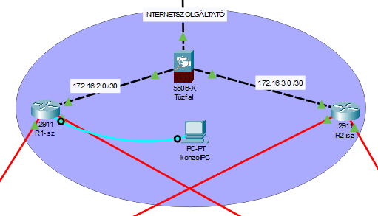

Local network provider
Provides the connection between the remote internet provider and the company network.
OSPF
VPN
SSH
Firewall
Console connection

Slide 11
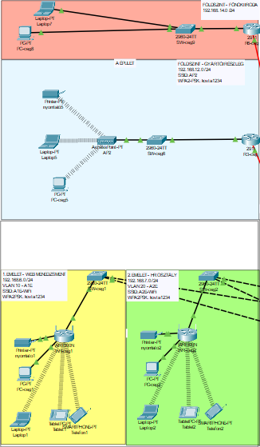
“A” building
A part of the offices are located here (HR, Web-management, boss office) and the production line.
DHCP
Wireless connection
VLAN
IPv6
OSPF
SSH

Slide 12
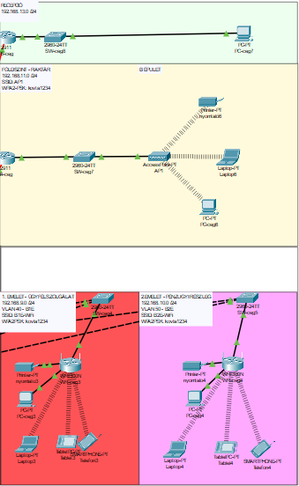
“B” building
The other offices (Support, Financial department), the reception, and the warehouse can be found here.
DHCP
Wireless connection
VLAN
OSPF
SSH
Static routing
Dynamic NAT

Slide 13
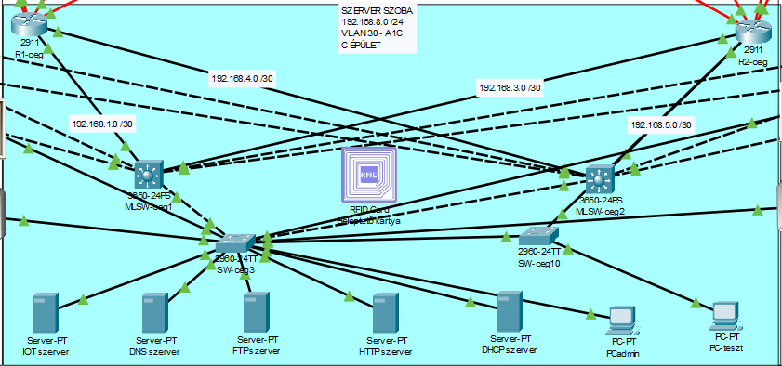
Server room
The center of the network, where the servers, routers and multilayer switches are located.
DNS
DHCP
HTTP
FTP
IOT
OSPF
Static NAT
VLAN

Slide 14
Testing
We used manual testing.
Communication testing
Network configuration inspection
Security check
The test cases were created based on a unique scenario which have:
ID
Description
Test steps
Pre-conditions
Expected results
Actual results
Test datetime
Cisco version
Fail/Pass
Bug report ID

Slide 15
Programs used for teamwork
Jira | Assigning tasks - Clockwork Free – Jira
Discord | Communication with the team
Git | To push the actual version of the network - link
Google Sheets | Documentation for the test - link

Slide 16

Git
Version tracking
Branches
Backup

Slide 17
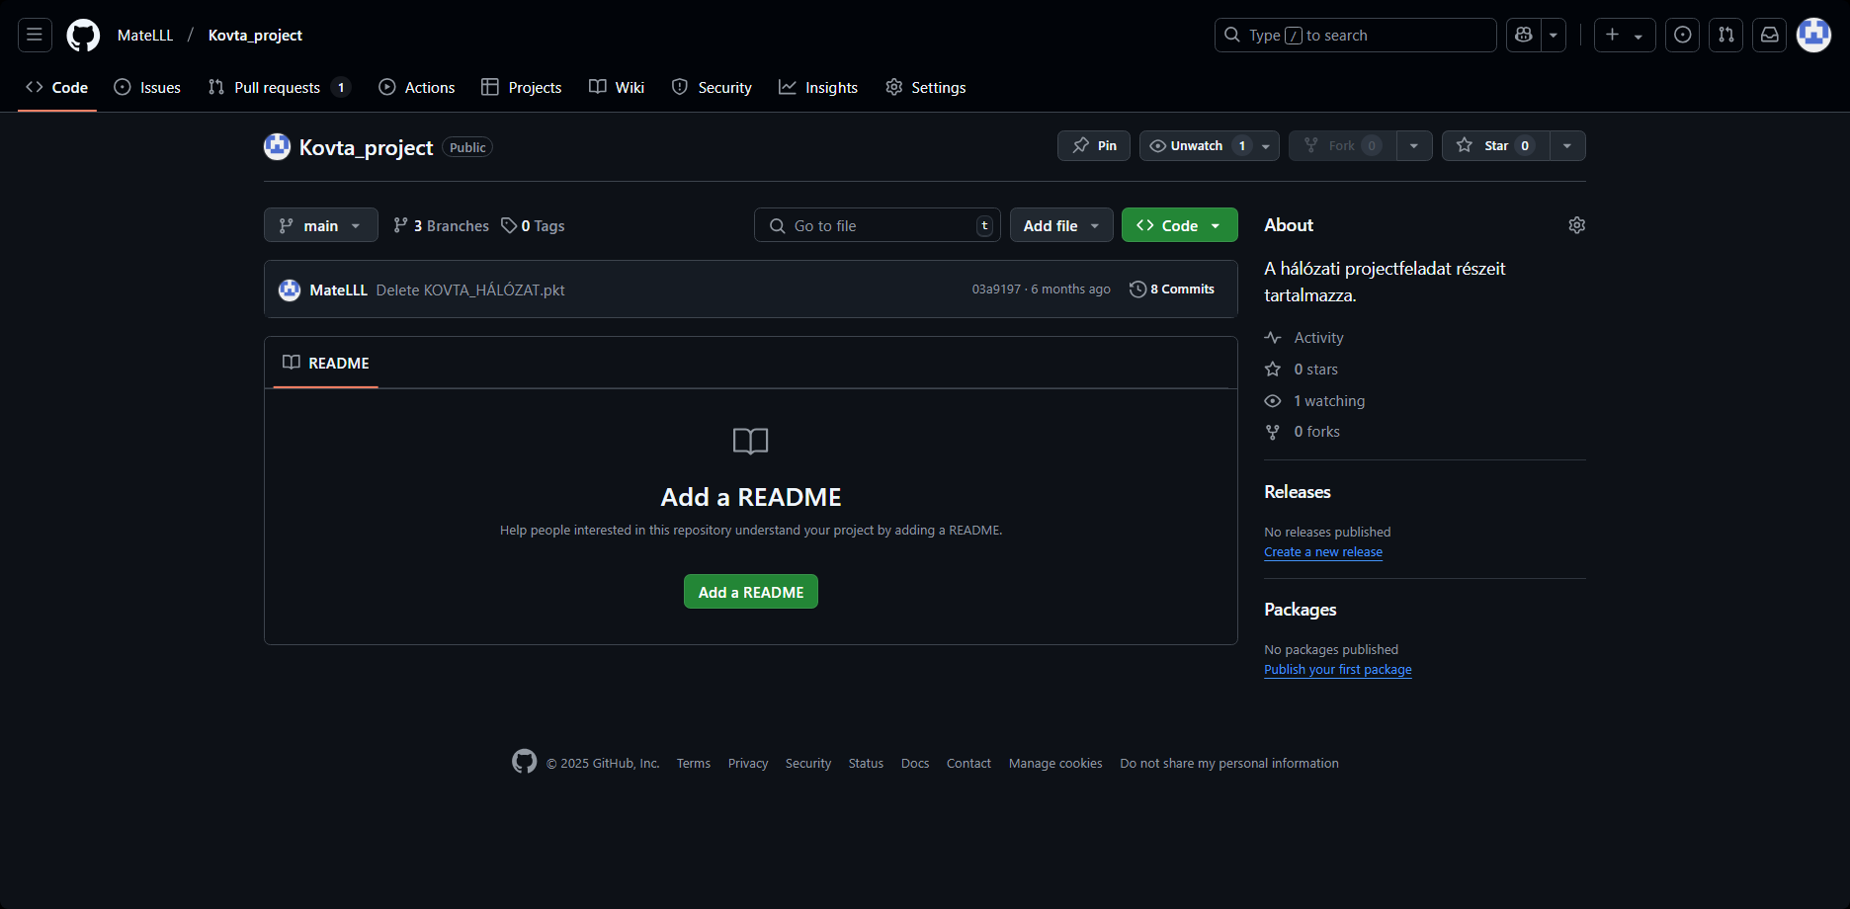

Slide 18
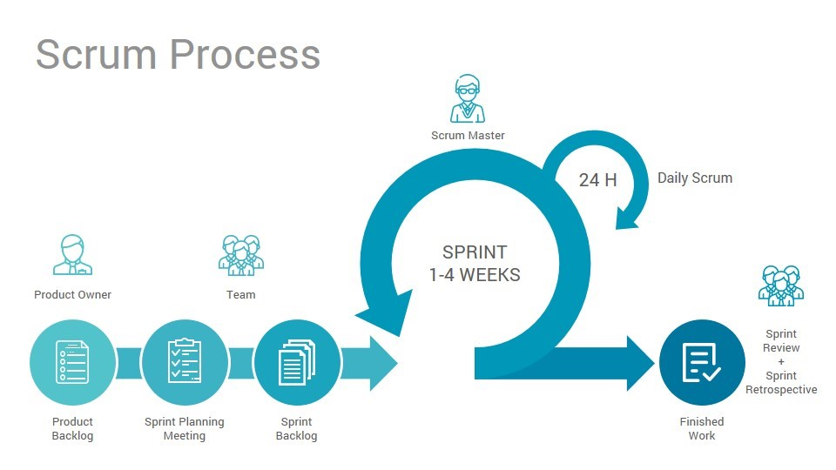
Jira
Task management
Time management (estimated time, clockwork)
Scrum elements

Slide 19
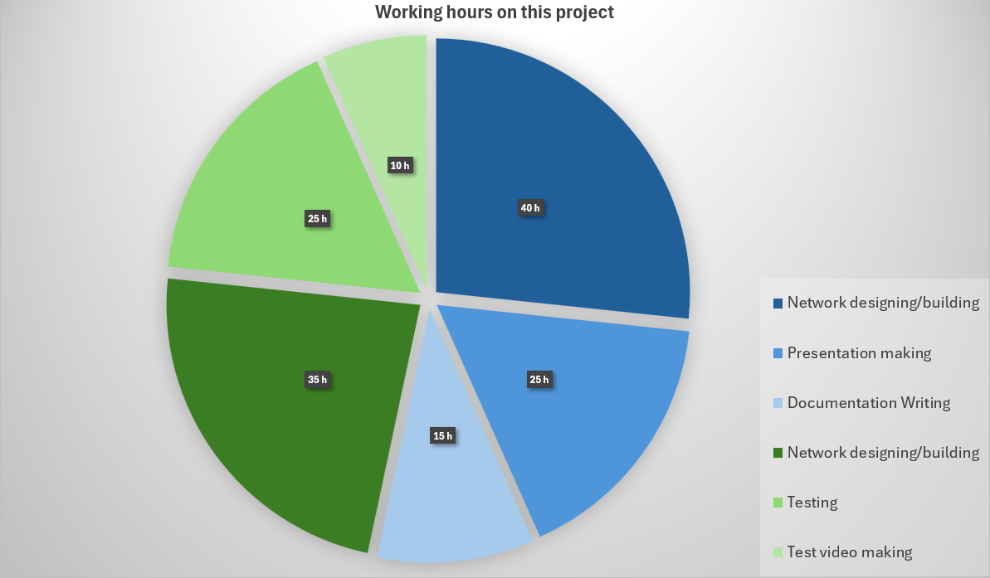
Toms Krisztián József
Palkó Máté

Slide 20
Future plans
01
02
03
PAT
IPv6 instead of IPv4
IOT sensors

Slide 21
SWOT analysis
S
W
Efficient teamwork
Discipline
Professional knowledge
Motivation
Procrastination
Stubbornness
Time management
Inflexibility
Weak competition
Luck
Strong economy
Strong competition
Advance of AI
Lack of demand
O
T

Slide 22
Thanks for watching
Feel free to ask questions!
Made by Palkó Máté and Toms Krisztián József

Slide 23
Thanks!
Do you have any questions?
youremail@freepik.com
+34 654 321 432
yourwebsite.com
Please keep this slide for attribution

