Slide 2
library(rvest) library(dplyr) library(rgdal) library(ggplot2) library(sf) library(stringr) library(lubridate) library(readr) library(tm) library(wordcloud) library(cowplot) library(stargazer) library(knitr)

Slide 3
Data scraping i uređivanje podataka

Slide 4
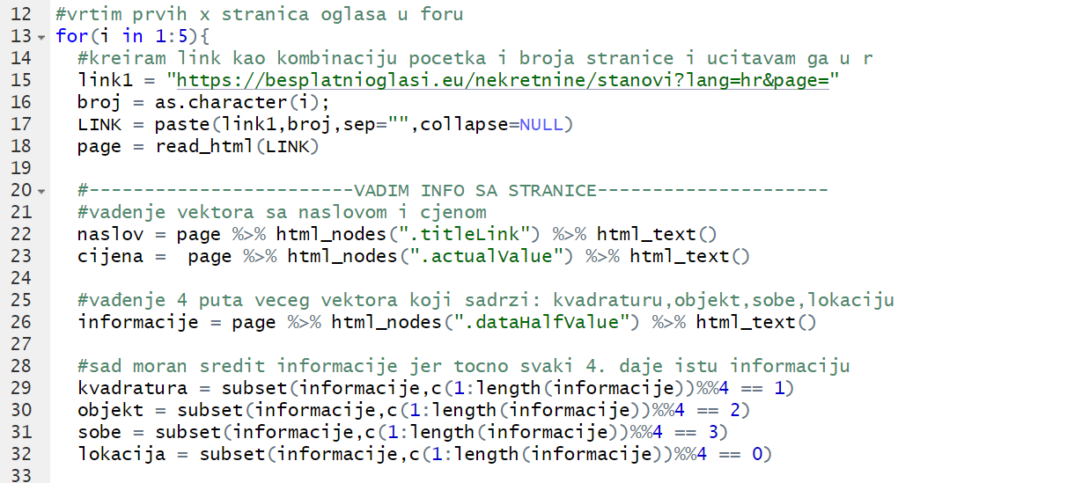

Slide 5
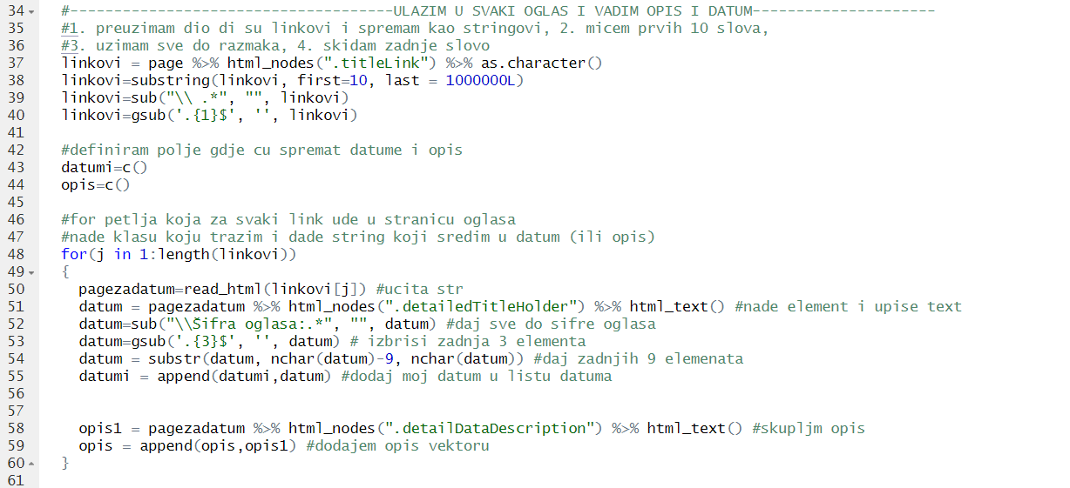

Slide 6
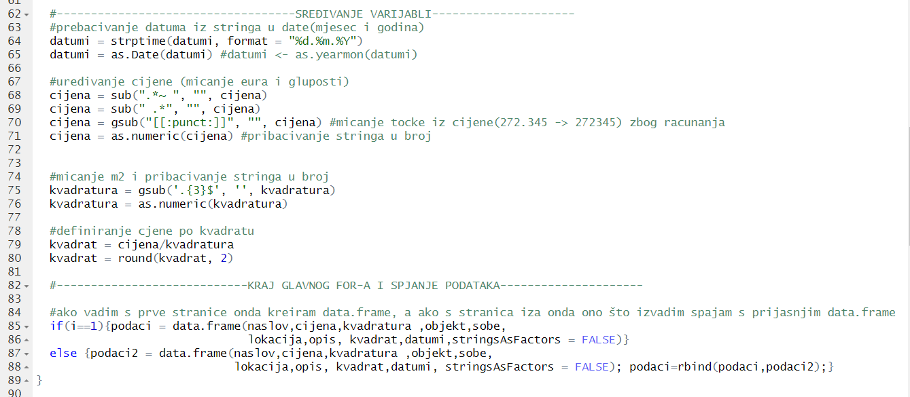

Slide 7
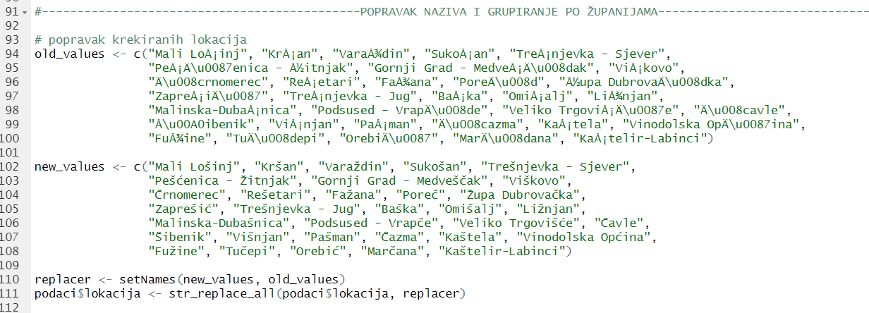

Slide 8
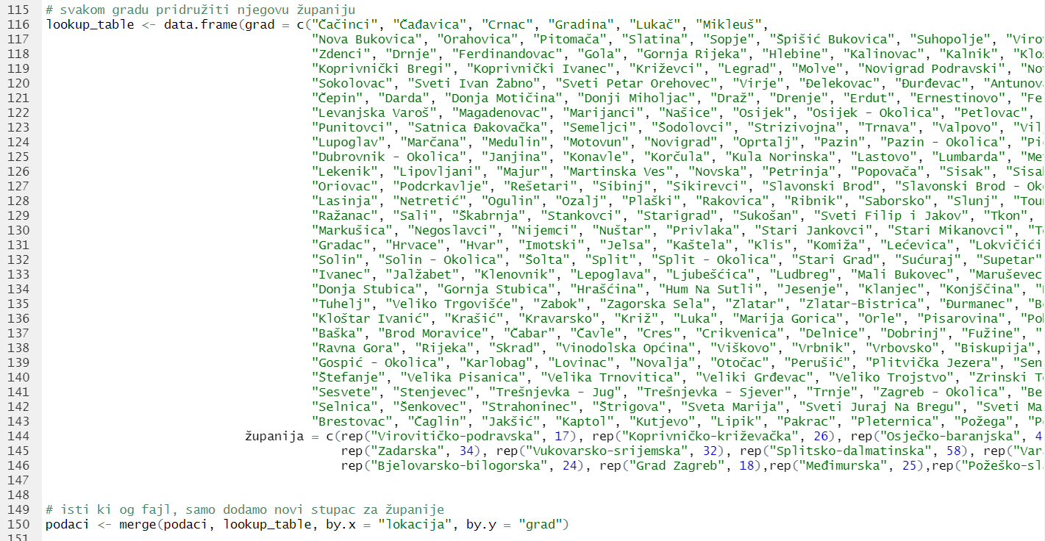

Slide 9
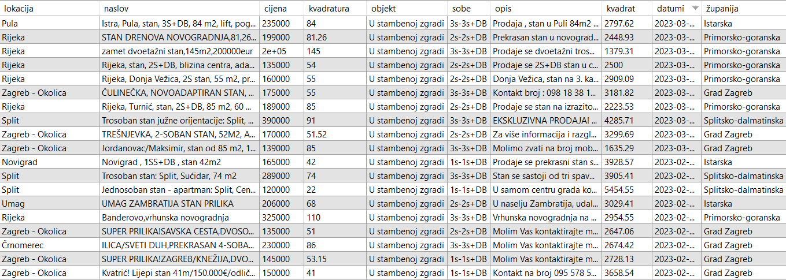
Tablica sa podacima

Slide 10
