Slide 1
TANKIES
PLAY AS GUEST
LOGIN
REGISTER

Slide 2


TANKIES
USERNAME
username123
PASSWORD
********
CONTINUE WITH GOOGLE .
CONTINUE WITH FACEBOOK .
OR
LOGIN

Slide 3







USERNAME123
SILVER:
120 600
GOLD:
80
NEW SHOP ITEMS WITH PRICES
TANKIES
CHATBOX
PLAY
CUSTOMIZE

Slide 4



ONLINE
OFFLINE
1 VS 1
CHATBOX
CASUAL
RANKED .
2 VS 2
USERNAME123
INVITE A FRIEND
2 VS AI
START GAME
FFA

Slide 5


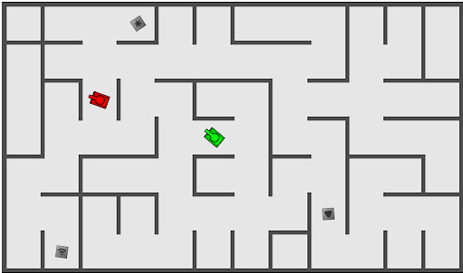
ROUND 4
GOAL: 10 POINTS
USERNAME123
2 : 1
RANDOM321
CHATBOX

