Slide 1


Slide 2
SwiftUI + MVI
Petr Chmelař 23. 3. 2022

Slide 3
Before SwiftUI
UIKit 👴🏼
Storyboards + XIBs 🎨 (or programmatically)
Imperative UI updates

Slide 4
UIKit architectures
MVC: ViewController … 🍝
MVVM: ViewController + ViewModel
VIPER, ReSwift, etc
RxSwift, ReactiveSwift, etc

Slide 5
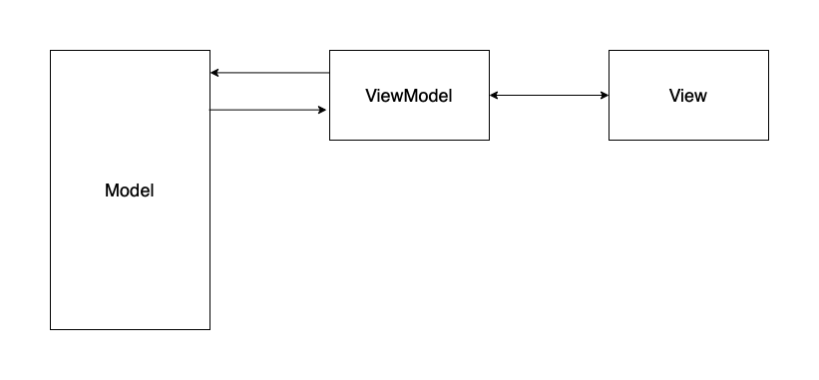
MVVM

Slide 6
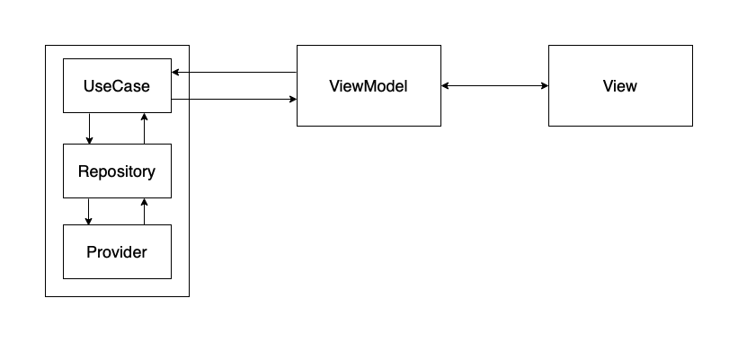
Clean Architecture ?

Slide 7
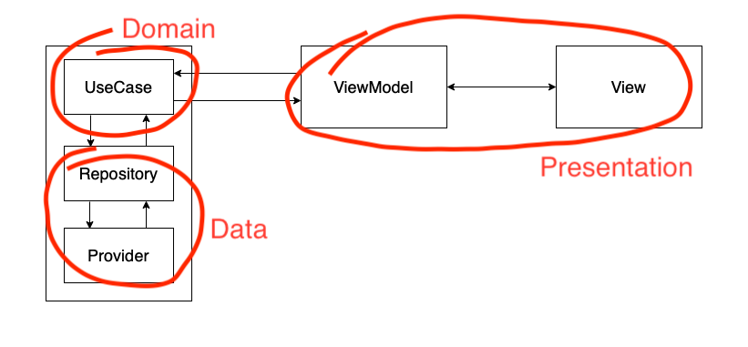
Clean Architecture ?

Slide 8
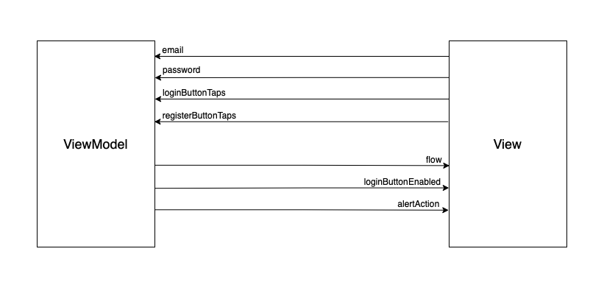
MVVM + RxSwift

Slide 9
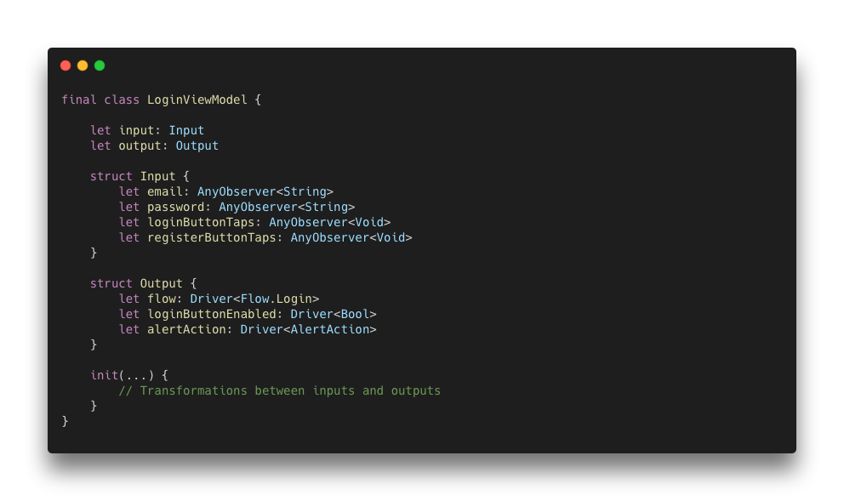
MVVM + RxSwift

Slide 10
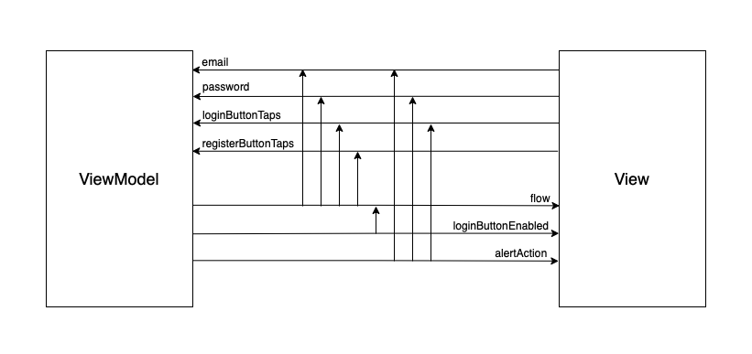
MVVM + RxSwift

Slide 11
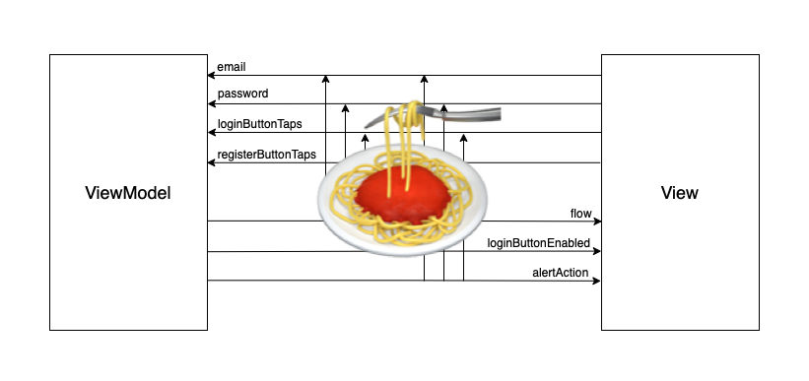
MVVM + RxSwift

Slide 12
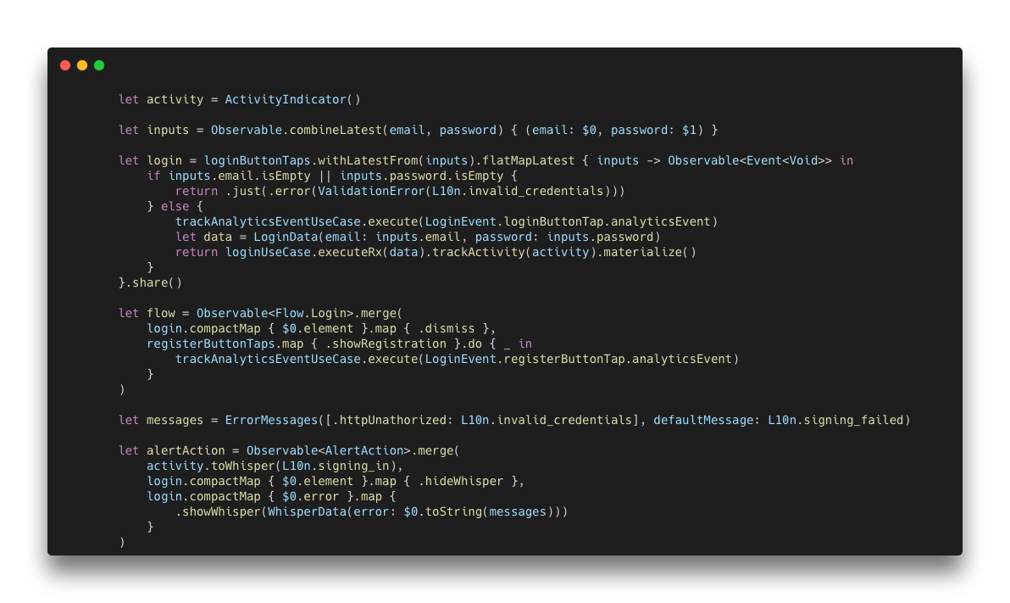
MVVM + RxSwift
🤯

Slide 13
SwiftUI
Since WWDC 2019 (iOS 13)
Live previews
Reactive UI updates 😍

Slide 14
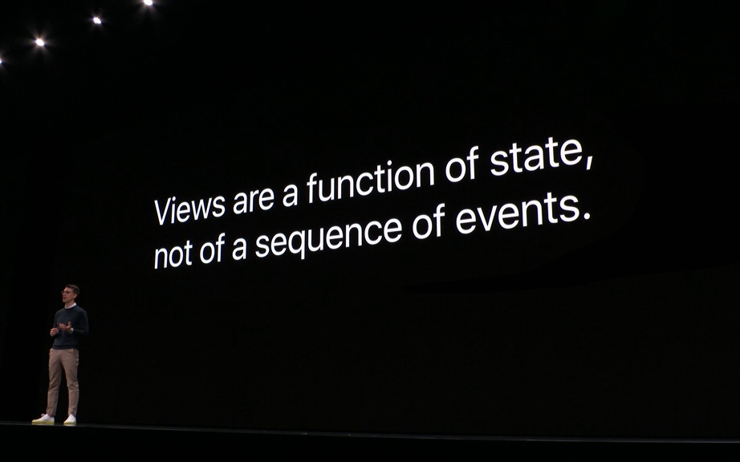
SwiftUI - Declarative framework

Slide 15
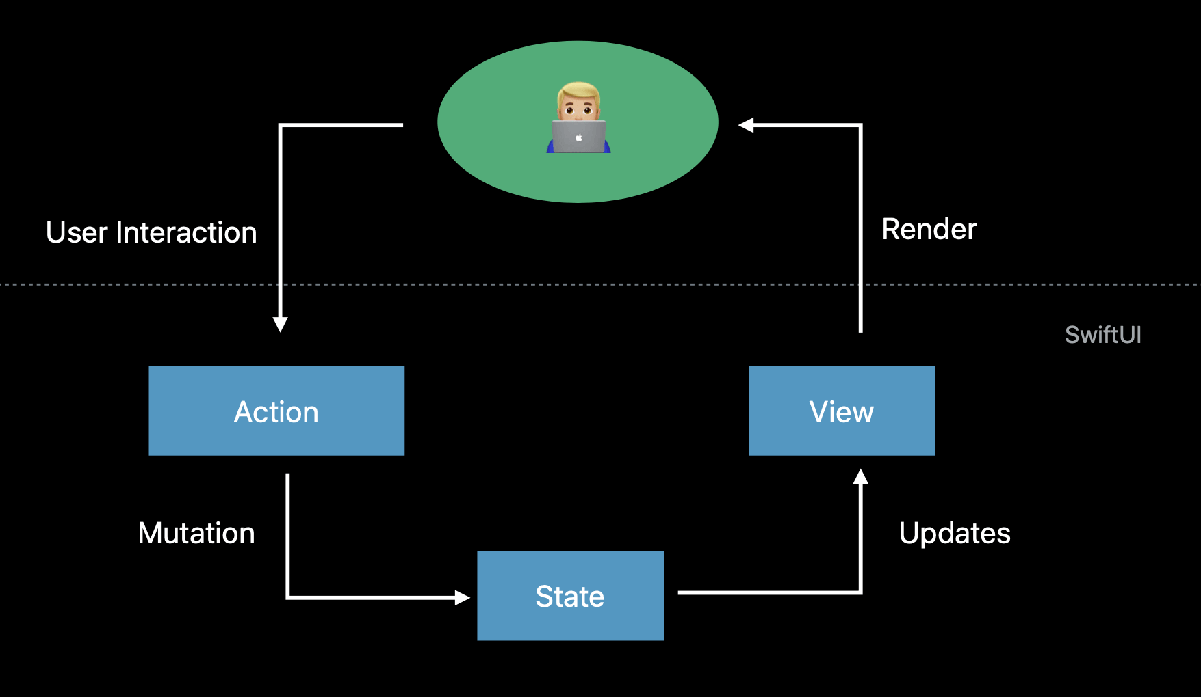
SwiftUI - Declarative framework

Slide 16
SwiftUI architectures
None - everything in Views
MVVM / VIPER / ReSwift / …
Maybe there is something else? 🤔

Slide 17
MVI: Model-View-Intent
Introduced in 2015 for Cycle.js
1) Reactive & Functional
2) Unidirectional Data Flow
3) Immutable State
-> Ideal for declarative UI frameworks 🤝

Slide 18
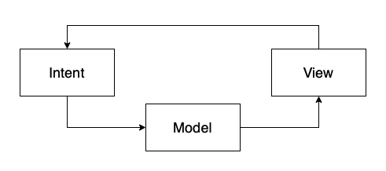
MVI: Model-View-Intent
Model represents a state
View represents the UI (function of state)
Intent represents an intention to perform an action

Slide 19
SwiftUI ❤️ MVI

Slide 20
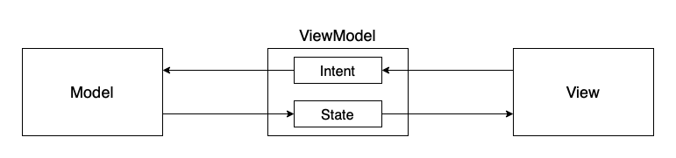
MVI: Model-View-Intent

Slide 21
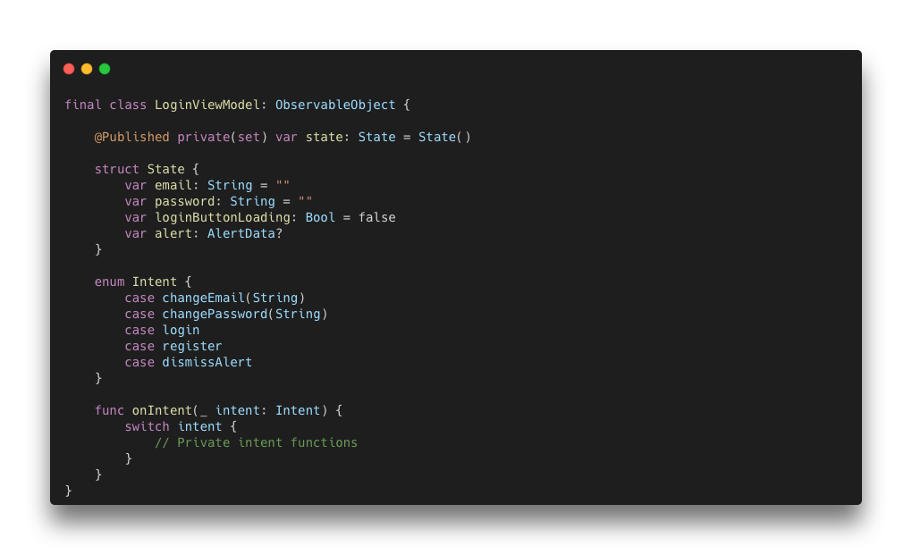
MVI: Model-View-Intent

Slide 22
Demo

Slide 23
https://github.com/MateeDevs

Slide 24
Thank you :)

