Slide 1
Heart Disease Prediction
♥
Using Machine Learning
AI & Machine Learning Project
Python
Scikit-Learn
Google Colab
Pandas & NumPy

Slide 2
Project Overview
🎯
📊
🤖
Goal
Dataset
Approach
Predict whether a patient has heart disease or not based on medical attributes using Machine Learning.
918 patient records with 12 medical features including age, cholesterol, ECG, blood pressure and more.
Train & compare 4 ML algorithms — Logistic Regression, SVM, Decision Tree, Random Forest.

Slide 3
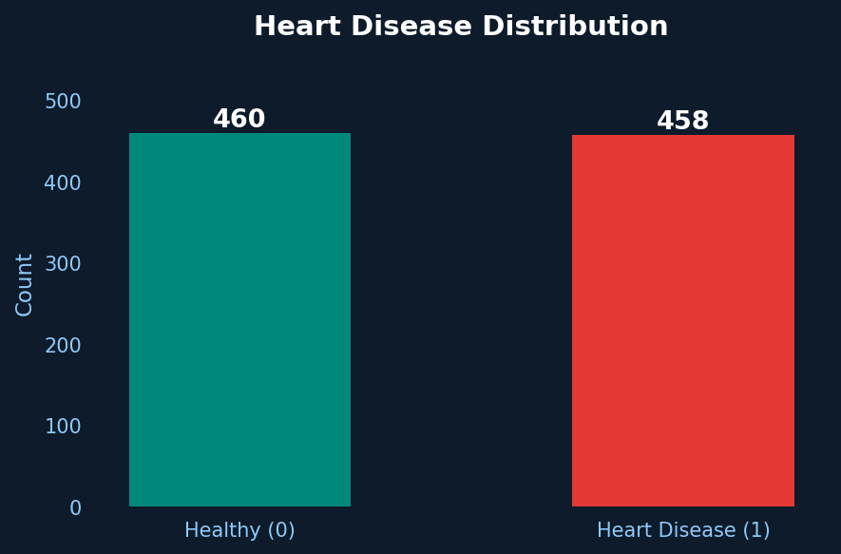
Dataset Information
918
12
80%
20%
Total Records
Features
Train Split
Test Split
Key Medical Features
Heart Disease Distribution
Feature | Description
Age | Patient's age in years
Sex | Male / Female
ChestPainType | Type of chest pain (0-3)
RestingBP | Resting blood pressure
Cholesterol | Serum cholesterol (mg/dl)
MaxHR | Max heart rate achieved
ExerciseAngina | Exercise-induced angina
HeartDisease | Target variable (0/1)

Slide 4
Technologies & Tools
🐍
☁️
🐼
Python
Google Colab
Pandas & NumPy
Core programming language for the entire project.
Cloud-based Jupyter notebook platform used for coding and execution.
Data manipulation, loading, cleaning and numerical computation.
📊
🤖
Matplotlib & Seaborn
Scikit-Learn
Data visualization for EDA charts and graphs.
Machine Learning library for training and evaluating all 4 models.

Slide 5
Project Workflow
01
02
03
04
05
Load Dataset
→
Data Understanding
→
Clean Data
→
Label Encoding
→
EDA
pd.read_csv('heart.csv')
df.info() / df.describe()
Remove nulls & duplicates
LabelEncoder()
Plots & Heatmaps
06
07
08
09
10
Feature Scaling
→
Model Training
→
Evaluation
→
Best Model
→
Prediction
StandardScaler()
4 ML Algorithms
Accuracy / CM / ROC
Random Forest
Final System

Slide 6
Data Preprocessing
🔍
Missing Values
# Code Snippet
df.isnull().sum() — No missing values found.
encoder = LabelEncoder()
cat_cols = [
🗑️
Duplicate Removal
'Sex', 'ChestPainType',
'RestingECG',
df.drop_duplicates(inplace=True)
'ExerciseAngina',
'ST_Slope'
]
🏷️
Label Encoding
for col in cat_cols:
df[col] = encoder\
5 categorical columns encoded: Sex, ChestPainType, RestingECG, ExerciseAngina, ST_Slope
.fit_transform(df[col])
scaler = StandardScaler()
⚖️
X_train = scaler\
Feature Scaling
.fit_transform(X_train)
StandardScaler() applied to normalize all features.

Slide 7
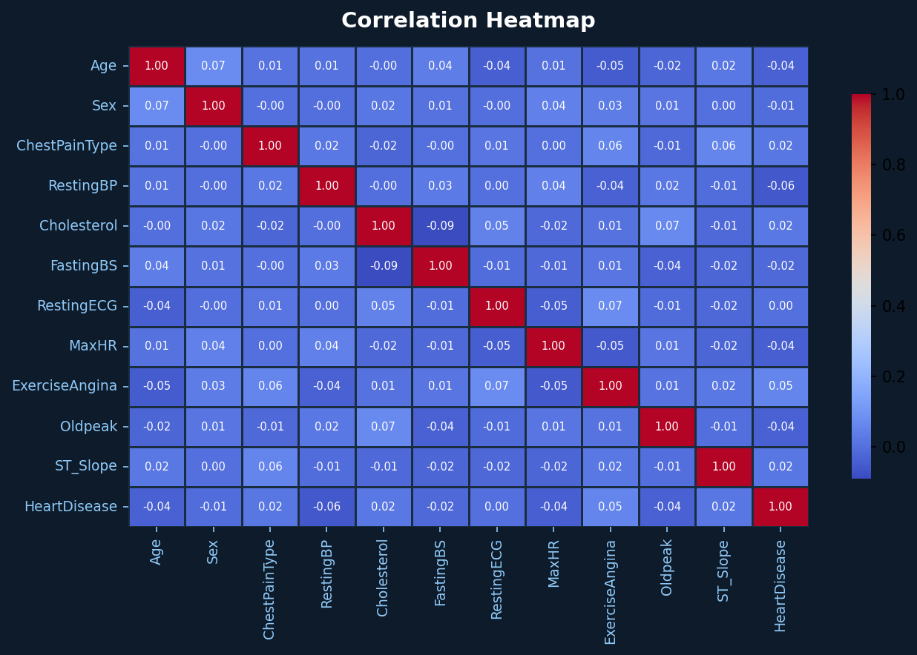
Exploratory Data Analysis (EDA)
Correlation Heatmap
Analyses Performed
📊
Heart Disease Distribution
Count of healthy vs diseased patients
👤
Age Distribution
Histogram with KDE curve
🔥
Correlation Heatmap
Feature relationships heatmap
💔
Chest Pain Analysis
Countplot by heart disease
🩺
Cholesterol Analysis
Boxplot by heart disease class

Slide 8
Machine Learning Models
📈
Logistic Regression
🎯
Support Vector Machine
Binary Classification
SVM — Kernel-based
model = LogisticRegression()
model.fit(X_train, y_train)
preds = model.predict(X_test)
model = SVC(probability=True)
model.fit(X_train, y_train)
preds = model.predict(X_test)
🌳
Decision Tree
🌲
Random Forest
Tree-Based Classifier
Ensemble Learning ⭐
model = DecisionTreeClassifier()
model.fit(X_train, y_train)
preds = model.predict(X_test)
model = RandomForestClassifier()
model.fit(X_train, y_train)
preds = model.predict(X_test)

Slide 9
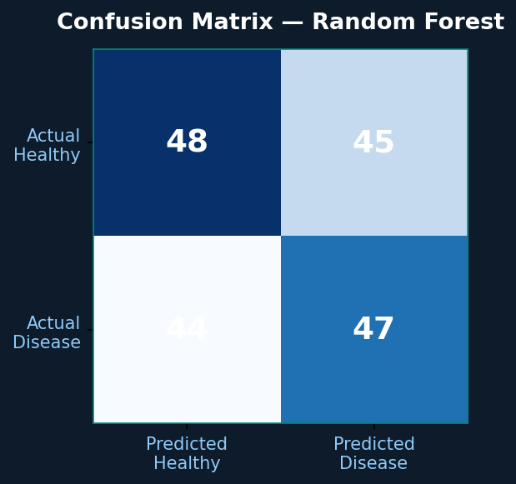
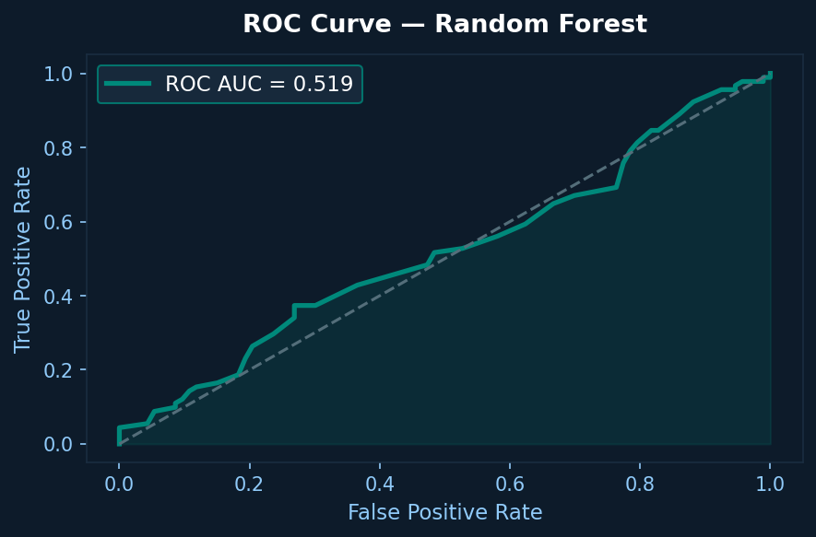
Model Evaluation
Confusion Matrix
ROC Curve
✅ Accuracy Score
📋 Classification Report
🔲 Confusion Matrix
📉 ROC-AUC Curve

Slide 10
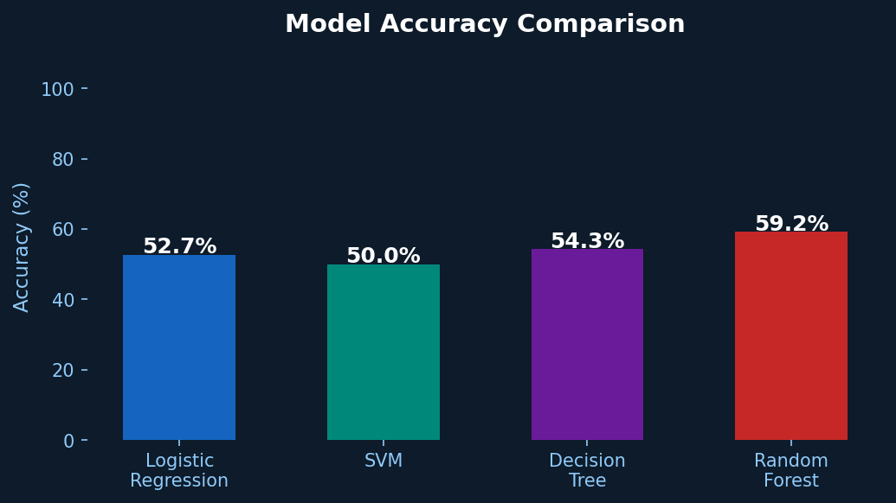
Accuracy Comparison
Model | Performance
Logistic Regression | Good
SVM | Good
Decision Tree | Good
Random Forest ⭐ | BEST
# Best Model Selection
best = max(results,
key=results.get)
print("Best:", best)
# >> Random Forest

Slide 11
Final Prediction System
📝
⚙️
🌲
🩺
→
→
→
Patient Input
Preprocessing
Random Forest
Prediction
11 medical features
Scale & encode
Trained model
Disease: Yes / No
# Sample Prediction
✅
sample = [[48, 1, 2, 130, 245,
0, 1, 150, 0, 1.2, 2]]
sample = scaler.transform(sample)
result = final_model.predict(sample)
if result[0] == 1:
print("Heart Disease Detected")
Output Result
"Heart Disease Detected"
or
"Patient is Normal"

Slide 12
Conclusion
1
Heart Disease Prediction System built using 4 ML algorithms in Python.
2
Dataset: 918 records with 12 medical features — cleaned, encoded and scaled.
3
Random Forest selected as best model after comprehensive comparison.
4
Evaluation: Accuracy Score, Classification Report, Confusion Matrix, ROC Curve.
5
Model saved using Pickle for future deployment in real-world applications.
AI & Machine Learning Project | Python · Scikit-Learn · Google Colab

Slide 13
Thank You
Heart Disease Prediction Using Machine Learning

