Slide 1
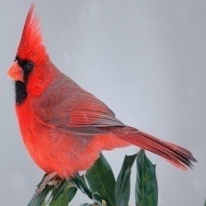
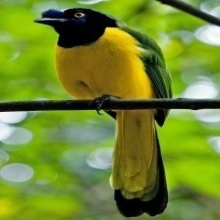
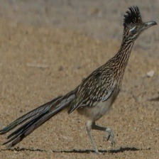
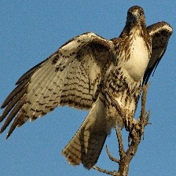
DATA 4380 · DATA PROBLEMS · COMPUTER VISION PROJECT
Which Texas Bird Is It?
Northern Cardinal
Green Jay
Classifying 10 species from a single photo with convolutional neural networks
Mateen Jan · Tej Govindu · Alejandro Alfonso
Instructor: Dr. Masoud Rostami · UT Arlington · November 18, 2026
Roadrunner
Red-tailed Hawk
Notes:
[MATEEN, slide 1: Title]
Good afternoon. We're Mateen, Tej and Alejandro, and our project is called Which Texas Bird Is It?
We trained a computer-vision model to look at one photo and name which of 10 Texas bird species it shows, including three pairs of birds that look almost the same.
I'll cover the problem, the data and how we prepared it. Tej will walk through our baseline and how we improved it, and Alejandro will cover the results, what the model actually looks at, and what we learned.

Slide 2
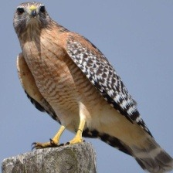
BACKGROUND
Some Texas birds are easy to tell apart; others fool even people
EASY
The problem
vs.
Given one photo, name the species, including birds that look nearly alike.
Why it matters
Bird-ID apps and citizen science (eBird, iNaturalist) turn photos into data ecologists use. A wrong ID is a bad record.
Northern Cardinal
Roadrunner
HARD
Who benefits
vs.
Beginner birders and students, citizen-science projects, researchers sorting large photo sets.
Why we chose it
Visual and fun, uses this unit's CNNs and transfer learning, and lookalikes make it a real challenge.
Red-tailed Hawk
Red-shouldered Hawk
2
Notes:
[MATEEN, slide 2: Background and motivation]
Identifying a bird from a photo is harder than it sounds. Anyone can tell a cardinal from a roadrunner, but two hawks, or a crow and a grackle, look almost the same at a glance. That's the problem we're solving: given one photo, name the species.
It matters because bird sightings are real data. Citizen-science apps like eBird and iNaturalist collect huge numbers of photos from regular people, and ecologists use them to track where species live and how populations change. A misidentified bird is a bad data point.
It helps beginner birders and students learning their local birds, the citizen-science projects that need clean records, and researchers sorting large photo collections.
We chose it because it's visual and fun, it uses the CNNs and transfer learning from this unit, and the lookalike pairs make it a real challenge instead of an easy yes-or-no.

Slide 3
PREVIOUS WORK
Earlier work told us to use a pretrained model, and to check what it looks at
 | Merlin Photo ID (Cornell Lab) | CUB-200-2011 (Wah et al., 2011) | BIRDS 525 projects (e.g., EfficientNet-B2) | Shortcut learning (Geirhos et al., 2020)
What / data | Bird-ID app; millions of eBird photos | Benchmark: 200 lookalike species, 11,788 photos | Our dataset, all 525 species | Review of models that 'cheat'
Method | Deep CNN + location and date | Original baselines, later deep CNNs | Fine-tuned ImageNet model | Wolf vs. husky model used snow
Found | Right bird in top 3 ~90% of the time | Baselines only 10–17%; fine-grained is hard | ~99% on clean, centered photos | High scores can come from background
How ours compares | Same task, 10 species, photo only | Same lookalike problem, smaller scale | Smaller, faster MobileNetV2 | We check with Grad-CAM heatmaps
Sources: Cornell Lab of Ornithology (n.d.); Wah et al. (2011); Piosenka (2023); Geirhos et al. (2020); Ribeiro et al. (2016). Full list on slide 20.
3
Notes:
[MATEEN, slide 3: Previous work]
Four pieces of earlier work shaped our project.
Merlin Photo ID, from the Cornell Lab of Ornithology, is a deep neural network trained on millions of birders' photos. It also uses where and when the photo was taken, and it gets the right bird in its top three about 90% of the time. Lesson: even the best system needs help on hard species.
CUB-200-2011 is the standard research benchmark for telling similar birds apart, with 200 species. Its original baselines got only 10 to 17% accuracy, which shows how hard fine-grained bird ID is.
Projects on our exact dataset fine-tuned large ImageNet models and reported about 99% accuracy, because the photos are clean and centered.
And research on shortcut learning shows models can score well for the wrong reason, like a famous wolf-versus-husky classifier that was really detecting snow.
So compared with these, we use a small, fast pretrained model, we focus on the lookalike pairs, and we check what the model actually looks at.

Slide 4
PROBLEM STATEMENT
Our question: can a CNN name the bird, even when species look alike?
"Can a convolutional neural network identify 10 common Texas bird species from a single photo,
and does it struggle most with birds that look alike?"
TARGET
TASK
UNIT
MAIN METRIC
Species (10 classes)
Multi-class classification
One photo, 224 × 224
Macro F1
1
Build a baseline before improving anything
2
Improve one step at a time; report what each step does, even if it doesn't help
3
Evaluate the final model once, on held-out test photos
4
Find where mistakes happen and what the model looks at
Success means: clearly beating the baseline, and being able to explain the mistakes the model still makes.
4
Notes:
[MATEEN, slide 4: Problem statement and objectives]
Our question: can a convolutional neural network identify 10 common Texas bird species from a single photo, and does it struggle most with birds that look alike?
The target is the species. It's multi-class classification with 10 classes, one prediction per photo. Our main metric is macro F1, the F1 score averaged over all 10 species, so every bird counts equally.
We set four objectives: build a baseline before improving anything; improve one step at a time and report what each step does, including the ones that don't help; evaluate the final model once on held-out test photos; and check where the mistakes happen and what the model looks at.
Success means clearly beating the baseline, and being able to explain the mistakes the model still makes.

Slide 5
DATA UNDERSTANDING
Data
›
Min. prep
›
Baseline
›
Improve
›
Models
›
Evaluate
1,710 photos of 10 species: clean, balanced, nothing missing
SOURCE
BIRDS 525 (Piosenka), CC0 public domain; Hugging Face mirror
ROWS
1,710 photos (one row = one photo)
FEATURES
Pixels: 224 × 224 × 3 colors ≈ 150,000 numbers, all numeric
TARGET
Species label, 10 classes
MISSING
None: every file opened, every photo labeled
Quality checks
• 0 broken files · 0 exact duplicates
• 22 outliers (1.3%): very dark, bright or high-contrast. Inspected: real photos (night sky, snow), so kept
Photos per species (all splits). Largest ÷ smallest = 1.49
5
Notes:
[MATEEN, slide 5: Dataset and data understanding]
Our data is BIRDS 525, a public image dataset of 525 species by Gerald Piosenka. The original Kaggle page has been taken down, so we used an identical public copy on Hugging Face. It's licensed CC0, which is public domain.
We kept 10 species that live in Texas: 1,710 photos. In table terms, each row is one photo. Its features are the pixels: 224 by 224 by 3 colors, about 150,000 numbers. The one label is the species. There's no missing data: every image opened and every image has a label.
The chart shows photos per species: 142 to 212 each, so the classes are fairly balanced, unlike our Dallas project.
On the right are our quality checks: no broken files and no exact duplicates. We also flagged 22 outliers: unusually dark, bright or high-contrast photos. We looked at every one. They're real photos against night skies, snow or bright sky, not errors, so we kept them.
That also matters for cleaning: in our Dallas project we had to drop over 124,000 rows with no due date. Here every photo is usable, so cleaning was about checking quality, not filling gaps.

Slide 6
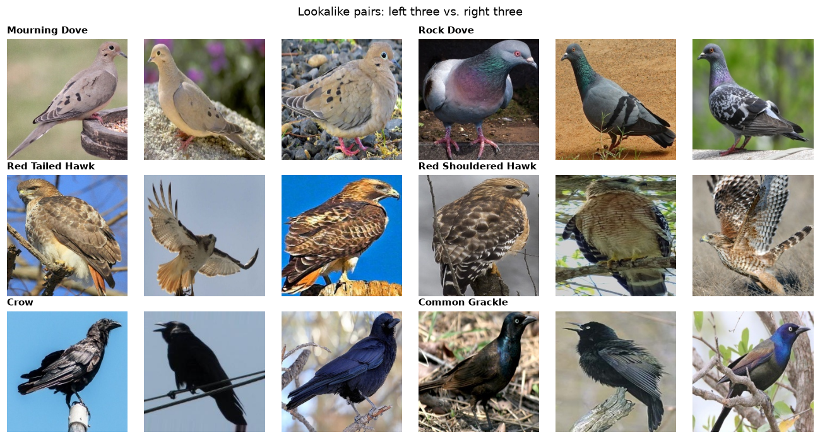
EDA
Data
›
Min. prep
›
Baseline
›
Improve
›
Models
›
Evaluate
Two findings shaped our plan: lookalike pairs, and hawks shot against sky
Share of photo border that is blue sky
Expected: most mistakes will fall inside these three pairs.
Expected but didn't find: duplicates or broken files in web-collected data.
Surprise: hawks ≈ ⅓ sky. Risk of learning "sky = hawk" → we check with Grad-CAM later.
6
Notes:
[MATEEN, slide 6: Exploratory data analysis]
Two things we found here shaped what we did next.
On the left are our three lookalike pairs: the Mourning Dove and Rock Dove, the Red-tailed and Red-shouldered Hawk, and the Crow and Common Grackle. A person can tell them apart by small details, like the grackle's yellow eye or the red-shouldered hawk's barred orange chest. We expected most of the model's mistakes to land inside these pairs.
On the right is what surprised us. We measured how much of each photo's border is blue sky. For both hawks it's about a third; for the Green Jay and Roadrunner it's 3 to 5%. A model could cheat by learning 'sky means hawk' instead of learning what a hawk looks like. That's called shortcut learning, and because of this chart we added heatmaps at the end to check where the model looks.
What we expected but didn't find: we expected a web-collected dataset to have duplicates or broken files. It had none.
We also checked whether the outliers favor one species. They're spread across all 10, with a few more among the dark birds, the crow and grackle, so they don't give the model an unfair hint about any one species.

Slide 7
MINIMUM PREPROCESSING
Data
›
Min. prep
›
Baseline
›
Improve
›
Models
›
Evaluate
Before the baseline, only what it couldn't run without
Quality checks
Stratified split
Resize
Scale pixels
broken, duplicate,
outlier photos
70 / 15 / 15,
seed 42
128 px for the
from-scratch CNN
0–255 → 0–1
Our split (the original test set had only 5 photos per species)
Held back for later (slides 9–10)
Train
1,197
256
257
• Data augmentation
• Full 224 px + ImageNet pixel scaling (−1…1)
• Pretrained features
Train: teaches the model
Validation: chooses between models
Test: used once, at the end
Stratified: every species keeps the same share in each split (~25 test photos per bird). No photo appears in two splits.
So each step's effect can be measured on its own.
7
Notes:
[MATEEN, slide 7: Minimum preprocessing]
Before the baseline, we did only what it couldn't run without.
First, the quality checks you just saw. Second, the split. The original dataset has only 5 test photos per species, so one mistake would swing accuracy by 2 points. We pooled all 1,710 photos and made our own stratified split: 70% train, 15% validation, 15% test, about 25 test photos per bird. Stratified means every species keeps the same share in each split, and a fixed random seed means anyone gets the same split.
Stratifying matters here because our smallest class, the Rock Dove, has only 142 photos. A purely random split could leave it with too few test photos to measure.
Third, for the baseline we shrank photos to 128 pixels so it trains quickly on a laptop, and scaled pixel values from 0–255 down to 0–1, which neural networks need.
Everything else we held back, so Tej can show what each step adds. And the rule throughout: training photos teach, validation photos choose, and test photos are used once, at the very end.
(Hand off: "Tej?")

Slide 8
BASELINE
Data
›
Min. prep
›
Baseline
›
Improve
›
Models
›
Evaluate
Our baseline CNN gets 61%: far above guessing, but 4 in 10 birds wrong
Photo
128×128×3
→
Conv 32
+ pool
→
Conv 64
+ pool
→
Conv 128
+ pool
→
Conv 128
+ pool
→
Avg + dropout
30%
→
Softmax
10 birds
Simple CNN: filters find edges → textures → beaks and wings; pooling shrinks the image between blocks. 242,122 weights, trained from scratch.
Majority guess
Baseline CNN
Why macro F1?
always "Red-tailed Hawk"
minimum preprocessing only
• F1 balances precision and recall for each species
• Macro = average over all 10 species equally
• A model can't score well by ignoring one bird
• CNN assumes: nearby pixels are related; a pattern means the same anywhere
0.02
0.61
validation macro F1
12.5% accuracy
validation macro F1
60.9% accuracy
8
Notes:
[TEJ, slide 8: Baseline model]
Thanks, Mateen. Our baseline has two parts.
First, the floor: always guess the most common species, the Red-tailed Hawk. That gets 12.5% accuracy and a macro F1 of 0.02. Any real model has to beat this.
Our real baseline is a simple CNN, a convolutional neural network, the standard starting point for images. It has four convolution blocks. Each one slides small filters over the photo to find edges, then textures, then shapes like beaks and wings, and pooling shrinks the image between blocks. At the end, a softmax layer gives a probability for each of the 10 birds.
A CNN assumes nearby pixels are related, and that a pattern means the same thing anywhere in the photo.
We use macro F1 because it averages all 10 species equally, so a model can't score well by ignoring one bird.
The baseline reaches a validation macro F1 of 0.61, about 61% accuracy. It's clearly learning, but it still gets about 4 in 10 birds wrong.
How we trained it: the Adam optimizer, up to 30 epochs, where one epoch is one pass through all 1,197 training photos, and early stopping that watches validation loss and keeps the best version. At the end, training accuracy was 68% and validation 63%. Those are close, so it isn't overfitting. If anything it was still learning when it hit the limit.

Slide 9
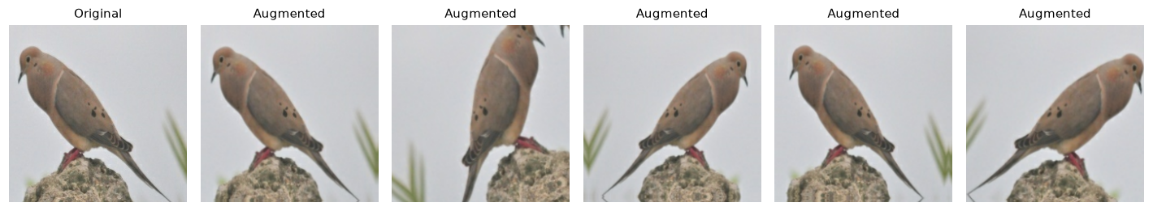
ADDITIONAL PREPROCESSING
Data
›
Min. prep
›
Baseline
›
Improve
›
Models
›
Evaluate
Data augmentation did not help, for either model
Training photos only: random flip · rotation ±36° · zoom ±10% · contrast ±20%. Validation and test photos are never changed.
Simple CNN
MobileNetV2 (slide 10)
Why? ~120 photos per bird; random changes make learning from scratch harder. Photos are already clean and centered.
without
with augmentation
without
with augmentation
0.608
0.558
0.964
0.956
Validation macro F1
9
Notes:
[TEJ, slide 9: Additional preprocessing: augmentation]
Our first improvement attempt was data augmentation: randomly flipping, rotating, zooming and changing the contrast of training photos, so the model sees more variety. Each choice fits birds: a bird facing left is the same species facing right, and birds are photographed at angles and in different light. It only applies to training photos.
Same CNN, same settings; augmentation was the only change. It didn't help: validation F1 went down, from 0.61 to 0.56.
To keep it fair, everything else stayed identical: same random seed, same architecture, same optimizer, same early stopping. On the training curves, in our backup slides, its validation accuracy bounced between about 48 and 55% while training accuracy kept climbing slowly.
Our explanation: with only about 120 photos per bird, a small network learning from scratch already struggles, and random changes make the task harder. It would need much longer training to benefit.
Later we ran the same check on the pretrained model: 0.956 with augmentation and 0.964 without. So augmentation didn't help either model, probably because these photos are already clean and centered. We didn't expect that, and we kept it in.

Slide 10
FEATURE ENGINEERING
Data
›
Min. prep
›
Baseline
›
Improve
›
Models
›
Evaluate
Swapping in pretrained features took F1 from 0.61 to 0.96
From scratch (baseline)
0.61
~1,200 of our photos
→
learn features
from scratch
→
242,122 weights
trained
→
validation macro F1
Transfer learning
0.96
~1.3 million
ImageNet photos
→
MobileNetV2 features
(frozen)
→
new 10-bird layer:
12,810 weights trained
→
validation macro F1
Images have no hand-made columns: the CNN learns its own features. Our feature decision was where they come from. Same photos, split and metric; only the features changed.
10
Notes:
[TEJ, slide 10: Feature engineering: transfer learning]
In a table, feature engineering means creating columns by hand. With images, a CNN learns its own features from the pixels. So our feature-engineering decision was where those features come from.
Our baseline learned its features from scratch, from about 1,200 photos. MobileNetV2 has already learned general visual features, like edges, textures, feathers and eyes, from about 1.3 million ImageNet photos, including many birds. Reusing them is called transfer learning.
We removed MobileNetV2's original 1,000-category output layer, froze everything else, and trained only a new 10-bird layer: 12,810 weights instead of the baseline's 242,000.
That one change took validation F1 from 0.61 to 0.96. Same photos, same split; the only difference is where the features come from. It's by far the biggest gain in the project.
Why does this work so well? The early layers of any image network learn general things, like edges, color blobs and textures, that are useful for almost any photo. Only the last step has to learn which combination of those means 'grackle' instead of 'crow'. And because those layers are frozen, they can't overfit to our small dataset.
Features we did not add: location and date, which Merlin uses. That's a future-work idea.

Slide 11
MODEL SELECTION
Data
›
Min. prep
›
Baseline
›
Improve
›
Models
›
Evaluate
Two model families, each with a clear reason to be there
 | Why we chose it | Strengths | Limitations | Preprocessing
Simple CNN | Standard first model for images; honest baseline | Transparent; small; trains from scratch | Needs far more data than ~120 photos/bird | 128 px, pixels 0–1
MobileNetV2, frozen | Small, fast pretrained CNN built for phones | Strong features from little data; ~4 min on a laptop | Assumes ImageNet features transfer; inherits its biases | 224 px, pixels −1…1
MobileNetV2, fine-tuned | Let top layers adapt to our 10 birds | More flexible | 1.5M trainable weights → overfits small data | Same, very small learning rate
Why not logistic regression or random forest? On raw pixels they treat 49,152 pixels as unrelated columns and ignore the image's 2-D structure.
11
Notes:
[TEJ, slide 11: Model selection]
We compared two families of models. Why not logistic regression or a random forest? On raw pixels they treat each pixel as an unrelated column and ignore the image's 2-D structure, so CNNs are the standard choice for photos.
The simple CNN is the most transparent model, small enough to train from scratch, and it's our honest baseline. Its weakness is that it needs far more data than we have. It needs pixels scaled to 0–1.
MobileNetV2 is small and fast, built for phones, so it trains on a laptop in about 4 minutes, and it brings pretrained features. Its weakness: it assumes ImageNet features transfer to our photos, and it inherits ImageNet's biases. It needs full 224-pixel images scaled to minus 1 to 1.
We ran MobileNetV2 two ways: frozen, where we train only the new output layer, and fine-tuned, where we also retrain its top layers with a very small learning rate.
To keep the comparison fair, every model was trained the same way: the Adam optimizer, cross-entropy loss, and early stopping on validation loss. Only the model changed.

Slide 12
MODEL IMPROVEMENT
Data
›
Min. prep
›
Baseline
›
Improve
›
Models
›
Evaluate
Every step changes one thing; only transfer learning moved the needle
Helped
Pretrained MobileNetV2 features: 0.608 → 0.956
Didn't help
Augmentation (both models) and fine-tuning
Surprise
Fine-tuning stopped after ~4 epochs: validation loss rose right away. 1.5M weights + 1,200 photos = memorizing
Validation macro F1 · dark blue = final model · red = a step that made things worse
12
Notes:
[TEJ, slide 12: Model improvement]
This chart shows every step on the validation set, and each bar changes one thing.
From left: guessing, 0.02. The baseline CNN in orange, 0.61. Adding augmentation, down to 0.56. Switching to pretrained MobileNetV2, up to 0.956. Removing augmentation, 0.964, the highest. And fine-tuning the top layers, 0.96, no better.
So we can credit the improvement to one decision: transfer learning. Two of our attempts didn't help, augmentation and fine-tuning, and we report both.
Fine-tuning not helping surprised us. Early stopping ended those runs after about 4 epochs, which means validation loss started getting worse right away. With only 1,200 photos, unfreezing 1.5 million weights gives the model room to memorize instead of learn.
You can see the opposite with the frozen model in our backup slide: its training and validation accuracy stay right together, around 95%, which means it isn't overfitting at all.

Slide 13
HYPERPARAMETER TUNING
Data
›
Min. prep
›
Baseline
›
Improve
›
Models
›
Evaluate
Tuning on validation picked the default settings: no gain
Grid search: 2 × 2 = 4 runs, validation macro F1
Unfrozen layers (30 vs. 60)
Learning rate
More layers = more flexibility, but more risk of overfitting ~1,200 photos
1e-5
3e-5
Top 30
layers
0.960
best = default
0.931
Learning rate (1e-5 vs. 3e-5)
Too high wrecks the pretrained weights; too low barely changes them
Top 60
layers
0.955
0.939
Before vs. after tuning
• Default (30 layers, 1e-5): 0.960
• Best of grid: 0.960, the same setting
• Higher learning rate hurt: 0.931–0.939
• Still below the frozen model (0.964)
Each run starts from the same frozen model and is scored on validation only. The test set never chose anything.
13
Notes:
[TEJ, slide 13: Hyperparameter tuning]
We tuned the fine-tuning step, because that's where the settings matter most. Two hyperparameters: how many of MobileNetV2's top layers to unfreeze, 30 or 60, because more layers means more flexibility but more risk of overfitting; and the learning rate, 1e-5 or 3e-5, because too high a rate wrecks the pretrained weights.
We used a grid search, all four combinations. Each started from the same frozen model and was scored on the validation set only. The test set was never used to choose anything.
Why grid search and not randomized search? With only four combinations, we can simply try them all. Randomized search makes sense when there are too many combinations to try.
Before and after: the default, 30 layers at 1e-5, scored 0.960, and it was also the best combination, so tuning changed nothing. The higher learning rate hurt: 0.93 to 0.94.
Tuning doesn't guarantee improvement, and here it confirmed that the simpler frozen model was already enough.
(Hand off: "Alejandro?")

Slide 14
EVALUATION
Data
›
Min. prep
›
Baseline
›
Improve
›
Models
›
Evaluate
On 257 unseen test photos, the final model is right 96% of the time
Model (test set) | Accuracy | Precision | Recall | F1 | ROC-AUC | Val. F1
Majority guess | 12.5% | 0.012 | 0.100 | 0.022 | 0.500 | 0.022
Baseline CNN | 68.5% | 0.717 | 0.686 | 0.679 | 0.957 | 0.608
CNN + augmentation | 55.6% | 0.588 | 0.552 | 0.559 | 0.923 | 0.558
MobileNetV2 + augmentation | 93.4% | 0.948 | 0.937 | 0.936 | 0.999 | 0.956
MobileNetV2, no aug. (FINAL) | 96.1% | 0.964 | 0.964 | 0.964 | 0.999 | 0.964
Fine-tuned (default) | 95.3% | 0.958 | 0.955 | 0.955 | 0.999 | 0.960
Fine-tuned (tuned) | 95.3% | 0.958 | 0.955 | 0.955 | 0.999 | 0.960
Precision, recall, F1, ROC-AUC = macro averages over the 10 species. Baseline row shaded.
Chosen on validation, before this table: highest validation F1; ties (≤ 0.005) go to the simpler model. The final model was best and simplest.
14
Notes:
[ALEJANDRO, slide 14: Model evaluation and comparison]
Thanks, Tej. Here's every model on the same 257 test photos, which none of them trained on.
We chose the final model before looking at this table, using validation macro F1, with one rule set in advance: if models are within 0.005 of each other, less than one photo, keep the simpler one. MobileNetV2, frozen, without augmentation, had the highest validation F1 and the fewest trained weights, so it's our final model.
A quick guide to the columns: accuracy is the share of photos labeled correctly. Precision asks: when the model says 'crow', how often is it right? Recall asks: of the real crows, how many did it find? F1 balances the two, and ROC-AUC measures how well it ranks the right species above the others. All of them are averaged over the 10 species.
On test it gets 96.1% accuracy and a macro F1 of 0.964, compared with 0.68 for the baseline CNN and 0.02 for guessing. Precision and recall are both about 96%, so it isn't trading one for the other.
One row worth noticing: MobileNetV2 with augmentation scored 0.956 on validation but 0.936 on test. With only about 25 photos per species, scores can move a couple of points between sets, so we don't read too much into small gaps.
Test scores line up with validation for every model, so our choices weren't overfit to the validation set. The fine-tuned model also does well here, 0.955, but switching now would mean choosing by the test set.

Slide 15
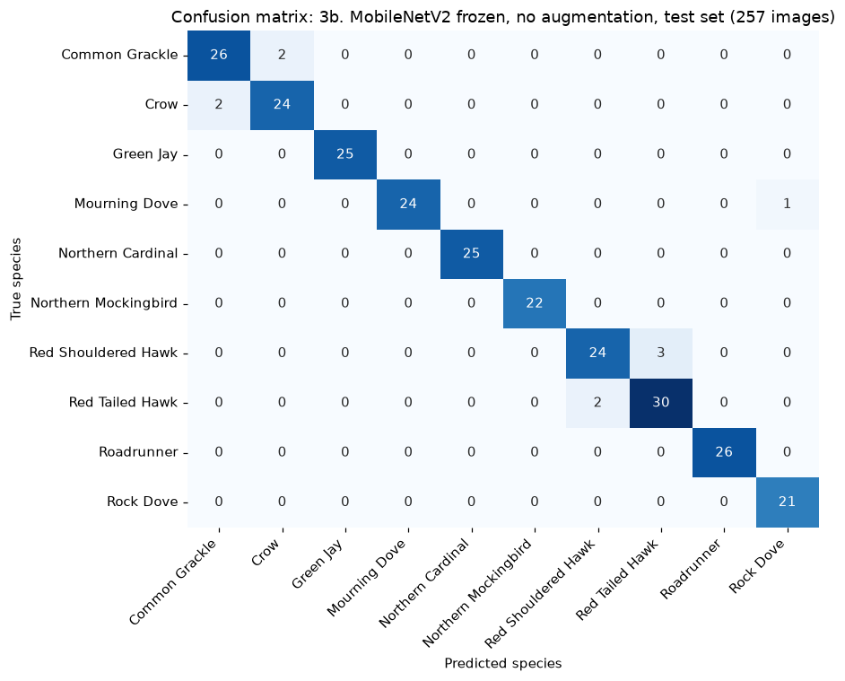
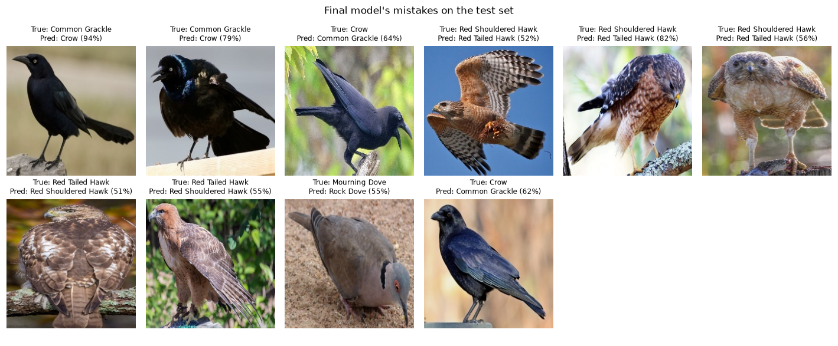
INTERPRETATION
Data
›
Min. prep
›
Baseline
›
Improve
›
Models
›
Evaluate
All 10 mistakes are between lookalike species, just as we expected
10
mistakes out of 257 test photos
10 / 10
inside a lookalike pair:
5 hawks · 4 crow/grackle · 1 dove
81
baseline mistakes, 49 outside the pairs
7 of 10 mistakes had confidence under 65%: the model is usually unsure when wrong.
15
Notes:
[ALEJANDRO, slide 15: Interpretation: what it gets wrong]
This is the final model's confusion matrix on the test set: the true species down the side, the predicted species across the top. Almost everything is on the diagonal.
It made 10 mistakes out of 257, and every one is inside a lookalike pair: 5 between the two hawks, 4 between the crow and the grackle, and 1 between the doves. No random mistakes, like calling a cardinal a hawk. The baseline made 81 mistakes, and 49 of those were outside the pairs.
Per species, four birds are perfect on the test set: the cardinal, green jay, roadrunner and mockingbird. The lowest are the two hawks and the black birds, around 0.91 to 0.93, exactly the pairs we predicted back on slide 6.
On the right are some of them, and they're understandable: a hawk seen from behind hides the chest and tail colors that separate the species, and a grackle in dull light loses its purple sheen and looks like a crow.
7 of the 10 mistakes had confidence under 65%, so the model is usually unsure when it's wrong. A real app could say 'not sure' instead of guessing.

Slide 16
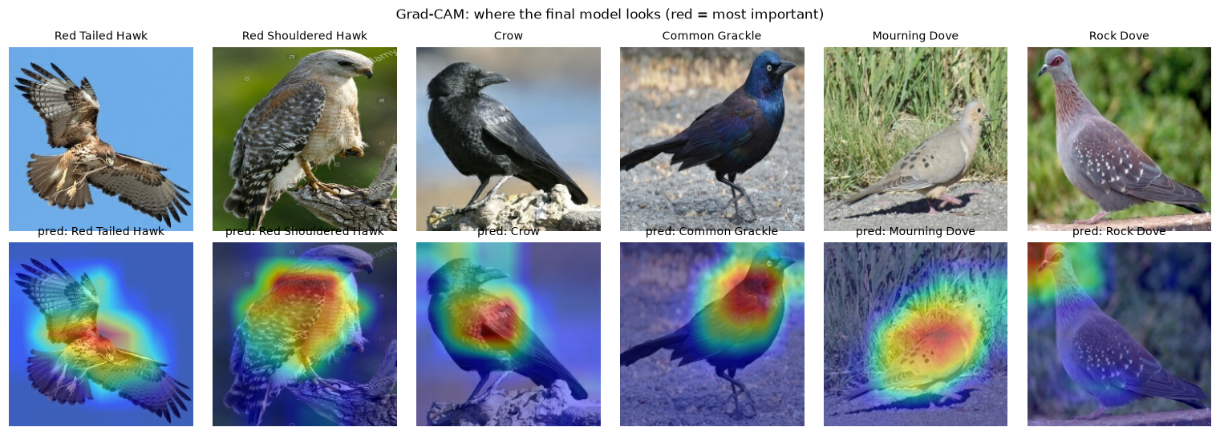
INTERPRETATION
Data
›
Min. prep
›
Baseline
›
Improve
›
Models
›
Evaluate
The model looks at the bird, not the sky
Across all 257 test photos: the outer frame is 49% of each image but gets only 17%–34% of the heatmap. Hawks: 27% and 23%.
Exception: the rock dove (far right) looks like a different pigeon: possible label error.
16
Notes:
[ALEJANDRO, slide 16: Interpretation: where it looks (Grad-CAM)]
Remember the sky problem: hawks are photographed against sky far more often. So we checked what the model actually looks at, using Grad-CAM. It colors the parts of the photo that pushed the model toward its answer; red means most important.
The top row is the original photo, and the bottom row is the same photo with the heatmap on top.
For the hawks, crow and grackle here, the heat sits on the bird's body: the chest, the tail, the head. That's the plumage that really separates these species.
We also measured it across all 257 test photos. The outer frame is about half of each image, but it gets only 17 to 34% of the heatmap for every species, including both hawks. So the model mostly looks at the bird, not the background.
One exception, on the far right: for this rock dove it focused on the corner. That bird also looks like a different pigeon species, which points to some label errors in the data.

Slide 17
KEY FINDINGS
Yes: a pretrained CNN names these birds, and fails only on true lookalikes
1
Baseline
2
What helped
Simple CNN: macro F1 0.61, far above guessing (0.02), but 4 in 10 birds wrong.
Transfer learning gave essentially the whole gain (0.61 → 0.96). Augmentation and fine-tuning didn't help.
3
Final model
4
Mistakes
Frozen MobileNetV2: 96.1% test accuracy, macro F1 0.964.
All 10 errors are between lookalikes, and the model looks at the bird, not the sky.
The insight: with small data, reusing what a big model already learned beat everything we tuned ourselves.
17
Notes:
[ALEJANDRO, slide 17: Key findings]
Back to our four objectives.
One, the baseline: a simple CNN reached a macro F1 of 0.61, far above guessing, but it got 4 in 10 birds wrong.
Two, what helped: transfer learning gave essentially the whole improvement, 0.61 to 0.96. Augmentation and fine-tuning didn't help.
Three, the final model, frozen MobileNetV2, names 96% of test photos correctly, with a macro F1 of 0.964.
Four, its mistakes are all between lookalike species, the same pairs a beginner birder would mix up, and it looks at the bird rather than the sky.
So yes, a CNN can identify these 10 Texas birds from one photo, and when it fails, it fails for understandable reasons. The insight: with small data, reusing what a big model already learned beats anything we tuned ourselves.

Slide 18
LIMITATIONS
96% here does not mean 96% in a Texas backyard
Clean, web-sourced photos
Cropped and centered; real backyard or trail-camera photos are blurrier and farther away.
Only 10 species
The model always picks one of the 10. Show it a penguin and it names a Texas bird.
Label noise
A few photos look mislabeled (a 'mourning dove' with a collared dove's neck ring).
Small test set, one split
~25 photos per species: one photo moves a species' score by ~4 points.
Inherited bias
MobileNetV2 brings ImageNet's biases; Grad-CAM shows where it looks, not why.
18
Notes:
[ALEJANDRO, slide 18: Limitations]
We want to be clear about what this does not show.
First, the photos are clean, cropped and centered, and many come from the web. Real backyard or trail-camera photos are blurrier and farther away, so 96% here does not mean 96% in the field.
Second, the model only knows 10 species, and it always picks one of them. Show it a penguin and it will confidently name a Texas bird.
Third, label noise: a few photos look mislabeled, like a 'mourning dove' with a collared dove's neck ring.
Fourth, a small test set and one split: about 25 photos per species, so one photo moves a species' score by about 4 points.
And finally, we inherit ImageNet's biases, and Grad-CAM shows where the model looks, not why.
How we'd address these: test on real Texas photos, re-check suspicious labels starting with the photos the model gets confidently wrong, and repeat the split a few times to report a range instead of one number.

Slide 19
CONCLUSION
A small pretrained model was enough; the hard part is the lookalikes
Summary
What we learned
• Question: can a CNN tell 10 Texas birds apart from one photo?
• Final model: frozen MobileNetV2, 96.1% on test vs. 68.5% for our baseline
• Only mistakes: genuine lookalikes
• In practice: useful for beginners and citizen science, if it says "not sure" when unsure
• Bigger isn't automatically better: the simplest transfer-learning model won.
• Steps we were sure would help (augmentation, fine-tuning) didn't. Testing one change at a time is how we found out.
• A high score isn't enough: we had to check what the model was looking at.
Future work
• Test on real Texas backyard photos
• More species + an "unknown bird" option
• Add location and date, like Merlin
19
Notes:
[ALEJANDRO, slide 19: Conclusion, future work and what we learned]
To sum up: we asked whether a CNN can tell 10 Texas birds apart from one photo. Our final model, a frozen pretrained MobileNetV2, gets 96% of test photos right, up from 68% for our baseline, and its only mistakes are between birds that genuinely look alike.
In practice, a model like this could help beginners and citizen-science apps, as long as it says 'not sure' when its confidence is low.
For example, below 65% confidence it could show its top two or three guesses instead of one answer. That alone would have covered 7 of our 10 mistakes.
Next steps: test it on real Texas backyard photos, add more species and an 'unknown bird' option, and use location and date the way Merlin does.
What we learned: a bigger or more complicated model isn't automatically better; the simplest transfer-learning model won. Steps we were sure would help, like augmentation, didn't. And a high score isn't enough: you have to check what the model is looking at.

Slide 20
REFERENCES
References (APA)
Abadi, M., et al. (2015). TensorFlow: Large-scale machine learning on heterogeneous systems. https://www.tensorflow.org
Cornell Lab of Ornithology. (n.d.). Merlin Bird ID [Mobile app]. https://merlin.allaboutbirds.org
Geirhos, R., Jacobsen, J.-H., Michaelis, C., Zemel, R., Brendel, W., Bethge, M., & Wichmann, F. A. (2020). Shortcut learning in deep neural networks. Nature Machine Intelligence, 2(11), 665–673.
Piosenka, G. (2023). BIRDS 525 species – Image classification [Data set]. Kaggle. Mirror: https://huggingface.co/datasets/chriamue/bird-species-dataset (CC0 1.0).
Ribeiro, M. T., Singh, S., & Guestrin, C. (2016). "Why should I trust you?": Explaining the predictions of any classifier. Proceedings of ACM SIGKDD, 1135–1144.
Sandler, M., Howard, A., Zhu, M., Zhmoginov, A., & Chen, L.-C. (2018). MobileNetV2: Inverted residuals and linear bottlenecks. Proceedings of IEEE CVPR, 4510–4520.
Selvaraju, R. R., Cogswell, M., Das, A., Vedantam, R., Parikh, D., & Batra, D. (2017). Grad-CAM: Visual explanations from deep networks via gradient-based localization. Proceedings of IEEE ICCV, 618–626.
Wah, C., Branson, S., Welinder, P., Perona, P., & Belongie, S. (2011). The Caltech-UCSD Birds-200-2011 dataset (Tech. Rep. CNS-TR-2011-001). California Institute of Technology.
Our code and notebooks: https://github.com/Mateen1367/BIRDS-PROJECT
20
Notes:
[ALEJANDRO, slide 20: References]
Our references are here in APA style: the dataset, the MobileNetV2 and Grad-CAM papers, the benchmarks we compared against, and our code on GitHub.

Slide 21
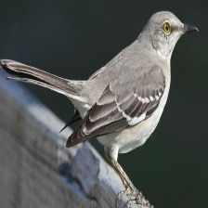
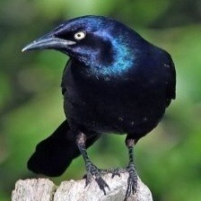
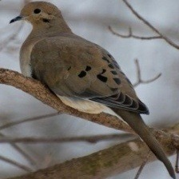
Thank you
Questions?
Northern Mockingbird
Common Grackle
Mateen Jan · Tej Govindu · Alejandro Alfonso
github.com/Mateen1367/BIRDS-PROJECT
Mourning Dove
Red-shouldered Hawk
Notes:
[ALEJANDRO, slide 21: Questions]
Thank you. We're happy to take any questions.

Slide 22
BACKUP
Every species improved; the hawks and black birds stay hardest
22
Notes:
[BACKUP] Per-species test F1, baseline vs. final model. Use if asked which birds are hardest.

Slide 23
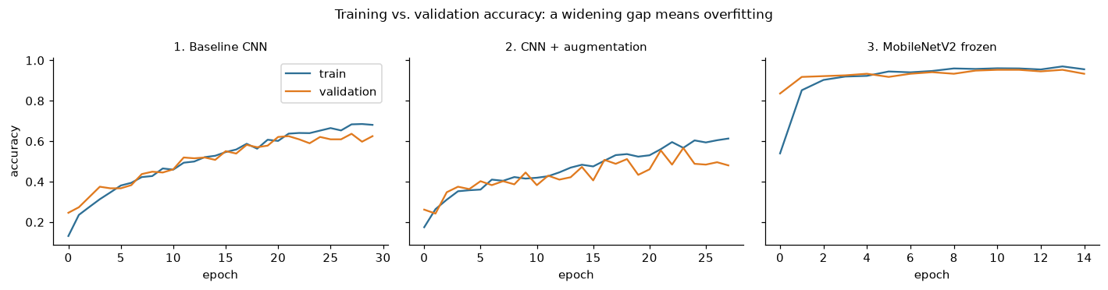
BACKUP
Training curves: the from-scratch CNNs were still learning at the epoch limit
23
Notes:
[BACKUP] Train vs. validation accuracy per epoch. Use if asked about overfitting or why augmentation hurt.

