Slide 1


News
Web Scraping the World A Deep Dive into BBC News Coverage
~Presented by Mateen Malik

Slide 2







Tools and Libraries Used
Intoduction
Python: Programming language for web scraping and data handling.
Google Colab: Used as the Integrated Development Environment (IDE).
Requests: For sending HTTP requests to retrieve HTML content.
BeautifulSoup: To parse HTML and extract data (headlines, categories, timestamps).
Pandas: For organizing data into a DataFrame and exporting it to a CSV file.
Lxml: HTML parser to assist BeautifulSoup.
CSV: Output format for storing the scraped data.
Objective: The objective of this project is to web scrape news data from the BBC News website and export the collected data to a CSV file for further use. This allows for easy access to organized data that can be used for analysis, visualization, or as part of a larger dataset.

Slide 3
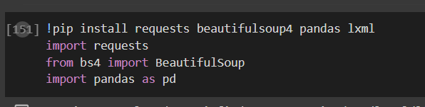
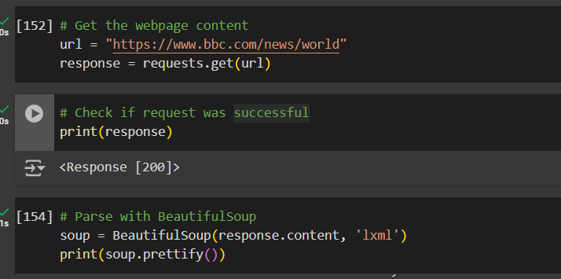
Web Scraping Process
Step 1: Sending HTTP Requests
Used the requests library to send HTTP requests to the BBC News website to retrieve HTML content.
Key Point: Connected to the BBC News website and downloaded the HTML of the page.
Step 2: Parsing HTML Content
Parsed HTML using BeautifulSoup to extract relevant information such as headlines, categories, and timestamps.
Key Point: Used BeautifulSoup to navigate the HTML and locate necessary data.
Step 3: Identifying Relevant Data Elements
Extracted data elements: Headlines, Category, Author, and Timestamp.
Key Point: Targeted HTML tags to extract key data like headlines and timestamps.

Slide 4
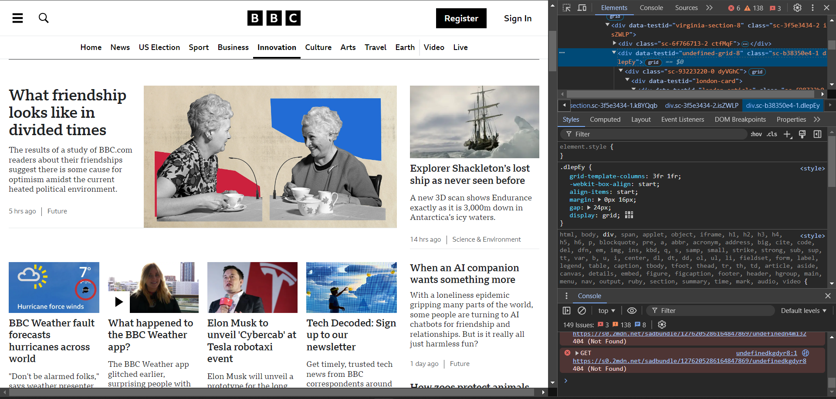
Inspecting Webpage Elements

Slide 5
Data Extraction
Overview of Extracted Elements:
Headlines: Extracted the title of each news article to understand what topics are trending.
Category: Retrieved the category or section to identify the type of content (e.g., World, Technology).
Author: Tried to capture the author's name, but in cases where it wasn't available, this field was left as None.
Timestamp: Collected the publication date to understand when the articles were released and to identify any patterns over time.
Methodology
Used BeautifulSoup to parse the HTML and identify specific tags to extract these elements.
Stored the extracted data in a structured format (a DataFrame) for ease of analysis and storage.
Key Point:
The extracted data included headlines, categories, authors, and timestamps, providing a comprehensive dataset for further analysis.

Slide 6
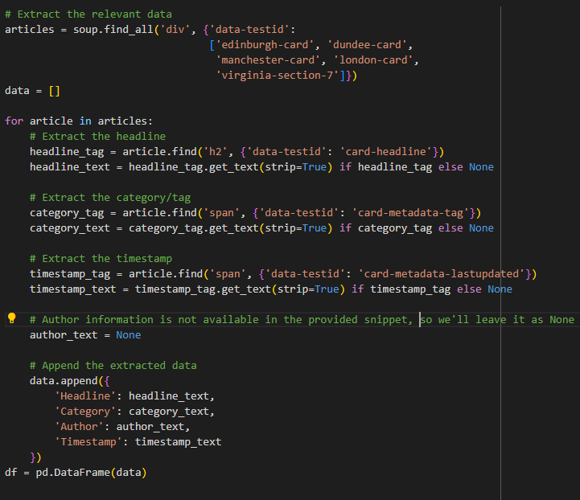
Data Extraction Code and Output
~Code

Slide 7
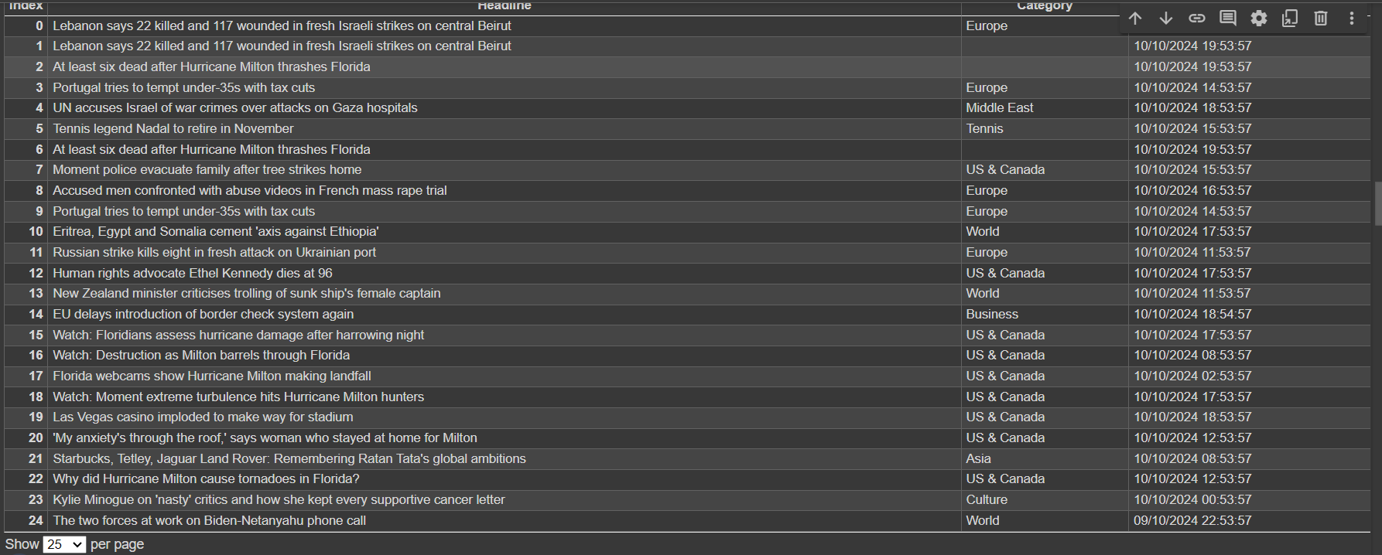
~Output

Slide 8
Data Preparation
Organizing Data
After extraction, data was organized using pandas into a structured DataFrame.
This tabular format makes it easy to manipulate and analyze the dataset.
Dropping Author Column
The Author column was dropped as most articles did not provide author information, making the column largely empty and unnecessary.
Converting Timestamp to Date-Time Format
The Timestamp was converted into a date-time format to facilitate accurate analysis, especially for identifying time-based trends.
Handling Missing Values
Rows with missing or NaN values in important columns like Category and Timestamp were removed.
This step ensured the data remained consistent and meaningful for analysis.
Storing Data
The cleaned and structured data was then exported to a CSV file.
This format allows easy sharing, storage, and further use of the dataset for analysis or visualization.
Key Point:
The data was cleaned and prepared by dropping unnecessary columns, handling missing values, and exporting the organized dataset to a CSV file.

Slide 9
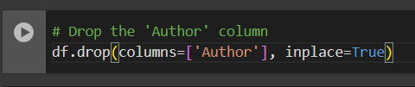
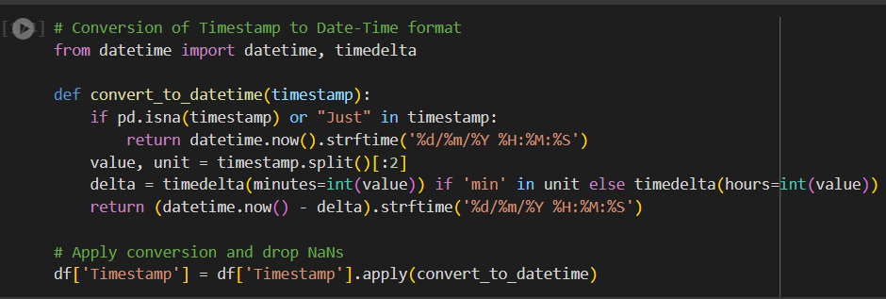
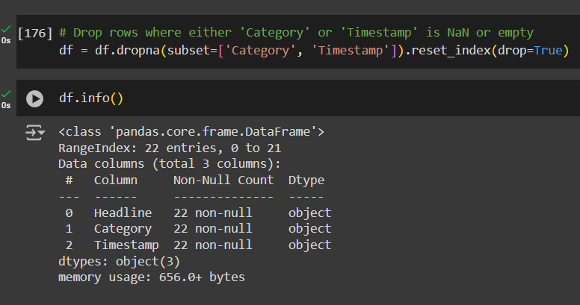
Data Preparation Code

Slide 10
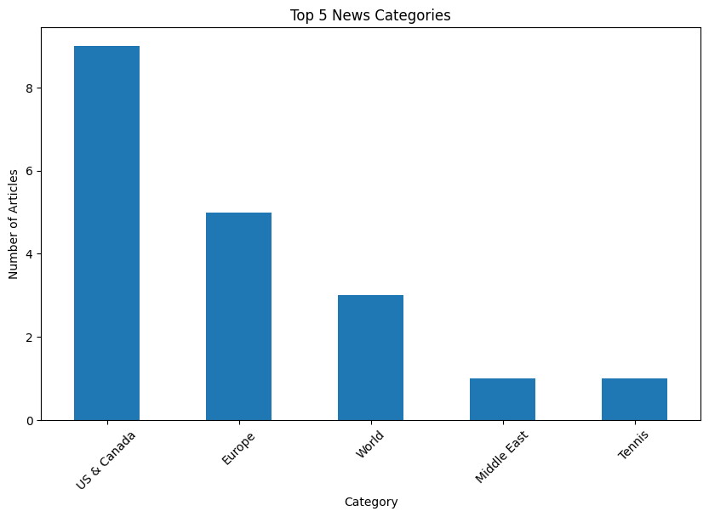
Top 5 News Categories - Data Analysis
Top 5 News Categories:
The chart shows the top 5 most frequent categories from BBC News articles.
Categories: US & Canada, Europe, World, Middle East, Tennis.
US & Canada had the highest number of articles, followed by Europe and World.
Key Insights:
US & Canada received the most coverage, showing a regional focus.
Europe and World also had significant coverage, while Middle East and Tennis were less frequent.
Visual Representation:
The bar chart illustrates the number of articles per category, highlighting key focus areas.

Slide 11
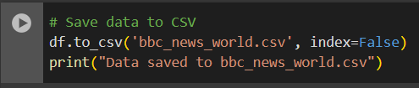
Storing Data into a CSV File
Output
Headline | Category | Timestamp
Four killed by tornadoes in Florida, as DeSantis warns of more Hurricane Milton flooding | US & Canada | 10-10-24 15:23
Where is Hurricane Milton now? | US & Canada | 10-10-24 15:23
Israeli strike on Gaza school sheltering displaced kills 28, paramedics say | Middle East | 10-10-24 11:54
Portugal tries to tempt under-35s with tax cuts | Europe | 10-10-24 15:04
Tennis legend Nadal to retire in November | Tennis | 10-10-24 15:54
Where is Hurricane Milton now? | US & Canada | 10-10-24 15:23
..... | ..... | .....

Slide 12
Challenges and Solutions
Conclusion
Successfully scraped, organized, and analyzed BBC News articles.
Focused on identifying top categories and publication trends.
Future Work: Expand the scope to include more news websites for broader analysis.
Challenges:
Managing unexpected HTML structures.
Maintaining data accuracy.
Solutions:
Conducting detailed webpage inspection.
Implementing error handling for unpredictable formats.
Thank You

